Slide 1
Chapter 5
Circuit Theorems
Taken from PowerPoint Slides for 172212
with slight modifications

Slide 2
Chapter Objectives
To study important circuit concepts and theorems that can reduce complexity of circuits being analyzed:
  Source transformation
  Superposition
  Thevenin’s theorem
  Norton’s theorem
  Maximum power transfer

Slide 3
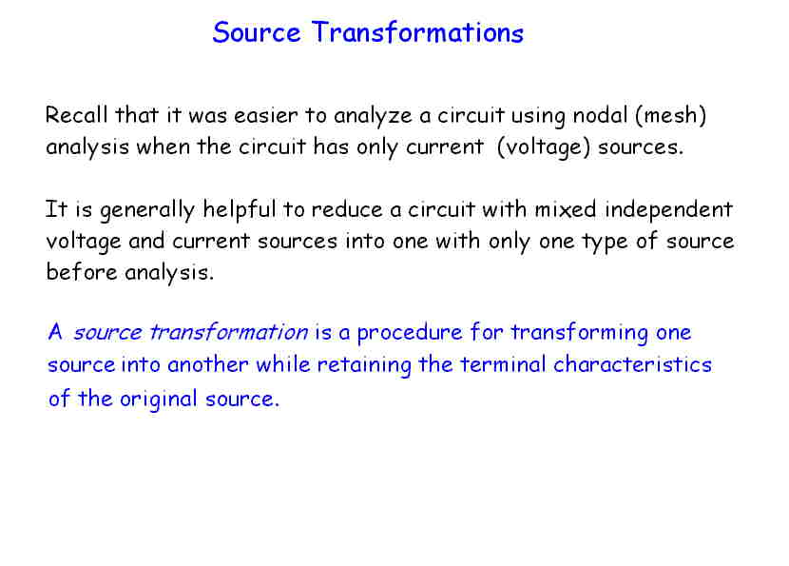

Slide 4
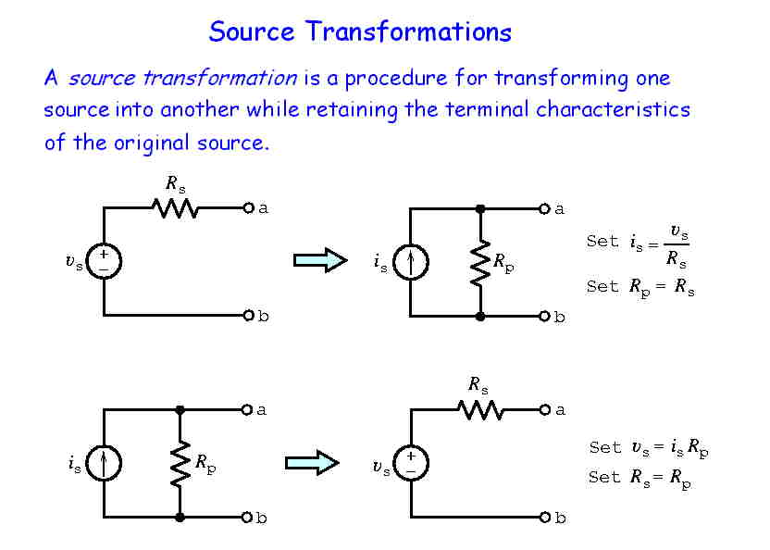

Slide 5
Duality and Dual Circuits
Circuits are said to be dual when the characterizing equations of one network can be obtained from the other by simply interchanging v and i and interchanging G and R.
Duality Pairs:
Resistance Conductance
Current Voltage
Series Parallel
Etc.

Slide 6
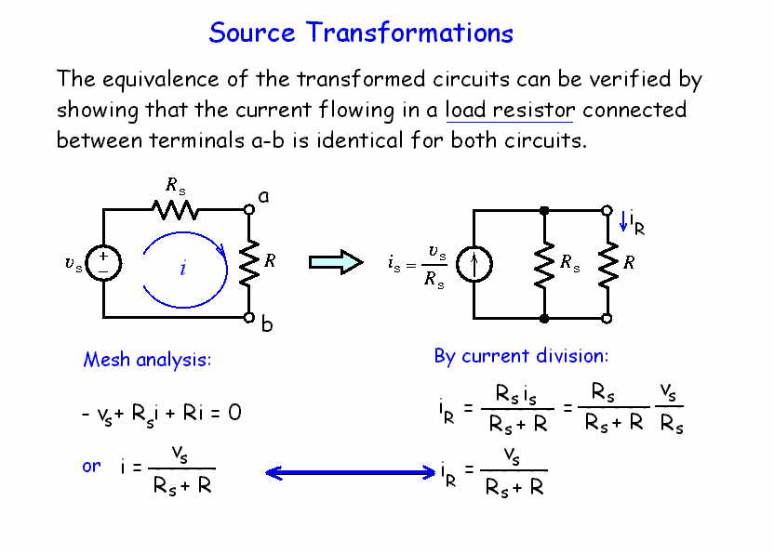

Slide 7
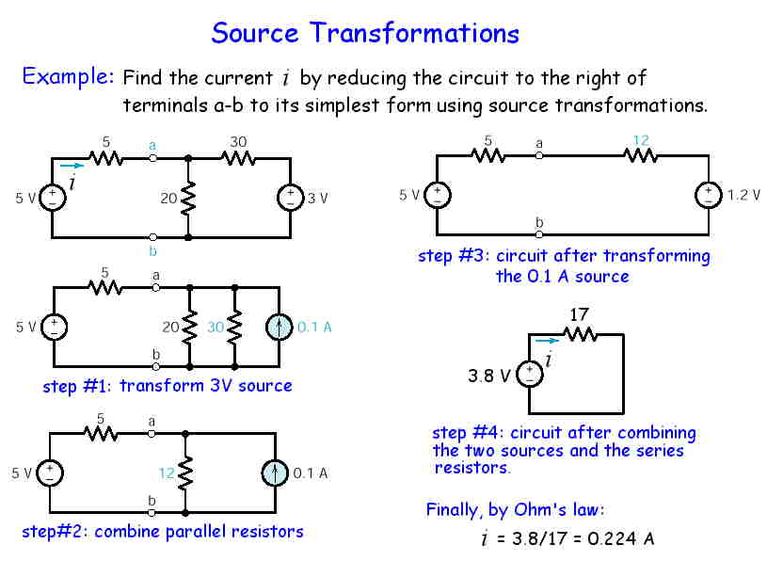

Slide 8
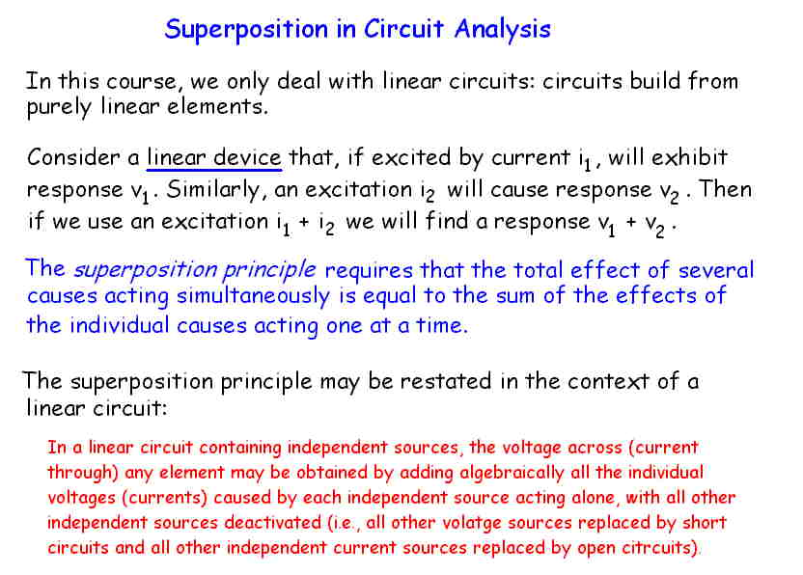

Slide 9
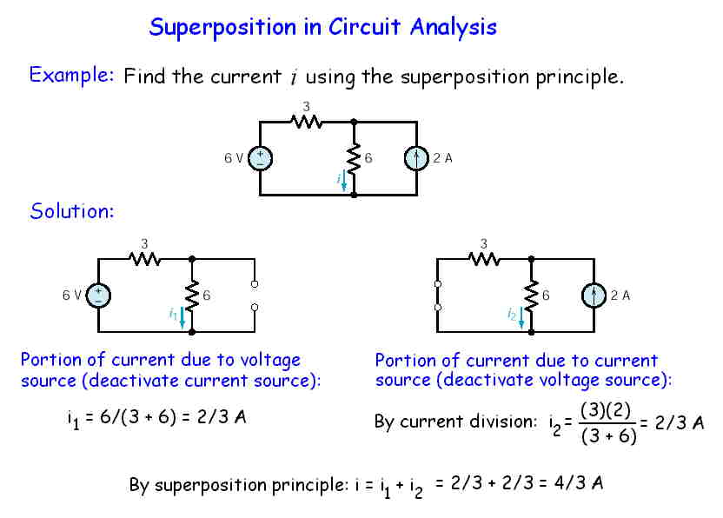

Slide 10
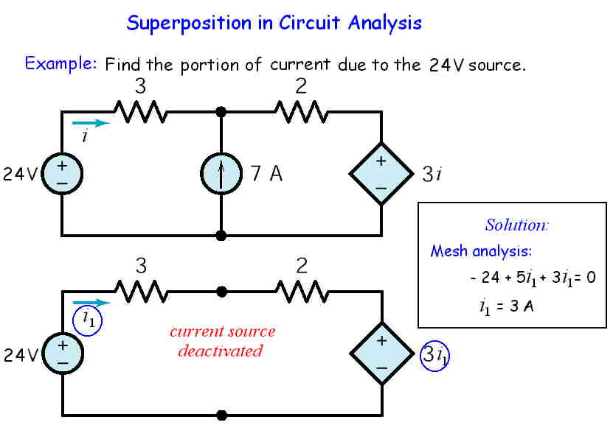

Slide 11
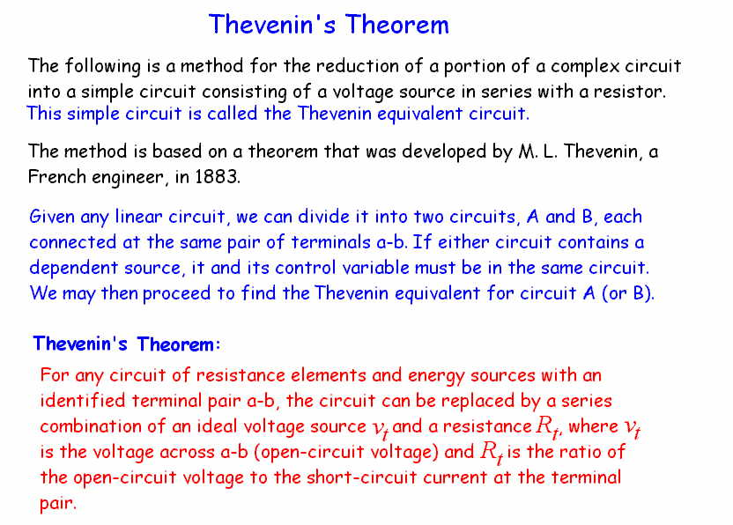

Slide 12
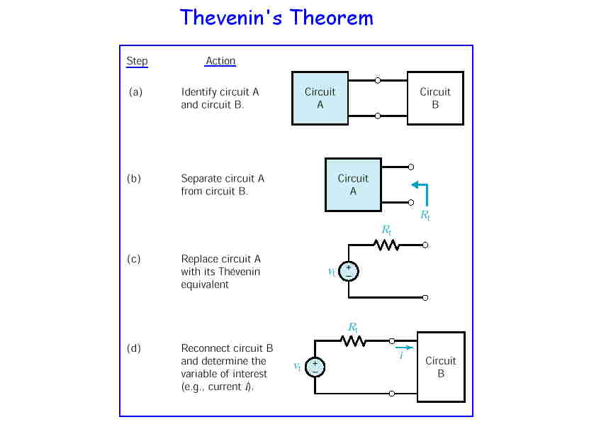

Slide 13
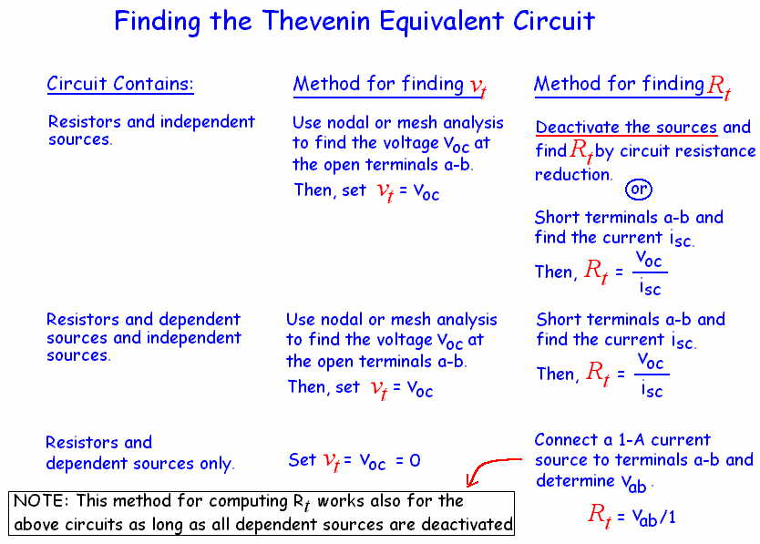

Slide 14
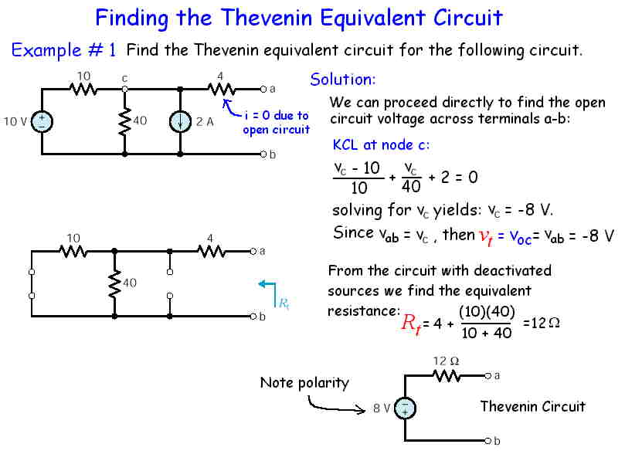

Slide 15
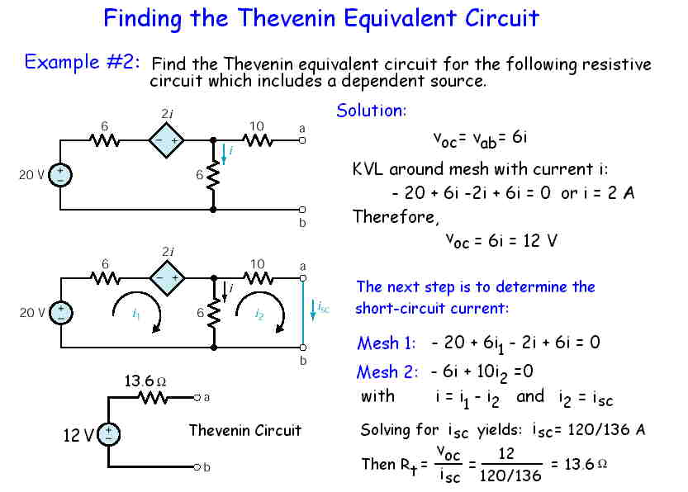

Slide 16
Exercises
Set aside the 10Ω resistor. Find the equivalent resistance of remaining 3.6Ω resistor using the methods described below:
  Short circuit across the 6Ω resistor to find the short-circuit current and use v_{oc} = 12V to find equiv. R.
  Set all independent source to zero value and connect the 6Ω resistor to a 6V voltage source. Then find total current flowing into the circuit, and find equiv. R from 6V/(total current).

Slide 17
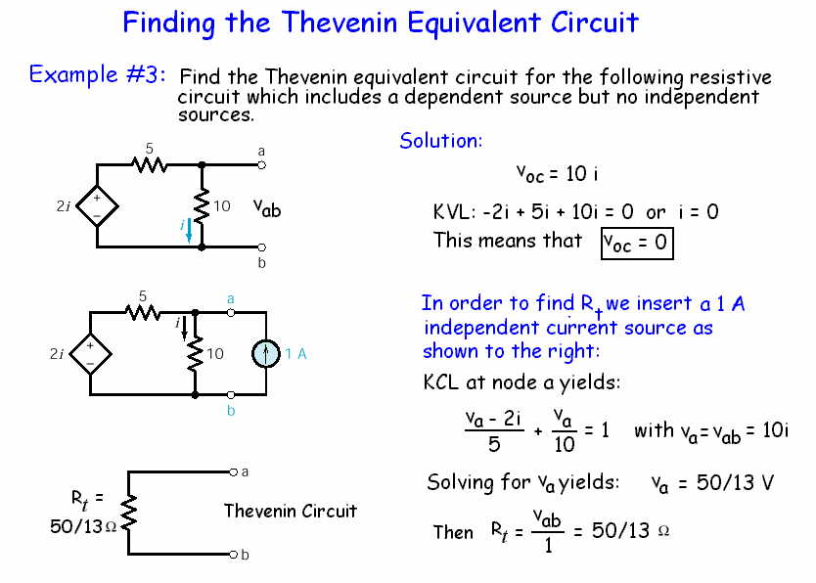

Slide 18
Exercise
Connect a 10V source to the terminals a and b. Find total current flowing out of the 10V source and use this current to calculate R_{t} = 10V/(total current).

Slide 19
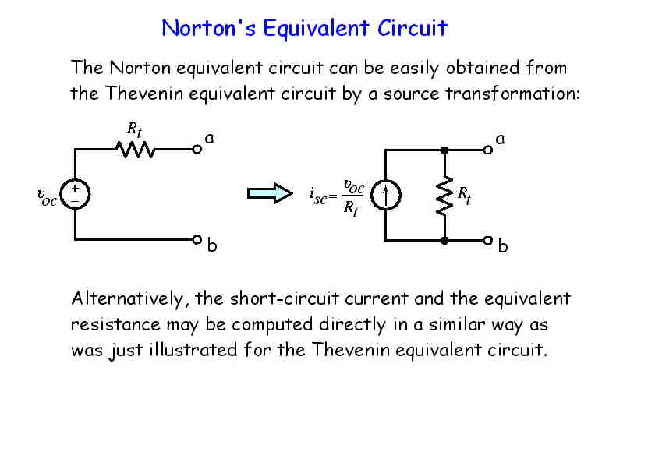

Slide 20
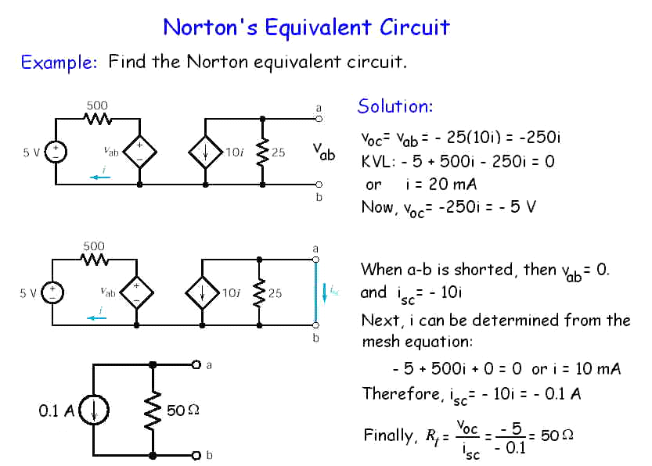

Slide 21
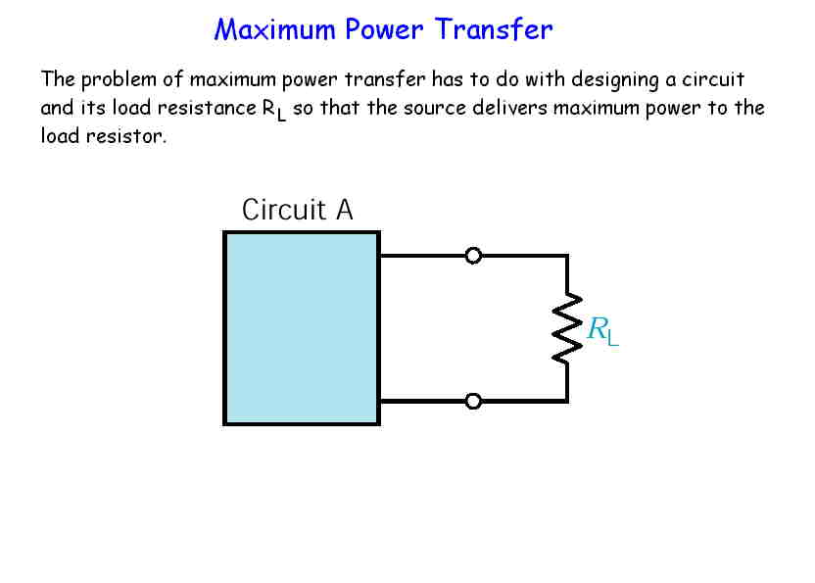

Slide 22
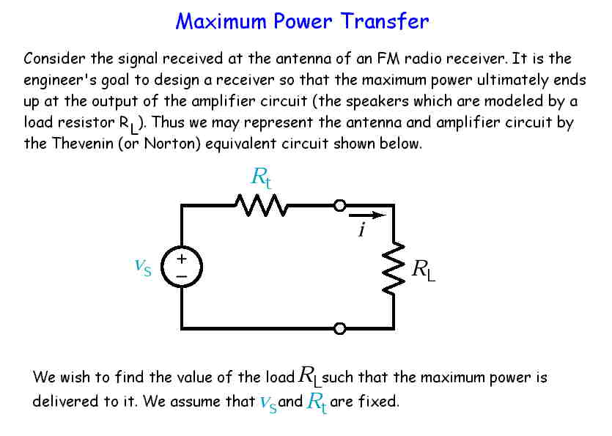

Slide 23
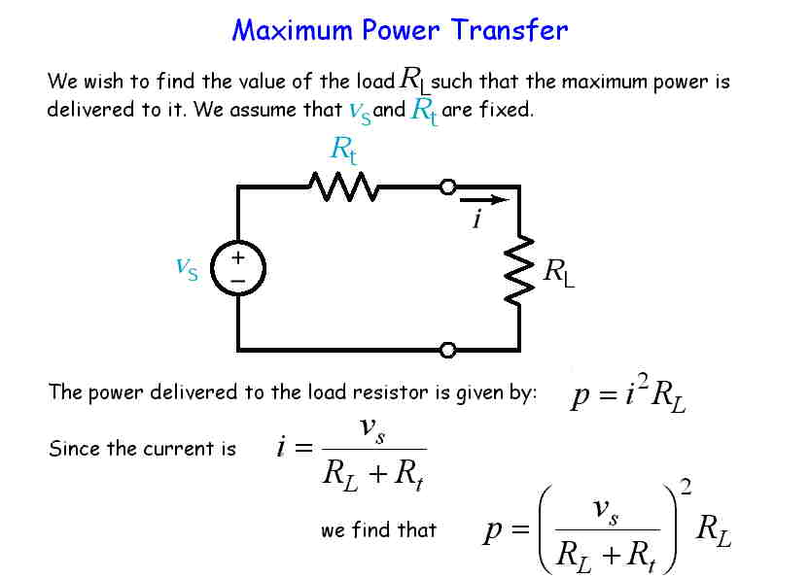

Slide 24
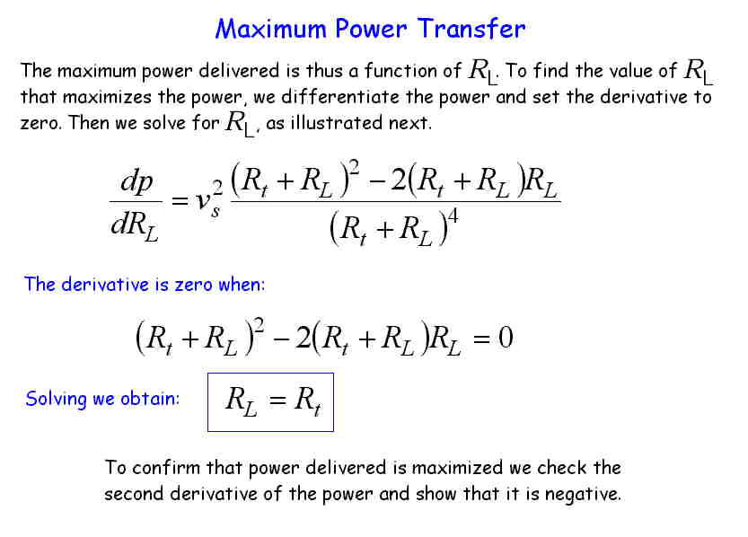

Slide 25
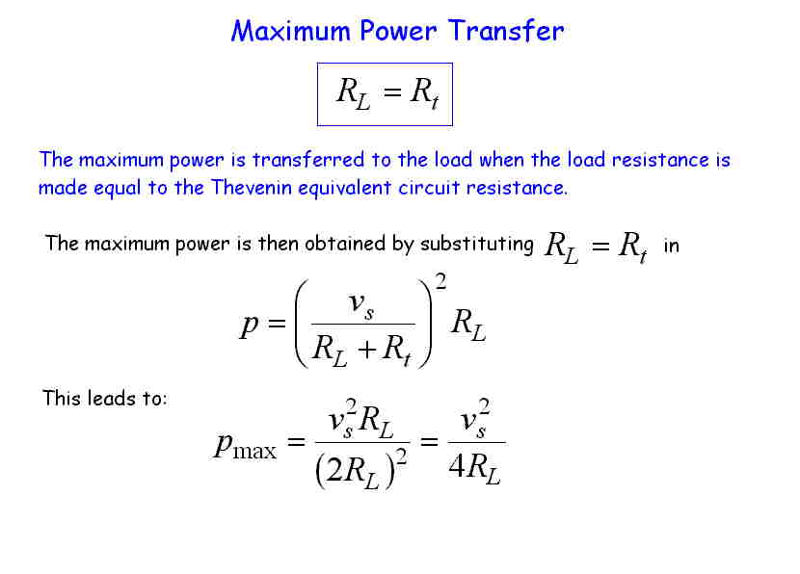

Slide 26
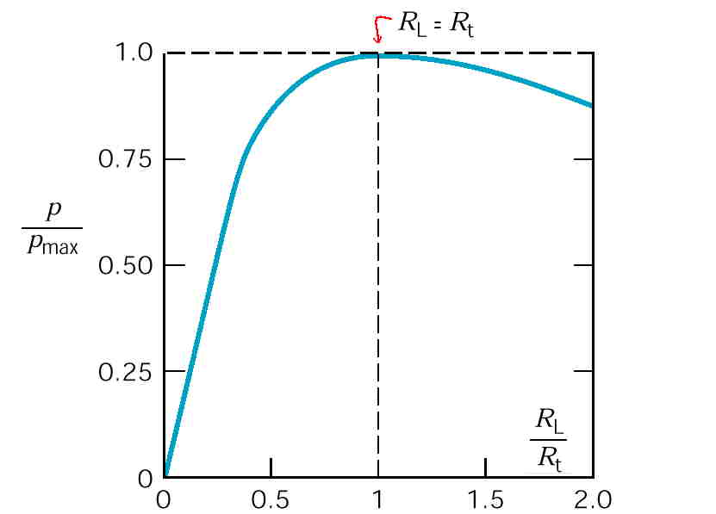

Slide 27
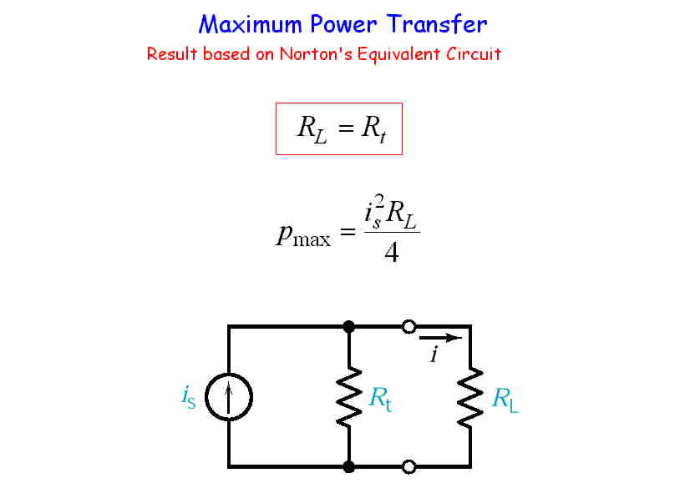

Slide 28
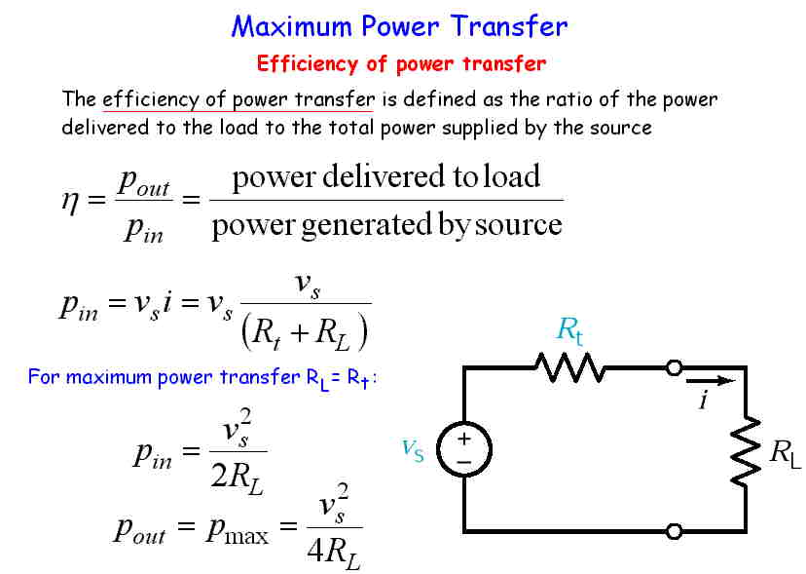

Slide 29
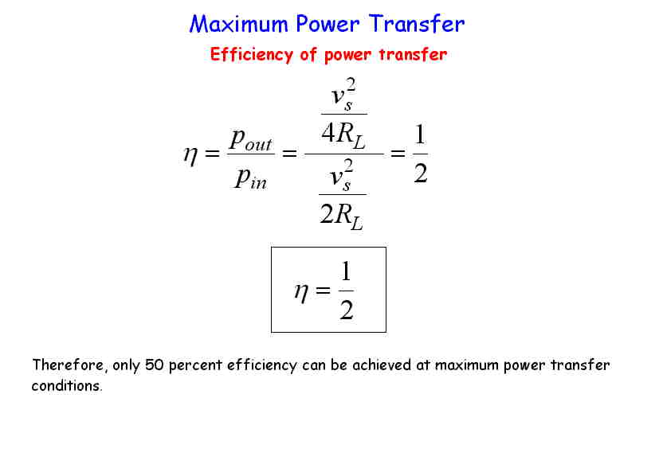

Slide 30
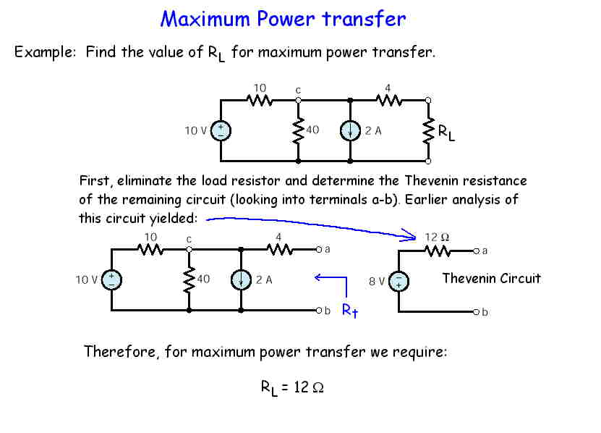

Slide 31
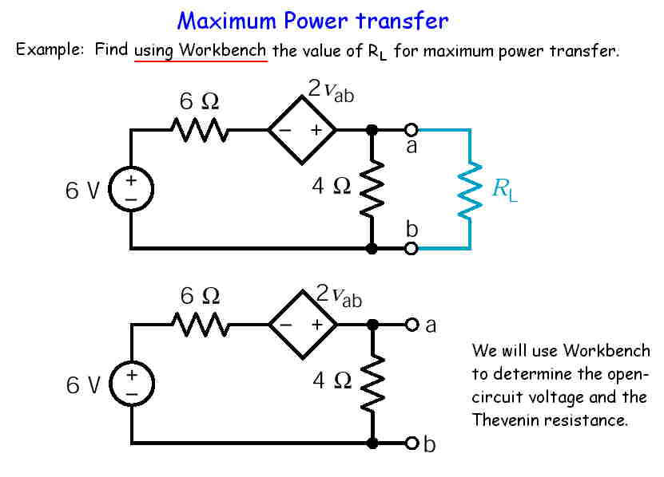

Slide 32
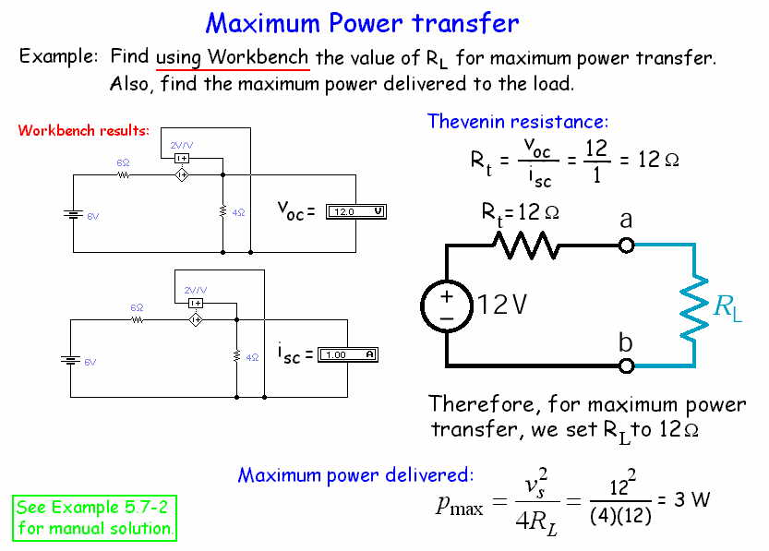

Slide 33
Summary
Source transformations
Superposition
Thevenin’s theorem
Norton’s equivalent circuits
Maximum power transfer

Slide 34
Chapter 6
Operational Amplifiers
The materials on this subject will be covered in 188211 Analog Electronics.

