Slide 1
Chapter 9
The Complete Response of Circuits
with Two Energy Storage Elements
Taken from PowerPoint Slides for 172212
with slight modifications

Slide 2
Chapter Objectives
To write a 2nd-order differential equation describing behaviors of circuits with two energy storage elements.
To solve such equations with different forcing functions.
To study responses of such circuits

Slide 3
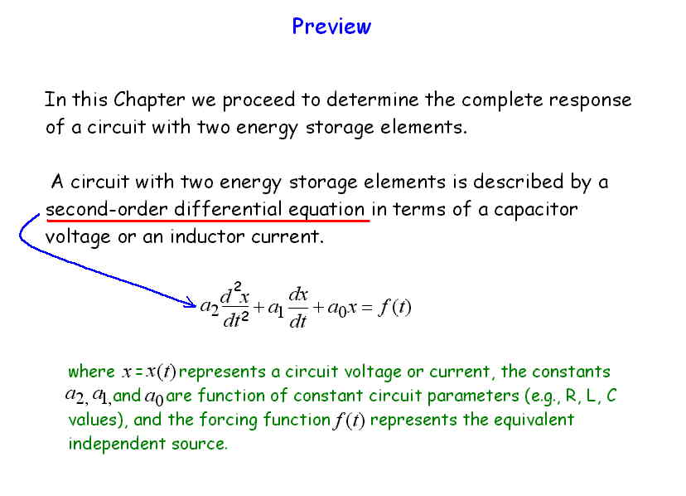

Slide 4
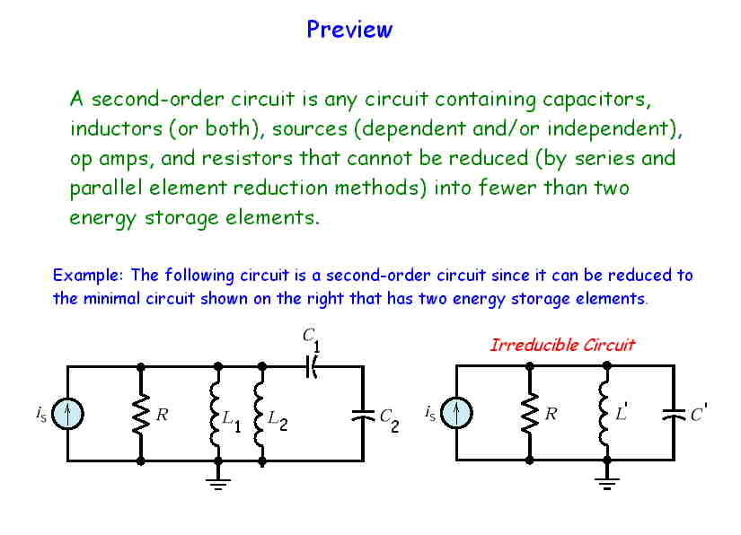

Slide 5
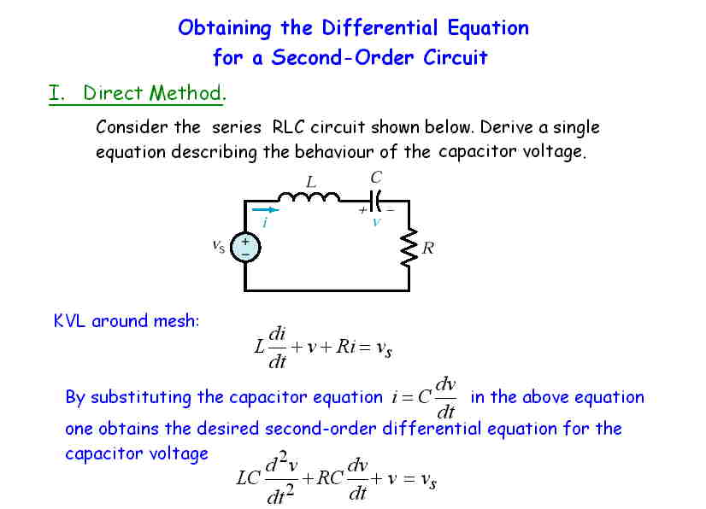

Slide 6
Direct Method
Step 1
Identify variables x₁ & x₂
Step 2
Write 1st order D.E.
Step 3
Obtain additional 1st order D.E. in terms of the 2nd variable
or
Step 4
Substitute (3) into (2) to get 2nd order D.E. in terms of x₂

Slide 7
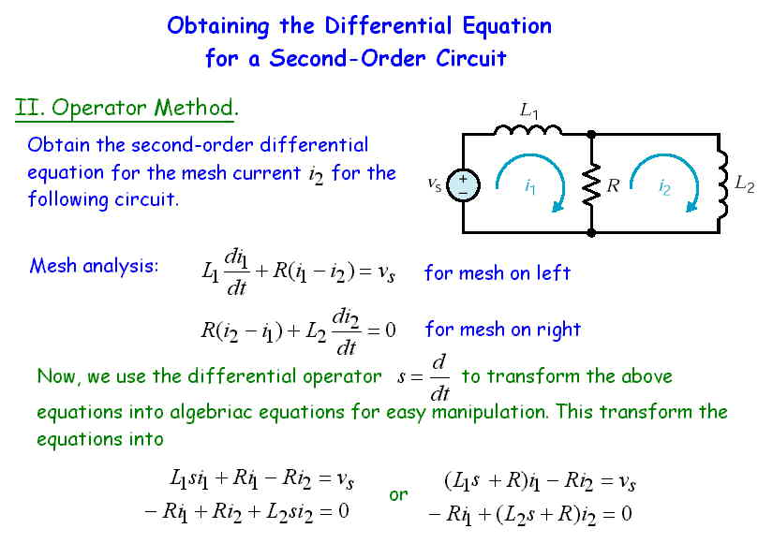

Slide 8
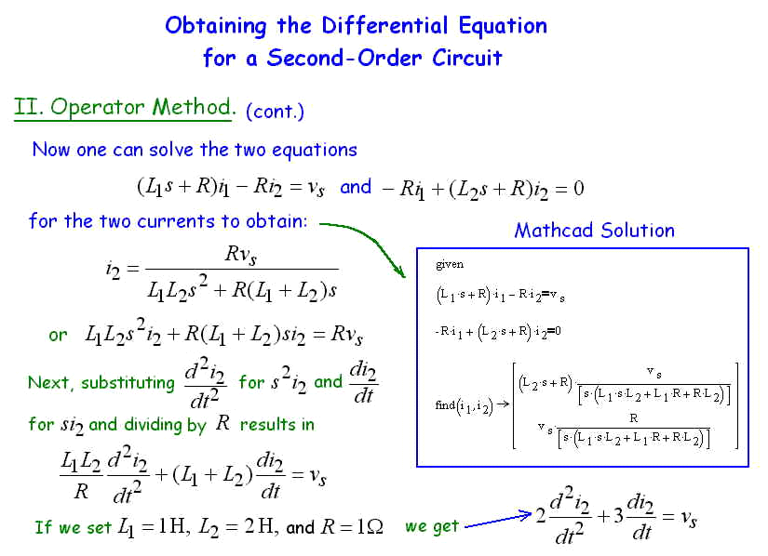

Slide 9
Operator Method
Step 1
Identify variable x₁ to be a desired solution
Step 2
Write two diff. equations in terms of x₁ & x₂
Step 3
Substitute differential operator s to obtain 2 algebraic equations
Step 4
Solve the equations to get x₁
Step 5
Convert the operators back to derivatives to get 2nd order D.E. in terms of x₁

Slide 10
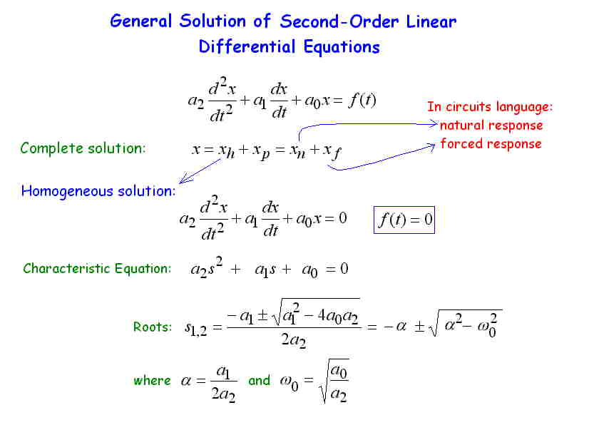

Slide 11
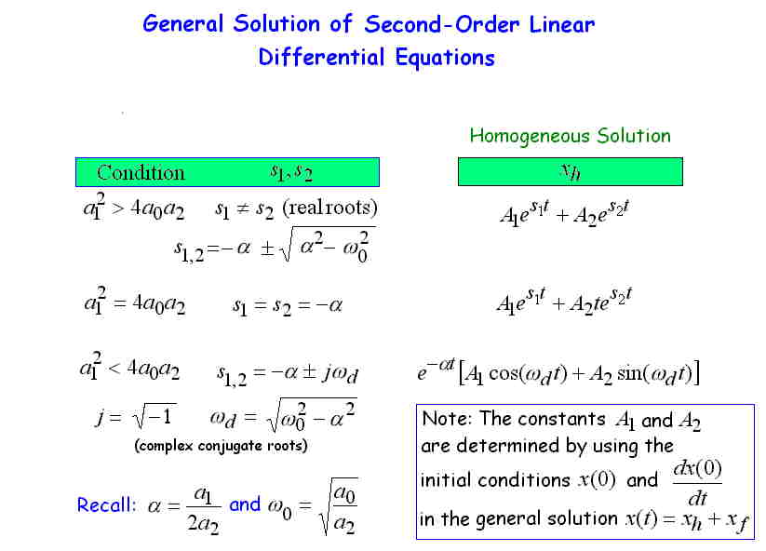

Slide 12
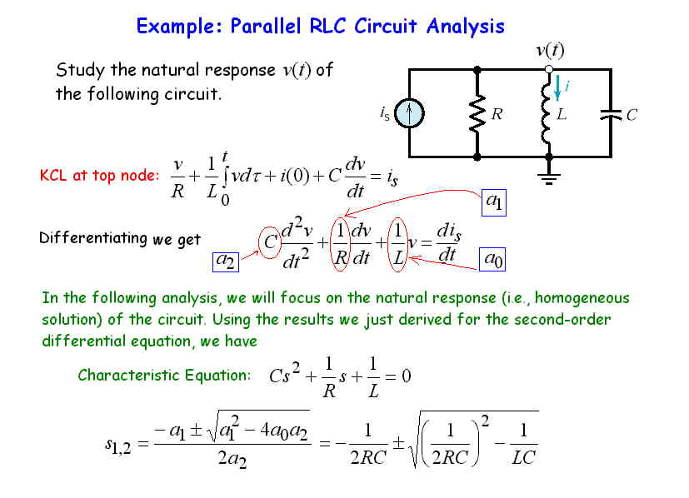

Slide 13
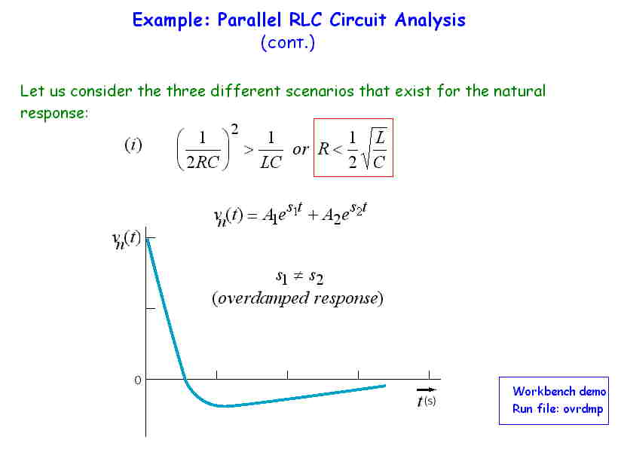

Slide 14
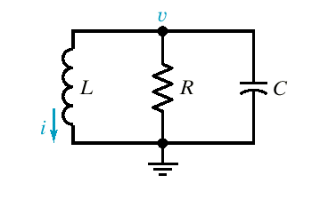
Ex 9.5-1
R = 2/3 Ω
v(0)= 10 V
i(0)= 2 A
L = 1 Η
C = 1/2 F
For parallel RLC

Slide 15
Rewrite equations (1) and (3) together.

Slide 16
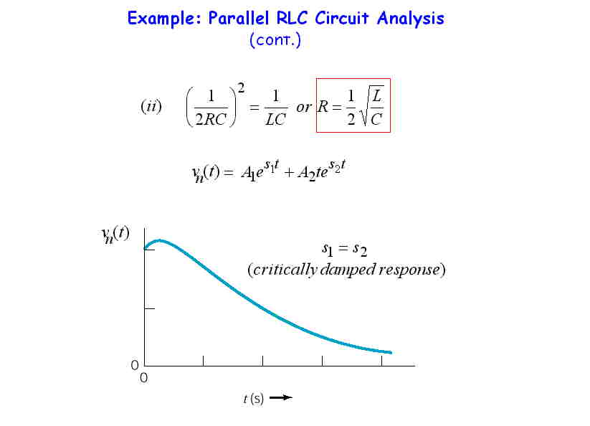

Slide 17
Natural Response s₁ = s₂
Sum of 2 exponentials
v(0), i(0)
1 undetermined constant 2 initial conditions to satisfy
Need a solution that contains 2 arbitrary constants
Try

Slide 18
Ex
v(0)= 5 V
i(0)= -6 A
R = 1 Ω
L = 1 Η
C = 1/4 F

Slide 19
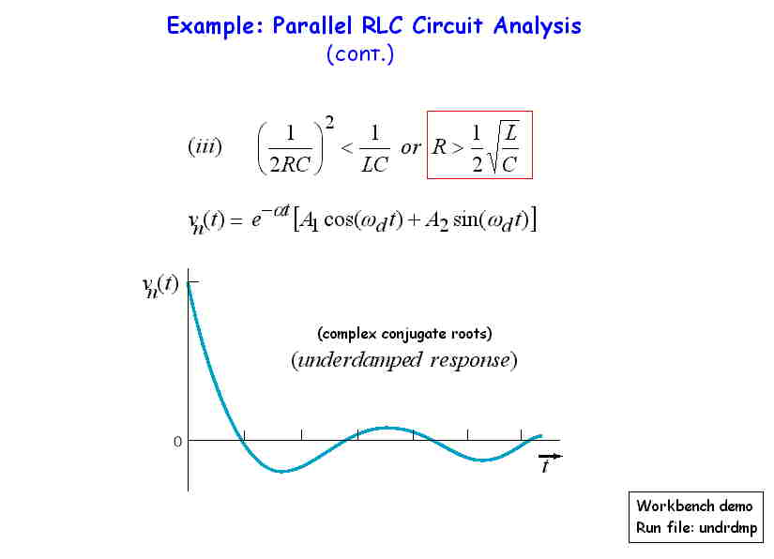

Slide 20
Natural Response
Use Euler identity
Substitute
to be determined by initial conditions

Slide 21
and
For parallel RLC

Slide 22
Ex 9.7-1
R = 25/3 Ω
v(0)= 10 V
i(0)= -0.6 A
L = 0.1 Η
C = 1 mF

Slide 23
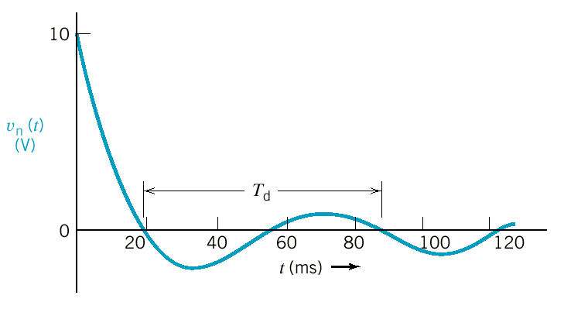
Period and frequency of the damped oscillation

Slide 24
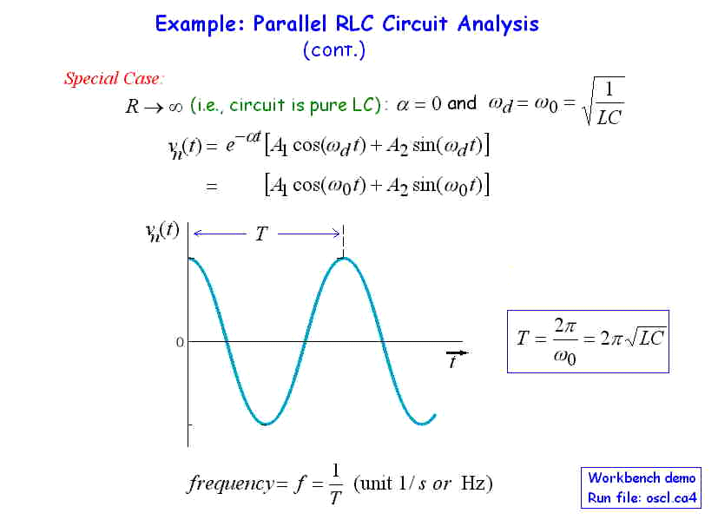
(Oscillator)

Slide 25
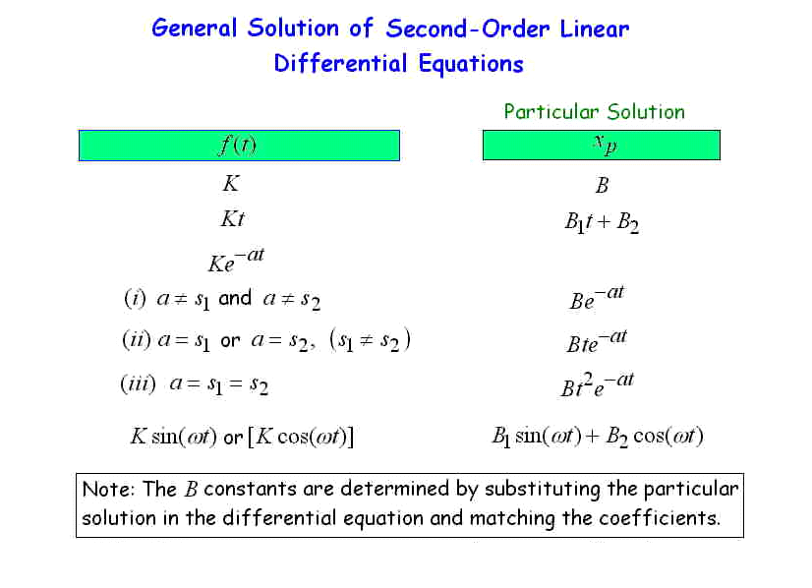
Particular

Slide 26
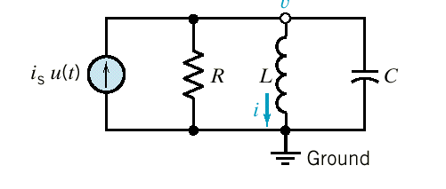
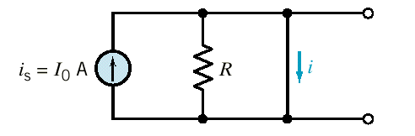
Forced Response of an RLC Circuit
Ex 9.8-1 Find forced response i_{f}.
Ex 9.8-2 Find forced response i_{f}.

Slide 27
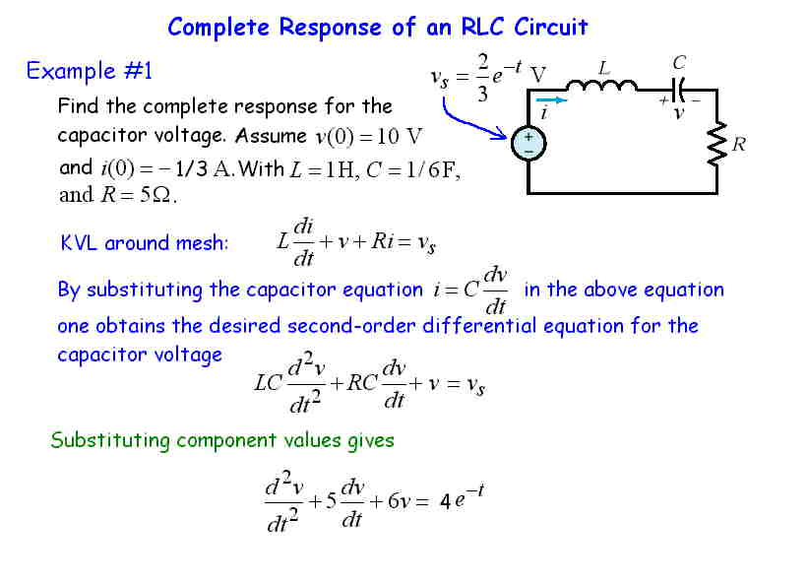

Slide 28
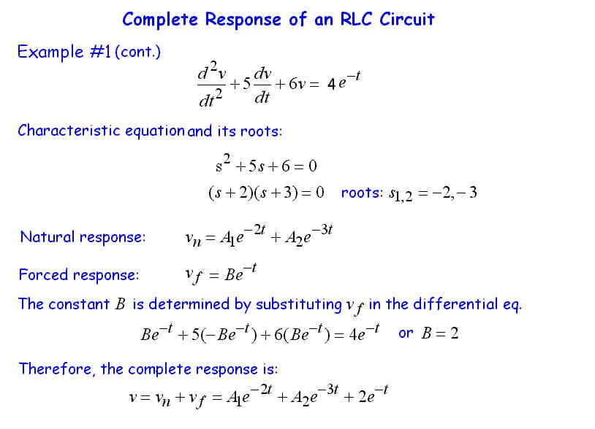

Slide 29
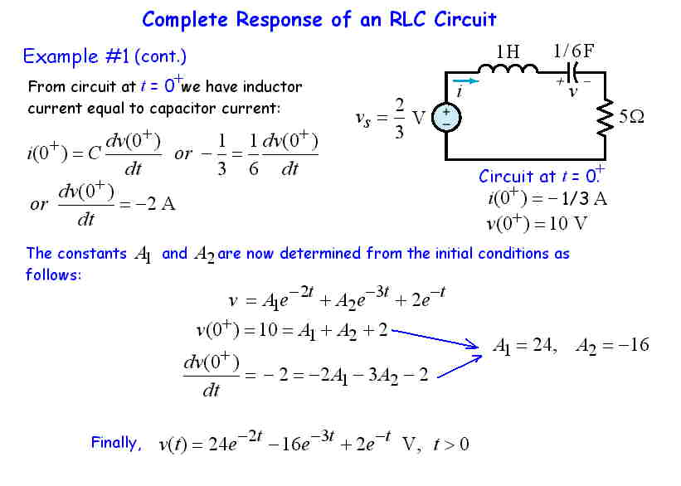

Slide 30
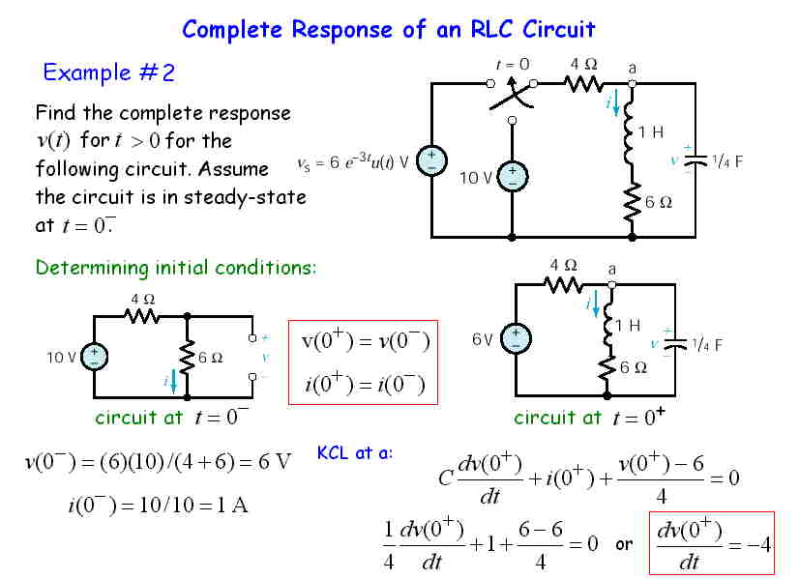

Slide 31
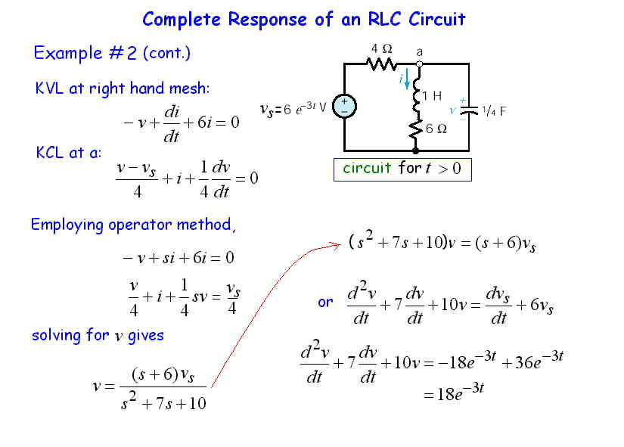

Slide 32
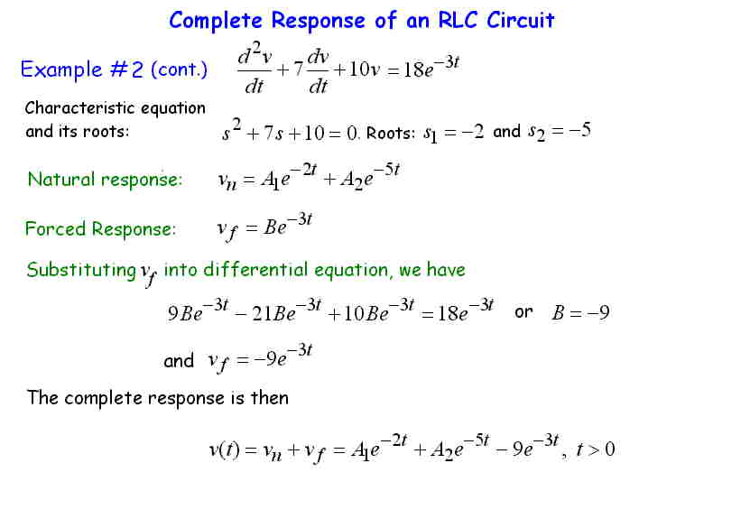

Slide 33
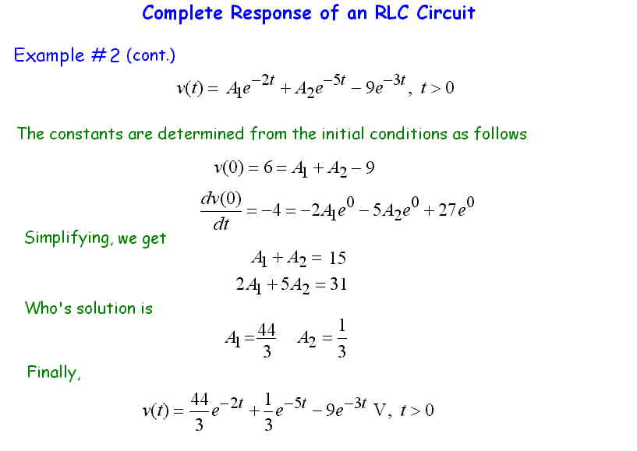

Slide 34
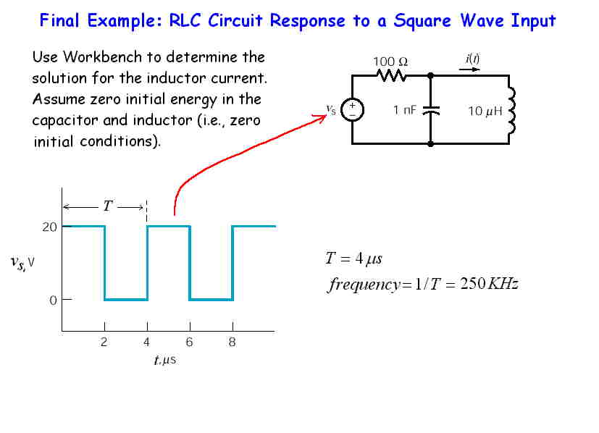

Slide 35
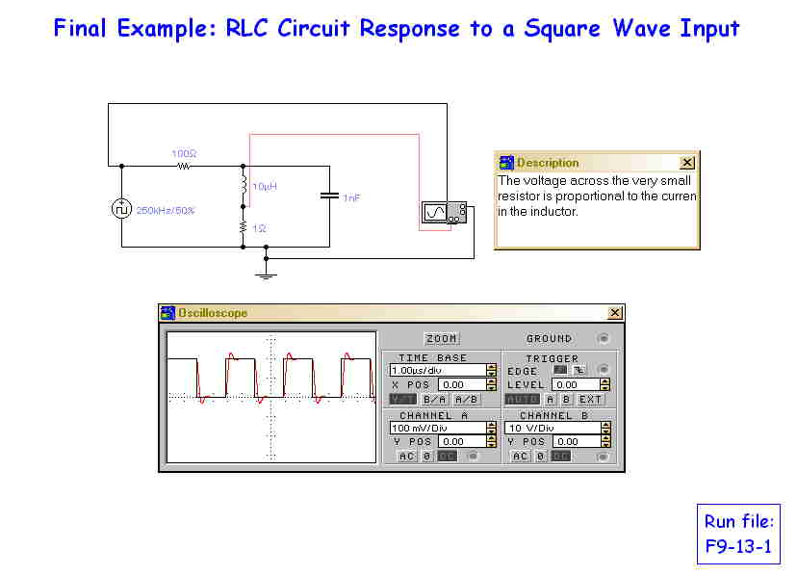

Slide 36
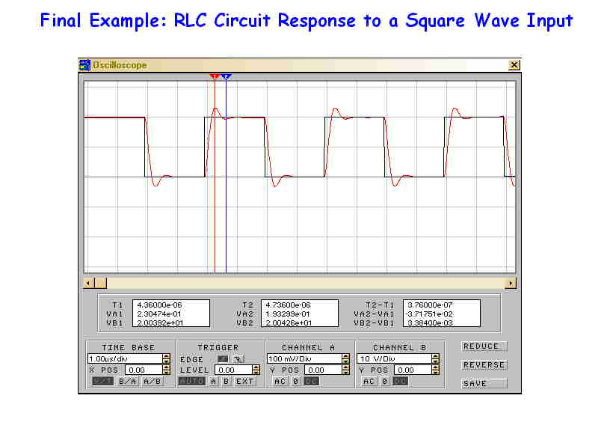

Slide 37
Summary
Writing 2nd-order differential equations from the circuits with two energy storage elements.
Three cases for natural responses:
  Underdamped (s_{1,2} – complex no.)
  Critically damped (s₁ = s₂ = real no.)
  Overdamped (s_{1,2} – two different real no.)
Solving such equations with different forcing functions.

