Slide 1
Chapter 10
Sinusoidal Steady-State Analysis
Taken from PowerPoint Slides for 172212
with slight modifications

Slide 2
Chapter Objectives
To study the development of phasor concept used in steady-state AC analysis
To introduce the concept of impedance and admittance
To apply the phasor concept to Kirchhoff’s laws and circuit theory

Slide 3
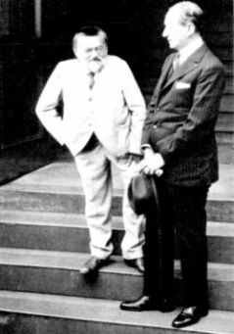
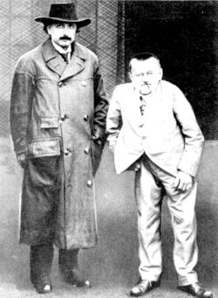
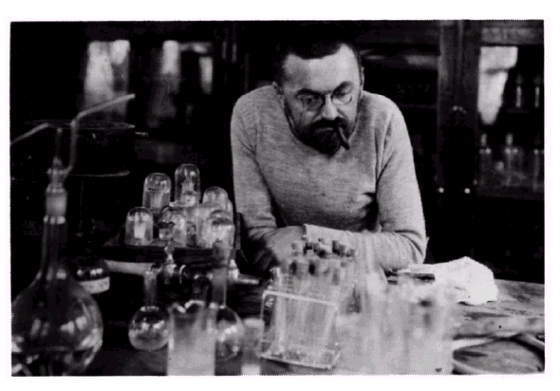
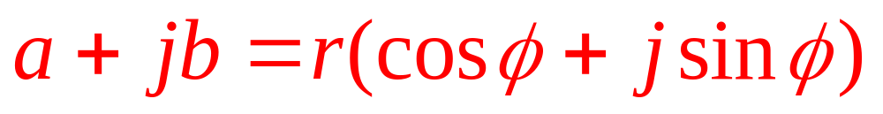
Charles P. Steinmetz (1865-1923), the developer of the
mathematical analytical tools for studying ac circuits.
Courtesy of General Electric Co.
http://chem.ch.huji.ac.il/~eugeniik/history/steinmetz.html

Slide 4
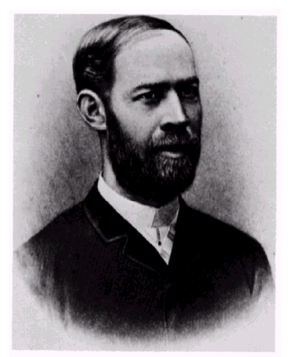
Heinrich R. Hertz (1857-1894).
Courtesy of the Institution of Electrical Engineers.
cycles/second
Hertz, Hz

Slide 5
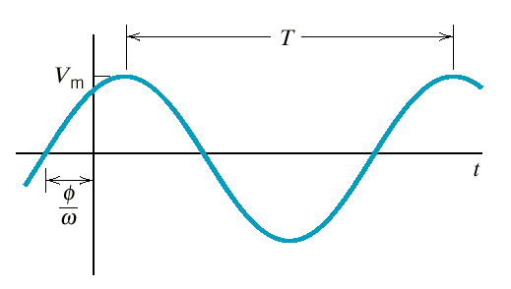
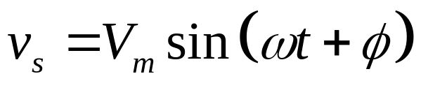
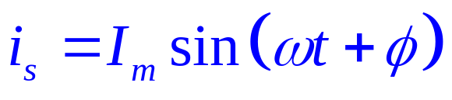
Sinusoidal Sources
Amplitude
Period = 1/f
Phase angle
Angular or radian
frequency = 2πf = 2π/T
Sinusoidal voltage source
Sinusoidal current source

Slide 6
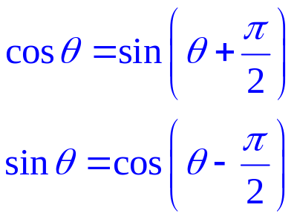
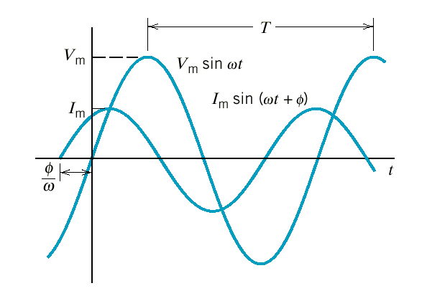
Example
v
i
Circuit
element
+
v
_
i
Voltage and current of a circuit element.
The current leads the voltage by φ radians.
OR
The voltage lags the current by φ radians.

Slide 7
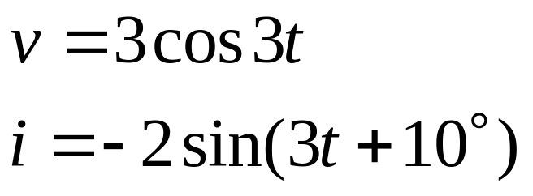
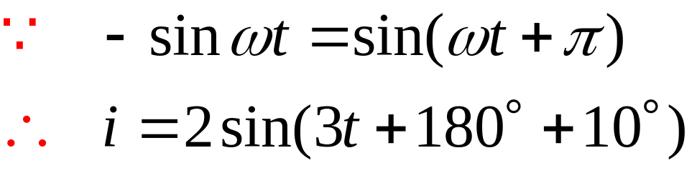
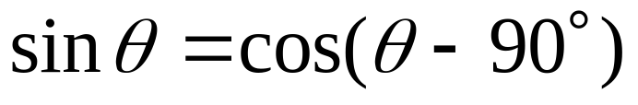
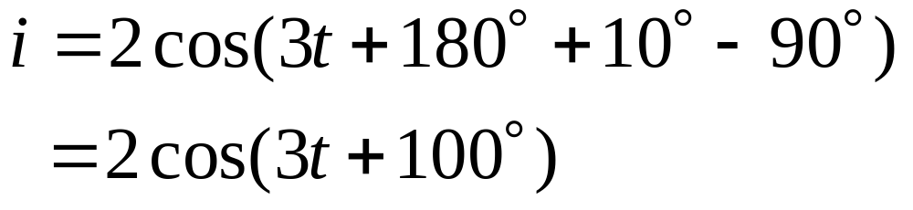

Example 10.3-1
Find their phase relationship
and
Therefore the current leads the voltage by .

Slide 8
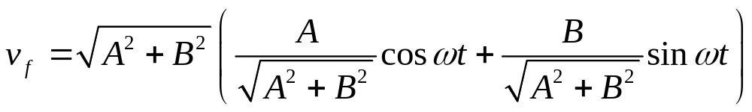
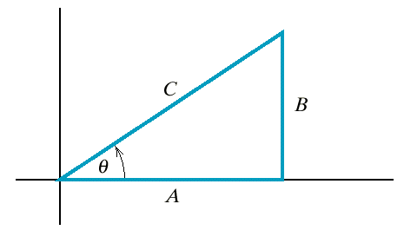
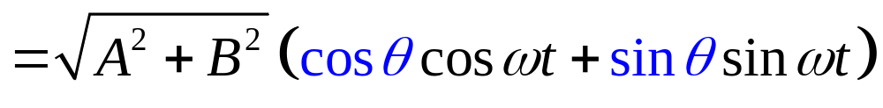
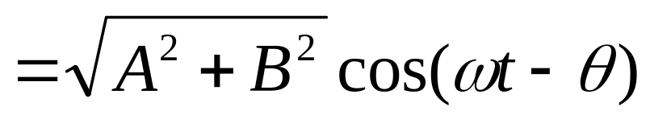
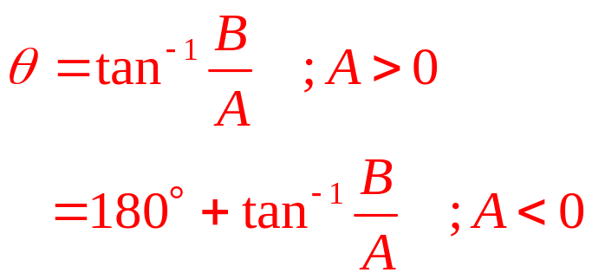

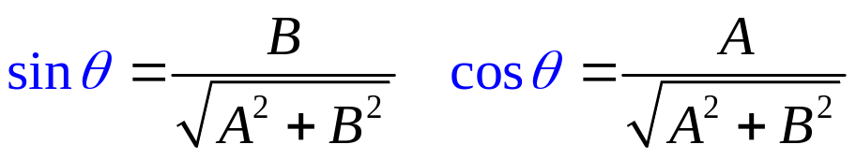
Recall
Triangle for A and B of Eq. 10.3-4,
where C = .

Slide 9
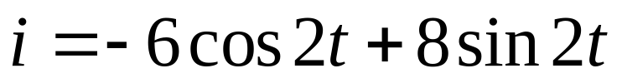
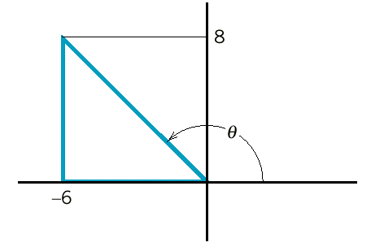
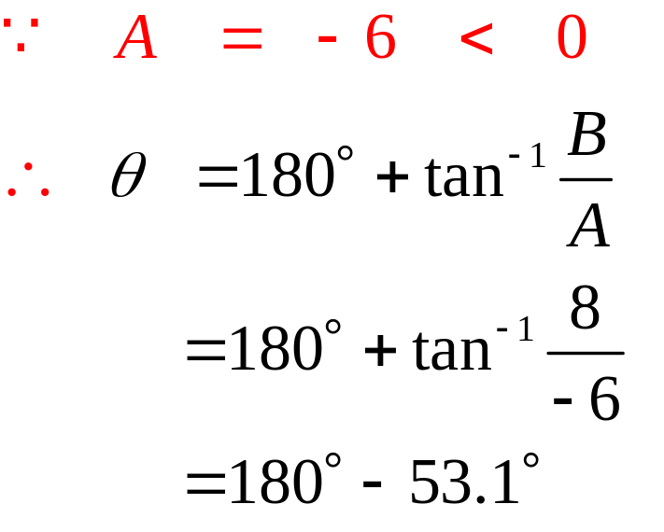
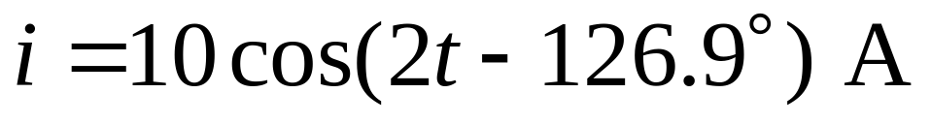
Example 10.3-2
A
B
B
A

Slide 10
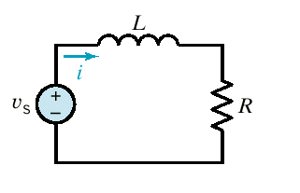
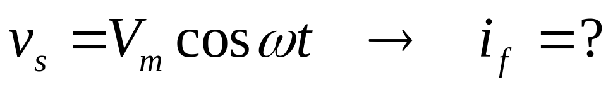
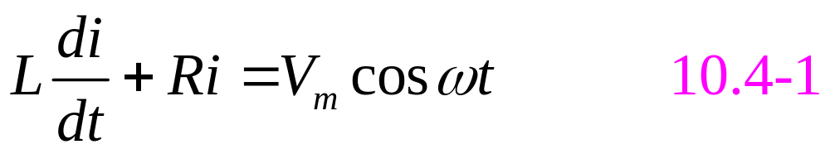
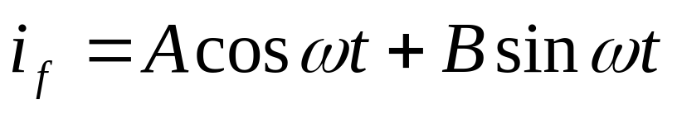
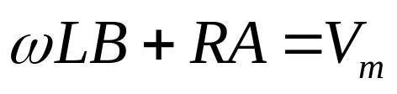

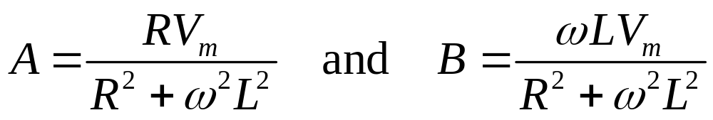
Steady-State Response of an RL circuit
An RL circuit
From #8&#9
Substitute the assumed solution into 10.4-1.
Coeff. of cos
Coeff. of sin
Solve for A & B

Slide 11
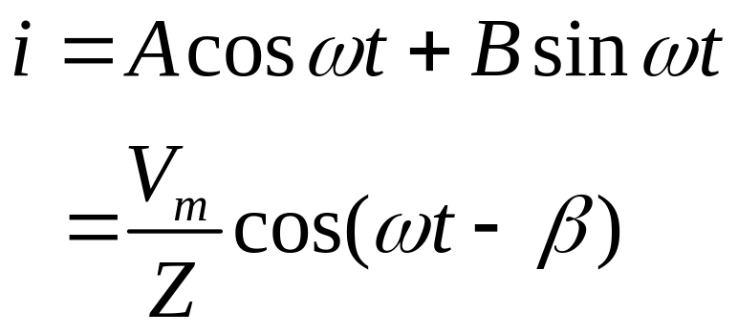
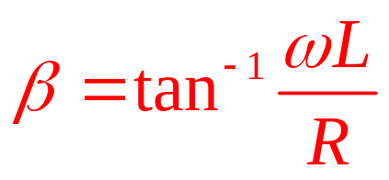
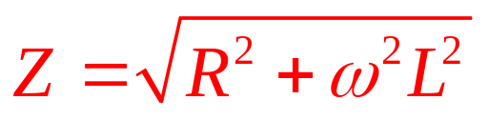
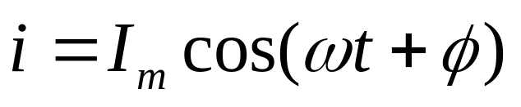
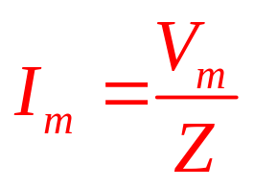
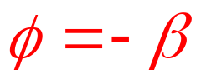
Steady-State Response of an RL circuit (cont.)
Thus the forced (steady-state) response is of the form

Slide 12
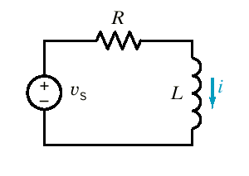
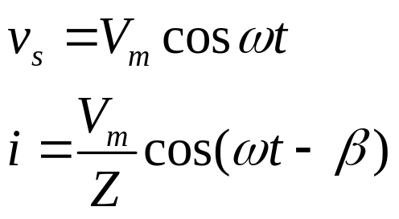
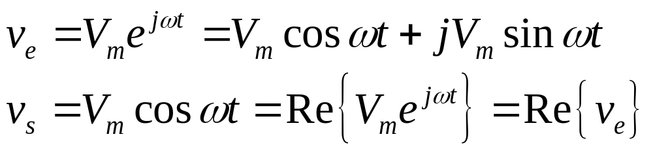
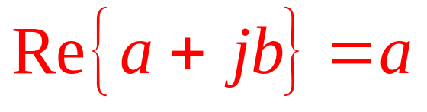
Complex Exponential Forcing Function
Input
Response
Magnitude
Phase
Frequency
Exponential Signal
Real part
Imaginary part
Note

Slide 13
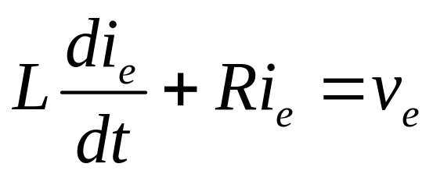
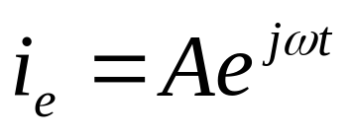
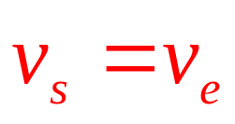
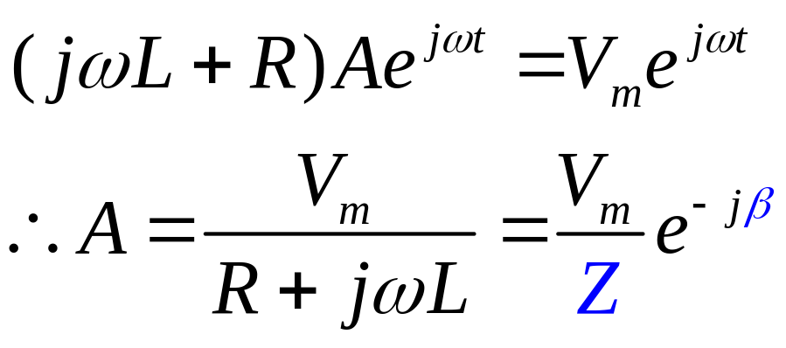
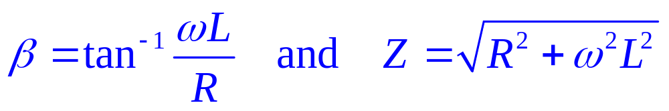
Complex Exponential Forcing Function (cont.)
Try
We get
where

Slide 14
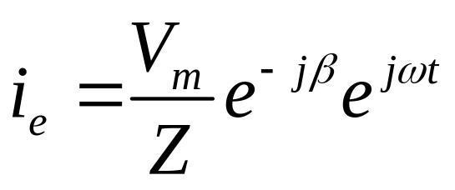
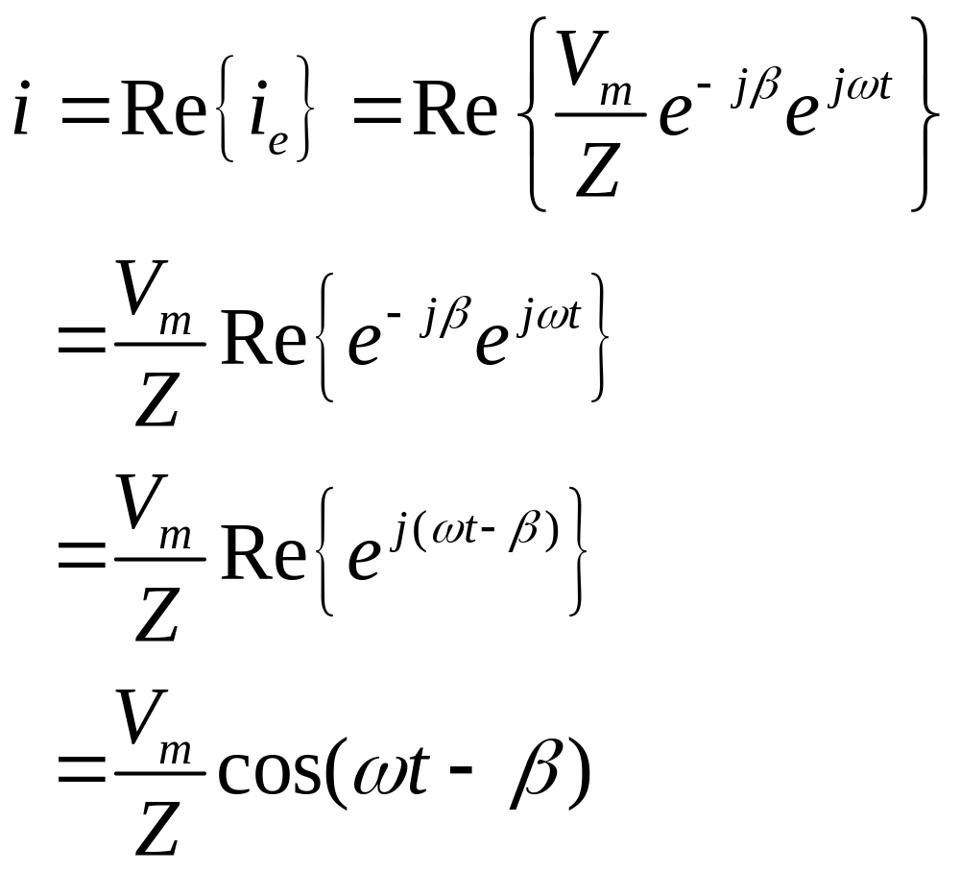
Complex Exponential Forcing Function (cont.)
Substituting for A
We expect

Slide 15
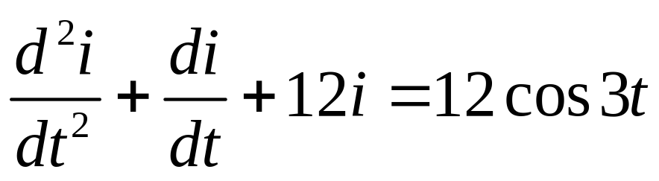
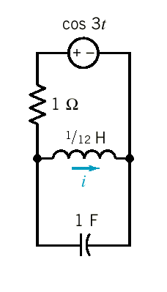
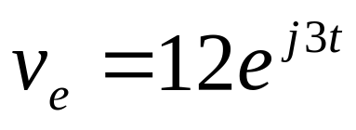



Example
We replace
Substituting i_{e}

Slide 16



Example(cont.)
The desired answer for the steady-state current
interchangeable

Slide 17




Using Complex Exponential Excitation to Determine
a Circuit’s SS Response to a Sinusoidal Source
Write the excitation as a cosine waveform with a phase angle
Introduce complex excitation
Use the assumed response
Determine the constant A

Slide 18



Obtain the solution
The desired response is
Example 10.5-1

Slide 19





Example 10.5-1(cont.)

Slide 20


Example 10.5-1(cont.)
The solution is
The actual response is

Slide 21


The Phasor Concept
A sinusoidal current or voltage at a given frequency
is characterized by its amplitude and phase angle.
Magnitude
Phase angle
Thus we may write
unchanged

Slide 22


The Phasor Concept(cont.)
A phasor is a complex number that represents the
magnitude and phase of a sinusoid.
Phasor
The Phasor Concept may be used when the circuit is
linear , in steady state, and all independent sources are
sinusoidal and have the same frequency.
A real sinusoidal current
Phasor notation

Slide 23



The Transformation
Time domain
Transformation
Frequency domain

Slide 24


The Transformation (cont.)
Time domain
Transformation
Frequency domain

Slide 25








Example
Substitute into 10.6-2
Suppress

Slide 26


Example (cont.)

Slide 27



Phasor Relationship for R, L, and C Elements
Time domain
Resistor
Frequency domain
Voltage and current are in phase.

Slide 28




Inductor
Time domain
Frequency domain
Voltage leads current by
Current lags voltage by

Slide 29




Capacitor
Time domain
Frequency domain
Voltage lags current by
Current leads voltage by

Slide 30





Impedance and Admittance
Impedance is defined as the ratio of the phasor voltage to the phasor current.
Ohm’s law in phasor notation
phase
magnitude
or
polar
exponential
rectangular

Slide 31







Graphical Representation of Impedance
R
Resistor
ωL
Inductor
Capacitor
1/ωC

Slide 32





Admittance is defined as the reciprocal of impedance.
conductance
In rectangular form
G
susceptance
Resistor
Inductor
1/ωL
Capacitor
ωC

Slide 33


Kirchhoff’s Laws using Phasors
KVL
KCL
Both Kirchhoff’s laws hold in the frequency domain and so all the techniques developed for resistive circuits hold.
Superposition
Thevenin & Norton Equivalent Circuits
Source Transformation
Node & Mesh Analysis
etc.

Slide 34




Impedances in series
Admittances in parallel

Slide 35





Example 10.9-1 R = 9 Ω, L = 10 mH, C = 1 mF, i = ?
KVL

Slide 36



Example 10.9-2 v = ?
KCL

Slide 37




Node Voltage & Mesh Current Using Phasors
v_{a} = ? v_{b} = ?

Slide 38





KCL at node a
KCL at node b
Rearranging
Admittance matrix

Slide 39



If I_{m} = 10 A and
Using Cramer’s rule to solve for V_{a}
Therefore the steady state voltage v_{a} is

Slide 40

V_{a} can also be found from

Slide 41


Therefore the steady state voltage v_{b} is

Slide 42




Example 10.10-1 v = ?
use supernode concept
introduced in Ch. 4

Slide 43



Example 10.10-1 (cont.)
KCL at supernode
Rearranging

Slide 44


Example 10.10-1 (cont.)
Therefore the steady state voltage v is

Slide 45




Example 10.10-2 i₁ = ?

Slide 46




Example 10.10-2 (cont.)
KVL at mesh 1 & 2
Using Cramer’s rule to solve for I₁
where is the determinant.

Slide 47



Superposition, Thevenin & Norton Equivalents
and Source Transformations
Example 10.11-1 i = ?
Consider the response to the voltage source acting alone = I₁

Slide 48




Example 10.11-1 (cont.)
Substitute

Slide 49




Example 10.11-1 (cont.)
Consider the response to the current source acting alone = I₂
Using the principle of superposition

Slide 50




Source Transformations

Slide 51





Example 10.11-2 I_{S} = ?

Slide 52




Example 10.11-3 Thevenin’s equivalent circuit
?

Slide 53




Example 10.11-4 Thevenin’s equivalent circuit

Slide 54






Example 10.11-5 Norton’s equivalent circuit
?

Slide 55




Phasor Diagrams
A Phasor Diagram is a graphical representation of phasors and their relationship on the complex plane.
Take I as a reference phasor
The voltage phasors are

Slide 56



Phasor Diagrams (cont.)
KVL
For a given L and C there will be a frequency ω that
Resonant frequency
Resonance

Slide 57
Summary
Sinusoidal sources
Steady-state response of an RL circuit for sinusoidal forcing function
Complex exponential forcing function
The phasor concept
Impedance and admittance
Electrical circuit laws using phasors

