Slide 1
Chapter 11
AC Steady-State Power

Slide 2
Chapter Objectives
To introduce the concept of the root-mean-square values
To study the complex power and power factor
To apply the power superposition principle

Slide 3
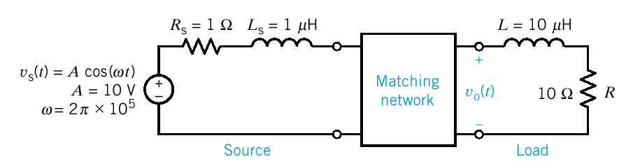
Matching Network for Maximum Power Transfer
Cellular Telephone
Design the matching network to transfer maximum power to the load where the load is the model of an antenna of a wireless communication system.

Slide 4
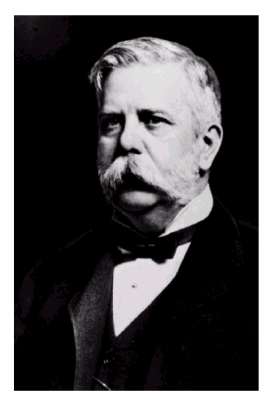
George Westinghouse, 1846-1914
The greatest engineer of his day, George Westinghouse modernized the railroad industry and established the electric power system.

Slide 5
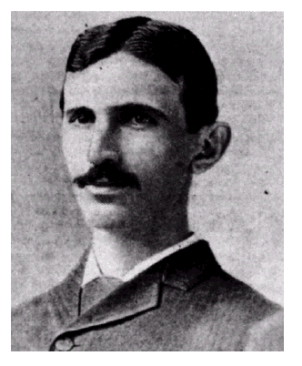
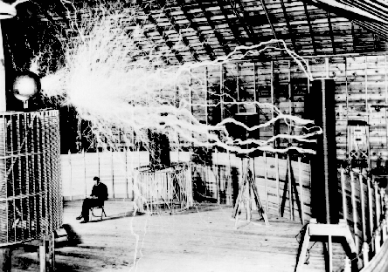
Nikola Tesla, 1856-1943
Tesla was responsible for many inventions, including the ac induction motor, and was a contributor to the selection of 60Hz as the standards ac frequency in the United States.

Slide 6
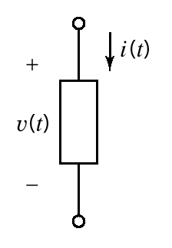
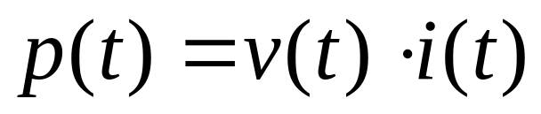
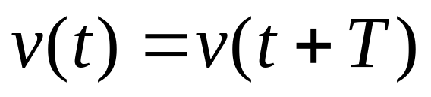
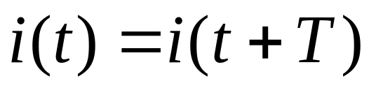
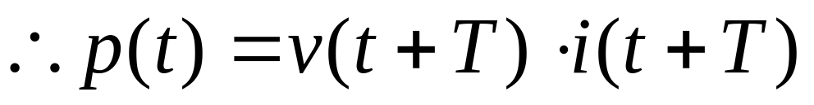
Instantaneous Power and Average Power
Instantaneous Power
A circuit element
If v(t) is a periodic function
Then for a linear circuit i(t) is also a periodic function

Slide 7
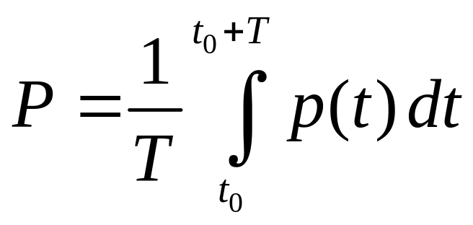
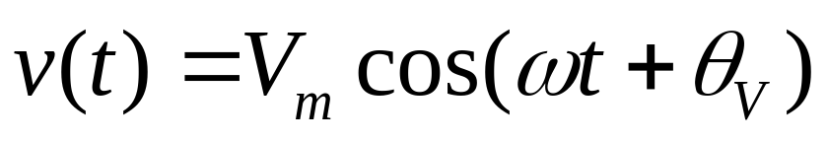
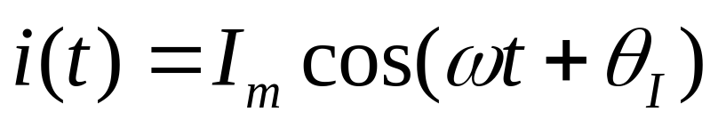
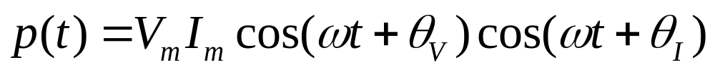
Instantaneous Power and Average Power(cont.)
Average Power
Arbitrary point in time
If v(t) is a sinusoidal function
For a linear circuit i(t) is also a sinusoidal function

Slide 8
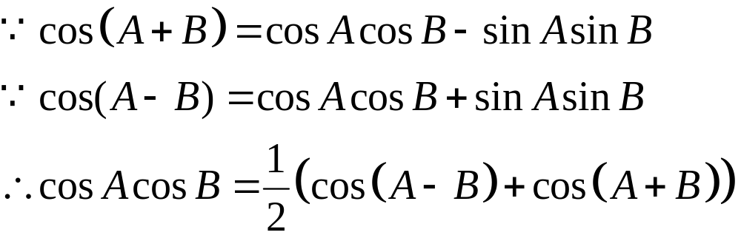
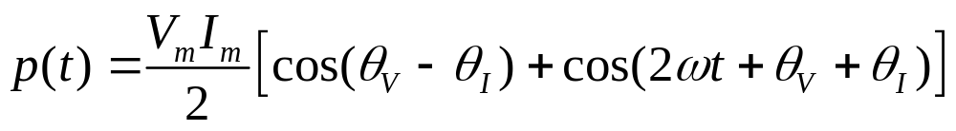
Thus
becomes
A
B
A-B
A+B

Slide 9
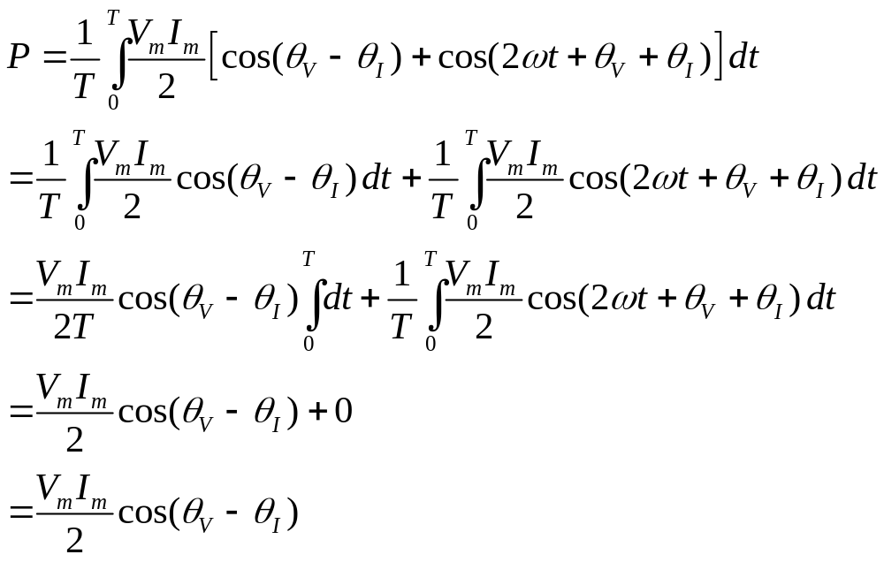
average value of the cosine
function over a complete
period is zero

Slide 10
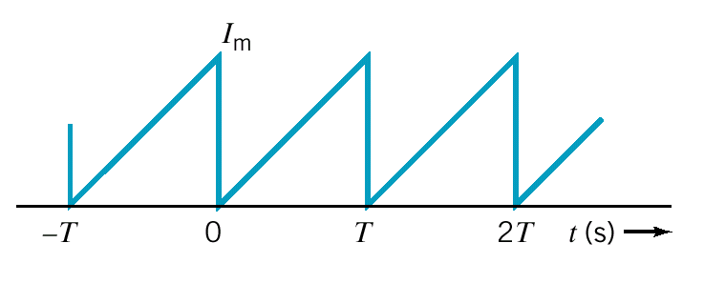
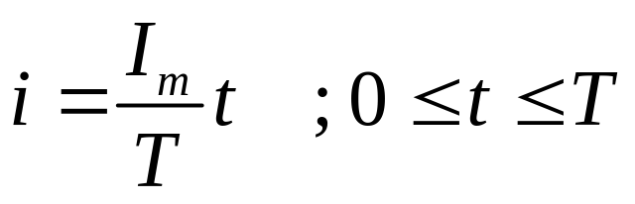
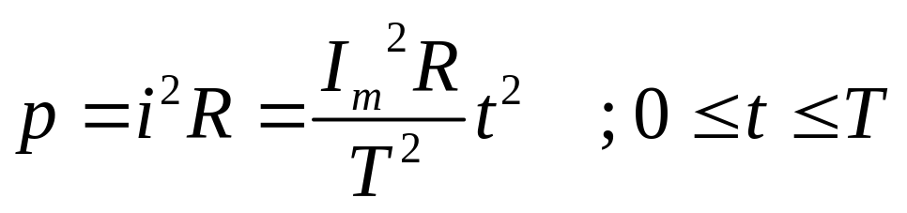
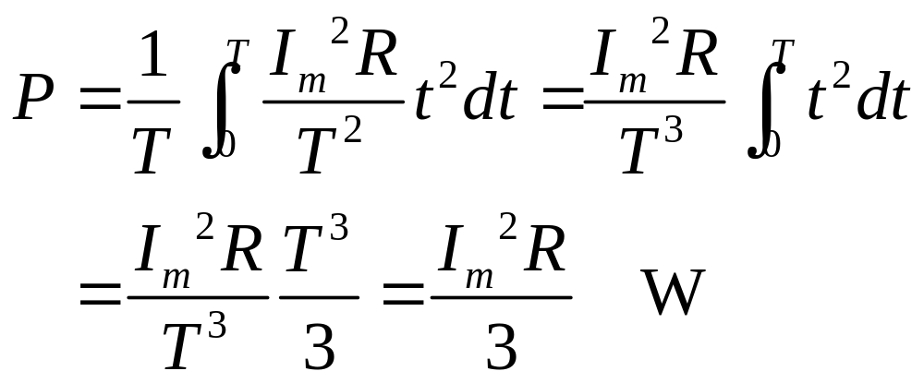
Example 11.3-1 P = ?
Using the period from
t = 0 to t = T
i(t) through a resistor R
The instantaneous power is
The average power is

Slide 11
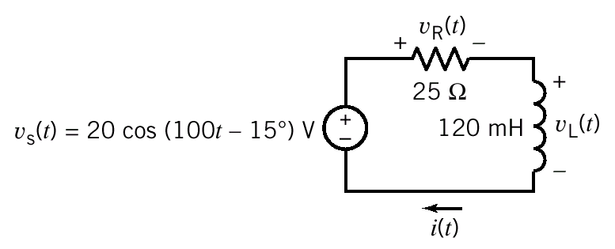
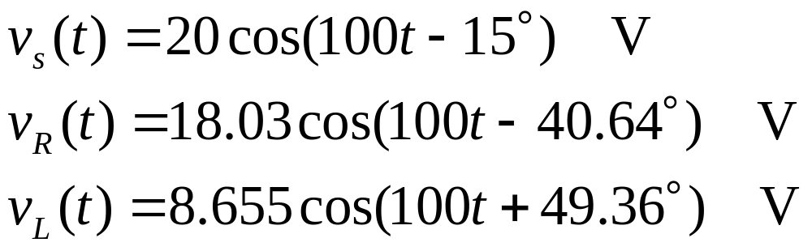
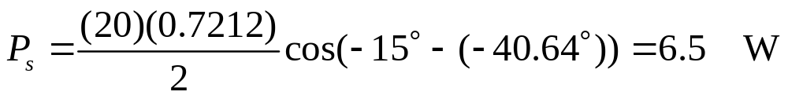
Example 11.3-2 P_{L} = ? P_{R} = ?
The element voltages are
The average power delivered by the voltage source is
The average power delivered to the voltage source is -6.5W.

Slide 12
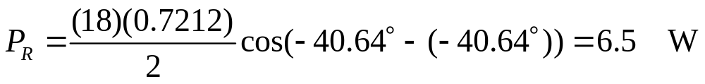
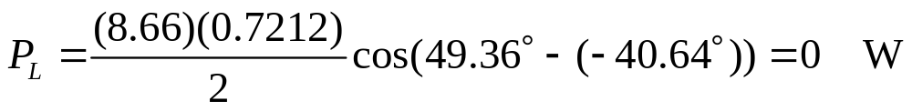
Example 11.3-2 (cont.)
The average power delivered to the resistor is
The average power delivered to the inductor is
WHY the average power delivered to the inductor equal to 0 ?
The angle of v_{L} always be 90 degrees larger than the angle of i_{L} and cos(90°) = 0.

Slide 13
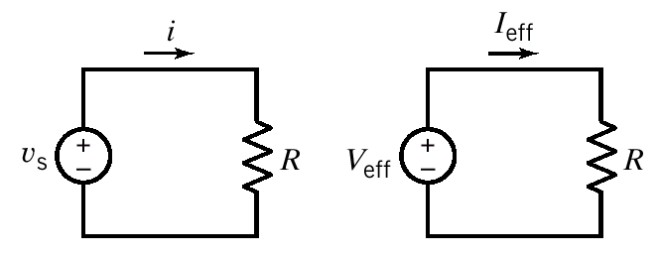

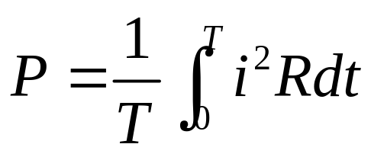
Effective Value of a Periodic Waveform
The goal is to find a dc voltage, V_{eff} (or dc current, I_{eff}), for a specified v_{s}(t) that will deliver the same average power
to R as would be delivered by the ac source.
The energy delivered in a period T is
The average power delivered to the resistor by a periodic current is

Slide 14
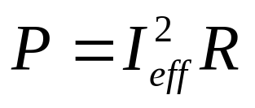
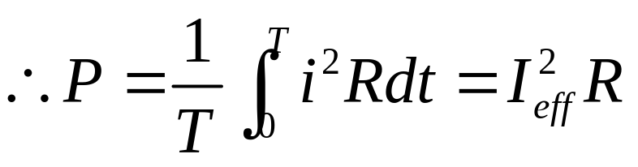
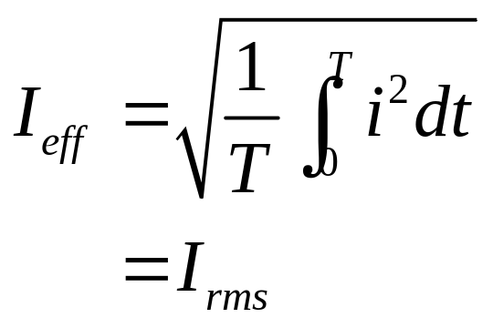
Effective Value of a Periodic Waveform (cont.)
The power delivered by a direct current is
Solve for I_{eff}
rms = root-mean-square
The effective value of a current is the steady current (dc) that transfer the same average power as the given time varying current.

Slide 15
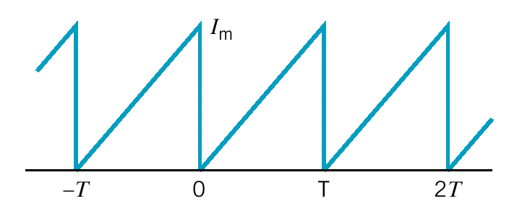
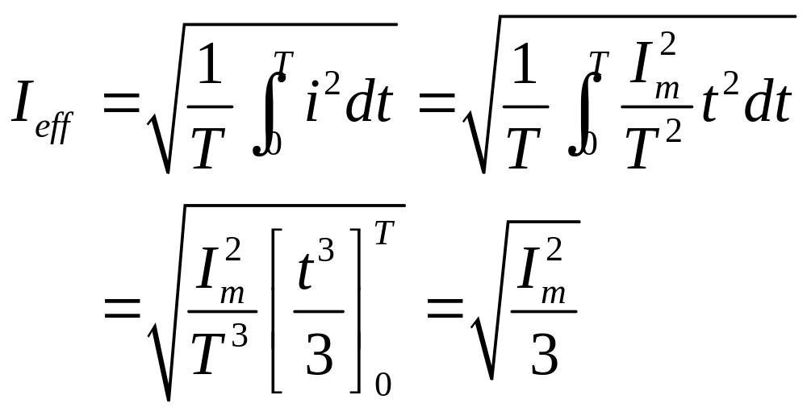
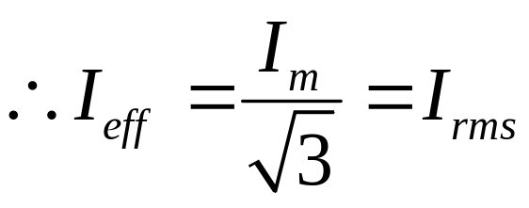
Example 11.4-1 I_{eff} = ?
Express the waveform over
the period of t = 0 to t = T
i(t) = sawtooth waveform

Slide 16
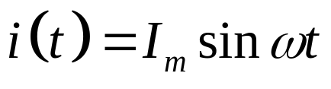
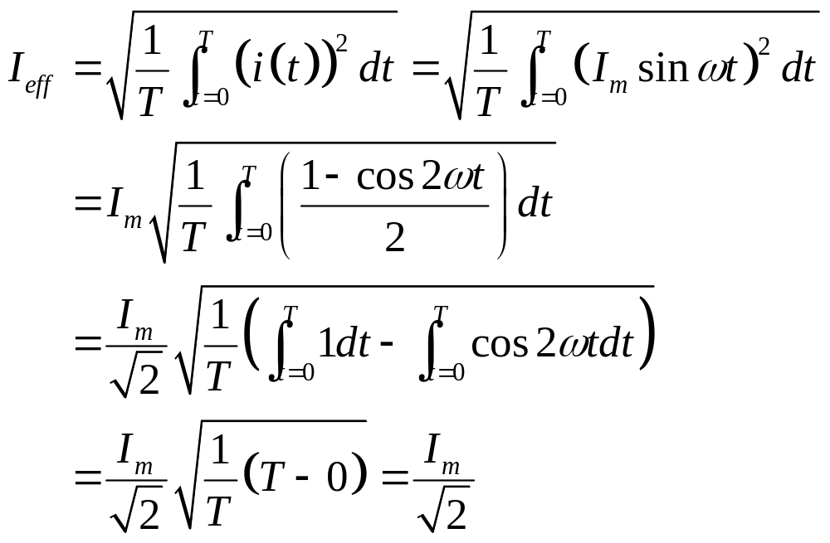
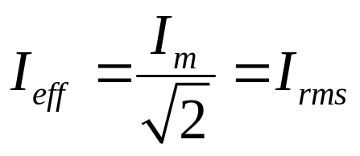
Sinusoidal Waveform (1)

Slide 17
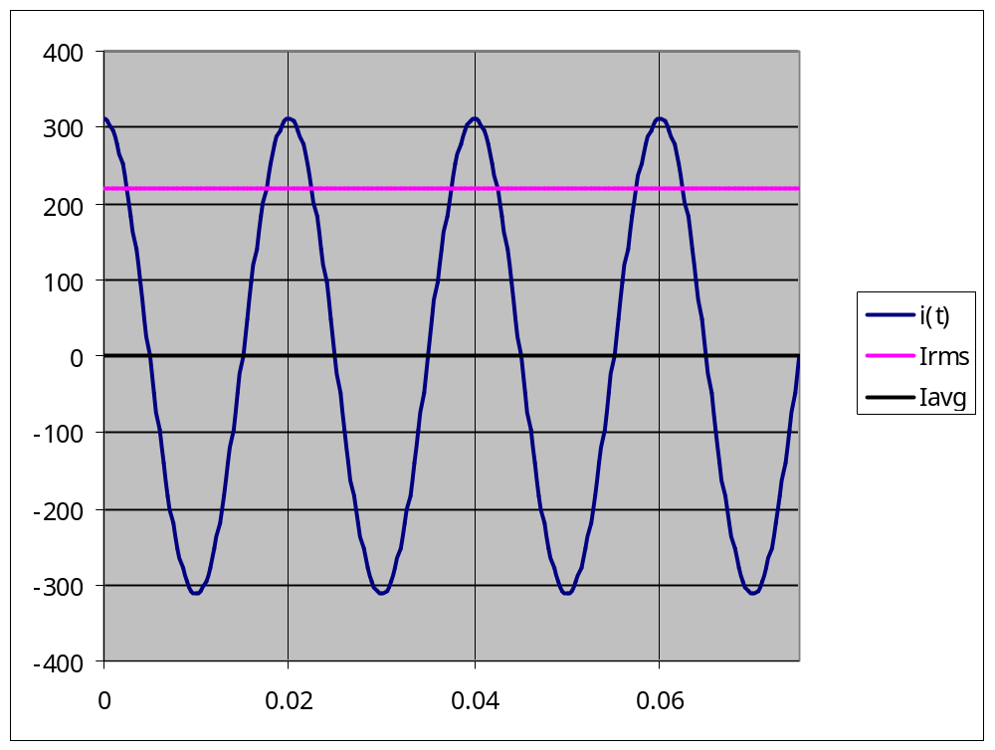
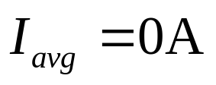
Sinusoidal Waveform (2)

Slide 18
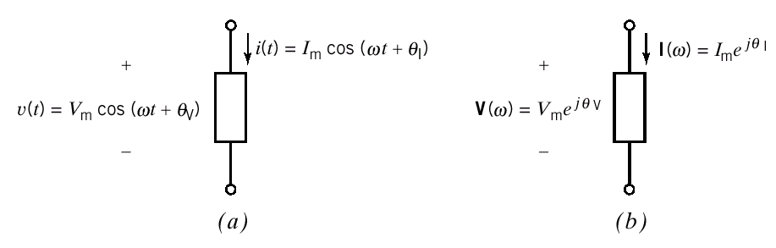
Complex Power
A linear circuit is excited by a sinusoidal input and the circuit has reached steady state.
The element voltage and current can be represented in
(a) the time domain
or (b) the frequency domain

Slide 19
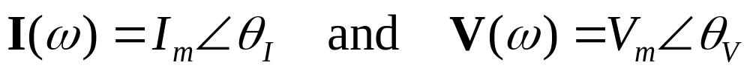
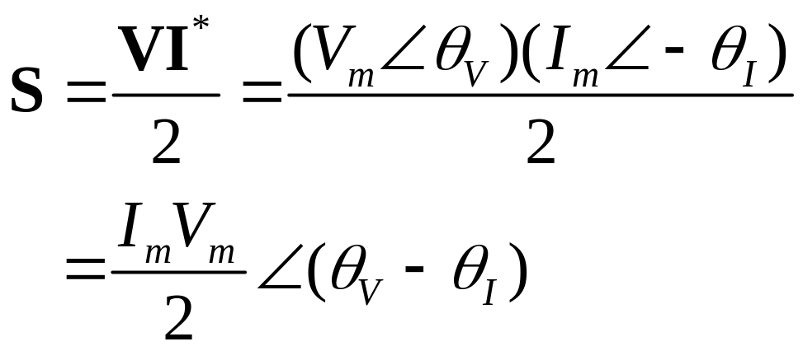
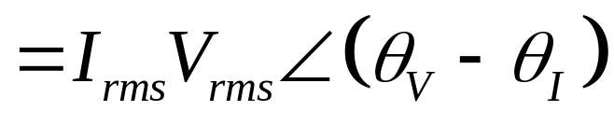
Complex Power (cont.)
To calculate average power from frequency domain
representation of voltage and current i.e. their phasors
The complex power delivered to the element is defined to be
Apparent
power
where I* = complex conjugate of I

Slide 20
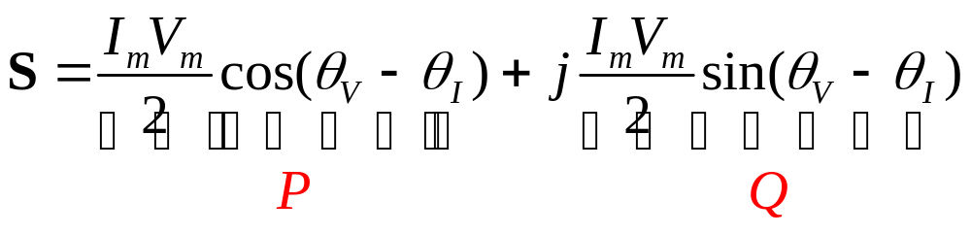
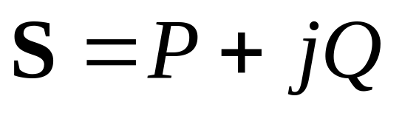
Complex Power (cont.)
The complex power in rectangular form is
or
real or average power
reactive power
Volt-Amp
Volt-Amp Reactive

Slide 21
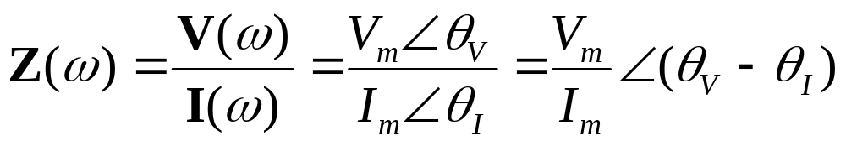
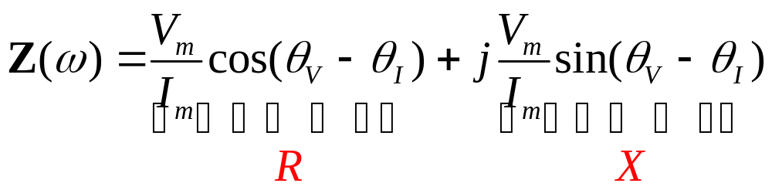
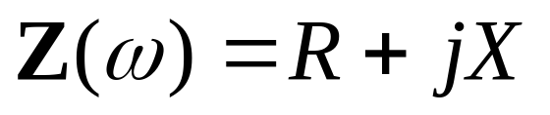
Complex Power (cont.)
The impedance of the element can be expressed as
In rectangular form
or
resistance
reactance

Slide 22
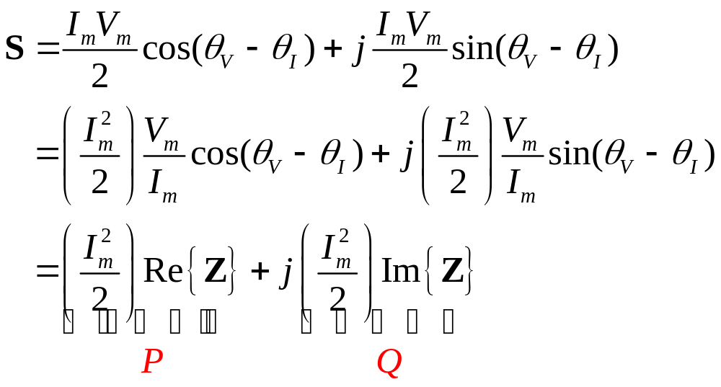
Complex Power (cont.)
The complex power can also be expressed in terms of the impedance

Slide 23
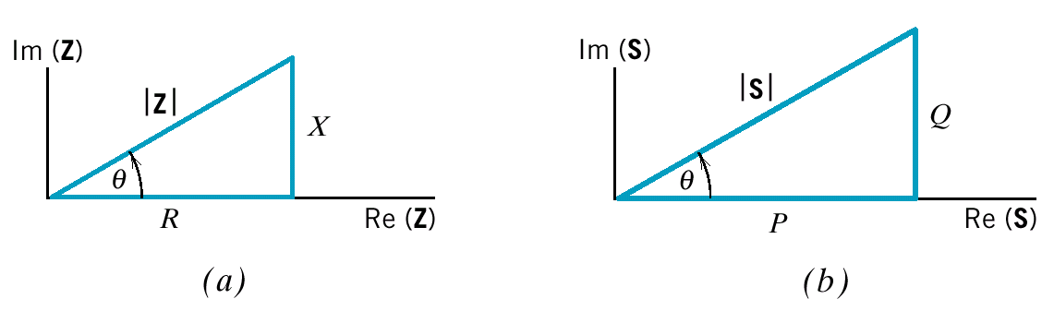
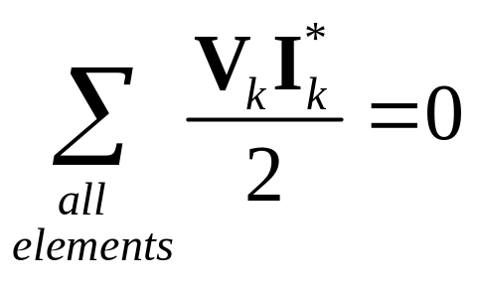
Complex Power (cont.)
The impedance triangle
The complex power triangle
The complex power is conserved
The sum of complex power absorbed by all elements of a circuit is zero.

Slide 24


Complex Power (cont.)
The complex power is conserved implies that both average power and reactive power are conserved.
or

Slide 25




Example 11.5-1 S is conserved ?
Solving for the mesh current
Use Ohm’s law to get the element voltage phasors

Slide 26



Example 11.5-1 (cont.)
Consider the voltage source
supplied by the source
For the resistor
absorbed by the resistor
For the inductor
delivered to the inductor

Slide 27


Example 11.5-1 (cont.)
For the capacitor
delivered to the capacitor
The total power absorbed by all elements (except source)
For all elements

Slide 28




Example 11.5-2 P is conserved ?
The average power for the resistor, inductor, and capacitor is
The average power supplied by the voltage source is

Slide 29



Power Factor
The ratio of the average power to the apparent power is called the power factor(pf).
Average power
apparent power
Therefore the average power

Slide 30




Power Factor (cont.)
The cosine is an even function
Need additional information in order to find the angle
Ex The transmission of electric power
Time
domain

Slide 31


Power Factor (cont.)
Frequency domain
We will adjust the power factor by adding compensating impedance to the load. The objective is to minimize the power loss (i.e. absorbed) in the transmission line.
The line
impedance

Slide 32




Power Factor (cont.)
The average power absorbed by the line is
The customer requires average power delivered to the load P at the load voltage V_{m}
Solving for I_{m}
max pf =1

Slide 33





Power Factor (cont.)
compensating
impedance
A compensating impedance has been attached across the terminals of the customer’s load. (pf 1)
corrected
The load impedance is and the
compensating impedance is
We want Z_{C} to absorb no average power so

Slide 34



Power Factor (cont.)
The impedance of the parallel combination Z_{P}
The power factor of the new combination
Calculate for R_{P} and X_{P}

Slide 35







Power Factor (cont.)
From
Solving for X_{C}
Typically the customer’s load is inductive.
Z_{C} = capacitive

Slide 36





Power Factor (cont.)
Solving for
Let
where

Slide 37




Example 11.6-1 I and pf = ?
Load = 50 kW of heating (resistive) and motor 0.86 lagging pf
Load 1 50 kW resistive load
Load 2 motor 0.86 lagging pf
P
Q

Slide 38



Example 11.6-1 (cont.)
To calculate the current

Slide 39





Example 11.6-2 pf ==> 0.95 and 1, C = ?
We wish to correct the pf to be pfc

Slide 40




Example 11.6-2 (cont.)
Or use

Slide 41


Example 11.6-2 (Revisited)
pf ==> 0.95 and 1, C = ?
Y_{C}
For pf = 1, add Y_{C} to obtain zero susceptance.
Y_{R}
Y_{C}
Y_{L}

Slide 42

Example 11.6-2 (Revisited)
pf ==> 0.95 and 1, C = ?
Y_{C}
Y_{R}
For pf = 0.95, add Y_{C} to obtain
Y_{C}
Y_{L}

Slide 43



The Power Superposition Principle for
Multi-Frequency Sinusoidal Excitation
0

Slide 44



The Power Superposition Principle (cont.)
Let the radian frequency of the 1st source = mω and
the radian frequency of the 2nd source = nω
integer

Slide 45



The Power Superposition Principle (cont.)
For the case that m and n are not integer
for example m = 1, n = 1.5

Slide 46


The Power Superposition Principle (cont.)
The superposition of average power
The average power delivered to a circuit by several sinusoidal sources, acting together, is equal to the sum of the average power delivered to the circuit by each source acting alone, if and only if, no two of the source have the same frequency.
If two or more sources are operating at the same frequency the principle of power superposition is not valid but the principle of superposition remains valid.
For N sources

Slide 47


Example 11.7-1 P = ?

Slide 48


Example 11.7-1(cont.)
Case I
These phasors correspond to different frequencies and
cannot be added.
Using the superposition
The average power can be calculated as
Since the two sinusoidal sources have different frequencies

Slide 49


Example 11.7-1(cont.)
Case II
Both phasors correspond to the same frequency and
can be added.
The sinusoidal current is
The average power can be calculated as
Power superposition cannot be used here because
both sources have same frequencies.

Slide 50







The Maximum Power Transfer Theorem
We wish to maximize P set

Slide 51




Coupled Inductors
both coil currents enter
the dotted ends of the coils
(b) one coil current enters the
dotted end of the coil, but
the other coil current enters
the undotted end

Slide 52
Summary
Instantaneous power and average power
Effective value of a periodic waveform
Complex power
Power factor
The power superposition principle
The maximum power transfer theorem
Coupled inductor and transformer

