Slide 1
Chapter 11
AC Steady-State Power

Slide 2
Chapter Objectives
To introduce the concept of the root-mean-square values
To study the complex power and power factor
To apply the power superposition principle

Slide 3
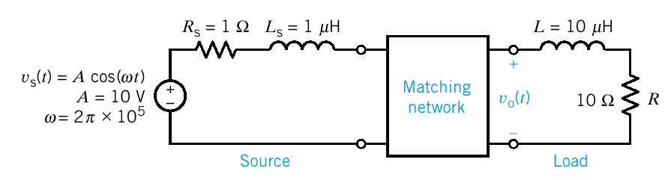
Matching Network for Maximum Power Transfer
Cellular Telephone
Design the matching network to transfer maximum power to the load where the load is the model of an antenna of a wireless communication system.

Slide 4
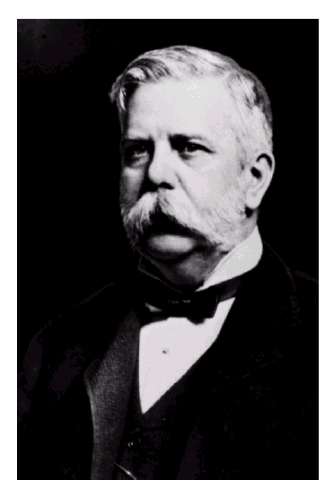
George Westinghouse, 1846-1914
The greatest engineer of his day, George Westinghouse modernized the railroad industry and established the electric power system.

Slide 5
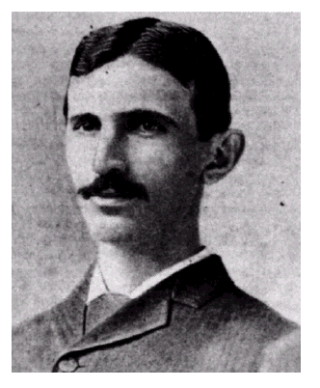
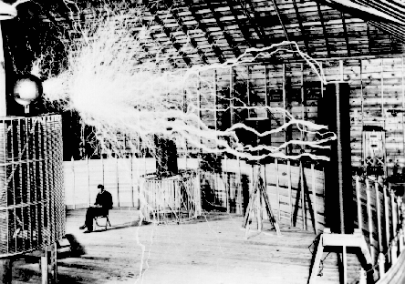
Nikola Tesla, 1856-1943
Tesla was responsible for many inventions, including the ac induction motor, and was a contributor to the selection of 60Hz as the standards ac frequency in the United States.

Slide 6
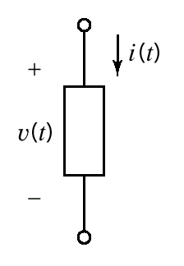
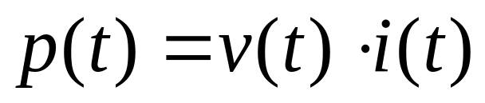
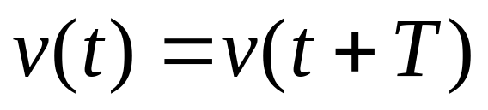
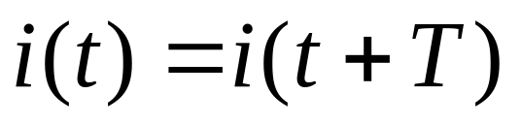
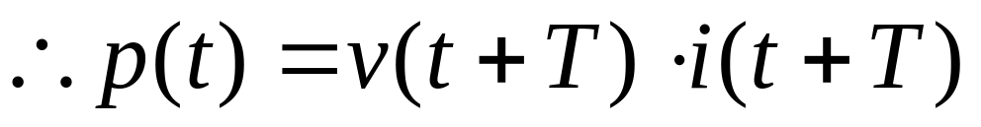
Instantaneous Power and Average Power
Instantaneous Power
A circuit element
If v(t) is a periodic function
Then for a linear circuit i(t) is also a periodic function

Slide 7
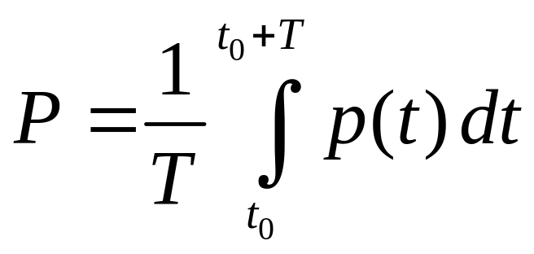
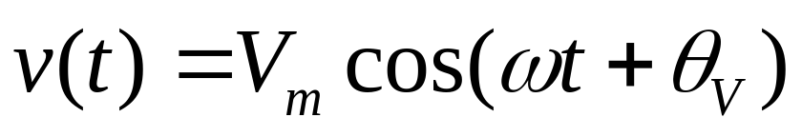
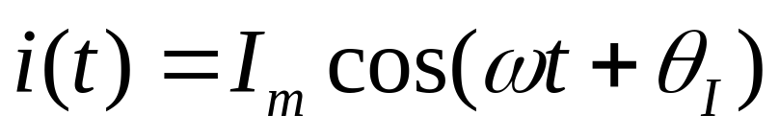
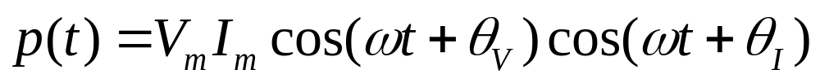
Instantaneous Power and Average Power(cont.)
Average Power
Arbitrary point in time
If v(t) is a sinusoidal function
For a linear circuit i(t) is also a sinusoidal function

Slide 8
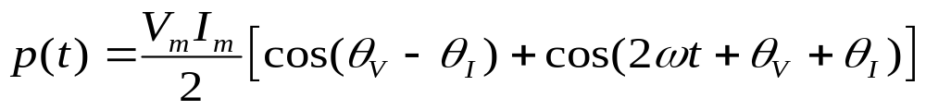
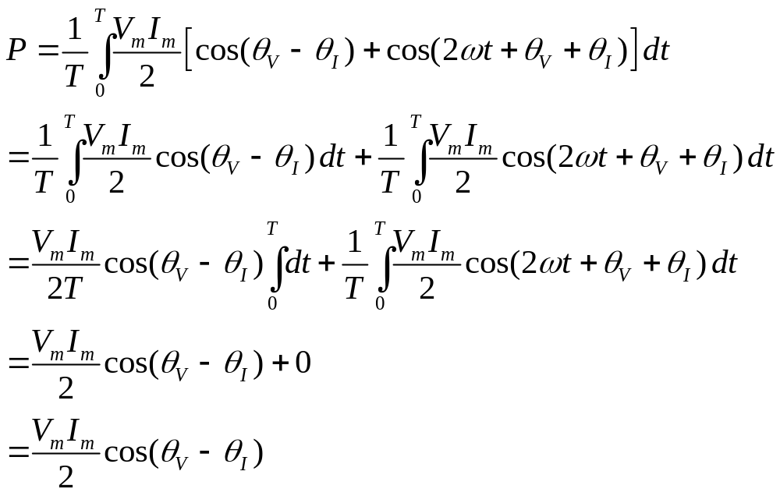
Instantaneous Power
average value of the cosine
function over a complete
period is zero
Average Power

Slide 9
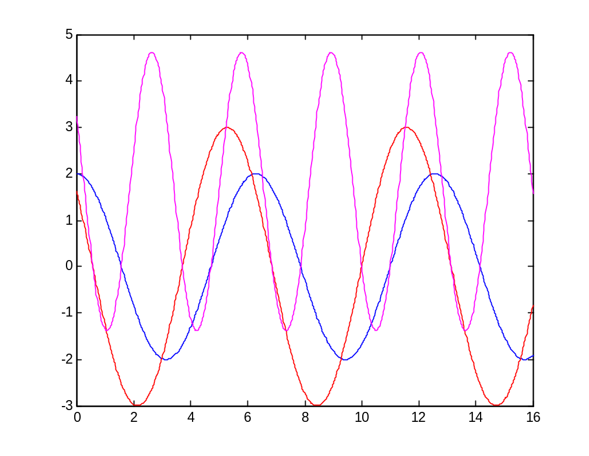







average power
Z
Simple ac circuit.
Plot of v(t), i(t) and p(t) for the circuit shown.

Slide 10
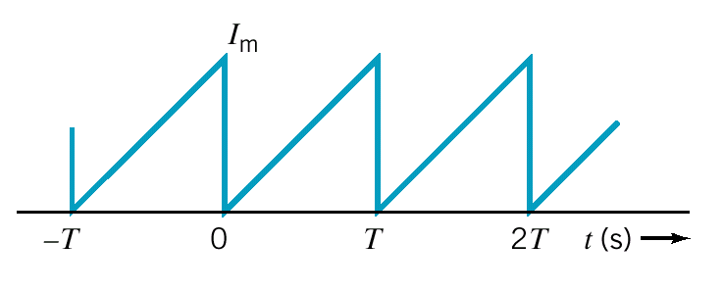
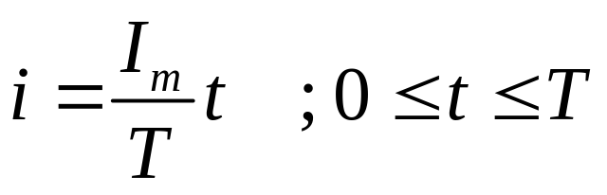
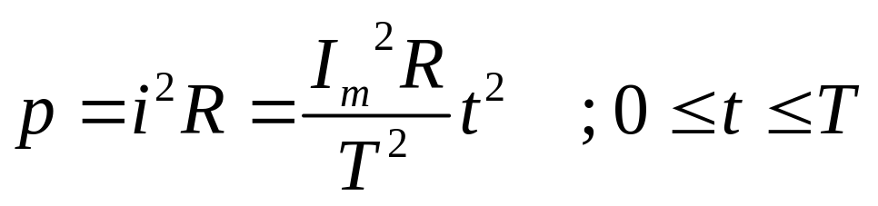
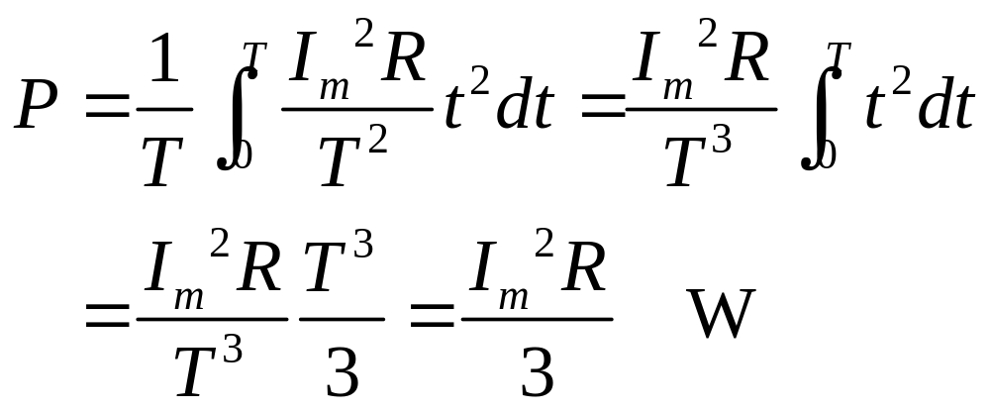
Example 11.3-1 P = ?
Using the period from
t = 0 to t = T
i(t) through a resistor R
The instantaneous power is
The average power is

Slide 11
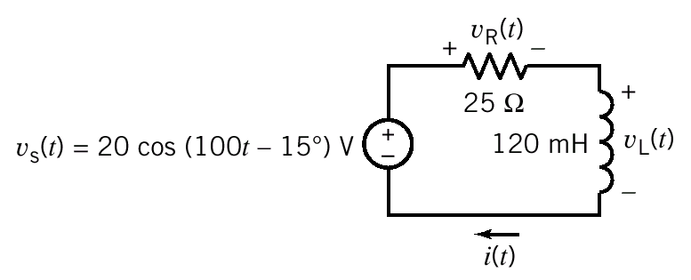
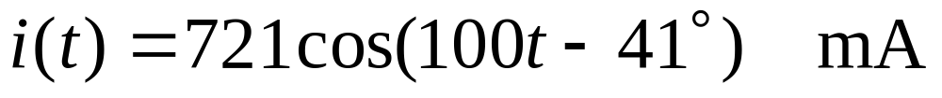
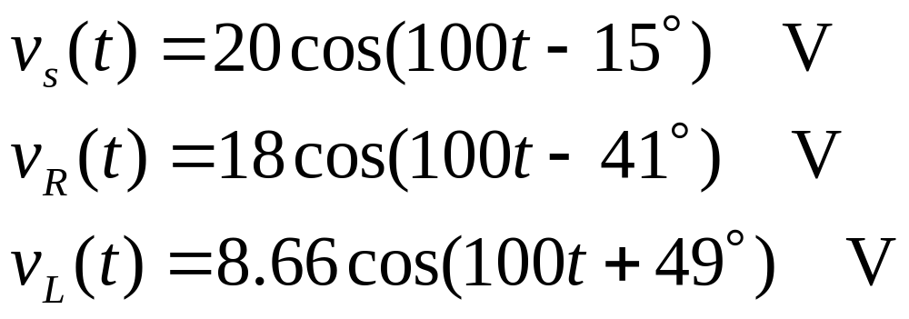
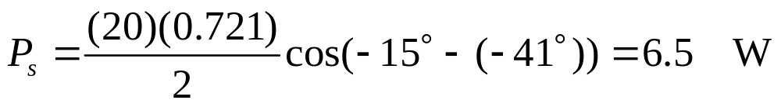
Example 11.3-2 P_{L} = ? P_{R} = ?
The element voltages are
.721×25 ≈ 18
.721×100×.120 ≈ 8.66
The average power delivered by the voltage source is
The average power delivered to the voltage source is -6.5W.

Slide 12
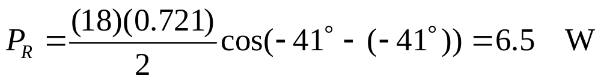
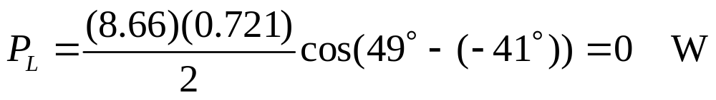
Example 11.3-2 (cont.)
The average power delivered to the resistor is
The average power delivered to the inductor is
WHY the average power delivered to the inductor equal to 0 ?
The angle of v_{L} always be 90 degrees larger than the angle of i_{L} and cos(90°) = 0.

Slide 13
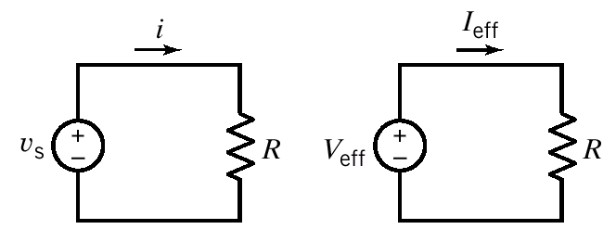

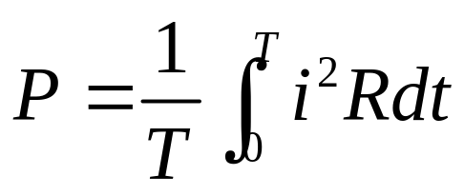
Effective Value of a Periodic Waveform
The goal is to find a dc voltage, V_{eff} (or dc current, I_{eff}), for a specified v_{s}(t) that will deliver the same average power
to R as would be delivered by the ac source.
The energy delivered in a period T is
The average power delivered to the resistor by a periodic current is

Slide 14
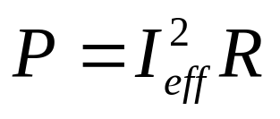
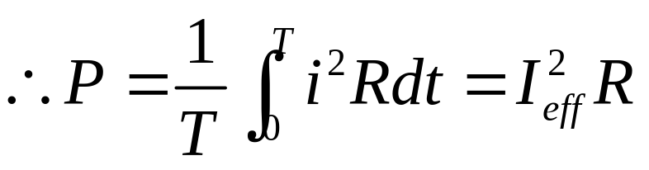
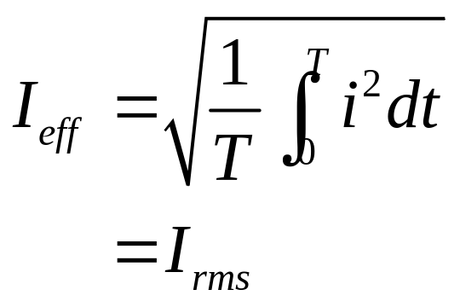
Effective Value of a Periodic Waveform (cont.)
The power delivered by a direct current is
Solve for I_{eff}
rms = root-mean-square
The effective value of a current is the steady current (dc) that transfer the same average power as the given time varying current.

Slide 15
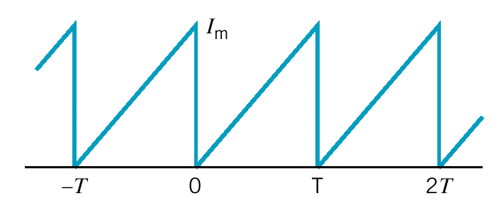
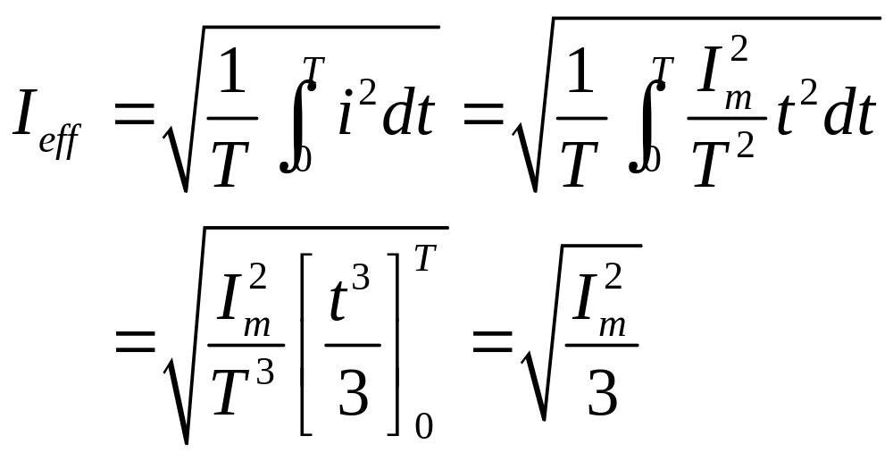
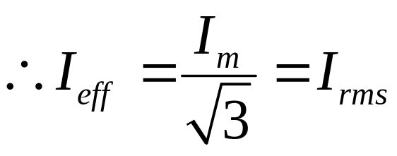
Example 11.4-1 I_{eff} = ?
Express the waveform over
the period of t = 0 to t = T
i(t) = sawtooth waveform

Slide 16
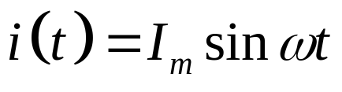
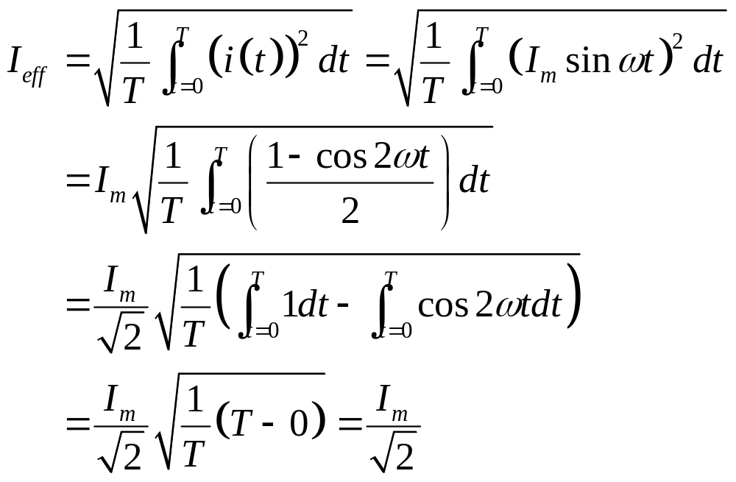
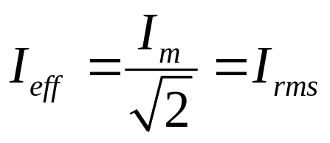
Sinusoidal Waveform

Slide 17
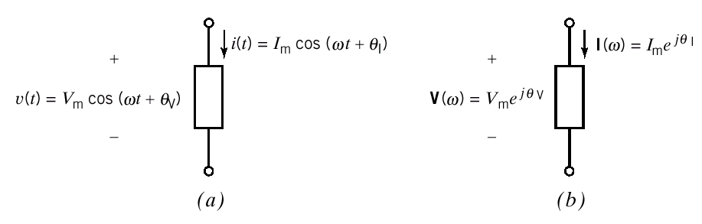
Complex Power
A linear circuit is excited by a sinusoidal input and the circuit has reached steady state.
The element voltage and current can be represented in
(a) the time domain
or (b) the frequency domain

Slide 18
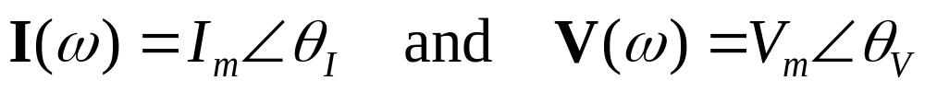
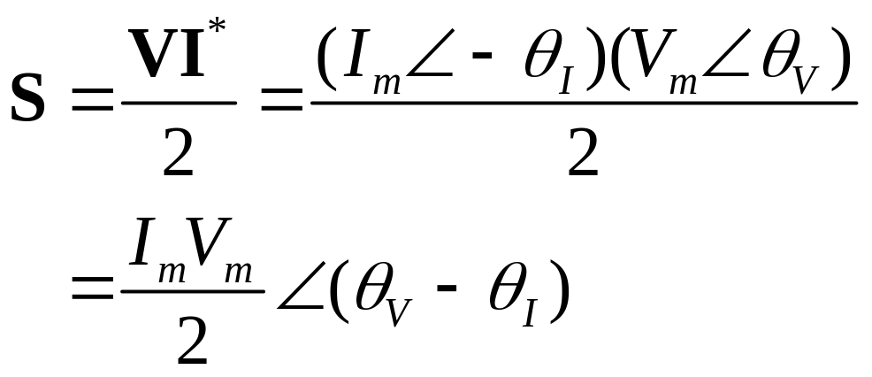
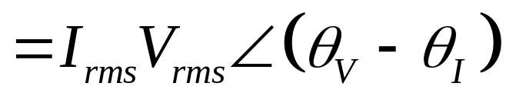
Complex Power (cont.)
To calculate average power from frequency domain
representation of voltage and current i.e. their phasors
The complex power delivered to the element is defined to be
|S|=V_{m}I_{m}/2
is called
Apparent
power
where I* = complex conjugate of I

Slide 19
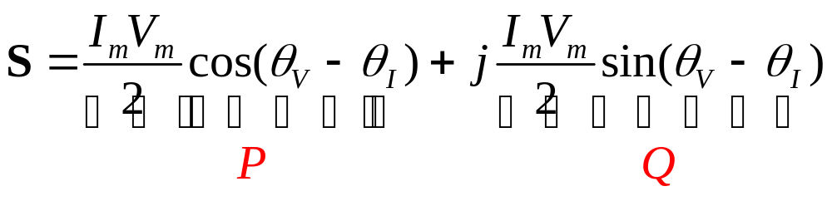
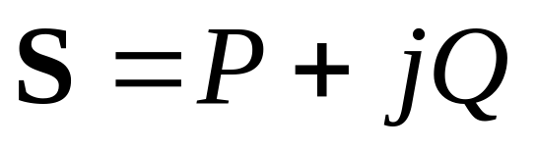
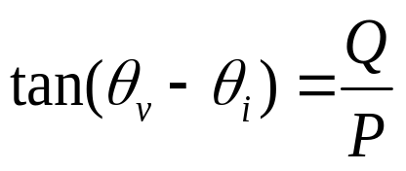
Complex Power (cont.)
The complex power in rectangular form is
or
real or average power
reactive power
Volt-Amp
Volt-Amp Reactive

Slide 20
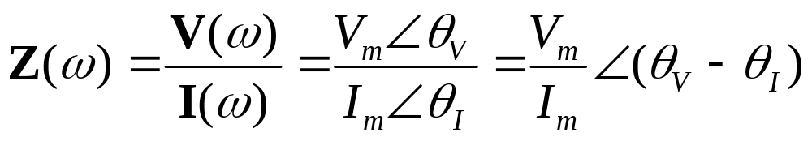
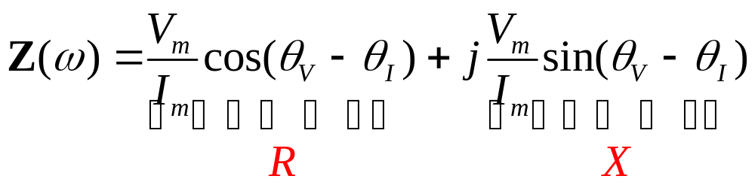
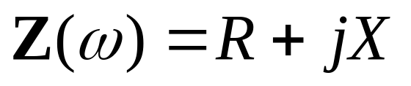
Complex Power (cont.)
The impedance of the element can be expressed as
In rectangular form
or
resistance
reactance

Slide 21
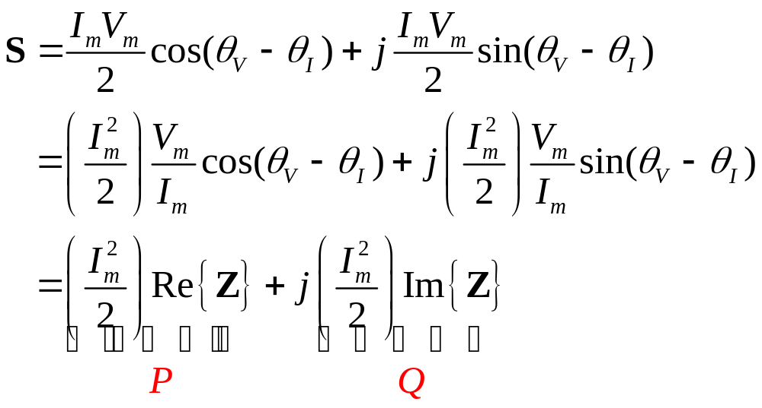
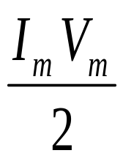
Complex Power (cont.)
The complex power can also be expressed in terms of the impedance
|S| =
Apparent
power

Slide 22
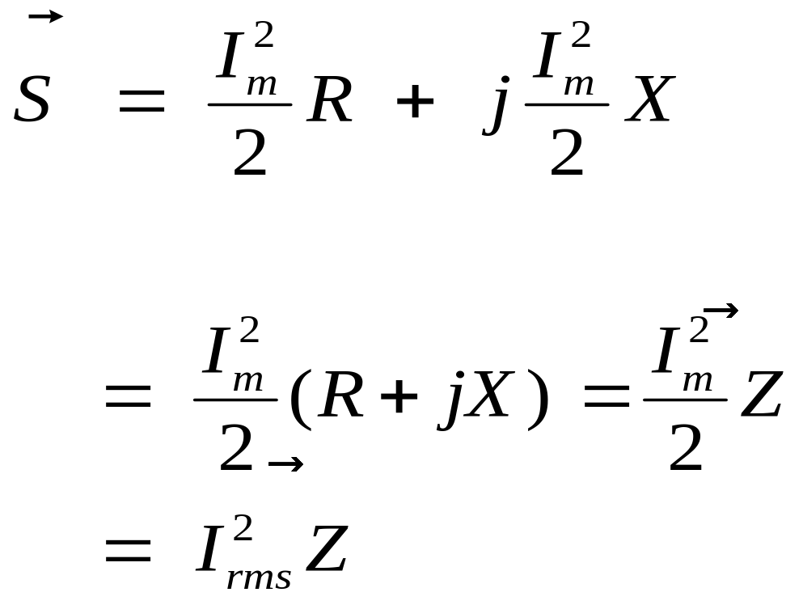


P
Q
✦
It is not true that imitating for DC.
×

Slide 23


Another Derivation
P
Q

Slide 24



Yet Another Derivation
P
Q

Slide 25


Complex Power (cont.)
The impedance triangle
The complex power triangle
The complex power is conserved
The sum of complex power absorbed by all elements of a circuit is zero.

Slide 26


Complex Power (cont.)
The complex power is conserved implies that both average power and reactive power are conserved.
or

Slide 27




Example 11.5-1 S is conserved ?
Solving for the mesh current
Use Ohm’s law to get the element voltage phasors

Slide 28



Example 11.5-1 (cont.)
Consider the voltage source
supplied by the source
For the resistor
absorbed by the resistor
For the inductor
delivered to the inductor

Slide 29


Example 11.5-1 (cont.)
For the capacitor
delivered to the capacitor
The total power absorbed by all elements (except source)
For all elements

Slide 30




Example 11.5-2 P is conserved ?
The average power for the resistor, inductor, and capacitor is
The average power supplied by the voltage source is

Slide 31
An electric load operates at 240 V rms. The load
absorbs an average power of 8 kW at a lagging
power factor of 0.8.
Calculate the complex power of the load.
Calculate the impedance of the load.
Solution a) From the Power Triangle
P = |S| cos θ cosθ = 0.8
Q = |S| sin θ sinθ = 0.6
Therefore |S| = P / cos θ = 8 kW / 0.8 = 10 kVA
Q = |S| sin θ = 6 kVAR
and S = 8 + j6 kVA
Example 11.5-3

Slide 32

pf
Using P = V_{rms}I_{rms}cos(θ ), we get
I_{rms} = 8000/(240×0.8) = 41.67 A
We know the angle of the load impedance
since it is the power factor angle:
θ = cos⁻¹(0.8) = 36.87°,
and θ is positive because pf is lagging.
Hence

Slide 33



Power Factor
The ratio of the average power to the apparent power is called the power factor(pf).
Average power
apparent power
“Why talk about leading and lagging pf at all? Why not just talk about the impedance of the load?” One reason is that, in some applications (e.g., power systems), a load may not consist simply of ordinary inductors, capacitors, and resistors. The load is usually an electric motor.
Therefore the average power

Slide 34




Power Factor (cont.)
The cosine is an even function
Need additional information in order to find the angle
(I leads V → capacitive load)
(I lags V → inductive load)
Ex The transmission of electric power
Time
domain

Slide 35


Power Factor (cont.)
Frequency domain
We will adjust the power factor by adding compensating impedance to the load. The objective is to minimize the power loss (i.e. absorbed) in the transmission line.
The line
impedance

Slide 36




Power Factor (cont.)
The average power absorbed by the line is
The customer requires average power delivered to the load P at the load voltage V_{m}
Solving for I_{m}
max pf =1

Slide 37





Power Factor (cont.)
compensating
impedance
A compensating impedance has been attached across the terminals of the customer’s load. (pf 1)
corrected
The load impedance is and the
compensating impedance is
We want Z_{C} to absorb no average power so

Slide 38



Power Factor (cont.)
The impedance of the parallel combination Z_{P}
The power factor of the new combination
Calculate for R_{P} and X_{P}

Slide 39







Power Factor (cont.)
From
Solving for X_{C}
Typically the customer’s load is inductive.
Z_{C} = capacitive

Slide 40





Power Factor (cont.)
Solving for
Let
where

Slide 41




Example 11.6-1 I and pf = ?
Load = 50 kW of heating (resistive) and motor 0.86 lagging pf
Load 1 50 kW resistive load
Load 2 motor 0.86 lagging pf
P
Q

Slide 42



Example 11.6-1 (cont.)
To calculate the current

Slide 43







Example 11.6-2 pf ==> 0.95 and 1, C = ?
We wish to correct the pf to be pfc

Slide 44




Example 11.6-2 (cont.)
Or use

Slide 45


Example 11.6-2 (Revisited)
pf ==> 0.95 and 1, C = ?
Y_{C}
For pf = 1, add Y_{C} to obtain zero susceptance.
Y_{R}
jY_{C}
jY_{L}

Slide 46

Example 11.6-2 (Revisited)
pf ==> 0.95 and 1, C = ?
Y_{C}
Y_{R}
-cos⁻¹0.95
For pf = 0.95, add Y_{C} to obtain
jY_{C}
jY_{L}
See D. E. Johnson, et al, “Electric Circuit Analysis”, Third Edition, pp.432-4.

Slide 47



The Power Superposition Principle for
Multi-Frequency Sinusoidal Excitation
0

Slide 48



The Power Superposition Principle (cont.)
Let the radian frequency of the 1st source = mω and
the radian frequency of the 2nd source = nω
integer

Slide 49



The Power Superposition Principle (cont.)
For the case that m and n are not integer
for example m = 1, n = 1.5

Slide 50


The Power Superposition Principle (cont.)
The superposition of average power
The average power delivered to a circuit by several sinusoidal sources, acting together, is equal to the sum of the average power delivered to the circuit by each source acting alone, if and only if, no two of the source have the same frequency.
If two or more sources are operating at the same frequency the principle of power superposition is not valid but the principle of superposition remains valid.
For N sources

Slide 51


Example 11.7-1 P = ?

Slide 52


Example 11.7-1(cont.)
Case I
These phasors correspond to different frequencies and
cannot be added.
Using the superposition
The average power can be calculated as
Since the two sinusoidal sources have different frequencies

Slide 53


Example 11.7-1(cont.)
Case II
Both phasors correspond to the same frequency and
can be added.
The sinusoidal current is
The average power can be calculated as
Power superposition cannot be used here because
both sources have same frequencies.

Slide 54







The Maximum Power Transfer Theorem
We wish to maximize P set

Slide 55




Coupled Inductors
both coil currents enter
the dotted ends of the coils
(b) one coil current enters the
dotted end of the coil, but
the other coil current enters
the undotted end

Slide 56
Summary
Instantaneous power and average power
Effective value of a periodic waveform
Complex power
Power factor
The power superposition principle
The maximum power transfer theorem
Coupled inductor and transformer

Slide 57
To accompany slides 7 and 8

Slide 58
We are operating in the sinusoidal steady
state, so we may choose any convenient reference
for zero time. Engineers concerned with operating
systems involving the transfer of large blocks of
power have found that a zero time corresponding
to the instant when the current is passing through
a positive maximum is convenient. This reference
system requires a shift of both the voltage and
current by θ_{i}. Thus
v(t) = V_{m}cos(ωt + θ_{v} - θ_{i});
i(t) = I_{m}cos(ωt)

Slide 59


p(t) = V_{m}I_{m}cos(ωt + θ_{v} - θ_{i})cos(ωt)
Expanding we get
Take notes of the following characteristics
of the instantaneous power:
Instantaneous Power
(1)

Slide 60

1. The average power is given by the first term
2. The frequency of the instantaneous power is
twice the frequency of the voltage or current.
3. If the circuit between the terminal is purely
resistive, the voltage and current are in phase,
θ_{v} = θ_{I} ⇒ P = V_{m}I_{m}/2, and (1) becomes
p(t) = P + Pcos2ωt
Average Power in watts
can never be negative, i.e. power cannot be extracted from a purely resistive
circuit. Rather, all the electric energy is dissipated in the form of thermal energy.

Slide 61


4. If the circuit between the terminal is purely
inductive, the voltage leads the current by 90°,
θ_{v} - θ_{i} = +90° and (1) becomes
The average power is zero.
5. If the circuit between the terminal is purely
capacitive, the voltage lags the current by 90°,
θ_{v} - θ_{i} = -90° and (1) becomes
The average power is zero.

Slide 62
In a purely inductive or purely capacitive circuit,
the average power is zero. Therefore no transformation
of energy from electric to nonelectric form takes place.
The instantaneous power is continually exchanged bet-
ween source driving the circuit and the magnetic field
associated with the inductive elements or the electric
field associated with the capacitive elements, at a freq-
uency of 2ω. In case of inductive elements when p(t) is
positive, energy is being stored on the magnetic fields,
and when p(t) is negative, energy is being extracted
from the magnetic fields.

Slide 63

The coefficient of sin2ωt is referred to as the
reactive power and is denoted Q. Hence
Q is positive for inductors (θ_{v} - θ_{i} = +90°)
and negative for capacitors (θ_{v} - θ_{i} = -90°).
If we use the notation for average and reactive
power, we can express Eq. (1) as
p(t) = P + Pcos2ωt - Qsin2ωt
Reactive Power in vars
absorb magnetizing vars
deliver magnetizing vars

Slide 64
The angle θ_{v} - θ_{i} is referred to as the power
factor angle. The cosine of this angle is called
the power factor, abbreviated pf, and the sine of
this angle is called the reactive factor, abbrevia-
ted rf. Thus
pf = cos(θ_{v} - θ_{i})
and
rf = sin(θ_{v} - θ_{i})
Once we know the magnitude of the power
factor, we know the magnitude of the reactive

Slide 65
factor. However, there is an ambiguity regarding
the algebraic sign of the reactive factor because
cos(θ_{v} - θ_{i}) = cos(θ_{i} - θ_{v}) and sin(θ_{v} - θ_{i}) =
-sin(θ_{i} - θ_{v}). To completely describe the reactive
factor through the power factor, we use the des-
criptive phrases lagging power factor and leading
power factor. Lagging power factor implies that
current lags voltage⎯hence an inductive load
(absorb magnetizing vars). Leading power factor
implies that current leads voltage⎯hence a capa-
citive load (deliver magnetizing vars).

Slide 66




EXAMPLE A power source with v(t) = 100cos50t
is connected to a load consisting of a resistor R= 20
ohms and inductor L = 4 H connected in series, as
shown in Fig 1. Find the current flowing through
the load, the instantaneous power, the average
power, and the power factor for this circuit.

Slide 67

SOLUTION The impedance of the load is
Z = 20 + j200
= 201∠84°
The current flowing through the load is
As a function of time the current flowing through
the load is
i(t) = 2cos(50t - 84°)

Slide 68



The instantaneous power is
The average power is
Finally, the power factor for the circuit is
(*)

Slide 69

We can also find p(t) by using Eq. (1):
Same answer as you would obtain by expanding (*).

Slide 70

The reactive power is
Same answer as the one we obtained previously.

Slide 71












PROBLEMS
1. Calculate all the voltages and currents in the circuit shown.
2. Calculate the average power and the reactive power at the
terminals of the network shown if
v = 100 cos (ωt + 15°) V
and i = 4 sin (ωt - 15°) A.
State whether the network inside the box is absorbing or
delivering (i) average power and (ii) magnetizing vars.

Slide 72




3. Suppose that a large consumer of electricity requires 10 kW of
power by using 230 V rms at a pf of 0.5 lagging.
a. Find the current drawn by the load.
b. If the transmission line resistance is R = 0.1 Ω, find the voltage
and the power that must be generated by the power company.
c. If the consumer can change the pf from 0.5 to 0.9 lagging, find
the decrease in watts the power company delivers.
pf angle of 60°
Load

Slide 73

4. A load is connected in parallel across a V_{rms} = 300 V power source. The
load is rated at 200W with a power factor given as pf = 0.8 lagging. Find
the rms current flowing through the load and describe a circuit that can
model the load. Assume that ω = 100.
5. A current i(t) = 40 cos(100t + 20°) is delivered to a capacitor C = 1/10 F.
Find the instantaneous power and average power.

Slide 74


SOLUTIONS
1.
Then

Slide 75


Finally,

Slide 76
2. i(t) = 4 sin (ωt - 15°) A
= 4 cos (ωt - 105°) A.
P = (100)(4) cos[15 - (-105)] = -100 W
Q = (100)(4) sin[15 - (-105)] = 173.21 VAR.
Note from the figure use of the passive sign
convention. The negative value of -100 W means
that the circuit inside the box is delivering average
power to the terminals.
The passive sign convention means that, as Q
is positive, the circuit inside the box is absorbing
magnetizing vars at its terminals.

Slide 77



a. The current drawn by the load has an rms
value of
b.
Thus, the voltage that must be generated by the
power company must have V_{S,rms} = 234.5 V.
Also the line loss is So the
power company has to produce 10,756 W.

Slide 78
If the consumer can change the pf from 0.5 to
0.9 lagging, the load current will become I_{rms}
= 48 A, so the line loss will be approximately
233 W, which is about 30% of the loss at the
power factor. The power company can now
deliver 523W less.

Slide 79


We can find the current by using
Again the load is lagging so we have
pf angle = +cos⁻¹ (0.8) = 37°
The impedance is (angle of the load impedance is the pf angle)
We can model the load as R = 203.65 in series
with L = 153/ω = 153/100 = 1.53 H.

Slide 80




5.
For a capacitor, we have the relationship
Therefore, v(t) = 4 cos(100t - 70°) V
The instantaneous power is
The average power is

