Slide 1
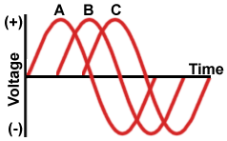
Chapter 12
Three-Phase Circuits

Slide 2
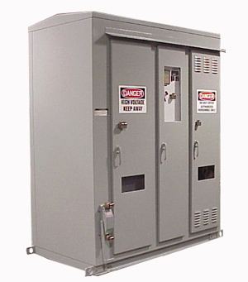
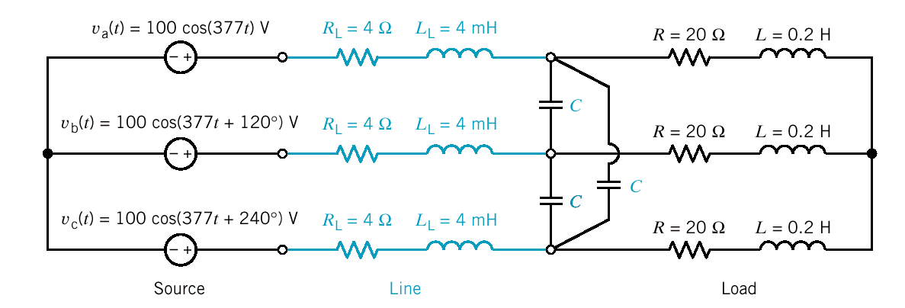
Power Factor Correction
Medium Voltage Metal
Enclosed Capacitor Banks
A balanced three-phase circuit

Slide 3
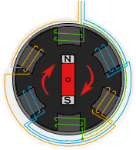
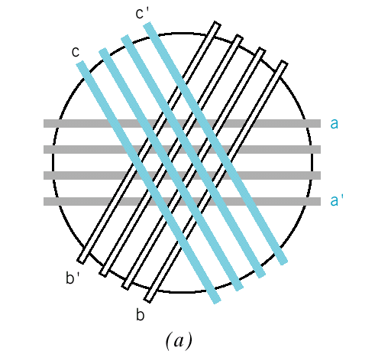
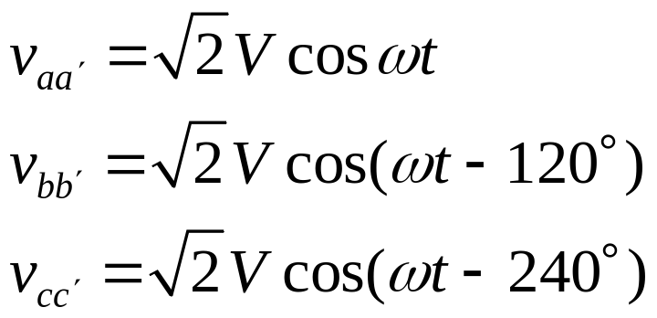
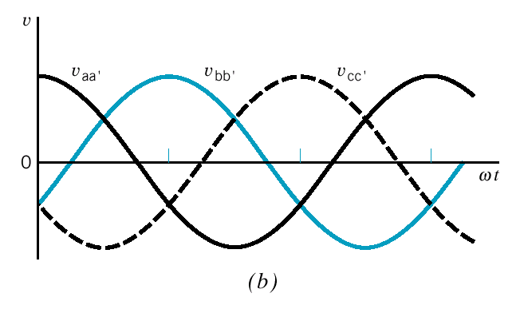
Three-Phase Voltages
The three windings on a cylindrical drum used to obtain three-phase voltages
(b) Balanced three-phase
voltages

Slide 4
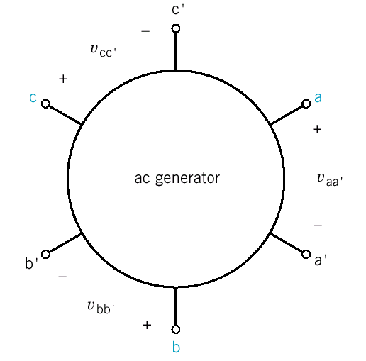
Three-Phase Voltages
Generator with six terminals

Slide 5
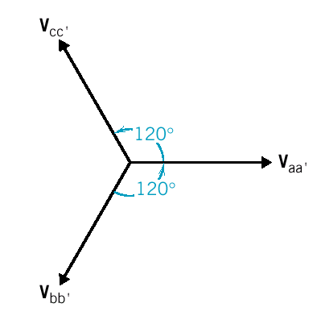
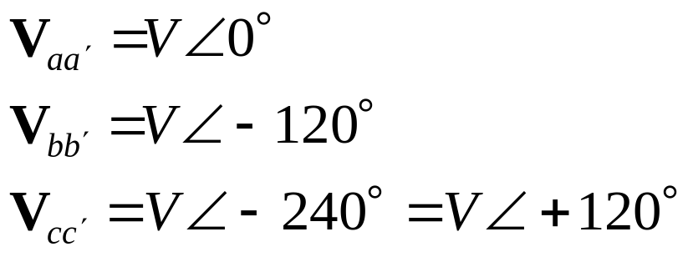
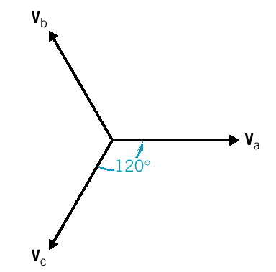
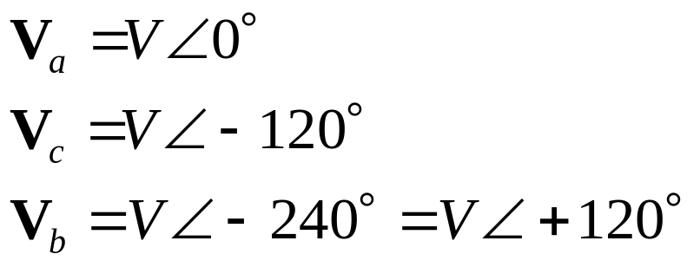
Three-Phase Balanced Voltages
Phase sequence or phase rotation is abc
Positive Phase Sequence
neutral terminal
Phase sequence or phase rotation is acb
Negative Phase Sequence

Slide 6
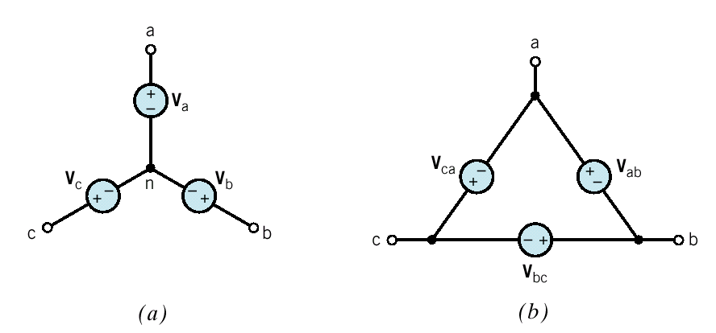
Two Common Methods of Connection
phase voltage
(a) Y-connected sources
(b) Δ-connected sources

Slide 7
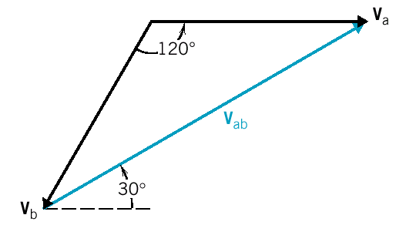
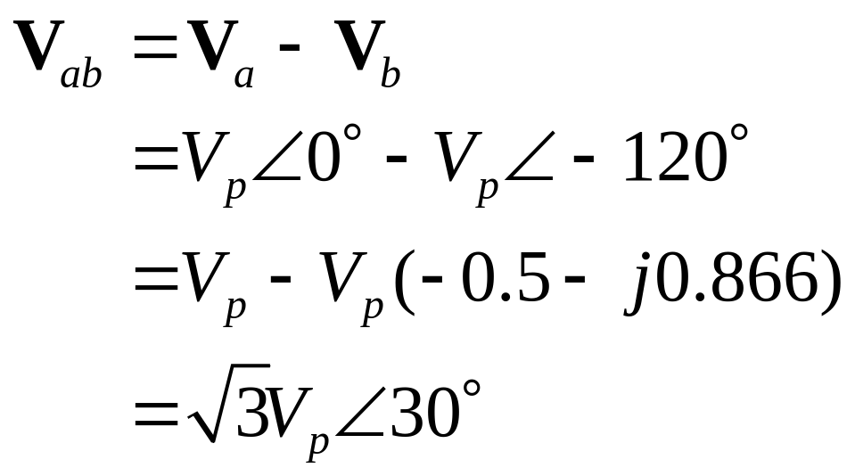
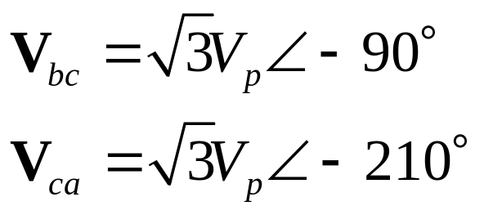
Phase and Line Voltages
The line-to-line voltage V_{ab} of
the Y-connected source
Similarly

Slide 8
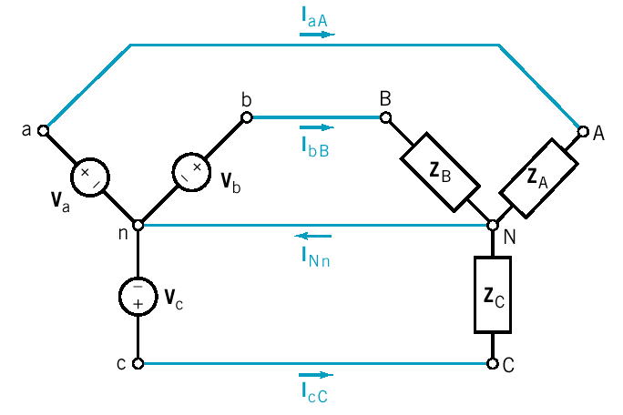
The Y-to-Y Circuit
A four-wire Y-to-Y circuit

Slide 9
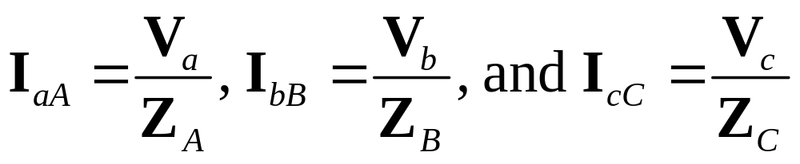
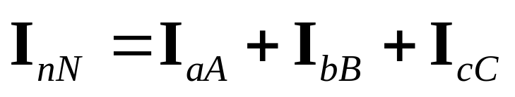
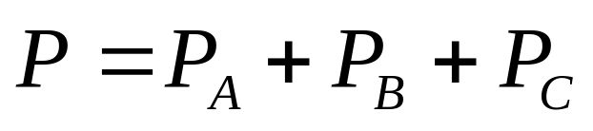
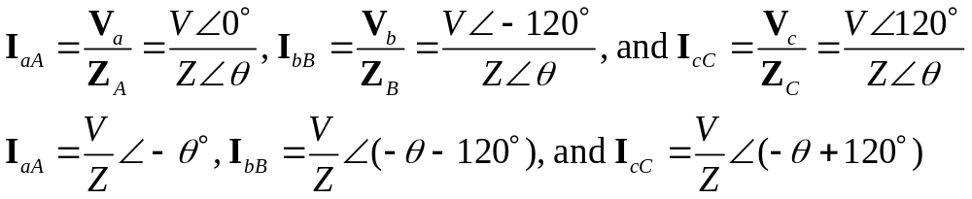
The Y-to-Y Circuit (cont.)
Four - wire
The average power delivered by the three-phase source
to the three-phase load
When Z_{A} = Z_{B} = Z_{C} the load is said to be balanced

Slide 10
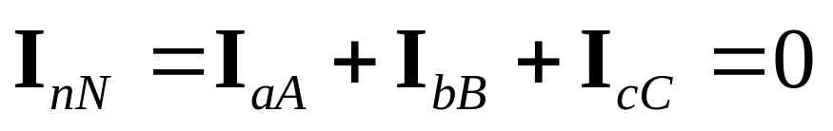
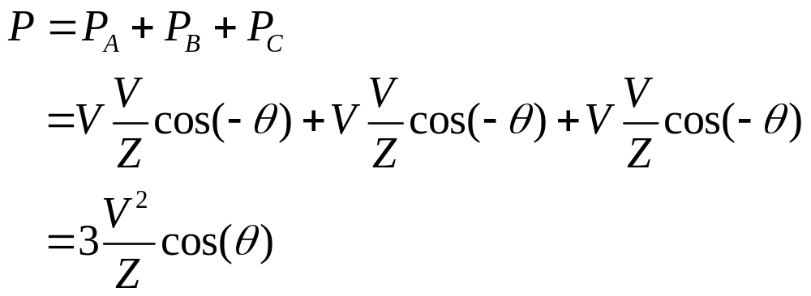
The Y-to-Y Circuit(cont.)
There is no current in the wire connecting the neutral node
of the source to the neutral node of the load.
The average power delivered to the load is

Slide 11
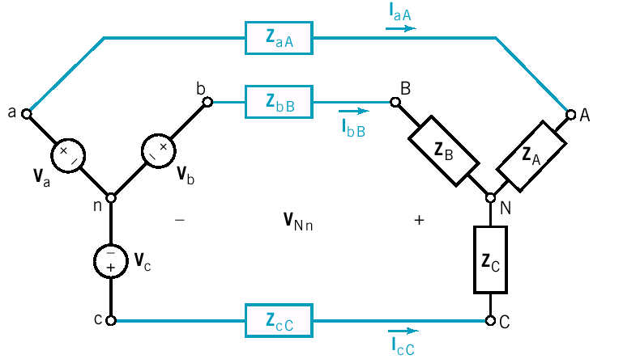
The Y-to-Y Circuit (cont.)
A three-wire Y-to-Y circuit

Slide 12
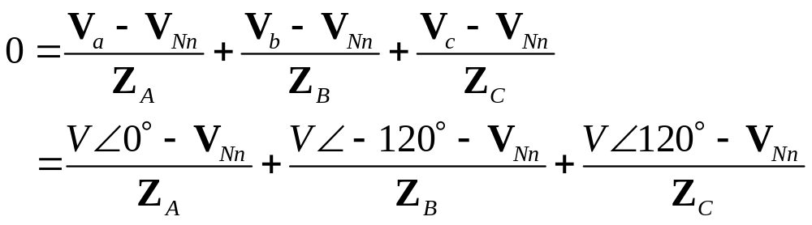
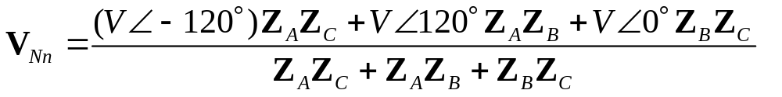
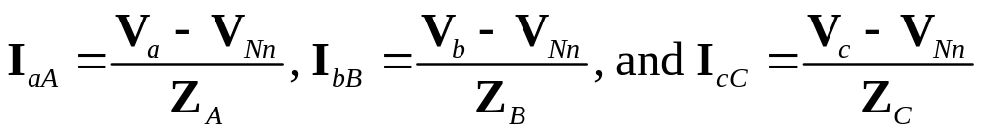
The Y-to-Y Circuit (cont.)
Three - wire
We need to solve for V_{Nn}
Solve for V_{Nn}

Slide 13
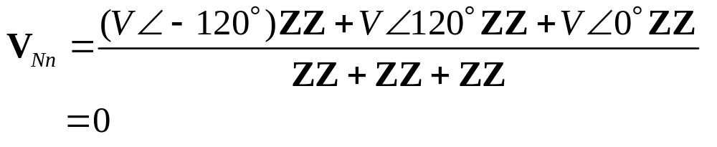
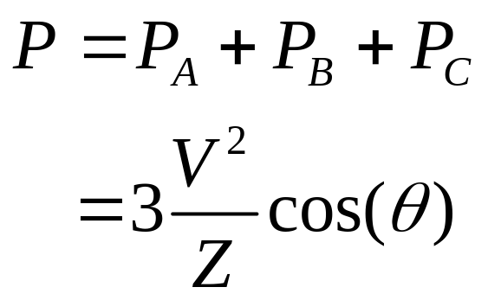
The Y-to-Y Circuit (cont.)
When the circuit is balanced i.e. Z_{A} = Z_{B} = Z_{C}
The average power delivered to the load is

Slide 14
The Y-to-Y Circuit (cont.)
Transmission lines
A three-wire Y-to-Y circuit with line impedances

Slide 15
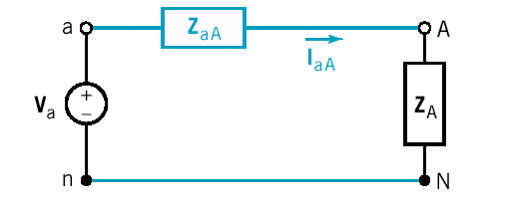
The Y-to-Y Circuit (cont.)
The analysis of balanced Y-Y circuits is simpler than the
analysis of unbalanced Y-Y circuits.
V_{Nn} = 0. It is not necessary to solve for V_{Nn} .
The line currents have equal magnitudes and
differ in phase by 120 degree.
Equal power is absorbed by each impedance.
Per-phase equivalent circuit

Slide 16
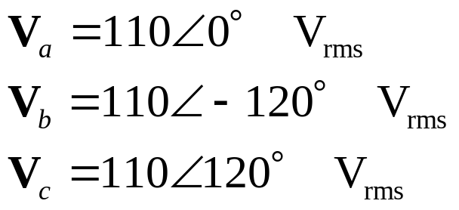
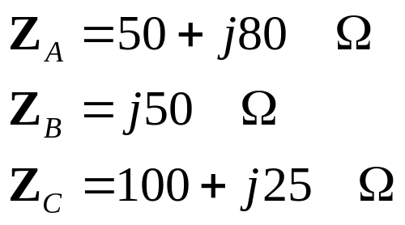
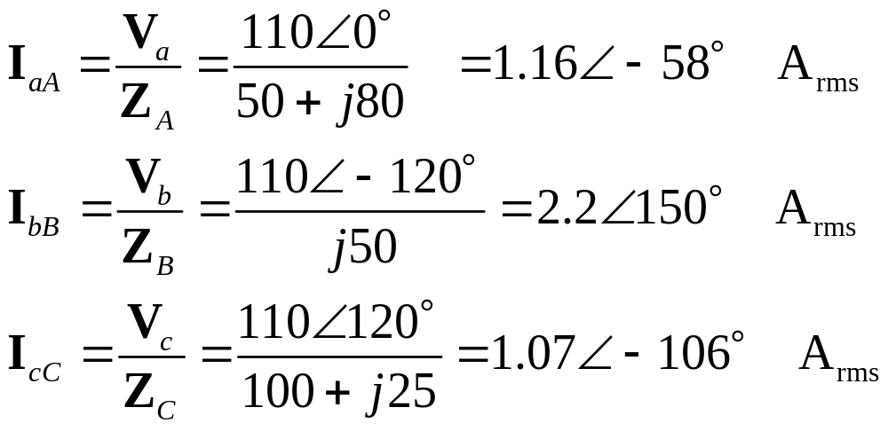
Example 12.4-1 S = ?
Unbalanced 4-wire

Slide 17
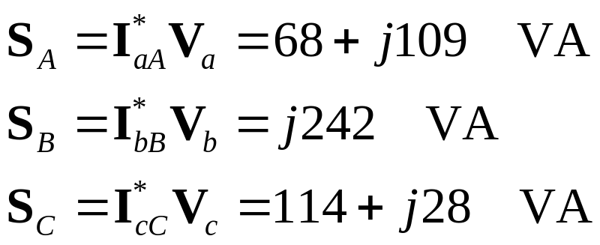
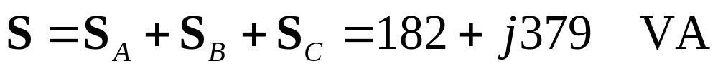
Example 12.4-1 (cont.)
The total complex power delivered to the three-phase load
is

Slide 18
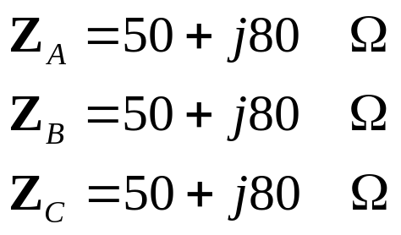
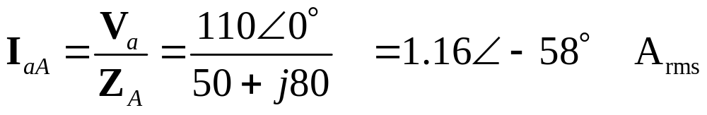
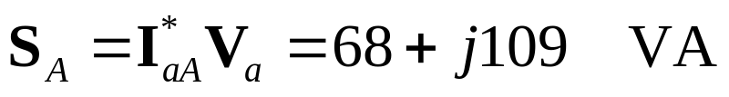
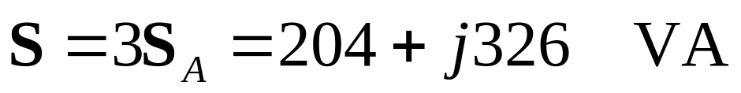
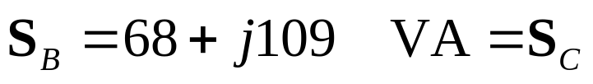
Example 12.4-2 S = ?
Balanced 4-wire
The total complex power delivered to the three-phase load
is
Also

Slide 19
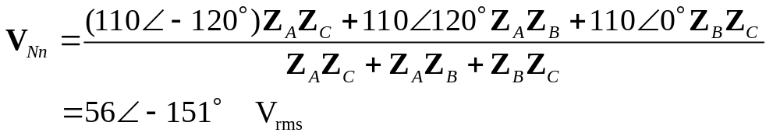
Example 12.4-3 S = ?
Unbalanced 3-wire
Determine V_{Nn}

Slide 20
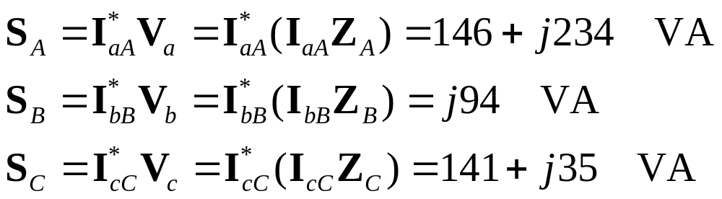
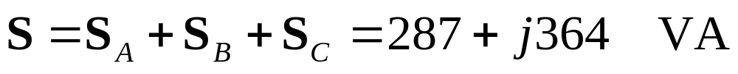
Example 12.4-3 (cont.)
The total complex power delivered to the three-phase load
is

Slide 21
Example 12.4-4 S = ?
Balanced 3-wire
The total complex power delivered to the three-phase load
is

Slide 22
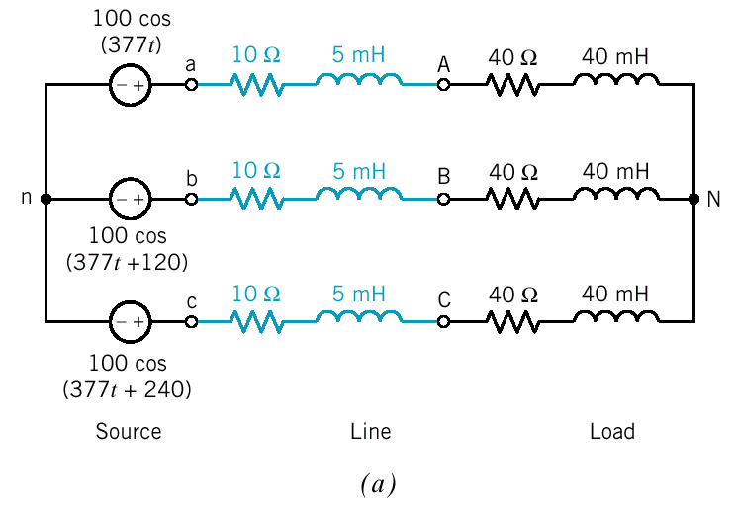
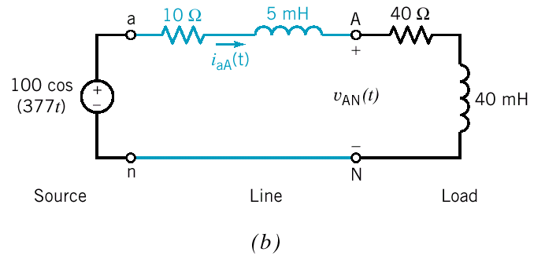
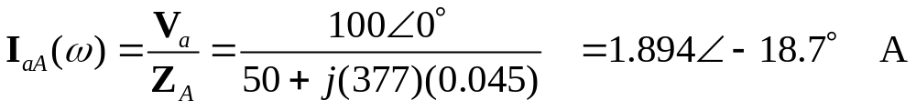
Example 12.4-5 P_{Load} = ? P_{Line} = ? P_{Source} = ?
per-phase
equivalent circuit
Balanced 3-wire
The phase voltage at the load is

Slide 23
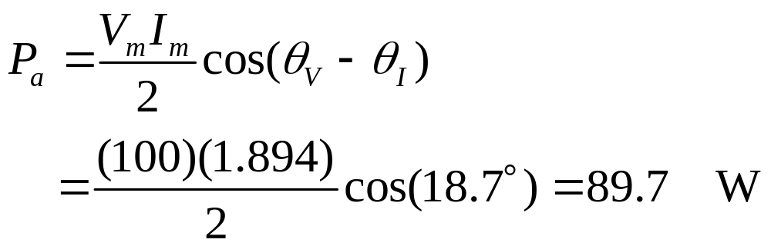
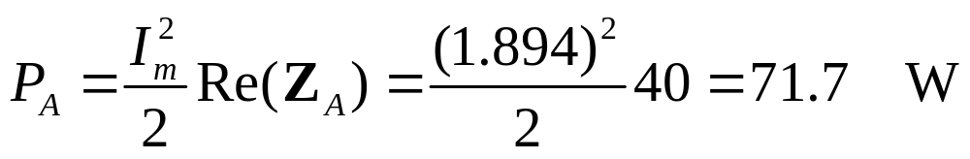
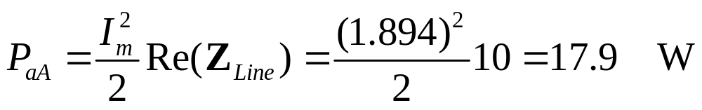

Example 12.4-5 (cont.)
The power delivered by the source is
The power delivered to the load is
The power lost in the line is

Slide 24
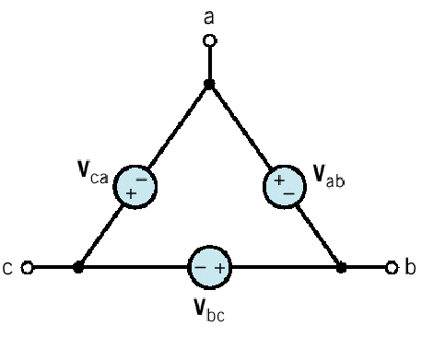


The Δ-Connected Source and Load
Circulating
current
Unacceptable
Total resistance around the loop
Therefore the Δ sources connection is seldom used
in practice.

Slide 25










The Δ-Y and Y- Δ Transformation

Slide 26

Example

Slide 27



The Y- Δ Circuits
where

Slide 28



The Y- Δ Circuits (cont.)
or

Slide 29





Example 12.6-1 I_{P} = ? I_{L} = ?
The Δ-connected load is balanced with
The line currents are

Slide 30




The Balanced Three-Phase Circuits
Y-to-Δ circuit
equivalent Y-to-Y circuit
per-phase equivalent circuit

Slide 31





Example 12.7-1 I_{P} = ?

Slide 32



Example 12.7-1 (cont.)
The voltages in the per-phase equivalent circuit are
The line-to-line voltages are

Slide 33


Instantaneous and Average Power in BTP Circuits
One advantage of three-phase power is the smooth flow of
energy to the load.
The instantaneous power

Slide 34


Instantaneous and Average Power in BTP Circuits
The total average power delivered to the balanced
Y-connected load is
Phase A

Slide 35

Instantaneous and Average Power in BTP Circuits
The total average power delivered to the balanced
Δ-connected load is

Slide 36

Example 12.8-1 P = ?

Slide 37




Two-Wattmeter Power Measurement
cc = current coil
vc = voltage coil
W1 read
W2 read
For balanced load with abc phase sequence

Slide 38





Two-Wattmeter Power Measurement(cont.)
To determine the power factor angle

Slide 39








Example 12.9-1 P = ?
line-to-line voltage = 220Vrms
The phase voltage
The line current
and

Slide 40


Electrodynamic Wattmeter

Slide 41



Digital Power Meter
VAR Meter
pf Meter

Slide 42
Summary
Three-Phase voltages
The Y-to-Y Circuits
The D-Connected Source and Load
The Y-to- D Circuits
Balanced Three-Phase Circuits
Instantaneous and Average Power in Bal. 3-φ Load
Two-Wattmeter Power Measurement

