Slide 1
188 210
Linear Circuit Analysis
Prerequisite: 315 112 Fundamental of Physics II
Asst. Prof. Chanchai Witsupalert
Dr. Warin Suwanwisoot
Asst. Prof. Rujchai Ung-arunyawee
Department of Computer Engineering
Faculty of Engineering
Khon Kaen University

Slide 2
Course Objectives
To provide basic concepts in circuit theory and analysis
To study behaviors of simple circuits as well as analytical techniques involved
To apply the concepts to more complex systems

Slide 3
Course Description
Basic concepts; Kirchhoff's current and voltage laws; node and loop analysis; circuit theorems; first order and second order linear circuits; sinusoidal steady-state analysis by phasor methods; sinusoidal steady-state power calculations.

Slide 4
Course Outline
 | Topics | Hours
1. | Basic Concepts | 5
2. | Kirchhoff's Current and Voltage Laws | 6
3. | Node and Loop Analysis | 6
4. | Circuit Theorems | 5
5. | First Order and Second Order Linear Circuits | 8
6. | Sinuosoidal Steady-State Analysis by Phasor Methods | 10
7. | Sinusoidal Steady-State Power Calculations | 5
Total |  | 45

Slide 5
Textbooks
Dorf RC, Svoboda JA. Introduction to Electric Circuits. 6th ed. New York: John Wiley & Sons, 1996.
Recommended:
1. เจมส์ ดับบิลว์ นิลส์สัน, ซูซาน เอ ไรเดล, ผู้แต่ง, สราวุฒิ สุจิตจร, กิตติ
อัตถกิจมงคล, ผู้แปลและเรียบเรียง, ทรงศักดิ์ มะระประเสริฐศักดิ์, บรรณาธิการ. วงจรไฟฟ้า. กรุงเทพฯ: เพียร์สัน เอ็ดดูเคชั่น อินโดไชน่า, 2547.
2. Nilsson JW, Riedel SA. Electric Circuits. New Jersey: Pearson/Prentice-Hall, 2005.
3. DeCarlo RA, Lin PM. Linear Circuit An.alysis. Prentice-Hall International, 1995.
4. Mayergoyz ID, Lawson W. Basic Electric Circuit Theory. San Diego: Academic Press, 1997.
5. Hayt Jr. WH, Kemmerly JE, Durbin SM. Engineering Circuit Analysis. 6th ed. New York: McGraw-Hill, 2002.

Slide 6
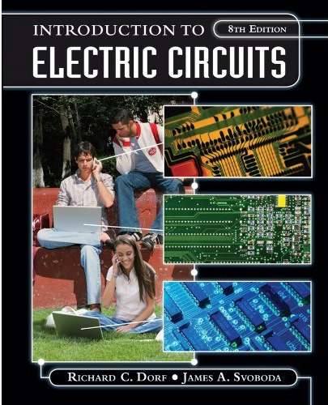
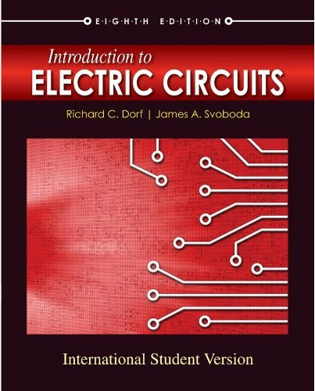
8th Edition
$144.66
$74.4

Slide 7
Assessment
Exam 1 25 %
Exam 2 25 %
Exam 3 25 %
Special assignments 15 %
Class attendance 10 %
(max. 6 absences)

Slide 8
Tools
(Not required but recommended)
Electronic Workbench (EWB)
MATLAB
SPICE
ORCAD
Excel

Slide 9
How Courses are Related (1)
Physics II
Linear Circuit Analysis
Pre
Analog Electronics
Co
Circuit Signal & Systems
Next Page
Co
Digital Electronics
Computer Architecture
Microprocessor & Interfacing
Microcontrollers
Advanced Digital System Design

Slide 10
How Courses are Related (2)
Circuit Signal & Systems
Statistics & Random Process
Data Communication & Computer Network I
Data Communication & Computer Network II
Digital Image Processing
Discrete-Time Signal Processing

