Slide 1
Toward Entailment Checking: Explore Eigenmarking Search
Tatpong Katanyukul
Computer Engineering, Khon Kaen University, Thailand
inCACCT 2025, 17-18 April, Chandigarh University, India
inCACCT 2025, 17-18 April, Chandigarh University, India

Slide 2
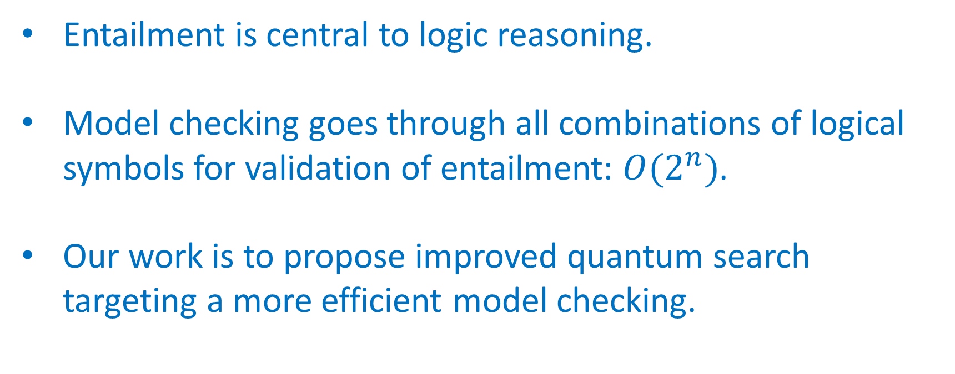
Big Picture
Entailment is central to logic reasoning.
Model checking goes through all combinations of logical symbols for validation of entailment: $O(2^{n})$.
Our work is to propose improved quantum search targeting a more efficient model checking.

Slide 3
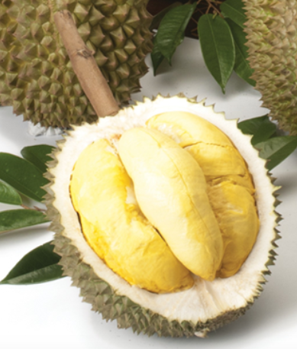






Logic Entailment: Model Checking
if and only if, in every truth scenario in which KB is true, α is true.
$$KB \text{⊨} α$$
Model checking = truth evaluation given truth values of all symbols.
KB:
Durians are spiky.
Durians are yummy.
α₁: Montong durian is spiky.
α₂: Montong durian is not spiky.
α₃: There is life on Mars.
α₄: There is no life on Mars.
Spiky Montong | Life on Mars | KB | α₁ | α₂ | α₃ | α₄
F | F | F | F | T | F | T
F | T | F | F | T | T | F
T | F | T | T | F | F | T
T | T | T | T | F | T | F
$$O(2^{n})$$
$$KB \text{⊨} α_{1}$$
$$KB \text{⊭} α_{2}$$
$$KB \text{⊭} α_{3}$$
$$KB \text{⊭} α_{4}$$

Slide 4
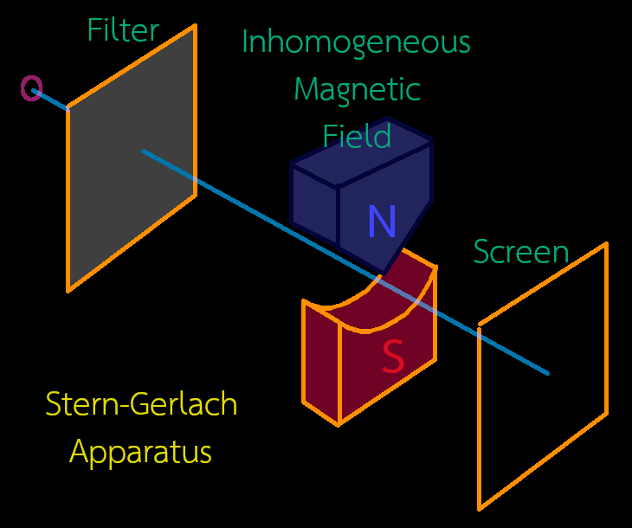
Quantum Computing and Quantum Mechanical Properties
Quantum computing utilizes quantum mechanical properties for computing.
The quantum effect is more prominent at a small scale.
Linear evolution
Measurement
Superposition, Entanglement, Tunneling.

Slide 5
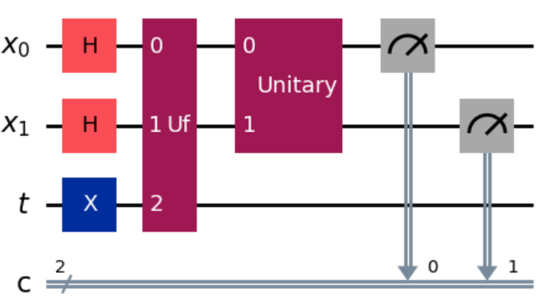
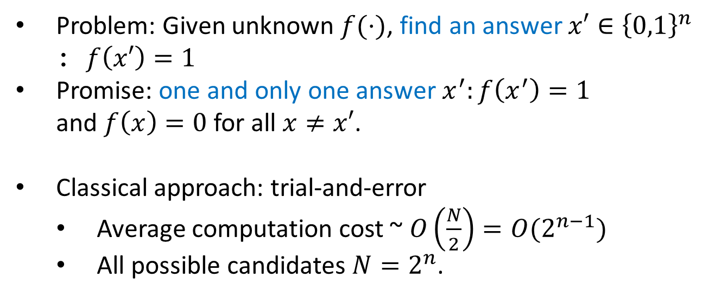
Grover Search
Problem: Given unknown $f(⋅)$, find an answer $x′∈{\left\{0,1\right\}}^{n}$ : $f\left(x′\right)=1$
Promise: one and only one answer $x^{′}:f\left(x^{′}\right)=1$ and $f\left(x\right)=0$ for all $x≠x′$.
Classical approach: trial-and-error
Average computation cost ~ $O\left(\frac{N}{2}\right)=O(2^{n−1})$
All possible candidates $N=2^{n}$.
Classical
…
X = 00 … 0
X = 11 … 1
f
Grover search

Slide 6
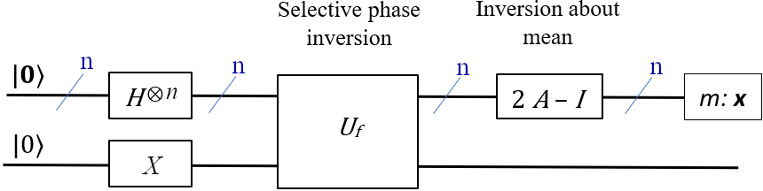
Grover Algorithm: Key Ideas
Evolve the probability amplitude of the answer eigenstate such that when measured, the answer is more likely to be observed.
~ Parallelism using superposition!
Implementation:
Selective phase inversion: mark the answer.
Inversion about the mean: amplify the answer’s probability amplitude.
This relies on that the answer is minority!

Slide 7
Challenges and Our Approach
Spiky Montong | Life on Mars | KB | α₁ | α₂ | α₃ | α₄
F | F | F | F | T | F | T
F | T | F | F | T | T | F
T | F | T | T | F | F | T
T | T | T | T | F | T | F
When KB = T,
No F
2 Fs
1 F
1 F
Original Grover search addresses 1-F case.
Our approach:
Additional qubits
Maintain minority condition for Grover amplification
Facilitate easy identification of no-winner case

Slide 8
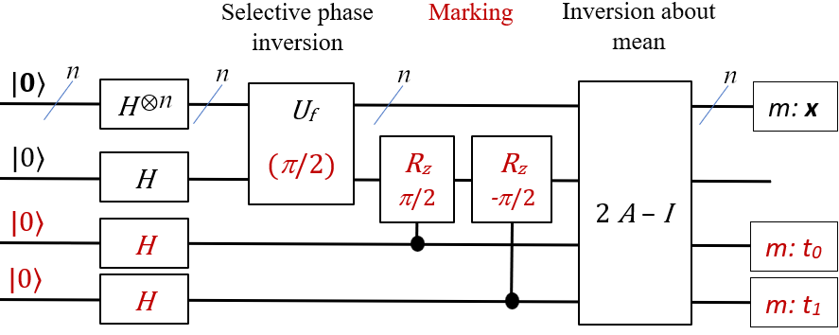
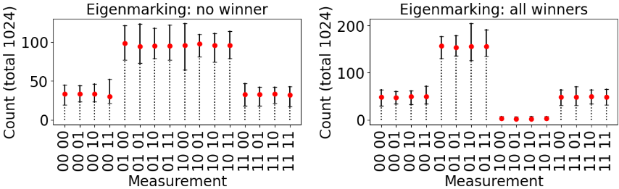
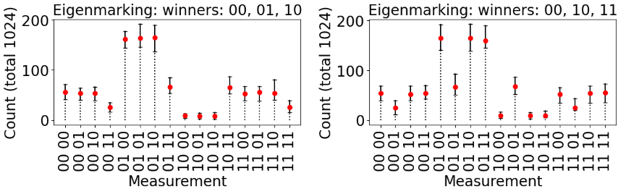
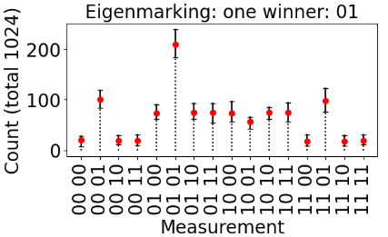
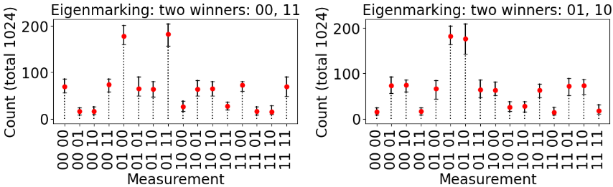
Eigenmarking
Complement group: 10
Answer group: 01

Slide 9
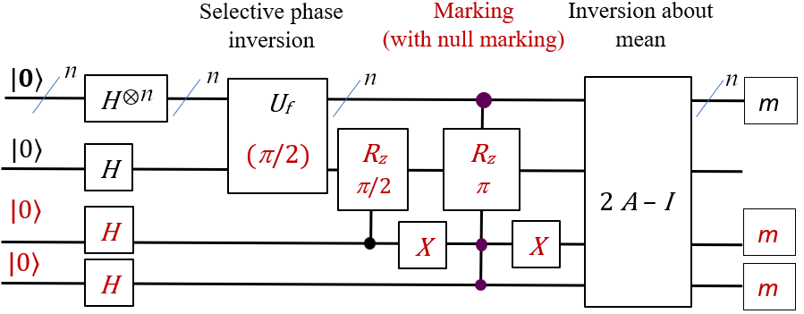
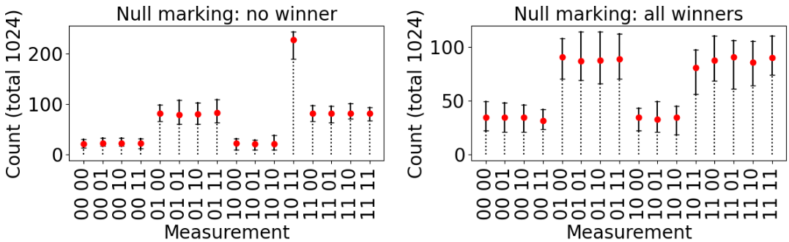
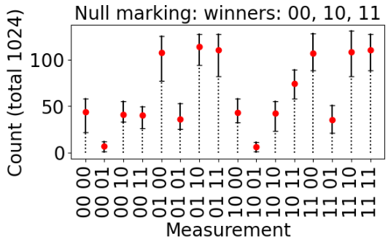
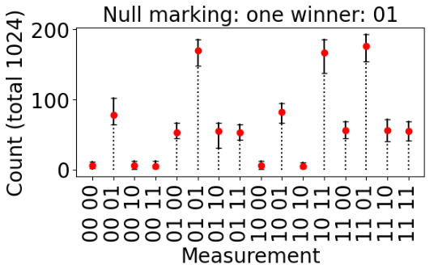
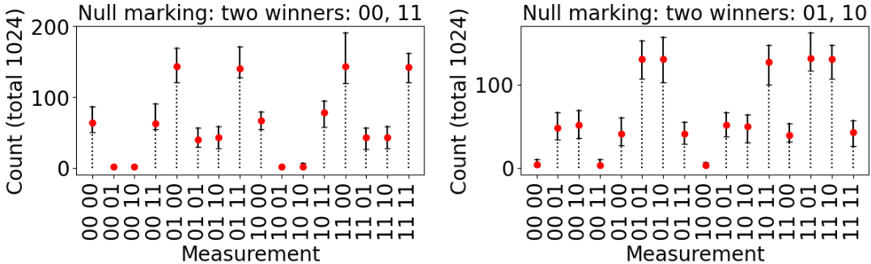
Null Eigenmarking
Null marking state 10 11
Answer group: 01

Slide 10
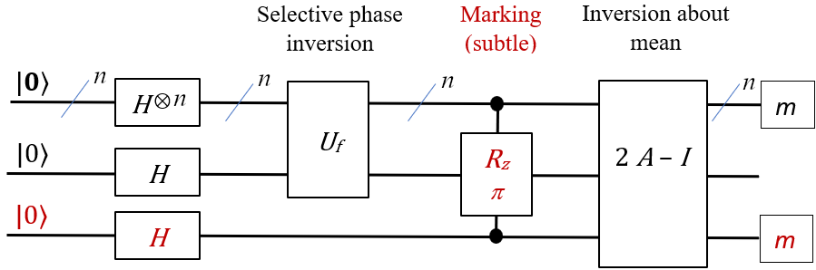
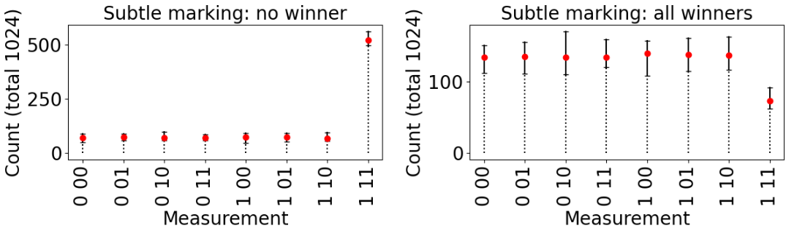
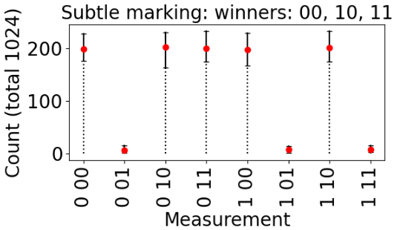
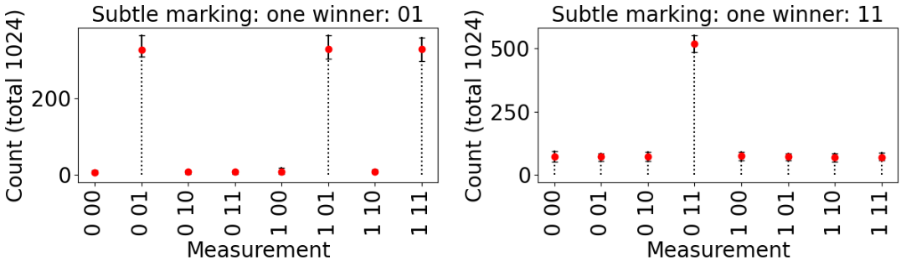
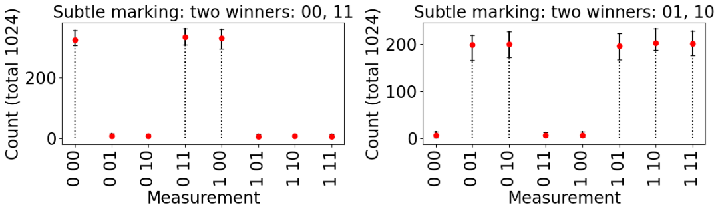
Subtle Eigenmarking
Answer group: 0
Complement state 1 11

Slide 11
Conclusion & Discussion
The ideas work! (at least for a two-qubit case, in a simulator.)
Quality of outcomes
Eigenmarking
Better at suppressing chances of dummy states: best global winning margin.
Quite well on distinguishability: best relative scores.
Subtle marking
Quite well on every aspect:
best local winning margin,
best absolute distinguishability.
Architectural aspect: subtle marking requires less modification, but needs multiple-qubit controls.
Limitations: Scalability? (more qubits) Reliability? (theoretical analysis) Robustness? (real QC)

Slide 12

Thank you
ਤੁਹਾਡਾ ਧੰਨਵਾਦ
धन्यवाद।
วัดพระธาตุขามแก่น (Phrathat Kham Kaen) Khon Kaen, Thailand
image: https://commons.wikimedia.org/wiki/File:%E0%B8%A7%E0%B8%B1%E0%B8%94%E0%B8%9E%E0%B8%A3%E0%B8%B0%E0%B8%98%E0%B8%B2%E0%B8%95%E0%B8%B8%E0%B8%82%E0%B8%B2%E0%B8%A1%E0%B9%81%E0%B8%81%E0%B9%88%E0%B8%99.jpg

Slide 13




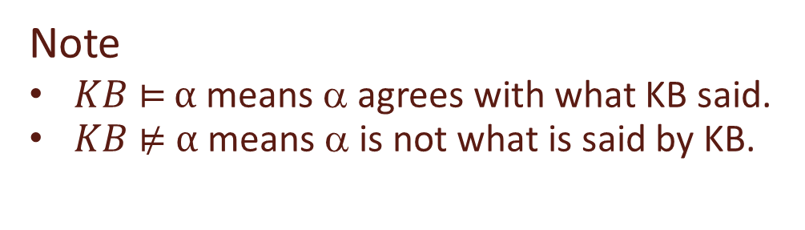

Logic Entailment
if and only if, in every model (truth scenario) in which KB is true, α is true.
$$KB \text{⊨} α$$
KB:
Durians are spiky.
Durians are yummy.
α₁: Montong durian is spiky.
α₂: Montong durian is not spiky.
α₃: There is life on Mars.
α₄: There is no life on Mars.
$$KB \text{⊨} α_{1}$$
$$KB \text{⊭} α_{2}$$
$$KB \text{⊭} α_{3}$$
$$KB \text{⊭} α_{4}$$
Note
$KB \text{⊨ }α$ means α agrees with what KB said.
$KB \text{⊭} α$ means α is not what is said by KB.

Slide 14
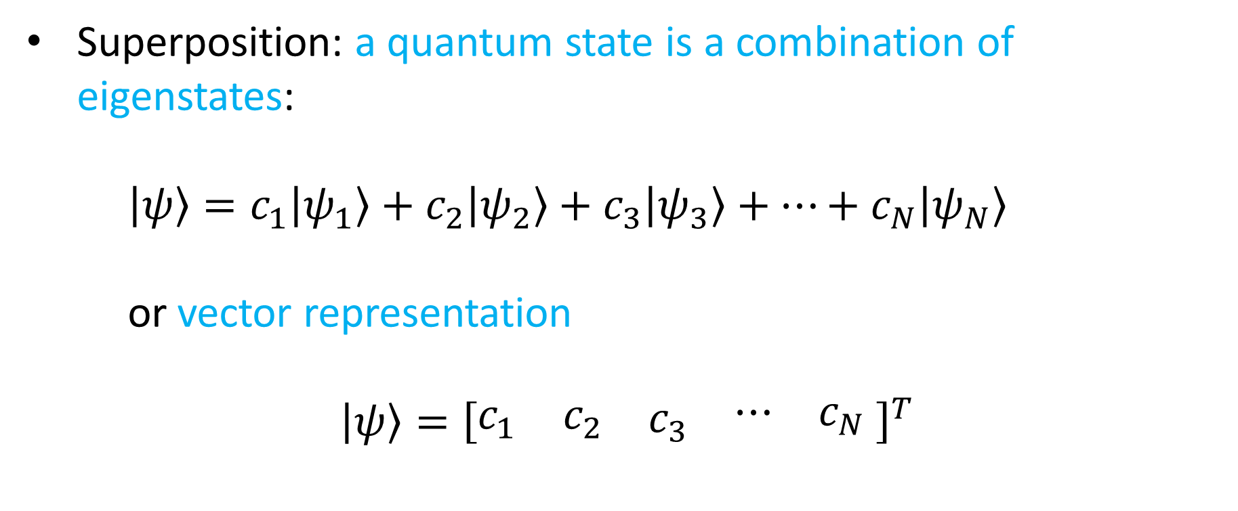
Quantum State and Superposition
Superposition: a quantum state is a combination of eigenstates:
$\left|ψ\right\rangle =c_{1}\left|ψ_{1}\right\rangle +c_{2}\left|ψ_{2}\right\rangle +c_{3}\left|ψ_{3}\right\rangle +⋯+c_{N}\left|ψ_{N}\right\rangle$
or vector representation
$$\left|ψ\right\rangle ={\left[\begin{matrix}\begin{matrix}c_{1} & c_{2}\end{matrix} & \begin{matrix}c_{3} & \begin{matrix}⋯ & c_{N}\end{matrix}\end{matrix}\end{matrix} \right]}^{T}$$

Slide 15
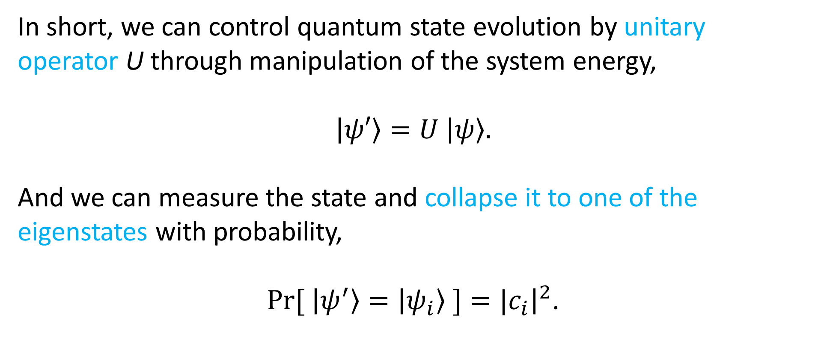
Quantum Computing
In short, we can control quantum state evolution by unitary operator U through manipulation of the system energy,
$$\left|ψ′\right\rangle =U \left|ψ\right\rangle .$$
And we can measure the state and collapse it to one of the eigenstates with probability,
$Pr[ \left|ψ^{′}\right\rangle =\left|ψ_{i}\right\rangle ]={|c}_{i}{\left.​\right|}^{2}$.

Slide 16
Shortcomings of Original Grover in Entailment Context
Designed for a lone match search.
Mitigation:
Probabilistic control over # applications.
Time-out to handle a no-winner case.
Entailment checking is likely to have multiple matches or no match at all
No match ⇒ no violation: the entailment is validated.

Slide 17
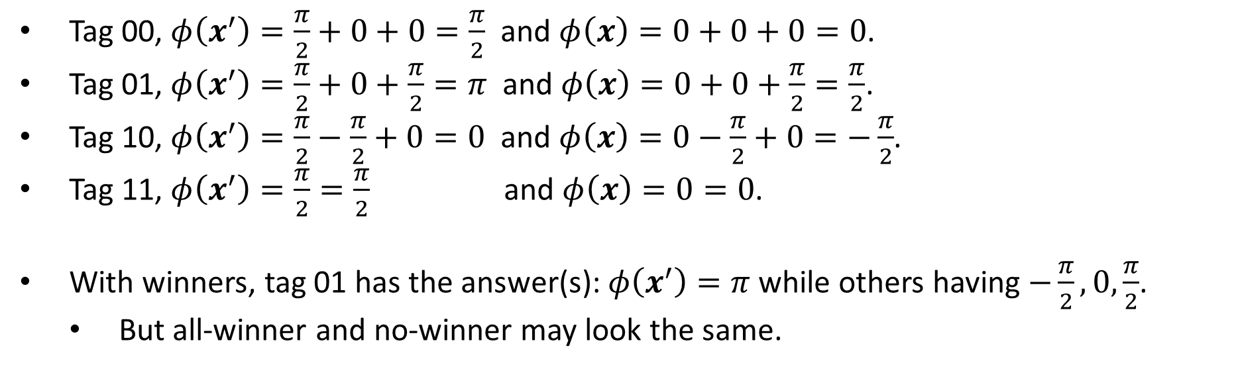
Eigenmarking
Tag 00, $φ\left(x^{′}\right)=\frac{π}{2}+0+0=\frac{π}{2}$ and $φ\left(x\right)=0+0+0=0$.
Tag 01, $φ\left(x^{′}\right)=\frac{π}{2}+0+\frac{π}{2}=π$ and $φ\left(x\right)=0+0+\frac{π}{2}=\frac{π}{2}$.
Tag 10, $φ\left(x^{′}\right)=\frac{π}{2}−\frac{π}{2}+0=0$ and $φ\left(x\right)=0−\frac{π}{2}+0=−\frac{π}{2}$.
Tag 11, $φ\left(x^{′}\right)=\frac{π}{2}=\frac{π}{2}$ and $φ\left(x\right)=0=0$.
With winners, tag 01 has the answer(s): $φ\left(x^{′}\right)=π$ while others having $−\frac{π}{2},0,\frac{π}{2}$.
But all-winner and no-winner may look the same.

Slide 18
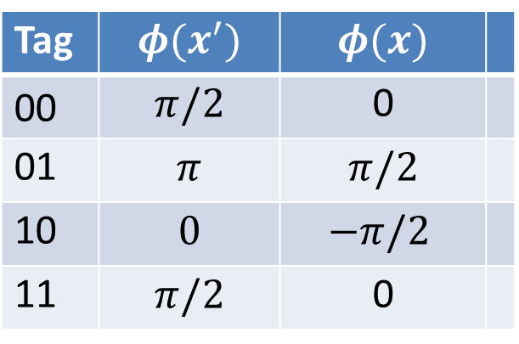
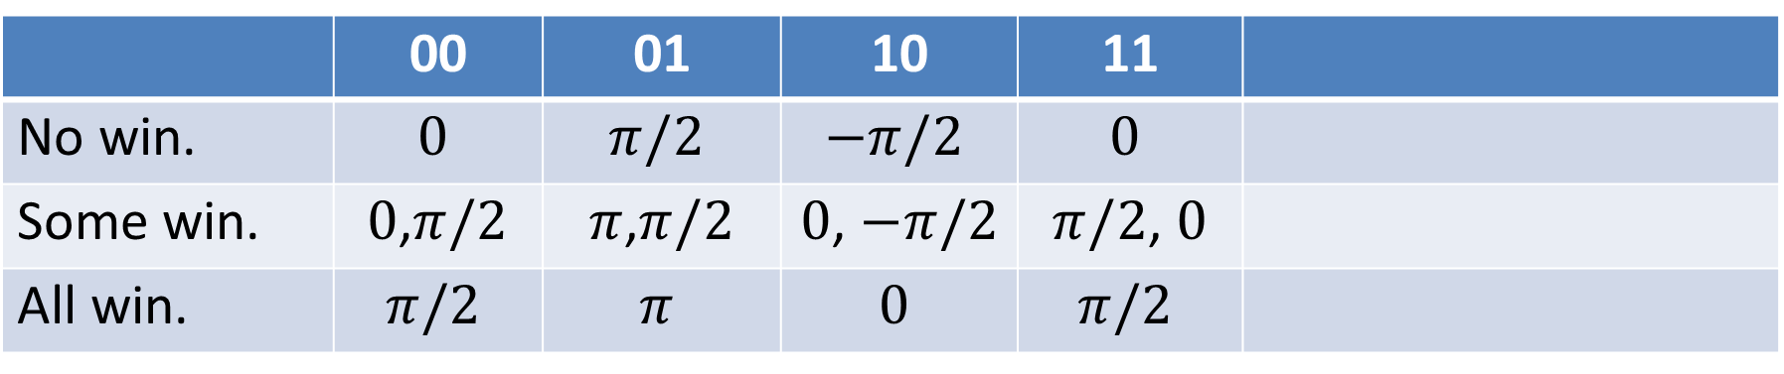
Eigenmarking: Cases
Tag | $$φ(x^{′})$$ | $$φ(x)$$
00 | $$π/2$$ | 0
01 | $$π$$ | $$π/2$$
10 | $$0$$ | $$−π/2$$
11 | $$π/2$$ | 0
 | 00 | 01 | 10 | 11
No win. | $$0$$ | $$π/2$$ | $$−π/2$$ | $$0$$
Some win. | $0$,$π/2$ | $π$,$π/2$ | $0$, $−π/2$ | $π/2$, $0$
All win. | $$π/2$$ | $$π$$ | $$0$$ | $$π/2$$
Our target
Complementary, esp., in no win.

Slide 19
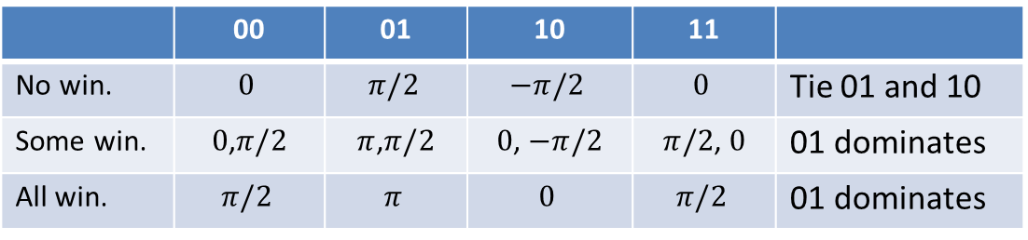
Results: Eigenmarking
 | 00 | 01 | 10 | 11
No win. | $$0$$ | $$π/2$$ | $$−π/2$$ | $$0$$ | Tie 01 and 10
Some win. | $0$,$π/2$ | $π$,$π/2$ | $0$, $−π/2$ | $π/2$, $0$ | 01 dominates
All win. | $$π/2$$ | $$π$$ | $$0$$ | $$π/2$$ | 01 dominates
Complement group: 10
Answer group: 01

Slide 20
Null and Subtle Eigenmarkings
Null marking
Explicit no-winner state
10 11
In entailment checking,
No-winner ~ no violation!
Subtle marking
Only one extra qubit!
No change to U_{f}
Cons
Multiple-qubit control

Slide 21
Results: Null Eigenmarking
Answer group: 01
Null marking state

Slide 22
Results: Subtle Eigenmarking
Answer group: 0
Complement state

Slide 23
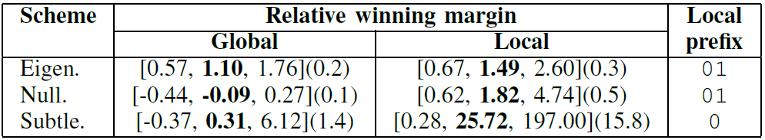
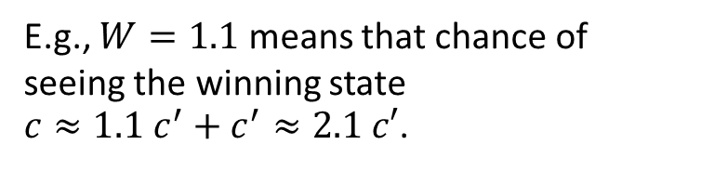
Final Results: Get The Winner
Relative difference between #counts (observed) of winning states and ones of non-winning state.
$$W=(c −c^{′})/c′$$
E.g., $W=1.1$ means that chance of seeing the winning state $c≈1.1 c^{′}+c^{′}≈2.1 c′$.

Slide 24
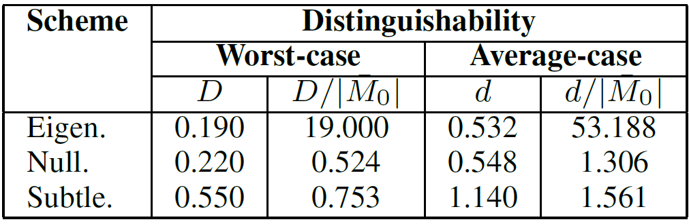
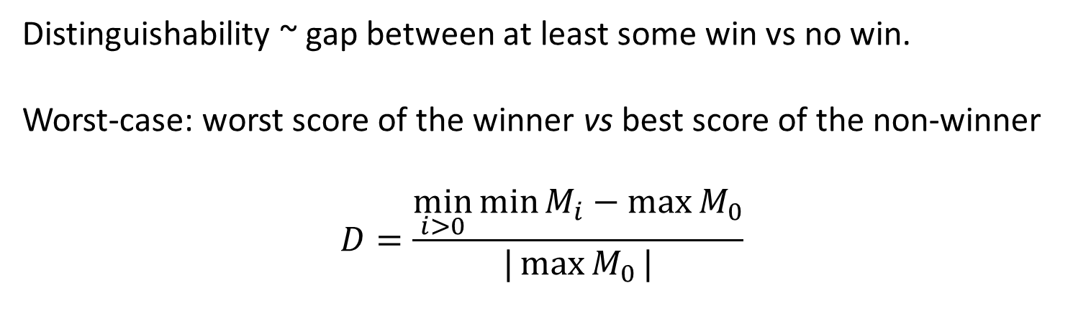
Final Results: Some Win VS No Win
Distinguishability ~ gap between at least some win vs no win.
Worst-case: worst score of the winner vs best score of the non-winner
$$D=\frac{\min_{i>0}{\min{M_{i}}}−\max{M_{0}}}{|\max{M_{0}}|}$$

Slide 25
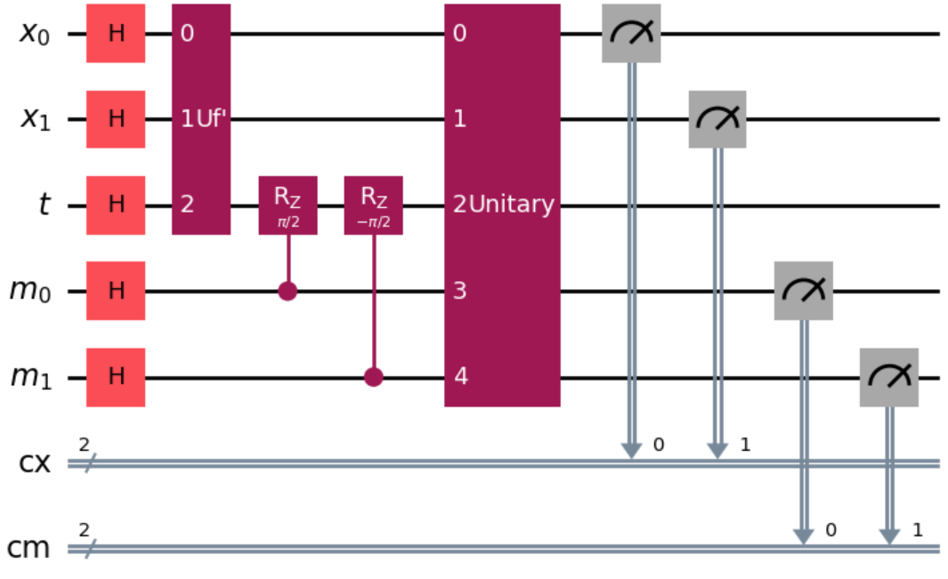
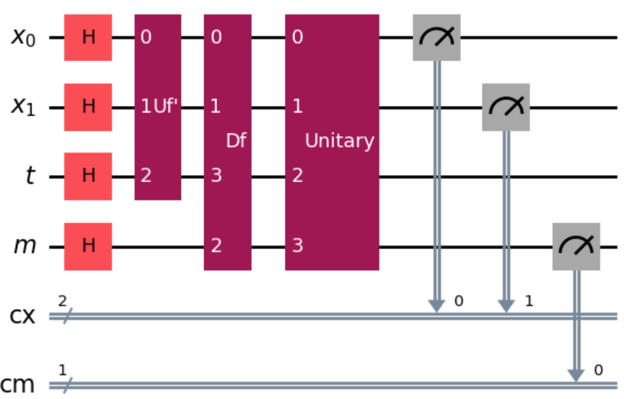
Architectures

Slide 26
Logic Entailment: Theorem Proving
if and only if, in every model (truth scenario) in which KB is true, α is true.
$$KB \text{⊨} α$$
KB:
Durians are spiky.
Durians are yummy.
α₁: Montong durian is spiky.
α₂: Montong durian is not spiky.
α₃: There is life on Mars.
α₄: There is no life on Mars.
$$KB \text{⊨} α_{1}$$
$$KB \text{⊭} α_{2}$$
$$KB \text{⊭} α_{3}$$
$$KB \text{⊭} α_{4}$$
Note
$KB \text{⊨ }α$ means α agrees with what KB said.
$KB \text{⊭} α$ means α is not what is said by KB.

Slide 27
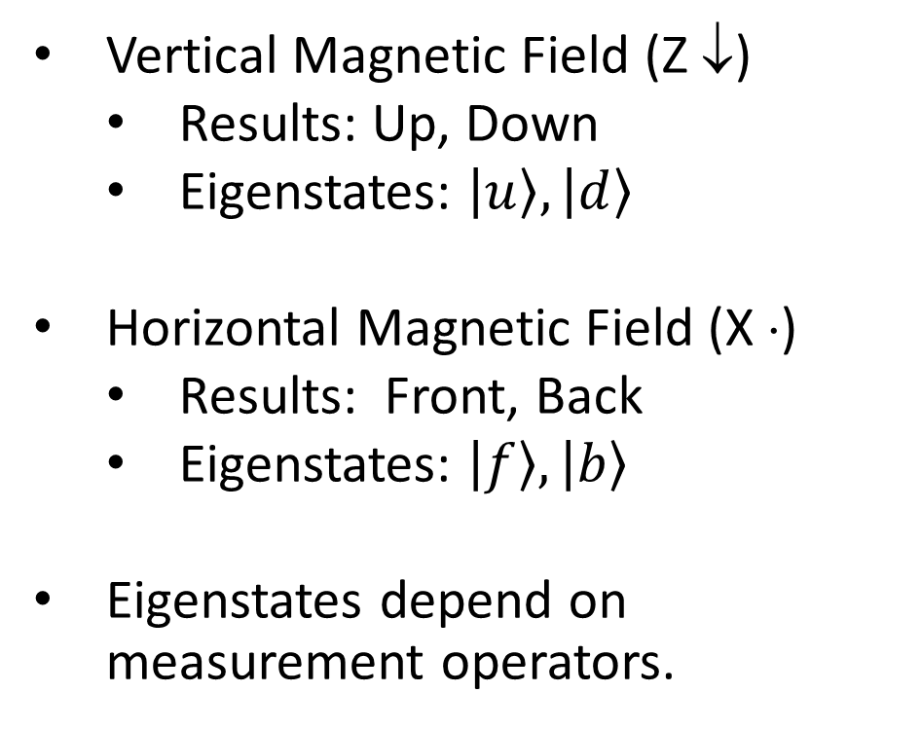
Eigenstates
Stern-Gerlach Experiments
Vertical Magnetic Field (Z ↓)
Results: Up, Down
Eigenstates: $\left|u\right\rangle ,\left|d\right\rangle$
Horizontal Magnetic Field (X ⋅)
Results: Front, Back
Eigenstates: $\left|f\right\rangle ,\left|b\right\rangle$
Eigenstates depend on measurement operators.
Z ↓ SG Apparatus

Slide 28
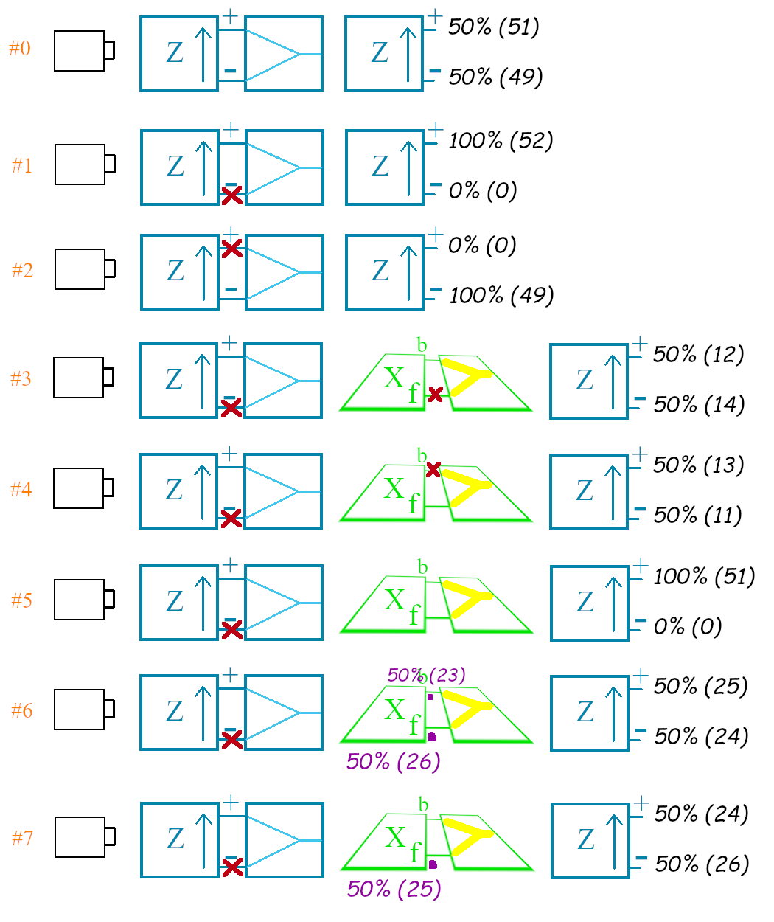
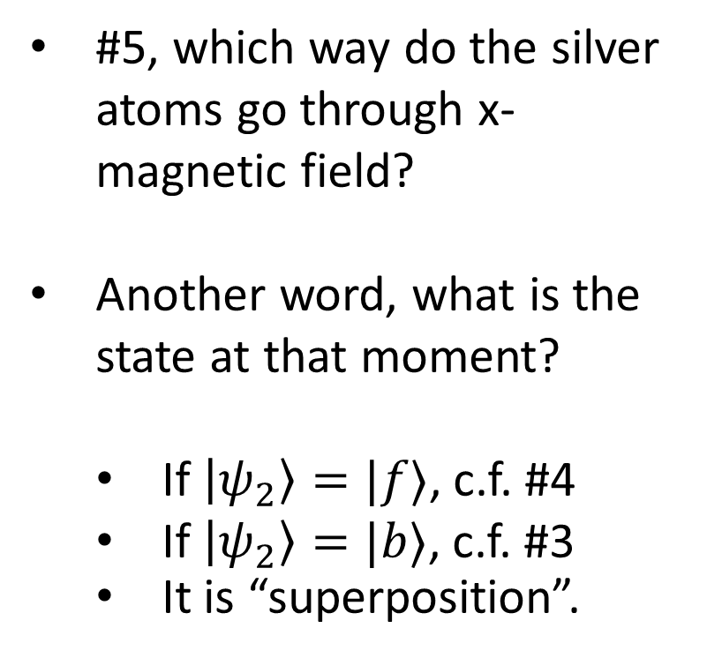
Superposition
Stern-Gerlach Experiments
#5, which way do the silver atoms go through x-magnetic field?
Another word, what is the state at that moment?
If $\left|ψ_{2}\right\rangle =|f⟩$, c.f. #4
If $\left|ψ_{2}\right\rangle =|b⟩$, c.f. #3
It is “superposition”.

Slide 29
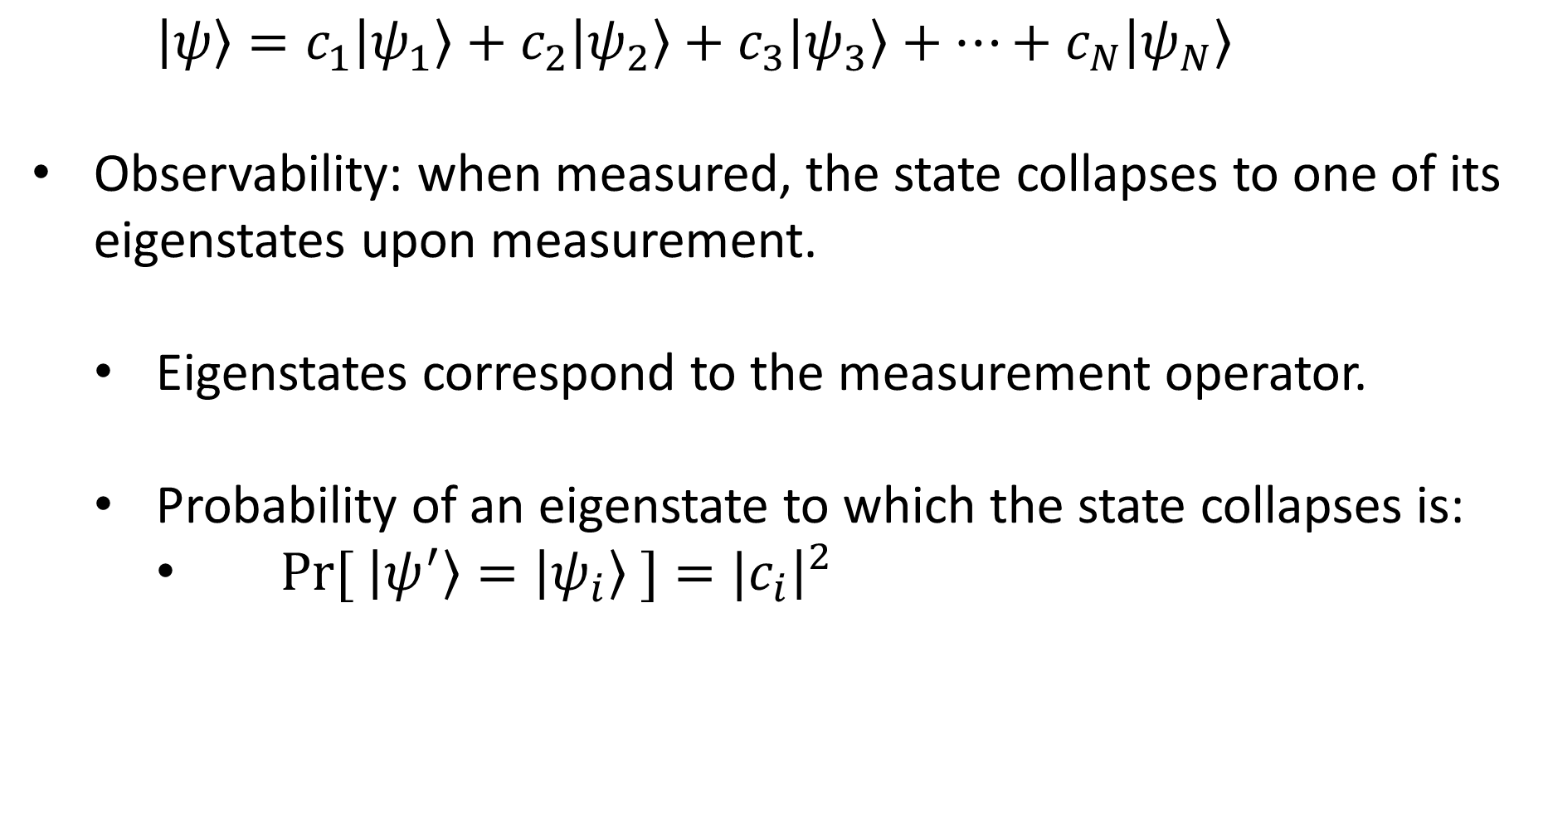
Eigenstates and Measurement
$\left|ψ\right\rangle =c_{1}\left|ψ_{1}\right\rangle +c_{2}\left|ψ_{2}\right\rangle +c_{3}\left|ψ_{3}\right\rangle +⋯+c_{N}\left|ψ_{N}\right\rangle$
Observability: when measured, the state collapses to one of its eigenstates upon measurement.
Eigenstates correspond to the measurement operator.
Probability of an eigenstate to which the state collapses is:
$Pr[ \left|ψ^{′}\right\rangle =\left|ψ_{i}\right\rangle ]={|c}_{i}{\left.​\right|}^{2}$

Slide 30
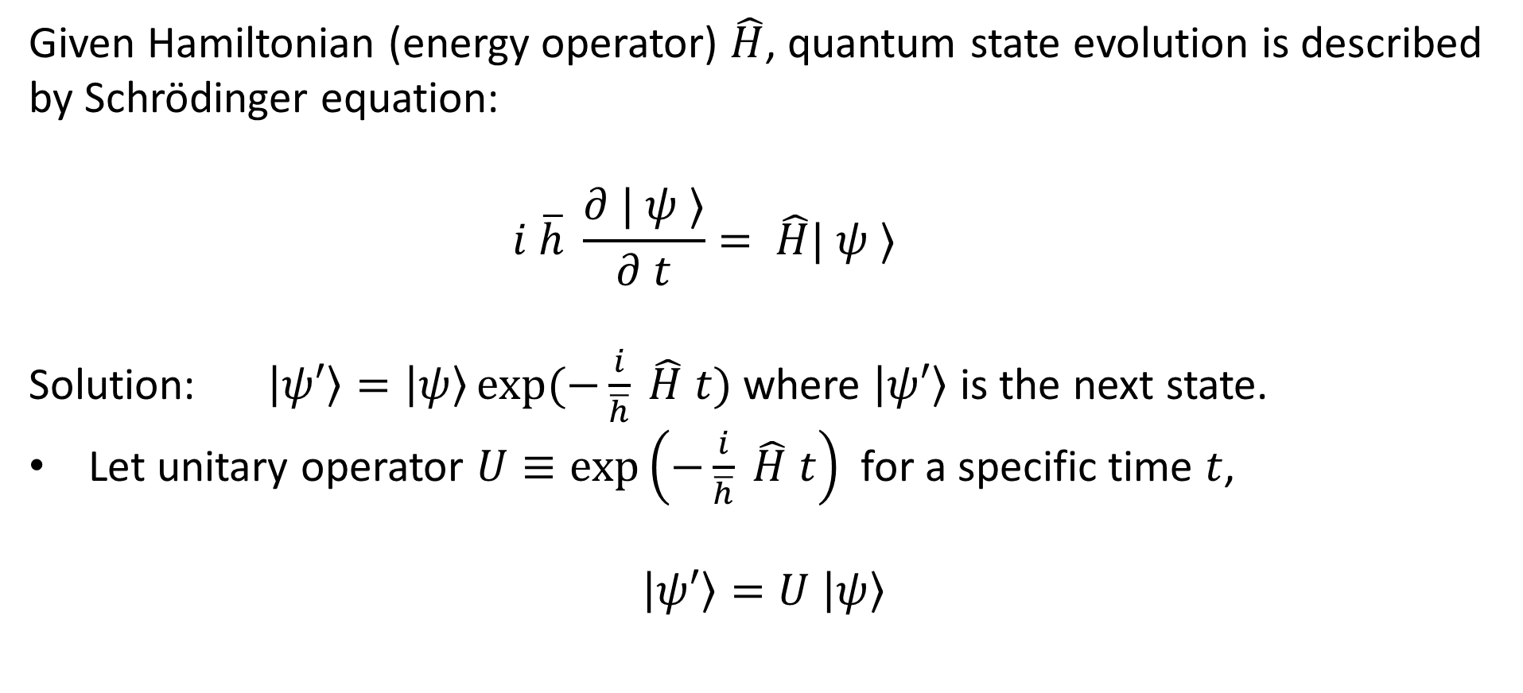
Quantum State Evolution
Given Hamiltonian (energy operator) $\hat{H}$, quantum state evolution is described by Schrödinger equation:
$$i \overline{h} \frac{∂ | ψ ⟩}{∂ t}= \hat{H}| ψ ⟩$$
Solution: $\left|ψ′\right\rangle =\left|ψ\right\rangle \exp{(−\frac{i}{\overline{h}} \hat{H} t)}$ where $\left|ψ′\right\rangle$ is the next state.
Let unitary operator $U≡\exp\left(−\frac{i}{\overline{h}} \hat{H} t\right)$ for a specific time $t$,
$$\left|ψ′\right\rangle =U \left|ψ\right\rangle$$

Slide 31
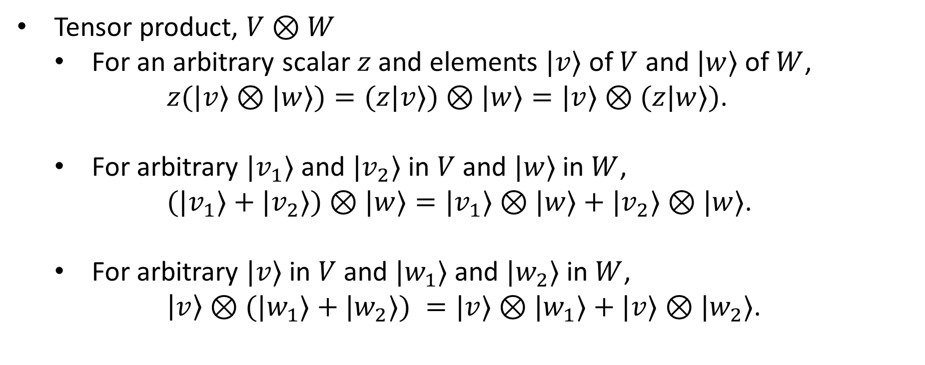
Tensor Product: Properties
Combining vector spaces together to form larger vector spaces
Tensor product, $V⊗W$
For an arbitrary scalar $z$ and elements $|v⟩$ of $V$ and $|w⟩$ of $W$,
$z(|v⟩⊗|w⟩)=(z|v⟩)⊗|w⟩=|v⟩⊗(z|w⟩)$.
For arbitrary $|v_{1}⟩$ and $|v_{2}⟩$ in $V$ and $|w⟩$ in $W$,
$(|v_{1}⟩+|v_{2}⟩)⊗|w⟩=|v_{1}⟩⊗|w⟩+|v_{2}⟩⊗|w⟩$.
For arbitrary $|v⟩$ in $V$ and $|w_{1}⟩$ and $|w_{2}⟩$ in $W$,
$\left|v\right\rangle ⊗(|w_{1}⟩+|w_{2}⟩) =|v⟩⊗|w_{1}⟩+|v⟩⊗|w_{2}⟩$.

Slide 32
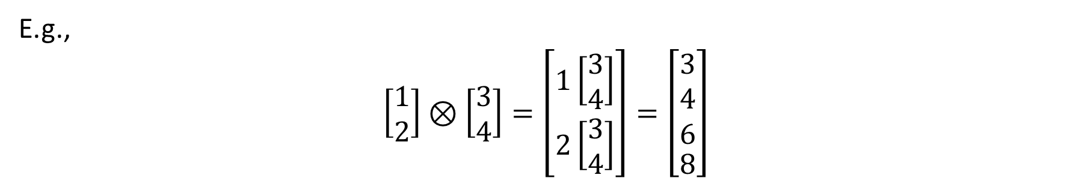
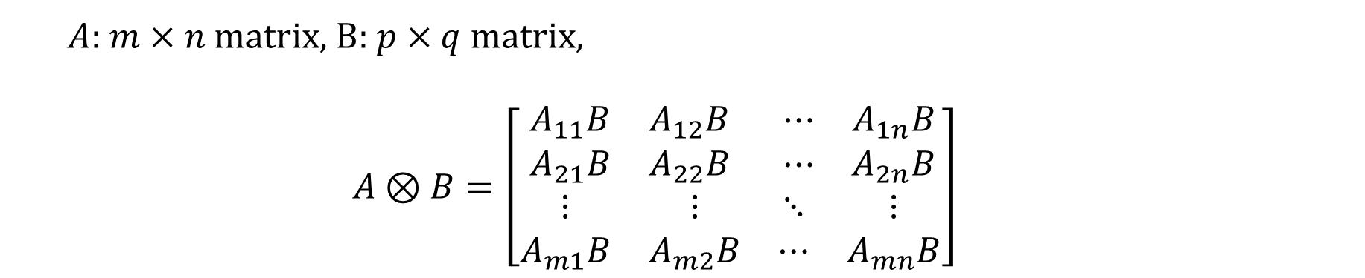
Tensor Product
Combining vector spaces together to form larger vector spaces
$A$: $m×n$matrix, B: $p×q$ matrix,
$$A⊗B=\left[\begin{matrix}\begin{matrix}A_{11}B & A_{12}B \\ A_{21}B & A_{22}B\end{matrix} & \begin{matrix}⋯ & A_{1n}B \\ ⋯ & A_{2n}B\end{matrix} \\ \begin{matrix}⋮ & ⋮ \\ A_{m1}B & A_{m2}B\end{matrix} & \begin{matrix}⋱ & ⋮ \\ ⋯ & A_{mn}B\end{matrix}\end{matrix}\right]$$
E.g.,
$$\left[\begin{matrix}1 \\ 2\end{matrix}\right]⊗\left[\begin{matrix}3 \\ 4\end{matrix}\right]=\left[\begin{matrix}1\left[\begin{matrix}3 \\ 4\end{matrix}\right] \\ 2\left[\begin{matrix}3 \\ 4\end{matrix}\right]\end{matrix}\right]=\left[\begin{aligned}\begin{matrix}3 \\ 4 \\ 6\end{matrix} \\ 8\end{aligned}\right]$$

Slide 33
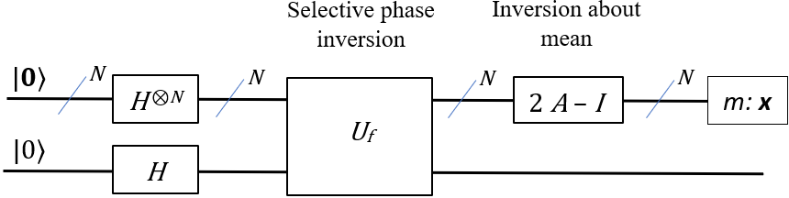
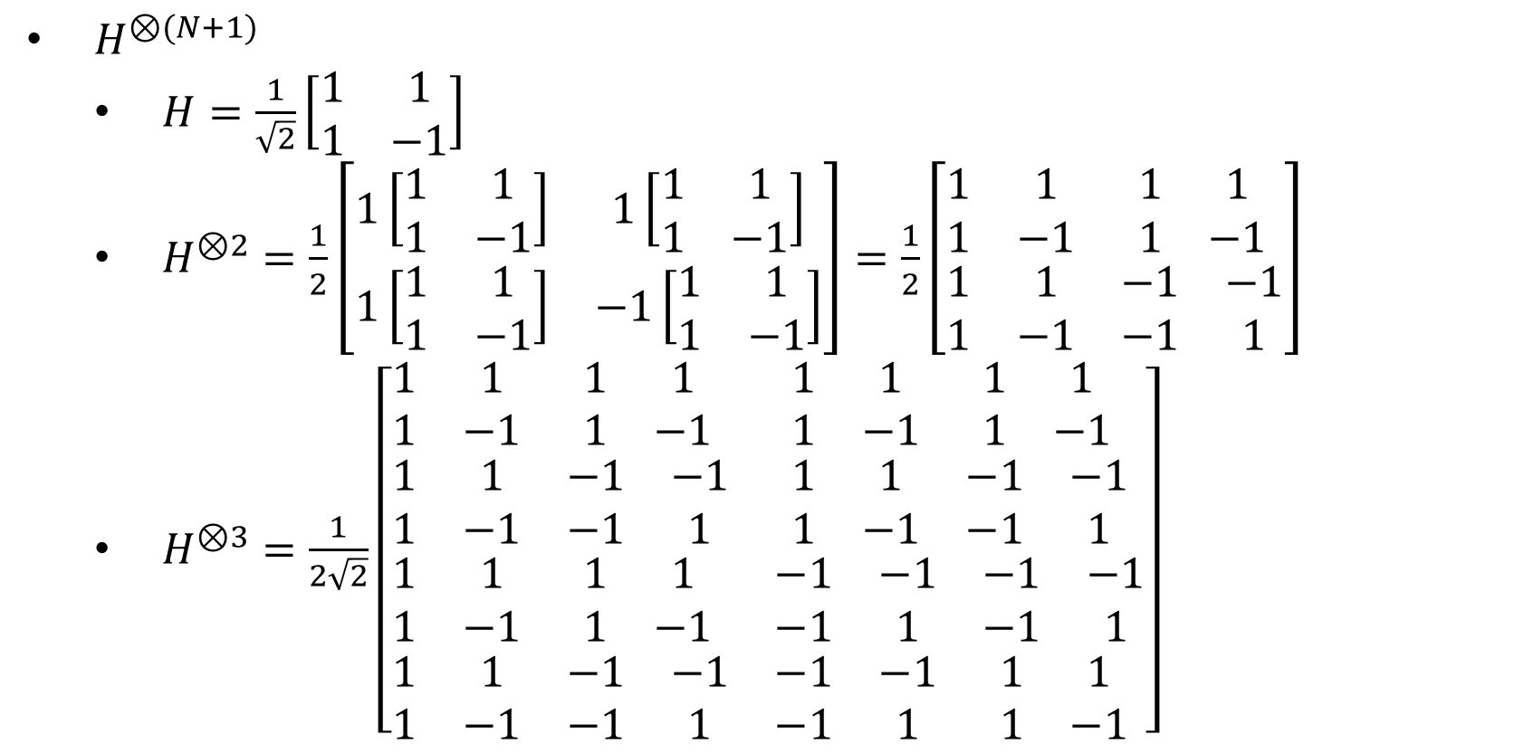
Related Matrices: Hadamard
$H^{⊗(N+1)}$
$H=\frac{1}{\sqrt{2}}\left[\begin{matrix}1 & 1 \\ 1 & −1\end{matrix}\right]$
$H^{⊗2}=\frac{1}{2}\left[\begin{matrix}1\left[\begin{matrix}1 & 1 \\ 1 & −1\end{matrix}\right] & 1\left[\begin{matrix}1 & 1 \\ 1 & −1\end{matrix}\right] \\ 1\left[\begin{matrix}1 & 1 \\ 1 & −1\end{matrix}\right] & −1\left[\begin{matrix}1 & 1 \\ 1 & −1\end{matrix}\right]\end{matrix}\right]=\frac{1}{2}\left[\begin{matrix}\begin{matrix}1 & 1 \\ 1 & −1\end{matrix} & \begin{matrix}1 & 1 \\ 1 & −1\end{matrix} \\ \begin{matrix}1 & 1 \\ 1 & −1\end{matrix} & \begin{matrix}−1 & −1 \\ −1 & 1\end{matrix}\end{matrix}\right]$
$H^{⊗3}=\frac{1}{2\sqrt{2}}\left[\begin{matrix}\begin{matrix}\begin{matrix}1 & 1 \\ 1 & −1\end{matrix} & \begin{matrix}1 & 1 \\ 1 & −1\end{matrix} \\ \begin{matrix}1 & 1 \\ 1 & −1\end{matrix} & \begin{matrix}−1 & −1 \\ −1 & 1\end{matrix}\end{matrix} & \begin{matrix}\begin{matrix}1 & 1 \\ 1 & −1\end{matrix} & \begin{matrix}1 & 1 \\ 1 & −1\end{matrix} \\ \begin{matrix}1 & 1 \\ 1 & −1\end{matrix} & \begin{matrix}−1 & −1 \\ −1 & 1\end{matrix}\end{matrix} \\ \begin{matrix}\begin{matrix}1 & 1 \\ 1 & −1\end{matrix} & \begin{matrix}1 & 1 \\ 1 & −1\end{matrix} \\ \begin{matrix}1 & 1 \\ 1 & −1\end{matrix} & \begin{matrix}−1 & −1 \\ −1 & 1\end{matrix}\end{matrix} & \begin{matrix}\begin{matrix}−1 & −1 \\ −1 & 1\end{matrix} & \begin{matrix}−1 & −1 \\ −1 & 1\end{matrix} \\ \begin{matrix}−1 & −1 \\ −1 & 1\end{matrix} & \begin{matrix}1 & 1 \\ 1 & −1\end{matrix}\end{matrix}\end{matrix}\right]$

Slide 34

Related Matrices: Selection
$U_{f}=\left|x^{′}\right\rangle \left\langle x^{′}\right|⊗R_{z}\left(π\right)+\sum_{x∈\tilde{X}}{\left|x\right\rangle \left\langle x\right|⊗I}$ and $R_{z}\left(π\right)=\left[\begin{matrix}1 & 0 \\ 0 & e^{iπ}\end{matrix}\right]$.
E.g., $N=2$, $x^{′}=$ 01
$$U_{f}=\left[\begin{matrix}\begin{matrix}0 & \\ & 1\end{matrix} & \begin{matrix} & \\ & \end{matrix} \\ \begin{matrix} & \\ & \end{matrix} & \begin{matrix}0 & \\ & 0\end{matrix}\end{matrix}\right]⊗\left[\begin{matrix}1 & 0 \\ 0 & e^{iπ}\end{matrix}\right]+\left[\begin{matrix}\begin{matrix}1 & \\ & 0\end{matrix} & \begin{matrix} & \\ & \end{matrix} \\ \begin{matrix} & \\ & \end{matrix} & \begin{matrix}1 & \\ & 1\end{matrix}\end{matrix}\right]⊗\left[\begin{matrix}1 & 0 \\ 0 & 1\end{matrix}\right]$$
$U_{f}=\left[\begin{matrix}\begin{matrix}\begin{matrix}0 & 0 \\ 0 & 0\end{matrix} & \\ & \begin{matrix}1 & 0 \\ 0 & e^{iπ}\end{matrix}\end{matrix} & \begin{matrix} & \\ & \end{matrix} \\ \begin{matrix} & \\ & \end{matrix} & \begin{matrix}\begin{matrix}0 & 0 \\ 0 & 0\end{matrix} & \\ & \begin{matrix}0 & 0 \\ 0 & 0\end{matrix}\end{matrix}\end{matrix}\right]$+ $\left[\begin{matrix}\begin{matrix}\begin{matrix}1 & 0 \\ 0 & 1\end{matrix} & \\ & \begin{matrix}0 & 0 \\ 0 & 0\end{matrix}\end{matrix} & \begin{matrix} & \\ & \end{matrix} \\ \begin{matrix} & \\ & \end{matrix} & \begin{matrix}\begin{matrix}1 & 0 \\ 0 & 1\end{matrix} & \\ & \begin{matrix}1 & 0 \\ 0 & 1\end{matrix}\end{matrix}\end{matrix}\right]=\left[\begin{matrix}\begin{matrix}\begin{matrix}1 & \\ & 1\end{matrix} & \begin{matrix} & \\ & \end{matrix} \\ \begin{matrix} & \\ & \end{matrix} & \begin{matrix}1 & \\ & e^{iπ}\end{matrix}\end{matrix} & \begin{matrix}\begin{matrix} & \\ & \end{matrix} & \begin{matrix} & \\ & \end{matrix} \\ \begin{matrix} & \\ & \end{matrix} & \begin{matrix} & \\ & \end{matrix}\end{matrix} \\ \begin{matrix}\begin{matrix} & \\ & \end{matrix} & \begin{matrix} & \\ & \end{matrix} \\ \begin{matrix} & \\ & \end{matrix} & \begin{matrix} & \\ & \end{matrix}\end{matrix} & \begin{matrix}\begin{matrix}1 & \\ & 1\end{matrix} & \begin{matrix} & \\ & \end{matrix} \\ \begin{matrix} & \\ & \end{matrix} & \begin{matrix}1 & \\ & 1\end{matrix}\end{matrix}\end{matrix}\right]$.
Note $e^{iπ}=−1$

Slide 35
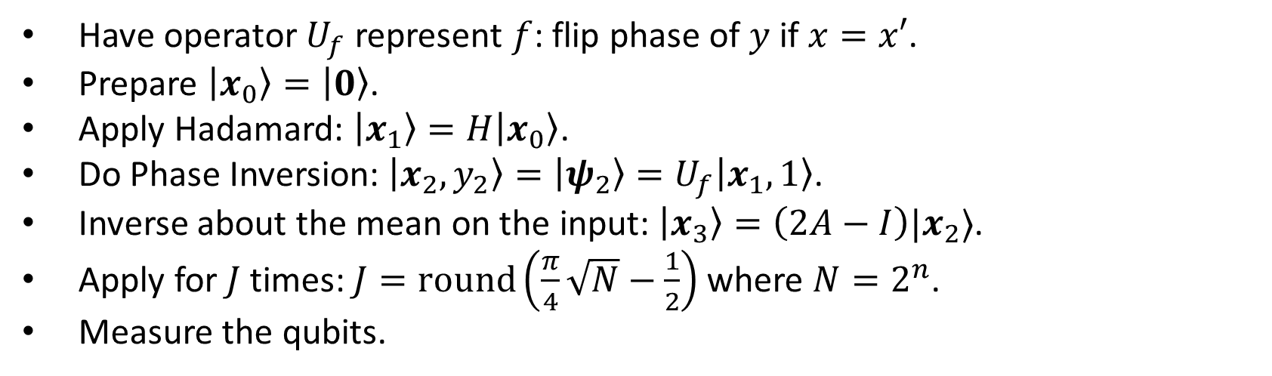
Grover Algorithm
Have operator $U_{f}$ represent $f$: flip phase of $y$ if $x=x′$.
Prepare $\left|x_{0}\right\rangle =\left|0\right\rangle$.
Apply Hadamard: $\left|x_{1}\right\rangle =H\left|x_{0}\right\rangle$.
Do Phase Inversion: $\left|x_{2},y_{2}\right\rangle =\left|ψ_{2}\right\rangle =U_{f}\left|x_{1},1\right\rangle$.
Inverse about the mean on the input: $\left|x_{3}\right\rangle =\left(2A−I\right)|x_{2}⟩$.
Apply for $J$ times: $J=round\left(\frac{π}{4}\sqrt{N}−\frac{1}{2}\right)$ where $N=2^{n}$.
Measure the qubits.

Slide 36
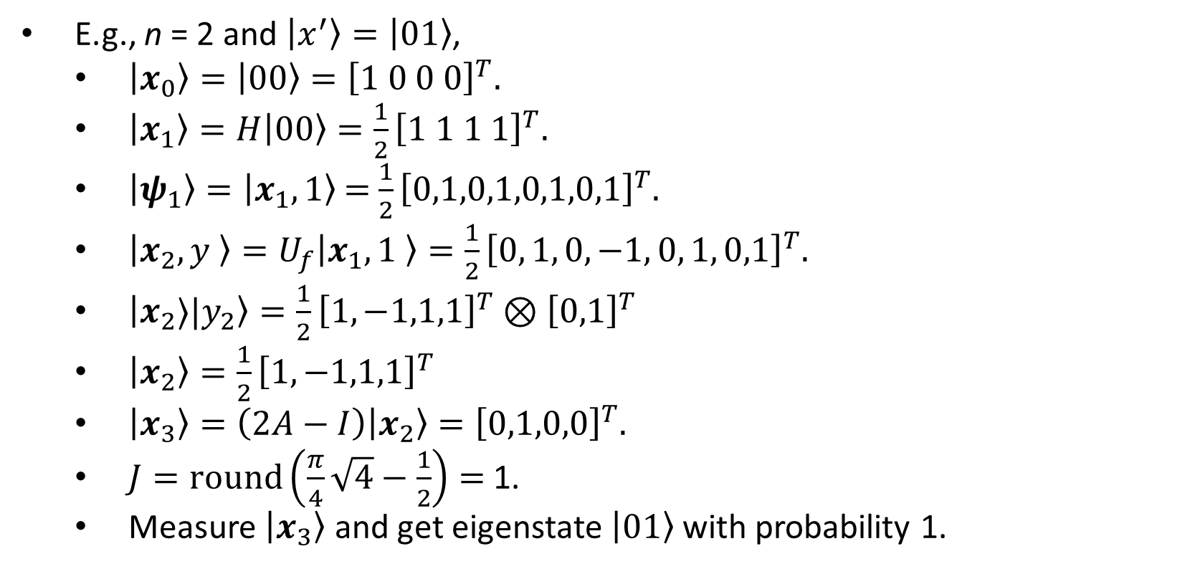
Grover Algorithm: Examples
E.g., n = 2 and $\left|x^{′}\right\rangle =\left|01\right\rangle$,
$\left|x_{0}\right\rangle =\left|00\right\rangle ={\left[1 0 0 0\right]}^{T}.$
$\left|x_{1}\right\rangle =H\left|00\right\rangle ={\frac{1}{2}\left[1 1 1 1\right]}^{T}.$
$\left|ψ_{1}\right\rangle =\left|x_{1},1\right\rangle$ = ${\frac{1}{2}\left[0,1,0,1,0,1,0,1\right]}^{T}$.
$\left|x_{2},y \right\rangle =U_{f}\left|x_{1},1 \right\rangle ={\frac{1}{2}\left[0, 1, 0, −1, 0, 1, 0,1\right]}^{T}.$
$\left|x_{2}⟩|y_{2}\right\rangle =\frac{1}{2}{\left[1,−1,1,1\right]}^{T}⊗{\left[0,1\right]}^{T}$
$\left|x_{2}\right\rangle =\frac{1}{2}{\left[1,−1,1,1\right]}^{T}$
$\left|x_{3}\right\rangle =\left(2A−I\right)\left|x_{2}\right\rangle ={\left[0,1,0,0\right]}^{T}.$
$J=round\left(\frac{π}{4}\sqrt{4}−\frac{1}{2}\right)=$ 1.
Measure $\left|x_{3}\right\rangle$ and get eigenstate $\left|01\right\rangle$ with probability 1.

Slide 37

Related Matrices: Average
x
$A=\frac{1}{2^{N}}\left[\begin{matrix}\begin{matrix}1 & 1 \\ 1 & 1\end{matrix} & \begin{matrix}⋯ & 1 \\ ⋯ & 1\end{matrix} \\ \begin{matrix}⋮ & ⋮ \\ 1 & 1\end{matrix} & \begin{matrix}⋱ & ⋮ \\ ⋯ & 1\end{matrix}\end{matrix}\right]$
$I=\left[\begin{matrix}\begin{matrix}1 & 0 \\ 0 & 1\end{matrix} & \begin{matrix}⋯ & 0 \\ ⋯ & 0\end{matrix} \\ \begin{matrix}⋮ & ⋮ \\ 0 & 0\end{matrix} & \begin{matrix}⋱ & ⋮ \\ ⋯ & 1\end{matrix}\end{matrix}\right]$
Inversion about mean:$\overline{x} −\left(x −\overline{x}\right)=2\overline{x}−x$
$That is, \left(2A−I\right)X$ where $AX$ computes the mean.
x – Mean
Mean
Mean – (x – Mean)

