Slide 1
The Heterogeneous Treatment Effect of Merger on Airfares
Evidence from Alaska Airlines-Virgin America Merger
Tatsuki Kikugawa
Georgetown University School of Foreign Service

Slide 2
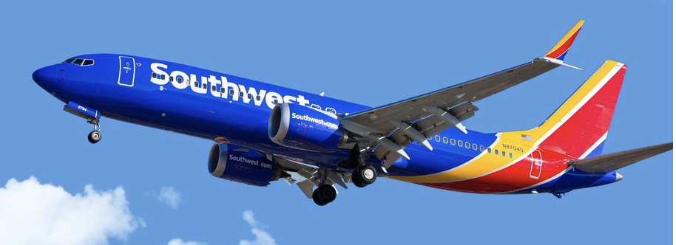
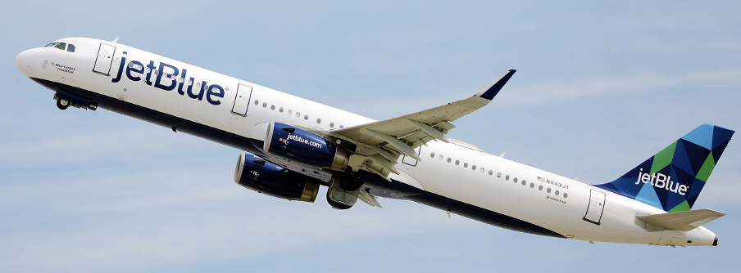
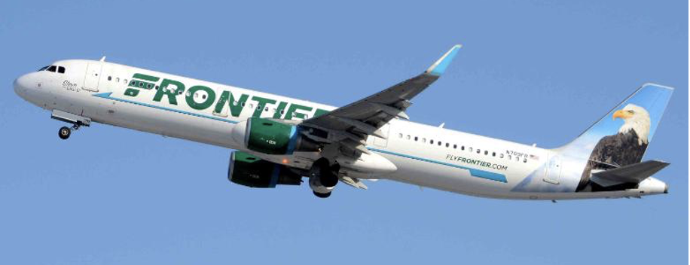
Introduction
General Questions:
How does an LCC ratio affect the airfares of a merged company?
How does an LCC ratio affect the airfares of a merged company’s market?
Answers:
1. LCCs mitigates the fare increase of the merged company
This downward pressure exists in all markets with LCCs (not limited to
the merged company’s markets)

Slide 3
Background Information
Concept 1: There are two types of airlines: Legacy airline and LCC
Legacy airlines is known as full-service carriers—e.g. United, American, and Delta
LCC airlines offer bargain prices in exchange for reduced service—e.g. Southwest, JetBlue
Concept 2: The US airline industry is Oligopoly
The “Big Four” airlines (United, Southwest, American, and Delta) occupy >60% of the market shares
Their dominance is due to a series of mergers and acquisitions since 2000
Concept 3: Alaska Airlines—Virgin America merger occurred in 2016
In April 2016, Alaska Airlines announced the takeover of Virgin America at $2.6 billion
In December 2016, the Department of Justice (DoJ) conditionally approved the merger

Slide 4
Research Questions
Goal 1: Heterogeneous treatment effect of the merger
What is the direct effect of the Alaska/Virgin merger on their prices?
How does that effect differ across markets with different degrees of competition from LCCs?
Goal 2: Spillover effect of the merger on Alaska/Virgin markets
What is the effect of the 2016 merger on the airfares of Alaska/Virgin markets (instead of the fares of Alaska/Virgin themselves)?
How does the effect differ across markets with different degrees of competition from LCCs?

Slide 5
Agenda
Roadmap:
Literature Review
Theory: Cournot Model
Empirical Strategy
FD/FE models
Two-way FE models
Results
Treatment effect
Spillover effect
Theory
Identification
Q1.
Treatment Effect
FD/FE
models
Cournot Model
Q2.
Spillover Effect
TWFE model

Slide 6
Literature: Mergers and LCCs
Effect of mergers on airfares
Several works indicate the upward/downward pressure of the merger on airfares
Luo (2014) finds that the Delta-Northwest merger in 2008 increases fares by 2.3%
Bontemps et al. (2021) observe the fare decrease in the American-US Airways merger
Effect of LCC entry to markets
Many studies show that LCC entry to markets significantly lowers the airfares (Dresner et al. 1996, Beckenstein et al. 2017, etc.) — See Figure 1.
Figure 1
Late 1990s
Early 2010s
Time
Market with
legacy carriers
LCC entrance
to market
Market with
legacy and LCCs
1. The result affects the factors to be considered in the merger evaluation of the DoJ
2. This is the first study investigating the 2016 Alaska/Virgin merger

Slide 7
Theory 1: Cournot model
Background
88% of the US airline routes consists of no more than three firms
Model
An oligopoly theory, a Cournot model with asymmetric costs
Model Assumption
⑴ Competing firms choose a quantity to produce independently and simultaneously
⑵ Firms produce identical/standardized goods (homogeneous product assumption)
Results
The model suggests that when two firms merge into one, the post-merger airfare is decreasing in the marginal cost of a competitor
This says, the post-merger price with an LCC competitor should be lower than the post-merger price with a high-cost competitor
This result holds for the merging company and its competitors

Slide 8
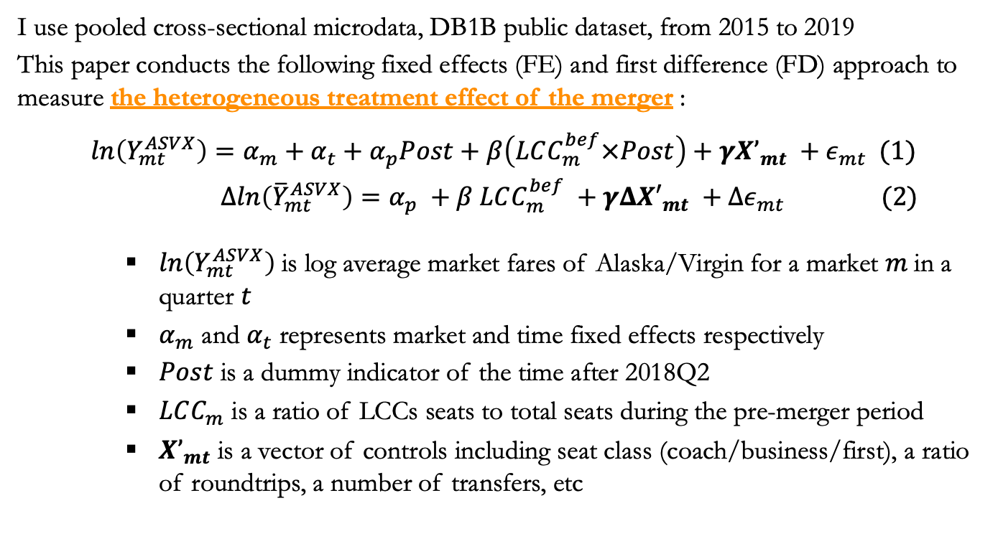
Empirical Strategy 1: Fixed effects and First difference models
I use pooled cross-sectional microdata, DB1B public dataset, from 2015 to 2019
This paper conducts the following fixed effects (FE) and first difference (FD) approach to measure the heterogeneous treatment effect of the merger :
$$ln\left(Y_{mt}^{ASVX}\right)=α_{m}+α_{t}+α_{p}Post+β\left(LCC_{m}^{bef}×Post\right)+γX’_{mt} +ε_{mt} (1)$$
$$Δln\left({\overline{Y}}_{mt}^{ASVX}\right)=α_{p} +β LCC_{m}^{bef} +γΔX′_{mt} +Δε_{mt} (2)$$
$ln\left(Y_{mt}^{ASVX}\right)$is log average market fares of Alaska/Virgin for a market 𝑚 in a quarter 𝑡
$α_{m}$ and $α_{t}$ represents market and time fixed effects respectively
$Post$ is a dummy indicator of the time after 2018Q2
$LCC_{m}$ is a ratio of LCCs seats to total seats during the pre-merger period
$X’_{mt}$ is a vector of controls including seat class (coach/business/first), a ratio of roundtrips, a number of transfers, etc
$α_{p}$ measures the direct effect of the merger on Alaska/Virgin airfares
$β$ captures how the effect differs across markets with different LCC presences

Slide 9
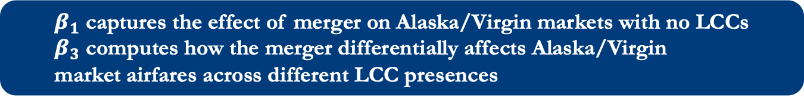
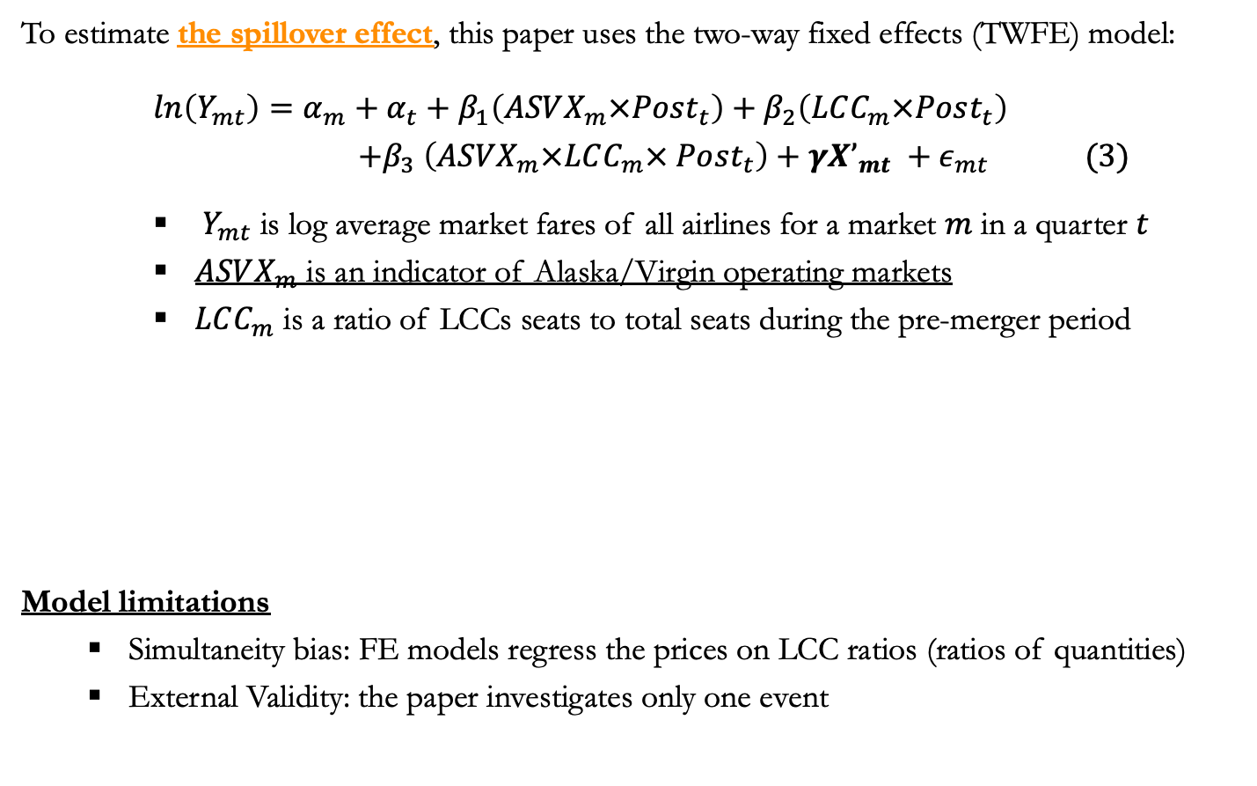
Empirical Strategy 2: Two-way fixed effects model
To estimate the spillover effect, this paper uses the two-way fixed effects (TWFE) model:
$ln\left(Y_{mt}\right)=α_{m}+α_{t}+β_{1}\left(ASVX_{m}×Post_{t}\right)+β_{2}\left(LCC_{m}×Post_{t}\right)$
$$+β_{3} \left(ASVX_{m}×LCC_{m}× Post_{t}\right)+γX’_{mt} +ε_{mt} (3)$$
$Y_{mt}$ is log average market fares of all airlines for a market $m$ in a quarter $t$
$ASVX_{m}$ is an indicator of Alaska/Virgin operating markets
$LCC_{m}$ is a ratio of LCCs seats to total seats during the pre-merger period
Model limitations
Simultaneity bias: FE models regress the prices on LCC ratios (ratios of quantities)
External Validity: the paper investigates only one event
$β_{1}$ captures the effect of merger on Alaska/Virgin markets with no LCCs
$β_{3}$ computes how the merger differentially affects Alaska/Virgin
market airfares across different LCC presences

Slide 10
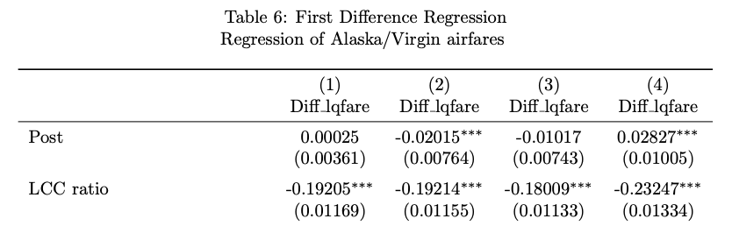
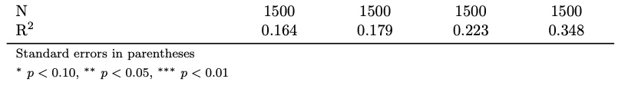
Result 1: Alaska raises its airfares by less when facing LCCs
The treatment of the merger on Alaska’s airfares
The merger increases the Alaska’s airfares by 2.8%
The effect of LCC competition on Alaska’s airfares
Alaska’s airfares increases 23% less in the market with a full presence of LCC than in the market with no LCC

Slide 11
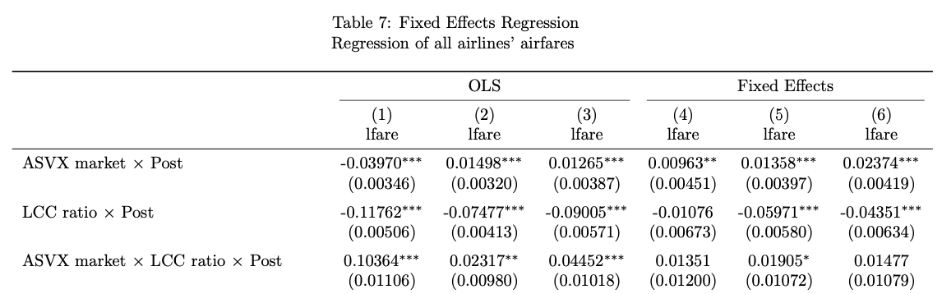
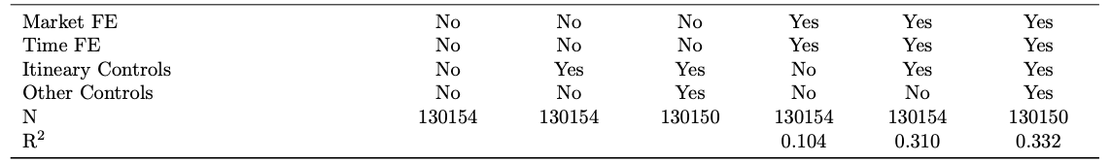
Result 2a: Spillover effect of the merger on airfares
The spillover effect of the merger on the Alaska/Virgin market airfares
The merger increases the ASVX market airfares by 2.4%
The effect of LCC competition on Alaska’s airfares
LCCs decrease the post-merger prices of all airlines compared to non-LCC markets, regardless of whether Alaska and Virgin operate in the markets

Slide 12
Result: Summary
Result 1: Treatment effect of the merger
A merger increases fares of the merged company
The merged company raises its airfares by less when facing LCCs
Result 2: Spillover effect of the merger in the markets
LCCs decrease the post-merger prices of all airlines compared to non-LCC markets, regardless of whether Alaska/Virgin operate in the market
Post-merger Fares
LCC Low (<50%)
LCC High (>50%)
Merged Company
Result 1
spillover
Merged Company’s Markets
Result 2
Non-Merged Company’s Markets

Slide 13
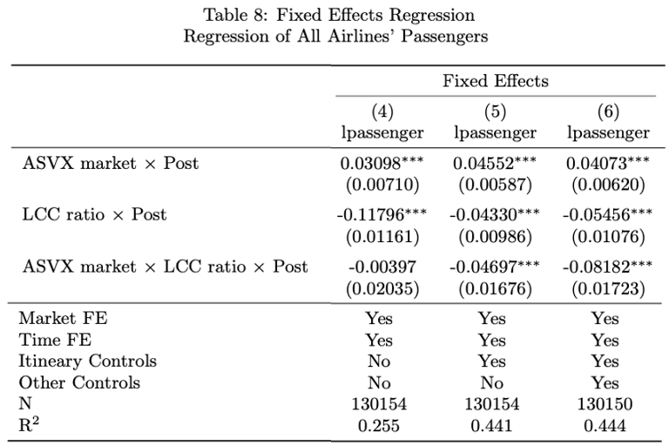

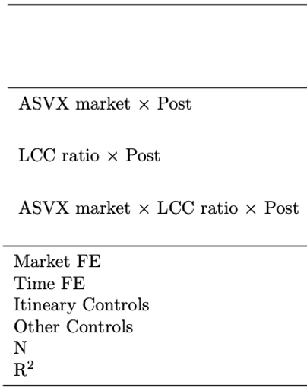
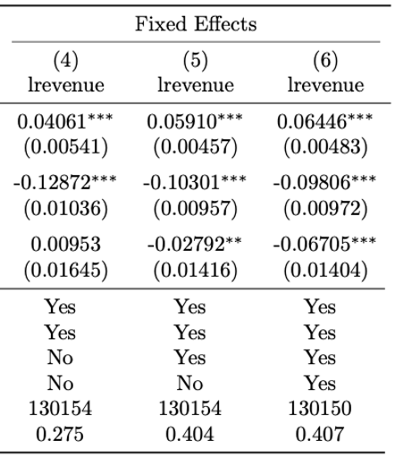
Result 2b: Spillover effect on quantity and revenue (Q&R)
The spillover effect of the merger on the ASVX market quantity
LCCs put downward pressure on post-merger number of seats (quantity) 8.2% more on ASVX markets than non- ASVX markets
The spillover effect of the merger on the ASVX market revenue
LCCs put downward pressure on post-merger revenue 6.7% more on ASVX markets than non- ASVX markets

Slide 14
Synthesizing my results to key implications
Direct implication: The effect of the merger in LCC markets
Our estimation provides the supporting evidence of the Cournot model
There are 2 possibilities on the spillover effect on airfares
LCCs drive down post-merger prices for reasons other than the merger
The merger is a “treatment” affecting all markets (not just ASVX markets)
The result on Q&R suggests something missing from the Cournot model:
Alaska/Virgin move seats from LCC to non-LCC markets for some reasons
Indirect implication: Ex-post evaluation of the Alaska-Virgin merger
Compared to the non-LCC markets, Alaska Airlines experienced decline in Q&R in LCC markets, implying relative share drop in LCC markets
This finding leads to the possibility that the DoJ could have overestimated the ex-ante share of Alaska/Virgin

Slide 15
Conclusion
This paper examines the heterogeneous treatment effect and the spillover effect of the 2016 Alaska/Virgin merger on airfares across markets with different LCC presence
The treatment/spillover effects are consistent with what the Cournot model predicts
LCCs decrease the post-merger prices of all airlines compared to non-LCC markets, regardless of whether Alaska and Virgin operate in the markets
Additionally, the result demonstrates that the greater LCC presence is associated with the lower number of passengers and revenue of the markets

Slide 16
Thank you for your attention!
Any question or comment?

Slide 17
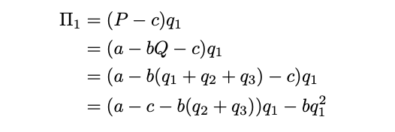
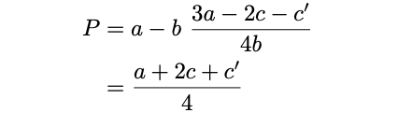
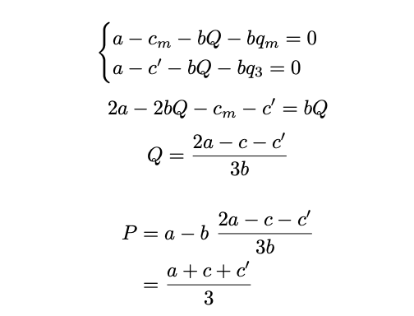
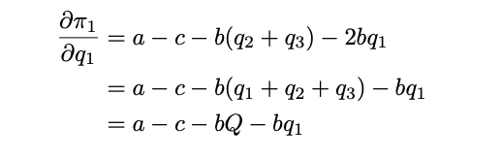
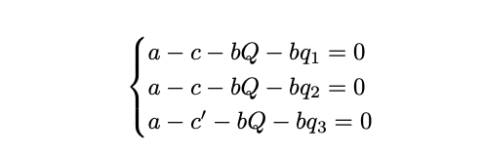
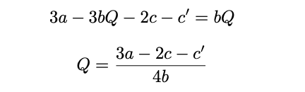
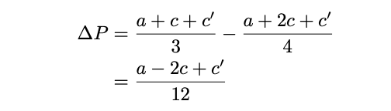

Appendix (1/n): Breakdown of the theory prediction
Cournot model with asymmetric costs
Firm 1, 2, and 3 produce q1, q2, and q3 with marginal cost c, c, and c’ respectively
I start from the inverse demand function ($P=a −bQ$) and consider a profit function:
Notes:
∆P is the theoretical prediction of the fare difference before and after the merger. In other words, if ∆P > 0, a merged company has increased the price after the merger.
∆P is increasing in the marginal cost of the competitor

Slide 18
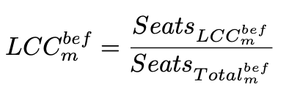
Appendix (2/n): Data
Data Description
The DB1B public data from the Department of Transportation
10% of all airline tickets in each quarter with > 20 million samples each year
US domestic markets with sufficient presence of LCCs
Variable Definition
LCC ratio is a ratio of the seats offered by LCCs to the total seats in a given market (m) in the pre-merger period (2015Q1-2018Q1)
Data Aggregation
I aggregate the (raw) ticket level data to airport-pair and to city-pair level
My main analysis
Ticket-level
Airport-pair level
City-pair level
(138K samples)
(63M samples)
(154K samples)

Slide 19
Appendix (3/n): Q&A materials
Q1: Why Cournot model instead of Bertrand model?
Given that each airline develops similar types of dynamic pricing models, an airline company can differentiate themselves only though their choice of the markets that they serve. Hence, choosing quantity to supply is a reasonable assumption to be imposed
Also, Brander et al. (1990) find empirical evidence that the Cournot model better fits the US airline industry than the Bertrand model
Q2: What could be executed better?
Another approach I could take is the structural approach where I model the demand and supply equilibrium through the generalized method of moments (GMM)
Q3: How does the simultaneity bias come into play?
Assuming the positive relationship between the market airfares and LCC ratios, the bias skews the negative coefficient to zero, dwarfing the estimate

