Slide 1

Research on Building Evolutionary Deep Learning
B4 Tatsuya Sugiyama
Notes:
Sugiyama will present a paper entitled " Research on Building Evolutionary Deep Learning"

Slide 2
Agenda
Background
Research Purpose
Proposed Method
Future Works
Notes:
Here's how it's presented

Slide 3
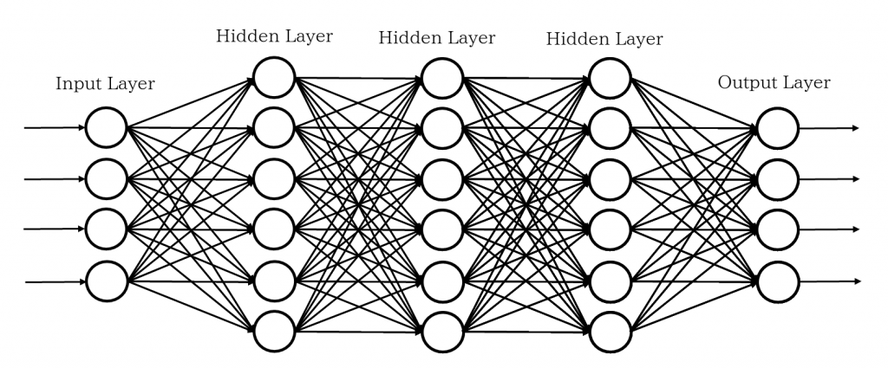
Background
Deep Neural Network
Success in Image, Speech, and Natural Language Problems
https://agirobots.com/blog-ai-ml-research-cnn-dnn/
Notes:
In recent years, machine learning has made remarkable progress and has been applied to a wide range of fields and many researches have been conducted.
For example, deep neural networks have attracted a great deal of attention for their high performance on speech, image and natural language problems.

Slide 4
Background
Deep Neural Network
Success in Image, Speech, and Natural Language Problems
Design is manual.
We want to automate it.
https://agirobots.com/blog-ai-ml-research-cnn-dnn/
Notes:
On the other hand, since DNNs, as the term implies, are deeply layered, they have many hyperparameters such as layer types, parameters, numbers, and connections between layers.
However, there are no clear guidelines for the design of the network and its architecture, so we had to go through a trial-and-error process to obtain good accuracy.

Slide 5
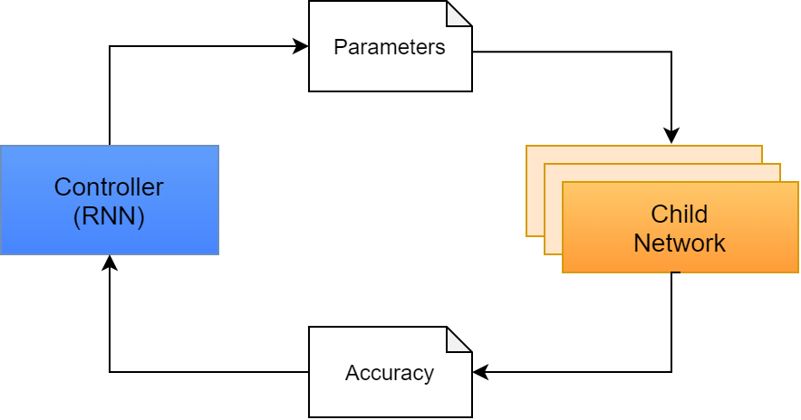
Background
Neural Architecture Search
one of the Automated Machine Learning methods
to optimize the network architecture by network
Barret Zoph and Quoc V. Le. Neural Architecture Search with Reinforcement Learning 2016
Notes:
Neural Architecture Search, one of the automated machine learning methods, is being looked at to solve this problem.
NAS searches in networks to optimize the architecture.

Slide 6
Agenda
Background
Research Purpose
Proposed Method
Future Works
Notes:
The next one is research purpose.

Slide 7
Research Purpose
computation time (2000 GPU-days)
Disadvantage of NAS
Notes:
Although NAS is able to optimize its architecture automatically, it has a major disadvantage in terms of computation time, which takes thousands of GPU days.
Therefore, it is necessary to reduce the computation time by adding restrictions to the network structure.

Slide 8
Research Purpose
short training time vs network flexibility
to find an appropriate constraint in shorter time.
Purpose
Notes:
In this study, we consider the trade-off between short training time and network flexibility to find an appropriate constraint.
The goal is to obtain a machine learning model with even higher accuracy and shorter time.

Slide 9
Agenda
Background
Research Purpose
Proposed Method
Future Works

Slide 10
Proposed Method
Differentiable Architecture
experimenting with various graph structure conditions on a cell
Hanxiao Liu and Karen Simonyan and Yiming Yang.
Differentiable Architecture Search, 2018
Notes:
A differentiable architecture has been proposed as a method to reduce training time.
But there was no detailed mention of the network space to be explored.
Our method builds on this and evaluates its performance by experimenting with various graph structure conditions on a cell that is one of the components of the network.

Slide 11
Proposed Method
Differentiable Architecture
experimenting with various graph structure conditions on a cell
Select The best performing configuration
Confirm the generality in other problems.
Hanxiao Liu and Karen Simonyan and Yiming Yang.
Differentiable Architecture Search, 2018
Notes:
The best performing configuration is then selected and the generality is confirmed in other problems.

Slide 12
Agenda
Background
Research Purpose
Proposed Method
Future Works
Notes:
Finally, there are future works.

Slide 13
Future Works
Explore the network for various architectures
Issue
Notes:
First, we will explore the network for various architectures other than DNN.

Slide 14
Future Works
Explore the network for various architectures
to build a general-purpose architecture search system
Issue
In the Future
Notes:
If we get good models that are close to existing methods, we will aim to build a general-purpose architecture search system in the future.

Slide 15
Thank you for your kindly attention

