Slide 1
Requirement
Implementation Method Selection
In-house Development/Outsourcing
Check-point | In-house Development | Outsourcing
Project Budget | Low budget | Medium-High Budget
Time Competitiveness | Short time | Short-Long time
Price Competitiveness | Low Price | Medium-High Price
Project Complexity | High complexity | Low-High Complexity
Project Flexibility | High flexibility | Low-Medium Flexibility
Market Competiveness | High competitive | Low-High Competitive
Project Management | High project Management | Low project management
Risk Management | High risk Management | Low risk Management

Slide 2
Project Example
Project | View | Detail | Selected option
TMS-OV | Project Budget | Low budget | In-house
 | Time Competitiveness | Short Timeline | In-house
 | Price Competitiveness | Low Price | In-house
 | Project Complexity | High Complexity | In-house/outsourcing
 | Project Flexibility | High Flexibility | In-house
 |  | High Competitive | In-house
 | Project Management | High Project Management | Outsourcing
 | Risk Management | High Risk Management | Outsourcing
 |  |  | Total Score : In-house (6) – Outsourcing (3)
Conclusion : In-house development is chosen but we have to manage the project very carefully and take the risk by taking good risk management to an account

Slide 3
Selected Function | Domestic | Import/Export | Cross-Border | Warehouse (Rental Fee)
Truck Inbound/Outbound | ☑
Order Management | ☑ | ☑ | ☑ | ☑
Delivery Note Management | ☑ | ☑ | ☑ | ☑
Shipment Management | ☑ | ☑ | ☑ | ☑
Tender/Accept/Reject | ☑ | ☑ | ☑ | ☑
GI/GR | ☑ | ☑ | ☑ | ☑
AR/AP | ☑ | ☑ | ☑ | ☑
LND | ☑
Document Return | ☑ | ☑ | ☑
GPS | ☑ | ☑ | ☑
Report | ☑ | ☑ | ☑

Slide 4


Web Server
Database Sever
www.tmsvn.com
Web App (Vietnam)
VietnamDB
Deploy
Main Web App (Lao)
www.tmscb.com
SCG
CBDB
Web App (Cambodia)
CambodiaDB
www.tmslao.com
CBDB
LaoDB
Web App (Lao)
www.tmsindo.com
CBDB
IndonesiaDB
Web App (Indo)
www.tmsmyanmar.com
CBDB
MyanmarDB
Web App (Myanmar)

Slide 5

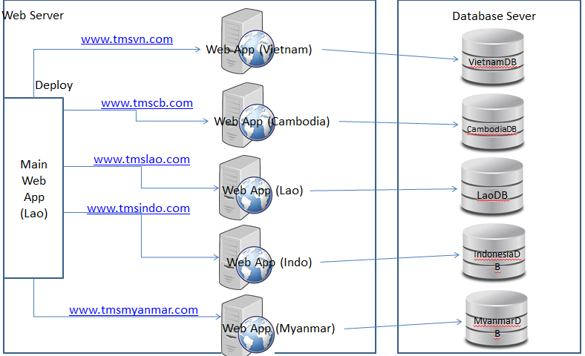

SCG
NON-SCG

Slide 8
Document Type | Time used/Document | Total Amount/Day | Total Time used/Day
DN Creation | 5 minutes | 30 | 150 minutes
Shipment Creation | 6 minutes | 30 | 150 minutes

