Slide 1
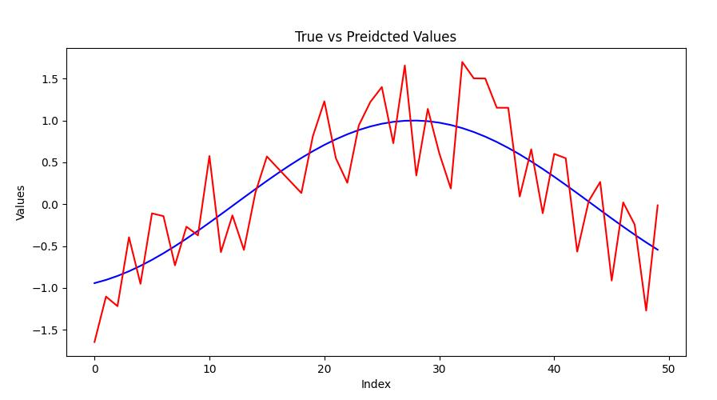
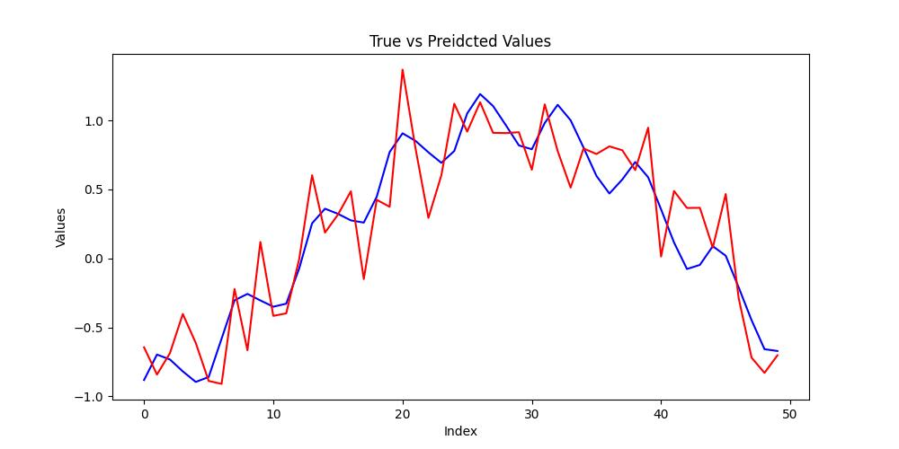
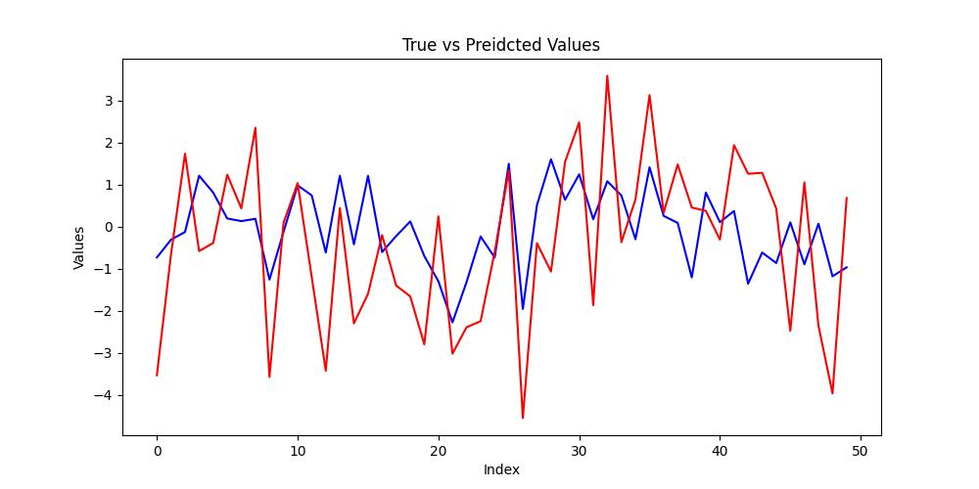
(a) Simple pendulum
(b) Forced oscillator
Test data
Model predictions
(c) Non-Markov Autoregressive process

