Slide 1
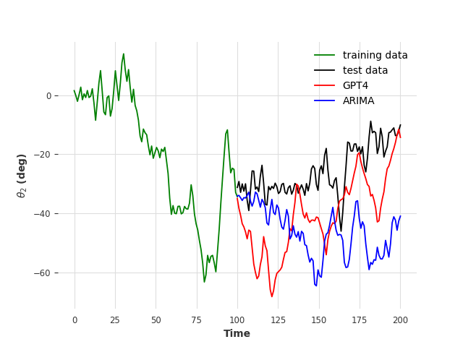
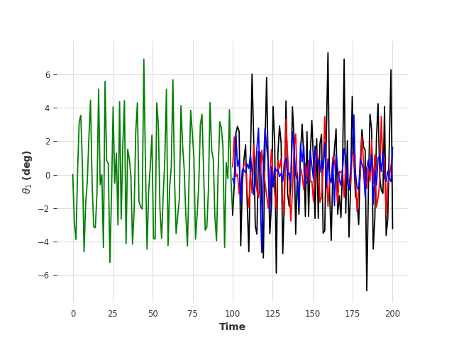
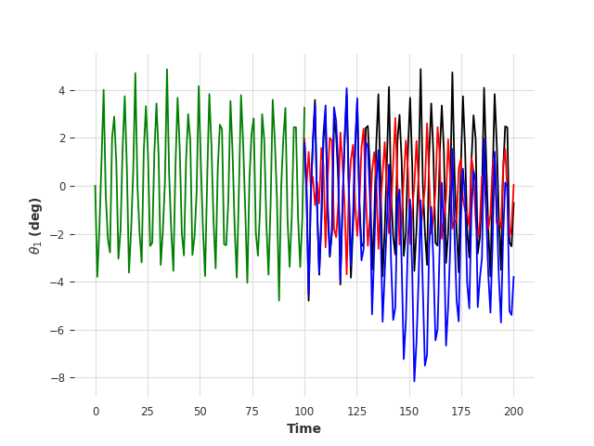



Chaotic
$$LE_{max}=0.0399$$
Chaotic
$$LE_{max}=0.0399$$
Quasi-periodic
$$LE_{max}=−0.1086$$
(a)
(b)
(c)

