Slide 1
GoalManager
Matthew Tennis | Andrew Keller | Miguel Morell
CSCI 4712: Senior Capstone Week 10

Slide 2
GoalManager Use Cases

Slide 3
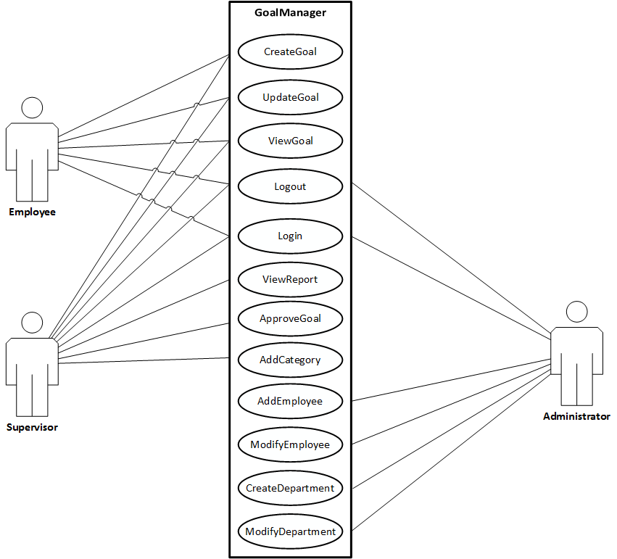
Use Case Description

Slide 4
GoalManager Database Schema

Slide 5
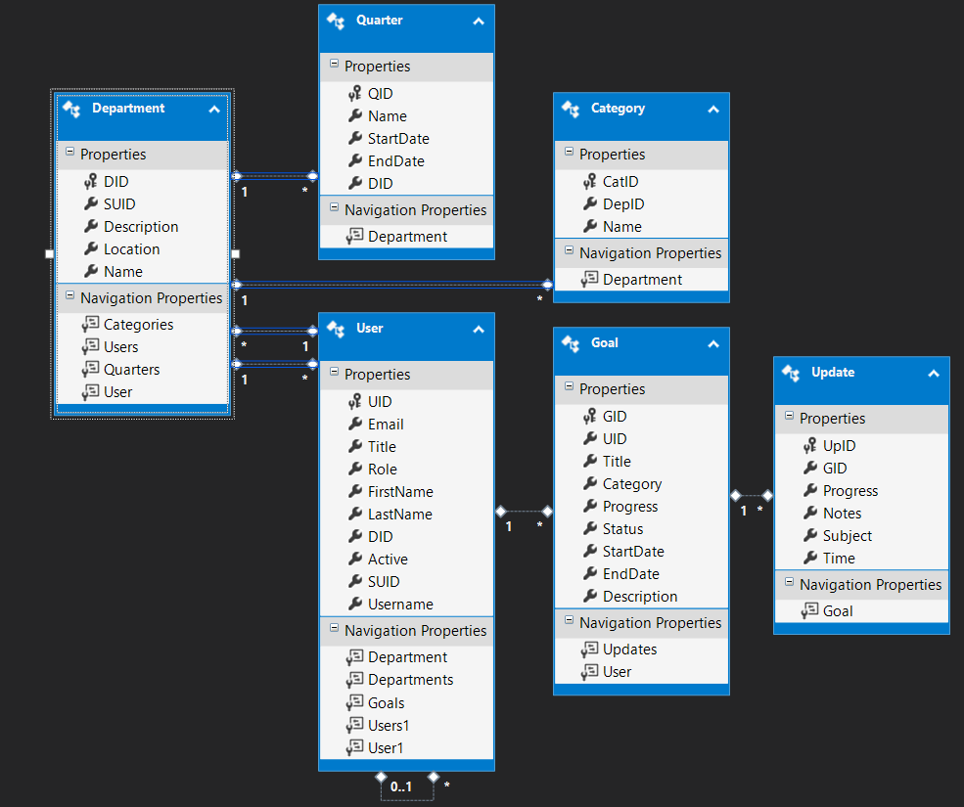

Slide 6
Use Cases

Slide 7
SupervisorHome
Implemented:
Supervisor’s managed Department(s)
Supervisor’s managed Employee(s)
Supervisor’s Goals
Supervisor’s

