Slide 1
GoalManager
Matthew Tennis | Andrew Keller | Miguel Morell
CSCI 4712: Senior Capstone Week 12

Slide 2
GoalManager Use Cases

Slide 3
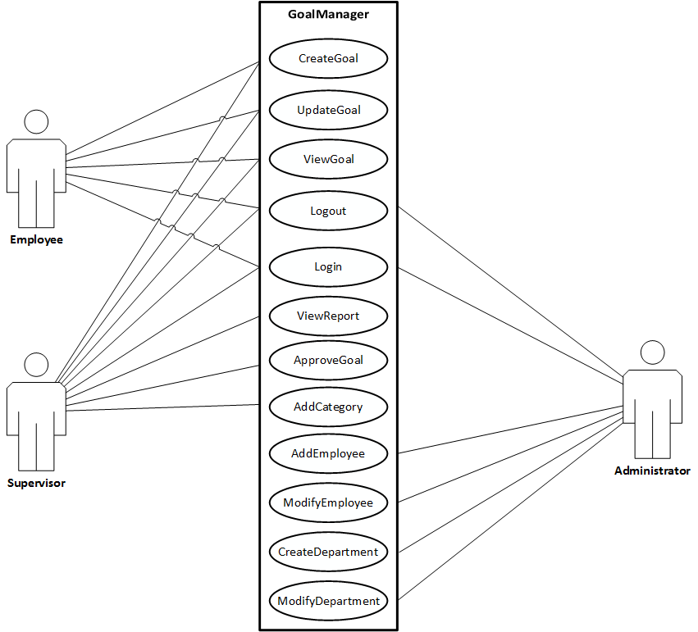
Use Case Description

Slide 4
GoalManager Database Schema

Slide 5
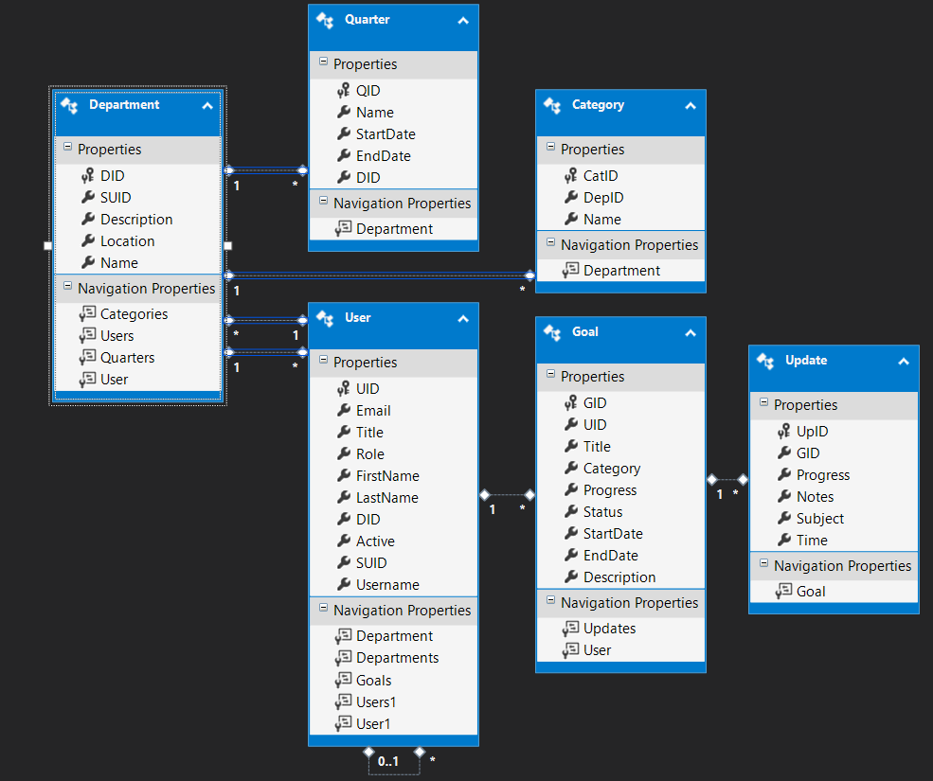

Slide 6
Use Cases

Slide 7
SupervisorHome
Implemented:
Supervisor’s managed Department(s)
Supervisor’s managed Employee(s)
Supervisor’s Goals
Supervisor’s Approval Queue
Approval Queue
Prioritizes managed Employees’ submitted Goals
Approve/Deny not implemented yet

Slide 8
ViewReport (Department)
Implemented:
Query database for:
Department Supervisor
Department Employees
Each Employee’s Goals (Dictionary<int, List<Goal>>)
Each Employee’s Goal’s Updates (Dictionary<int, List<Update>>)

Slide 9
Nonfunctional Requirements

Slide 10
Access Control
GUI controls do not permit unauthorized access
Role-based permissions
Vulnerabilities exist in URL / GET manipulation

