Slide 1
GoalManager
Matthew Tennis | Andrew Keller | Miguel Morell
CSCI 4712: Senior Capstone Week 10

Slide 2
GoalManager Use Cases

Slide 3
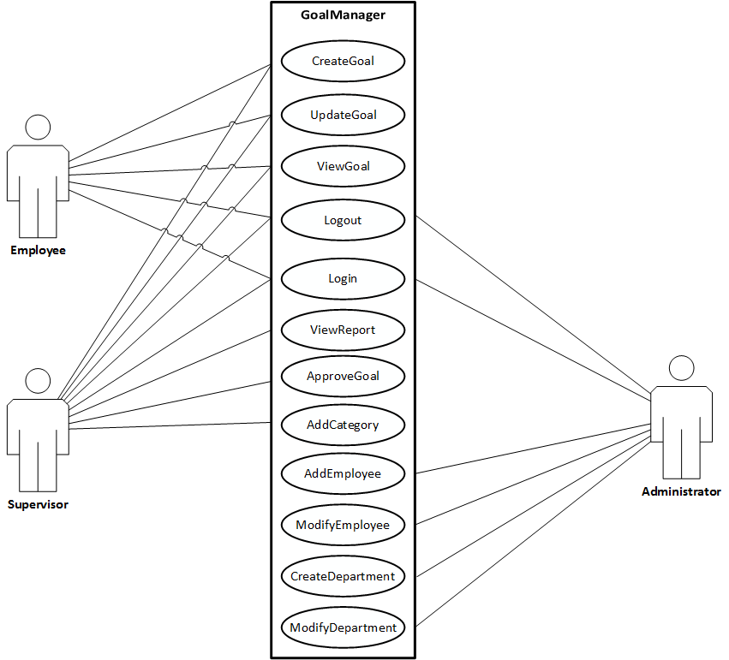
Use Case Description

Slide 4
GoalManager Database Schema

Slide 5
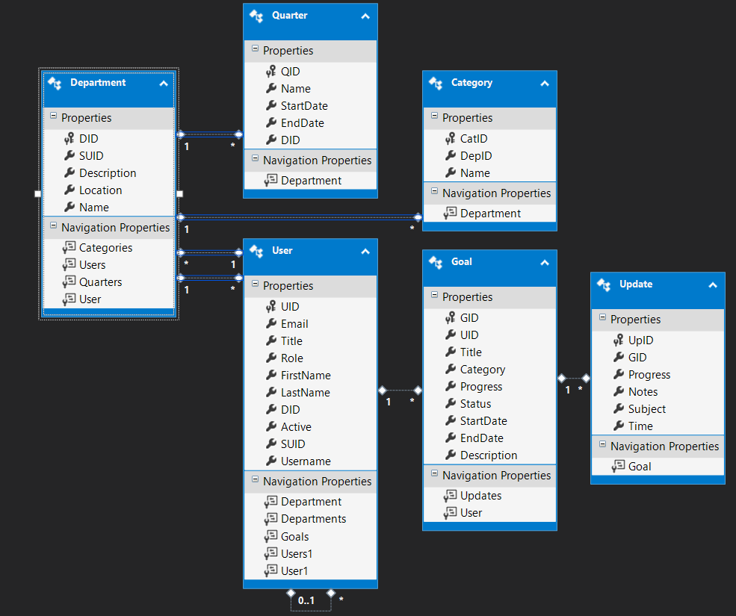

Slide 6
New and Updated Use Case Descriptions

Slide 7
CreateDepartment

Slide 8
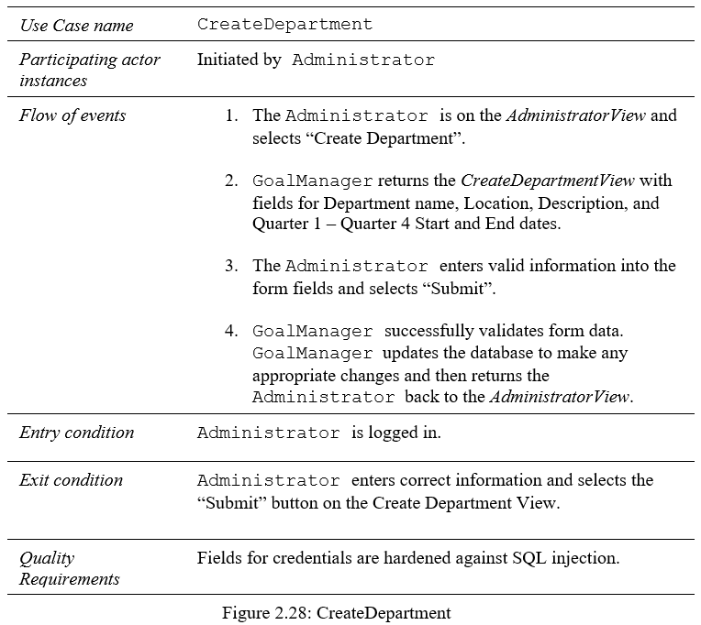
CreateDepartment

Slide 9
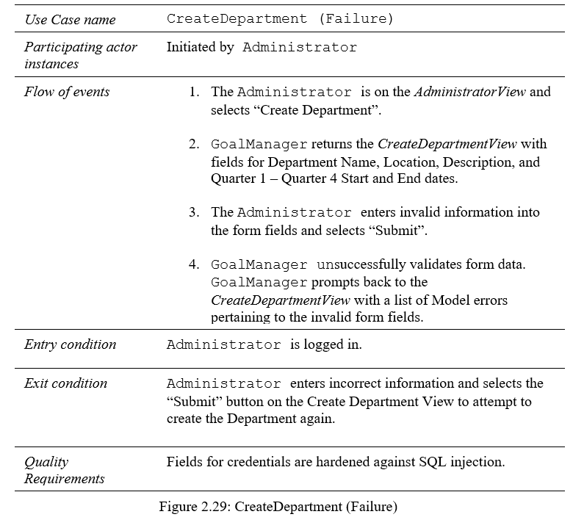
CreateDepartment (Failure)

Slide 10
ModifyDepartment

Slide 11
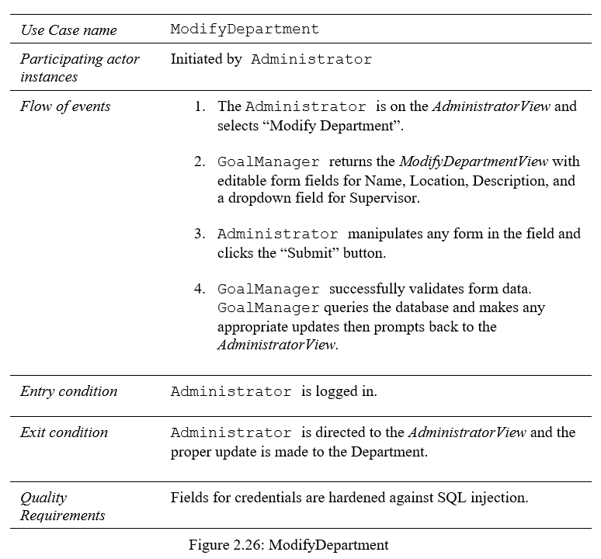
ModifyDepartment

Slide 12
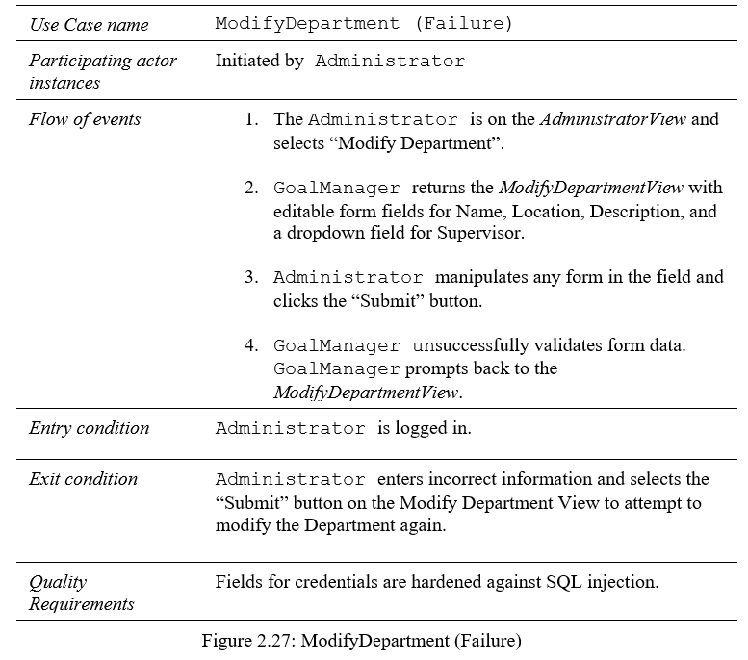
ModifyDepartment (Failure)

