Slide 1
GoalManager
Matthew Tennis | Andrew Keller | Miguel Morell
CSCI 4712: Senior Capstone Week 13 | 12 April 2017

Slide 2
GoalManager Use Cases

Slide 3
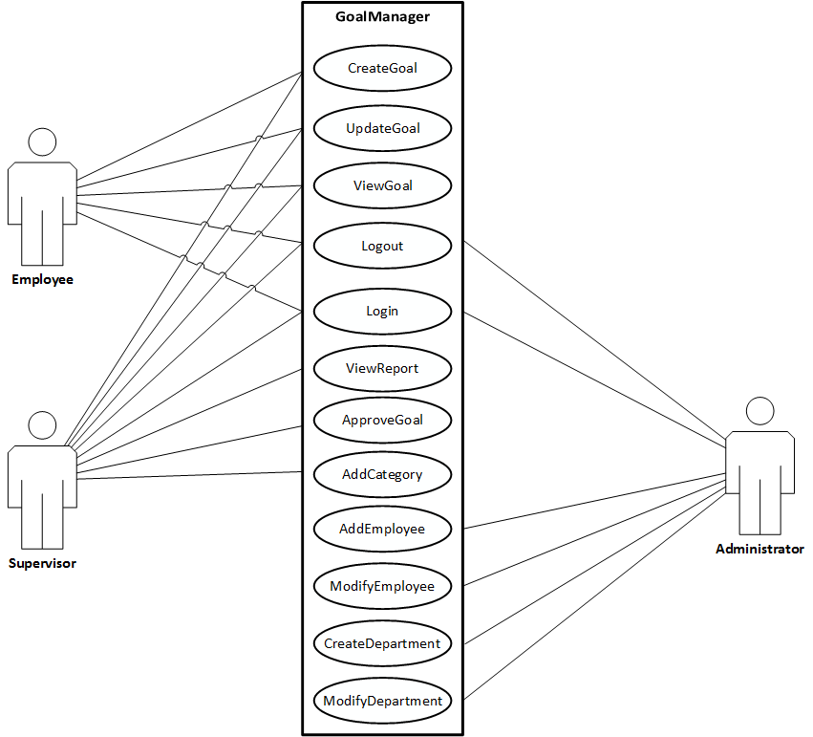
Use Case Description

Slide 4
GoalManager Database Schema

Slide 5
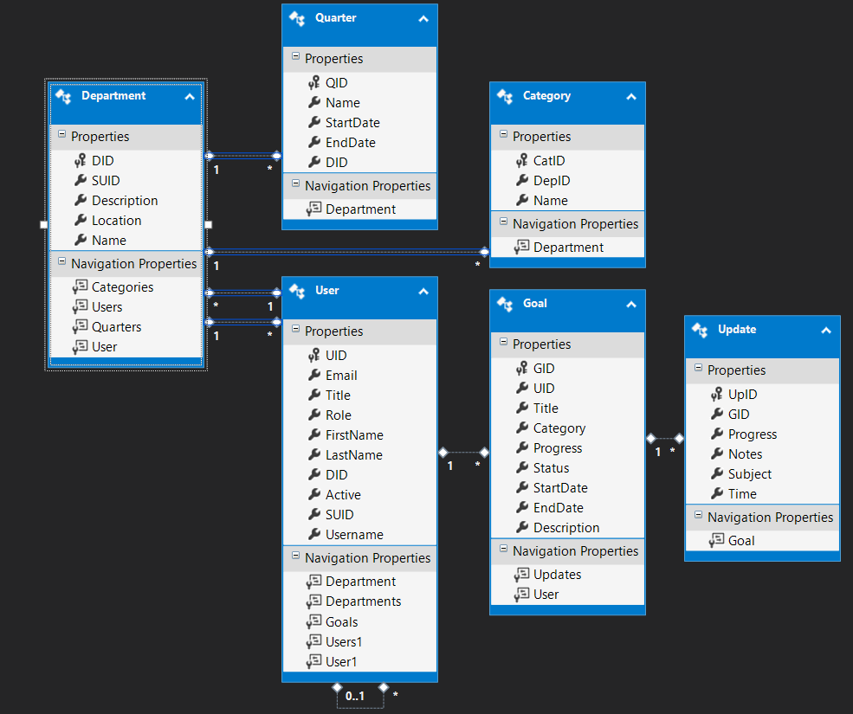

Slide 6
Use Cases

Slide 7
ViewReport (Employee)
Implemented:
Query database for:
Employee’s Goals
Each Goal’s Updates (Dictionary <int,List<Update>>)
ActiveGoals, PendingGoals, FailedGoals, DeniedGoals
Approval Queue
Lists Employees’ Goals that are pending approval

Slide 8
ViewReport (Department)
Implemented:
Query database for:
Managed Employees’ Goals (Dictionary<int,List<Goal>>)
Each Goal’s Updates (Dictionary <int,List<Update>>)
ApprovalQueue, PendingGoals, FailedGoals
Approval Queue
Prioritizes managed Employees’ submitted Goals

Slide 9
Modified CreateDepartment
Updated:
Removal of test data
Removal of unnecessary hard-coded form data
Correctly pulling available Supervisors to assign Dept. Supervisor
Implementation
Quarter logic – Start Date can’t be before End Date
Error/Exception handling

Slide 10
Modified CreateEmployee
Updated:
Removal of inefficient database queries
Removal of “magic number” validation failure
Error & exception handling
GET query hardening

Slide 11
ApproveGoal & DenyGoal
Fully implemented
SupervisorHome is presents managed Employees’ pending Goals
Approve/Deny correctly updates Goal “Active” and “Status” attributes
Uses ActionMethod w/o rendered View
GET query hardening

Slide 12
Updating Home Views
AdminHome:
Correctly pull lists of Employees vs Administrators
SupervisorHome:
Clearer data presentation
Current implementation removed empty list checks (temporary)

Slide 13
Goal Progress Logic
A successful Goal Update now:
Checks if Update progress is >= Goal’s prior Progress
Provided Progress passes validation, Goal’s Progress attribute is updated & presented
Progress bounded [0,100]

Slide 14
Nonfunctional Requirements

Slide 15
Error & Exception Handling
Failed form validation returns to appropriate GET method
If GET query string carries invalid reference IDs (for DB lookup), exception is handled and returned to GET
If POST form data carries invalid reference, exception is handled gracefully
Changed reference keys to string to prevent easily-manipulated exploitation

Slide 16
Database
Decommissioning of test EE, Supervisor, and Admin in progress
Current implementation in need of much more test data (TODO)
Presentation is lacking real production data

Slide 17
Access Control
Expanded role-based authentication
Expanded PartialData.cs for SessionData:
Added simple strings from database to eliminate extra database queries

Slide 18
Views, HTML, and .css
Improved .css to better reflect official TaxSlayer font face, button style, and more
Across the board changes
DateTime objects have been pretty-printed
TaxSlayer favicon .ico added

Slide 19
TODO

Slide 20
ViewReport Data Presentation
Working prototype binds data to JavaScript library presentation
Sortable lists in a separate branch
Research on best graphical JavaScript library for infographic display
AddCategories (Supervisor & Administrator function), which will include modifying existing categories

