Slide 1
GoalManager
Matthew Tennis | Andrew Keller | Miguel Morell
CSCI 4712: Senior Capstone Week 10

Slide 2
GoalManager Use Cases

Slide 3
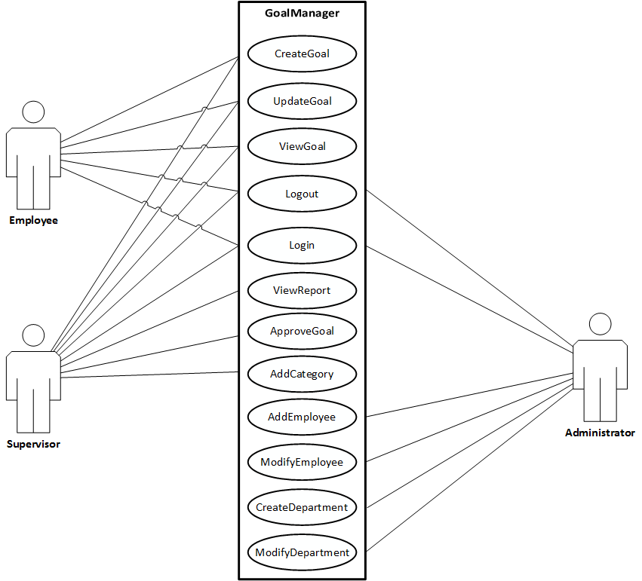
Use Case Description

Slide 4
New and Updated Use Case Descriptions

Slide 5
CreateDepartment

Slide 6
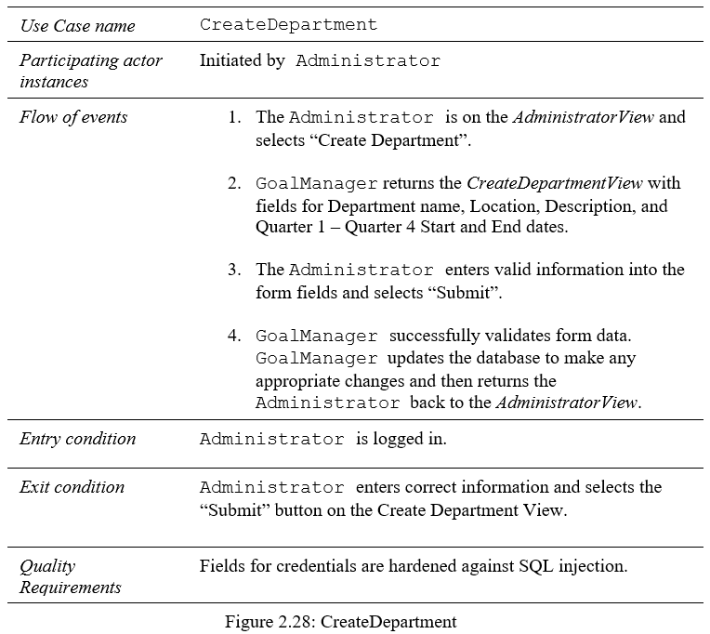
CreateDepartment

Slide 7
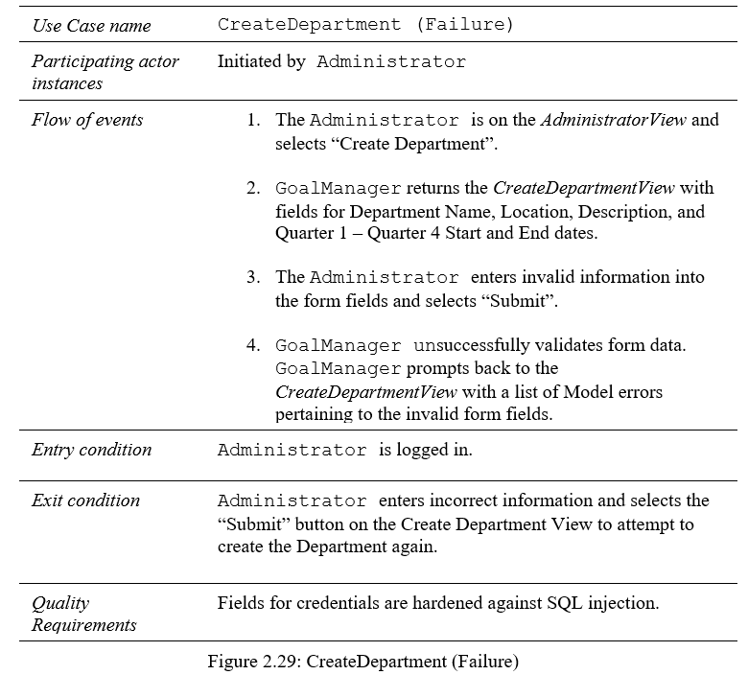
CreateDepartment (Failure)

Slide 8
ModifyDepartment

Slide 9
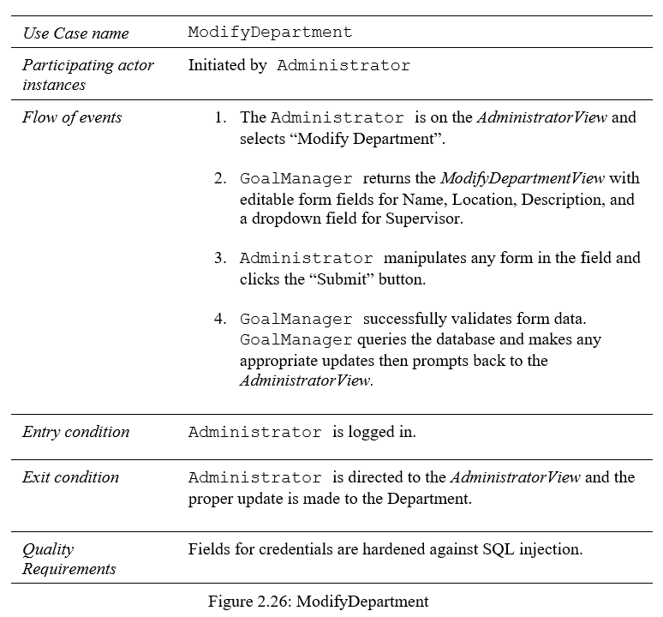
ModifyDepartment

Slide 10
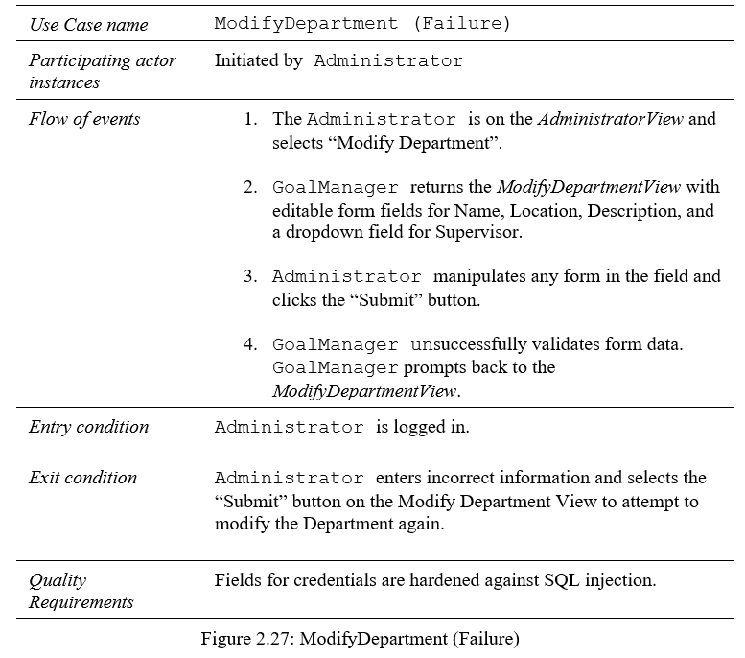
ModifyDepartment (Failure)

