Slide 1
JavaScript and native apps
Making some “native” desktop apps using the power of JS

Slide 2
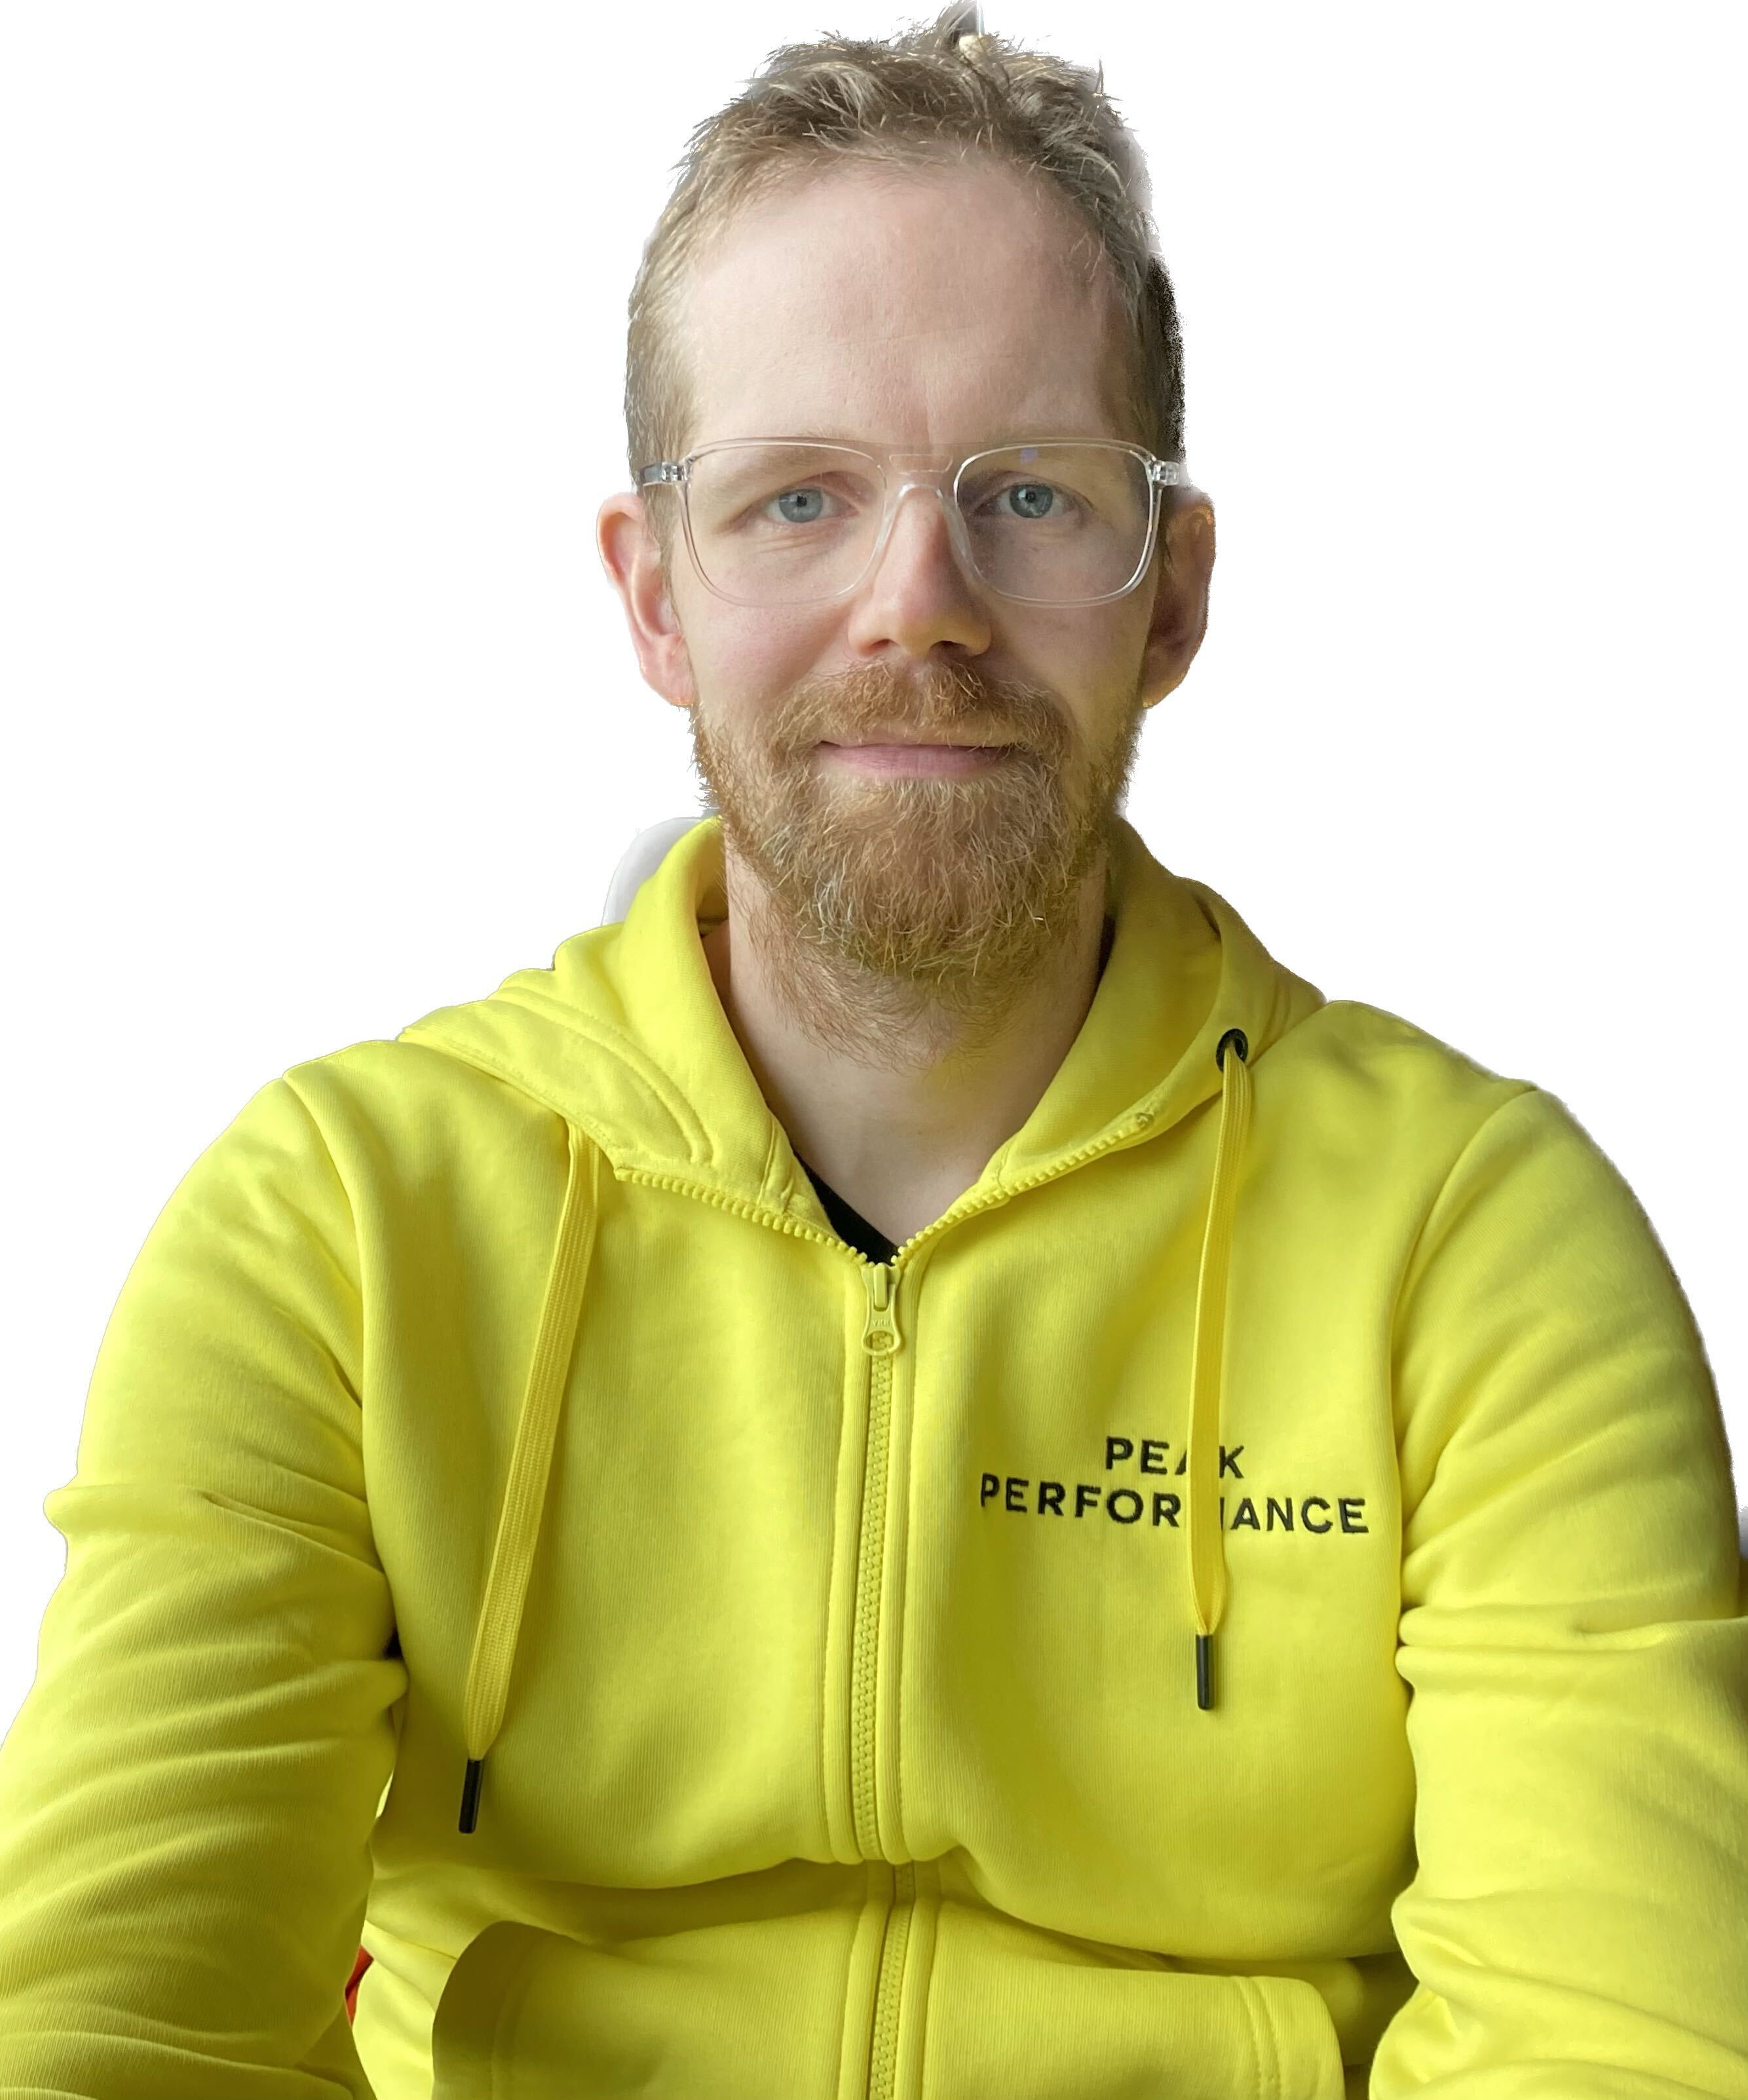
intro
Me
@tatut on X / GitHub
Notes:
Who am I? Well I’m a software architect here at Solita and I’ve been doing this for over a quarter of a century. At Solita for 12 years now.
Most of my career has been web apps backed by databases and integrations related to those.
I did start webdev with CGI-BIN back in the nineties, and did PHP in 2000-2002, then various Java based frameworks.
Obviously jumped to React train on 2014 and done lots of work with that.
How many still write code? I was thinking about this talk and whether or not people still care about this stuff… hopefully some do.
We will be looking at lots in this talk.
Also luckily this session seems to be very heavy on the native side, the next talk being about react native… so we won’t talk about that.

Slide 3
intro
Me
You
Notes:
You are a JavaScript developer?
How many still write code? I was thinking about this talk and whether or not people still care about this stuff… hopefully some do.
How many do React? How many do non-web stuff.
How many code in compile-to-JS languages?
We will be looking at lots in this talk.
Also luckily this session seems to be very heavy on the native side, the next talk being about react native… so we won’t talk about that.

Slide 4

intro
Me
You
Solita
Notes:
Solita is where we are now, founded 30 years ago in Tampere.
I’m from our Oulu office.
We have lots of offices and do lots of stuff in the tech space… so check our website or talk to our people here.

Slide 5
intro
Me
You
Solita
This presentation
Notes:
Solita is where we are now, founded 30 years ago in Tampere.
I’m from our Oulu office.
We have lots of offices and do lots of stuff in the tech space… so check our website or talk to our people here.

Slide 6
Making native apps
So we will try three different strategies
We want to have
  Native launching application
    .exe for Windows
    .app bundle for Mac
    Whatever Linux distros want these days (.deb or AppImage)

Slide 7
ElectronJS
The obvious first attempt, just use Node and any web tech to make a ”native” app
Super easy, you don’t need to write any non-JS code

Slide 8
DEMO
Notes:
Talk about previous project with electron + pg + clj + react

Slide 9





Why do we care about native?
I wish I could make
nice pics, videos and anything
by just asking the machine
to do it
A random person in 2022

Slide 10







WISH
GRANTED
I wish I could make
nice pics, videos and anything
by just asking the machine
to do it
Monkey’s paw
A random person in 2022

Slide 11












WISH
GRANTED
I wish I could make
nice pics, videos and anything
by just asking the machine
to do it
RAM costs 5x
Monkey’s paw
A random person in 2022

Slide 12
WISH
GRANTED
Component
shortages
I wish I could make
nice pics, videos and anything
by just asking the machine
to do it
RAM costs 5x
Monkey’s paw
A random person in 2022

Slide 13
WISH
GRANTED
Component
shortages
Endless slop
everywhere
I wish I could make
nice pics, videos and anything
by just asking the machine
to do it
RAM costs 5x
Monkey’s paw
A random person in 2022

Slide 14
The consumer landscape
Laptop specs as of fall 2026
  Baseline is 8gb of memory (the low-end machines)
  16gb is the common consumer memory
  Developers and other professionals use 24-48 gb machines
    You are developing on a machine that is way more powerful than your users (likely) have
Notes:
How many of you test on an 8 gig machine?

Slide 15
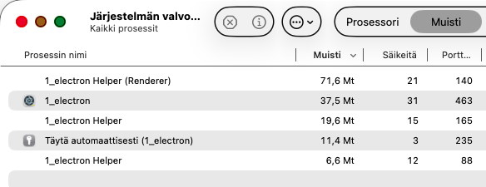

Memory use
Reasonable?
  1gb+ for a weather app (Win11)
  300mb – 1gb for a music player? (Spotify)
  1gb+ for chat apps and video conferencing (Slack, Teams)
Our little todo app
after initial render

Slide 16
Memory use
Reasonable?
  1gb+ for a weather app (Win11)
  300mb – 1gb for a music player? (Spotify)
  1gb+ for chat apps and video conferencing (Slack, Teams)
Why?
  The common theme here is that they are web apps
  Embedding a full browser engine hosting a React app
Notes:
Fun fact:
The

Slide 17
Memory use
Reasonable?
  1gb+ for a weather app (Win11)
  300mb – 1gb for a music player? (Spotify)
  1gb+ for chat apps and video conferencing (Slack, Teams)
Why?
  The common theme here is that they are web apps
  Embedding a full browser engine hosting a React app
  Easier for developers?
Notes:
Fun fact: the spotify app bundle contains login.spa which is a login page with 1,3 megabytes of MINIFIED javascript

Slide 18
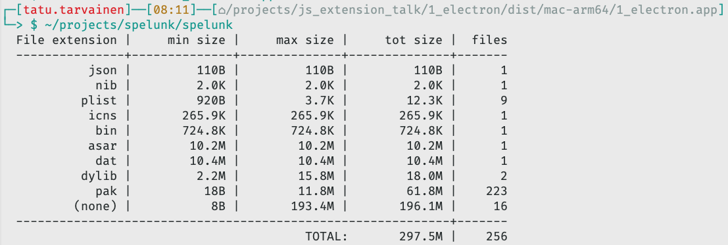

Disk use
Perhaps not that big of a deal
The Mac .app bundle has 287 megabytes of other stuff apart from our app code
Our app assets
(HTML/JS/CSS etc)
Notes:
Who has deployed an electron app?
Talk about R2: electron wrapper that launched postgresql, clojure backend and launched the react UI

Slide 19

BREAKING NEWS
Windows latest:
  Every Windows 11 app should kill Electron, and Discord just showed why: no “Starting” screen and 70% less RAM, even with two accounts signed in
Notes:
So Discord just announced a rust rewrite of their client…
But we don’t need to go that far and ditch JavaScript.

Slide 20
One step further
So perhaps embedding Chromium is not that good
  Each app having its own copy of Chromium (on disk and in memory)
Let’s try something else

Slide 21
WebUI
A light weight library to get a Web view (using the one already present in the OS)
Using a native scaffold, run you webapp
  Can call from native land to JS and vice versa
  https://webui.me

Slide 22
DEMO

Slide 23
WebUI pros & cons
Compared to Electron
  Very small app images
  Somewhat less memory (OS has webview code in memory)
But OS provided webview is more of a moving target (it might be Edge or Safari, depending on what’s available)
Unchanged: still a web app masquerading as a native app
  You can expose C functions (to JS for app services like storage)

Slide 24






We need to go deeper!
Leo in Inception

Slide 25
Rolling our own
JavaScript was of course originally made for the browsers to enhance HTML pages… but we can still ditch HTML

Slide 26
Rolling our own
JavaScript was of course originally made for the browsers to enhance HTML pages… but we can still ditch HTML
What if we rendered with something completely different?

Slide 27
We’ll start with C that will be the main program to launch and control all the other parts
Todo app
main.c

Slide 28
We’ll start with C that will be the main program to launch and control all the other parts
Add a UI ”framework”
  Let’s use microui a small immediate mode UI library
  It’s renderer agnostic, so it doesn’t tie into any drawing library
Implement a small OS specific renderer (Cocoa on Mac)
  Could easily use win32 API in Windows (or X11, OpenGL, Vulkan, etc)
Todo app
microui
Cocoa
main.c

Slide 29
We’ll start with C that will be the main program to launch and control all the other parts
Add a UI ”framework”
  Let’s use microui a small immediate mode UI library
  It’s renderer agnostic, so it doesn’t tie into any drawing library
Implement a small OS specific renderer (Cocoa on Mac)
  Could easily use win32 API in Windows (or X11, OpenGL, Vulkan, etc)
We also need a JavaScript engine, let’s use a small embeddable one: QuickJS
Todo app
QuickJS
microui
Cocoa
main.c

Slide 30
We’ll start with C that will be the main program to launch and control all the other parts
Add a UI ”framework”
  Let’s use microui a small immediate mode UI library
  It’s renderer agnostic, so it doesn’t tie into any drawing library
Implement a small OS specific renderer (Cocoa on Mac)
  Could easily use win32 API in Windows (or X11, OpenGL, Vulkan, etc)
We also need a JavaScript engine, let’s use a small embeddable one: QuickJS
Last, but not least, the actual application logic
  The logic will use microui functions to render the user interface
  All data remains in the JS side
Todo app
app.js logic code
QuickJS
microui
Cocoa
main.c

Slide 31
DEMO

Slide 32
Why roll your own?
Pareto principle applies
  20% of the features bring 80% of the value
  You can make your env that just supports what your app needs with way less code than a general purpose platform

Slide 33
Why roll your own?
Pareto principle applies
  20% of the features bring 80% of the value
  You can make your env that just supports what your app needs with way less code than a general purpose platform
Full control
  We are controlling everything
  Not tied to OS components apart from the graphics system

Slide 34
Further work
Add persistence
  Just include SQLite library, you get a full database in a file
Console
  Either in the terminal, or add UI
Reloading
  Thread to watch the file for changes, reload the JS for instant feedback

Slide 35
Conclusion?
Not being a complete memory hog => GOOD
*BUT* you don’t necessarily need to switch to Rust

