Slide 1
CREO TECHNOLOGIES
INSTRUCTOR-LED CERTIFICATION SERIES
WEEK
2
Databricks Certified
Data Engineer Associate
▸ Data Ingestion & Loading — full coverage (~20%)
▸ Data Transformation & Modeling — cleaning, joins,
dedup, MERGE, data quality (~22%)
▸ Together: 40%+ of your exam, today
Ingestion & Transformation
COPY INTO · Auto Loader · Bronze→Silver · MERGE
Notes:
Open with the 5-question Week 1 retrieval quiz (DROP semantics, CTAS rule, hierarchy, time travel, volume path). Then the hook: who found the duplicates and NULLs in the Week 1 file? That dirty data is today's raw material.

Slide 2
THE SESSION IN ONE QUESTION
How do you load files that keep arriving — safely?
~20%
~22%
2
INGESTION DOMAIN
TRANSFORMATION DOMAIN
TOOLS YOU'LL RUN: COPY INTO + AUTO LOADER
THE THREAD A professional pipeline can be run twice without harm. COPY INTO is idempotent at the FILE level; MERGE at the ROW level; checkpoints make streams exactly-once. Every exam scenario rewards this instinct.
CREO TECHNOLOGIES · DATABRICKS DATA ENGINEER ASSOCIATE
WEEK 2 · JUNE 2026 · 2
Notes:
Frame the whole session: loading once isn't the job; loading repeatedly without ever double-loading is. The answer-word is IDEMPOTENT and it threads every segment today.

Slide 3
WEEK 1 CALLBACK · UNDER THE HOOD
Delta vs Parquet — and where Iceberg fits
PARQUET — A FILE FORMAT
DELTA — A TABLE FORMAT
One file = columns + values, compressed
Same Parquet data files underneath
No history, no transactions, no schema rules
_delta_log = ordered JSON commits = the truth
A folder of Parquet files has no single "truth"
Adds ACID, time travel, schema enforcement
ENRICHMENT · FLAG IT That database icon is physically Parquet files + a _delta_log folder. Iceberg is another table format; Databricks reads/writes it via UniForm + managed Iceberg tables.
CREO TECHNOLOGIES · DATABRICKS DATA ENGINEER ASSOCIATE
WEEK 2 · JUNE 2026 · 3
Notes:
Close the Week 1 threads that lit up the room. The reveal: a 'table' is a folder of Parquet data files plus a _delta_log of ordered JSON commits — that log is what makes it a TABLE format, not just a file format. Parquet alone = no ACID, no history. Iceberg is a peer table format; Databricks interoperates via UniForm (Delta exposes Iceberg-readable metadata) and managed Iceberg tables in Unity Catalog. Exam-relevant: Delta is the DEFAULT format. Iceberg/UniForm = enrichment, label it clearly, do not let it sprawl into a segment.

Slide 4
EXAM DOMAIN 2 · THE SKELETON
The ingestion ladder: managed → custom
LAKEFLOW CONNECT — MANAGED CONNECTORS
MOST MANAGED least code, least control MOST CUSTOM most code, most control
SaaS & databases (Salesforce, SQL Server) — least code
LAKEFLOW SPARK DECLARATIVE PIPELINES
declarative ETL — Auto Loader under the hood
AUTO LOADER · COPY INTO
incremental file ingestion you configure
STRUCTURED STREAMING · JDBC / REST IN NOTEBOOKS
maximum control, maximum maintenance
CREO TECHNOLOGIES · DATABRICKS DATA ENGINEER ASSOCIATE
WEEK 2 · JUNE 2026 · 4
Notes:
Everything in this domain refines one box on this ladder. Many exam questions resolve to: pick the MOST MANAGED thing that satisfies the constraints. ADF translation: managed connectors = copy activity with built-in linked services.

Slide 5
EXAM DOMAIN 2 · VERBATIM OBJECTIVE
COPY INTO — incremental loading in pure SQL
copy_into.sql
Tracks files already-loaded files are skipped
COPY INTO sales_bronze
FROM (SELECT *, current_timestamp() AS _ingested_at
FROM '/Volumes/ws/lab/landing/incoming/')
FILEFORMAT = CSV
FORMAT_OPTIONS ('header' = 'true')
COPY_OPTIONS ('mergeSchema' = 'true');
-- run it again right now:
-- num_inserted_rows = 0 ← idempotent
Retriable + idempotent the exam words
Sweet spot thousands of files, SQL-first, scheduled batch
DAY-BY-DAY Day 1: loads 2 files → Day 2 rerun: 0 rows → new file lands → rerun: loads ONLY the new file.
CREO TECHNOLOGIES · DATABRICKS DATA ENGINEER ASSOCIATE
WEEK 2 · JUNE 2026 · 5
Notes:
Live syntax matters — they write this in the lab. Stress file-tracking semantics: it remembers FILES, not rows. Rerun = 0 rows. Contrast with INSERT INTO SELECT read_files — that double-loads. The trap inverts: a renamed/moved file WILL reload.

Slide 6
UNDER THE HOOD · ENRICHMENT
Where does COPY INTO remember what it loaded?
inspect_copy_into
In the _delta_log each commit lists the files it ingested
DESCRIBE HISTORY sales_bronze;
-- operation = COPY INTO numFiles = 2
-- now list the table's own _delta_log:
ls .../sales_bronze/_delta_log/
-- 00000000000000000000.json commit 0
-- 00000000000000000001.json commit 1
-- each commit's "add" entries name the
-- files already loaded -> reruns skip them
Rerun = 0 rows those paths are already named → skipped
The trap a renamed/moved file is "new" → reloads
EXAM vs ENRICHMENT The exam tests the behavior (idempotent, file-tracked). WHERE it is tracked — the Delta log — is the "why" that makes it stick.
CREO TECHNOLOGIES · DATABRICKS DATA ENGINEER ASSOCIATE
WEEK 2 · JUNE 2026 · 6
Notes:
Tie straight back to Week 1's 'the log IS the table's truth.' COPY INTO records the files it loaded as part of each commit in the target table's own _delta_log — not a separate catalog. That's why rerun = 0 rows. Drill the trap orally: a renamed or moved file looks new (new path), so it reloads; force=true disables the skip entirely. Behavior is exam-tested; the storage location is the enrichment.

Slide 7
EXAM DOMAIN 2 · HEAVYWEIGHT TOPIC
Auto Loader — cloudFiles, four essentials
auto_loader.py
Millions of files directory listing or file notification discovery
(spark.readStream
.format('cloudFiles') # ① Auto Loader
.option('cloudFiles.format','csv')
.option('cloudFiles.schemaLocation',
chk) # ② schema memory
.load(src)
.writeStream
.option('checkpointLocation', chk) # ③ exactly-once
.trigger(availableNow=True) # ④ batch cadence
.toTable('ws.lab.sales_bronze_al'))
Schema evolution addNewColumns: fail → restart picks it up
_rescued_data mismatches kept, not dropped
availableNow streaming tech, batch schedule
CREO TECHNOLOGIES · DATABRICKS DATA ENGINEER ASSOCIATE
WEEK 2 · JUNE 2026 · 7
Notes:
Anatomy drill: readStream + cloudFiles format + schemaLocation (remembered schema) + checkpointLocation (exactly-once bookkeeping) + availableNow (process new files, stop). Scales to millions of files; file-notification mode for extreme volume. _rescued_data catches non-conforming values.

Slide 8
UNDER THE HOOD · ENRICHMENT
Auto Loader's checkpoint is a real folder
inspect_checkpoint
_schemas/ the schema it inferred and remembers
ls .../landing/_checkpoints/sales_al/
-- _schemas/ inferred schema, versioned
-- offsets/ what's been read
-- commits/ what's been processed
-- sources/.../rocksdb/ files-seen index
-- metadata stream id
-- delete this folder = amnesia:
-- next run reprocesses every file
offsets + commits stream progress = exactly-once
RocksDB the embedded index of files already seen
Delete it = amnesia the next run reprocesses everything
CREO TECHNOLOGIES · DATABRICKS DATA ENGINEER ASSOCIATE
WEEK 2 · JUNE 2026 · 8
Notes:
Make 'checkpoint = exactly-once' physical. schemaLocation persists the inferred schema under _schemas/ (versioned); the checkpoint tracks processed files via offsets/, commits/, and an embedded RocksDB index under sources/. This is the concrete answer to 'how does it know it already saw that file?' Deleting the checkpoint folder = the stream reprocesses from scratch. Enrichment — the exam tests the concept and _rescued_data, not the folder layout.

Slide 9
THE EXAM'S FAVORITE FORK
COPY INTO vs. Auto Loader
 | COPY INTO | Auto Loader
Language | SQL statement | PySpark Structured Streaming (cloudFiles)
Scale | Thousands of files | Millions of files
Discovery | Lists source path per run | Directory listing or file notification
Schema drift | mergeSchema option | Inference + evolution + _rescued_data
Cadence | Scheduled batch | Continuous or availableNow batch
Exam keywords | “SQL command” · “rerun-safe” | “millions of files” · “evolving schema” · “low latency”
TIEBREAK Modest volume + SQL-only team → COPY INTO. Anything with scale, drift, or streaming words → Auto Loader.
CREO TECHNOLOGIES · DATABRICKS DATA ENGINEER ASSOCIATE
WEEK 2 · JUNE 2026 · 9
Notes:
Two-question discriminator: (1) how many files / how often? (2) does schema drift or latency matter? Both are current and exam-listed. 'Best' = simplest tool that satisfies every stated constraint.

Slide 10
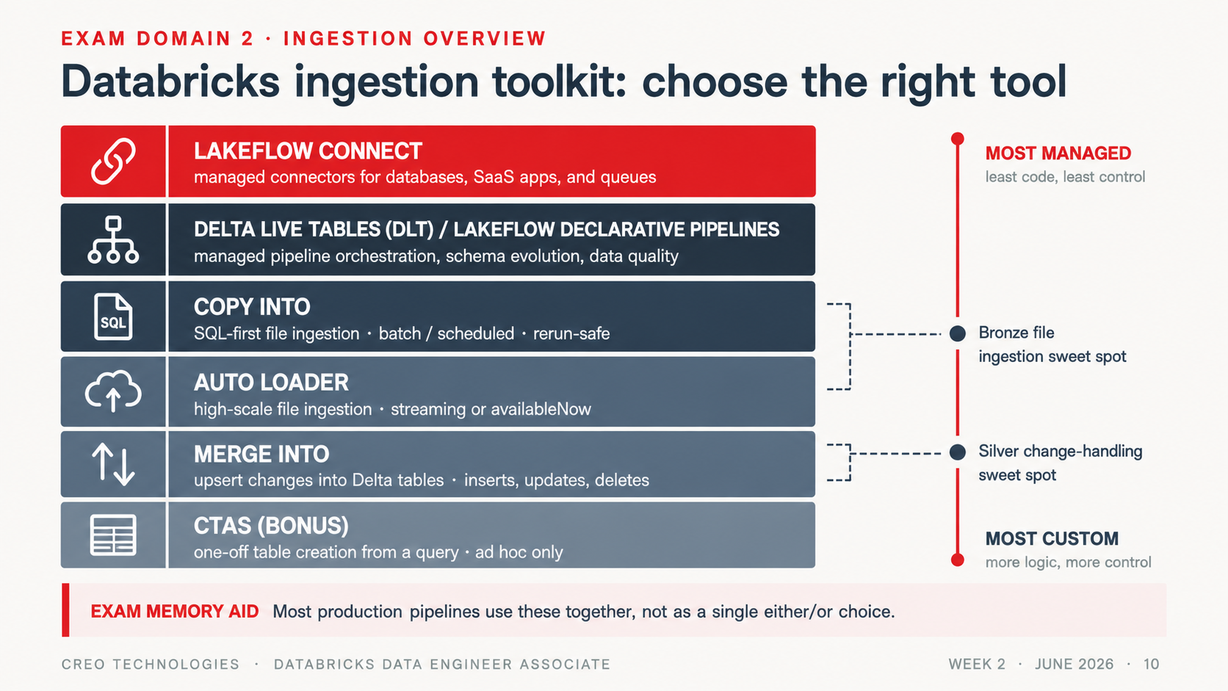
Notes:
Two-question discriminator: (1) how many files / how often? (2) does schema drift or latency matter? Both are current and exam-listed. 'Best' = simplest tool that satisfies every stated constraint.

Slide 11
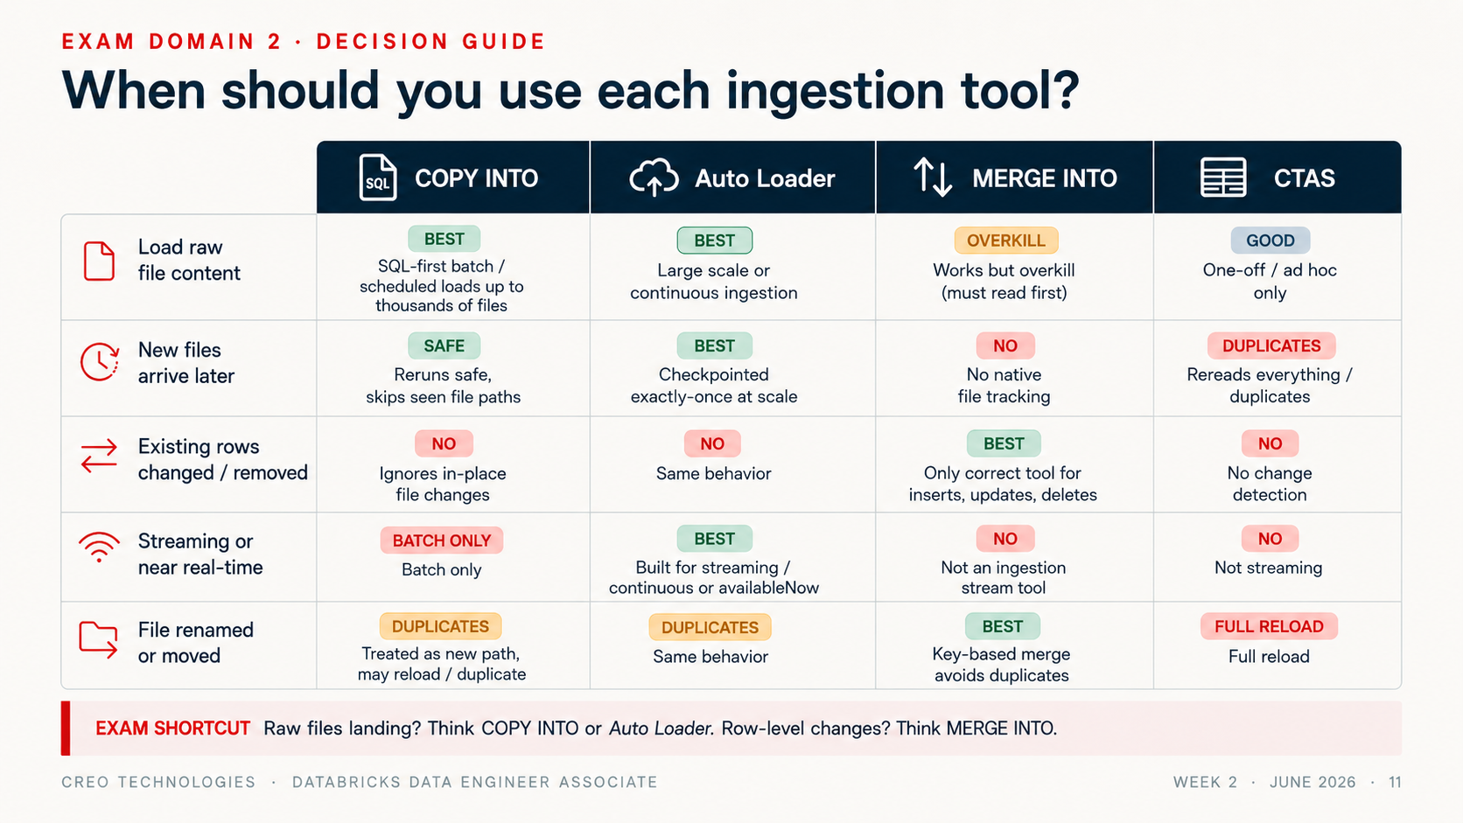
Notes:
Two-question discriminator: (1) how many files / how often? (2) does schema drift or latency matter? Both are current and exam-listed. 'Best' = simplest tool that satisfies every stated constraint.

Slide 12
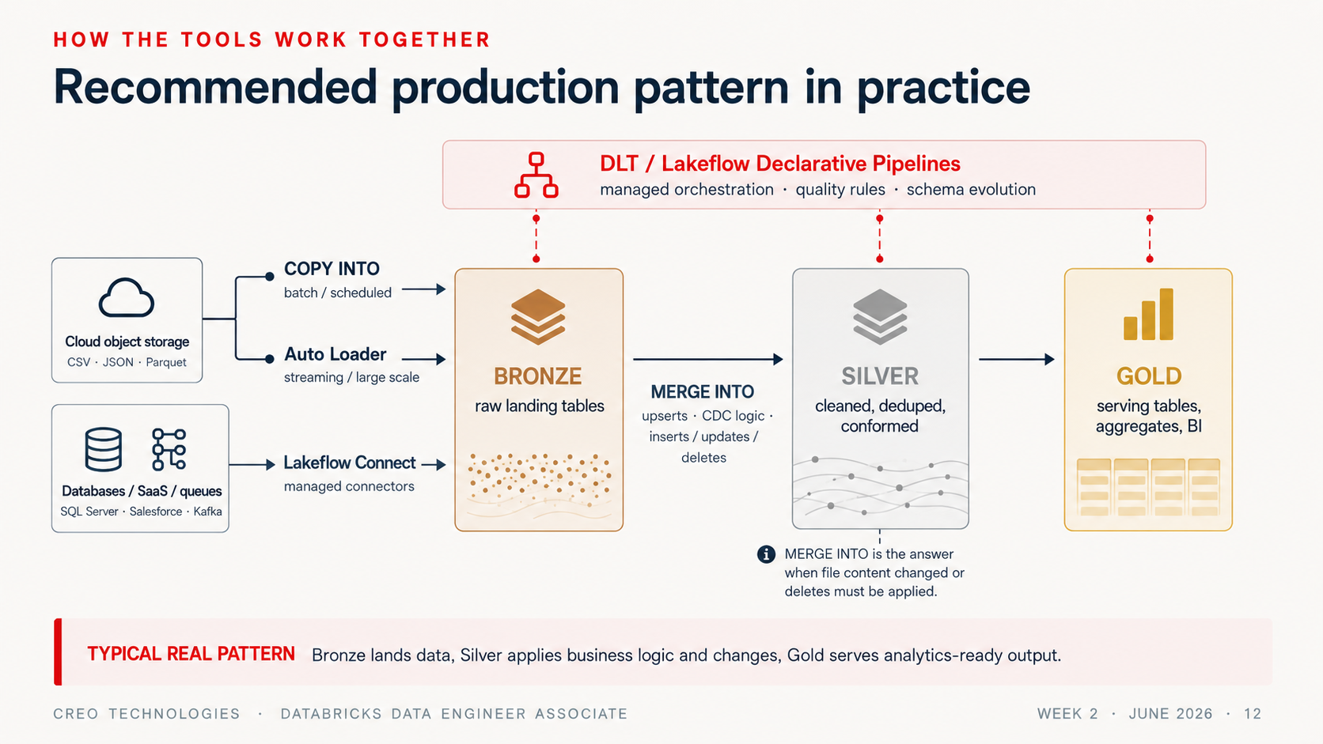
Notes:
Two-question discriminator: (1) how many files / how often? (2) does schema drift or latency matter? Both are current and exam-listed. 'Best' = simplest tool that satisfies every stated constraint.

Slide 13
EXAM DOMAIN 2 · CONCEPT (PAID FEATURE)
Lakeflow Connect, partners, and DIY
1
2
Managed connectors
Standard connectors
Salesforce, SQL Server, enterprise SaaS — fully managed into UC tables. “Zero engineering” is the trigger phrase.
Built-in connectors for files and queues that you configure and operate.
3
4
Partner connectors
JDBC / REST in notebooks
Fivetran & friends — when the org already standardized on a partner stack.
Custom APIs and auth — your code, landed in volumes/tables, scheduled with Lakeflow Jobs.
EXAM CONCEPT Managed connectors require enterprise sources + paid infrastructure — concept-only in Free Edition, fully testable on the exam.
CREO TECHNOLOGIES · DATABRICKS DATA ENGINEER ASSOCIATE
WEEK 2 · JUNE 2026 · 10
Notes:
Free Edition can't demo managed connectors — label it: exam concept. What the exam wants: given source type + effort budget, pick the layer. JDBC/REST in a notebook is a LEGITIMATE exam answer when no connector exists — scheduled by Lakeflow Jobs.

Slide 14
EXAM DOMAINS 2 & 3
Semi-structured data: store nested, query nested
nested_json.sql
STRUCT contact.city — dot path on parsed data
SELECT customer_id,
contact.city AS city, -- dot into STRUCT
explode(favorite_categories)
AS fav_category -- ARRAY -> rows
FROM read_files(
'/Volumes/.../customers.json',
format => 'json');
-- 1 customer x 3 categories = 3 rows
ARRAY explode() = one row per element
Trap explode does NOT flatten structs — arrays only
CREO TECHNOLOGIES · DATABRICKS DATA ENGINEER ASSOCIATE
WEEK 2 · JUNE 2026 · 11
Notes:
Mental shift for warehouse people: don't pre-flatten JSON into staging tables. Dot syntax digs into parsed STRUCTs (colon digs into raw JSON strings). explode() expands ARRAYS into rows — verbatim outline item.

Slide 15
THE BRONZE/SILVER CONTRACT
Enforce by default, evolve on purpose
BRONZE — THE OPEN DOOR
SILVER — THE BOUNCER
Schema evolution ON (mergeSchema / addNewColumns)
Enforcement: mismatched writes are REJECTED
_rescued_data as the safety net
NOT NULL + CHECK constraints as contracts
All strings + audit columns — type later
Typed, deduplicated, validated
EXAM ANSWER SHAPE “Where do you absorb schema drift?” Bronze. “Where do you enforce?” Silver and gold. One sentence, many questions.
CREO TECHNOLOGIES · DATABRICKS DATA ENGINEER ASSOCIATE
WEEK 2 · JUNE 2026 · 12
Notes:
Attach the Week 1 concept to each tool. The design pattern answers a family of exam questions: bronze absorbs drift (evolution + rescue), silver is a contract (enforcement + constraints). Oral check: new column arrives, default Auto Loader settings — what happens?

Slide 16
EXAM DOMAIN 3 · VERBATIM OBJECTIVE
Bronze → silver: the same moves, two dialects
silver.sql
silver.py
-- SQL
CREATE OR REPLACE TABLE sales_silver AS
SELECT DISTINCT
CAST(order_date AS DATE) AS order_date,
CAST(quantity AS INT) AS quantity,
ROUND(quantity*unit_price,2) AS line_total
FROM sales_bronze
WHERE order_id IS NOT NULL;
# PySpark — same pipeline
(spark.table('sales_bronze')
.where(col('order_id').isNotNull())
.withColumn('order_date',
to_date('order_date'))
.withColumn('quantity',
col('quantity').cast('int'))
.dropDuplicates(['order_id']))
FLUENCY RULE Exam code is SQL when possible, Python otherwise — read withColumn, na.drop, where as fast as you read SELECT.
CREO TECHNOLOGIES · DATABRICKS DATA ENGINEER ASSOCIATE
WEEK 2 · JUNE 2026 · 13
Notes:
The new exam tests PySpark DataFrame reading fluency. Show the mapping once and it clicks. NULL arithmetic callback: quantity * unit_price is NULL if either side is NULL — they saw this in Week 1's stretch.

Slide 17
EXAM DOMAIN 3 · VERBATIM LIST
Joins, broadcast, and the UNION trap
Inner · left · cross · multi-key ON a.k1 = b.k1 AND a.k2 = b.k2
UNION BEHAVIOR
Operation | Dedupes?
UNION (SQL) | Yes
UNION ALL | No
df.union() | No — by position!
unionByName() | No — by name
Broadcast join small table copied to every executor — no big-side shuffle (auto under ~10MB threshold, or hint)
Anti-join idiom LEFT JOIN ... WHERE right.key IS NULL → find non-matches
TRAP “UNION is just faster UNION ALL” — backwards. UNION pays a dedup cost; UNION ALL is the cheap one.
CREO TECHNOLOGIES · DATABRICKS DATA ENGINEER ASSOCIATE
WEEK 2 · JUNE 2026 · 14
Notes:
Two exam hooks. Broadcast: small-dim-to-big-fact eliminates the shuffle of the large side (returns in Week 4's Spark UI). UNION trap, three facts: SQL UNION dedupes; UNION ALL doesn't; PySpark df.union() does NOT dedupe and matches BY POSITION.

Slide 18
EXAM DOMAIN 3 · OFFICIAL SAMPLE Q1 TERRITORY
Deduplication and aggregation, exam-style
dedup_agg.sql
DISTINCT identical rows — either survives
-- keep the LATEST row per key
SELECT * FROM (
SELECT *, ROW_NUMBER() OVER (
PARTITION BY customer_id
ORDER BY updated_at DESC) AS rn
FROM updates) WHERE rn = 1;
-- fast approximate cardinality
SELECT approx_count_distinct(user_id)
FROM billions_of_rows;
ROW_NUMBER = 1 you choose the survivor
dropDuplicates(['k']) arbitrary row per key
approx_count_distinct speed for a small bounded error
CREO TECHNOLOGIES · DATABRICKS DATA ENGINEER ASSOCIATE
WEEK 2 · JUNE 2026 · 15
Notes:
The retired official sample (hospital billing) is exactly groupBy + sum + count_distinct with correct aliases — its trap is counting the WRONG COLUMN. Dedup decision: DISTINCT for identical rows; ROW_NUMBER when you must control WHICH duplicate survives.

Slide 19
EXAM DOMAIN 3 · CORE DML
MERGE INTO — the idempotent upsert
merge.sql
Atomic one transaction, one version
MERGE INTO sales_silver AS t
USING corrections AS s
ON t.order_id = s.order_id
WHEN MATCHED THEN UPDATE SET *
WHEN NOT MATCHED THEN INSERT *;
-- rerun it: converges to the same state
-- (matched rows rewrite identical values)
Use for corrections, CDC apply, upserts
vs INSERT append-only, duplicates on rerun
Trap duplicate source keys → error
CREO TECHNOLOGIES · DATABRICKS DATA ENGINEER ASSOCIATE
WEEK 2 · JUNE 2026 · 16
Notes:
Position MERGE as 'the source sent us fixes' — exactly today's lab. One atomic statement, one new table version. Famous failure: multiple source rows matching one target row errors out — dedupe the source first.

Slide 20
UNDER THE HOOD · ENRICHMENT
What MERGE actually does to your files
after_merge
Copy-on-write a changed row rewrites its whole Parquet file
DESCRIBE HISTORY sales_silver;
-- operation = MERGE
-- numTargetRowsUpdated = 2
-- numTargetRowsInserted = 3
-- numTargetFilesRemoved = 1 (old)
-- numTargetFilesAdded = 1 (rewrite)
-- copy-on-write: a changed row rewrites
-- its whole Parquet file -> new commit
-- (deletion vectors defer the rewrite)
New commit old files removed, new added in _delta_log
Deletion vectors modern default: soft-delete, skip the rewrite
Why a new version time travel + idempotency, made physical
CREO TECHNOLOGIES · DATABRICKS DATA ENGINEER ASSOCIATE
WEEK 2 · JUNE 2026 · 17
Notes:
The payoff slide for the idempotency thread. Classic Delta MERGE is copy-on-write: a single changed row forces a rewrite of the entire Parquet file containing it, recorded as one atomic commit (old files removed, new files added). That's WHY it produces a new version and why rerun converges. Modern runtimes default managed tables to deletion vectors (merge-on-read): the row is soft-deleted via a tiny side file, deferring the rewrite to OPTIMIZE. Teach copy-on-write as the model; mention deletion vectors as the optimization. Exam tests behavior, not storage mechanism.

Slide 21
EXAM DOMAIN 3 · DATA QUALITY
The data-quality escalation ladder
QUERY
CHECKS
CONSTRAINTS
QUARANTINE
LDP
EXPECTATIONS
→
→
→
cheap, manual,
advisory
NOT NULL · CHECK
violating write FAILS
bad rows split out,
pipeline keeps flowing
declarative: warn /
drop / fail + metrics
THE DISTRACTOR PAIR “A CHECK constraint drops the bad rows.” FALSE — it rejects the whole transaction. Expectations with a DROP policy (Lakeflow Spark Declarative Pipelines) are the thing that drops rows. Exam concept: LDP hands-on depth comes via pipelines, syntax shown in Week 3.
CREO TECHNOLOGIES · DATABRICKS DATA ENGINEER ASSOCIATE
WEEK 2 · JUNE 2026 · 18
Notes:
Verbatim objective: apply quality checks for reliable silver/gold. Key distinction the exam tests: a CHECK violation ABORTS THE ENTIRE WRITE — it does not skip bad rows. Skipping gracefully is the quarantine pattern or declarative expectations with a DROP policy.

Slide 22
EXAM READINESS
Keyword → tool: how today gets tested
When the stem says… | The answer is usually…
“millions of files” · “evolving schema” · “near-real-time” | Auto Loader (file notification at extreme scale)
“SQL command” · “nightly batch” · “rerun must be safe” | COPY INTO
“Salesforce / SQL Server” · “minimal engineering” | Lakeflow Connect managed connector
“custom REST API” · “special auth” | Notebook client + Lakeflow Jobs schedule
“corrected records arrived” · “apply changes” | MERGE INTO (it's DML, not ingestion!)
“keep most recent per key” | ROW_NUMBER() OVER (PARTITION BY … ORDER BY … DESC) = 1
CAMEO Know the four tuning parameter names (shuffle.partitions, parallelism, executor/driver memory, autoBroadcastJoinThreshold) — full story Week 4.
CREO TECHNOLOGIES · DATABRICKS DATA ENGINEER ASSOCIATE
WEEK 2 · JUNE 2026 · 19
Notes:
Model one elimination: '~200 CSV files nightly, SQL, rerun-safe' — Auto Loader works but isn't BEST (stem says SQL + modest volume); INSERT SELECT isn't rerun-safe; managed connector is for SaaS, not files → COPY INTO. Tuning parameters get one mention (Week 4 depth).

Slide 23
WEEK 2 COMPLETE
Your pipeline is now rerunnable
COPY INTO + Auto Loader: incremental, file-tracked, exactly-once
NEXT
Bronze absorbs drift; silver enforces contracts
Lakeflow Jobs +
CI/CD —
schedule it,
break it,
repair it
MERGE applies corrections idempotently — run it twice, same state
Quality: constraints reject, quarantine preserves, expectations declare
CREO TECHNOLOGIES · DATABRICKS DATA ENGINEER ASSOCIATE
WEEK 2 · JUNE 2026 · 20
Notes:
Close on idempotency: ask the room where it came from at each step (file tracking, checkpoints, MERGE keys). Tease Week 3: 'you'll stop running these cells by hand.' Homework: ingestion docs + PySpark mirror exercise.

