Slide 1
CREO TECHNOLOGIES
INSTRUCTOR-LED CERTIFICATION SERIES
WEEK
1
Databricks Certified
Data Engineer Associate
▸ Databricks Intelligence Platform
▸ Data Transformation & Modeling — DDL foundations
▸ Governance & Security — managed vs. external (seeded)
Lakehouse Foundations
Delta Lake · Unity Catalog · Table Fundamentals
Notes:
Welcome. Set the contract: this is a certification bridge for working data engineers, not a beginner course. Audience includes Creo client guests — keep Azure translations friendly but Databricks-first. Exam: May 4, 2026 guide, 45 questions, 90 minutes.

Slide 2
THE CERTIFICATION
What this exam actually is
45
90
7
$200
2 yrs
SCORED QUESTIONS
MINUTES
EXAM DOMAINS
REGISTRATION
VALIDITY
DON'T GET TRICKED The May 4, 2026 guide added CI/CD and reorganized everything. Most online question banks target the old 5-domain exam — they miss entire domains.
Code in the exam: SQL when possible, Python otherwise — you need reading fluency in both.
CREO TECHNOLOGIES · DATABRICKS DATA ENGINEER ASSOCIATE
WEEK 1 · JUNE 2026 · 2
Notes:
Warn learners off stale prep material: the exam changed May 4, 2026 — 7 domains now, including a brand-new CI/CD domain. Code is SQL when possible, Python otherwise. Pace math: 2 minutes per question.

Slide 3
THE PROGRAM
Five Fridays, seven domains
W1
W2
W3
Lakehouse Foundations
Ingestion + Transformation
Jobs + CI/CD
Platform · Delta · Unity Catalog · tables & views
COPY INTO · Auto Loader · bronze→silver · MERGE (~40%+ of exam)
Lakeflow Jobs · triggers · Git folders · Automation Bundles
W4
W5
→
Governance + Optimization
Capstone + Mock
Every Friday, same rhythm
GRANT/DENY · masks · Spark UI · Liquid Clustering
End-to-end build · 45-question mock · exam strategy
Recap → concepts → live demo → hands-on lab → activity → quiz
CREO TECHNOLOGIES · DATABRICKS DATA ENGINEER ASSOCIATE
WEEK 1 · JUNE 2026 · 3
Notes:
Show where each exam domain lives in the course. Today seeds three domains. Weights are estimates aligned to the official objective counts.

Slide 4
FOR ADF · SYNAPSE · FABRIC ENGINEERS
Translate your vocabulary
What you say today | What Databricks calls it | Watch out for
ADF pipeline | Lakeflow Jobs (orchestration) | Code-adjacent tasks, not drag-and-drop activities
ADF copy activity / linked service | Lakeflow Connect connectors | Managed connectors = least engineering
Synapse dedicated SQL pool | SQL warehouse on Delta tables | No separate warehouse engine or data copy
Fabric OneLake + shortcuts | Unity Catalog + external locations | One governance tree across all workspaces
Fabric Lakehouse / Warehouse split | One lakehouse, one format (Delta) | Same tables serve every workload
CREO TECHNOLOGIES · DATABRICKS DATA ENGINEER ASSOCIATE
WEEK 1 · JUNE 2026 · 4
Notes:
Two minutes max — this buys trust, not exam points. Key warning: answering exam questions with Azure mental models is this audience's #1 source of wrong answers. Fabric users already know Delta — their instincts transfer well.

Slide 5
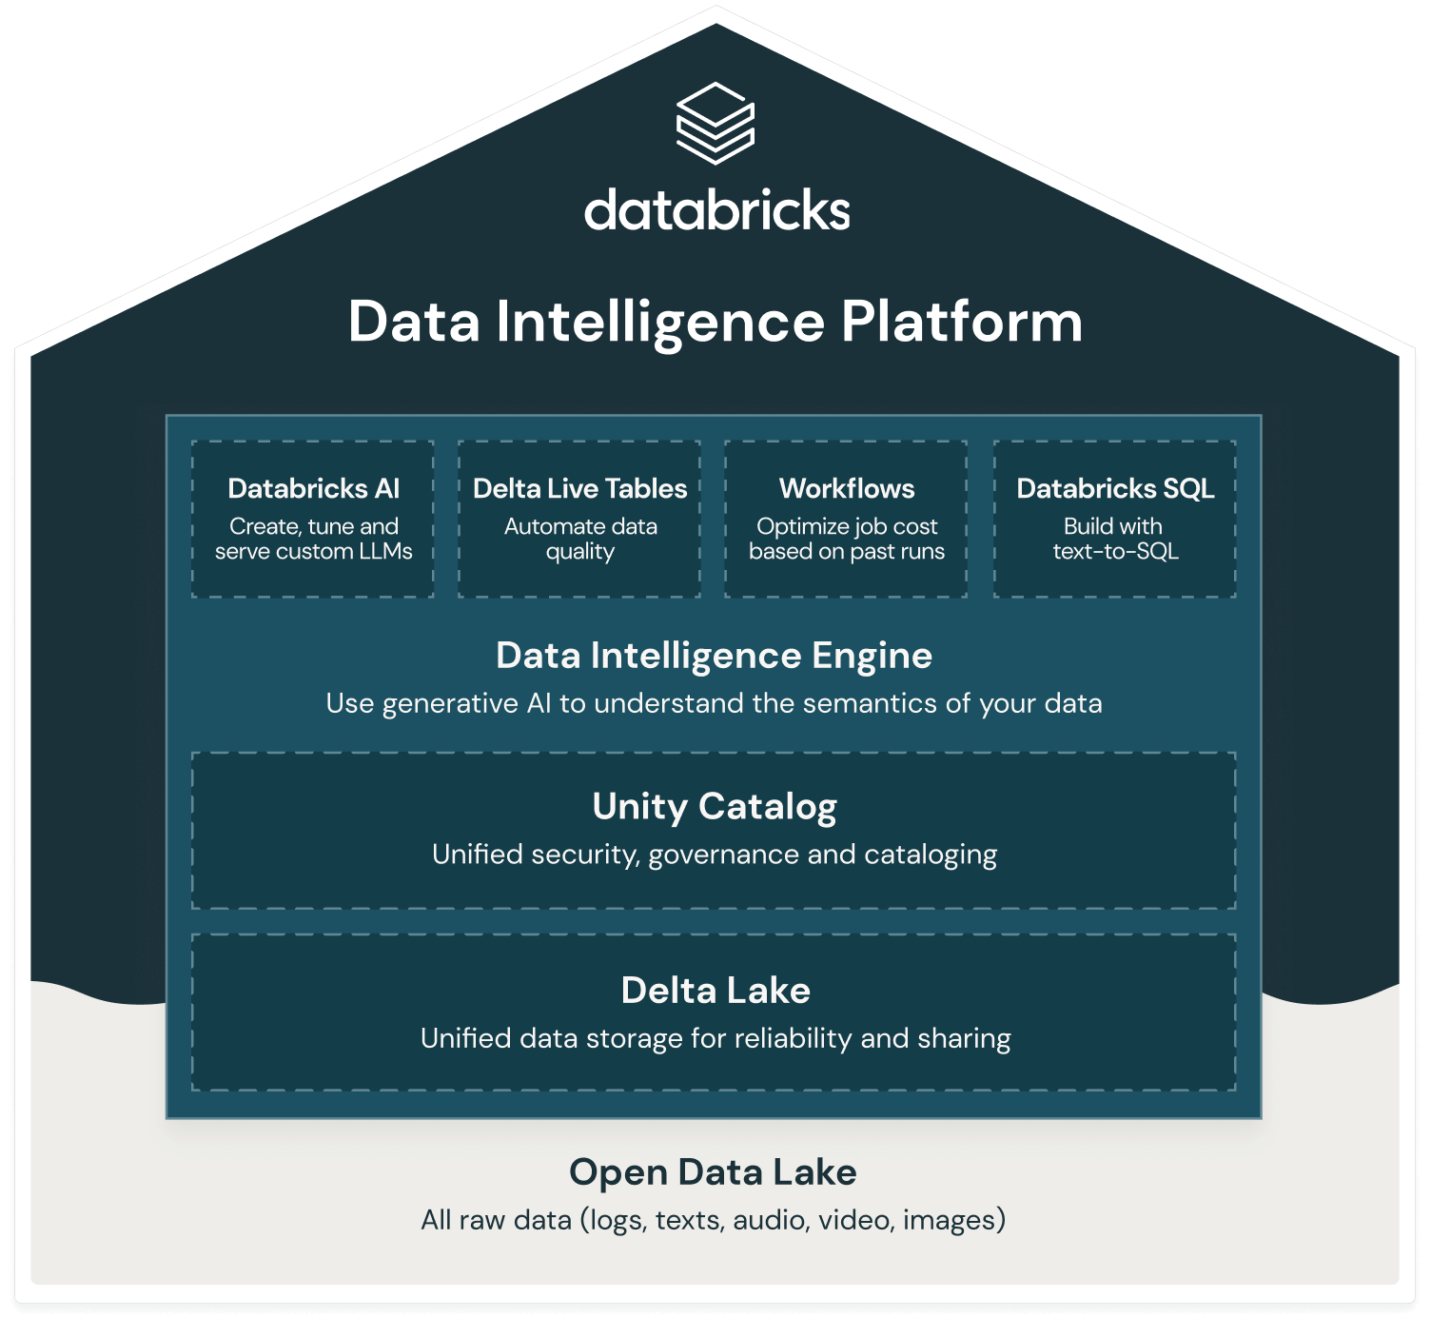
EXAM DOMAIN 1
The lakehouse
Notes:
One level up, this is how Databricks markets the Data Intelligence Platform: Databricks AI, Delta Live Tables, Workflows, and Databricks SQL sit on a Data Intelligence Engine, all governed by Unity Catalog and backed by Delta Lake on an open data lake.

Slide 6
EXAM DOMAIN 1
The lakehouse, layer by layer
One copy of data open Parquet + Delta in your cloud account — no warehouse/lake split
THE STACK
WORKLOADS — ETL · SQL/BI · Streaming · ML/AI
Unified governance Unity Catalog secures every table, file, and model in one tree
COMPUTE — SQL warehouses · serverless · clusters
Every workload, same tables ETL, SQL/BI, streaming, and ML hit identical data
UNITY CATALOG — governance & lineage
DELTA LAKE — ACID on open Parquet
Open formats = no lock-in external engines can read your tables
CLOUD OBJECT STORAGE — S3 · ADLS · GCS
CREO TECHNOLOGIES · DATABRICKS DATA ENGINEER ASSOCIATE
WEEK 1 · JUNE 2026 · 5
Notes:
Let’s peel this picture apart into layers so we can name exactly what each part of the lakehouse does
In layer form, we’ve got one copy of data in open Parquet plus Delta in your cloud account, Unity Catalog for unified governance, every workload hitting the same tables, and open formats so other engines can read your data
Domain 1 core. Why the lakehouse exists: warehouses gave ACID + performance but closed formats and copies; lakes gave cheap open storage but no reliability. Delta on object storage closes the gap. 'Data Intelligence Platform' = this stack plus the AI layer. Keep returning to this diagram all course.

Slide 7
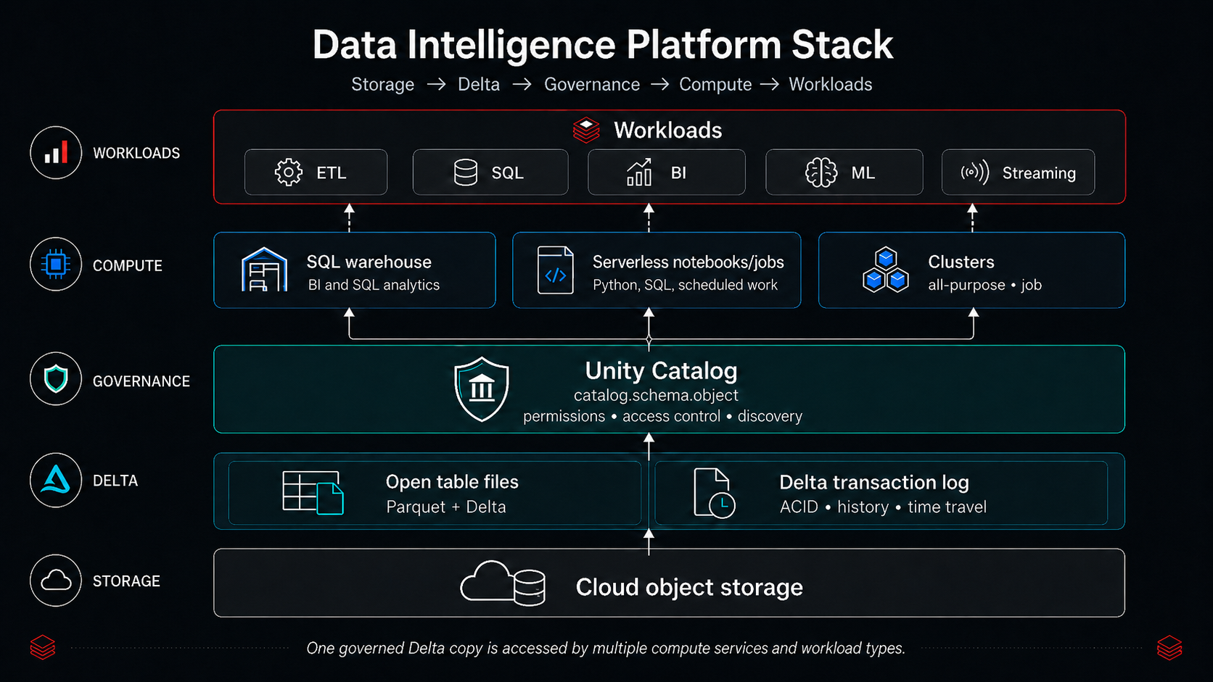
Notes:
Now I’ll show a more detailed stack view that adds the concrete compute pieces Databricks gives us on top of these layers.
This stack diagram maps those layers to actual components: cloud object storage at the bottom; Delta Lake tables with a transaction log; Unity Catalog as governance; and above that, the compute layer—SQL warehouses, serverless notebooks/jobs, and clusters—running ETL, SQL/BI, ML, and streaming workloads against the same data.

Slide 8
EXAM DOMAIN 1
Pick the right compute for the job
1
2
Serverless SQL warehouse
Serverless compute (notebook / job)
SQL analytics, BI, dashboards. Instant start, auto-scaling. SQL-only teams' default.
Python + SQL without cluster management. Hands-off, auto-optimized — exam keyword.
3
4
All-purpose cluster
Job cluster / job compute
Interactive development, shared by humans. Lingers — more expensive per job. (Concept on Free Edition.)
Created per run, terminated after. THE production answer on cost grounds. (Concept on Free Edition.)
COMMON TRAP “All-purpose clusters for production because they're always on” — backwards. Job compute terminates; that's why it wins.
CREO TECHNOLOGIES · DATABRICKS DATA ENGINEER ASSOCIATE
WEEK 1 · JUNE 2026 · 6
Notes:
Serverless SQL warehouse — Best for SQL analytics, BI, and dashboards; Databricks manages scaling and startup.
Serverless compute — For notebooks, jobs, and pipelines without cluster management; fully managed option when available.
All-purpose cluster — Best for interactive development, exploration, and debugging; can stay running, so usually costs more if used for scheduled workloads.
Job cluster / job compute — Created for a job run and terminated after completion; common exam answer for scheduled ETL and cost-efficient production batch workloads.
Given all these compute options, the natural question is: which one should you pick for a given job, especially on the exam?
Finally, here’s how to choose compute: serverless SQL warehouses for BI and SQL dashboards; serverless notebook/job compute for Python and SQL without managing clusters; all‑purpose clusters for interactive, shared development; and job clusters as the cost‑efficient production default.
The exam loves 'which compute should they use?' Decision logic: workload type, interactivity, cost. Free Edition is serverless-only (one 2X-Small SQL warehouse) — cluster configuration is exam-concept only here. Serverless's exam keyword: hands-off, auto-optimized.

Slide 9
EXAM DOMAIN 1 · DELTA LAKE
A Delta table is just files — plus a log
Parquet + _delta_log ordered JSON commits + checkpoints are the source of truth
INSIDE THE TABLE DIRECTORY
my_table/
ACID on object storage readers always see the latest committed snapshot
part-0001.parquet
part-0002.parquet
Default format USING DELTA is implicit — an exam-tested fact
_delta_log/
00000.json ← v0 commit
Open standard readable by non-Databricks engines
00001.json ← v1 commit
the log IS the table's truth
CREO TECHNOLOGIES · DATABRICKS DATA ENGINEER ASSOCIATE
WEEK 1 · JUNE 2026 · 7
Notes:
Demystify: Parquet data files + _delta_log transaction log. The ordered log records every add/remove — that's what gives ACID, consistent reads, and versions. Delta is the DEFAULT format: CREATE TABLE with no USING clause makes a Delta table. Open source, not proprietary.

Slide 10
EXAM DOMAIN 3 · DELTA DML
History, time travel, and the undo button
time_travel.sql
Versioned writes free audit trail per table
-- every write = a new version
DESCRIBE HISTORY sales_raw;
-- read the past
SELECT * FROM sales_raw VERSION AS OF 0;
SELECT * FROM sales_raw
TIMESTAMP AS OF '2026-06-01';
-- the undo button
RESTORE TABLE sales_raw TO VERSION AS OF 0;
Schema enforcement mismatched writes are rejected by default
Evolution is opt-in mergeSchema and friends — Week 2
VACUUM limits travel removed files = unreachable versions
CREO TECHNOLOGIES · DATABRICKS DATA ENGINEER ASSOCIATE
WEEK 1 · JUNE 2026 · 8
Notes:
Because the log records every version: query the past, audit changes, roll back mistakes. Schema enforcement = warehouse-grade safety (bad writes fail). VACUUM bounds how far back you can travel — one sentence now, depth in Week 4.

Slide 11
EXAM DOMAINS 1 & 7
Unity Catalog: one tree, three-level names
catalog.schema.object the three-level namespace — say it on every query
THE HIERARCHY
METASTORE
One metastore account-level governance; workspaces share it
workspace
samples
Securables tables, views, volumes, functions, models
lab1_you (schema)
TABLES
& VIEWS
VOLUMES
(files)
FUNCTIONS
What UC adds GRANTs, auditing, lineage, discovery
CREO TECHNOLOGIES · DATABRICKS DATA ENGINEER ASSOCIATE
WEEK 1 · JUNE 2026 · 9
Notes:
The single most reused mental model of the course: metastore → catalog → schema → securables, addressed catalog.schema.object. In Free Edition labs everything lives in workspace.<your_schema>; samples is read-only shared data. Privileges inherit DOWN the tree — Week 4 builds on this.

Slide 12
EXAM DOMAIN 7 · GUARANTEED TOPIC
Managed vs. external tables
MANAGED (DEFAULT + RECOMMENDED)
EXTERNAL
UC controls metadata AND data files
UC controls metadata ONLY — your storage path
DROP TABLE deletes the data (UNDROP window)
DROP TABLE removes metadata; files remain
Unlocks predictive optimization
For shared estates & hard location requirements
EXAM REFLEX DESCRIBE EXTENDED → find Type: MANAGED or EXTERNAL, then predict what DROP does. Two questions live here.
CREO TECHNOLOGIES · DATABRICKS DATA ENGINEER ASSOCIATE
WEEK 1 · JUNE 2026 · 10
Notes:
The #1 gotcha for warehouse people. Drill DROP behavior both directions orally. Why managed is recommended: Databricks owns layout → automatic optimization. Free Edition has no external locations — external tables are exam-concept only here. Conversion exists (Week 4).

Slide 13
EXAM DOMAINS 2 & 7
Volumes: governed storage for files
Non-tabular data landing CSVs/JSON, images, libraries
volumes.sql
-- the path shape (memorize)
/Volumes/<catalog>/<schema>/<volume>/...
SELECT * FROM read_files(
'/Volumes/workspace/lab1_you/
landing/sales.csv',
format => 'csv', header => true);
Same governance a securable in the schema, like a table
Not queryable directly query files IN it via read_files()
TRAP SELECT * FROM my_volume fails — a volume is not a table. Load it or read_files it.
CREO TECHNOLOGIES · DATABRICKS DATA ENGINEER ASSOCIATE
WEEK 1 · JUNE 2026 · 11
Notes:
Volumes killed the 'random files in DBFS' anti-pattern. Tables govern tabular data; volumes govern everything else, same catalog.schema.volume addressing. Say the path out loud: slash-Volumes-catalog-schema-volume. Labs stage every file here.

Slide 14
EXAM DOMAIN 3 · MOST-TESTED SYNTAX
CREATE TABLE, CTAS, OR REPLACE
ddl_patterns.sql
CTAS rule cannot declare (col TYPE) — eliminate any option that does
-- explicit schema, empty table
CREATE OR REPLACE TABLE t (id INT, amt DOUBLE);
-- CTAS: create AND populate, schema inferred
CREATE TABLE t2 AS
SELECT CAST(order_date AS DATE) AS order_date,
fare_amount
FROM samples.nyctaxi.trips;
-- no-op if t3 already exists (not a refresh!)
CREATE TABLE IF NOT EXISTS t3 (id INT);
OR REPLACE atomic, idempotent, history preserved
Delta by default no USING clause needed
CREO TECHNOLOGIES · DATABRICKS DATA ENGINEER ASSOCIATE
WEEK 1 · JUNE 2026 · 12
Notes:
Two of five official sample questions test exactly this. Drill the CTAS rule: schema comes FROM the query — no column-type list allowed; CAST in the SELECT. OR REPLACE is atomic and keeps history. IF NOT EXISTS does NOTHING if the table exists.

Slide 15
EXAM DOMAIN 3 · GOLD OBJECTS
View, temp view, materialized view, streaming table
Object | Stores data? | Freshness at read | Visibility | Choose when
View | No — stored query | Always current | Governed in UC | Reusable logic, cheap reads
Temp view | No | Always current | Your session only | Scratch work, dies with session
Materialized view | Yes — precomputed | As of last refresh | Governed in UC | Expensive query, frequent reads
Streaming table | Yes — incremental | Continuously appended | Governed in UC | Append-only ingestion
CLASSIC QUESTION “A colleague can't see your view” → it was a TEMP view. Session-scoped, invisible to others.
CREO TECHNOLOGIES · DATABRICKS DATA ENGINEER ASSOCIATE
WEEK 1 · JUNE 2026 · 13
Notes:
The exam twist: choosing among all four for a gold-layer scenario. Heuristics — expensive dashboard aggregation hit often: MV. Always-current logic wrapper: view. Session scratch: temp view. Incremental append ingestion: streaming table. MVs can serve STALE data between refreshes.

Slide 16
EXAM DOMAIN 3 · NAMED OBJECTIVE
Medallion architecture: bronze → silver → gold
SOURCES
BRONZE
SILVER
GOLD
BI · ML
→
→
→
→
files · APIs · DBs
raw, as-ingested
preserves fidelity
cleaned, deduped,
typed, validated
aggregated,
business-shaped
consumers
MISCONCEPTION TO KILL “Bronze should be cleaned a little so it's usable.” No — cleansing belongs in silver. Bronze stays raw so you can always replay. The exam asks for each layer's PURPOSE.
CREO TECHNOLOGIES · DATABRICKS DATA ENGINEER ASSOCIATE
WEEK 1 · JUNE 2026 · 14
Notes:
Progressive refinement with replayability: if silver logic was wrong, rebuild from bronze without re-extracting. Bronze's value IS its rawness — pre-cleaning bronze destroys the replay story. This is the course spine; Week 2 builds it for real.

Slide 17
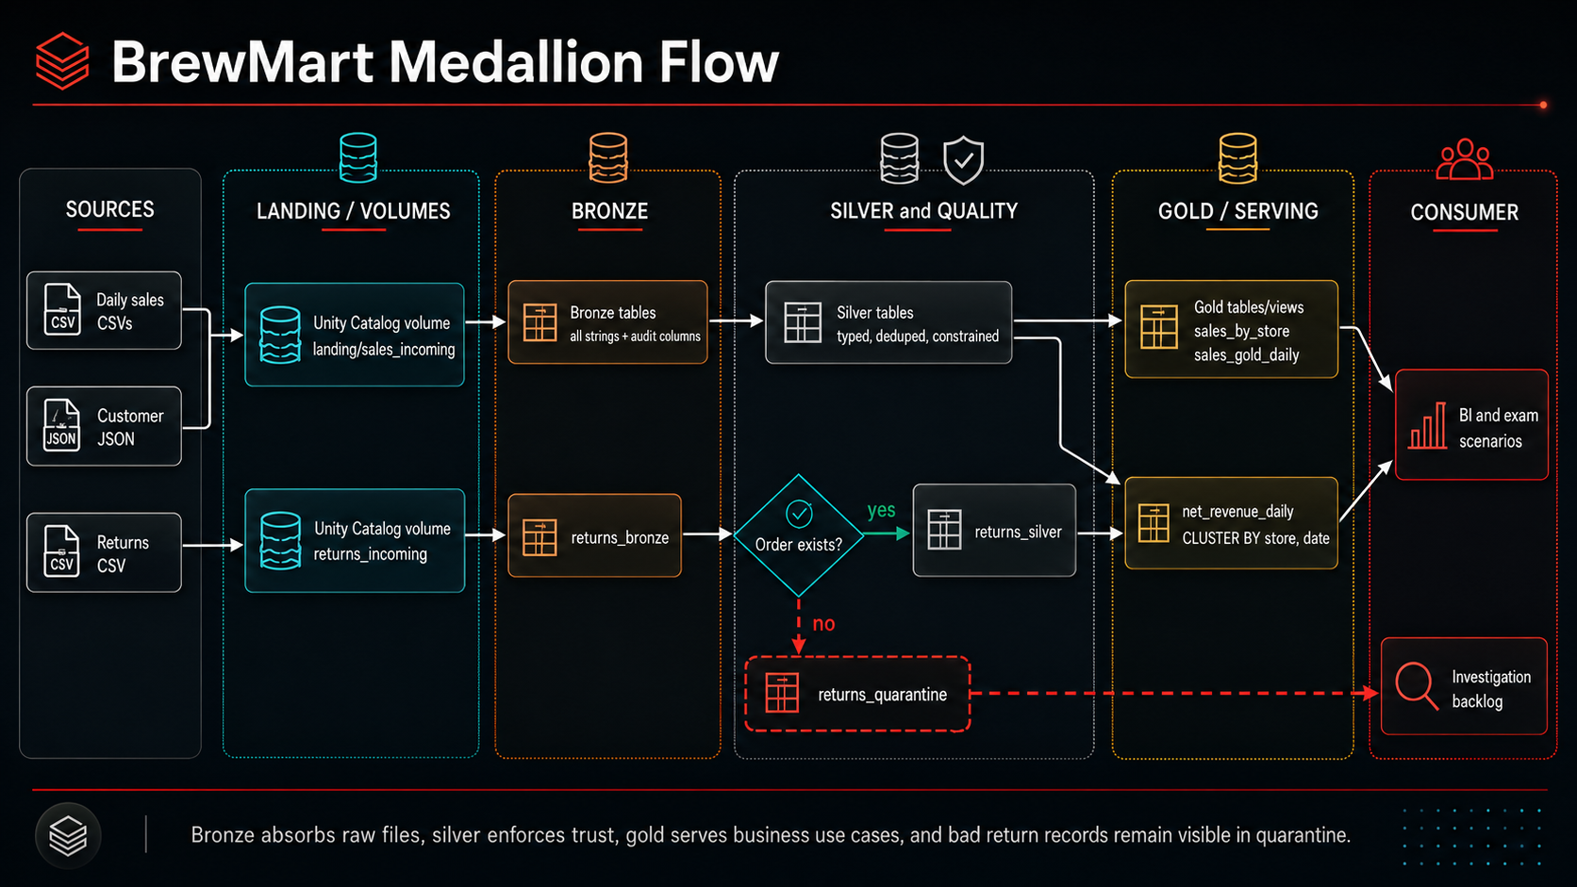
Notes:
Daily sales and returns land in one governed Unity Catalog volume, but in separate directories. This isolates feeds with different schemas, arrival schedules, and ingestion state.
Each feed then receives its own bronze table. We keep sales and returns separate because they represent different business events and data contracts. Bronze preserves the source shape and adds ingestion audit metadata.
In silver, sales records are typed, deduplicated, and constrained. Returns require an additional quality decision: does the referenced order exist?
Valid returns enter returns_silver. Unmatched returns enter returns_quarantine. Quarantine does not mean deletion or pipeline failure. It keeps questionable records visible so they can be investigated and reprocessed later.
Gold is shaped around business use cases. Trusted sales support sales_by_store and sales_gold_daily. Calculating net_revenue_daily requires both trusted sales and trusted returns because the return feed identifies what was returned, while the sales data supplies the original store, date, and price.
CLUSTER BY (store, order_date) describes how the net-revenue table is organized for common store-and-date queries. It is a physical optimization choice, not another medallion layer.
These gold outputs serve BI and SQL analytics, while quarantined records follow a separate operational review path.
Key takeaway: Bronze preserves evidence, silver establishes trust, gold answers business questions, and quarantine keeps rejected data accountable.
Transition: “Now that we have seen the complete scenario, we will begin building its central path incrementally across the course.”

Slide 18
EXAM READINESS
How Week 1 gets tested — and what's next
Recall: default format · hierarchy order · DROP semantics
HOMEWORK
Docs: lakehouse, Delta, UC object model, medallion
Syntax: CREATE/CTAS/OR REPLACE · VERSION AS OF · three-level names
Rebuild the demo from a blank notebook
Scenarios: which compute · which gold object · what happens to files when…
Keep your schema — Week 2 needs it
Elimination: distractors are real features applied to the wrong situation
ANCHORS One copy in Delta · one governance tree · bronze stays raw.
CREO TECHNOLOGIES · DATABRICKS DATA ENGINEER ASSOCIATE
WEEK 1 · JUNE 2026 · 15
Notes:
Walk official sample Q4 (CREATE OR REPLACE) with elimination: invented syntax dies first (WITH COLUMNS), then constraint-violators (IF NOT EXISTS fails 'regardless of whether it exists'). Homework: docs reading + recreate the demo from memory. Keep all lab objects — Week 2 builds on them.

Slide 19
WEEK 1 COMPLETE
You can now speak Databricks
Lakehouse stack: storage → Delta → Unity Catalog → compute → workloads
NEXT
Tables, views, volumes — created, inspected, time-traveled, restored
Ingestion & ELT —
COPY INTO,
Auto Loader,
bronze→silver
Managed vs. external: you know what DROP does to each
Medallion: bronze absorbs, silver enforces, gold serves
CREO TECHNOLOGIES · DATABRICKS DATA ENGINEER ASSOCIATE
WEEK 1 · JUNE 2026 · 16
Notes:
Close with the three anchors. Assign homework explicitly. Next week starts from their lab schema — nothing gets deleted.

