Slide 1
EXPEDITORS · ENGINEERING KICKOFF DAY
Git & GitHub Fundamentals
Everything you need on day one: the mental model, the daily workflow,
and your first push to GitHub.
6 hours · live on Zoom
teach → demo → hands-on labs
GitHub Codespaces or local terminal
$ git init your-career
Initialized empty repository.
$ git commit -m "Day 1: learn Git & GitHub"
[main a1b2c3d] Day 1: learn Git & GitHub

Slide 2
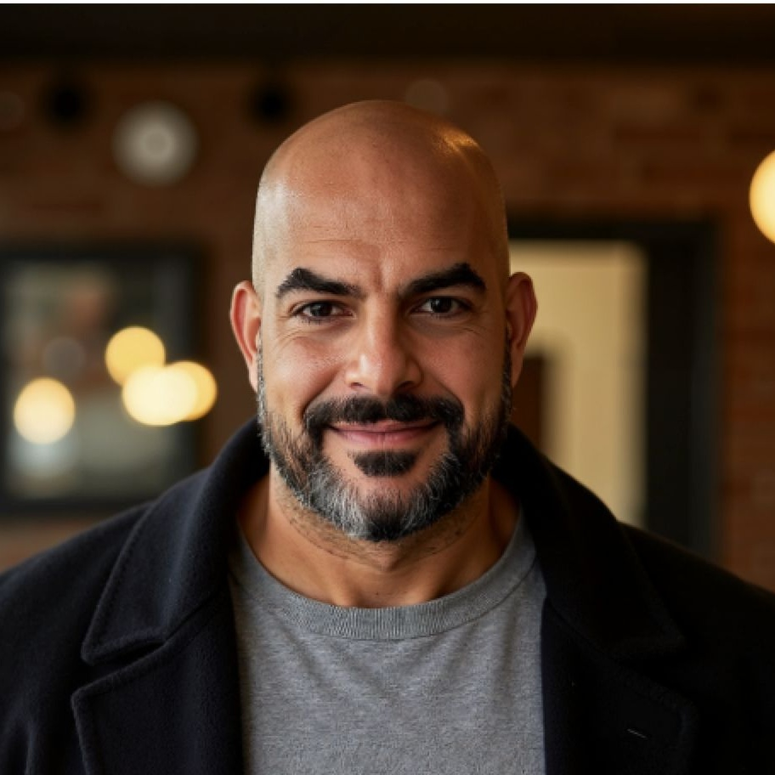

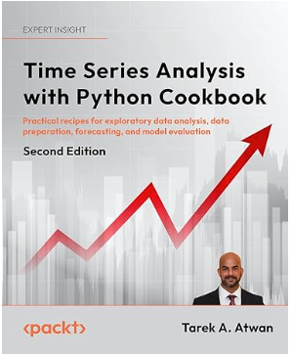
CONSULTING & CORPORATE TRAINING SPECIALIST
Data Science · AI / ML · Generative AI · Cloud Architecture · Analytics · Cybersecurity
20+
2,000+
40+
11+
Years of Experience
Fellows Trained
Fortune 500 Clients
Cloud Certifications
CONSULTING EXPERTISE
TRAINING & EDUCATION
▸ AI Strategy & Transformation
AI/ML adoption roadmaps · enterprise GenAI integration
▸ Data Architecture & Engineering
Lakehouses · cloud pipelines · MLOps · DataOps · streaming
▸ Generative AI & LLM Solutions
Agentic AI, Automation, LangChain · LangGraph · Multi-Agent Systems · RAG · LLMOps
▸ Cybersecurity & Data Governance
Secure & Responsible AI/data frameworks
▸ Cloud Architecture
AWS · Azure · GCP · solution design & migration
▸ Executive & Board-Level Advisory
Strategic guidance for C-suite & government agencies
SECTORS:
Finance · Healthcare · Telecom · Government · Media · Energy · Retail
▸ Academic Instruction (7+ Years)
Lead Instructor: University of Southern California · Arizona State University · Pepperdine University
▸ Corporate Training
Pluralsight Elite Instructor — Intuit · LEGO · J&J · NY Life · Hartford
▸ Large-Scale Bootcamps
2,000+ fellows — USAID Tech for Jobs (18-week Data Analytics)
▸ Cybersecurity Training
20-week bootcamp · Cyber Advance for Women in MENA · CompTIA Security+
▸ GenAI & AI Engineering
LLMs · LangChain · LlamaIndex · CrewAI · NLP · Computer Vision
▸ Curriculum Topics
ML · Deep Learning · Data Engineering · Python · Cloud · MLOps · dbt · Kafka
TAREK ATWAN
Senior Advisor | Corporate Trainer
CONTACT
Email tatwan@ensemblemethods.com
Web www.tarekatwan.com
LinkedIn /in/tarekatwan
Location Amman, Jordan | Global
CERTIFICATIONS
Microsoft Azure (5x)
Amazon AWS (3x)
Google Cloud Digital Leader
Databricks · Kafka · Airflow
AWARDS & EDUCATION
Pluralsight Elite 2023 · 2024 · 2025
Packt Best Seller – Data Analytics 2022
NOTABLE CLIENTS: LEGO · Johnson & Johnson · Intuit · American Express · Disney · AT&T · McDonald's · Wells Fargo · NBCUniversal · T-Mobile · Amgen · ARAMCO · Emirates Airlines · Dubai Health Authority · ADIA · QIA · DIFC · Shell · BP · STC · Careem · Ooredoo
PUBLISHED AUTHOR Best Seller – Data Analytics (Packt Publishing)
Time Series Analysis with Python Cookbook 1st Ed. 2022 · Japanese Ed. 2023 · 2nd Ed. 2026

Slide 3
YOUR DAY, MAPPED
Agenda — 8:30 AM to 2:30 PM
MORNING
AFTERNOON
8:30
Welcome + environment check
11:30
Lunch (60 min)
8:45
M1 · The Git Mental Model
12:30
LAB 3 · Local Meets Remote
9:25
LAB 1 · Your First Repository
12:55
M4 · Branching Basics
9:45
Break (10 min)
1:30
LAB 4 · Branch, Change, Merge
9:55
M2 · Everyday Git Workflow
1:55
Break (10 min)
10:30
LAB 2 · Edit → Stage → Commit
2:05
M5 · Collaboration Preview
10:55
M3 · GitHub Fundamentals
2:22
Wrap-up · cheat sheet · Q&A
Git & GitHub Fundamentals · Expeditors
2

Slide 4
FORMAT
How today works
1
I explain
2
I demo
3
You do
Short concept blocks with diagrams — the why before the how.
Live on my terminal / Codespaces. Watch the commands and their output.
A hands-on lab after every module. Follow-along steps + a solo challenge.
WHAT YOU NEED TODAY
A GitHub account (free) — that's genuinely it. Labs run in GitHub Codespaces, a full dev machine in your browser. Prefer local? A terminal with Git 2.23+ works too.
Git & GitHub Fundamentals · Expeditors
3

Slide 5
01
MODULE 1 OF 5
The Git Mental Model
Goal — understand what Git does before touching commands.
git status
git add
git commit
git log
Git & GitHub Fundamentals · Expeditors
4

Slide 6
MODULE 1 · THE PROBLEM
Why version control exists
LIFE WITHOUT IT
LIFE WITH GIT
report.docx
report_v2.docx
report_final.docx
report_final_FINAL.docx
report_final_REAL_use-this-one.docx
copy of report_final (3).docx
$ git log --oneline
8d3f2e1 Fix totals in Q4 summary
5b9c044 Add executive summary
21aa7f0 Rewrite intro after review
9e0d512 First draft of report
Which one works? Who changed what? Can we go back?
One file. Full history. Every version recoverable. Every change explained — and it works for a whole team at once.
Git & GitHub Fundamentals · Expeditors
5

Slide 7
MODULE 1 · THE TOOL
What is Git?
Git is a version control system: it takes snapshots of your whole project every time you commit — like a save point in a video game you can always return to.
~94%
2005
100%
of professional developers use Git — the de-facto industry standard
created by Linus Torvalds to manage the Linux kernel
local & free — full history on your machine, works offline
Git ≠ GitHub. Git is the tool on your machine. GitHub is a website that hosts Git repositories. More on that after lunch — for now, everything is local.
Git & GitHub Fundamentals · Expeditors
6

Slide 8
MODULE 1 · WHERE CODE LIVES
Local vs. remote
YOUR MACHINE
GITHUB
(local)
push ↑
(remote)
your repository
working files + full history,
all inside the .git folder
a copy of the repository
shared home base your
whole team syncs with
pull ↓
Nothing syncs automatically. Your laptop and GitHub are two separate repositories — they only exchange commits when you explicitly push or pull. This morning: 100% local. This afternoon: we connect the two.
Git & GitHub Fundamentals · Expeditors
7

Slide 9
MODULE 1 · THE CORE DIAGRAM · WHERE EVERY CHANGE LIVES
The three areas
WORKING DIRECTORY
STAGING AREA
REPOSITORY
git add
git commit
your files, as you edit them
changes you've marked
for the next snapshot
permanent, committed
history in .git
“the workbench”
“the shopping cart”
“the photo album”
Changes flow one way: edit → git add → git commit. Why a staging area at all? So you choose exactly what goes into each snapshot — you can edit five files but commit two clean, focused changes.
Git & GitHub Fundamentals · Expeditors
8

Slide 10
MODULE 1 · YOUR DAILY TRIO
Three commands you'll run constantly
git status
git add
git commit
Where am I?
Stage it
Snapshot it
Shows what's changed, what's staged, and what Git suggests next. Free to run, impossible to break anything.
Moves a change from the working directory into the staging area. Nothing is saved yet — you're loading the cart.
Permanently records everything staged, with a message and a unique ID (hash). This is the save point.
Run it before and after every other command — it's your GPS.
git add <file> for precision · git add . for everything
git commit -m "Clear, imperative message"
Git & GitHub Fundamentals · Expeditors
9

Slide 11
MODULE 1 · READING HISTORY
Anatomy of a commit
1
The hash — a unique fingerprint of this exact snapshot. First 7 characters are enough to refer to it.
$ git log
commit 8d3f2e1a94c7b02f6e5d3a18c2b4f9e7…
Author: Ada Lovelace <ada@expeditors.com>
Date: Thu Jun 11 09:14:02 2026
Add shipment tracking endpoint
2
Who & when — every commit is signed — that's why we ran git config on day one.
3
The message — the only part a human writes. Future-you and teammates depend on it.
A commit is a snapshot, not a diff. Git stores the state of every file at that moment — which is why jumping to any point in history is instant and safe.
Git & GitHub Fundamentals · Expeditors
10

Slide 12
MODULE 1 · YOUR GPS
How to read git status
GREEN staged — in the cart, will be in the next commit
$ git status
On branch main
Changes to be committed:
new file: invoice.py
Changes not staged for commit:
modified: README.md
Untracked files:
notes.txt
RED (modified) tracked file changed, but not staged yet
RED (untracked) brand-new file Git isn't managing at all
Habit of the day: when in doubt, git status. It tells you the state and suggests the next command.
Git & GitHub Fundamentals · Expeditors
11

Slide 13
LIVE DEMO → THEN YOU
Module 1: watch first, then it's your turn
DURING THE DEMO, WATCH FOR…
HANDS-ON · 20 MIN
git status before git init — why the error?
The hidden .git folder — where history lives
Red → green → clean as one change travels through
What git log shows after the first commit
Lab 1 — Your First Repository
labs/lab-01-your-first-repository.md
You're done when:
A repo with 3 commits, made by you
You can explain red vs. green in git status
Bonus: you found your root commit's full hash
Git & GitHub Fundamentals · Expeditors
12

Slide 14
02
MODULE 2 OF 5
Everyday Git Workflow
Goal — build comfort with the edit → stage → commit cycle you'll run for the rest of your career.
git diff
git log --oneline
.gitignore
Git & GitHub Fundamentals · Expeditors
13

Slide 15
MODULE 2 · THE RHYTHM
The loop you'll run thousands of times
1
2
3
4
EDIT
REVIEW
STAGE
COMMIT
change files in your editor
git status + git diff — what did I change?
git add the changes that belong together
git commit -m with a clear message
…and back to editing — small loops, many times a day
Commit small, commit often. Professionals commit several times an hour. Small commits = easy code review, easy bug hunting, easy undo.
Git & GitHub Fundamentals · Expeditors
14

Slide 16
MODULE 2 · NEVER COMMIT BLIND
git diff answers two different questions
git diff
git diff --staged
“What have I edited but not yet staged?”
“What exactly am I about to commit?”
Compares working directory ↔ staging area. The moment you git add, the change leaves this view.
Compares staging area ↔ last commit. Your final self-review before the snapshot becomes permanent.
Run while editing
Run right before every commit
Reading a diff: - removed line + added line — a changed line shows as one of each. A change lives in exactly one of the two views, never both.
Git & GitHub Fundamentals · Expeditors
15

Slide 17
MODULE 2 · TIME TRAVEL, READ-ONLY
The git log toolbox
git log
full detail: hash, author, date, message
reading one commit closely
git log --oneline
one commit per line
your daily driver — quick orientation
git log --oneline --graph
draws branch & merge structure
seeing how work flowed together
git log -p -2
full diffs for the last 2 commits
what exactly changed, line by line
Stuck in the pager? Long output opens in a scroll view — press q to quit. (Everyone hits this. Now you know.)
Git & GitHub Fundamentals · Expeditors
16

Slide 18
MODULE 2 · WRITE FOR FUTURE-YOU
Commit messages that age well
✗ UNHELPFUL
✓ USEFUL
"stuff"
"asdf"
"fixed it"
"changes"
"final commit (for real)"
"Add customs form validation"
"Fix rounding error in totals"
"Remove unused login helper"
"Update README setup steps"
Imperative mood
“Add…”, “Fix…” — matches Git's own style
Say what & why
a teammate should get it without reading code
~50 chars first line
short enough to scan in git log --oneline
Git & GitHub Fundamentals · Expeditors
17

Slide 19
MODULE 2 · KEEP THE JUNK OUT
.gitignore — what Git should never track
A plain text file of patterns. Anything matching is invisible to Git — it stays on your disk but never gets staged or committed. The .gitignore itself IS committed, so the whole team ignores the same things.
Secrets — API keys, passwords, .env files — leaked keys on public GitHub get found by bots in seconds
# .gitignore
*.log
# any log file, anywhere
.env
# secrets & credentials
node_modules/
# huge installed dependencies
build/
# generated output
Generated files — build output, logs, caches — recreated anyway, just noise in history
Dependencies — node_modules/ and friends — hundreds of MB that install from a list
⚠ Gotcha: .gitignore only affects untracked files — a pushed secret must be rotated, not just deleted.
Git & GitHub Fundamentals · Expeditors
18

Slide 20
LIVE DEMO → THEN YOU
Module 2: watch first, then it's your turn
DURING THE DEMO, WATCH FOR…
HANDS-ON · 25 MIN
A change visible in git diff… then 'vanishing' after add
git diff --staged as the pre-commit review
A fake API key — and how .gitignore hides it
git log --oneline vs git log -p
Lab 2 — Edit → Stage → Commit
labs/lab-02-everyday-workflow.md
You're done when:
You used both diff views and can explain them
A .gitignore hiding logs, secrets & build output
Challenge: farewell() committed with a clean message
Git & GitHub Fundamentals · Expeditors
19

Slide 21
03
MODULE 3 OF 5
GitHub Fundamentals
Goal — push your code to GitHub, pull it back down, and clone like it's day one on the job.
git push
git pull
git clone
git remote
Git & GitHub Fundamentals · Expeditors
20

Slide 22
MODULE 3 · TWO DIFFERENT THINGS
Git vs. GitHub
GIT
GITHUB
the version control tool
runs on your machine
works fully offline
made by Linus Torvalds, 2005
free, open source
a website that hosts Git repos
runs in the cloud
adds collaboration: PRs, reviews, issues
owned by Microsoft, ~150M+ users
one of several hosts (GitLab, Bitbucket)
Analogy: Git is to GitHub what photos are to Instagram — the thing itself vs. the place you share it.
Git & GitHub Fundamentals · Expeditors
21

Slide 23
MODULE 3 · MORE THAN STORAGE
What GitHub gives you
Backup & hosting
Collaboration
Pull requests
your repo, safe in the cloud, browsable from anywhere
many people, one codebase, without emailing zip files
propose → review → merge: how teams ship (preview at 2:05)
Issues & projects
Actions (CI/CD)
Codespaces
track bugs, ideas and work alongside the code
robots that test and deploy your code on every push
a full dev machine in your browser — you're using it today
Today we use: hosting + Codespaces. The rest is your roadmap.
Git & GitHub Fundamentals · Expeditors
22

Slide 24
MODULE 3 · THE BRIDGE
Four verbs that move commits
☁️ origin (GitHub)
git push
git pull
send my commits up
fetch + merge their commits
your local repo
git clone — first copy: entire repo + history, remote pre-wired. Day one at any job.
git fetch — download news without merging. Look before you leap; pull = fetch + merge.
Git & GitHub Fundamentals · Expeditors
23

Slide 25
MODULE 3 · THREE STEPS, ONCE PER PROJECT
Publishing an existing local repo
1
Create an EMPTY repo on GitHub
in the browser — leave every checkbox unchecked
github.com → New repository. No README, no .gitignore — your local repo already has history; two histories collide.
2
Tell Git where the remote is
$ git remote add origin https://github.com/you/repo.git
“origin” is just the conventional nickname for the remote's URL.
3
Push and link the branch
$ git push -u origin main
-u links local main to origin's main — after this, plain git push / git pull just work.
Then verify in the browser: refresh the repo page — your files, commits and hashes are there.
Git & GitHub Fundamentals · Expeditors
24

Slide 26
MODULE 3 · PROVING WHO YOU ARE
Authentication in 2026 (no passwords!)
GitHub removed password pushes in 2021. Today it's tokens managed for you — usually via a one-time browser sign-in.
TODAY
LOCAL DEFAULT
LATER
Codespaces
HTTPS + credential manager
SSH keys / gh CLI
Already signed in. Pushing to your own repos just works. Zero setup — today's happy path.
First push opens a browser sign-in; Git Credential Manager stores a token. Standard on Windows & macOS.
Key pair on your machine, or `gh auth login`. Preferred by many pros — a topic for later, not today.
If auth fights you in the lab, raise a hand fast — it's the #1 first-day friction in real jobs too.
Git & GitHub Fundamentals · Expeditors
25

Slide 27
MODULE 3 · TWO WAYS EVERY REPO BEGINS
init + connect vs. clone
PROJECT BORN ON YOUR MACHINE
PROJECT ALREADY EXISTS SOMEWHERE
git init
work, add, commit…
git remote add origin <url>
git push -u origin main
git clone <url>
…that's it. One command:
✓ full history downloaded
✓ origin remote pre-configured
✓ main checked out, tracking set
You had it first; GitHub gets a copy.
Day one at every job starts here.
Golden habit: pull before you start working, pull before you push. Most sync pain disappears.
Git & GitHub Fundamentals · Expeditors
26

Slide 28
LIVE DEMO → THEN YOU
Module 3: watch first, then it's your turn
DURING THE DEMO, WATCH FOR…
HANDS-ON · 25 MIN
Creating the GitHub repo EMPTY — and why
remote add + push -u, then refresh the browser
Editing on GitHub.com → my laptop has no idea → pull
clone bringing down history + remote in one step
Lab 3 — Local Meets Remote
labs/lab-03-local-meets-remote.md
You're done when:
Your repo is live on github.com
You round-tripped a change: web edit → pull
Challenge: synced two local copies through GitHub
Git & GitHub Fundamentals · Expeditors
27

Slide 29
04
MODULE 4 OF 5
Branching Basics
Goal — understand branches well enough to stop fearing them.
git switch -c
git merge
git branch -d
Git & GitHub Fundamentals · Expeditors
28

Slide 30
MODULE 4 · SMALLER THAN YOU THINK
A branch is just a movable pointer
new-feature
a1f
b72
c93
d04
main
41 bytes
instant
fearless
a branch is literally a tiny file holding one commit hash — not a copy of your code
creating or switching costs nothing; Git just repaints your folder from its database
commits on a branch are as safe as commits anywhere — branches protect work, not endanger it
Git & GitHub Fundamentals · Expeditors
29

Slide 31
MODULE 4 · THE POINT OF IT ALL
Why branches exist
Experiment safely — try anything on a branch — main is untouched until you decide to merge
$ git branch
* main
$ git switch -c fix-totals
Switched to a new branch
'fix-totals'
$ git branch
* fix-totals
main
Work in parallel — five teammates, five branches, zero stepping on each other
Keep main shippable — the team's rule: main always works. All work happens on branches
Real-team rule you'll meet everywhere: nobody commits directly to main. Every change rides in on a branch.
Git & GitHub Fundamentals · Expeditors
30

Slide 32
MODULE 4 · THE MOVES · AND THE DISAPPEARING FILE
Creating and switching branches
git switch -c <name>
create a new branch and move onto it (-c = create)
THE “WHOA” MOMENT
Switch branches and files appear or vanish from your folder. Nothing is deleted — Git repaints your working directory to match the branch's snapshot. Your work lives in commits, not in the folder.
git switch <name>
move to an existing branch
git branch
list branches; * marks where you are
git branch -d <name>
delete a merged branch (it refuses if unmerged — safe)
Seen git checkout in old tutorials? Same job. switch (2019) is the modern, single-purpose command — use it; translate checkout when you read it.
Git & GitHub Fundamentals · Expeditors
31

Slide 33
MODULE 4 · BRINGING WORK HOME
Merging: two shapes of history
FAST-FORWARD
MERGE COMMIT
main didn't move while you worked → Git slides the pointer forward. No new commit.
both branches moved → Git creates one new commit with two parents, tying history together.
main slides ▸ here
merge commit (2 parents)
$ git merge → “Fast-forward”
$ git merge → “Merge made by ort”
One rule to remember: switch to the branch that should RECEIVE the changes, then git merge <branch>
Git & GitHub Fundamentals · Expeditors
32

Slide 34
MODULE 4 · AWARENESS, NOT MASTERY
Merge conflicts: a question, not an error
When two branches change the same lines, Git won't guess. It pauses the merge and asks you to choose. Different files or different lines? Git merges silently — conflicts are rarer than their reputation.
between <<<<<<< and ======= :
your current branch's version
between ======= and >>>>>>> :
the incoming branch's version
<<<<<<< HEAD
# Team Engineering Journal
=======
# My Engineering Journal
>>>>>>> update-title
1. open the file
→
2. keep what's right
→
3. delete the markers
→
4. add + commit
Git & GitHub Fundamentals · Expeditors
33

Slide 35
LIVE DEMO → THEN YOU
Module 4: watch first, then it's your turn
DURING THE DEMO, WATCH FOR…
HANDS-ON · 25 MIN
A file disappearing as I switch branches (and coming back)
Fast-forward merge — watch the pointer slide
A conflict made on purpose — and resolved calmly
Deleting a branch ≠ deleting work
Lab 4 — Branch, Change, Merge
labs/lab-04-branch-change-merge.md
You're done when:
You branched, committed, merged, and cleaned up
You resolved one guided conflict — and survived
Challenge: you can explain FF vs. merge commit
Git & GitHub Fundamentals · Expeditors
34

Slide 36
05
MODULE 5 OF 5
Collaboration Preview
Goal — see where this is heading — how real teams turn branches into shipped software.
pull requests
code review
protected main
Git & GitHub Fundamentals · Expeditors
35

Slide 37
MODULE 5 · THE BIG PICTURE
How real teams ship code
1
2
3
4
5
branch
→
commit
→
pull request
→
review
→
merge
start from up-to-date main
small commits on your branch
“please review & merge my branch”
teammates comment, you revise
approved work lands in main
…then everyone pulls the new main, branches again, and the loop continues.
Today you already did steps 1, 2 and 5 — solo. A pull request is just the team version of the merge you ran in Lab 4: same merge, plus a conversation in the middle. That conversation is the next session.
Git & GitHub Fundamentals · Expeditors
36

Slide 38
MODULE 5 · THE COLLABORATION UNIT
What a pull request actually is
A pull request (PR) is a request to merge one branch into another — wrapped in a discussion page on GitHub. It's not a Git command; it's a GitHub feature built on top of branches and merges you already know.
A diff anyone can read — every changed line, side by side, in the browser
A conversation — comments on specific lines; questions before code lands
A quality gate — approvals and automated tests must pass before merge
A paper trail — months later: what changed, who, and—crucially—why
Why “pull” request? You're asking the project to pull your branch in. (Odd name, universal term.)
Git & GitHub Fundamentals · Expeditors
37

Slide 39
MODULE 5 · THE TEAM'S SOURCE OF TRUTH
main is sacred — and usually locked
WHAT “MAIN” MEANS ON A TEAM
SO WHEN YOU SEE…
The shared, always-working version of the project — what ships to customers.
Branch protection (a GitHub setting) typically enforces:
no direct commits to main — PRs only
at least one approving review
automated tests must pass first
$ git push
remote: error:
protected branch
hint: use a PR
…it's not broken. It's the team's safety system saying: branch, then PR.
Git & GitHub Fundamentals · Expeditors
38

Slide 40
TAKE THIS WITH YOU
Your day-one cheat sheet
git init
start a repo here
git clone <url>
copy a remote repo
git status
where am I? (run constantly)
git push / pull
send / receive commits
git add <f> / .
stage changes
git remote -v
where is my remote?
git commit -m "…"
snapshot what's staged
git switch -c <b>
new branch + switch
git diff / --staged
unstaged / staged changes
git merge <b>
merge <b> into current
git log --oneline
compact history
git branch -d <b>
delete merged branch
Stuck? git status first. Then ask. Nothing committed is ever truly lost.
Git & GitHub Fundamentals · Expeditors
39

Slide 41
YOU SHIPPED TODAY
From zero to push in one day
✓ a repo with real history, built commit by commit
✓ the three-areas model — you know where every change lives
✓ your code on GitHub, pushed, pulled and cloned
✓ a branch merged (and one conflict survived)
KEEP GOING
Pro Git (free book) — git-scm.com/book
GitHub Skills — skills.github.com
When it goes wrong — ohshitgit.com
Next session: pull requests & team workflow
$ git commit -m "Day 1 complete — Git fundamentals unlocked"
$ git push # see you at the next session!
Git & GitHub Fundamentals · Expeditors
40

