Slide 1
Collections

Slide 2

What is a collection
Group of objects
Different kinds of operations
1. store
2. retrieve
3. manipulate
4. communicate aggregate data

Slide 3
What is collection framework
A collections framework is a unified architecture for representing and manipulating collections. All collections frameworks contain the following:
Interfaces
Implementations
Algorithms

Slide 4

Benefits of the Java Collections Framework
Reduces programming effort
Increases program speed and quality
Reduces effort to learn and to use new APIs
Reduces effort to design new APIs
Software reuse

Slide 5
Interfaces
Collection
Map
List
Set
Queue
Interface | Ordered | Dupes | Notes
List | Yes | Yes | Positional access; element insertion control
Map | Can be | No(Keys) | Unique keys; one value to one key
Queue | Yes | Yes | Holds elements, usually FIFO
Set | Can be | No | Unique items

Slide 6
Collection
int size()
Returns the number of elements in this collection
boolean isEmpty()
Returns true if this collection contains no elements
void clear();
Remove all of the elements from this collection
boolean contains(E item)
Returns true if this collection contains the specified element
boolean containsAll(Collection<? extends E> c)
Returns true if this collection contains all of the elements in the specified collection
Object[] toArray()
Е[] toArray(Е [])
Returns an array containing all of the elements in this collection

Slide 7
Collection
boolean add(E item)
Ensures that this collection contains the specified element
boolean addAll(Collection<? extends E> c)
Adds all of the elements in the specified collection to this collection
boolean remove(E item)
Removes a single instance of the specified element from this collection, if it is present .
boolean removeAll(Collection<? extends E> c)
Removes all of this collection's elements that are also contained in the specified collection

Slide 8
Iterator
Allows the iteration of container classes.
boolean hasNext()
Returns true if the iteration has more elements.
E next()
Returns the next element in the iteration.
Throws: NoSuchElementException - if the iteration has no more elements
void remove()
Removes from the underlying collection the last element returned by this iterator (optional operation). This method can be called only once per call to next().
Throws: UnsupportedOperationException - if the remove operation is not supported by this iterator IllegalStateException - if the next method has not yet been called, or the remove method has already been called after the last call to the next method

Slide 9
Iterator
List<Integer> numbers = new ArrayList<>();
numbers.add(12);
numbers.add(48);
numbers.add(56);
Iterator iterator = numbers.iterator();
iterator.hasNext(); //true iterator.next(); //12
iterator.hasNext(); //true iterator.next(); //48
iterator.hasNext(); //true iterator.next(); //56
iterator.hasNext();//false
iterator.next(); java.util.NoSuchElementException
here
12
48
56
12
48
56
12
48
56
12
48
56

Slide 10
Iterator
List<Integer> numbers = new ArrayList<>();
numbers.add(12);
numbers.add(48);
numbers.add(56);
Iterator iterator = numbers.iterator();
iterator.remove(); java.lang.IllegalStateException
iterator.next();
iterator.remove();
iterator.remove(); java.lang.IllegalStateException
here
12
48
56
12
48
56
48
56

Slide 11
Iterating over collections
Since JDK 1.5 for-each has been introduced
for (Type element: collection){…};
In for each loop you can use any object that is implemented Iterable<E>:
Iterator<E> iterator();
Interface Collection<E> extends Iterable<E>
For each will be working with any collection
int a[] = new int[10];
for (int i : a){
System.out.println(i);
}
List<Byte> a=new ArrayList<Byte>();
for (byte i : a){
System.out.println(i); }

Slide 12
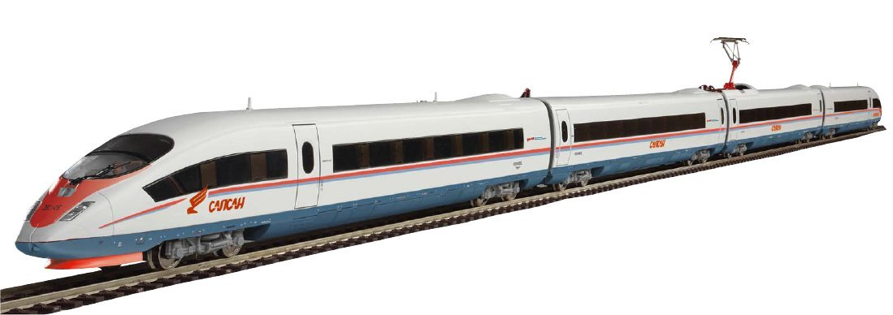
List
Ordered
May contain duplicate elements
Positional access
Search.
Iteration
Range-view

Slide 13
List
List
AbstractList
RandomAccess
AbstractSequentialList
ArrayList
Vector
Stack
LinkedList

Slide 14
Linked List
public class LinkedList<E> extends AbstractSequentialList<E> implements List<E>, Deque<E>, Cloneable, Serializable.
is not synchronized.
Null
Node 1
Node 2
Node 3
Node 4
prev
elem
prev
elem
next
next
prev
elem
next
prev
elem
next
Null
first
last

Slide 15
ArrayList
public class ArrayList<E> extends AbstractList<E> implements List<E>, RandomAccess, Cloneable, Serializable
is not synchronized
Resizable-array implementation of the List interface.
Size = 4
elem1 | elem2 | null | elem3 | null | null | null | null | null | null

Slide 16

ArrayList vs LinkedList
ArrayList offers constant-time positional access and is just plain fast. It does not have to allocate a node object for each element in the List, and it can take advantage of System.arraycopy when it has to move multiple elements at the same time.
If you frequently add elements to the beginning of the List or iterate over the List to delete elements from its interior, you should consider using LinkedList.
Positional access requires linear-time in a LinkedList and constant-time in an ArrayList
LinkedList has six optional operations: addFirst, getFirst, removeFirst, addLast, getLast, and removeLast. LinkedList also implements the Deque interface.
If you think you want to use a LinkedList, measure the
performance of your application with both LinkedList
and ArrayList before making your choice;
ArrayList is usually faster

Slide 17

ArrayList vs Arrays
Arrays are fixed size whereas ArrayList size is dynamic.
Arrays can contain primitive or Objects whereas ArrayList can contain only Objects.
Arrays doesn’t provide a lot of features like ArrayList, such as addAll, removeAll, iterator etc.
Arrays are covariant, Generics are invariant.
Arrays are reified. Arrays know and enforce their element types at runtime. Generics are implemented by erasure.
If you are working on fixed multi-dimensional situation,
using [][] is far more easier than List<List<>>
If the size of list is fixed and mostly used to store
and traverse them better use arrays.
1) Object[] objArray = new Long[1];
ObjArray[0] = “I don’t fit in”; // Throws ArrayStoreException
2) Won’t compile
List<Object> ol = new ArrayList<Long>();//Incompatible types

Slide 18
ListIterator
ListIterator Interface is used to traverse the element in backward and forward direction.
id | add(E e) Inserts the specified element into the list (optional operation).
boolean | hasNext() Returns true if this list iterator has more elements when traversing the list in the forward direction.
boolean | hasPrevious() Returns true if this list iterator has more elements when traversing the list in the reverse direction.
E | next() Returns the next element in the list and advances the cursor position.
int | nextIndex() Returns the index of the element that would be returned by a subsequent call to next().
E | previous() Returns the previous element in the list and moves the cursor position backwards.
int | previousIndex() Returns the index of the element that would be returned by a subsequent call to previous().
void | remove() Removes from the list the last element that was returned by next() or previous() (optional operation).
void | set(E e) Replaces the last element returned by next() or previous() with the specified element (optional operation).

Slide 19

Map
Keys to values
Keys must be unique

Slide 20
Map
Map
SortedMap
NavigableMap
Dictionary
AbstractMap
HashTable
HashMap
TreeMap
LinkedHashMap

Slide 21
HashMap
public class HashMap<K,V> extends AbstractMap<K,V> implements Map<K,V>, Cloneable, Serializable
Hash table based
Permits null values
Permits null key
unsynchronized
Provides constant time performance for the basic operations (get and put)
If you want maximum speed and don’t care about order use HashMap

Slide 22
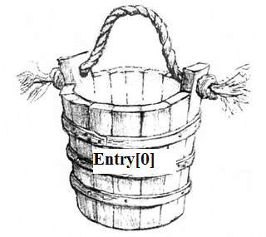
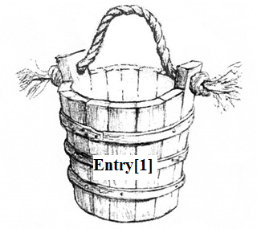
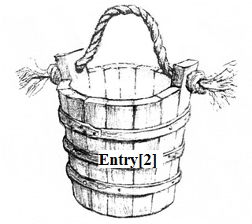

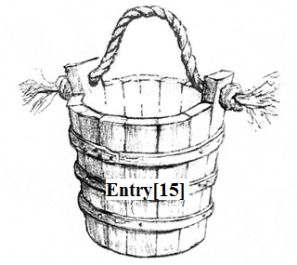
HashMap
table
initialCapacity = 16
loadFactor = 0.75f
[0]
key
value
next
key
value
next
[1]
[2]
key
value
next
null
[15]

Slide 23
HashMap
table
hash = 34
Index = 34%16 = 2
[0]
key1
value
next
key2
value
next
key4
value
next
Hash(key4.hashCode)
[1]
[2]
key4
value
next
key3
value
next
null
[15]

Slide 24
HashMap
table
hash = 34
Index = 34%16 = 2
[0]
key1
value
next
key2
value
next
key4
value2
next
Hash(key4.hashCode)
Comparing hash
for keys
[1]
Comparing
equality for keys
hash = 34
[2]
key4
value1
next
key3
value
next
null
[15]

Slide 25
HashMap
table
[0]
key1
value
next
key2
value
next
[1]
[2]
key4
value2
next
key3
value
next
null
[15]

Slide 26
HashMap
table
hash = 63
Index = 63%16 = 15
[0]
key1
value
next
key2
value
next
key5
value
next
Hash(key5.hashCode)
[1]
[2]
key4
value2
next
hash = 63
key3
value
next
null
[15]

Slide 27
HashMap
table
[0]
key1
value
next
key2
value
next
[1]
[2]
key4
value1
next
hash = 63
[15]
key5
value
next
key3
value
next
null

Slide 28

equals
It is reflexive: for any non-null reference value x, x.equals(x) should return true.

Slide 29

equals
It is symmetric: for any non-null reference values x and y, x.equals(y) should return true if and only if y.equals(x) returns true.

Slide 30
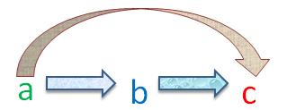
equals
It is transitive: for any non-null reference values x, y, and z, if x.equals(y) returns true and y.equals(z) returns true, then x.equals(z) should return true.

Slide 31

equals
It is consistent: for any non-null reference values x and y, multiple invocations of x.equals(y) should be consistent.

Slide 32

equals
For any non-null reference value x, x.equals(null) should return false.

Slide 33
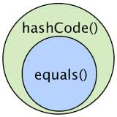
hashCode
invoked on the same object hashCode must consistently return the same integer
If two objects are equal then calling the hashCode method on each of the two objects must produce the same integer result.
if two objects are unequal it is possible that hashCodes will be the same

Slide 34

String is a good key for HashMap. But why?

Slide 35
Immutable objects
Its state cannot be modified after construction
All it’s fields are final
It is properly constructed (the this reference does not escape during construction)
The only real disadvantage – require separate object for each distinct value. It can be costly

Slide 36
Map Views
keySet — the Set of keys contained in the Map.
values — The Collection of values contained in the Map. This Collection is not a Set, because multiple keys can map to the same value.
entrySet — the Set of key-value pairs contained in the Map. The Map interface provides a small nested interface called Map.Entry, the type of the elements in this Set.

Slide 37
Example
Calculate how many times each words appear in the file
Scanner scanner = new Scanner(new File("G:\\example.txt"));
Map<String, Integer> statistics = new HashMap<>();
while (scanner.hasNext()) {
String word = scanner.useDelimiter("\\s+").next();
Integer count = statistics.get(word);
if (count == null) {
count = 0;
}
statistics.put(word, ++count);
}
System.out.println(statistics);
//мама мыла раму мама готовила обед
//готовила = 1 мама =2 мыла =1 обед=1 раму=1

Slide 38
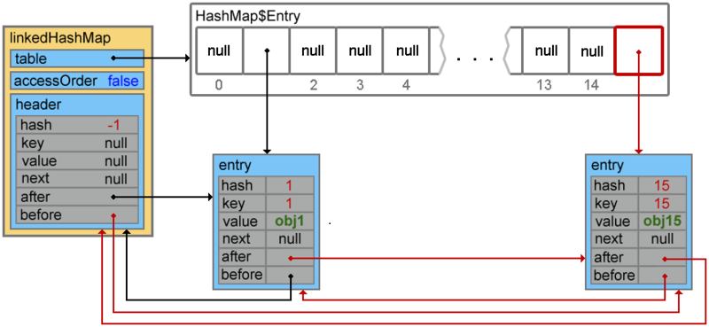
LinkedHashMap
Hash table and linked list implementation of the Map interface, with predictable iteration order. This implementation differs from HashMap in that it maintains a doubly-linked list running through all of its entries

Slide 39
LinkedHashMap
LRU caches -Least Recently Used. When performing LRU caching, you always throw out the data that was least recently used.
The removeEldestEntry(Map.Entry) method may be overridden to impose a policy for removing stale mappings automatically when new mappings are added to the map.
Sample use: this override will allow the map to grow up to 100 entries and then delete the eldest entry each time a new entry is added, maintaining a steady state of 100 entries.
private static final int MAX_ENTRIES = 100;
protected boolean removeEldestEntry(Map.Entry eldest) { return size() > MAX_ENTRIES;
}

Slide 40
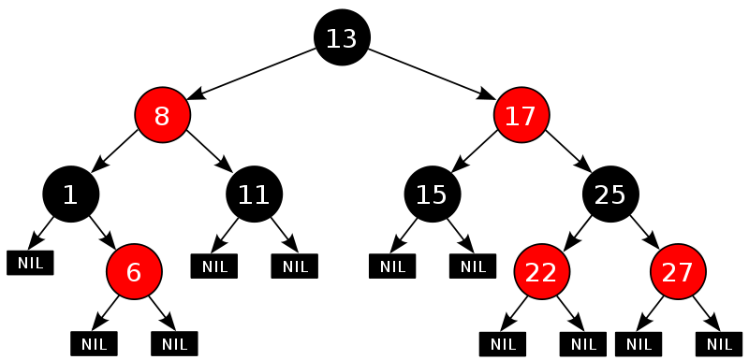
TreeMap
A Red-Black tree based NavigableMap implementation.
sorted according to the natural ordering of its keys, or by a Comparator.
self-balancing

Slide 41
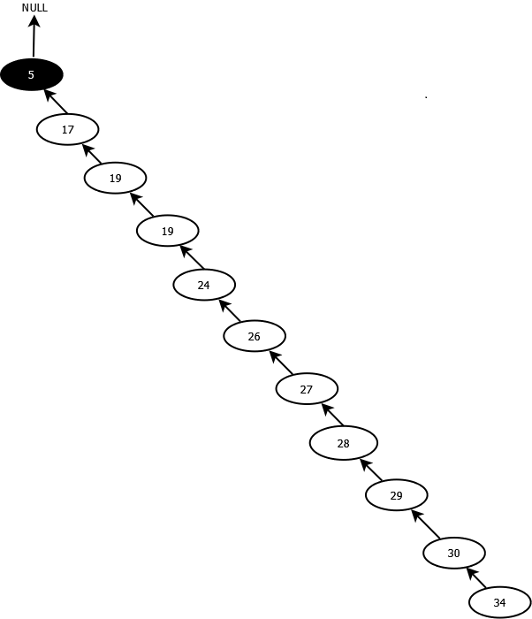
Unbalanced Tree
5,17,19,24,26,27,28,29,30,34,

Slide 42
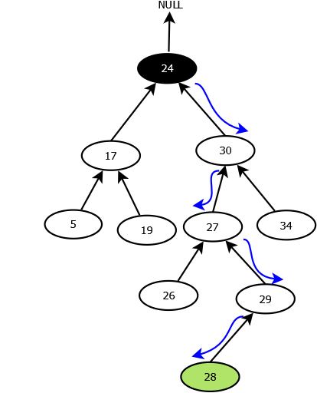
Balanced Tree
5,17,19,24,26,27,28,29,30,34,
Trying find element 28.

Slide 43

Comparable
natural ordering
sgn(x.compareTo(y)) ==
-sgn(y.compareTo(x))
for all x and y
transitive: (x.compareTo(y) > 0 && y.compareTo(z) > 0) implies x.compareTo(z) > 0.
x.compareTo(y) == 0 implies that sgn(x.compareTo(z)) == sgn(y.compareTo(z)), for all z.
It is strongly recommended, but not strictly required, that (x.compareTo(y)== 0) == (x.equals(y)).

Slide 44

TreeMap vs HashMap
If you need SortedMap operations or key-ordered Collection-view iteration, use TreeMap;
If you want maximum speed and don't care about iteration order, use HashMap;

Slide 45

Set
No duplicates
Must be able to compare.

Slide 46
Set
Set
SortedSet
AbstractSet
NavigableSet
HashSet
TreeSet
LinkedHashSet

Slide 47

HashSet & TreeSet
public HashSet() {
map = new HashMap<>();
}
// Dummy value to associate with an Object in the backing Map
private static final Object PRESENT = new Object();
public boolean add(E e) {
return map.put(e,PRESENT)==null;
}
public TreeSet() {
this(new TreeMap<E,Object>());
}
// Dummy value to associate with an Object in the backing Map
private static final Object PRESENT = new Object();
public boolean add(E e) {
return m.put(e, PRESENT)==null;
}

Slide 48
Example
Gets set of words in the file
Scanner scanner = new Scanner(new File("G:\\example.txt"));
Set<String> words = new TreeSet<>();
while (scanner.hasNext()) {
String word = scanner.useDelimiter("\\s+").next();
words.add(word);
}
System.out.println(words);
//мама мыла раму мама готовила обед
//готовила мама мыла обед раму

Slide 49
Collection hierarchy
Iterable
Queue
Collection
Set
SortedSet
Dequeue
List
NavigableSet
AbstractQueue
AbstractCollection
PriorityQueue
AbstractList
AbstractSet
AbstractSequentialList
ArrayList
Vector
EnumSet
HashSet
TreeSet
LinkedList
RandomAccess
Stack
LinkedHashSet

Slide 50
Collection hierarchy
Map
SortedMap
NavigableMap
Dictionary
AbstractMap
HashTable
EnumMap
HashMap
IdentityHashMap
WeekHashMap
TreeMap
Properties
LinkedHashMap

Slide 51

Summary
For the Set interface, HashSet is the most commonly used implementation.
For the List interface, ArrayList is the most commonly used implementation.
For the Map interface, HashMap is the most commonly used implementation.
For the Queue interface, LinkedList is the most commonly used implementation.
For the Deque interface, ArrayDeque is the most commonly used implementation.

Slide 52
Implementations | Interface | Ordered | Sorted | Dupes | Notes
ArrayList | List | Index | No | Yes | Fast resizable array
LinkedList | List | Index | No | Yes | Doubly linked list
Vector | List | Index | No | Yes | Legacy, synchronized
HashMap | Map | No | No | No | Key/value pairs
HashTable | Map | No | No | No | Legacy, synchronized
LinkedHashMap | Map | Insertion, last access | No | No | Linked list, hashtable
TreeMap | Map | Balanced | Yes | No | Red-black tree map
PriorityQueue | Queue | Priority | Yes | Yes | Heap implementation
HashSet | Set | No | No | No | Fast access set
LinkedHashSet | Set | Insertion | No | No | Linked list, hashSet
TreeSet | Set | Sorted | Yes | No | Red-black tree set

Slide 53


Slide 54

https://docs.oracle.com/javase/tutorial/collections/
http://habrahabr.ru/post/65617/
http://habrahabr.ru/post/127864/
http://habrahabr.ru/post/129037/
http://habrahabr.ru/post/128269/
http://habrahabr.ru/post/128017/

Slide 55
Задание №1
Задание №1
Будем реализовывать ‘text-analyzer’. Приложение запрашивает у пользователя путь к файлу и тип операции которую будет выполнять, после завершения операции выведется результат и пользователь снова будет опрошен.
Операция№1 Имя = frequency
Вывести два наиболее встречаемых слова, слова отсортировать их в алфавитном порядку по убыванию, и вывести сколько раз слово встречается в тексте.
good -> 23
allow -> 2
Операция№2 Имя = length
Найти первые три самых длинных слова, отсортировать их по длине по убыванию.
battle -> 6
map -> 3
a – 1
Операция№3 Имя = duplicates
Найти первых три слова у которых есть дубликаты и распечатать их в обратном порядке в верхнем регистре отсортированные по длине по возрастанию (e.g. map -> pam)
PAM
WOLLA
STNEMUGRA

Slide 56
Задание №2
Задание №2
Переопределить механизм генерации хеш-кода для строчных ключей (использовать два разных метода генерации: в качестве хеш-кода использовать длину строки и сумму первых четырех символов).
Для обоих случаев заполнить таблицу парами артикул (строка) – значение (обьект из второго задания).
Исследовать порядок вывода элементов встроенным итератором для обоих случаев генерации хеш-кода при использовании HashMap и LinkedHashMap.

Slide 57
Задание №3
Задание№3
Выполнить задание из модуля Java.SE.02.Object-oriented programming in Java, сохраняя объекты приложения в одном или нескольких файлах с применением механизма сериализации. Объекты могут содержать поля, помеченные как static, а также transient. Для изменения информации и извлечения информации в файле создать специальный класс-коннектор с необходимыми для выполнения этих задач методами

