Slide 1

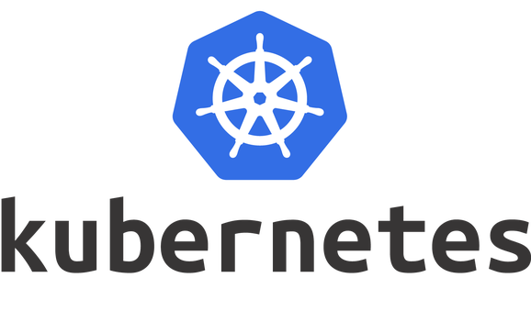
[ Adam ]
9739110917

Slide 2

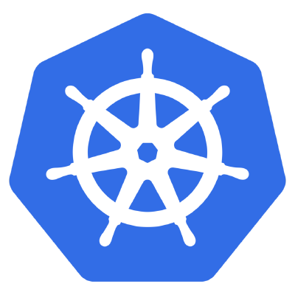
Kubernetes

Slide 3
Software Deployments
Software deployment includes all the process required for preparing a software application to run and operate in a specific environment.
It involves installation, configuration, testing and making changes to optimize the performance of the software.
Types of deployments ?
Recreate: Version A is terminated then version B is rolled out.
Ramped (also known as rolling-update or incremental): Version B is slowly rolled out and replacing version A.
Blue/Green: Version B is released alongside version A, then the traffic is switched to version B.
Canary: Version B is released to a subset of users, then proceed to a full rollout.
DEV
QA
PERF
STAGE
PROD

Slide 4


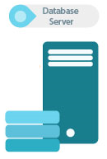


Load Balancer
Message Queue

Slide 5
Streamline Deployments using Docker
Compose the application into Docker Images
Break the application components into individual containers
Split the data that’s shared between services into volumes
Separate responsibilities so that each containers runs only one component/executable
Store the changeable data (configurations, logs) as Volumes so that they are mounted on various containers
Modern development’s primary focus is often based around three central concepts:
efficiency
reliability
repeatability

Slide 6



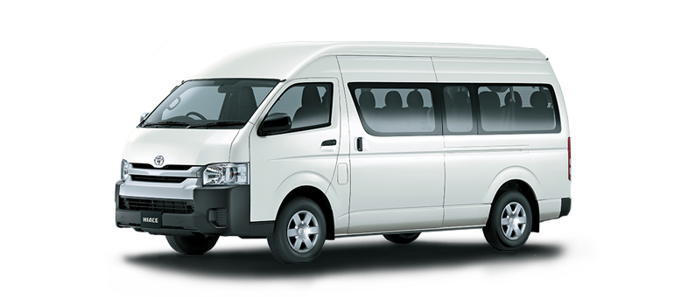

Slide 7
Why do we want a Container Orchestration System?
Imagine that you had to run hundreds of containers. You will need from a management angle to make sure that the cluster is up and running and have necessary features like:
Health Checks on the Containers
Launching a fixed set of Containers for a particular Docker image
Scaling the number of Containers up and down depending on the load
Performing rolling update of software across containers

Slide 8
What is Kubernetes?
K8s is an open-source container-orchestration system for automating deployment, scaling and management of containerized applications across clusters of hosts.
At a high level, it takes multiple Containers running on different hosts and lets you use them together.
Run containers anywhere on clusters of physical, virtual machines and cloud infrastructure.
Start, stop, update, and manage a cluster of machines running containers in a consistent and maintainable way.
A declarative language for launching containers.
We will define the desired state, K8s will monitor the current actual state and synchronize it with the desired state.
K8s provides the tooling to manage the when, where, and how many of the application stack and its components.
K8s also allows finer control of resource usage, such as CPU, memory, and disk space across our infrastructure.

Slide 9
Features of Kubernetes
Following are some of the important features of Kubernetes:
Continuous development, integration and deployment
Containerized infrastructure
Application-centric management
Auto-scalable infrastructure
Environment consistency across development testing and production
Loosely coupled infrastructure, where each component can act as a separate unit
Higher density of resource utilization

Slide 10

What is an API? (Application Programming Interface)
API is a software intermediary that allows two applications to talk to each other. Each time you use an app like Facebook, send an instant message, or check the weather on your phone, you’re using an API
RESTful API is a method of allowing communication between a web-based client and server

Slide 11

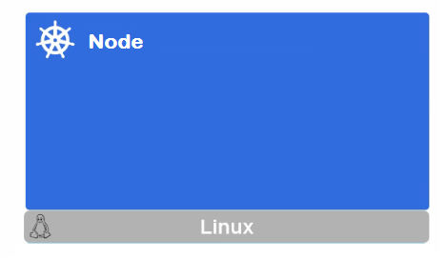
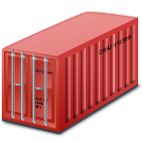
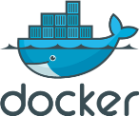
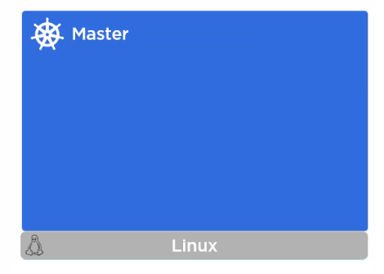

Kubernetes Architecture
Docker Registry
UI
User
Interface
API
CLI
Command
Line
Notes:
What is API?
https://www.mulesoft.com/resources/api/what-is-an-api
https://www.upwork.com/hiring/development/intro-to-apis-what-is-an-api/

Slide 12




Kubernetes Master
Master is the brain of the cluster
Master orchestrates the cluster
We will access the master to initiate changes and
not the nodes directly
Master consists of these components:
kube-apiserver
kube-scheduler
kube-controller-manager
etcd
All the master components are set up on a single host
Multiple masters are configured for High-Availability
We can communicate to the master node via the CLI, the GUI (Dashboard), or via APIs
Server
Scheduler
Controller
Keystore

Slide 13
kube-apiserver
Frontend to the cluster
Our communication to cluster happens only through apiserver
Maintains RESTful web services for querying and defining our desired cluster and workload state by consuming the YAML content
etcd
Acts as the memory for the Brian(master)
It stores the configuration information i.e Cluster state
It is a high availability key value store that can be distributed among multiple nodes
It is accessible only by Kubernetes API server
Server

Slide 14
kube-controller-manager
Watches over the state of the cluster and their job is to steer the cluster into the desired state at any time
If actual state is different, scheduler will be invoked to ensure the correct number of containers are running
Responsible for noticing and responding when nodes go down
Responsible for maintaining the correct number of Instances specified
kube-scheduler
Scheduler works with the API server to schedule workloads on the nodes.
It uses different node for matching the desired state and spreads containers across the cluster
Controller

Slide 15

Kubernetes Nodes

Slide 16
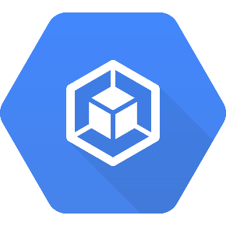

Kubernetes Nodes(Minions)
Nodes are the machines in which containers run
Node consists of these components:
kubelet
kube-proxy
Container engine
These components, receive workloads to execute, and update the cluster on their status
Kubelet
Proxy
Engine
To run and manage a container's lifecycle, we need a container runtime on the worker node. Some examples of container runtimes are:
containerd
rkt
lxd.

Slide 17
kubelet
The main kubernetes agent
Interacts with the API server on the Master
Registers the Node with the cluster
Updates the workloads that have been invoked by the scheduler:
Mount Volumes
Run containers
Report the status of the node
Run container liveness probe
Kube-proxy
Instead of connecting directly to Containers to access the applications, we use a logical construct called a Service as a connection endpoint. A Service groups related Pods and, when accessed, load balances to them
Proxy which runs on each worker node and listens to the API server, sets up the routes so that it can reach to it

Slide 18
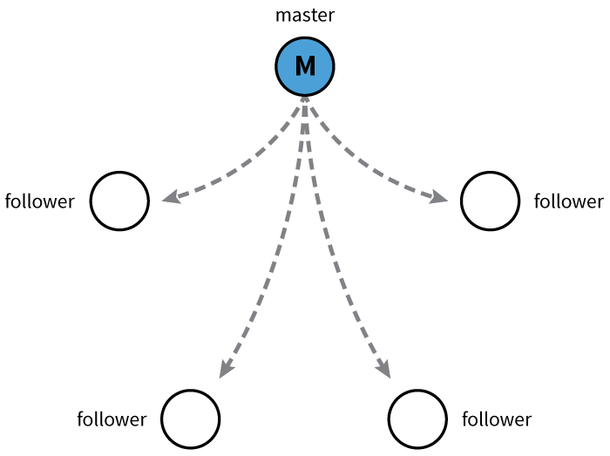
kubelet
Kubernetes uses etcd to store the cluster state & etcd is a distributed key-value store based on the Raft Consensus Algorithm.
Raft allows a collection of machines to work as a coherent group that can survive the failures of some of its members
At any given time, one of the nodes in the group will be the master, and the rest of them will be the followers
Any node can be treated as a master

Slide 19
Kubernetes Objects

Slide 20

Kubernetes Objects
Kubernetes uses Objects to represent the state of your cluster
What containerized applications are running (and on which nodes)
The resources available to those applications
The policies around how those applications behave, such as restart policies, upgrades, and fault-tolerance
Once you create the object, the Kubernetes system will constantly work to ensure that object exists and maintain cluster’s desired state
Every Kubernetes object includes two nested fields that govern the object’s configuration: the object spec and the object status
The spec, which we provide, describes your desired state for the object–the characteristics that you want the object to have.
The status describes the actual state of the object, and is supplied and updated by the Kubernetes system.
All objects in the are identified by a Unique Name and a UID.
Notes:
Objects has a state in which we define properties and its value

Slide 21
Kubernetes Objects
The basic Kubernetes objects include:
Pod
Service
Volume
Namespace
In addition, Kubernetes contains a number of higher-level abstractions called Controllers. Controllers build upon the basic objects, and provide additional functionality:
ReplicaSet
Deployment
StatefulSet
DaemonSet
Job

Slide 22
Kubernetes Objects Management
The kubectl command-line tool supports several different ways to create and manage Kubernetes objects
Declarative is about describing what you're trying to achieve, without instructing how to do it
Imperative explicitly tells "how" to accomplish it
Management technique | Operates on | Recommended environment
Imperative commands | Live objects | Development projects
Declarative object configuration | Individual files (yaml/json) | Production

Slide 23
Kubernetes Configuration
All-in-One Single-Node Installation
With all-in-one, all the master and worker components are installed on a single node. This is very useful for learning, development, and testing. This type should not be used in production. Minikube is one such example, and we are going to explore it in future chapters.
Single-Node etcd, Single-Master, and Multi-Worker Installation
In this setup, we have a single master node, which also runs a single-node etcd instance. Multiple worker nodes are connected to the master node.
Single-Node etcd, Multi-Master, and Multi-Worker Installation
In this setup, we have multiple master nodes, which work in an HA mode, but we have a single-node etcd instance. Multiple worker nodes are connected to the master nodes.

Slide 24
Infrastructure for Kubernetes Installation
Localhost Installation - Minikube
On-Premise Installation - Vagrant, Vmware, KVM
Cloud Installation
Google Kubernetes Engine (GKE)
Azure Container Service (AKS)
Amazon Elastic Container Service for Kubernetes (EKS)
OpenShift
Platform9
IBM Cloud Container Service
Kubernetes Installation Tools/Resources:
Kubeadm
Kubespray
kops

Slide 25
Setting Up a Single-Node Kubernetes Cluster with Minikube (EC2 Ubuntu)
Install Docker
$ sudo apt update && apt -y install docker.io
Install kubectl
$ curl -LO https://storage.googleapis.com/kubernetes-release/release/$(curl -s https://storage.googleapis.com/kubernetes-release/release/stable.txt)/bin/linux/amd64/kubectl && chmod +x ./kubectl && sudo mv ./kubectl /usr/local/bin/kubectl
Install Minikube
$ curl -Lo minikube https://storage.googleapis.com/minikube/releases/latest/minikube-linux-amd64 && chmod +x minikube && sudo mv minikube /usr/local/bin/
Start Minikube
$ minikube start --vm-driver=none
$ minikube status
Notes:
$ Minikube version

Slide 26
Kubectl Usage
$ kubectl [COMMAND] [TYPE] [NAME] [flags]
COMMAND: Specifies the operation that you want to perform on one or more resources, for example create, apply, get, describe, delete, exec …
TYPE: Specifies the resource type i.e nodes, pods, services, rc, rs …
NAME: Specifies the name of the resource
flags: Optional arguments
$ kubectl version
$ kubectl get node
$ kubectl describe nodes <nodename>

Slide 27
Pods

Slide 28
POD
Pod
A Pod is the smallest and simplest unit in the Kubernetes object model that you
create or deploy.
A Pod represents a running process on your cluster.
A Pod encapsulates an application container, storage resources, a unique network IP, and options that govern how the container(s) should run
Kubernetes manages the Pods rather than the containers directly.
Pods in a Kubernetes cluster can be used in two main ways:
Pods that run a single container - common usecase
Pods that run multiple containers that need to work together
Each Pod is assigned a unique IP address.
Every container in a Pod shares the IP address and network ports.
Containers inside a Pod can communicate with one another using localhost.
All containers in the Pod can access the shared volumes, allowing those containers to share data.
Kubernetes scales pods and not containers

Slide 29
Understanding Pods
Pod
When a Pod gets created, it is scheduled to run on a Node in your cluster.
The Pod remains on that Node until the process is terminated, the pod object is deleted, the pod is evicted for lack of resources, or the Node fails.
If a Pod is scheduled to a Node that fails, or if the scheduling operation itself fails, the Pod is deleted
If a node dies, the pods scheduled to that node are scheduled for deletion, after a timeout period.
A given pod (UID) is not “rescheduled” to a new node; instead, it will be replaced by an identical pod, with even the same name if desired, but with a new UID
Volumes in a pod will exists as long as that pod (with that UID) exists. If that pod is deleted for any reason, volume is also destroyed and created as new on new pod
Kubernetes uses a Controller, that handles the work of managing the Pod instances.
A Controller can create and manage multiple Pods, handling replication, rollout and providing self-healing capabilities

Slide 30
Kubernetes YAML Basics
API: version
Kind: object we are trying to achieve
metadata: name and label
spec: set of data which the defines the desired state for the resource
-- properties you can set for a Container:
name
image
command
args
workingDir
ports
env
resources
volumeMounts
livenessProbe
readinessProbe
livecycle
terminationMessagePath
imagePullPolicy - Always
securityContext
stdin
stdinOnce
tty

Slide 31
Pod Single Container Pod - Example1: pod1.yml
kind: Pod # Object Type
apiVersion: v1 # API version
metadata: # Set of data which describes the Object
name: testpod # Name of the Object
spec: # Data which describes the state of the Object
containers: # Data which describes the Container details
- name: c00 # Name of the Container
image: ubuntu # Base Image which is used to create Container
command: ["/bin/bash", "-c", "while true; do echo Hello-Adam; sleep 5 ; done"]
restartPolicy: Never # Defaults to Always
Always means that the container will be restarted even if it exited with a zero exit code
OnFailure means that the container will only be restarted if it exited with a non-zero exit code
Never means that the container will not be restarted regardless of why it exited.

Slide 32
Create or update an Object
$ kubectl create -f pod1.yml (or)
$ kubectl apply -f pod1.yml
Get the list of the pod objects available
$ kubectl get pods
$ kubectl get pods -o wide
$ kubectl get pods --all-namespaces
Get the details of the pod object
$ kubectl describe pod <podname>
Get running logs from the container inside the pod object
$ kubectl logs -f <podname>
$ kubectl logs -f <podname> -c <containername>

Slide 33
Pod Annotate - Example2: podannotate.yml
kind: Pod
apiVersion: v1
metadata:
name: testpod2
annotations: # comments to describe the Object usage
description: our first testpod
spec:
containers:
- name: c00
image: ubuntu
command: ["/bin/bash", "-c", "while true; do echo Hello-Adam; sleep 5 ; done"]

Slide 34
$ kubectl apply -f podannotate.yml
Run OS commands in an existing pod (1 container pod)
$ kubectl exec <podname> -- <OScmd>
$ kubectl exec testpod2 -- hostname -i
Run OS commands in an existing container( multi container pod)
$ kubectl exec <podname> -c <containername> -- <OScmd>
Attach to the running container interactively
$ kubectl exec <podname> -i -t -- /bin/bash (or)
$ kubectl attach <podname> -i
Delete a Pod
$ kubectl delete pods <podname> (or)
$ kubectl delete -f <YAML>

Slide 35
Pod Multi-container Pod - Example3: podmulcont.yml
kind: Pod
apiVersion: v1
metadata:
name: testpod3
spec:
containers:
- name: c00
image: ubuntu
command: ["/bin/bash", "-c", "while true; do echo Hello-Adam; sleep 5 ; done"]
- name: c01
image: ubuntu
command: ["/bin/bash", "-c", "while true; do echo Hello-Students; sleep 5 ; done"]
$ kubectl apply -f podmulcont.xml

Slide 36
Pod Environment Variables – Example4: podenv.yml
kind: Pod
apiVersion: v1
metadata:
name: environments
spec:
containers:
- name: c00
image: ubuntu
command: ["/bin/bash", "-c", "while true; do echo Hello-Adam; sleep 5 ; done"]
env: # List of environment variables to be used inside the pod
- name: <Name of the environment variable>
value: <value>
$ kubectl apply -f podmulcont.xml
$ kubectl exec environments -- env

Slide 37
Labels & Selectors

Slide 38
Labels & Selectors
Labels are the mechanism you use to organize Kubernetes objects
A label is a key-value pair without any predefined meaning that can be attached to the Objects
Labels are similar to Tags in AWS or Git where you use a name to quick reference
So you’re free to choose labels as you need it to refer an environment which is used for Dev or Testing or Production, refer an product group like DepartmentX, DepartmentY
Multiple labels can be added to a single object

Slide 39
Pod Labels – Example6: podlabels.yml
kind: Pod
apiVersion: v1
metadata:
name: labelspod
labels: # Specifies the Label details under it
<Keyname1>: <value>
<Keyname2>: <value>
spec:
containers:
- name: c00
image: ubuntu
command: ["/bin/bash", "-c", "while true; do echo Hello-Adam; sleep 5 ; done"]

Slide 40
$ kubectl apply -f podlabels.yml
To see list of pods available with details of Labels if any attached to it
$ kubectl get pods --show-labels
Add a label to an existing pod
$ kubectl label pods <podname> <labelkey>=<value>
List pods matching a label
$ kubectl get pods -l <label>=<value>
We can also delete pods based on label selection
$ kubectl delete pods -l <label>=<value>

Slide 41
Label Selectors
Unlike name/UIDs, Labels do not provide uniqueness, as in general, we can expect many objects to carry the same label
Once labels are attached to an object, we would need filters to narrow down and these are called as Label Selectors
The API currently supports two types of selectors: equality-based and set-based
A label selector can be made of multiple requirements which are comma-separated
Equality-based requirement: ( = , != )
environment = production
tier != frontend
Set-based requirement: (in,notin and exists)
environment in (production, qa)
tier notin (frontend, backend)

Slide 42
K8s also support set-based selectors i.e match multiple values
$ kubectl get pods -l 'label in (value1, value2)‘
$ kubectl get pods -l 'env in (development, testing)‘
List pods matching multiple values
$ kubectl get pods -l environment=testing, tier=frontend

Slide 43
Node Selectors
One use case for selecting labels is to constrain the set of nodes onto which a pod can schedule i.e You can tell a pod to only be able to run on particular nodes
Generally such constraints are unnecessary, as the scheduler will automatically do a reasonable placement, but on certain circumstances we might need it
We can use labels to tag Nodes
You the nodes are tagged, you can use the Label Selectors to specify the pods run only of specific nodes
First we tag the node
Use nodeSelector to the pod configuration

Slide 44
Node Selectors – Example7: nodelabels.yml
kind: Pod
apiVersion: v1
metadata:
name: nodelabels
labels:
env: development
spec:
containers:
- name: c00
image: ubuntu
command: ["/bin/bash", "-c", "while true; do echo Hello-Adam; sleep 5 ; done"]
nodeSelector: # specifies which node to run the pod
hardware: t2-medium

Slide 45
$ kubectl apply -f nodelabels.yml
$ kubectl describe node <nodename>
$ kubectl get pods
- you would see the status for this new pod is pending, as there are no nodes which has the label
$ kubectl describe pods <podname>
Add a label to an node
$ kubectl label nodes <nodename> <labelkey>=<value>
$ kubectl label nodes minikube hardware=t2-medium
$ kubectl describe node <nodename>
$ kubectl get pods

Slide 46
Scaling and Replication

Slide 47
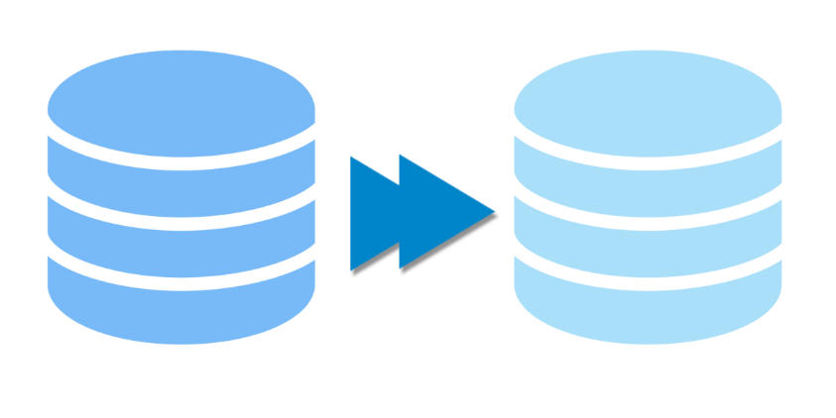
Scaling & Replication
Kubernetes was designed to orchestrate multiple containers and replication.
Need for multiple containers/replication helps us with these:
Reliability: By having multiple versions of an application, you prevent problems if one or more fails.
Load balancing: Having multiple versions of a container enables you to easily send traffic to different instances to prevent overloading of a single instance or node
Scaling: When load does become too much for the number of existing instances, Kubernetes enables you to easily scale up your application, adding additional instances as needed
Rolling updates: updates to a service by replacing pods one-by-one

Slide 48
Replication Controller
A Replication Controller is a object that enables you to easily create multiple pods, then make sure that that number of pods always exists.
If a pod created using RC will be automatically replaced if they does crash,fail, deleted or terminated
Using RC is recommended if you just want to make sure 1 pod is always running, even after system reboots
You can run the RC with 1 replica & the RC will make sure the pod is always running

Slide 49
RC – Example8: rc.yml
kind: ReplicationController # this defines to create the object of replication type
apiVersion: v1
metadata:
name: replicationcontroller
spec:
replicas: 2 # this element defines the desired number of pods
selector: # tells the controller which pods to watch/belong to this Replication Controller
myname: adam # these must match the labels
template: # template element defines a template to launch a new pod
metadata:
name: testpod6
labels: # selector values need to match the labels values specified in the pod template
myname: adam
spec:
containers:
- name: c00
image: ubuntu
command: ["/bin/bash", "-c", "while true; do echo Hello-Adam; sleep 5 ; done"]

Slide 50
$ kubectl apply -f rc.yml
$ kubectl get pods --show-labels
$ kubectl get pods -l myname=adam
$ kubectl get rc
Delete the pod & RC will recreate it
$ kubectl delete pods <podname>
$ kubectl describe rc <replicationcontrollername>
Scale Replicas:
$ kubectl scale --replicas=<num> rc/<replicationcontrollername> (OR)
$ kubectl scale --replicas=<num> <resourcetype> -l <key>=<value>
$ kubectl scale --replicas=2 rc -l myname=adam
Delete Replicationcontroller:
$ kubectl delete rc <replicationcontrollername>

Slide 51
Replication Set
ReplicaSet is the next generation Replication Controller
The replication controller only supports equality-based selector whereas the replica set supports set-based selector i.e filtering according to set of values
ReplicaSet rather than the Replication Controller is used by other objects like Deployment

Slide 52
RS – Example9: rc.yml
kind: ReplicaSet # Defines the object to be ReplicaSet
apiVersion: apps/v1 # Replicaset is not available on v1
metadata:
name: myreplicaset
spec:
replicas: 2 # this element defines the desired number of pods
selector: # tells the controller which pods to watch/belong to this Replication Set
matchExpressions: # these must match the labels
- {key: myname, operator: In, values: [adam, adamm, aadam]}
- {key: env, operator: NotIn, values: [production]}
template: # template element defines a template to launch a new pod
metadata:
name: testpod7
labels: # selector values need to match the labels values specified in the pod template
myname: adam
spec:
containers:
- name: c00
image: ubuntu
command: ["/bin/bash", "-c", "while true; do echo Hello-Adam; sleep 5 ; done"]

Slide 53
$ kubectl apply -f rs.yml
$ kubectl get rs
$ kubectl describe rs <replicasetname>
Scale Replicas:
$ kubectl scale --replicas=1 rs/myreplicaset (OR)
$ kubectl scale --replicas=2 rs -l myname=adam
Delete ReplicaSet:
$ kubectl delete rs <replicasetname>

Slide 54
Deployments

Slide 55
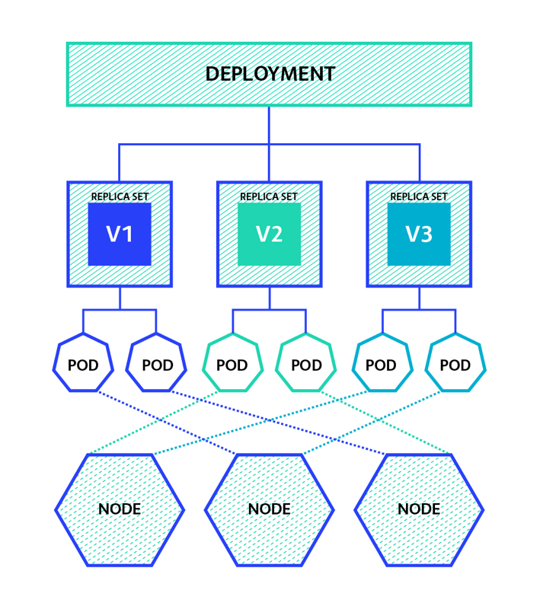
Deployments
Just using RC & RS might be cumbersome to deploy apps, update or rollback apps in the cluster
A Deployment object acts as a supervisor for pods, giving you fine-grained control over how and when a new pod is rolled out, updated or rolled back to a previous state
When using Deployment object, we first define the state of the App, then k8s master schedules mentioned app instance onto specific individual Nodes
K8s then monitors, if the Node hosting an instance goes
down or pod is deleted, the Deployment controller
replaces it.
This provides a self-healing mechanism to address
machine failure or maintenance.

Slide 56
The following are typical use cases for Deployments:
Create a Deployment to rollout a ReplicaSet. The ReplicaSet creates Pods in the background. Check the status of the rollout to see if it succeeds or not.
Declare the new state of the Pods by updating the PodTemplateSpec of the Deployment. A new ReplicaSet is created and the Deployment manages moving the Pods from the old ReplicaSet to the new one at a controlled rate. Each new ReplicaSet updates the revision of the Deployment.
Rollback to an earlier Deployment revision if the current state of the Deployment is not stable. Each rollback updates the revision of the Deployment.
Scale up the Deployment to facilitate more load.
Pause the Deployment to apply multiple fixes to its PodTemplateSpec and then resume it to start a new rollout.
Use the status of the Deployment as an indicator that a rollout has stuck.
Clean up older ReplicaSets that you don’t need anymore

Slide 57
Deployments – Example10: deployments.yml
kind: Deployment
apiVersion: extensions/v1beta1
metadata:
name: mydeployments
spec:
replicas: 2
template:
metadata:
name: testpod8
labels:
objtype: deployment
spec:
containers:
- name: c00
image: ubuntu
command: ["/bin/bash", "-c", "while true; do echo Hello-Adam; sleep 5 ; done"]

Slide 58
Creating a Deployment
$ kubectl apply -f pod8.xml
$ kubectl get deploy
$ kubectl describe deploy/<deploymentname>
$ kubectl get rs
$ kubectl get pods
Updating a Deployment
Change the echo cmd & save the yml content as new file & apply it:
$ kubectl apply –f <yml>
$ kubectl get pods
We will see the rollout of two new pods with the updated cmd, as well as old pods being terminated
Also, a new replica set has been created by the deployment
$ kubectl get rs
Recovering from crashes
$ kubectl delete pod <podname>
Scaling a Deployment
$ kubectl scale --replicas=<num> deployment/<deploymentname>

Slide 59
Manage the rollout of a resource
Usage $ kubectl rollout SUBCOMMAND OBJECT
history View rollout history
pause Mark the provided resource as paused
resume Resume a paused resource
status Show the status of the rollout
undo Undo a previous rollout
Deployment status
$ kubectl rollout status deployment/<deploymentname>
Deployment history
$ kubectl rollout history deploy/<deploymentname>

Slide 60
Rolling Back a Deployment
If there are problems in the deployment Kubernetes will automatically roll back to the previous version, however you can also explicitly roll back to a specific revision, as in our case to revision 1 (the original pod version)
$ kubectl rollout undo deploy/<deploymentname> --to-revision=1
$ kubectl rollout undo deploy/<deploymentname>
Set the image of the deployment
$ kubectl set image deployment/<deploymentname> <containername>=<image>
Remove the deployment, with it the replica sets and pods it supervises
$ kubectl delete deploy <deploymentname>
Pausing and Resuming a Deployment
$ kubectl rollout pause deploy/<deploymentname>
$ kubectl rollout resume deploy/<deploymentname>

Slide 61
Services

Slide 62
Services
When using RC, pods are terminated and created during scaling or replication operations
When using Deployments, while updating the image version the pods are terminated & new pods take the place of older pods.
Pods are very dynamic i.e they come & go on the k8s cluster and on any of the available nodes & it would be difficult to access the pods as the pods IP changes once its recreated
Service Object is an logical bridge between pods & endusers, which provides Virtual IP (VIP) address.
Service allows clients to reliably connect to the containers running in the pod using the VIP.
The VIP is not an actual IP connected to a network interface, but its purpose is purely to forward traffic to one or more pods.
kube-proxy is the one which Keeps the mapping between the VIP and the pods up-to-date, which queries the API server to learn about new services in the cluster.

Slide 63
Although each Pod has a unique IP address, those IPs are not exposed outside the cluster.
Services helps to expose the VIP mapped to the pods & allows applications to receive traffic
Labels are used to select which are the Pods to be put under a Service.
Creating a Service will create an endpoint to access the pods/Application in it.
Services can be exposed in different ways by specifying a type in the Service Spec:
ClusterIP (default) - Exposes VIP only reachable from within the cluster.
NodePort - Exposes the Service on the same port of each selected Node in the cluster using NAT. Makes a Service accessible from outside the cluster using <NodeIP>:<NodePort>.
LoadBalancer - Created by cloud providers that will route external traffic to every node on the NodePort (ex: ELB on AWS).
By default service can run only between ports 30000-32767

Slide 64
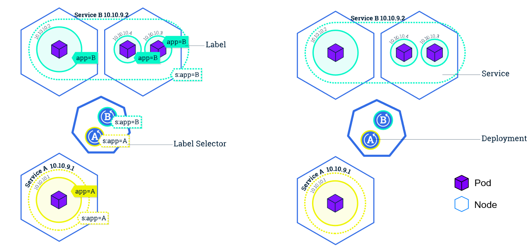

Slide 65
Services – Example11: podwithports.yml
kind: Pod
apiVersion: v1
metadata:
name: testservice
labels:
myvalue: demo # Label for applying service later
spec:
containers:
- name: c00
image: httpd
ports:
- containerPort: 80 # Expose port 80 from container
$ kubectl describe pod <podname>

Slide 66
Services – Example11: service.yml
kind: Service # Defines to create Service type Object
apiVersion: v1
metadata:
name: demoservice
spec:
ports:
- port: 80 # Containers port exposed
targetPort: 80 # Pods port
selector:
myvalue: demo # Apply this service to any pods which has the specific label
type: <type> # Specifies the service type i.e ClusterIP or NodePort

Slide 67
List the services available in the cluster
$ kubectl apply –f service.yml
$ kubectl get svc
$ kubectl describe pod <podname>
- curl <podIP>:80
$ kubectl describe svc <servicename>
- curl <serviceIP>:80
Delete a service
$ kubectl delete svc <servicename>
Change the Service type to NodePort & try accessing the port 80 from Node
$ kubectl describe svc <servicename>
- http://<publicIP>:<NodePort-exposedby-service>

Slide 68
HealthChecks

Slide 69

Health Checks
A Pod is considered ready when all of its Containers are ready.
In order to verify if a container in a pod is healthy and ready to serve traffic, Kubernetes provides for a range of health checking mechanisms
Health checks, or probes are carried out by the kubelet to determine when to restart a container (for livenessProbe) and used by services and deployments to determine if a pod should receive traffic (for readinessProbe).
For example, liveness probes could catch a deadlock, where an application is running, but unable to make progress. Restarting a Container in such a state can help to make the application more available despite bugs.
One use of readiness probes is to control which Pods are used as backends for Services. When a Pod is not ready, it is removed from Service load balancers.
For running healthchecks we would use cmds specific to the application.
If the command succeeds, it returns 0, and the kubelet considers the Container to be alive and healthy. If the command returns a non-zero value, the kubelet kills the Container and restarts it.

Slide 70
LivenessProbe With CMD – Example12: livenessprobecmd.yml
apiVersion: v1
kind: Pod
metadata:
labels:
test: liveness
name: mylivenessprobe
spec:
containers:
- name: liveness
image: ubuntu
args:
- /bin/sh
- -c
- touch /tmp/healthy; sleep 1000
livenessProbe: # define the health check
exec:
command: # command to run periodically
- cat
- /tmp/healthy
initialDelaySeconds: 5 # Wait for the specified time before it runs the first probe
periodSeconds: 5 # Run the above command every 5 sec
timeoutSeconds: 30 # Seconds to timeout if the cmd is not responding

Slide 71
$ kubectl apply –f livenessprobecmd.yml
$ kubectl describe pod mylivenessprobe
Delete the file & kubelet would recreate the container
$ kubectl exec mylivenessprobe -- rm /tmp/healthy
$ kubectl describe pod mylivenessprobe

Slide 72
LivenessProbe With URL – Example13: livenessprobeurl.yml
apiVersion: v1
kind: Pod
metadata:
labels:
test: liveness
name: mylivenessprobeurl
spec:
containers:
- name: c00
image: httpd
ports:
- containerPort: 80
livenessProbe:
initialDelaySeconds: 2
periodSeconds: 5
httpGet: # HTTP URL to check periodically
path: / # Endpoint to check inside the container / means http://localhost/
port: 80 # Specific port to check

Slide 73
$ kubectl apply –f livenessprobeurl.yml
$ kubectl describe pod mylivenessprobeurl
Delete the file & kubelet would recreate the container
$ kubectl exec mylivenessprobeurl -- service stop httpd
$ kubectl describe pod mylivenessprobeurl

Slide 74
Readiness check
While both liveness and readiness check and describe the state of the service, they serve quite a different purpose.
Liveness describes if the pod has started and everything inside it is ready to take the load. If not, then it gets restarted. This does not include any external dependencies like for example databases, which are clearly something the service doesn't have control over. We don't get much benefit if we restart the service when the database is down, because it will not help.
This is where Readiness checks come in. This is basically a check if the application can handle the incoming requests.
It should do a sanity check against both internal and external elements that make the service go, so the connection to the database should be checked there.
If the check fails, the service is not being restarted, but the Kubernetes will not direct any traffic to it. This is particularly useful if we perform a rolling update and the new version has some issue connecting to the DB. In this case, it stays not ready, but those instances are not being restarted.

Slide 75
ReadinessProbe With URL – Example13: readinessprobeurl.yml
kind: Pod
apiVersion: v1
metadata:
name: testservice
labels:
myvalue: demo
spec:
containers:
- name: c00
image: httpd
ports:
- containerPort: 80
livenessProbe:
initialDelaySeconds: 2
periodSeconds: 5
httpGet:
path: /
port: 80
readinessProbe: # Healthcheck for readiness
initialDelaySeconds: 10
httpGet:
path: /
port: 80

Slide 76
When to use Readiness and Liveness Probes
Despite how great readiness and liveness probes can be, they’re not always necessary. When updating deployments, Kubernetes will already wait for a replacement pod to start running before removing the old pod. Additionally, if a pod stops running, it will automatically try to restart it. Where these probes prove their worth is the time between when a pod starts running and when your service actually starts functioning. Kubernetes already knows if your container is running, probes let it know if your container is functioning.
If one of our services take time between when a pod starts running and the service is actually responding to requests can be significant (5–10 seconds). Without a readiness probe, we’d end up with at least that much downtime every time we updated that deployment.
Additionally, we have a number of services that can fail in ways that don’t always result in the container crashing. These aren’t particularly common, but when it happens, it’s nice to have a livenessprobe around to catch the issue and restart the container.

Slide 77

Volumes
Containers are ephemeral (short lived in nature).
All data stored inside a container is deleted if the container crashes. However, the kubelet will restart it with a clean state, which means that it will not have any of the old data
To overcome this problem, Kubernetes uses Volumes. A Volume is essentially a directory backed by a storage medium. The storage medium and its content are determined by the Volume Type.
In Kubernetes, a Volume is attached to a Pod and shared among the containers of that Pod.
The Volume has the same life span as the Pod, and it outlives the containers of the Pod - this allows data to be preserved across container restarts.

Slide 78
Volume Types
A Volume Type decides the properties of the directory, like size, content, etc. Some examples of Volume Types are:
node-local types such as emptyDir and hostPath
file-sharing types such as nfs
cloud provider-specific types like awsElasticBlockStore, azureDisk, or gcePersistentDisk
distributed file system types, for example glusterfs or cephfs
special-purpose types like secret, gitRepo
persistentVolumeClaim

Slide 79
emptyDir
Use this when we want to share contents between multiple containers on the same pod & not to the host machine
An emptyDir volume is first created when a Pod is assigned to a Node, and exists as long as that Pod is running on that node.
As the name says, it is initially empty.
Containers in the Pod can all read and write the same files in the emptyDir volume, though that volume can be mounted at the same or different paths in each Container.
When a Pod is removed from a node for any reason, the data in the emptyDir is deleted forever.
A Container crashing does not remove a Pod from a node, so the data in an emptyDir volume is safe across Container crashes.

Slide 80
emptyDir – Example14: emptyDir.yml
apiVersion: v1
kind: Pod
metadata:
name: myvolemptydir
spec:
containers:
- name: c1
image: centos
command:
- "bin/bash"
- "-c"
- "sleep 10000"
volumeMounts: # Mount definition inside the container
- name: xchange
mountPath: "/tmp/xchange“ # Path inside the container to share
- name: c2
image: centos
command:
- "bin/bash"
- "-c"
- "sleep 10000"
volumeMounts:
- name: xchange
mountPath: "/tmp/data"
volumes: # Definition for host
- name: xchange
emptyDir: {}

Slide 81
$ kubectl apply –f emptyDir.yml
$ kubectl describe pods myvolemptydir
create a file in c1 container
$ kubectl exec myvolemptydir -c c1 -i -t -- bash
echo “Testing” > /tmp/xchange/test
$ kubectl exec myvolemptydir -c c2 -i -t – bash
cat /tmp/xchange/test
mount|grep "/tmp/data"

Slide 82
hostPath
Use this when we want to access the content of a pod/container from hostmachine
A hostPath volume mounts a file or directory from the host node’s filesystem into your Pod.
For example, some uses for a hostPath are:
running a Container that needs access to Docker internals; use a hostPath of /var/lib/docker
allowing a Pod to specify whether a given hostPath should exist prior to the Pod running, whether it should be created, and what it should exist as

Slide 83
hostPath – Example14: hostPath.yml
apiVersion: v1
kind: Pod
metadata:
name: myvolhostpath
spec:
containers:
- image: centos
name: testc
command:
- "bin/bash"
- "-c"
- "sleep 10000"
volumeMounts:
- mountPath: /tmp/hostpath
name: testvolume
volumes:
- name: testvolume
hostPath:
path: /tmp/data # directory location on host
# If this dir doesnt exist at the given path, an empty directory will be created with 755
#type: Directory

Slide 84
$ kubectl apply –f hostpath.yml
$ kubectl describe pods myvolhostpath
create a dummy file under /tmp/data on host
$ kubectl exec myvolhostpath -c testc -i -t -- bash
ls /tmp/hostpath

Slide 85
PersistentVolumes
In a typical IT environment, storage is managed by the storage/system administrators. The end user will just get instructions to use the storage, but does not have to worry about the underlying storage management.
In the containerized world, we would like to follow similar rules, but it becomes challenging, given the many Volume Types we have seen earlier. Kubernetes resolves this problem with the PersistentVolume (PV) subsystem.
A persistent volume (PV) is a cluster-wide resource that you can use to store data in a way that it persists beyond the lifetime of a pod.
The PV is not backed by locally-attached storage on a worker node but by networked storage system such as EBS or NFS or a distributed filesystem like Ceph.
K8s provides APIs for users and administrators to manage and consume storage. To manage the Volume, it uses the PersistentVolume API resource type, and to consume it, uses the PersistentVolumeClaim API resource type.

Slide 86
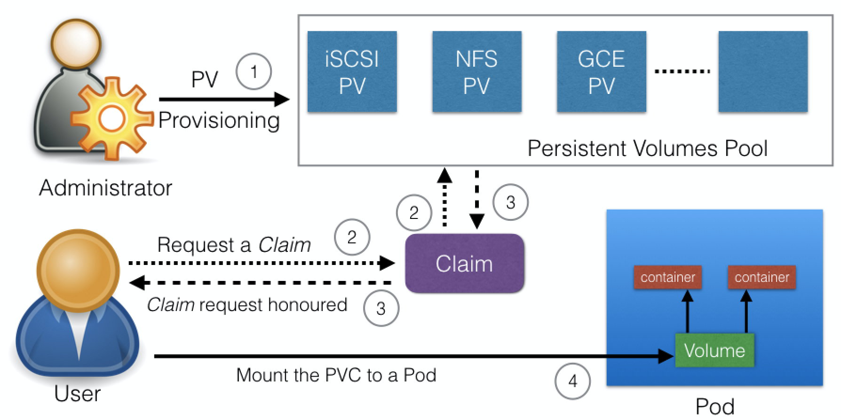
PersistentVolumeClaims
In order to use a PV you need to claim it first, using a persistent volume claim (PVC).
The PVC requests a PV with your desired specification (size, access modes, speed, etc.) from Kubernetes and once a suitable PersistentVolume is found, it is bound to a PersistentVolumeClaim.
After a successful bound to a pod, you can mount it as a volume.
Once a user finishes its work, the attached PersistentVolumes can be released. The underlying PersistentVolumes can then be reclaimed and recycled for future usage.

Slide 87
awsElasticBlockStore
An awsElasticBlockStore volume mounts an Amazon Web Services (AWS) EBS Volume into your Pod. Unlike emptyDir, which is erased when a Pod is removed, the contents of an EBS volume are preserved and the volume is merely unmounted.
This means that an EBS volume can be pre-populated with data, and that data can be “handed off” between Pods.
There are some restrictions when using an awsElasticBlockStore volume:
the nodes on which Pods are running must be AWS EC2 instances
those instances need to be in the same region and availability-zone as the EBS volume
EBS only supports a single EC2 instance mounting a volume

Slide 88
PersistentVolumeClaim – Example15: ebspvc.yml
apiVersion: v1
kind: PersistentVolumeClaim
metadata:
name: myebsvolclaim
spec:
accessModes:
- ReadWriteOnce
resources:
requests:
storage: 1Gi
$ kubectl apply –f ebspvc.yml
$ kubectl get pvc

Slide 89
PersistentVolume – Example15: ebspv.yml
apiVersion: v1
kind: PersistentVolume
metadata:
name: myebsvol
spec:
capacity:
storage: 1Gi
accessModes:
- ReadWriteOnce
persistentVolumeReclaimPolicy: Recycle
awsElasticBlockStore:
volumeID: <MY-EBS-VOLUME-ID>
fsType: ext4
$ kubectl apply –f ebspv.yml
$ kubectl get pv
Notes:
AWS->services->EC2->Volumes

Slide 90
Deployment with PersistentVolume – Example15: ebsdeploy.yml
apiVersion: extensions/v1beta1
kind: Deployment
metadata:
name: ebspvdeploy
spec:
replicas: 1
template:
metadata:
labels:
app: mypv
spec:
containers:
- name: shell
image: centos
command:
- "bin/bash"
- "-c"
- "sleep 10000"
volumeMounts:
- name: mypd
mountPath: "/tmp/persistent"
volumes:
- name: mypd
persistentVolumeClaim:
claimName: myebsvolclaim

Slide 91
$ kubectl apply -f ebsdeploy.yml
$ kubectl get pods
$ kubectl get pvc
$ kubectl get pv
$ kubectl exec -it <podname> -- bash
- touch /tmp/persistent/TESTFILE
Create a new deployment/pod & you can see the same file exists on new pod
$ kubectl exec -it <newpodname> -- bash
- ls /tmp/persistent/TESTFILE
$ kubectl delete pvc <pvclaimname>

Slide 92
Namespace
You can name your object, but if many are using the cluster then it would be difficult for managing.
A namespace is a group of related elements that each have a unique name or identifier. Namespace is used to uniquely identify one or more names from other similar names of different objects, groups or the namespace in general.
Kubernetes namespaces help different projects, teams, or customers to share a Kubernetes cluster & provides:
A scope for every Names.
A mechanism to attach authorization and policy to a subsection of the cluster.
By default, a Kubernetes cluster will instantiate a default namespace when provisioning the cluster to hold the default set of Pods, Services, and Deployments used by the cluster
We can use resource quota on specifying how many resources each namespace can use.
Most Kubernetes resources (e.g. pods, services, replication controllers, and others) are in some namespaces. And low-level resources, such as nodes and persistentVolumes, are not in any namespace.
Namespaces are intended for use in environments with many users spread across multiple teams, or projects. For clusters with a few to tens of users, you should not need to create or think about namespaces at all.

Slide 93
Create new namespaces
Lets assume we have shared Kubernetes cluster for dev & QA use cases.
The dev team would like to maintain a space in the cluster where they can get a view on the list of Pods, Services, and Deployments they use to build and run their application. In this no restrictions are put on who can or cannot modify resources to enable agile development.
For QA team we can enforce strict procedures on who can or cannot manipulate the set of Pods, Services, and Deployments.
Partition the Kubernetes cluster into two namespaces: dev & QA
$ kubectl get namespaces

Slide 94
Namespace – Example16: nsdev.yml & nsqa.yml
---nsdev.yml---
apiVersion: v1
kind: Namespace
metadata:
name: development
labels:
name: development
---nsqa.yml---
apiVersion: v1
kind: Namespace
metadata:
name: testing
labels:
name: testing
$ kubectl apply -f nsdev.yml
$ kubectl apply -f nsqa.yml
$ kubectl get namespaces (or) $ kubectl get namespaces --show-labels

Slide 95
Create a Sample pod:
kind: Pod
apiVersion: v1
metadata:
name: testpod
spec:
containers:
- name: c00
image: ubuntu
command: ["/bin/bash", "-c", "while true; do echo Hello-Adam; sleep 5 ; done"]
Lauch a pod in the new namespace temporarily:
$ kubectl apply --namespace=<namespace> -f <yml>
List the pods specific to namespace
$ kubectl get pods # this will not list any pods
$ kubectl get pods --namespace=<namespace>
$ kubectl delete namespace <namespace>

Slide 96
Save the namespace for all subsequent kubectl commands in that context:
$ kubectl config set-context $(kubectl config current-context) --namespace=<insert-namespace-name-here>
Create a new pod & validate it
$ kubectl apply –f <yml>
$ kubectl config view | grep namespace:
To see which Kubernetes resources are and aren’t in a namespace:
$ kubectl api-resources --namespaced=true # In a namespace
$ kubectl api-resources --namespaced=false # Not in a namespace

Slide 97
Secrets & ConfigMap

Slide 98
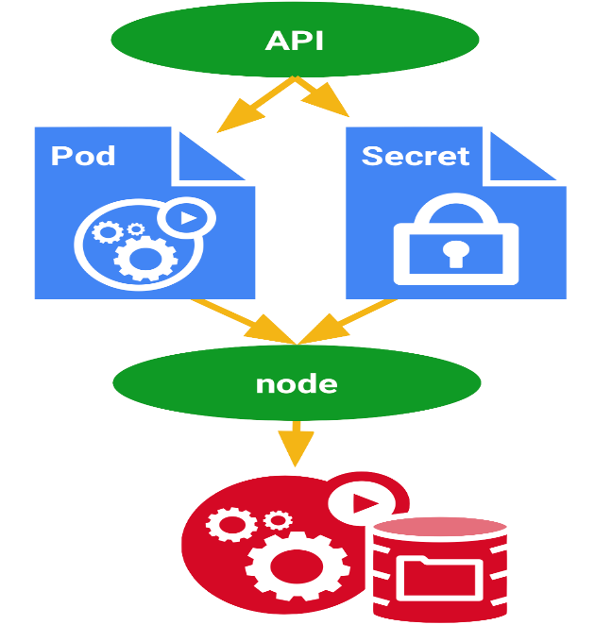
Secrets
You don’t want sensitive information such as a database password or an API key kept around in clear text
Secrets provide you with a mechanism to use such information in a safe and reliable way with the following properties:
Secrets are namespaced objects, that is, exist in the context of a namespace
You can access them via a volume or an environment variable from a container running in a pod
The secret data on nodes is stored in tmpfs volumes (Tmpfs is a file system which keeps all files in virtual memory. Everything in tmpfs is temporary in the sense that no files will be created on your hard drive.)
A per-secret size limit of 1MB exists
The API server stores secrets as plaintext in etcd

Slide 99
Secrets can be created :
from a text file
from a Yaml file
Secrets can be accessed in following ways:
use secrets as environment variables
use secrets as volumes in the pod
Create a secret from a text file or dir (generic type)
$ echo "root" > username.txt; echo "password" > password.txt
$ kubectl create secret <type> <secretname> --from-file=<filetoread>
$ kubectl create secret generic mysecret --from-file=username.txt --from-file=password.txt
$ kubectl describe secrets/<secretname>

Slide 100
Using Secrets through Volumes – Example17: volsecrets.yml
apiVersion: v1
kind: Pod
metadata:
name: myvolsecret
spec:
containers:
- name: c1
image: centos
command: ["/bin/bash", "-c", "while true; do echo Hello-Adam; sleep 5 ; done"]
volumeMounts:
- name: testsecret
mountPath: "/tmp/mysecrets" # the secret files will be mounted as ReadOnly by default here
volumes:
- name: testsecret
secret:
secretName: <secretname> # this should match the secret name created in the first step

Slide 101
$ kubectl apply -f volsecrets.yml
Create a container & verify the secrets mounted
$ kubectl exec myvolsecret -i -t -- /bin/bash
- ls /tmp/secrets (readonly)
- ls -al /tmp/secrets

Slide 102
Using Secrets through Environment Variables – Example18: envsecrets.yml
apiVersion: v1
kind: Pod
metadata:
name: myenvsecret
spec:
containers:
- name: c1
image: centos
command: ["/bin/bash", "-c", "while true; do echo Hello-Adam; sleep 5 ; done"]
env:
- name: MYENVUSER # env name in which value of the key is stored
valueFrom:
secretKeyRef:
name: mysecret # name of the secret created
key: username.txt # name of the key

Slide 103
Create secret from a YAML file – Example19: yamlsecrets.yml
apiVersion: v1
kind: Secret # this defines to create a secret object
metadata:
name: myyamlsecret
type: Opaque
data:
<keyname>: <value> # value must be in 'base64 data‘
# myname: YWRhbQo=
$ echo adam | base64
$ kubectl apply -f yamlsecrets.yml
$ kubectl describe secrets/myyamlsecret

Slide 104
Accessing the secret using environment variable– Example20: yamlenvsecrets.yml
apiVersion: v1
kind: Pod
metadata:
name: yamlenvsecret
spec:
containers:
- name: c1
image: centos
command: ["/bin/bash", "-c", "while true; do echo Hello-Adam; sleep 5 ; done"]
env:
- name: MYENVUSER # env name in which value of the key is stored
valueFrom:
secretKeyRef:
name: myyamlsecret # name of the secret created
key: myname # name of the key

Slide 105
$ kubectl apply -f yamlenvsecrets.yml
$ kubectl exec yamlenvsecret -it -- /bin/bash
- env |grep MYENVUSER

Slide 106
ConfigMap
While performing application deployments on kubernetes cluster, sometimes we need to change the application configuration file depending on environments like dev, qa, stage or prod.
Changing this application configuration file means we need to change source code, commit the change, creating a new image and then go through the complete deployment process.
Hence these configurations should be decoupled from image content in order to keep containerized applications portable.
This is where Kubernetes’s ConfigMap comes handy. It allows us to handle configuration files much more efficiently.
ConfigMaps are useful for storing and sharing non-sensitive, unencrypted configuration information. Use secrets otherwise.
ConfigMap can be used to store fine-grained information like individual properties or entire config files.
ConfigMaps are not intended to act as a replacement for a properties file.

Slide 107
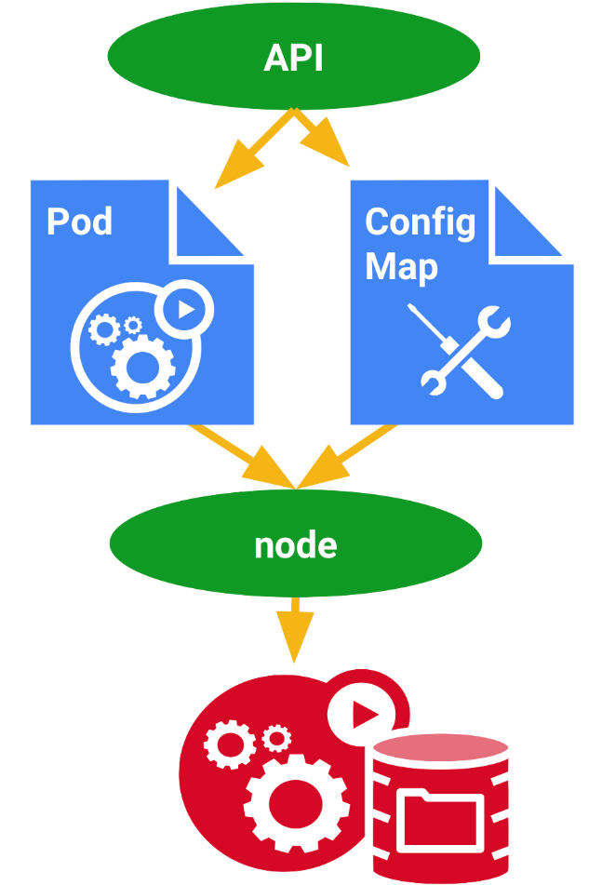
Create a ConfigMap:
We can create configmaps:
From command
From files
ConfigMap can be accessed in following ways:
As environment variables
As volumes in the pod
Create ConfigMaps from files
$ kubectl create configmap <mapname> --from-file=<filetoread>
$ kubectl create configmap mymap --from-file=sample.conf
$ kubectl describe configmaps/<mapname>
$ kubectl get configmap <mapname> -o yaml

Slide 108
Using ConfigMap through Volumes – Example: volconfig.yml
apiVersion: v1
kind: Pod
metadata:
name: myvolconfig
spec:
containers:
- name: c1
image: centos
command: ["/bin/bash", "-c", "while true; do echo Hello-Adam; sleep 5 ; done"]
volumeMounts:
- name: testconfigmap
mountPath: "/tmp/config" # the config files will be mounted as ReadOnly by default here
volumes:
- name: testconfigmap
configMap:
name: <mapname> # this should match the config map name created in the first step
items:
- key: <filename> # the name of the file used during creating the map
path: <filename> # the name of the file to be present inside the volume

Slide 109
$ kubectl apply -f volconfig.yml
Create a container & verify the Configs mounted
$ kubectl exec myvolconfig -i -t -- /bin/bash
- ls /tmp/config (readonly)

Slide 110
Using Configmap through Environment Variables – Example: envconfig.yml
apiVersion: v1
kind: Pod
metadata:
name: myenvconfig
spec:
containers:
- name: c1
image: centos
command: ["/bin/bash", "-c", "while true; do echo Hello-Adam; sleep 5 ; done"]
env:
- name: MYENV # env name in which value of the key is stored
valueFrom:
configMapKeyRef:
name: <mapname> # name of the config created
key: <keyname> # name of the file or key to be used

Slide 111
$ kubectl apply -f envconfig.yml
Create a container & verify the Configs mounted
$ kubectl exec myenvconfig -i -t -- /bin/bash
- echo $MYENV

Slide 112
Create ConfigMap from a YAML file – Example: yamlconfig.yml
apiVersion: v1
kind: ConfigMap # Defines the object to be Configmap
metadata:
name: myyamlmap
# namespace: default # Can specify which namespace to relate
data:
<keyname> : <value> # data to be stored
# SKILL: devops
# CLASS: kubernetes
$ kubectl apply -f yamlconfig.yml
$ kubectl describe configmaps/<mapname>
$ kubectl get configmap <mapname> -o yaml

Slide 113
Accessing Config using environment variable - Example20: yamlenvconfig.yml
apiVersion: v1
kind: Pod
metadata:
name: yamlenvconfig
spec:
containers:
- name: c1
image: centos
command: ["/bin/bash", "-c", "while true; do echo Hello-Adam; sleep 5 ; done"]
env:
- name: MYENV # env name in which value of the key is stored
valueFrom:
configMapKeyRef:
name: myyamlmap
key: SKILL # name of the key

Slide 114
$ kubectl apply -f yamlenvconfig.yml
$ kubectl exec yamlenvsecret -it -- /bin/bash
- env |grep MYENVUSER

Slide 115
Accessing the Config using Volumes – Example: yamlvolconfig.yml
apiVersion: v1
kind: Pod
metadata:
name: yamlvolsecret
spec:
containers:
- name: c1
image: centos
command: ["/bin/bash", "-c", "while true; do echo Hello-Adam; sleep 5 ; done"]
volumeMounts:
- name: testconfig
mountPath: "/tmp/mysecrets" # the config files will be mounted as ReadOnly by default here
volumes:
- name: testconfig
configMap:
secretName: myyamlmap

Slide 116
$ kubectl apply -f yamlvolconfig.yml
$ kubectl exec yamlvolconfig -it -- /bin/bash
- ls /tmp/myconfig

Slide 117
Managing Compute Resources for Containers
A pod in Kubernetes will run with no limits on CPU and memory
You can optionally specify how much CPU and memory (RAM) each Container needs.
Scheduler decides about which nodes to place Pods, only if the Node has enough CPU resources available to satisfy the Pod CPU request
CPU is specified in units of cores, and memory is specified in units of bytes.
Two types of constraints can be set for each resource type: requests and limits
A request is the amount of that resources that the system will guarantee for the container, and Kubernetes will use this value to decide on which node to place the pod
A limit is the maximum amount of resources that Kubernetes will allow the container to use. In the case that request is not set for a container, it defaults to limit. If limit is not set, then if defaults to 0 (unbounded).
CPU values are specified in “millicpu” and memory in MiB

Slide 118
Pod Resources – Example5: podresources.yml
apiVersion: v1
kind: Pod
metadata:
name: resources
spec:
containers:
- name: resource
image: centos
command: ["/bin/bash", "-c", "while true; do echo Hello-Adam; sleep 5 ; done"]
resources: # Describes the type of resources to be used
requests:
memory: "<value in mebibytes>" # A mebibyte is 1,048,576 bytes, ex: 64Mi
cpu: "<value in millicores >" # CPU core split into 1000 units (milli = 1000), ex: 100m
limits:
memory: "<value in mebibytes>" # ex: 128Mi
cpu: "<value in millicores >" # ex: 200m

Slide 119
$ kubectl apply -f podresources.yml
$ kubectl describe pods resources
To see the pods that uses the most cpu and memory
$ kubectl top pod --all-namespaces
To see the total cpu, memory usage of all pods
$ kubectl get nodes --no-headers | awk '{print $1}' | xargs -I {} sh -c 'echo {}; kubectl describe node {} | grep Allocated -A 5 | grep -ve Event -ve Allocated -ve percent -ve -- ; echo‘

Slide 120

Resource Quotas
A Kubernetes cluster can be divided into namespaces. If a Container is created in a namespace that has a default CPU limit, and the Container does not specify its own CPU limit, then the Container is assigned the default CPU limit.
Namespaces can be assigned ResourceQuota objects, this will limit the amount of usage allowed to the objects in that namespace. You can limit:
Compute
Storage
Memory
Here are two of the restrictions that a resource quota imposes on a namespace:
Every Container that runs in the namespace must have its own CPU limit.
The total amount of CPU used by all Containers in the namespace must not exceed a specified limit.

Slide 121
Ex: Lets examine a deployment which has 3 replicas where each containers uses 200m, however set the namespace to use 400m allocated
-- cpulimit.yaml--
apiVersion: v1
kind: ResourceQuota
metadata:
name: myquota
spec:
hard:
limits.cpu: "400m"
limits.memory: “400Mi"
requests.cpu: "200m"
requests.memory: "200Mi"
$ kubectl apply -f cpulimit.yml --namespace=testing

Slide 122
ResourceQuota - Example21: quotadeploy.yml
kind: Deployment
apiVersion: extensions/v1beta1
metadata:
name: deployments
spec:
replicas: 3
template:
metadata:
name: testpod8
labels:
objtype: deployment
spec:
containers:
- name: c00
image: ubuntu
command: ["/bin/bash", "-c", "while true; do echo Hello-Adam; sleep 5 ; done"]
resources:
requests:
cpu: "200m"

Slide 123
$ kubectl apply -f quotadeploy.yml --namespace=testing
$ kubectl get pods --namespace=testing
$ kubectl describe deployments deployments --namespace=testing
$ kubectl delete -f cpulimit.yml --namespace=testing

Slide 124
Configure Default CPU Requests and Limits for a Namespace
Create a LimitRange and a Pod: cpudefault.yml
apiVersion: v1
kind: LimitRange
metadata:
name: cpu-limit-range
spec:
limits:
- default:
cpu: 1
defaultRequest:
cpu: 0.5
type: Container

Slide 125
$ kubectl apply -f cpudefault.yml --namespace=testing
Create a pod - cpupod.yml
apiVersion: v1
kind: Pod
metadata:
name: default-cpu-demo
spec:
containers:
- name: default-cpu-demo-ctr
image: nginx
$ kubectl apply -f cpupod.yml --namespace=testing
$ kubectl get pod default-cpu-demo --output=yaml --namespace=testing
The output shows that the Pod’s Container has a CPU request of 500 millicpus and a CPU limit of 1 cpu. These are the default values specified by the LimitRange

Slide 126
What if you specify a Container’s limit, but not its request?
Create a Pod in which the Container specifies a CPU limit, but not a request: cpupod2.yml
apiVersion: v1
kind: Pod
metadata:
name: default-cpu-demo-2
spec:
containers:
- name: default-cpu-demo-2-ctr
image: nginx
resources:
limits:
cpu: "1"

Slide 127
$ kubectl apply -f cpupod2.yml --namespace=testing
$ kubectl get pod default-cpu-demo-2 --output=yaml --namespace=testing
The output shows that the Container’s CPU request is set to match its CPU limit.
Notice that the Container was not assigned the default CPU request value of 0.5 cpu.

Slide 128
What if you specify a Container’s request, but not its limit?
Create a Pod in which the Container specifies a CPU request, but not a limit: cpupod3.yml
apiVersion: v1
kind: Pod
metadata:
name: default-cpu-demo-3
spec:
containers:
- name: default-cpu-demo-3-ctr
image: nginx
resources:
requests:
cpu: "0.75"

Slide 129
$ kubectl create -f cpupod3.yml --namespace=testing
$ kubectl get pod default-cpu-demo-3 --output=yaml --namespace=testing
The output shows that the Container’s CPU request is set to the value specified in the Container’s configuration file.
The Container’s CPU limit is set to 1 cpu, which is the default CPU limit for the namespace

Slide 130
Configure Min & Max Memory Constraints for a Namespace
Create a LimitRange and a Pod: memdefault.yml
apiVersion: v1
kind: LimitRange
metadata:
name: mem-min-max-demo-lr
spec:
limits:
- max:
memory: 1Gi
min:
memory: 500Mi
type: Container

Slide 131
$ kubectl apply -f memdefault.yml --namespace=testing
$ kubectl get limitrange mem-min-max-demo-lr --namespace=testing
Create a pod - mempod.yml
apiVersion: v1
kind: Pod
metadata:
name: constraints-mem-demo
spec:
containers:
- name: constraints-mem-demo-ctr
image: nginx
resources:
limits:
memory: "800Mi"
requests:
memory: "600Mi"
$ kubectl apply -f mempod.yml --namespace=testing
$ kubectl get pod constraints-mem-demo --output=yaml --namespace=testing
The output shows that the Container has a memory request of 600 MiB and a memory limit of 800 MiB. These satisfy the constraints imposed by the LimitRange.

Slide 132
Attempt to create a Pod that exceeds the maximum memory constraint
Create a Pod in which the Container specifies a memory request of 800 MiB and a memory limit of 1.5 GiB: mempod2.yml
apiVersion: v1
kind: Pod
metadata:
name: constraints-mem-demo-2
spec:
containers:
- name: constraints-mem-demo-2-ctr
image: nginx
resources:
limits:
memory: "1.5Gi"
requests:
memory: "800Mi"

Slide 133
$ kubectl apply -f mempod2.yml --namespace=testing
$ kubectl get pod constraints-mem-demo-2 --output=yaml --namespace=testing
The output shows that the Pod does not get created, because the Container specifies a memory limit that is too large

Slide 134
Attempt to create a Pod that does not meet the minimum memory request
Create a Pod in which the Container specifies a memory request of 100 MiB and a memory limit of 800 MiB: mempod3.yml
apiVersion: v1
kind: Pod
metadata:
name: constraints-mem-demo-3
spec:
containers:
- name: constraints-mem-demo-3-ctr
image: nginx
resources:
limits:
memory: "800Mi"
requests:
memory: "100Mi"

Slide 135
$ kubectl apply -f mempod3.yml --namespace=testing
$ kubectl get pod constraints-mem-demo-3 --output=yaml --namespace=testing
The Pod does not get created, because the Container specifies a memory request that is too small

Slide 136
Create a Pod that does not specify any memory request or limit
Create a Pod in which the Container does not specify a memory request, and it does not specify a memory limit: mempod4.yml
apiVersion: v1
kind: Pod
metadata:
name: constraints-mem-demo-4
spec:
containers:
- name: constraints-mem-demo-4-ctr
image: nginx

Slide 137
$ kubectl create -f mempod4.yml --namespace=testing
$ kubectl get pod constraints-mem-demo-4 --output=yaml --namespace=testing
The output shows that the Pod’s Container has a memory request of 1 GiB and a memory limit of 1 GiB

Slide 138
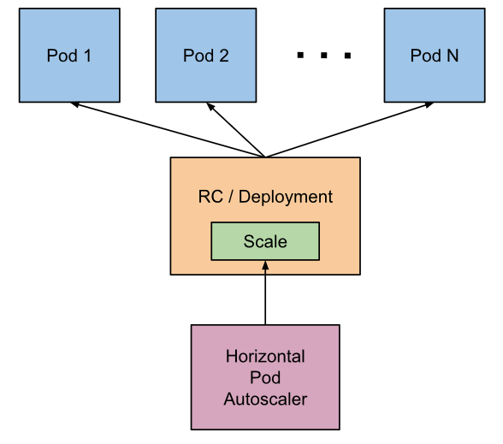
Autoscalling (Horizontal Pod Autoscaler)
K8s has the possibility to automatically scale pods based on observed CPU utilization (or with custom metrics), which is Horizontal Pod Autoscaling
Scaling can be done only for scalable objects like controller, deployment or replica set.
HPA is implemented as a Kubernetes API resource and a controller.
The controller periodically adjusts the number of replicas in a replication controller or deployment to match the observed average CPU utilization to the target specified by user.

Slide 139
How does the Horizontal Pod Autoscaler work?
The HPA is implemented as a control loop, with a period controlled by the controller manager’s --horizontal-pod-autoscaler-sync-period flag (with a default value of 15 seconds).
During each period, the controller manager queries the resource utilization against the metrics specified in each HorizontalPodAutoscaler definition.
For per-pod resource metrics (like CPU), the controller fetches the metrics from the resource metrics API for each pod targeted by the HorizontalPodAutoscaler.
Then, if a target utilization value is set, the controller calculates the utilization value as a percentage of the equivalent resource request on the containers in each pod.
If a target raw value is set, the raw metric values are used directly. The controller then takes the mean of the utilization or the raw value (depending on the type of target specified) across all targeted pods, and produces a ratio used to scale the number of desired replicas

Slide 140
deployhpa.yml
kind: Deployment
apiVersion: extensions/v1beta1
metadata:
name: mydeployments
spec:
replicas: 2
template:
metadata:
name: testpod
labels:
myvalue: demo
spec:
containers:
- name: c00
image: httpd
ports:
- containerPort: 80
resources:
requests:
cpu: 200m

Slide 141
Servicehpa.yml
kind: Service # Defines to create Service type Object
apiVersion: v1
metadata:
name: demoservice
spec:
ports:
- port: 80 # Containers port exposed
targetPort: 80 # Pods port
selector:
myvalue: demo

Slide 142
hpa.yml
kind: HorizontalPodAutoscaler
apiVersion: autoscaling/v1
metadata:
name: myhpa
spec:
scaleTargetRef:
apiVersion: extensions/v1beta1
kind: Deployment
name: mydeployments
minReplicas: 1
maxReplicas: 5
targetCPUUtilizationPercentage: 50

Slide 143
$ kubectl apply -f deployhpa.yml
$ kubectl apply -f servicehpa.yml
$ kubectl apply -f hpa.yml
$ kubectl get hpa

Slide 144
Logging
Logging is one option to understand what is going on inside your applications and the cluster at large
apiVersion: v1
kind: Pod
metadata:
name: logme
spec:
containers:
- name: loggen
image: centos
command:
- "bin/bash"
- "-c"
- "while true; do echo $(date) | tee /dev/stderr; sleep 1; done"

Slide 145
$ kubectl apply -f log.yml
$ kubectl logs logme
$ kubectl logs -f logme
To view the five most recent log lines
$ kubectl logs --tail=5 logme
To view the five most recent log lines live
$ kubectl logs --tail=5 -f logme
To view the log from the past 10 sec
$ kubectl logs --since=10s logme
View the logs for the previous instance of the container in a pod if it exists
$ kubectl logs -p logme

Slide 146
Pod LifeCycle

Slide 147
Pod Phases
The phase of a Pod is a simple, high-level summary of where the Pod is in its lifecycle.
Here are the possible values for phase:
Pod
Pod
Pod
Pod
Pending
Running
Succeeded
Failed
Pod
Pod
Completed
Unknown

Slide 148
Pending:
The Pod has been accepted by the Kubernetes system, but its not running
one or more of the Container images is still downloading
If the pod cannot be scheduled because of resource constraints
Running:
The Pod has been bound to a node
All of the Containers have been created
At least one Container is still running, or is in the process of starting or restarting
Succeeded:
All Containers in the Pod have terminated in success, and will not be restarted
Pod
Pod
Pod

Slide 149
Failed:
All Containers in the Pod have terminated, and at least one Container has
terminated in failure.
The Container either exited with non-zero status or was terminated by the system
Unknown:
State of the Pod could not be obtained
Typically due to an Error in Network or communicating with the host of the Pod
Completed:
The pod has run to completion as there’s nothing to keep it running eg. Completed Jobs
Pod
Pod
Pod

Slide 150
Pod Conditions
A Pod has a PodStatus, which has an array of PodConditions through which the Pod has or has not passed.
Using ‘kubectl describe pod PODNAME’ you can get the condition of a Pod
These are the possible types:
PodScheduled: the Pod has been scheduled to a node
Ready: the Pod is able to serve requests and will be added to the load balancing pools of all matching Services
Initialized: all init containers have started successfully
Unschedulable: the scheduler cannot schedule the Pod right now, for example due to lacking of resources or other constraints
ContainersReady: all containers in the Pod are ready

Slide 151
Container States
Once Pod is assigned to a node by scheduler, kubelet starts creating containers using container runtime
Using ‘kubectl get pod PODNAME –o yaml’ state is displayed for each container within that Pod
There are three possible states of containers:
Waiting: A container in Waiting state still indicates that its pulling images, applying Secrets, etc
Running: Indicates that the container is executing without issues. Once a container enters into Running
Terminated: Indicates that the container completed its execution and has stopped running.A container enters into this when it has successfully completed execution or when it has failed for some reason

Slide 152
Pod Lifecycle
Initial Delay Sec
Readiness Probe
Liveness Probe
Post Start Hook
Pre Start Hook
Type Status
Initialized True
Ready True
PodScheduled True
Init Container
Main Container
Type Status
Initialized False
Ready False
PodScheduled True
Type Status
Initialized True
Ready False
PodScheduled True

Slide 153
Raw Kubernetes Install

Slide 154
Setup Master on AWS EC2 – Ubuntu (2 cpu):
Install Docker CE
$ apt update
$ apt install -y docker.io
Add the repo for Kubernetes
$ curl -s https://packages.cloud.google.com/apt/doc/apt-key.gpg | apt-key add -
$ cat << EOF > /etc/apt/sources.list.d/kubernetes.list
deb http://apt.kubernetes.io/ kubernetes-xenial main
EOF
Install Kubernetes components
$ apt update
$ apt install -y kubelet kubeadm kubectl

Slide 155
Initialize the cluster using the IP range for Flannel.
$ kubeadm init --pod-network-cidr=10.244.0.0/16
Copy the kubeadmin join command that is in the output. We will need this later.
Add port obtained from above cmd in the Inbound rules
Exit sudo and copy the admin.conf to your home directory and take ownership as normal user
$ mkdir -p $HOME/.kube
$ sudo cp -i /etc/kubernetes/admin.conf $HOME/.kube/config
$ sudo chown $(id -u):$(id -g) $HOME/.kube/config
You should now deploy a pod network to the cluster
$ kubectl apply -f https://raw.githubusercontent.com/coreos/flannel/master/Documentation/kube-flannel.yml

Slide 156
Setup node on AWS EC2 – Ubuntu:
Install Docker CE
$ apt update
$ apt install -y docker.io
Add the repo for Kubernetes
$ curl -s https://packages.cloud.google.com/apt/doc/apt-key.gpg | apt-key add -
$ cat << EOF > /etc/apt/sources.list.d/kubernetes.list
deb http://apt.kubernetes.io/ kubernetes-xenial main
EOF
Install Kubernetes components
$ apt update
$ apt install -y kubeadm
Join the cluster by running the output cmd obtained from ‘kubadm init’ on master as root:

