Slide 1
The Bionic Blinkenlight
Neuromorphic analog design for makers
Christoph Maier

Slide 2
Want to do fun technical stuff?
Conventional Wisdom:
Get Yourself an Education and Credentials, and we may let you do it.

Slide 3
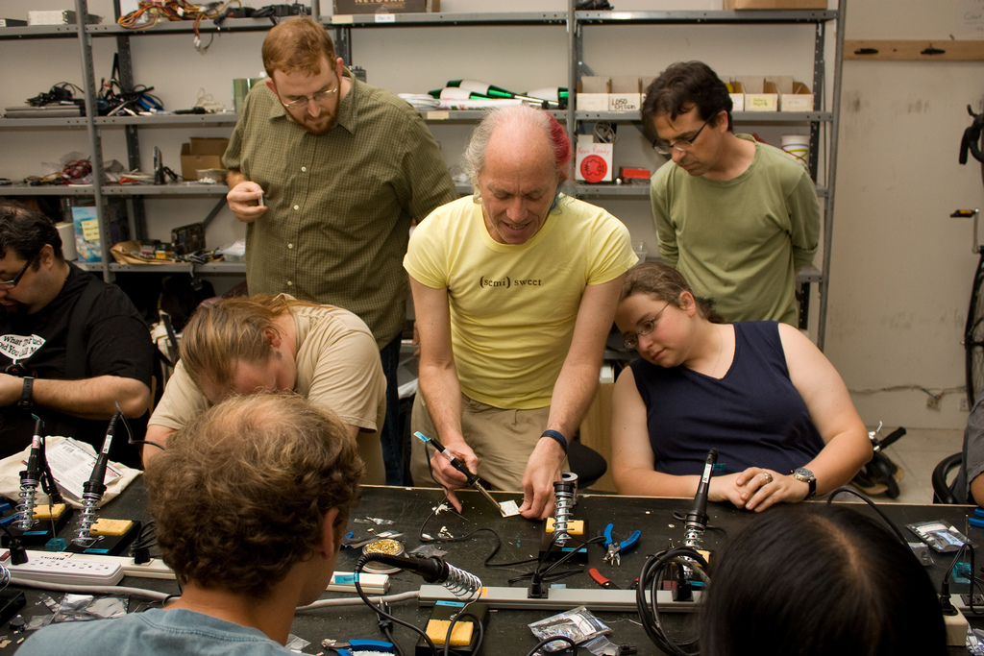
These Days, Interesting Stuff Happens at Hackerspaces
We Don't Need No Education
(well, at least to get started)
Just come in and hack!
Photo by Brian Ferrell http://www.flickr.com/photos/endenizen/2973867978 Attribution-Noncommercial-Share Alike 2.0 Generic Creative Commons License

Slide 4
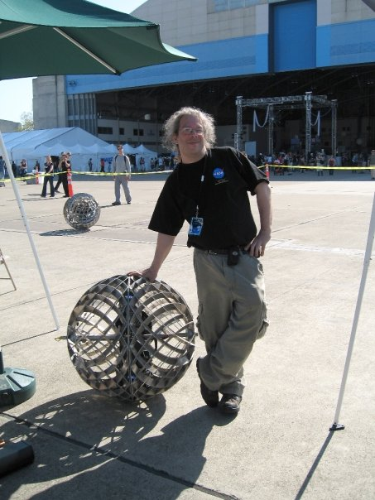
A question for hardware hackers
“If, hypothetically, you were asked to come up with a 3-5 day workshop on Open Hardware, what would you include ? (Jeri: This means *besides* 555s :) )”
[Steve Okay on Facebook]

Slide 5
The Usual Suspects
“Basic” electronics
usually requires digital integrated circuits (555)
and/or
a host computer (e.g., arduino)
... you need to be a programmer before you can even think of playing with electronics.

Slide 6
A Look at Biology
Our brain doesn't use digital circuits...

Slide 7
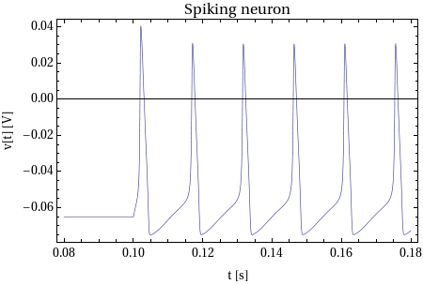
Neurons – how do they work?
Neurons communicate with spikes.

Slide 8
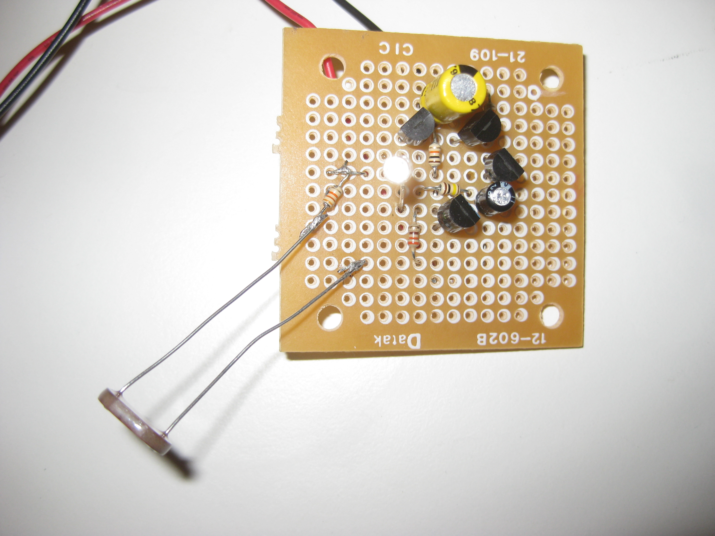
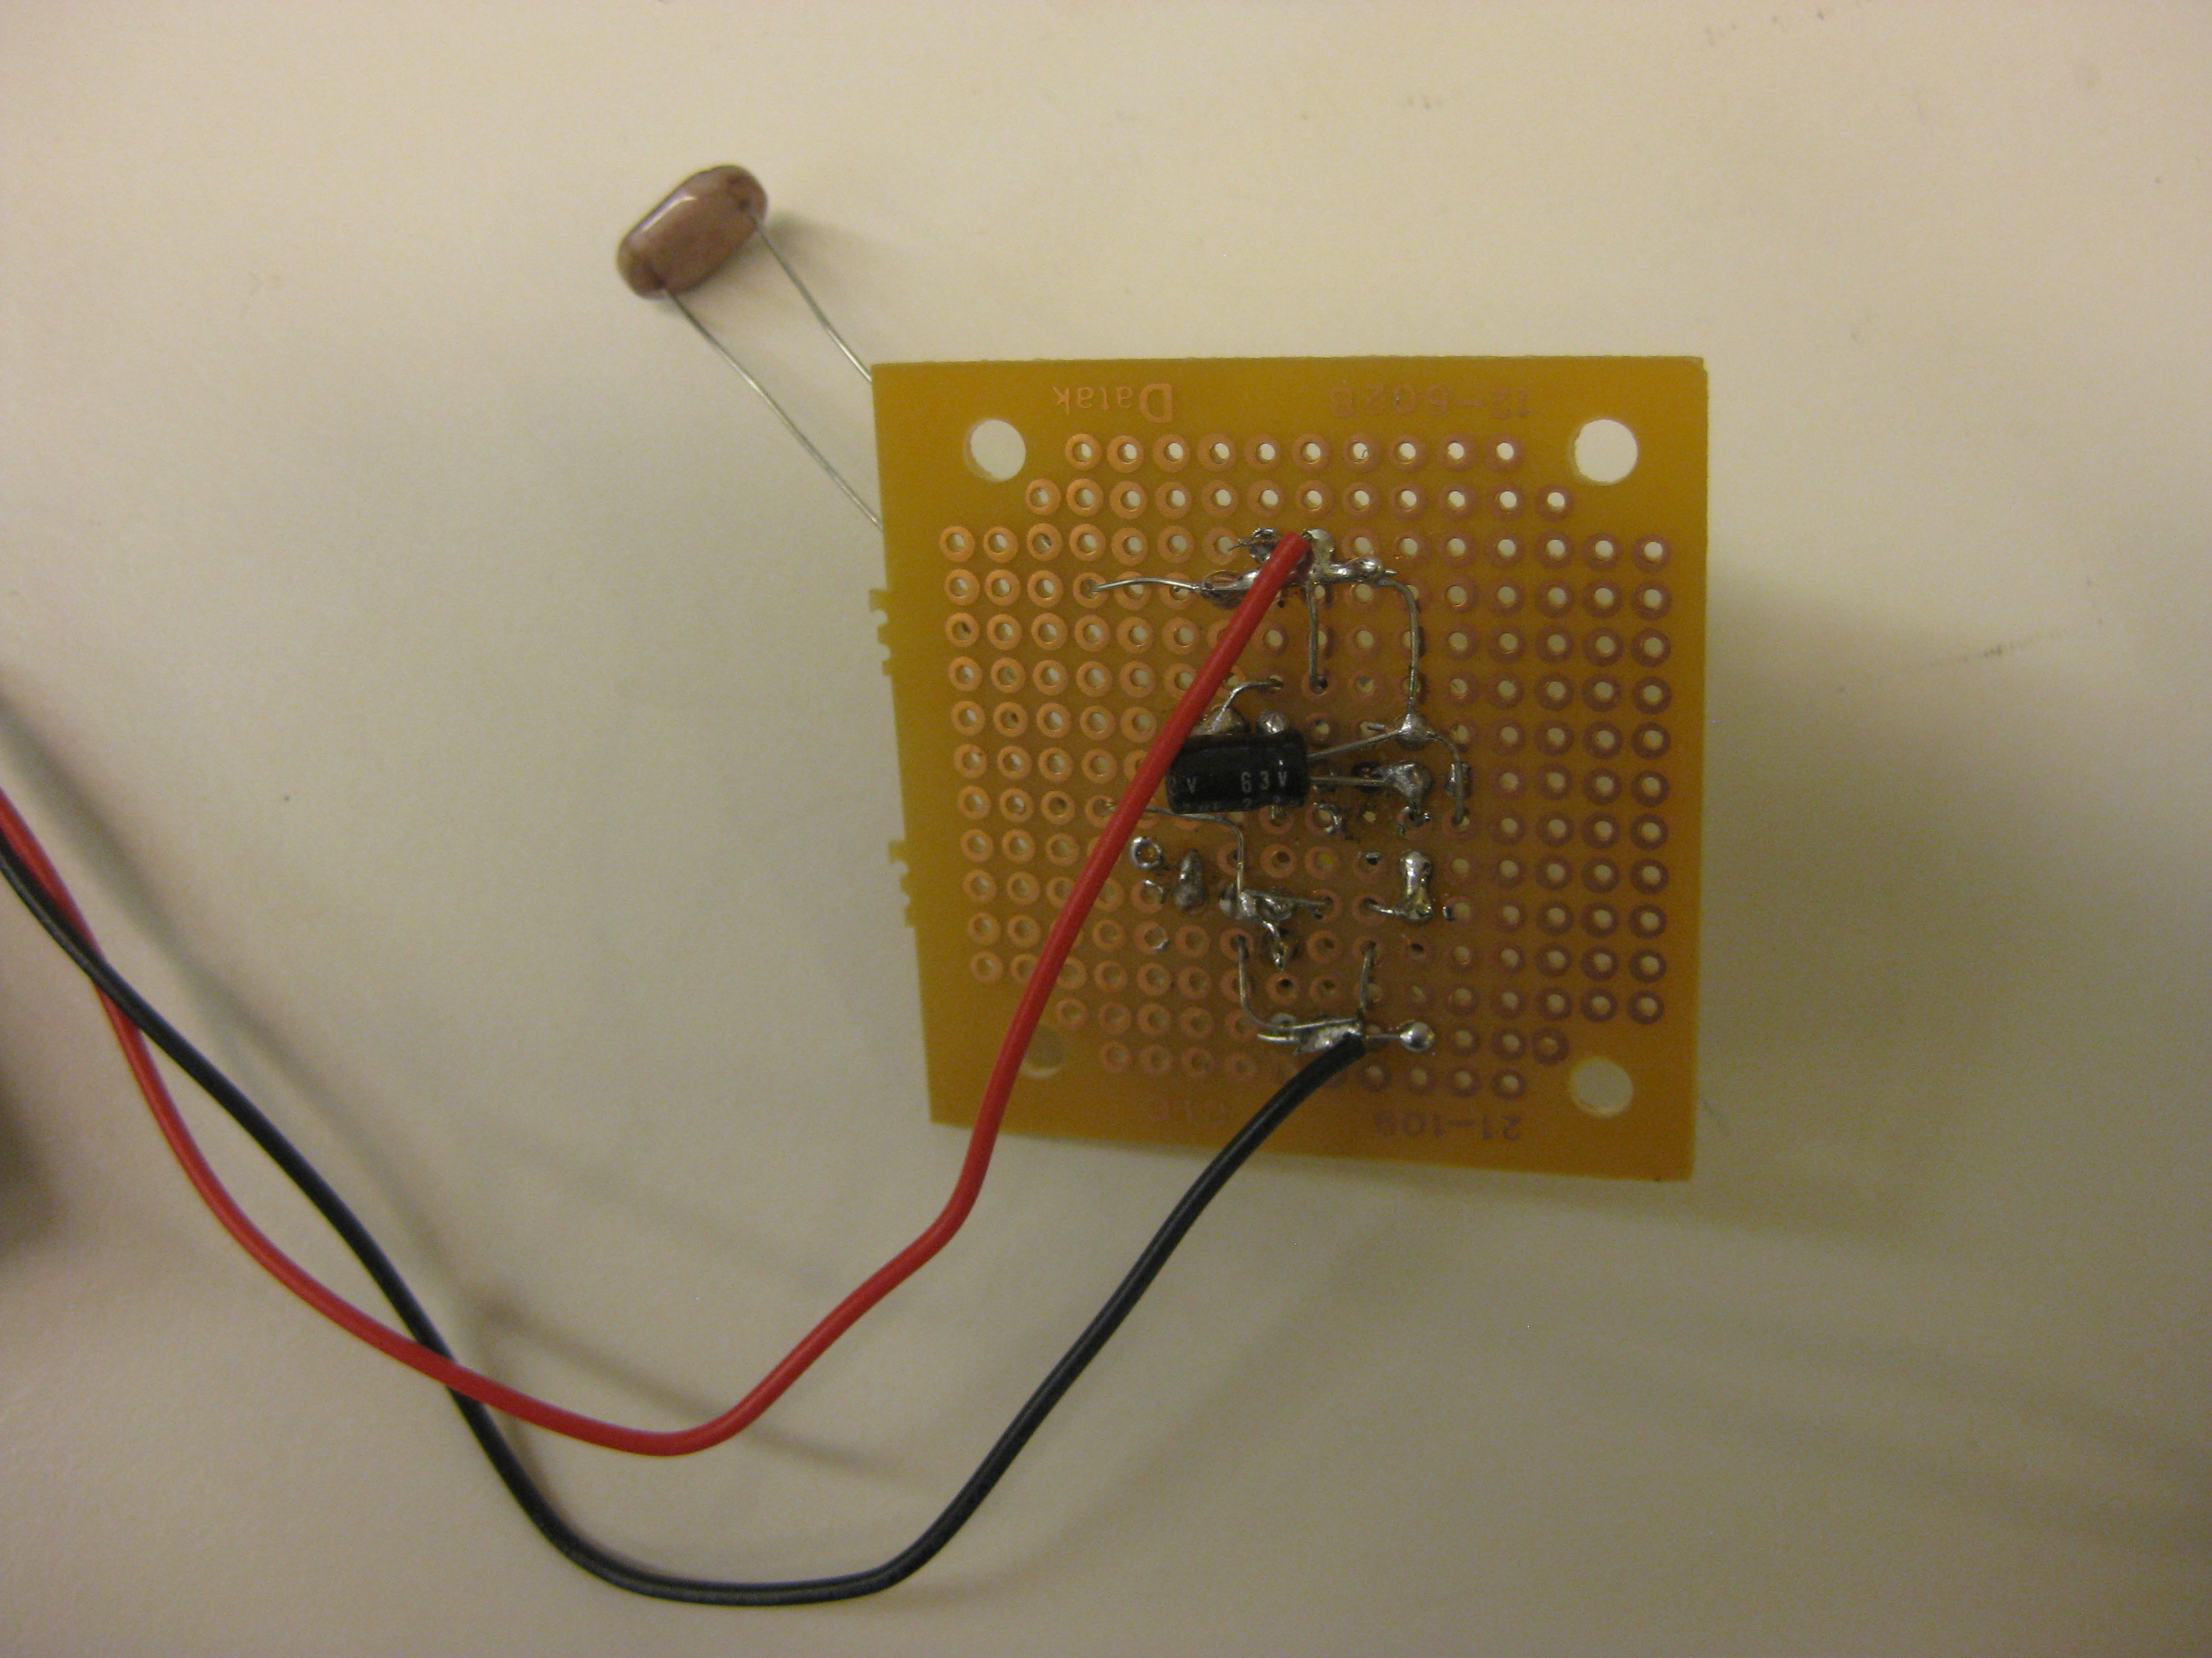
Electronic spiking neuron
Only 4 transistors
You can see it firing

Slide 9
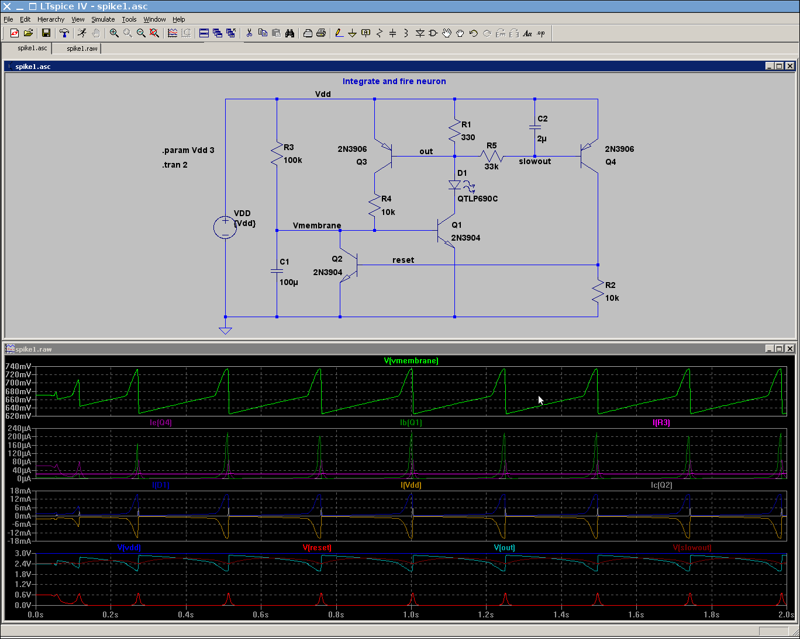

Slide 10
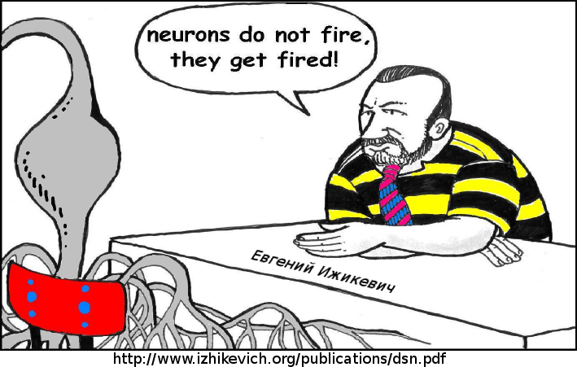
Electronic Neural Networks
When neurons interact with each other,
things get interesting
Ongoing research topic in academia & industry
Towards 10⁶ neurons on a VLSI chip
... brought to your local hackerspace.

Slide 11
Neural Networking
Light sensitive resistor R3
sees spike from D1
of other neuron(s)

Slide 12
Synchronized fireflies: Neuron with light sensor fires every 4th excitation spike

Slide 13
2:1 synchronization with mutual photoresistor coupling

Slide 14
Thanks to
Teddy (Theodore) Yu
for explaining how spiking electronic neurons work
Gert Cauwenberghs
for letting me workplay at his lab at UCSD
Mitch Altman
for introducing me to hackerspaces
Mike Chi and Siddharth Joshi
for helping with measurements

Slide 15
If you want to get really serious ...
look, for example, at
http://www.isn.ucsd.edu/pubs/biocas10_neurodyn.pdf
or
http://www.izhikevich.org/human_brain_simulation/Blue_Brain.htm
#models%20of%20spiking%20neurons
or
http://www.stanford.edu/group/brainsinsilicon/neurogrid.html
and search the internet for
“Neuromorphic engineering”

