Slide 1



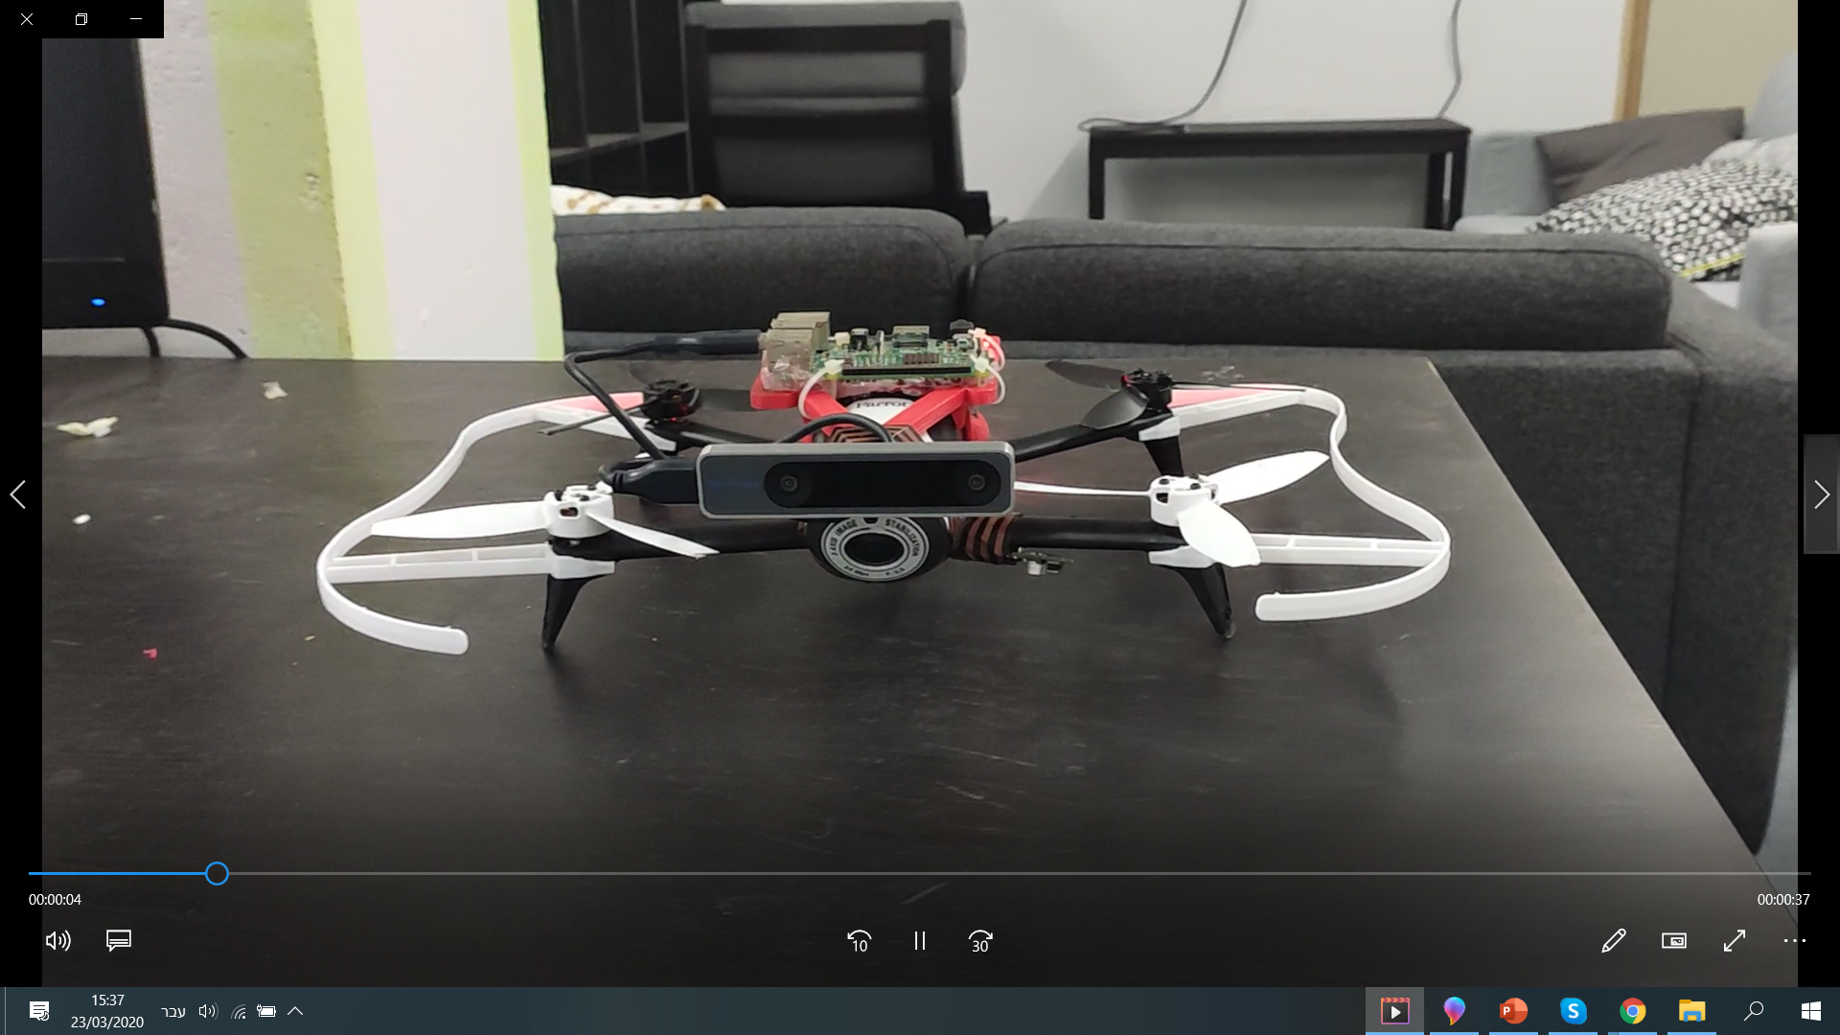
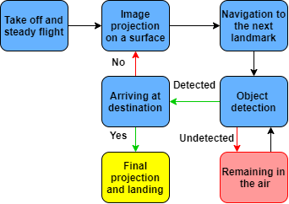
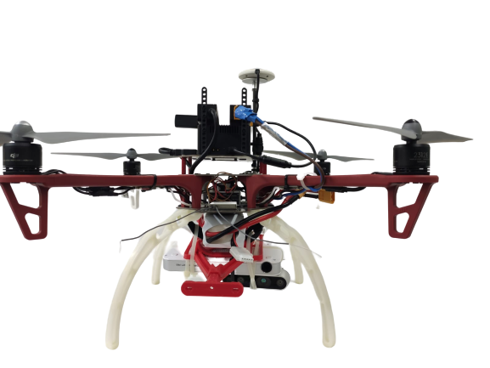
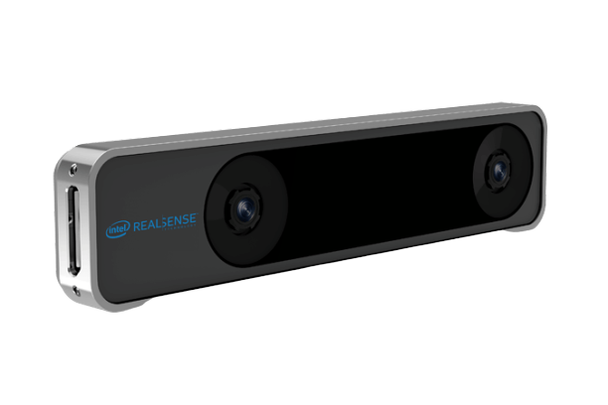

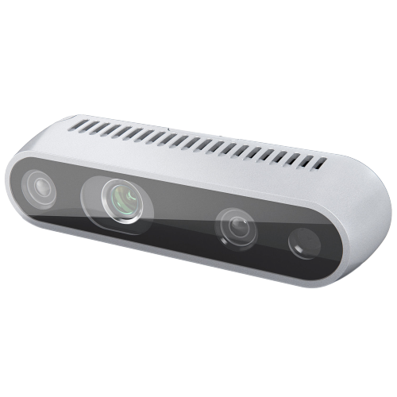
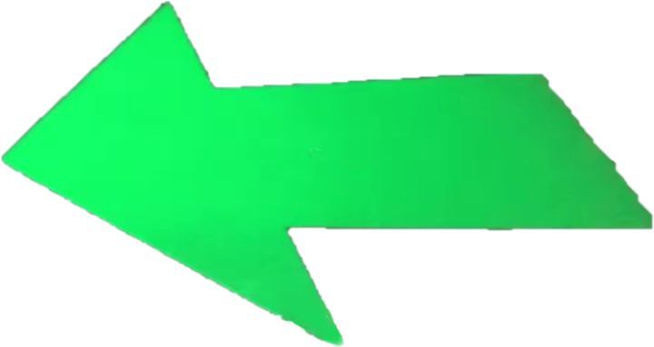
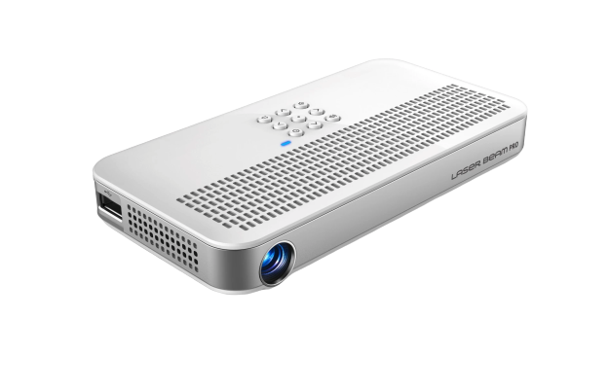
Air Navigation with Autonomous Drone
Project Number: 19-1-1-1758
Names: Ofir Miran, Roni Caduri
Advisor: Yonatan Mandel
Introduction:
Drones are used for a large variety of applications in recent years from travel industry to crime fighting.
Our goal is to use an autonomous drone for navigating humans, while projecting useful signs on the ground.
These signs instruct the users how to navigate through different paths, without the use of GPS technology.
This use of drones can come in particularly handy when navigating at night or exploring areas without GPS.
Implementation & Results:
State machine
Motivation:
Improving the uses of autonomous drones in the image processing field.
There is growing demand for nano drones. The project will aim at deepening understanding of that topic.
Contribute to the innovative field of drones combining projectors.
Main parts of the drone:
Bebop/DJI
The drones used in our project.
JETSON TX2/raspberry pi
A supercomputers which features a variety of standard hardware interfaces. This is the “hurt” of the drone.
Intel Realsense 265 camera:
Senses the current location of the drone.
Sends the location coordinates to the control algorithm.
Intel Realsense D435 camera:
Captures live video from the projected signs that are visible on the ground.
Sends frames to the object detection algorithm.
Laser Beam Pro Projector:
Projects images on the ground that can instruct the user to the destination point.
This images can be an arrow, stop sign, etc.
Algorithms:
- Robot Operating System
A flexible framework for writing robot software. Using ROS we could split the project into sub packages (small projects) that collaborate and build upon each others.
Control algorithm:
Responsible for the drone stable flight, combining SLAM technology.
Object Detection algorithm:
Check whether the user is currently in one of the path’s landmark.
Projection algorithm:
Lead the user to the destination while ordering the projection of effective signs.

