Slide 1


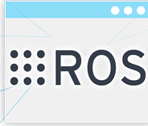
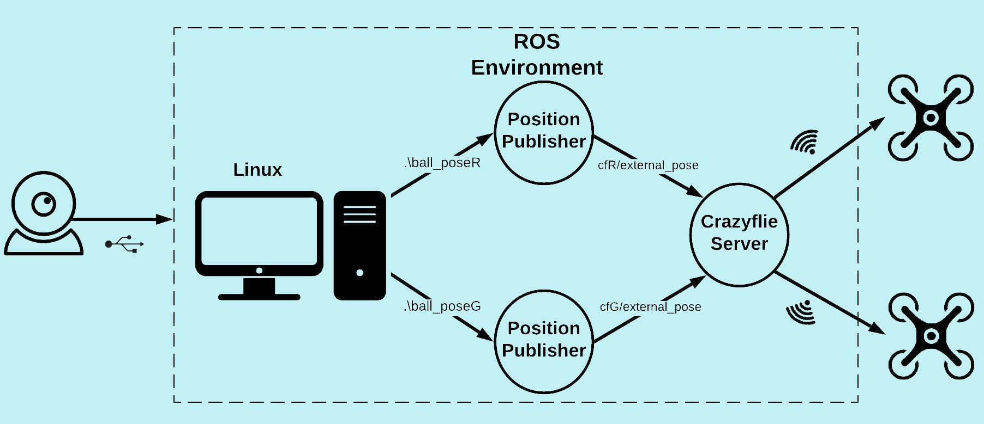
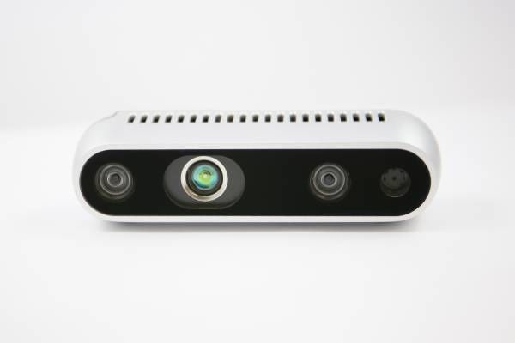
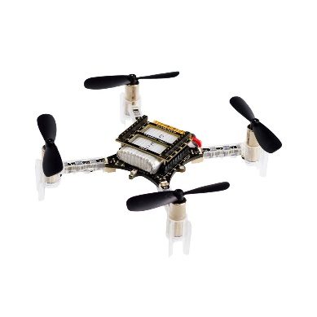
Autonomous Nano-Drones Indoor Navigation System Based On Depth-RGB Image Processing
Project Number: 18-1-1-1622
By: Saar Adutler, Mor Yagel Advisor: Yonatan Mandel
Project Carried Out at Tel Aviv Univesity, 2019
Abstract:
The system provides the ability to plan and execute an autonomous group flight of nano quadcopters in an indoor environment under real-time conditions, using minimalistic and portable equipment.
ROS - Robotic Operating System A collection of software frameworks for robot software development.
Solution:
Each drone carries a colored ball.
The colored balls are being detected by image processing over the RGB stream from the RealSense camera.
Using the depth stream, the ball 2D- RBG position are being transformed to 3D-RealWorld axes and then published into the crazyflie server.
The positions are then transmitted via radio to the drones’ on-board controller, which in turn calculates motors’ velocity commands.
Intel RealSense D435
USB-powered camera that includes pair of depth sensors, an RGB sensor and an infrared projector.
Crazyflie 2.0
Lightweight, open source flying development platform based on a
nano quadcopter.
Features:
Hovering
Way-point Navigation
Synced group flight

