Slide 1
BUILDOTS UPDATE : 13/01/2020

Slide 2
SUMMARY
Buildots calibration
3 experiments : 30 FPS, 3 camera models, CLOSE, 1000px
3 experiments : 30 FPS, 3 camera models, CLOSE, 2000px

Slide 3
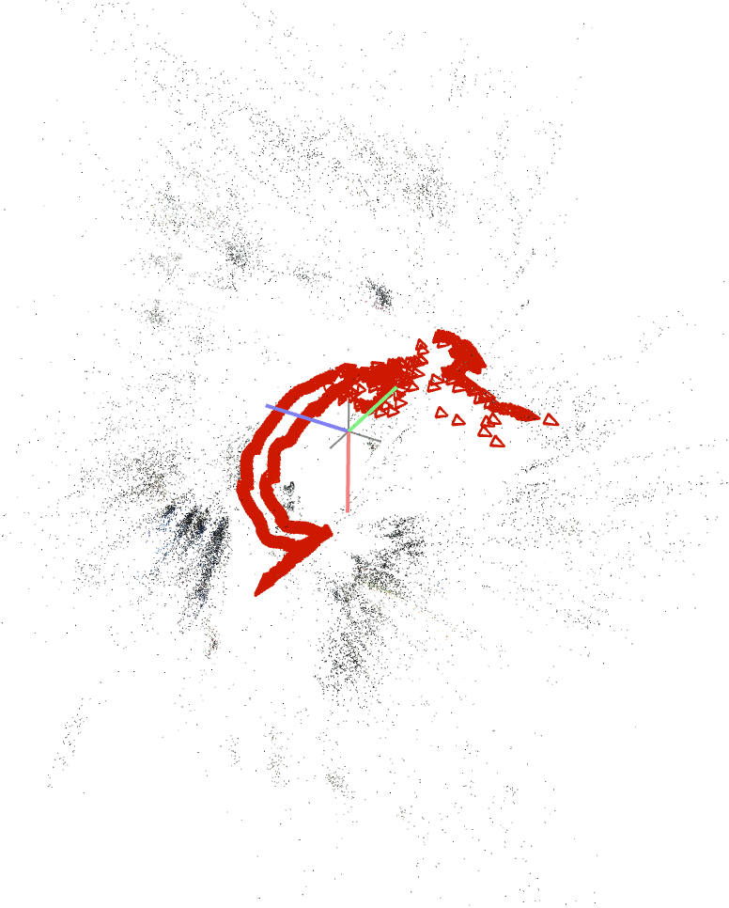
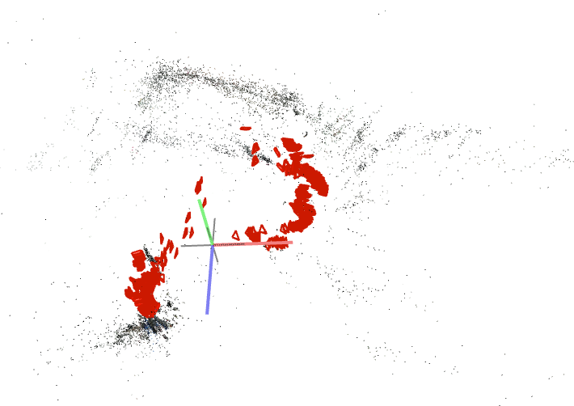
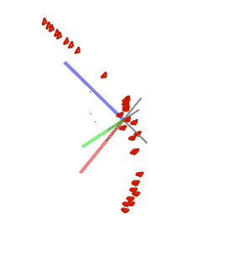
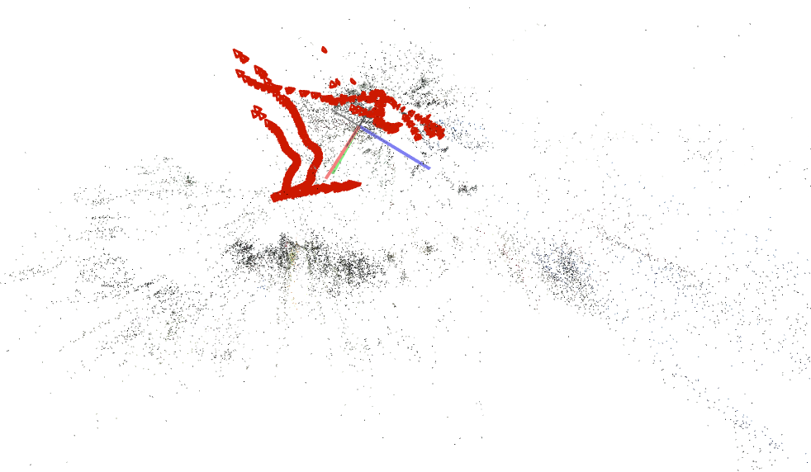
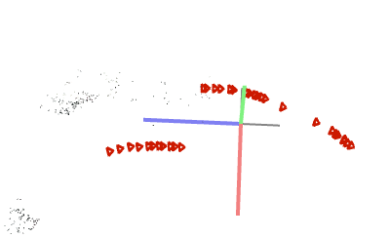
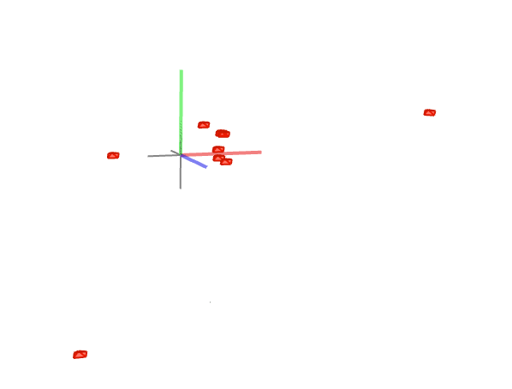
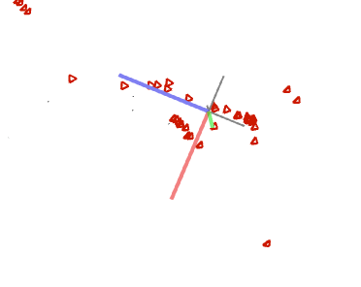
PREVIEW :1000 px
SIMPLE_RADIAL_FISHEYE 1 Sparse model | SIMPLE_RADIAL 1 Sparse model | OPENCV 7 Sparse models

Slide 4
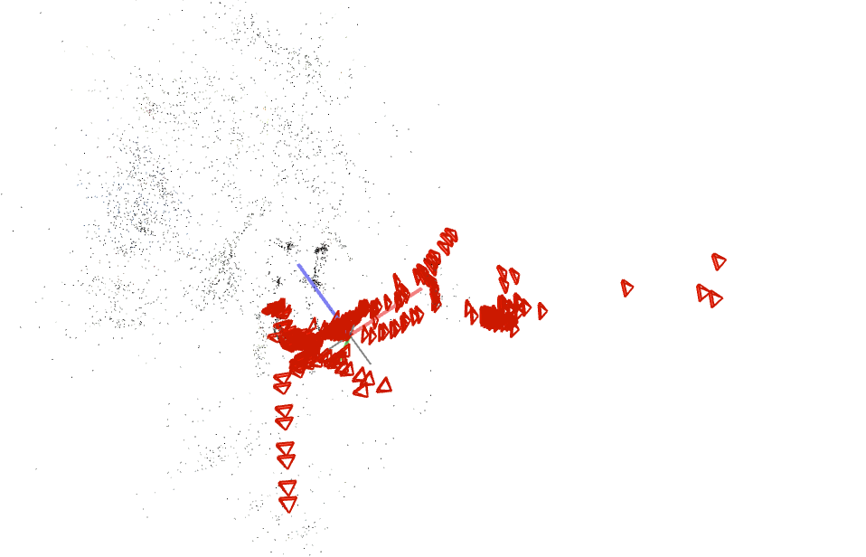
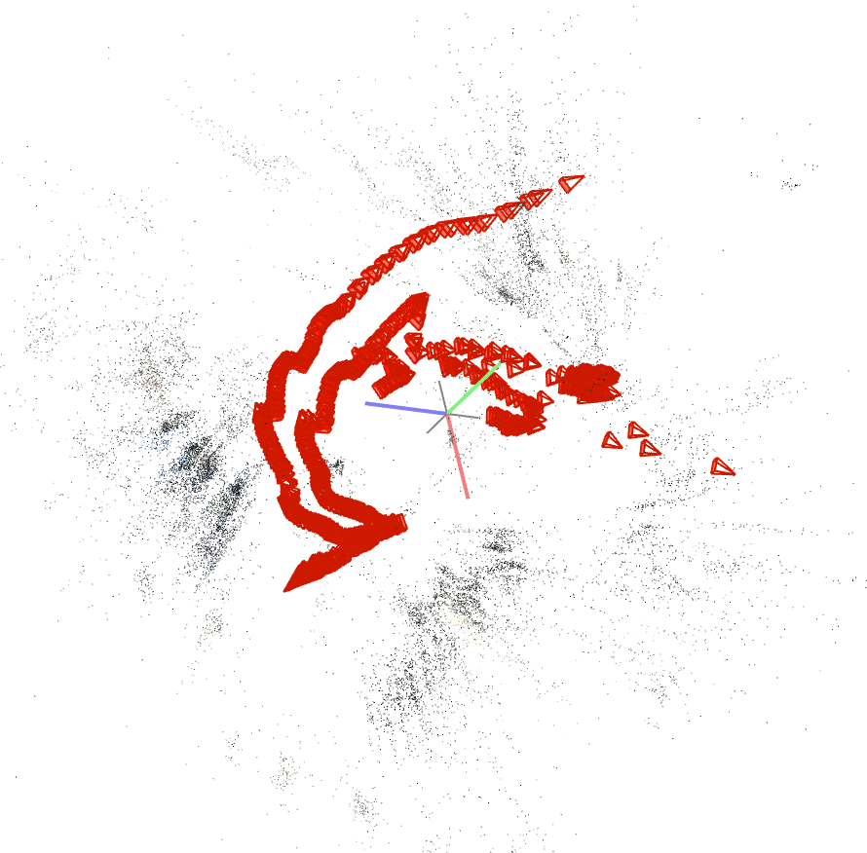
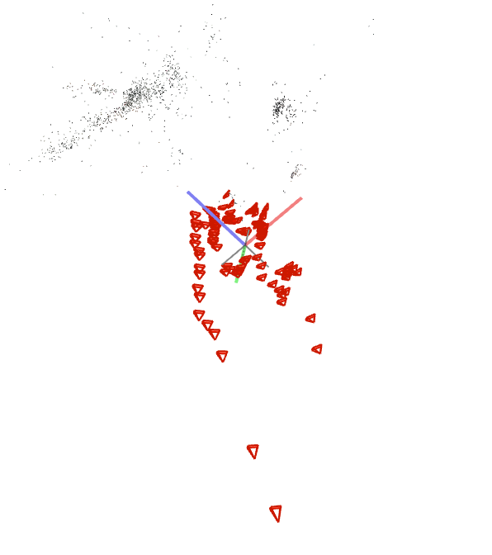
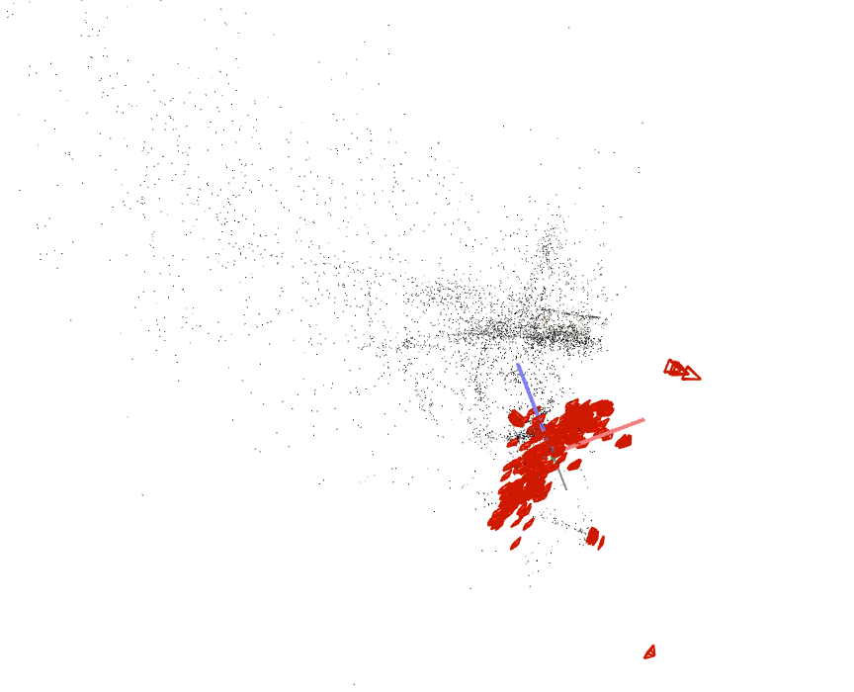
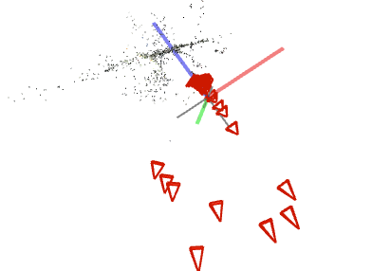
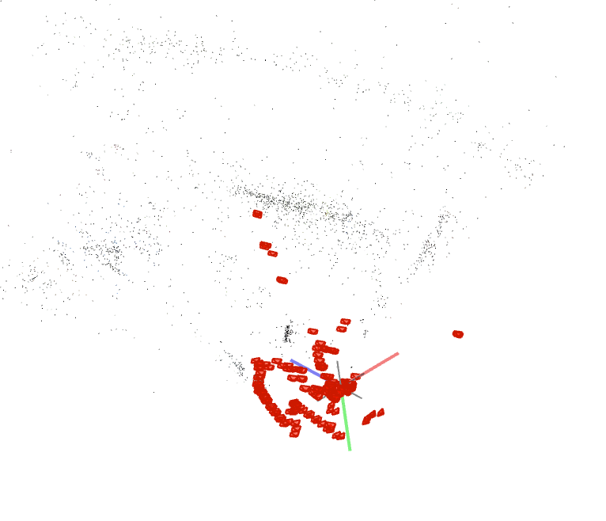
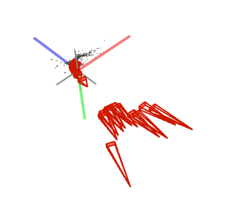
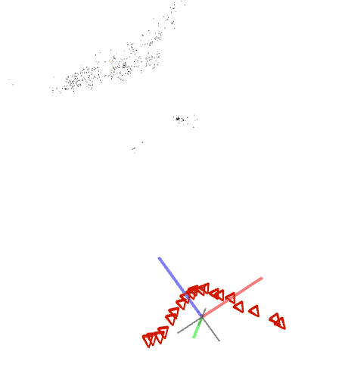
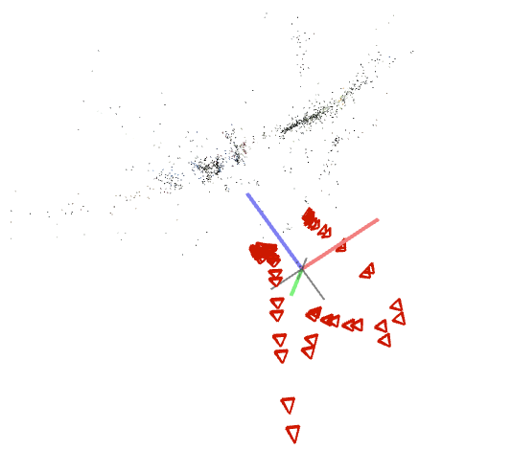
PREVIEW : 2000 px
SIMPLE_RADIAL_FISHEYE 4 Sparse models | SIMPLE_RADIAL 6 Sparse models | OPENCV 1 Sparse model

Slide 5
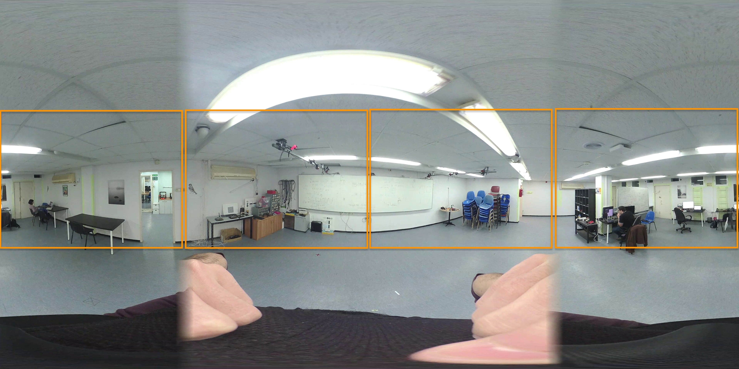
CONCLUSION
None of the 6 experiments are a success
Need a new strategy for poorly textured dataset :
Decomposing 360° equirectangular view into 4 x 90° FOV calibrated frames

Slide 6
Experiment 1
FPS : 30
# Frames : 712
Record length : 36 [s]
Camera distance model : CLOSE
Frame size : 1000
Camera model : SIMPLE_RADIAL_FISHEYE
Sparse models :

Slide 7
Experiment 2
FPS : 30
# Frames : 712
Record length : 36 [s]
Camera distance model : CLOSE
Frame size : 1000
Camera model : SIMPLE_RADIAL
Sparse models :

Slide 8
Experiment 3
FPS : 30
# Frames : 712
Record length : 36 [s]
Camera distance model : CLOSE
Frame size : 1000
Camera model : OPENCV
Sparse models : 7

Slide 9
Experiment 4
FPS : 30
# Frames : 712
Record length : 36 [s]
Camera distance model : CLOSE
Frame size : 2000
Camera model : SIMPLE_RADIAL_FISHEYE
Sparse models : 4

Slide 10
Experiment 5
FPS : 30
# Frames : 712
Record length : 36 [s]
Camera distance model : CLOSE
Frame size : 2000
Camera model : SIMPLE_RADIAL
Sparse models : 6

Slide 11
Experiment 6
FPS : 30
# Frames : 712
Record length : 36 [s]
Camera distance model : CLOSE
Frame size : 2000
Camera model : OPENCV
Sparse model : 1

