Slide 1


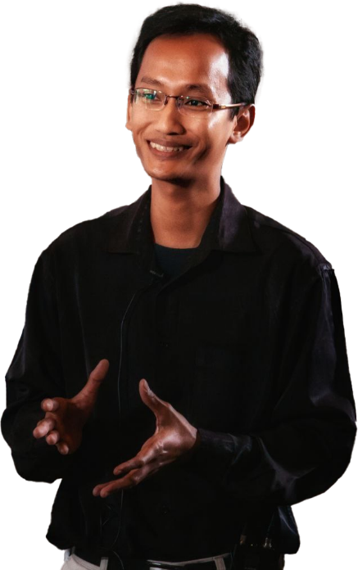





S.Si, MScTech, PhD
TAUFIK SUTANTO
Specialization:
Data Science, Big Data, Parallel & Distributed Computing, Machine Learning, Applied Mathematics & Statistics, Information System.
Current Position:
Founder: taudata Analytics (Indonesia)
Lecturer: UIN Syarif Hidayatullah Jakarta, UI Depok (PKWT) Researcher: PPIM UIN-SH Jakarta*
Education:
Khalifa University (Postdoctoral – Data Driven Dynamical Systems) – 2022
Queensland University of Technology (PhD – Data Science for Big Data) - 2017
Tohoku University (Research Program, Machine Learning) - 2007
University of New South Wales (MScTech – Applied Math/Data Mining) - 2005
University of Indonesia (Ssi – Mathematics/Computational Statistics) - 2001
Awards:
One of the best researcher KemenAg - 2019
QUT Write-Up Award - 2017
Australian Leadership Award - 2013
Outstanding Awards PDT ADS - 2012 MonbuKagaKusho – 2007
Junior Achievement International - 2002, ...
Contact: Taufik.Sutanto@uinjkt.ac.id

