Slide 1
PERSONAL PORTFOLIO / 2026
6+
CHAGAM
NITHIN REDDY
YEARS OF
EXPERIENCE
SOCIAL MEDIA MANAGER · DIGITAL MARKETING
Building digital presence through content, campaigns and community across entertainment, education and brand marketing.
6+ YEARS OF EXPERIENCE
STRATEGY / CONTENT / CAMPAIGNS / GROWTH

Slide 2
01 / PROFILE
A career built across content, campaigns and audiences
Social media management and digital marketing experience across entertainment, education and brand-led businesses.
6+
01
ENTERTAINMENT
Film and music promotions, social-first content and audience engagement.
02
EDUCATION
School campaigns, sports promotions, admissions and event content.
YEARS OF EXPERIENCE
Social media management • digital marketing • analytics
03
BRAND MARKETING
Organic marketing, paid media, SEO and digital presence.
Experience summary based on the resume provided and project details shared for this portfolio.

Slide 3
02 / CAREER JOURNEY
Five chapters. One evolving skill set.
The timeline below follows the employment dates and role titles in your latest resume.
2020–2021
ADITYA MUSIC
Social Media Executive
Film and music promotions, social channels, audience development.
2021–2022
TICKET FACTORY
Digital Marketing Executive
Movie promotion, scripts, short-form shoots and channel growth.
2022–2023
SREENIDHI INTERNATIONAL SCHOOL
Digital Marketing Executive
Sports campaigns, admissions and content production.
2023–2024
GOLDEN SHUTTER STUDIO
Digital Marketing Manager
Paid media, SEO, website upkeep and social calendars.
2024–PRESENT
K-INNOVATIVE HUB PVT LTD
Social Media Manager
Organic marketing, content operations and multi-brand social media.
Note: date ranges are reproduced from the resume; the Ticket Factory and Sreenidhi ranges overlap for one month as written in the source CV.

Slide 4
03 / BRAND EXPERIENCE
Two chapters in entertainment marketing
The first part of this portfolio documents my work across music-led film promotion and movie marketing.
ADITYA
ADITYA MUSIC
TICKET
TICKET FACTORY
Social Media Executive
March 2020 – May 2021
FACTORY
Digital Marketing Executive
June 2021 – July 2022
M U S I C
Film promotions • Music campaigns • Audience growth
Promotional scripts • Campaign ideas • Movie marketing
Logo panels are editable portfolio wordmarks; replace with original brand files if you have them.
04

Slide 5
CHAPTER 01
ADITYA MUSIC
ADITYA
M U S I C
Social Media Executive / March 2020 – May 2021
MAA PAATA MEE NOTA
Worked across social media promotions for major Telugu film projects, including campaign creatives, music-led content, short-form video and audience engagement.
130K FOLLOWERS
Social page creation, audience development and Facebook revenue activity (as listed in the resume).
SELECTED FILM CAMPAIGNS
PUSHPA: THE RISE
VAKEEL SAAB
LOVE STORY
MOST ELIGIBLE BACHELOR
Campaign contribution details are listed on the following project slides.
05

Slide 6
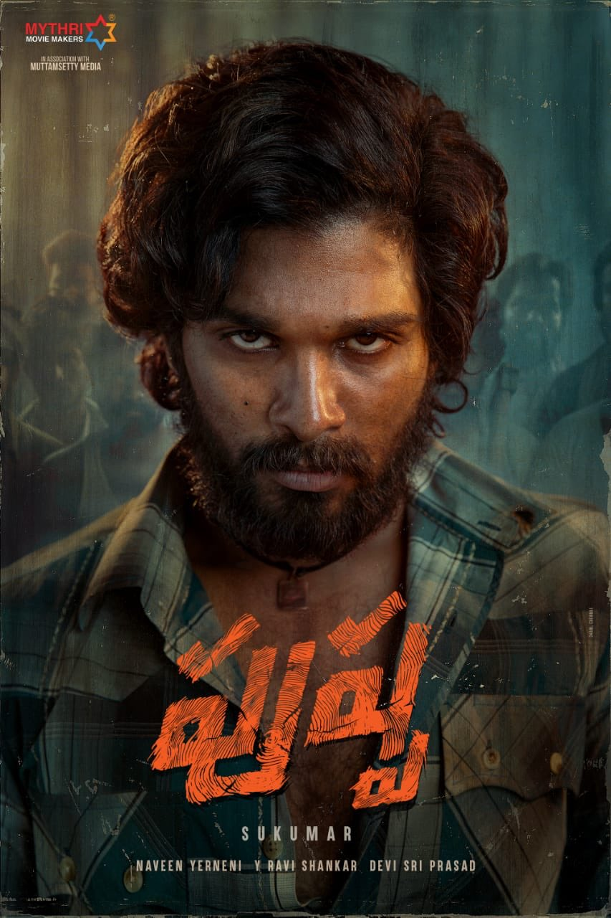
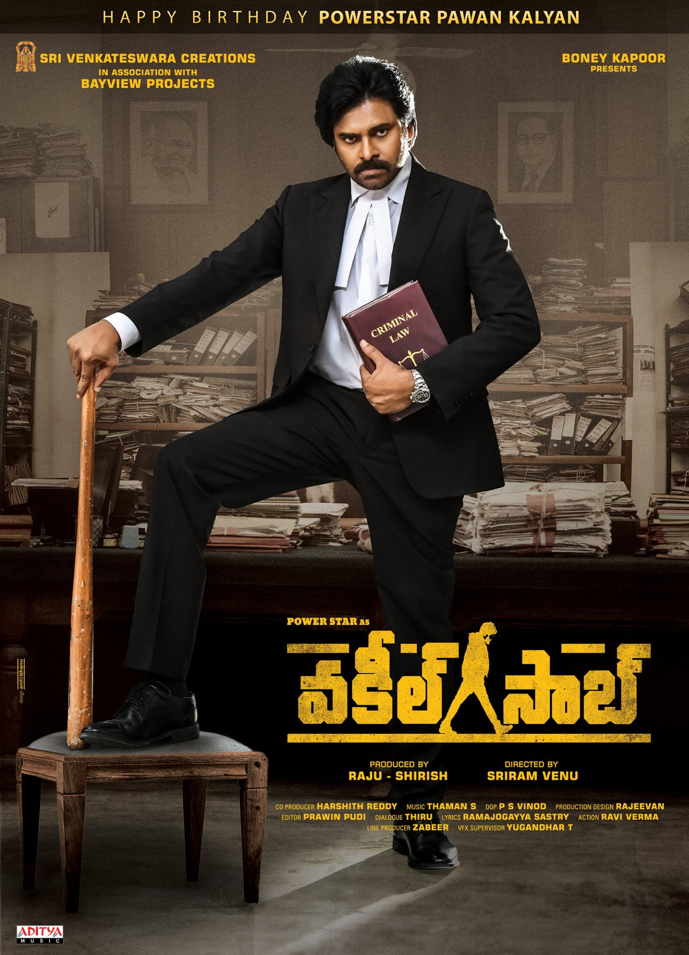
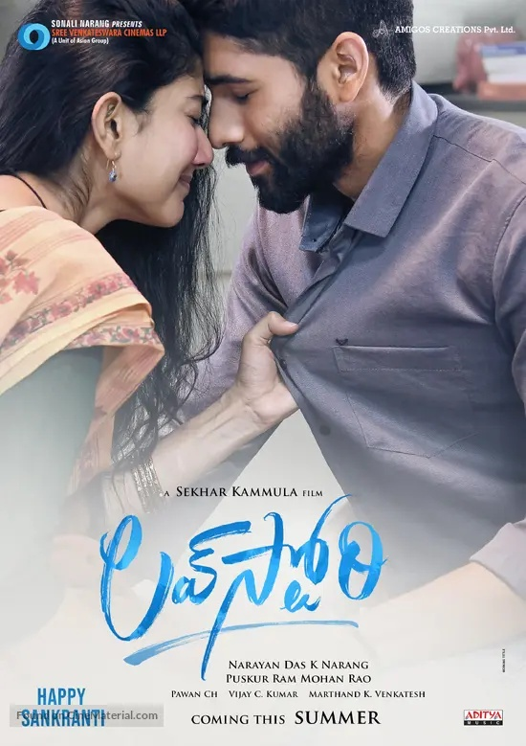
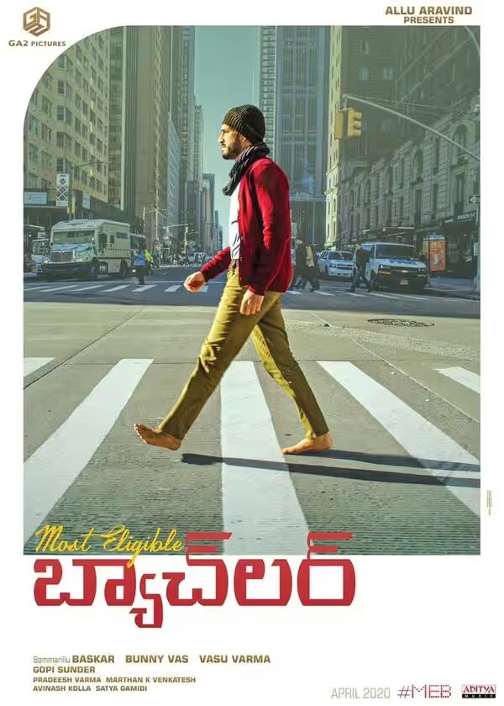
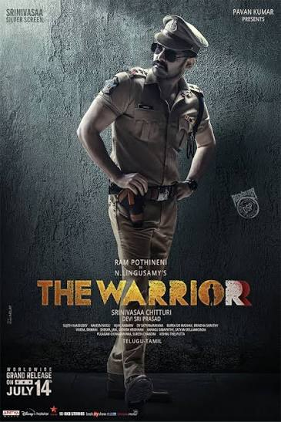
ADITYA MUSIC / SELECTED FILM CAMPAIGNS
Film promotions
Selected Telugu film projects from my Aditya Music chapter
PUSHPA: THE RISE
VAKEEL SAAB
LOVE STORY
MOST ELIGIBLE BACHELOR
THE WARRIOR
06

Slide 7
ADITYA MUSIC / ROLE & CONTRIBUTIONS
What I worked on
Social Media Executive • March 2020 – May 2021
FILM & MUSIC PROMOTION
01
Social media promotional posts and creative campaigns
02
Song promotions and lyrical video promotion
03
Teaser and trailer promotions
04
Reels and short-form video content
05
Captions, copywriting and campaign execution
06
Audience engagement and social media growth
The above reflects the shared campaign responsibilities across the selected film projects.
07

Slide 8
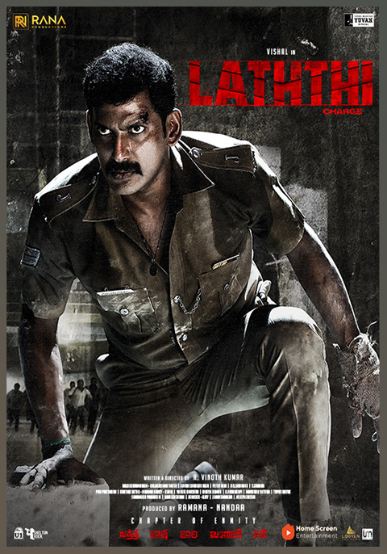
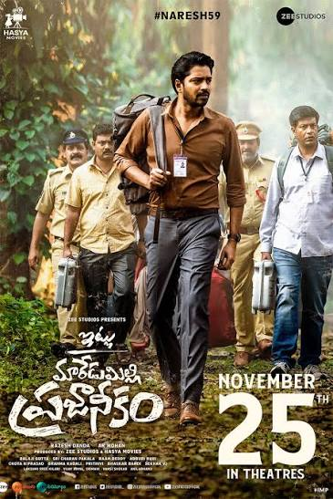
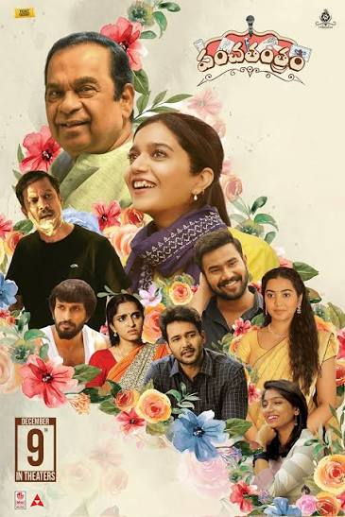
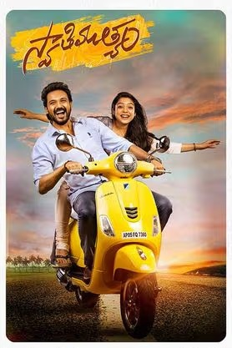
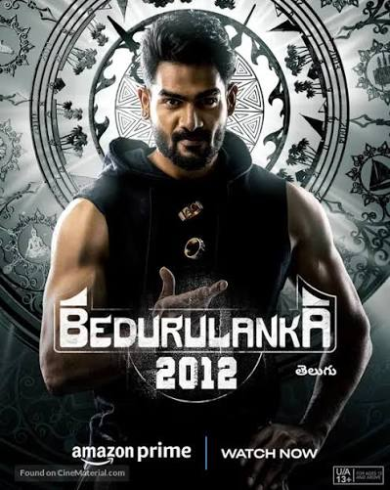
TICKET FACTORY / SELECTED FILM CAMPAIGNS
Film promotions
Selected projects from my digital marketing role at Ticket Factory
LATHthi
ITLU MAREDUMILLI PRAJANEekam
PANCHATHANTRAM
BEDURULANKA 2012
SWATHIMUTHYAM
NITHIN CHAGAM REDDY / PORTFOLIO
10

Slide 9
TICKET FACTORY / ROLE & CONTRIBUTIONS
What I worked on
Digital Marketing Executive • June 2021 – July 2022
FILM & DIGITAL PROMOTION
01
Movie promotional script writing
02
Social media campaigns for film releases
03
Promotional concepts and creative ideas
04
Short-form promotional content and shoot support
05
Digital channel growth and audience engagement
06
Campaign coordination and content execution
The responsibilities above represent the shared work across the selected film campaigns.
NITHIN CHAGAM REDDY / PORTFOLIO
11

Slide 10
CHAPTER 03
Sreenidhi International School
EXPERIENCE • EXECUTION • COLLABORATION
Supporting the school’s digital presence through content, communication and marketing execution.
A practical chapter in my digital marketing journey.
ROLE
Digital Marketing Executive
DURATION
June 2022 – June 2023
NITHIN CHAGAM REDDY / PORTFOLIO
10

Slide 11
SREENIDHI INTERNATIONAL SCHOOL / ROLE & CONTRIBUTIONS
My work & responsibilities
Digital Marketing Executive • June 2022 – June 2023
A general overview of responsibilities; no specific achievements or performance metrics are claimed.
01
Social media content
02
Content coordination
Supported routine social media content and publishing.
Coordinated content requirements with relevant teams.
03
School activities
04
Creative support
Supported communication around school activities and events.
Helped prepare and organise digital marketing creatives.
05
Publishing support
06
Digital presence
Assisted with scheduling, posting and maintaining content flow.
Helped maintain consistent online communication.
NITHIN CHAGAM REDDY / PORTFOLIO
11

Slide 12
CHAPTER 04
Golden Shutter Studio
EXPERIENCE • EXECUTION • COLLABORATION
Freelance digital marketing work focused on planning, content coordination and online brand communication.
A practical chapter in my digital marketing journey.
ROLE
Digital Marketing Manager (Freelance)
DURATION
July 2023 – July 2024
NITHIN CHAGAM REDDY / PORTFOLIO
12

Slide 13
GOLDEN SHUTTER STUDIO / ROLE & CONTRIBUTIONS
My work & responsibilities
Digital Marketing Manager (Freelance) • July 2023 – July 2024
Responsibilities are presented generically, without adding unverified client names, campaigns or results.
01
Marketing planning
02
Social media management
Supported digital marketing planning based on project requirements.
Managed routine social media content and publishing activities.
03
Content development
04
Campaign coordination
Worked on content ideas, captions and creative direction.
Coordinated marketing deliverables and content timelines.
05
Brand communication
06
Execution & follow-up
Supported consistent messaging and online brand presentation.
Followed up on content requirements and day-to-day execution.
NITHIN CHAGAM REDDY / PORTFOLIO
13

Slide 14



CHAPTER 05
K-Innovative Hub
K
Social Media Manager • August 2024 – Present
A multi-brand social media chapter across education, events and sustainable products.
INNOVATIVE HUB
DIGITAL • CREATIVE • SOCIAL
Multi-brand content • Reels • Campaigns • Community engagement
The chapter combines day-to-day page management with event-led storytelling and campaign execution.
NITHIN CHAGAM REDDY / PORTFOLIO
14

Slide 15
K-INNOVATIVE HUB / WHAT I MANAGED
Multi-brand social media execution
Managing content flow, campaigns and audience engagement across multiple brand pages.
01
Page management
02
Content planning
Publishing and maintaining active social media pages across the brand portfolio.
Planning posts and reels around events, campaigns and brand communication needs.
03
Reel production
04
Event coverage
Coordinating reel concepts, footage, editing requirements and publishing.
Turning school functions and large events into social-first content.
05
Community growth
06
Cross-team coordination
Monitoring engagement and supporting follower and audience growth.
Working with school teams, designers, photographers, videographers and stakeholders.
NITHIN CHAGAM REDDY / PORTFOLIO
16

Slide 16
K-INNOVATIVE HUB / EVENT STORYTELLING
From campus moments to digital stories
A selection of event themes supported through content and reel-making.
ANNUAL DAY
GLOW PEACE
INVESTITURE
FERIYA Y FIESTA
Performances • highlights • school pride
Peace • wellbeing • participation
Leadership • responsibility • student voice
Competitions • creativity • campus energy
Photo references found during research: DPS Nacharam official gallery (Feriya Y Fiesta, Investiture, Annual Day and Glow Peace listings).
Note: graphic panels are illustrative, not original event photographs. Official gallery pages are linked for real imagery.
dpsnacharam.in/gallery • dpsnacharam.in/cbse-gallary
NITHIN CHAGAM REDDY / PORTFOLIO
20

Slide 17
K-INNOVATIVE HUB / CAMPAIGN HIGHLIGHTS
Campaigns across schools
Event-led storytelling, on-ground coverage and short-form video content.
ANNUAL DAYS
GLOW PEACE
INVESTITURE CEREMONIES
Capturing performances, celebrations and school milestones.
Coverage and content around the school’s peace / wellness event.
Highlighting student leadership, oath-taking and ceremony moments.
FERIYA Y FIESTA — DPS NACHARAM
SPORTS & SCHOOL EVENTS
ALWAYS-ON CONTENT
Multi-day inter-school fest coverage across activities and performances.
Reels and posts to extend event visibility beyond the campus.
Regular content planning, reels and engagement across pages.
Official public event references: DPS Nacharam gallery and Feriya Y Fiesta event materials.
dpsnacharam.in/cbse-gallary • fyf.dpsnacharam.com
NITHIN CHAGAM REDDY / PORTFOLIO
17

Slide 18
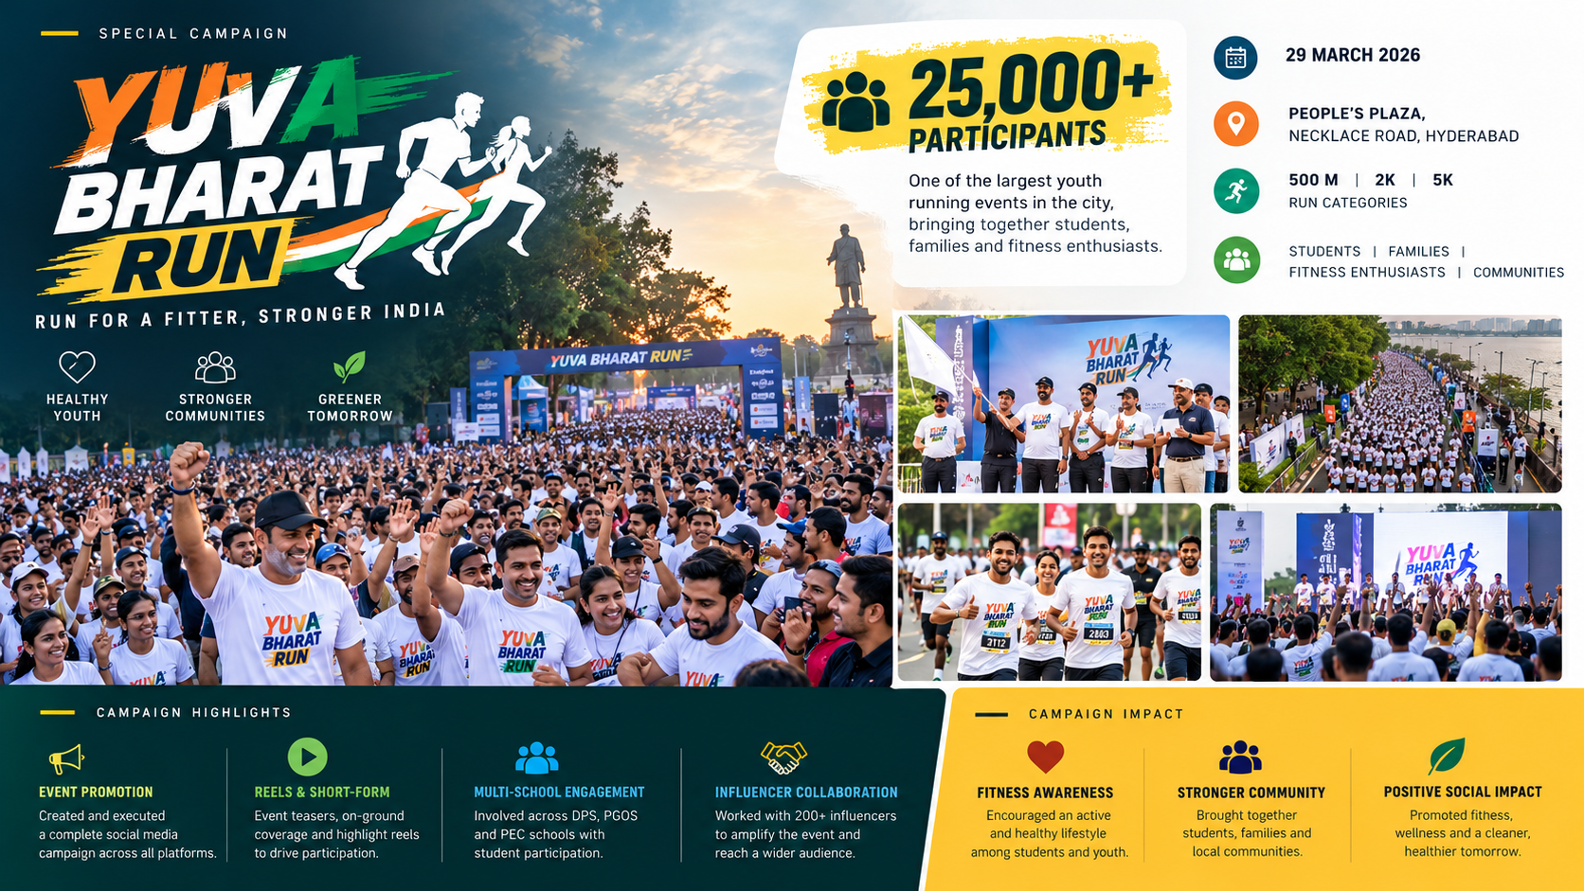
YUVA BHARAT RUN / CAMPAIGN VISUAL SHOWCASE
Illustrative campaign visual — replace with original event photographs for a fully authentic portfolio.

Slide 19
SPECIAL CAMPAIGN / YUVA BHARAT RUN
Yuva Bharat Run
25,000+
PARTICIPANTS
A large-scale youth and community fitness event in Hyderabad.
Campaign focus
01
Promotional content for a youth-focused community event.
RUN • BOND • BUILD
02
Event storytelling through short-form video and social content.
FITNESS / YOUTH / COMMUNITY
03
Visibility around participation, fitness and community spirit.
04
Special presentation and campaign communication support.
Public event information: 29 March 2026 • People’s Plaza, Necklace Road, Hyderabad • 500m, 2K and 5K categories.
Official event website: yuvabharatrun.com
NITHIN CHAGAM REDDY / PORTFOLIO
19

Slide 20
K-INNOVATIVE HUB / OUTPUT & IMPACT
Yuva Bharat Run
Portfolio highlights based on the figures provided for this chapter.
200+
300+
INFLUENCERS BROUGHT TOGETHER
REELS CREATED
Coordinated influencer participation across campaigns and brand activity.
Short-form video output across school events and brand pages.
Additional contribution
Growth and engagement support across the managed pages, alongside event coverage and ongoing content execution.
Figures are supplied by Nithin; add platform analytics screenshots if you want the achievements independently evidenced.
NITHIN CHAGAM REDDY / PORTFOLIO
18

Slide 21
THANK YOU
LET’S CREATE SOMETHING
MEANINGFUL TOGETHER.
NITHIN REDDY
Cotact me:
Social Media Manager • Digital Marketing
PHONE
9113955857
EMAIL
nithinreddy370@gmail.com
CONTENT / CAMPAIGNS / COMMUNITY / GROWTH
PORTFOLIO • 2026

