Slide 1
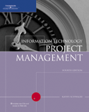
Chapter 7:
Project Cost Management
Information Technology Project Management,
Fourth Edition
Dr. Ignatius Joko Dewanto., S.Kom., MM

Slide 2
Learning Objectives
Understand the importance of project cost management.
Explain basic project cost management principles, concepts, and terms.
Discuss different types of cost estimates and methods for preparing them.

Slide 3
What Went Wrong?
According to the San Francisco Chronicle’s front-page story, “Computer Bumbling Costs the State $1 Billion,” the state of California had a series of expensive IT project failures in the late 1990s, costing taxpayers nearly $1 billion…It was ironic that the state that was leading in the creation of computers was also the state most behind in using computer technology to improve its services.*
The Internal Revenue Service (IRS) managed a series of project failures that cost taxpayers over $50 billion a year—roughly as much money as the annual net profit of the entire computer industry.**
Connecticut General Life Insurance Co. sued PeopleSoft over an aborted installation of a finance system.***
*Lucas, Greg, “Computer Bumbling Costs the State $1 Billion,” San Francisco Chronicle (2/21/99).
**James, Geoffrey, “IT Fiascoes . . . and How to Avoid Them,” Datamation (November 1997).
***Songini, Marc L., “PeopleSoft project ends in court,” ComputerWorld (September 2001).

Slide 4
What is Cost and Project Cost Management?
Cost is a resource sacrificed or foregone to achieve a specific objective, or something given up in exchange.
Costs are usually measured in monetary units, such as dollars.
Project cost management includes the processes required to ensure that the project is completed within an approved budget.

Slide 5
Project Cost Management Processes
Cost estimating: Developing an approximation or estimate of the costs of the resources needed to complete a project.
Cost budgeting: Allocating the overall cost estimate to individual work items to establish a baseline for measuring performance.
Cost control: Controlling changes to the project budget.

Slide 6
Basic Principles of Cost Management
Most members of an executive board have a better understanding and are more interested in financial terms than IT terms, so IT project managers must speak their language.
  Profits are revenues minus expenses.
  Life cycle costing considers the total cost of ownership, or development plus support costs, for a project.
  Cash flow analysis determines the estimated annual costs and benefits for a project and the resulting annual cash flow.

Slide 7
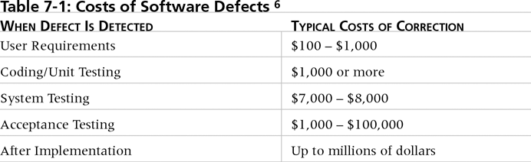
Table 7-1. Cost of Software Defects*
It is important to spend money up-front on IT projects to avoid spending a lot more later.
*Collard, Ross, Software Testing and Quality Assurance, working paper (1997).

Slide 8
Basic Principles of Cost Management
Tangible costs or benefits are those costs or benefits that an organization can easily measure in dollars.
Intangible costs or benefits are costs or benefits that are difficult to measure in monetary terms.
Direct costs are costs that can be directly related to producing the products and services of the project.
Indirect costs are costs that are not directly related to the products or services of the project, but are indirectly related to performing the project.
Sunk cost is money that has been spent in the past; when deciding what projects to invest in or continue, you should not include sunk costs.

Slide 9
Cost Estimating
Project managers must take cost estimates seriously if they want to complete projects within budget constraints.
It’s important to know the types of cost estimates, how to prepare cost estimates, and typical problems associated with IT cost estimates.

Slide 10
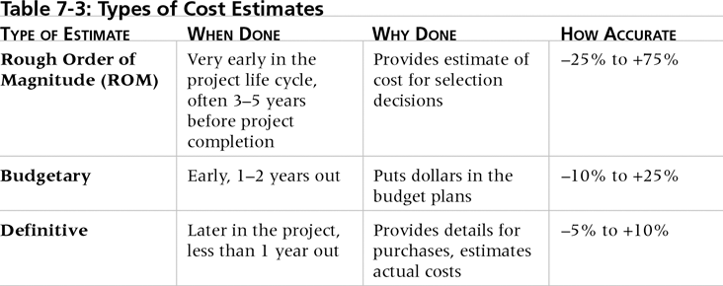
Table 7-2. Types of Cost Estimates

Slide 11
Estimates
Charter
Approval
Plan
Approval
Pre-Launch
Launch
Execute
Size Estimates (Macro)
Task-based Estimates
Project Schedule
+/- 35% range
+/- 15% range
+/- 10% range

Slide 12
Cost Management Plan
A cost management plan is a document that describes how the organization will manage cost variances on the project.
A large percentage of total project costs are often labor costs, so project managers must develop and track estimates for labor.

Slide 13
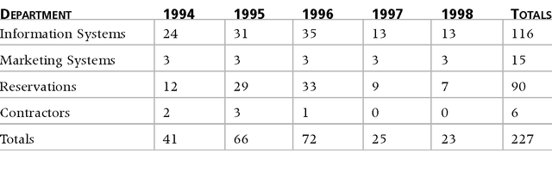
Table 7-3. Maximum Departmental Headcounts by Year
A large percentage of the costs of many IT projects are
human resource costs.

Slide 14
Cost Estimation Tools and Techniques
Basic tools and techniques for cost estimates:
  Analogous or top-down estimates: Use the actual cost of a previous, similar project as the basis for estimating the cost of the current project.
  Bottom-up estimates: Involve estimating individual work items or activities and summing them to get a project total.
  Parametric modeling: Uses project characteristics (parameters) in a mathematical model to estimate project costs.
  Computerized tools: Tools, such as spreadsheets and project management software, that can make working with different cost estimates and cost estimation tools easier.

Slide 15
Constructive Cost Model (COCOMO)
Barry Boehm helped develop the COCOMO models for estimating software development costs.
Parameters include:
  Function points: Technology-independent assessments of the functions involved in developing a system.
  Source Lines of Code (SLOC): A human-written line of code that is not a blank line or comment.
Boehm suggests that only parametric models do not suffer from the limits of human decision-making.

Slide 16
Typical Problems with IT
Cost Estimates
Developing an estimate for a large software project is a complex task that requires a significant amount of effort.
People who develop estimates often do not have much experience.
Human beings are biased toward underestimation.
Management might ask for an estimate, but really desire a bid to win a major contract or get internal funding.

Slide 17
Sample Cost Estimate
See pages 262-266 for a detailed example that describes how to create a cost estimate for the Surveyor Pro project described in the opening case.
Before creating an estimate, know what it will be used for, gather as much information about the project as possible, and clarify the ground rules and assumptions for the estimate.
If possible, estimate costs by major WBS categories.
Create a cost model to make it easy to change and document the estimate.

Slide 18
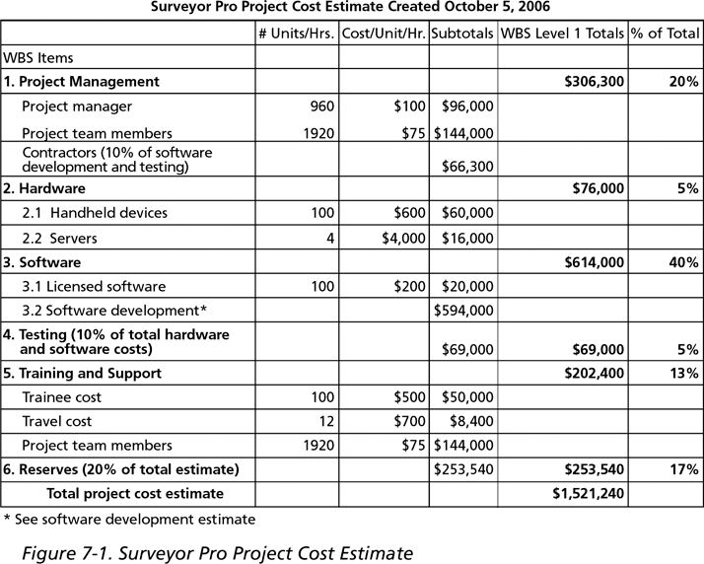
Figure 7-1. Surveyor Pro Project Cost Estimate

Slide 19
Cost Budgeting
Cost budgeting involves allocating the project cost estimate to individual work items over time.
The WBS is a required input for the cost budgeting process because it defines the work items.
Important goal is to produce a cost baseline:
  A time-phased budget that project managers use to measure and monitor cost performance.

Slide 20
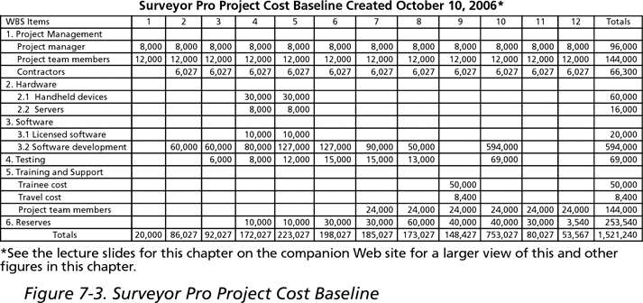
Figure 7-3. Surveyor Pro Project
Cost Baseline

Slide 21
Cost Control
Project cost control includes:
  Monitoring cost performance.
  Ensuring that only appropriate project changes are included in a revised cost baseline.
  Informing project stakeholders of authorized changes to the project that will affect costs.
Many organizations around the globe have problems with cost control.

Slide 22
Earned Value Management (EVM)
EVM is a project performance measurement technique that integrates scope, time, and cost data.
Given a baseline (original plan plus approved changes), you can determine how well the project is meeting its goals.
You must enter actual information periodically to use EVM.
More and more organizations around the world are using EVM to help control project costs.

Slide 23
Earned Value Management Terms
The planned value (PV), formerly called the budgeted cost of work scheduled (BCWS), also called the budget, is that portion of the approved total cost estimate planned to be spent on an activity during a given period.
Actual cost (AC), formerly called actual cost of work performed (ACWP), is the total of direct and indirect costs incurred in accomplishing work on an activity during a given period.
The earned value (EV), formerly called the budgeted cost of work performed (BCWP), is an estimate of the value of the physical work actually completed.
EV is based on the original planned costs for the project or activity and the rate at which the team is completing work on the project or activity to date.

Slide 24
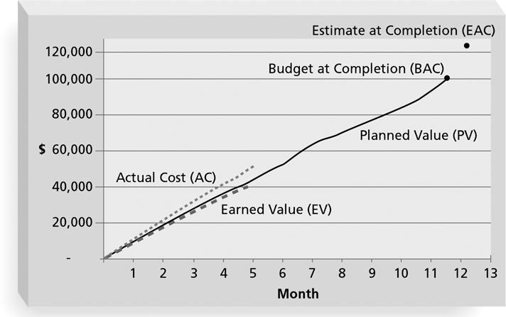
Figure 7-5. Earned Value Chart for Project after Five Months
If the EV line is below the AC or PV line, there are problems in those areas.

Slide 25
Project Portfolio Management
Many organizations collect and control an entire suite of projects or investments as one set of interrelated activities in a portfolio.
Project portfolio management has five levels:
  Put all your projects in one database.
  Prioritize the projects in your database.
  Divide your projects into two or three budgets based on type of investment.
  Automate the repository.
  Apply modern portfolio theory, including risk-return tools that map project risk on a curve.

Slide 26
Using Software to Assist in Cost Management
Spreadsheets are a common tool for resource planning, cost estimating, cost budgeting, and cost control.
Many companies use more sophisticated and centralized financial applications software for cost information.
Project management software has many cost-related features, especially enterprise PM software.

Slide 27
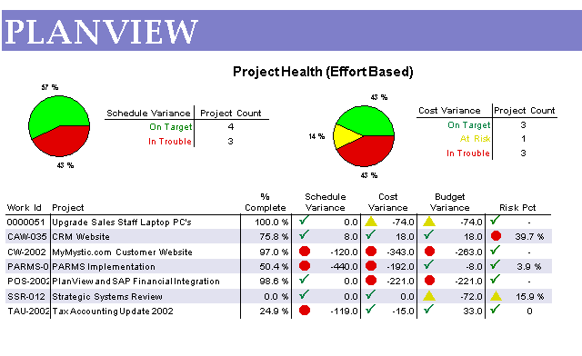
Figure 7-6. Sample Project Portfolio Management Screen Showing Project Health

Slide 28
Chapter Summary
Project cost management is traditionally a weak area in IT projects, and project managers must work to improve their ability to deliver projects within approved budgets.
Main processes include:
  Cost estimating
  Cost budgeting
  Cost control

