Slide 1
Chapter 11:
Project Procurement Management
Dr. Ignaitus Joko Dewanto., S.Kom., MM
Copyright Course Technology 1999

Slide 2
Importance of Project Procurement Management
Procurement means acquiring goods and/or services from an outside source
Other terms include purchasing and outsourcing
Experts predict that by the year 2000 the worldwide information technology outsourcing market will grow to over $100 billion
Copyright Course Technology 1999

Slide 3
Why Outsource?
To reduce both fixed and recurrent costs
To allow the client organization to focus on its core business
To access skills and technologies
To provide flexibility
To increase accountability
Copyright Course Technology 1999

Slide 4
Project Procurement Management Processes
Procurement planning: determining what to procure and when
Solicitation planning: documenting product requirements and identifying potential sources
Solicitation: obtaining quotations, bids, offers, or proposals as appropriate
Source selection: choosing from among potential vendors
Contract administration: managing the relationship with the vendor
Contract close-out: completion and settlement of the contract
Copyright Course Technology 1999

Slide 5
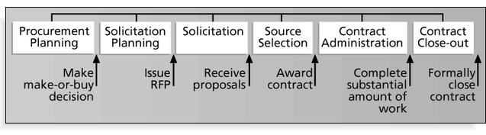
Figure 11-1. Project Procurement Management Processes and Key Outputs
Copyright Course Technology 1999

Slide 6
Procurement Planning
Procurement planning involves identifying which project needs can be best met by using products or services outside the organization. It includes deciding
  whether to procure
  how to procure
  what to procure
  how much to procure
  when to procure
Copyright Course Technology 1999

Slide 7
Collaborative Procurement
Several organizations, even competitors, have found that it makes sense to collaborate on procurement for some projects
Kodak worked with several competitors to develop the Advantix Advanced Photo System (see What Went Right? on pg. 303)
Copyright Course Technology 1999

Slide 8
Procurement Planning Tools and Techniques
Make-or-buy analysis: determining whether a particular product or service should be made or performed inside the organization or purchased from someone else. Often involves financial analysis
Experts, both internal and external, can provide valuable inputs in procurement decisions
Copyright Course Technology 1999

Slide 9
Types of Contracts
Fixed price or lump sum: involve a fixed total price for a well-defined product or service
Cost reimbursable: involve payment to the seller for direct and indirect costs
Unit price contracts: require the buyer to pay the seller a predetermined amount per unit of service
Copyright Course Technology 1999

Slide 10
Cost Reimbursable Contracts
Cost plus incentive fee (CPIF): the buyer pays the seller for allowable performance costs plus a predetermined fee and an incentive bonus
Cost plus fixed fee (CPFF): the buyer pays the seller for allowable performance costs plus a fixed fee payment usually based on a percentage of estimated costs
Cost plus percentage of costs (CPPC): the buyer pays the seller for allowable performance costs plus a predetermined percentage based on total costs
Copyright Course Technology 1999

Slide 11
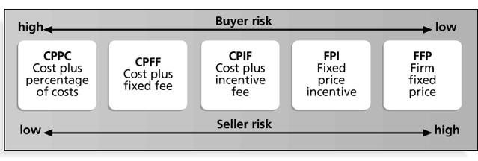
Figure 11-2. Contract Types Versus Risk
Copyright Course Technology 1999

Slide 12
Statement of Work (SOW)
A statement of work is a description of the work required for the procurement
Many contracts, or other mutually binding agreements, include SOWs
A good SOW gives bidders a better understanding of the buyer’s expectations
Copyright Course Technology 1999

Slide 13
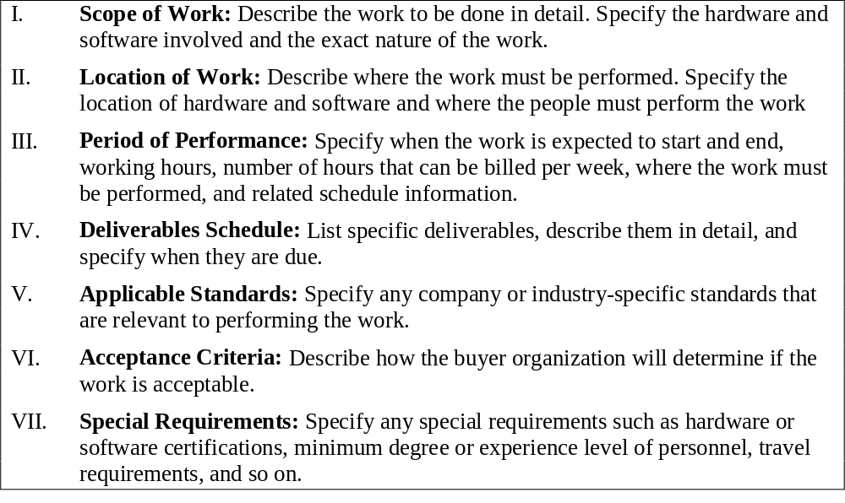
Figure 11-3. Statement of Work (SOW) Template
Copyright Course Technology 1999

Slide 14
Solicitation Planning
Solicitation planning involves preparing several documents:
  Request for Proposals: used to solicit proposals from prospective sellers where there are several ways to meet the sellers’ needs
  Requests for Quotes: used to solicit quotes for well-defined procurements
  Invitations for bid or negotiation, and initial contractor responses are also part of solicitation planning
Copyright Course Technology 1999

Slide 15
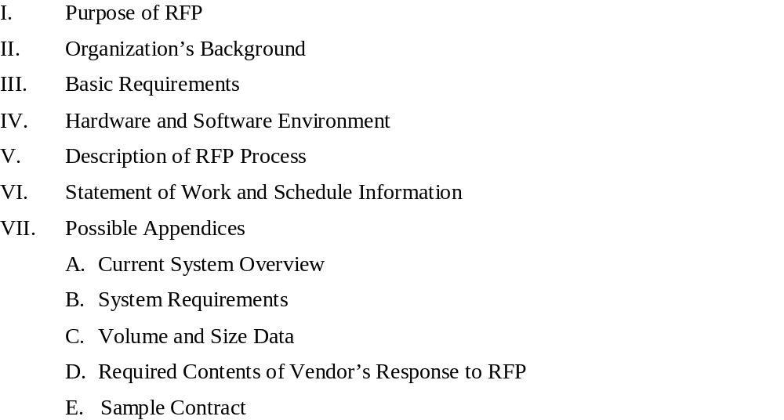
Figure 11-4. Outline for a Request for Proposal (RFP)
Copyright Course Technology 1999

Slide 16
Solicitation
Solicitation involves obtaining proposals or bids from prospective sellers
Organizations can advertise to procure goods and services in several ways
  approaching the preferred vendor
  approaching several potential vendors
  advertising to anyone interested
A bidders’ conference can help clarify the buyer’s expectations
Copyright Course Technology 1999

Slide 17
Source Selection
Source selection involves
  evaluating bidders’ proposals
  choosing the best one
  negotiating the contract
  awarding the contract
It is helpful to prepare formal evaluation procedures for selecting vendors
Buyers often create a “short list”
Copyright Course Technology 1999

Slide 18
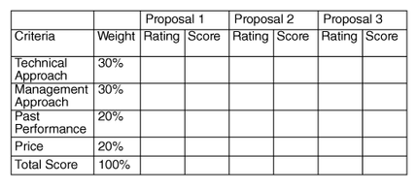
Figure 11-5. Sample Proposal Evaluation Sheet
Copyright Course Technology 1999

Slide 19
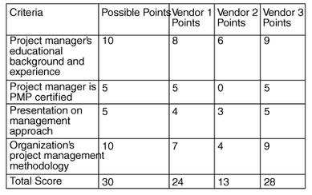
Figure 11-6. Detailed Criteria for Selecting Vendors
Copyright Course Technology 1999

Slide 20
Contract Administration
Contract administration ensures that the seller’s performance meets contractual requirements
Contracts are legal relationships, so it is important that legal and contracting professionals be involved in writing and administering contracts
Many project managers ignore contractual issues, which can result in serious problems (see What Went Wrong? on pg. 315)
Copyright Course Technology 1999

Slide 21
Suggestions on Change Control for Contracts
Changes to any part of the project need to be reviewed, approved, and documented by the same people in the same way that the original part of the plan was approved
Evaluation of any change should include an impact analysis. How will the change affect the scope, time, cost, and quality of the goods or services being provided?
Changes must be documented in writing. Project team members should also document all important meetings and telephone phone calls
Copyright Course Technology 1999

Slide 22
Contract Close-out
Contract close-out includes
  product verification to determine if all work was completed correctly and satisfactorily
  administrative activities to update records to reflect final results
  archiving information for future use
Procurement audits identify lessons learned in the procurement process
Copyright Course Technology 1999

Slide 23
Discussion Questions
Discuss the scenario in the opening case. Have you experienced similar situations? How did the parties involved handle them?
Provide examples of information technology goods and services that were outsourced. Which were for information technology projects and which were parts of on-going operations? Was it advantageous for the organization to use outsourcing?
Some experts recommend working with preferred vendors, even if their prices may be higher than other vendors. Why do you think this is the case?
Copyright Course Technology 1999

