Slide 1

Project Communications Management
Information Technology Project Management,
Fourth Edition
Dr. Ignatius Joko Dewanto., S.Kom., MM.

Slide 2
Learning Objectives
Understand the importance of good communications in projects.
Explain the elements of project communications planning, including how to create a communications management plan and perform a stakeholder communications analysis.
Describe various methods for distributing project information and the advantages and disadvantages of each, discuss the importance of addressing individual communication needs, and calculate the number of communications channels in a project.
Information Technology Project Management, Fourth

Slide 3
Importance of Good Communications
The greatest threat to many projects is a failure to communicate.
Our culture does not portray IT professionals as being good communicators.
Research shows that IT professionals must be able to communicate effectively to succeed in their positions.
Strong verbal skills are a key factor in career advancement for IT professionals.
Information Technology Project Management, Fourth

Slide 4
Project Communications
Management Processes
Communications planning: Determining the information and communications needs of the stakeholders.
Information distribution: Making needed information available to project stakeholders in a timely manner.
Performance reporting: Collecting and disseminating performance information, including status reports, progress measurement, and forecasting.
Managing stakeholders: Managing communications to satisfy the needs and expectations of project stakeholders and to resolve issues.
Information Technology Project Management, Fourth

Slide 5
Communications Planning
Every project should include some type of communications management plan, a document that guides project communications.
Creating a stakeholder analysis for project communications also aids in communications planning.
Information Technology Project Management, Fourth

Slide 6
Communications Management
Plan Contents
Stakeholder communications requirements.
Information to be communicated, including format, content, and level of detail.
The people who will receive the information and who will produce it.
Suggested methods or technologies for conveying the information.
Information Technology Project Management, Fourth

Slide 7
Communications Management
Plan Contents (cont’d)
Frequency of communication.
Escalation procedures for resolving issues.
Revision procedures for updating the communications management plan.
A glossary of common terminology.
Information Technology Project Management, Fourth

Slide 8
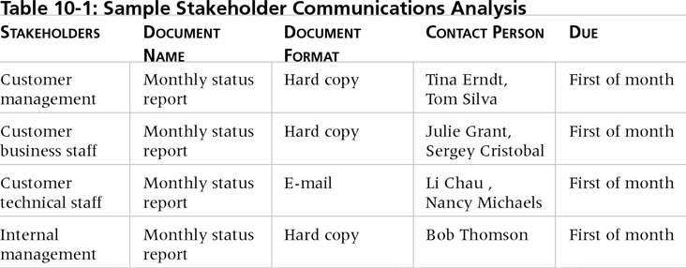
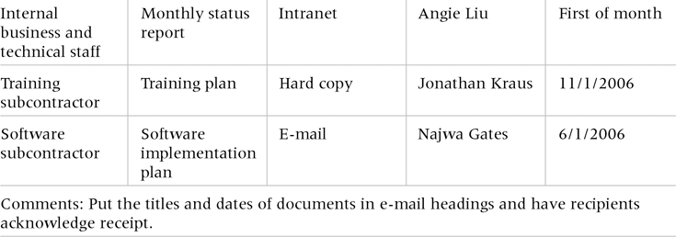
Table 10-1. Sample Stakeholder Analysis for Project Communications
Information Technology Project Management, Fourth

Slide 9
Information Distribution
Getting the right information to the right people at the right time and in a useful format is just as important as developing the information in the first place.
Important considerations include:
  Using technology to enhance information distribution.
  Formal and informal methods for distributing information.
Information Technology Project Management, Fourth

Slide 10
Distributing Information in an Effective and Timely Manner
Don’t bury crucial information.
Don’t be afraid to report bad information.
Oral communication via meetings and informal talks helps bring important information—good and bad—out into the open.
Information Technology Project Management, Fourth

Slide 11
Importance of Face-to-Face Communication
Research says that in a face-to-face interaction:
  58 percent of communication is through body language.
  35 percent of communication is through how the words are said.
  7 percent of communication is through the content or words that are spoken.
Pay attention to more than just the actual words someone is saying.
A person’s tone of voice and body language say a lot about how he or she really feels.
Information Technology Project Management, Fourth

Slide 12
Encouraging More Face-to-Face Interactions
Short, frequent meetings are often very effective in IT projects.
Stand-up meetings force people to focus on what they really need to communicate.
Some companies have policies preventing the use of e-mail between certain hours or even entire days of the week.
Information Technology Project Management, Fourth

Slide 13
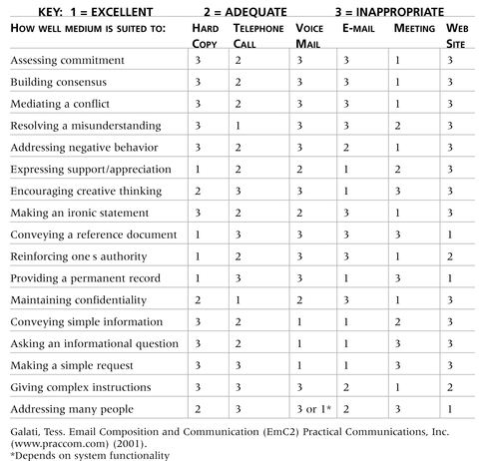
Table 10-2. Media Choice Table
Information Technology Project Management, Fourth

Slide 14
Understanding Group and Individual Communication Needs
People are not interchangeable parts.
As illustrated in Brooks’ book The Mythical Man-Month, you cannot assume that a task originally scheduled to take two months of one person’s time can be done in one month by two people.
Nine women cannot produce a baby in one month!
Information Technology Project Management, Fourth

Slide 15
Personal Preferences Affect Communication Needs
Introverts like more private communications, while extroverts like to discuss things in public.
Intuitive people like to understand the big picture, while sensing people need step-by-step details.
Thinkers want to know the logic behind decisions, while feeling people want to know how something affects them personally.
Judging people are driven to meet deadlines while perceiving people need more help in developing and following plans.
Information Technology Project Management, Fourth

Slide 16
Other Communication Considerations
Rarely does the receiver interpret a message exactly as the sender intended.
Geographic location and cultural background affect the complexity of project communications.
  Different working hours
  Language barriers
  Different cultural norms
Information Technology Project Management, Fourth

Slide 17
Setting the Stage for Communicating
Bad News
Dear Mom and Dad, or should I say Grandma & Grandpa,
Yes, I am pregnant. No, I’m not married yet since Larry, my boyfriend, is out of a job. Larry’s employers just don’t seem to appreciate the skills he has learned since he quit high school. Larry looks much younger than you, Dad, even though he is three years older. I’m quitting college and getting a job so we can get an apartment before the baby is born. I found a beautiful apartment above a 24-hour auto repair garage with good insulation so the exhaust fumes and noise won’t bother us.
I’m very happy. I thought you would be too.
Love, Ashley
P.S. There is no Larry. I’m not pregnant. I’m not getting married. I’m not quitting school, but I am getting a “D” in Chemistry. I just wanted you to have some perspective.
Information Technology Project Management, Fourth

Slide 18
Determining the Number of Communications Channels
As the number of people involved increases, the complexity of communications increases because there are more communications channels or pathways through which people can communicate.
Number of communications channels = n(n-1)
2
where n is the number of people involved.
Information Technology Project Management, Fourth

Slide 19
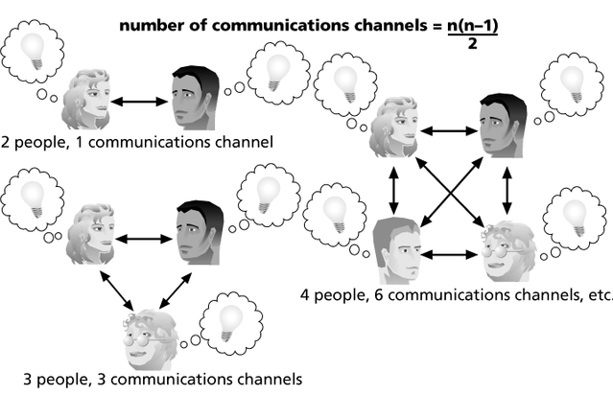
Figure 10-1. The Impact of the Number of People on Communications Channels
Information Technology Project Management, Fourth

Slide 20
Performance Reporting
Performance reporting keeps stakeholders informed about how resources are being used to achieve project objectives.
  Status reports describe where the project stands at a specific point in time.
  Progress reports describe what the project team has accomplished during a certain period of time.
  Forecasts predict future project status and progress based on past information and trends.
Information Technology Project Management, Fourth

Slide 21
Managing Stakeholders
Project managers must understand and work with various stakeholders.
Need to devise a way to identify and resolve issues.
Two important tools include:
  Expectations management matrix
  Issue log
Information Technology Project Management, Fourth

Slide 22
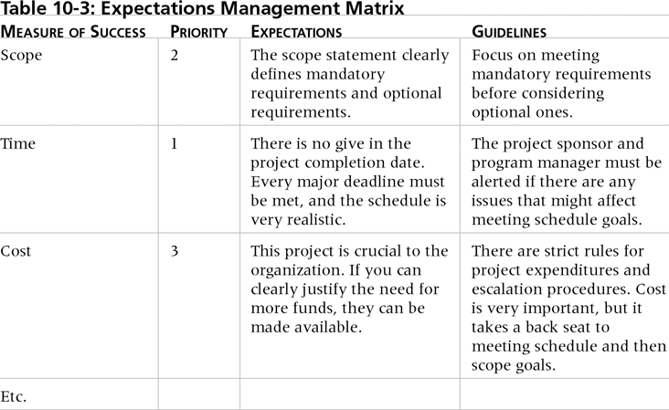
Table 10-3. Expectations
Management Matrix
Information Technology Project Management, Fourth

Slide 23
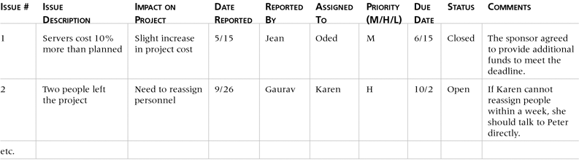
Table 10-4. Issue Log
Information Technology Project Management, Fourth

