Slide 1

SECTION 1
THE PROJECT MANAGEMENT FRAMEWORK
Dr. Ir. IGNATIUS JOKO DEWANTO., MM
PMBOK®
Fourth Edition
MAGISTER TEKNIK INFORMATIKA
STMIK - RAHARJA

Slide 2
CHAPTER 1
INTRODUCTION

Slide 3
Introduction
What is PMBOK Guide?
PMBOK Guide is a recognized standard for the
project management profession.
What is a standard?
A standard is a formal document that describes
established norms, methods, processes, and practices.
How did it evolve?
The knowledge contained in this standard evolved from the recognized good practices of project management practitioners who contributed to the development of this standard.

Slide 4
Introduction
PMBOK Guide Layout
Chapter 01 & 02
Provides an introduction to key concepts in the project management field.
Chapter 03
Is the standard for project management.
Its summarizes the processes, inputs, and outputs that are considered good practices on most projects most of the time.
Chapter 04 – 12
Are the guide to the project management body of knowledge.
They expand on the information in the standard by describing the inputs and outputs as well as tools and techniques used in managing projects.

Slide 5
Introduction
The PMBOK Guide provides guidelines for managing
individual projects.
The PMBOK Guide
defines project management and related concepts, and
describes the project management life cycle and the related processes

Slide 6
1.1 Purpose of the PMBOK Guide
The increasing acceptance of project management indicates that the application of appropriate knowledge, processes, skills, tools, and techniques can have a significant impact on project success.
The PMBOK Guide identifies that subset of the
project management body of knowledge [which is]
“generally recognized” as “good practice”.

Slide 7
1.1 Purpose of the PMBOK Guide
What does “generally recognized” mean?
It means the knowledge and practices described
are applicable to most projects most of the time, and
there is consensus about their value and usefulness.
What does “good practice” mean?
It means there is general agreement that
the application of these skills, tools, and techniques
can enhance the chances of success
over a wide range of projects.

Slide 8
1.1 Purpose of the PMBOK Guide
Good practice does not mean that the knowledge described
should always be applied uniformly to all projects.
The organization and/or project management team is responsible for determining what is appropriate for any given project.

Slide 9
1.1 Purpose of the PMBOK Guide
Common Vocabulary
The PMBOK Guide also provides and promotes a common vocabulary within the project management profession for discussing, writing, and applying project management concepts.
Such a standard vocabulary is an essential element of a professional discipline
Foundational Project Management Reference
The Project Management Institute (PMI) views this standard as a foundational project management reference for its professional development programs and certifications

Slide 10
Purpose of the PMBOK Guide
PMI Code of Ethics and Professional Conduct
In addition to
the standards that establish guidelines for
project management processes, tools, and techniques,
the PMI Code of Ethics and Professional Conduct
guides practitioners of the profession of project management
and
describes the expectations practitioners have of themselves and others.

Slide 11
1.2 What is a project?
Definition
A project is a temporary endeavor
undertaken to create a unique product, service, or result.
Temporary endeavor with a definite beginning and end.
The end is reached when
the project’s objectives have been achieved or
when the project is terminated because its objectives will not or cannot be met, or
when the need for the project no longer exists.

Slide 12
1.2 What is a project?
Definition – Misconceptions:
Temporary does not necessarily mean short in duration.
Temporary does not generally apply to out put of the project (the product, service, or result created by the project); most projects are undertaken to create a lasting outcome. [and lasting impact.]
Definition: “create”:
  A product that can be either a component of another item or an end item in itself,
  A capability to perform a service (e.g., a business function that supports production or distribution), or
  A result such as an outcome or document (e.g., a research project that develops knowledge that can be used to determine whether a trend is present or a new process will benefit society).

Slide 13
1.2 What is a project?
Definition – “unique”
Every project creates a unique product, service, or result.
Although repetitive elements may be present in some project deliverables, this repetition does not change the fundamental uniqueness of the project work.
An ongoing work effort is generally a repetitive process because it follows an organization’s existing procedures.

Slide 14
1.2 What is a project?
Differences from routine repetitive work
In contrast, because of the unique nature of projects, there may be uncertainties about the products, services, or results that the project creates.
Project tasks can be new to a project team, which necessitates more dedicated planning than other routine work.
In addition, projects are undertaken at all organizational levels.
A project can involve a single person, a single organizational unit, or multiple organizational units.

Slide 15
1.2 What is a project?
Examples of Projects
Examples of projects include, but are not limited to:
Developing a new product or service,
Effecting a change in the structure, staffing, or style of an organization,
developing or acquiring a new or modified information system,
Constructing a building or infrastructure, or
Implementing a new business process or procedure.

Slide 16
1.2 What is a project?
Project Exist in All Organizations
- Public Sector Organization
- Business Organization
- Non Governmental Organizations etc
Why?
Because organizations are open systems. They have to respond to both internal and external changes
To meet their development agenda
To satisfy customers
To survive
To solve problems and grab opportunities

Slide 17
1.3 What is project management?
What is Project Management?
Project management is the
application of
knowledge,
skills,
tools, and
techniques
to project activities
to meet the project requirements.

Slide 18
1.3 What is project management?
How is project Management accomplished?
Project management is accomplished through the
appropriate application and integration
of the 42 logically grouped project management processes.
The 42 project management processes are logically grouped in to
five “Process Groups”.
These Process Groups are:
  Initiating,
  Planning,
  Executing,
  Monitoring and Controlling, and
  Closing.

Slide 19
1.3 What is project management?
What does a project typically include?
Identifying requirements
Addressing the various needs, concerns, & expectations of stakeholders as the project is planned & carried out,
Balancing the competing project constraints including, but not limited to:
Scope,
Quality,
Schedule,
Budget,
Resources, and
Risk.

Slide 20
1.3 What is project management?
What is interdependency of constraints?
The relationship among these factors [the constraints] is such that if any one factor changes, at least one other factor is likely to be affected.
Example:
For example, if the schedule is shortened, often the budget needs to be increased to add additional resources to complete the same amount of work in less time. If a budget increase is not possible, the scope or quality may be reduced to deliver a product in less time for the same budget.

Slide 21
1.3 What is project management?
Constraints – Key points
Project stakeholders may have differing ideas as to which factors are the most important, creating an even greater challenge.
Changing the project requirements may create additional risks.
The project team must be able to assess the situation and balance the demands in order to deliver a successful project.

Slide 22
1.3 What is project management?
Because of the potential for change, the project management plan is iterative and goes through progressive elaboration throughout the project’s life cycle.
What is iteration?
What is progressive elaboration?
Progressive elaboration involves
continuously improving and detailing a plan
as more-detailed and specific information and more accurate estimates become available.
Progressive elaboration allows a project management team to manage to a greater level of detail as the project evolves.

Slide 23
Approach Towards Studying Project Management
Views of Project Management Process
Atomistic View
Holistic View – Integrated Project Management
Dimensions of Project Management Process
Technical
Sociocultural

Slide 24
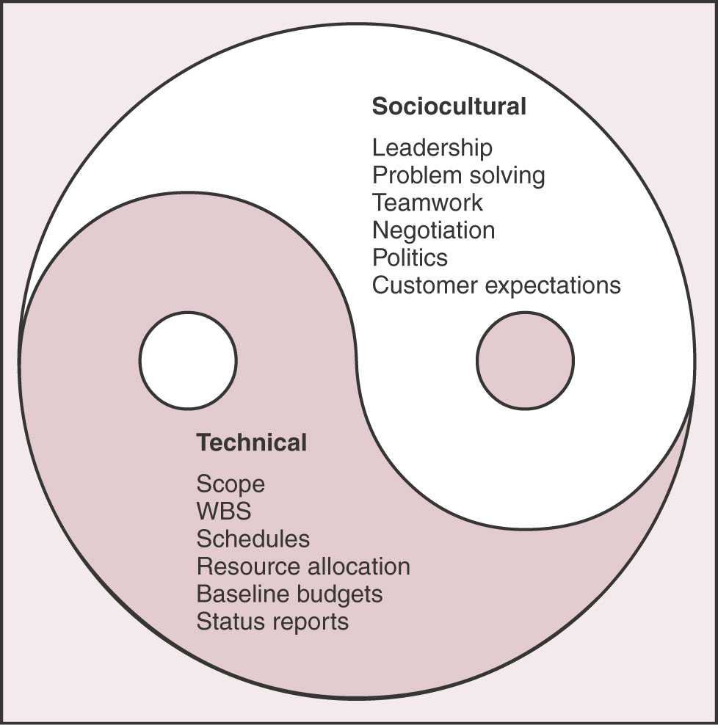
Approach Towards Studying Project Management
Dimensions of Project Management Process

Slide 25
1.4 Relationships B/W Project, Program, & Portfolio Mgt.
Broader Context of Project Management
In mature project management organizations,
project management exists in a broader context
governed by
program management and portfolio management.

Slide 26
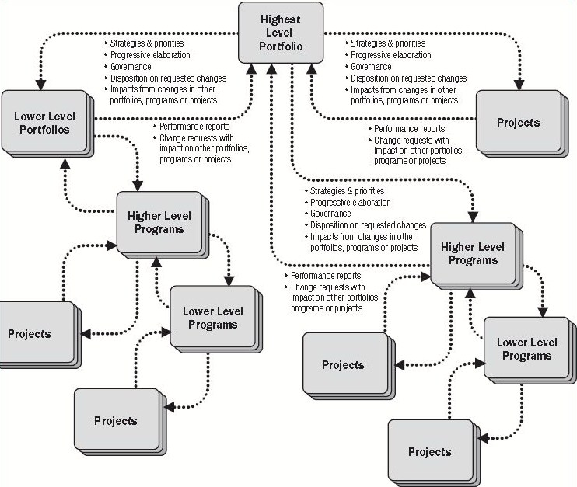

Slide 27
1.4 Relationships B/W Project, Program, & Portfolio Mgt.
The Figure focuses/shows that,
organizational strategies and priorities are linked, and
there is relationships between portfolios and programs, and
there is relationship between programs and individual projects.

Slide 28
1.4 Relationships B/W Project, Program, & Portfolio Mgt.
Key points:
Organizational planning impacts the projects by means of
project prioritization based on risk, funding, and the organization’s strategic plan.
Organizational planning can direct the funding and support for the component projects on the basis of risk categories, specific lines of business, or general types of projects, such as infrastructure and internal process improvement.

Slide 29
1.4 Relationships B/W Project, Program, & Portfolio Mgt.
1.4.1 Portfolio Management
What is ‘portfolio’?
A portfolio refers to a
collection of projects or programs and other work
that are grouped together to
facilitate effective management of that work
to meet strategic business objectives.
The projects or programs of the portfolio
may not necessarily be interdependent or directly related.

Slide 30
1.4 Relationships B/W Project, Program, & Portfolio Mgt.
1.4.1 Portfolio Management
The projects or programs of the portfolio
may not necessarily be interdependent or directly related.
For example, an infrastructure firm that has the
strategic objective of “maximizing the return on its investments” may put together a portfolio that includes
a mix of projects in oil and gas, power, water, roads, rail, and airports.
From this mix, the firm may choose to manage related projects as one program. All of the power projects may be grouped together as a power program. Similarly, all of the water projects may be grouped together as a water program.

Slide 31
1.4 Relationships B/W Project, Program, & Portfolio Mgt.
1.4.1 Portfolio Management
What is portfolio management?
It refers to the centralized management of one or more portfolios.
What is portfolio management involve?
It includes identifying, prioritizing, authorizing, managing, and controlling projects, programs, and other related work, to achieve specific strategic business objectives.
What does portfolio management focus on?
It focuses on ensuring that projects and programs are reviewed to prioritize resource allocation, and that the management of the portfolio is consistent with and aligned to organizational strategies.

Slide 32
1.4 Relationships B/W Project, Program, & Portfolio Mgt.
1.4.2 Program Management
Definition of ‘Program’
A program is defined as a group of related projects
managed in a coordinated way to obtain benefits and control not available from managing them individually.
Key Points:
Programs may include elements of related work outside the scope of the discrete projects in the program.
A project may or may not be part of a program but a program will always have projects.

Slide 33
1.4 Relationships B/W Project, Program, & Portfolio Mgt.
1.4.2 Program Management
Definition of ‘Program management’
Program management is defined as the
centralized coordinated management of a program to
achieve the program’s strategic objectives and benefits.
Key Point:
Projects within a program are related through the
common outcome or collective capability.
If the relationship between projects is only that of a shared client, seller, technology, or resource, the effort should be managed as a portfolio of projects rather than as a program.

Slide 34
1.4 Relationships B/W Project, Program, & Portfolio Mgt.
1.4.2 Program Management
Focus of Program Management:
It focuses on the project interdependencies and
helps to determine the optimal approach for managing them.
Actions related to these interdependencies may include:
Resolving resource constraints and/or conflicts that affect multiple projects within the program;
Aligning organizational/strategic direction that affects project and program goals and objectives; and
Resolving issues and change management within a shared governance structure.

Slide 35
1.4 Relationships B/W Project, Program, & Portfolio Mgt.
1.4.2 Program Management
An Example of a Program :
An example of a program would be a
new communications satellite system
with projects for
design of the satellite and of the ground stations,
construction of each,
integration of the system, and
launch of the satellite.

Slide 36
1.4 Relationships B/W Project, Program, & Portfolio Mgt.
Difference in approaches
Projects, programs, and portfolios have different approaches.
Table 1-1
shows the
comparison of project, program, and portfolio views
across several domains including
change,
leadership,
management, and
others.

Slide 37
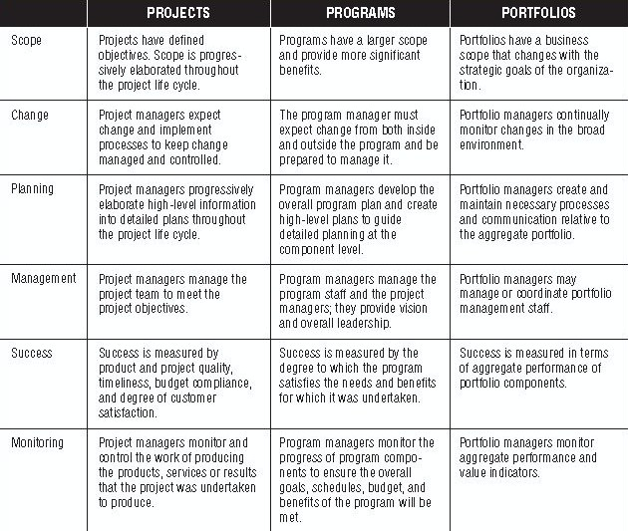

Slide 38
1.4 Relationships B/W Project, Program, & Portfolio Mgt.
1.4.3 Projects and Strategic Planning
Projects are often utilized as a means of achieving an organization’s strategic plan.
Projects are typically authorized as a result of
one or more of the following strategic considerations:
  Market demand
  Strategic opportunity/business need
  Customer request
  Technological advance
  Legal requirements

Slide 39
1.4 Relationships B/W Project, Program, & Portfolio Mgt.
1.4.3 Projects and Strategic Planning
Key Points
Projects, within programs or portfolios, are a means of achieving organizational goals and objectives, often in the context of a strategic plan.
Although a group of projects within a program can have discrete benefits, they can also contribute to the benefits of the program, to the objectives of the portfolio, and to the strategic plan of the organization.
Organizations manage portfolios based on their strategic plan, which may dictate a hierarchy to the portfolio, program, or projects involved.

Slide 40
1.4 Relationships B/W Project, Program, & Portfolio Mgt.
1.4.3 Projects and Strategic Planning
Key Points
One goal of portfolio management is to maximize the value of the portfolio by the careful examination of its components—the constituent programs, projects, and other related work.
Those components contributing the least to the portfolio’s strategic objectives may be excluded. In this way, an organization’s strategic plan becomes the primary factor guiding investments in projects.
At the same time, projects provide feedback to programs and portfolios by means of status reports and change requests that may impact other projects, programs, or portfolios. The needs of the projects, including the resource needs, are rolled up and communicated back to the portfolio level, which in turn sets the direction for organizational planning.

Slide 41
1.4 Relationships B/W Project, Program, & Portfolio Mgt.
1.4.4 Project Management Office (PMO)
Definition:
PMO is an organizational body or entity
assigned various responsibilities related to the
centralized and coordinated management of those projects under its domain.
Responsibility of PMO:
The responsibilities of a PMO can range from providing project management support functions to actually being responsible for the direct management of a project.
Key Point:
The projects supported or administered by the PMO may not be related, other than by being managed together.

Slide 42
1.4 Relationships B/W Project, Program, & Portfolio Mgt.
1.4.4 Project Management Office
Key Points:
The specific form, function, and structure of a PMO is dependent upon the needs of the organization that it supports.
A PMO may be delegated the authority to act as an integral stakeholder and a key decision maker during the beginning of each project, to make recommendations, or to terminate projects or take other actions as required to keep business objectives consistent.
In addition, the PMO may be involved in the selection, management, and deployment of shared or dedicated project resources.

Slide 43
1.4 Relationships B/W Project, Program, & Portfolio Mgt.
1.4.4 Project Management Office
Primary Function:
To support project managers in a variety of ways which may include, but are not limited to:
  Managing shared resources across all projects administered by PMO
  Identifying & developing project mgt. methodology, best practices, & standards
  Coaching, mentoring, training, and oversight;
  Monitoring compliance with project management standards, policies, procedures, and templates via project audits;
  Developing and managing project policies, procedures, templates, and other shared documentation , and
  Coordinating communication across projects.

Slide 44
1.4 Relationships B/W Project, Program, & Portfolio Mgt.
1.4.4 Project Management Office
PMO and Project Managers Pursue Different Objectives:
Project managers and PMOs pursue different objectives
and, as such, are driven by different requirements.
All of these efforts, however, are aligned with the
strategic needs of the organization.

Slide 45
1.4 Relationships B/W Project, Program, & Portfolio Mgt.
1.4.4 Project Management Office
PMO and Project Managers have Different Roles:
The project manager focuses on the specified project objectives, while the PMO manages major program scope changes which may be seen as potential opportunities to better achieve
business objectives.
The project manager controls the assigned project resources to best meet project objectives while the PMO optimizes the use of shared organizational resources across all projects.
The project manager manages the constraints (scope, schedule, cost, and quality, etc.) of the individual projects while the PMO manages the methodologies, standards, overall risk/opportunity, and interdependencies among projects at the enterprise level.

Slide 46
1.5 Project Management and Operations Management
Definition:
Operations are an organizational function performing the ongoing execution of activities that produce the same product or provide a repetitive service.
Examples:
Production operations, manufacturing operations, and accounting operations, etc.
Key Points:
Though temporary in nature, projects can help achieve the organizational goals when they are aligned with the organization’s strategy.
Organizations sometimes change their operations, products, or systems by creating strategic business initiatives.

Slide 47
1.5 Project Management and Operations Management
Projects require project management while
operations require business process mgt. or operations management.
Projects can intersect with operations at various points during the product life cycle, such as:
  At each closeout phase;
  When developing a new product, upgrading a product, or expanding outputs;
  Improvement of operations or the product development process; or
  Until the divestment of the operations at the end of the product life cycle.

Slide 48
1.5 Project Management and Operations Management
Key Points:
At each point, deliverables and knowledge are
transferred between the project and operations
for implementation of the delivered work.
This occurs through a transfer of project resources to operations toward the end of the project, or through a transfer of operational resources to the project at the start.
Operations are permanent endeavors that produce repetitive outputs, with resources assigned to do basically the same set of tasks according to the standards institutionalized in a product life cycle. Unlike the ongoing nature of operations,
projects are temporary endeavors.

Slide 49
1.7 Project Management Body of Knowledge
The PMBOK Guide is the standard for managing most projects most of the time across many types of industries.
This standard describes the project management processes, tools, and techniques used to manage a project toward a successful outcome.
This standard is unique to the project management field and has interrelationships to other project management disciplines such as program management and portfolio management.
Project management standards do not address all details of every topic.

Slide 50
1.7 Project Management Body of Knowledge
This standard is limited to single projects and the project management processes that are generally recognized as good practice.
Other standards may be consulted for additional information on the broader context in which projects are accomplished.
Management of programs is addressed in The Standard for Program Management, and
Management of portfolios is addressed in The Standard for Portfolio Management.
Examination of an enterprise’s project management process capabilities is addressed in Organizational Project Management Maturity Model (OPM3 ).

Slide 51
1.8 Enterprise Environmental Factors
Definition:
Enterprise environmental factors refer to both internal and external environmental factors that surround or influence a project’s success.
These factors may come from any or all of the enterprises involved in the project.
Enterprise environmental factors may
enhance or constrain project management options and
may have a positive or negative influence on the outcome.
They are considered as inputs to most planning processes.

Slide 52
1.8 Enterprise Environmental Factors
Enterprise environmental factors include, but are not limited to:
Organizational culture, structure, and processes;
Government or industry standards (e.g., regulatory agency regulations, codes of conduct, product standards, quality standards, and workmanship standards);
Infrastructure (e.g., existing facilities and capital equipment);
Existing human resources (e.g., skills, disciplines, and knowledge, such as design, development, law, contracting, and purchasing)
Personnel administration (e.g., staffing and retention guidelines, employee performance reviews and training records, overtime policy, and time tracking);

Slide 53
1.8 Enterprise Environmental Factors
  Company work authorization systems;
  Marketplace conditions;
  Stakeholder risk tolerances;
  Political climate;
  Organization’s established communications channels;
  Commercial databases (e.g., standardized cost estimating data, industry risk study information, and risk databases); and
  Project management information systems (e.g., an automated tool, such as a scheduling software tool, a configuration management system, an information collection and distribution system, or web interfaces to other online automated systems).

