Slide 1
SIKLUS HIDUP PROYEK / THE PROJECT LIFE CYCLE
PROJECT MANAGEMENT LIFE CYCLE
I. Joko Dewanto
LSU 01/18/2005
TEKNIK INFORMATIKA – FAKULTAS ILMU KOMPUTER

Slide 2
GOAL OBJECTIVE
To Understand project phase
To mastering process flow during life cycle
To implment Preliminary Design Review (PDR)
To implment Critical Design Review (CDR)
To implment Flight Readines Review (FRR)
LSU 01/18/2005
PROJECT LIFE CYCLE

Slide 3
THE PROJECT PHASES
All projects complete roughly the same phases from inception to completion
DESIGN
PDR
DEVELOPMENT
CDR
FABRICATION
INTEGRATION
OPERATION
FRR
TESTING
LSU 01/18/2005
PROJECT LIFE CYCLE

Slide 4
THE DESIGN PHASE
“Paper” study of all issues to establish major concepts and plans
Little to no hardware testing or prototyping
Define science goals and objectives
System level design (subject of Lecture 3)
  System requirements derived from goals and objectives
  Identify major subsystems and interfaces
Concept hardware and software design
  Derived from system requirements and constraints
  Identify parts, costs & availability
Establish tasks, schedule, resource needs and plans for remaining phases of life-cycle
Develop preliminary risk assessment & management plan
Phase terminates with Preliminary Design Review (PDR)
LSU 01/18/2005
PROJECT LIFE CYCLE

Slide 5
THE DEVELOPMENT PHASE - 1
Detailed in-depth study when all design components are finalized
Test concepts by prototyping
  Not building flight hardware
  Used to gain information necessary to refine or finalize a design
  Applies to structure, electronics, sensors and software
Finalize hardware & software design
  Complete system design
  Define interfaces and develop appropriate Interface Control Documents (ICD)
  Complete detailed design
Design
Prototype
Test
Complete Design
LSU 01/18/2005
PROJECT LIFE CYCLE

Slide 6
THE DEVELOPMENT PHASE - 2
Purchase long lead items (identified at PDR)
Finalize plans for pre-flight phases
  Fabrication, integration, calibration and testing
  Tasks, schedule, procedures, resource needs, costs
Update risk assessment & management plan
  Preliminary plan should already be in use for tracking and mitigating risks during development
Develop preliminary mission operations & data analysis plan
Phase terminate with Critical Design Review (CDR)
LSU 01/18/2005
PROJECT LIFE CYCLE

Slide 7
THE FABRICATION PHASE
Implement construction of flight components
Order Parts
Training
Parts procurement
  Test that parts satisfy flight
  requirements before assembly
Assemble hardware & software subsystems
  Training may be required for particular assemblies
  Fabricate component with qualified parts
  If part fails initial inspection and testing, return to assembly for rework / fixing
  If part fails thermal testing return to assembly for rework / fixing
Once complete move to integration
QA / QC
Assembly
Inspect/Test
Thermal Test
Integration
LSU 01/18/2005
PROJECT LIFE CYCLE

Slide 8
THE INTEGRATION PHASE
Subassemblies are put together to make the final package
Make sure all parts fit together, if not then rework
Make sure power system is delivering proper voltage and current
Connect electronics and sensors
Install software and run
Fix issues before proceeding to system testing
Fit Check
Integrate
Fix
Test
System Testing
LSU 01/18/2005
PROJECT LIFE CYCLE

Slide 9
THE SYSTEM TESTING PHASE
Payload flight certification
Functional Test
Fix
Integrated payload must first be fully functional
Calibration values are determined
  Sensors, ADC gain, timing
Payload must function correctly during thermal, pressure & shock testing
  If not, fix and begin again
  If OK, then validate calibrations
Test and test data must be documented
Proceed to Flight Readiness Review
Calibration
Thermal Test
Pressure Test
Shock Test
Check Calibration
FRR
LSU 01/18/2005
PROJECT LIFE CYCLE

Slide 10
MISSION OPERATIONS & DATA ANALYSIS (MO&DA)
Operate payload during flight & obtain science results
Mission Operations plan includes the following
  Sequence of operations to prepare payload for vehicle integration
  Sequence of operations to prepare payload for launch
  Flight profile requirements
  Operations, commanding, contingencies during flight
  Recovery handling and operations
Data Analysis plan describes what happens to the flight data
  Flight data handling, processing and analysis sequence
  Specify data required from vehicle
LSU 01/18/2005
PROJECT LIFE CYCLE

Slide 11
PROCESS FLOW DURING LIFE CYCLE
Effort focus changes as a function of phase
  Design can be highly theoretical involving simulations and calculations
  Development involves “experiments” and testing concepts to gain information necessary for the design
  Fabrication, Integration, and System testing requires skilled technical help to realize the design in hardware and software
  MO&DA requires “scientists” to direct the proper use of the payload and to turn the data into science results
Resource needs and costs changes as a function of phase
  Design requires no hardware and few personnel
  Development costs increase a bit with some prototyping
  Major cost in personnel and hardware is in fabrication, integration and testing
  MO&DA drops down to no hardware and few personnel
LSU 01/18/2005
PROJECT LIFE CYCLE

Slide 12
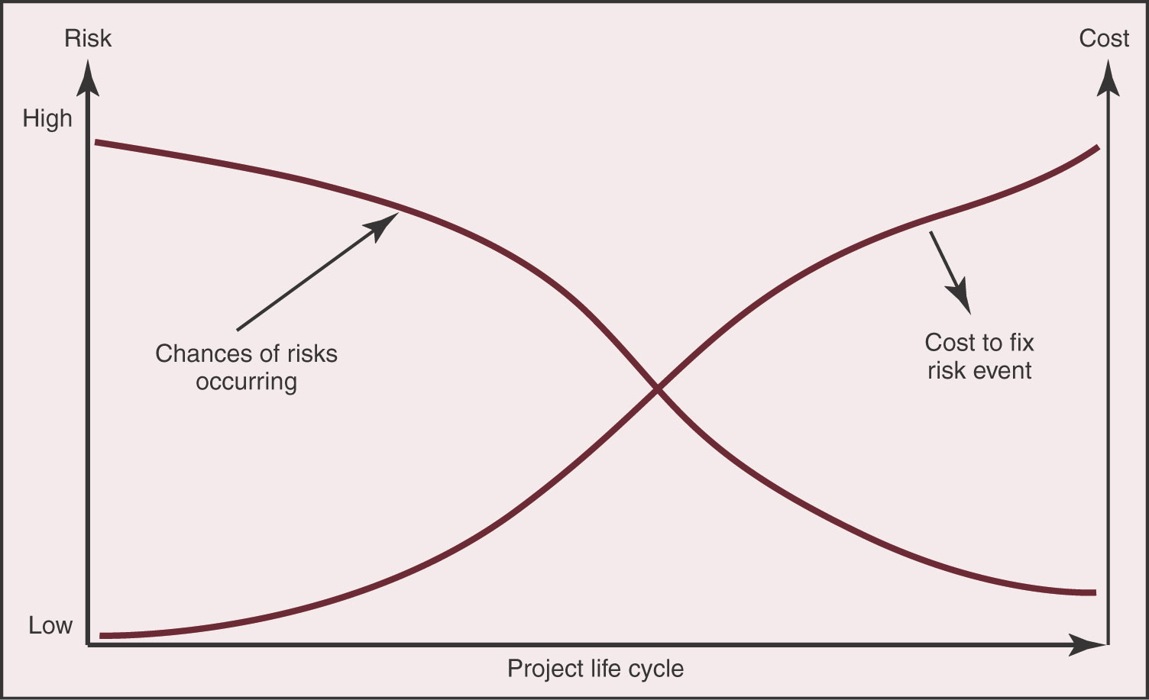
PROJECT RISK MANAGEMENT
“The essence of project management is risk management”
Probability of a disaster decreases during the life of a project
Cost to recover from a problem increases during the project
Catch & correct problems early!
LSU 01/18/2005
PROJECT LIFE CYCLE

Slide 13
PROJECT MILESTONES
There are three major reviews during the project
Preliminary Design Review (PDR)
  Follows design phase
Critical Design Review (CDR)
  Follows development phase
Flight Readiness Review (FRR)
  Prior to flight
The team must prepare written documents and oral presentations for each review
LSU 01/18/2005
PROJECT LIFE CYCLE

Slide 14
PRELIMINARY DESIGN REVIEW (PDR)
The PDR should cover results from your design phase including:
  Goals & objectives
  Preliminary System design
  Concept hardware & software design
  Tasks, schedule, resource needs, long-lead items
  Preliminary risk assessment & management plan
Should show that you have “thought the problem through”
Include written document and oral presentation
  Format of document will be discussed in Lecture 8
A member of the LA ACES Project will attend and participate in the PDR
LSU 01/18/2005
PROJECT LIFE CYCLE

Slide 15
CRITICAL DESIGN REVIEW (CDR)
The CDR should cover results from your development phase including:
  Resolving issues identified during the PDR
  Prototyping results and “proven” designs
  Completed system design and defined interfaces
  Finalize tasks, schedule, procedures and costs
  Updated risk assessment & management plan
  Preliminary MO & DA plan
Determines whether you are ready to begin building your payload
Include written report and oral presentation
Precise date for CDR should be identified during PDR
LSU 01/18/2005
PROJECT LIFE CYCLE

Slide 16
FLIGHT READINESS REVIEW (FRR)
The FRR reviews all aspects of your payload
  Documentation of as-built configuration
  Is payload safe?
  Will payload perform properly?
  Does payload satisfy the flight constraints?
The FRR will determine whether you are allowed to attach your payload to the flight vehicle!
Written FRR document sent to LA ACES Project 2 weeks before flight
Oral FRR presentation during the launch trip
Details about what is expected during the FRR are provided in Ballooning Unit, Lecture 5
LSU 01/18/2005
PROJECT LIFE CYCLE

Slide 17
PRELIMINARY LSU 2005 SCHEDULE
Payload Concept January 25
PDR February 17
CDR (specify at PDR) (March 24)
FRR Document May 9
Launch Trip May 22 – 26
  FRR Defense May 23
  Launch, Flight Ops May 24
  Data Analysis May 25
  Science Presentation May 26
LSU 01/18/2005
PROJECT LIFE CYCLE

