Slide 1
Millman’s Theorem & Compensation Theorem
Fahmida Ahmed Antara
Assistant Professor, dept. of IRE
1

Slide 2
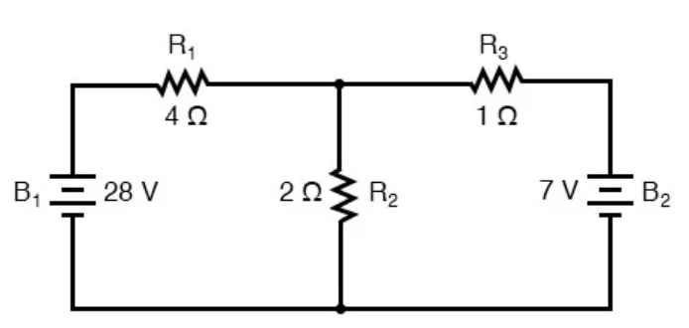

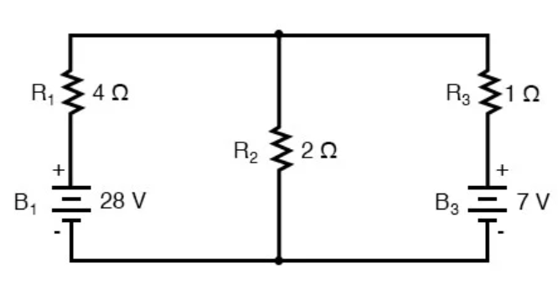
Millman’s Theorem
In Millman’s Theorem, the circuit is re-drawn as a parallel network of branches, each branch containing a resistor or series battery/resistor combination.
Millman’s Theorem is applicable only to those circuits which can be redrawn accordingly.
The circuit in fig. 1 can be redrawn as fig. 2 to apply Millman’s theorem.
By considering the supply voltage within each branch and the resistance within each branch, Millman’s Theorem will tell us the voltage across all branches.
fig. 1
fig. 2
2

Slide 3
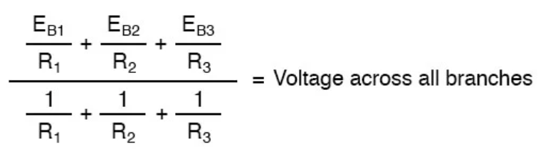
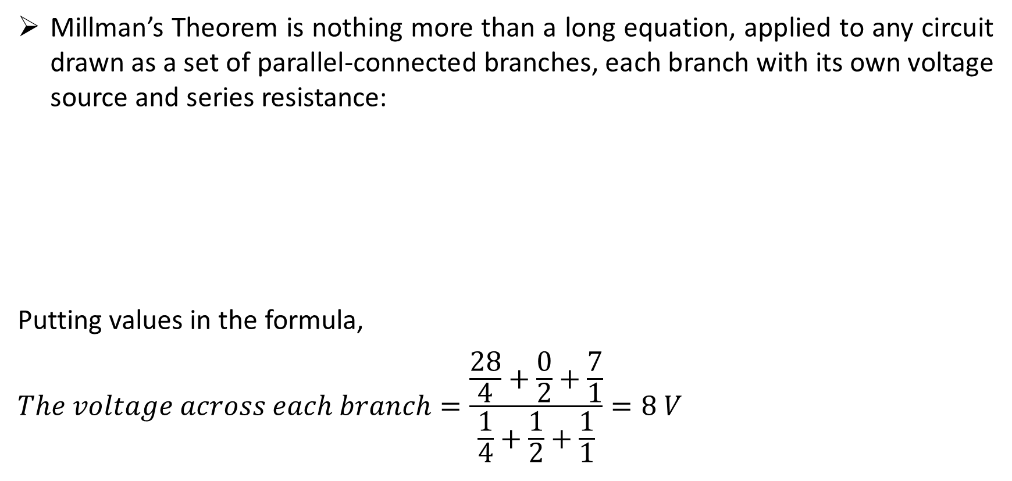
Cont.
Millman’s Theorem is nothing more than a long equation, applied to any circuit drawn as a set of parallel-connected branches, each branch with its own voltage source and series resistance:
Putting values in the formula,
$$The voltage across each branch=\frac{\frac{28}{4}+\frac{0}{2}+\frac{7}{1}}{\frac{1}{4}+\frac{1}{2}+\frac{1}{1}}=8 V$$
fig. 2
3

Slide 4
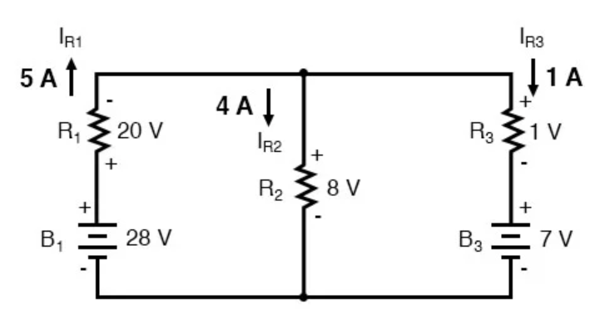
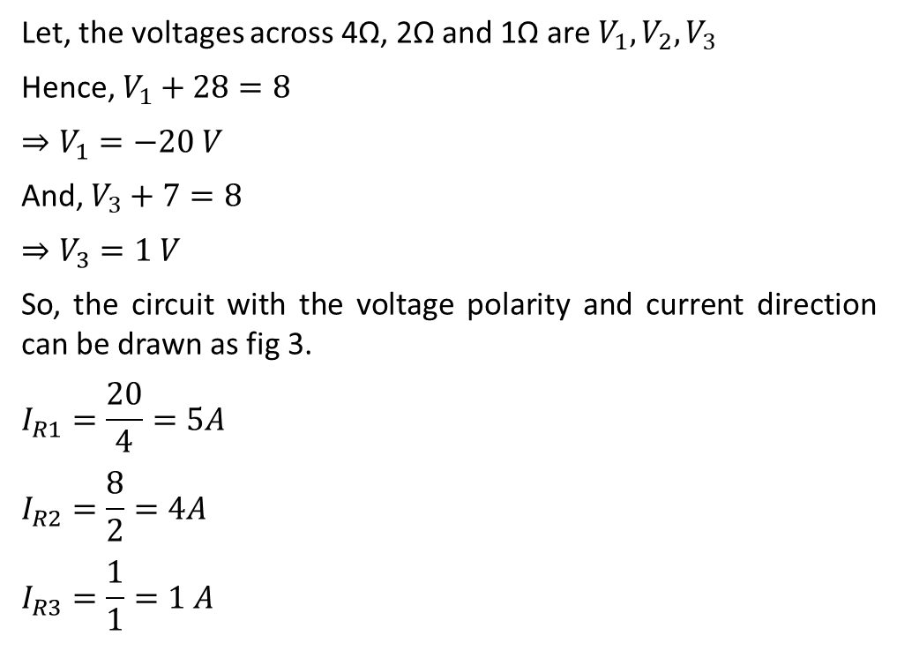
Cont.
Let, the voltages across 4Ω, 2Ω and 1Ω are $V_{1},V_{2},V_{3}$
Hence, $V_{1}+28=8$
$$⇒V_{1}=−20 V$$
And, $V_{3}+7=8$
$$⇒V_{3}=1 V$$
So, the circuit with the voltage polarity and current direction can be drawn as fig 3.
$$I_{R1}=\frac{20}{4}=5A$$
$$I_{R2}=\frac{8}{2}=4A$$
$$I_{R3}=\frac{1}{1}=1 A$$
fig. 2
fig. 3

Slide 5
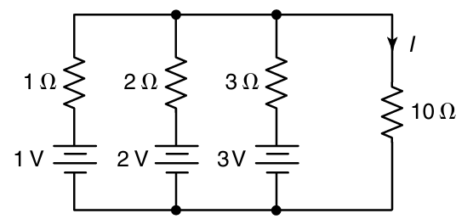
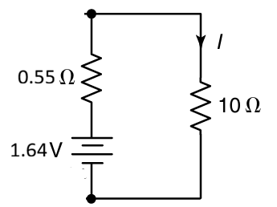
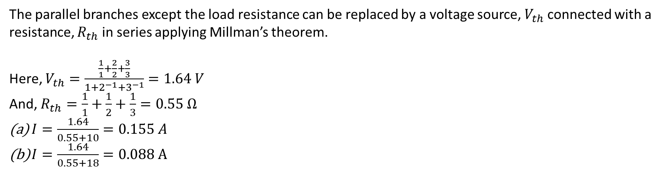
Example-2
Find the load current, $I$ of the following circuit using Millman’s theorem.
Repeat question (a) if the load resistance is 18 Ω.
The parallel branches except the load resistance can be replaced by a voltage source, $V_{th}$connected with a resistance, $R_{th}$ in series applying Millman’s theorem.
Here, $V_{th}=\frac{\frac{1}{1}+\frac{2}{2}+\frac{3}{3}}{1+2^{−1}+3^{−1}}=1.64 V$
And, $R_{th}=\frac{1}{1}+\frac{1}{2}+\frac{1}{3}=0.55 Ω$
$I=\frac{1.64}{0.55+10}=0.155 A$
$I=\frac{1.64}{0.55+18}=0.088 A$

Slide 6
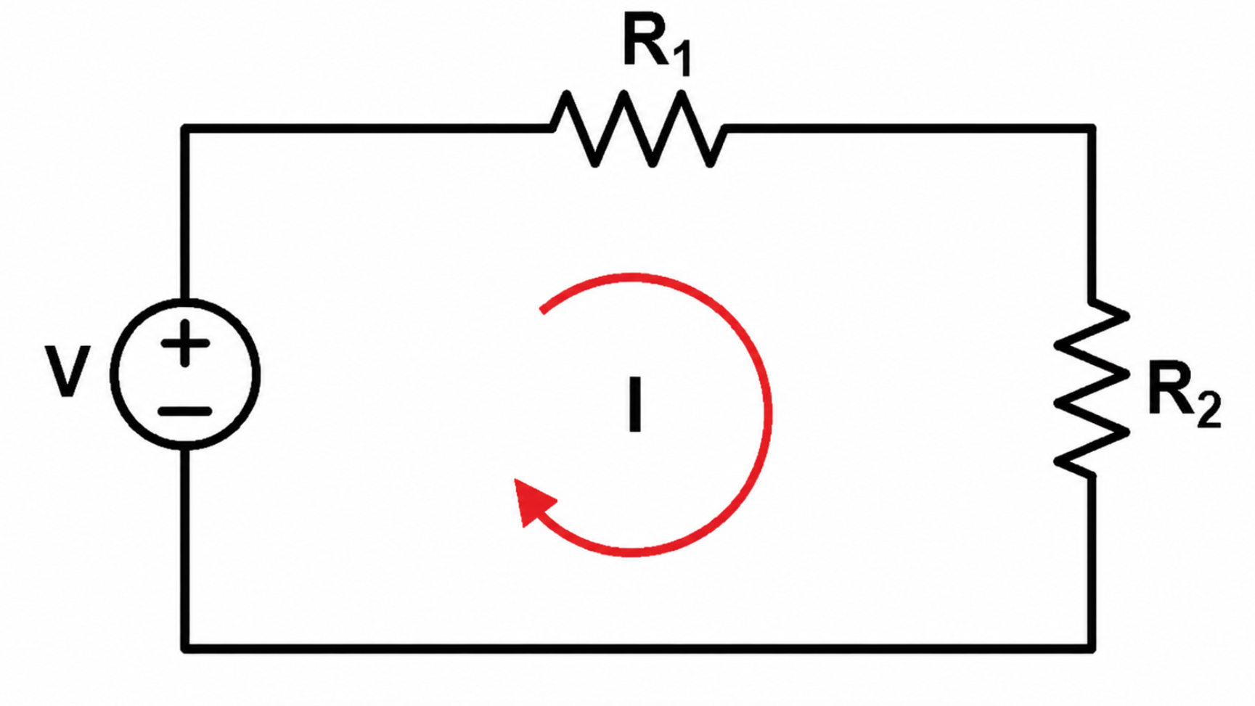
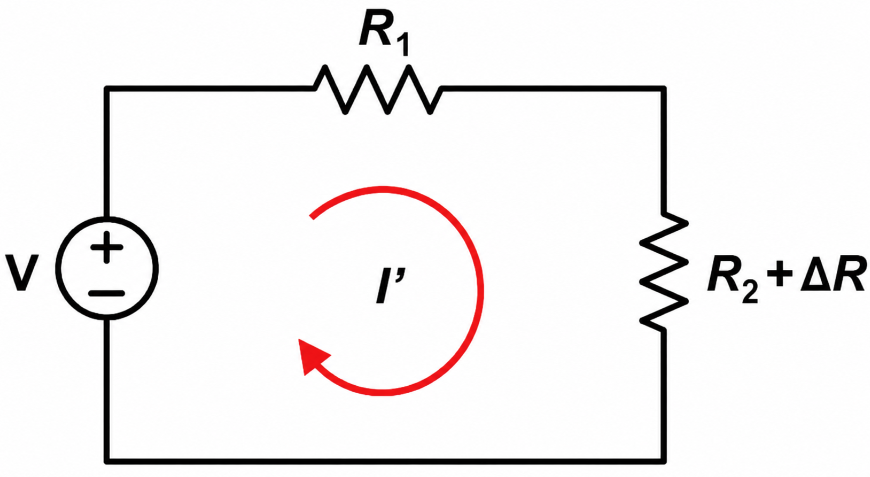
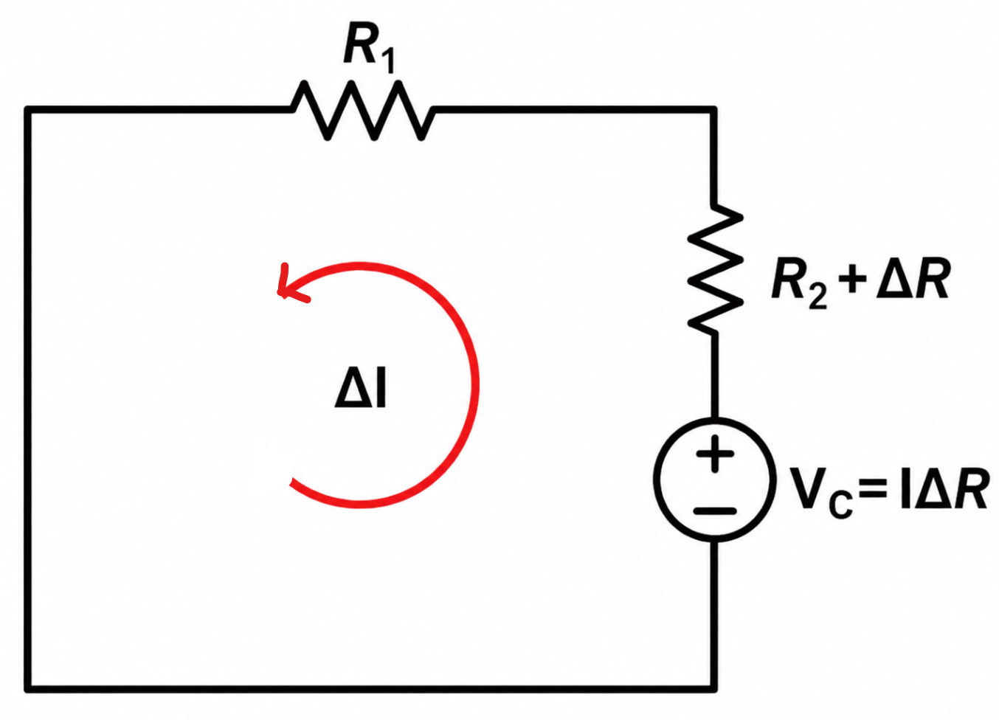
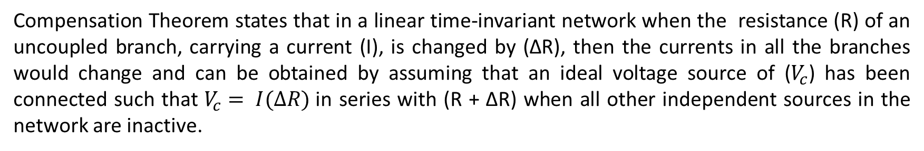
Compensation Theorem
Compensation Theorem states that in a linear time-invariant network when the resistance (R) of an uncoupled branch, carrying a current (I), is changed by (ΔR), then the currents in all the branches would change and can be obtained by assuming that an ideal voltage source of ($V_{c}$) has been connected such that $V_{c}= I(ΔR)$in series with (R + ΔR) when all other independent sources in the network are inactive.
7

Slide 7
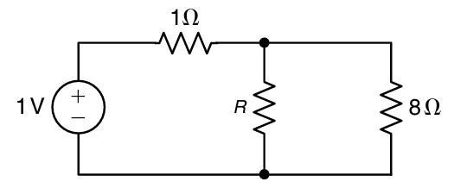
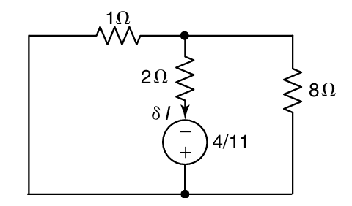
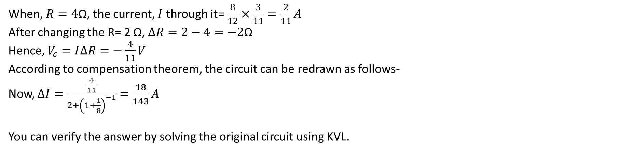
Example-3
In the network shown in following figure, the resistance R is changed from 4Ω to 2Ω. Verify the compensation theorem.
When, $R=4\text{Ω}$, the current, $I$ through it= $\frac{8}{12}×\frac{3}{11}=\frac{2}{11}A$
After changing the R= 2 Ω, $∆R=2−4=−2\text{Ω}$
Hence, $V_{c}=I∆R=−\frac{4}{11}V$
According to compensation theorem, the circuit can be redrawn as follows-
Now, $∆I=\frac{\frac{4}{11}}{2+{\left(1+\frac{1}{8}\right)}^{−1}}=\frac{18}{143}A$
You can verify the answer by solving the original circuit using KVL.

Slide 8
Thank You!

