Slide 1

Pertemuan 12 Balanced Binary Tree Search
Oleh
Dr. Yoga Religia, S.Kom, M.Kom.
✆ 081390601900
🖂 yoga.religia@pelitabangsa.ac.id

Slide 2
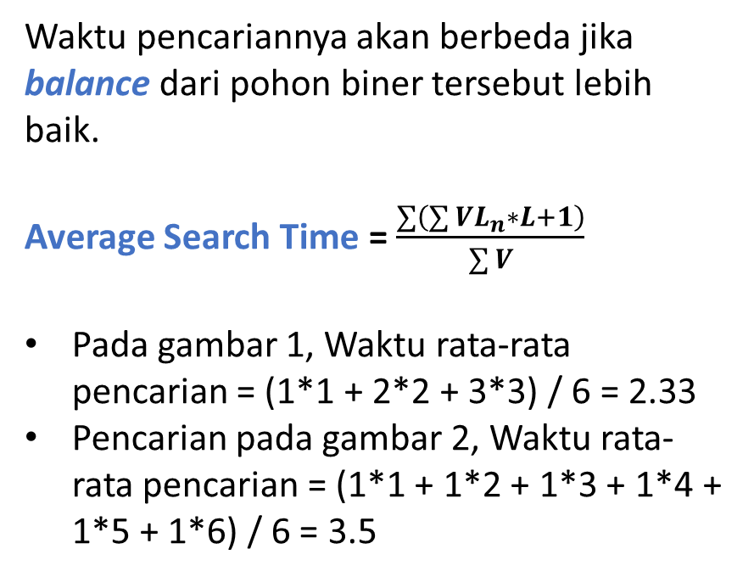
Pencarian Pohon Biner Berimbang
A
A
B
C
B
D
E
F
C
D
Gambar 1
E
Gambar 2
F

Slide 3
Contoh Balance Binary Tree
Jika Depth = 3, jumlah simpul = 15
Maka, Waktu rata-rata pencarian = (1*1 + 2*2 + 4*3 + 8*4) / 15 = 3.27
Meskipun jumlah simpul naik 2 kali lipat, karena pohon binernya balance, waktu rata-rata pencarian tidak naik 2 kali lipat.
Kedalaman | Jumlah Simpul | Waktu Rata-rata | Kenaikan
0 | 1 | 1.00 | -
1 | 3 | 1.66 | 66 %
2 | 7 | 2.43 | 46 %
3 | 15 | 3.27 | 34 %
4 | 31 | 4.16 | 27 %
5 | 63 | 5.09 | 22 %
Algoritma Balenching Binary Tree ada 4 :
Right Rotation
Left Rotation
Right Rotation dilanjut Left Rotation
Left Rotation dilanjut Right Rotation

Slide 4


Algoritma Right Rotation & Left Rotation
Void RightRotation ( ){
Simpul *Q ;
Q = Root -> Left ;
Root -> Left = Q -> Right ;
Q -> Right = Root ;
Root = Q ;
}
A
Q
B
C
Void LeftRotation ( ){
Simpul *Q ;
Q = Root -> Right ;
Root -> Right = Q -> Left ;
Q -> Left = Root ;
Root = Q ;
}
A
Q
B
C

Slide 5
Latihan Individu : Buatlah algoritmanya agar binary tree tersebut dapat balance
A
A
1
B
B
2
C
C

Slide 6
Jawaban
Nomor 1.
Q = Root -> Right
R = Q -> Left
Q -> Left = R -> Right
R -> Right = Q
Root -> Right = R -> Left
R -> Left = Root
Root = R
Nomor 2.
Q = Root -> Left
R = Q -> Right
Q -> Right = R -> Left
R -> Left = Q
Root -> Left = R -> Right
R -> Right = Root
Root = R

