Slide 1
Major Project Final Phase Presentation
School of Computer Science and Engineering
B.Tech (CSE) 5th Semester
Project ID- PT137
Project Title- Intelligent Credit Risk Assessment using Explainable AI
Project Guide
Ms. Shalini Singh
School of Computer Science and Engineering
IILM University, Greater Noida
Team Members
Kushagra Sharma (2410031018)
Nikhil Verma (2410031015)
Taufique Raza (2410031042)
Shams Shahzad (2410030720)
Notes:
Introduce the team, the guide and the project: Intelligent Credit Risk Assessment using Explainable AI (PT137). Phase-1 proposed the idea; this presentation covers the completed system, results and dashboard.

Slide 2


Major Project Final Presentation
Contents
01
Abstract
Goals, methodology and headline results
05
Models & Results
Benchmarking four classifiers
02
Problem & Literature
Black-box dilemma, regulation and research gap
06
Explainable AI & Dashboard
SHAP, LIME case studies and Streamlit app
03
Objectives
Five engineering goals and governance limits
07
Governance & Conclusion
Limitations, future scope and references
04
Data & Pipeline
German Credit data, EDA and leakage-safe design
Notes:
Walk through the flow: problem and literature, objectives, data and pipeline, model results, explainability and dashboard, then governance and conclusion.

Slide 3
Major Project Final Presentation | Project ID: PT137
Abstract
Context: Ensemble models (XGBoost, LightGBM, Random Forest) outperform classical scorecards at predicting loan default, but their opacity complicates ECOA adverse-action notices and GDPR Art. 22 safeguards.
Approach: Leakage-safe scikit-learn pipelines on the Statlog German Credit benchmark (1,000 applicants, 20 attributes), with 5-fold stratified CV on 800 records and a held-out test of 200.
Results: XGBoost: CV ROC-AUC 0.7889 vs test 0.7890. Logistic Regression: best test ROC-AUC (0.8040). Random Forest: highest precision (74.19%) with the lowest FPR (5.71%).
Explainability: SHAP ranks checking status, loan duration and credit history as top risk drivers; LIME adds rule-based reasons. Both run side by side in a Streamlit underwriting dashboard.
Notes:
One-minute summary: why explainability matters in lending, what we built, the headline numbers, and the dashboard that makes the model auditable.

Slide 4
Major Project Final Presentation | Project ID: PT137
Problem Definition
Black-Box Dilemma: An ensemble aggregates hundreds of non-linear trees, so no underwriter can trace why a borrower received a high default probability.
Regulatory Pressure: ECOA / Regulation B requires specific principal reasons for adverse action, and CFPB Circular 2022-03 rejects "the algorithm is too complex" as an excuse. GDPR Art. 22 demands safeguards for automated decisions.
Fairness & Trust: Unaudited models can encode bias through proxies such as age, gender or foreign-worker status, and loan officers cannot validate or explain rejections.
Accuracy vs Transparency: Scorecards are interpretable but weaker on complex profiles; ensembles are accurate but opaque.
Objective: A leakage-safe framework pairing XGBoost, LightGBM and Random Forest with SHAP and LIME inside an interactive underwriting dashboard.
Notes:
Stress that lending decisions affect livelihoods and civil rights, so accuracy alone is not enough. Mention that XAI supports, but does not replace, legal compliance.

Slide 5
Major Project Final Presentation | Project ID: PT137
Literature Survey
Classical Scorecards: Altman Z-score (1968), LDA and Logistic Regression are transparent but struggle with non-linear, high-dimensional borrower data.
Ensemble Learning: Random Forest (Breiman, 2001), XGBoost (Chen & Guestrin, 2016) and LightGBM (Ke et al., 2017) lead credit benchmarks but act as black boxes.
SHAP: Lundberg & Lee (2017) ground attributions in Shapley values; TreeExplainer (Lundberg et al., 2018) computes exact values in polynomial time.
LIME: Ribeiro et al. (2016) fit local surrogates that produce human-readable decision rules for individual predictions.
Research Gap: Bussmann et al. (2021) linked ensembles and auditing, yet few studies compare SHAP and LIME side by side on the same applicant in a real-time interface. This project closes that gap.
Notes:
Three epochs: scorecards, ensembles, XAI. Our contribution is the dual-XAI validation inside one dashboard, which the literature rarely does.

Slide 6
Major Project Final Presentation | Project ID: PT137
Objectives
Data Architecture: Zero-leakage preprocessing pipeline producing a 61-dimensional feature matrix with strict train/test isolation.
Multi-Model Benchmarking: Compare Logistic Regression, Random Forest, XGBoost and LightGBM using 5-fold CV and a 200-record held-out test.
Global & Local XAI (SHAP): TreeExplainer for population-level risk drivers and exact per-applicant log-odds attributions.
Surrogate Interpretability (LIME): Rule-based local explanations that loan officers can act on.
Interactive Deployment: Streamlit dashboard returning risk class, default probability and side-by-side SHAP / LIME views.
Governance Boundaries: State clearly what XAI cannot prove: causality, fairness or legal compliance.
Notes:
Five engineering objectives from the report plus the governance boundary we set ourselves.

Slide 7
Major Project Final Presentation | Project ID: PT137
Dataset & Exploratory Analysis
Benchmark: Statlog German Credit Data (UCI): 1,000 historical loan applicants, 20 attributes (7 numerical, 13 categorical).
Data quality: Zero missing values and zero duplicates. Amounts are in Deutsche Mark; this is not an Indian lending dataset.
Target: 70% non-risky vs 30% risky (2.33 : 1). Approving everyone already scores 70% accuracy, so ROC-AUC, PR-AUC, recall and FPR are used.
Risky borrowers: take larger and longer loans: +31.9% credit amount and +29.4% duration versus good borrowers.
Strongest signals: checking status, savings and credit history. An overdrawn account defaults at 49.3%, versus 11.7% with no checking account.
Default rate by checking-account status (portfolio average: 30%)
Source: Table 3.3, n = 1,000 (A11: 274, A12: 269, A13: 63, A14: 394)
Notes:
Explain why German Credit was chosen: small, clean and well documented, ideal for XAI benchmarking. Point at the chart: checking account status separates risk cohorts strongly (49% vs 12%).

Slide 8
Major Project Final Presentation | Project ID: PT137
Leakage-Safe Pipeline & Protocol
STEP 1
Raw Data
1,000 applicants x 20 attributes; 0% missing, 0% duplicates.
STEP 2
Stratified 80/20 Split
800 train (560 good / 240 risky) and 200 test (140 / 60); 30% default rate preserved.
STEP 3
Preprocessing
StandardScaler on 7 numerics + OneHotEncoder on 13 categoricals = 61 features.
STEP 4
5-Fold Stratified CV
Fresh pipeline per fold: fit on 640, validate on 160 for model selection.
STEP 5
Final Test
Refit on all 800, then evaluate once on the 200 sequestered records.
Why this protects the results
Scalers and encoders are fitted on training folds only, never on validation or test data.
The test split is transformed with frozen parameters and used once, after all tuning is finished.
Stratification and metrics beyond accuracy (ROC-AUC, PR-AUC, recall, FPR) handle the 2.33 : 1 class imbalance.
Notes:
Data leakage is the most common hidden flaw in credit models. Our scikit-learn Pipeline guarantees preprocessing is fitted inside each training fold, and the 200-record test set is touched exactly once.

Slide 9
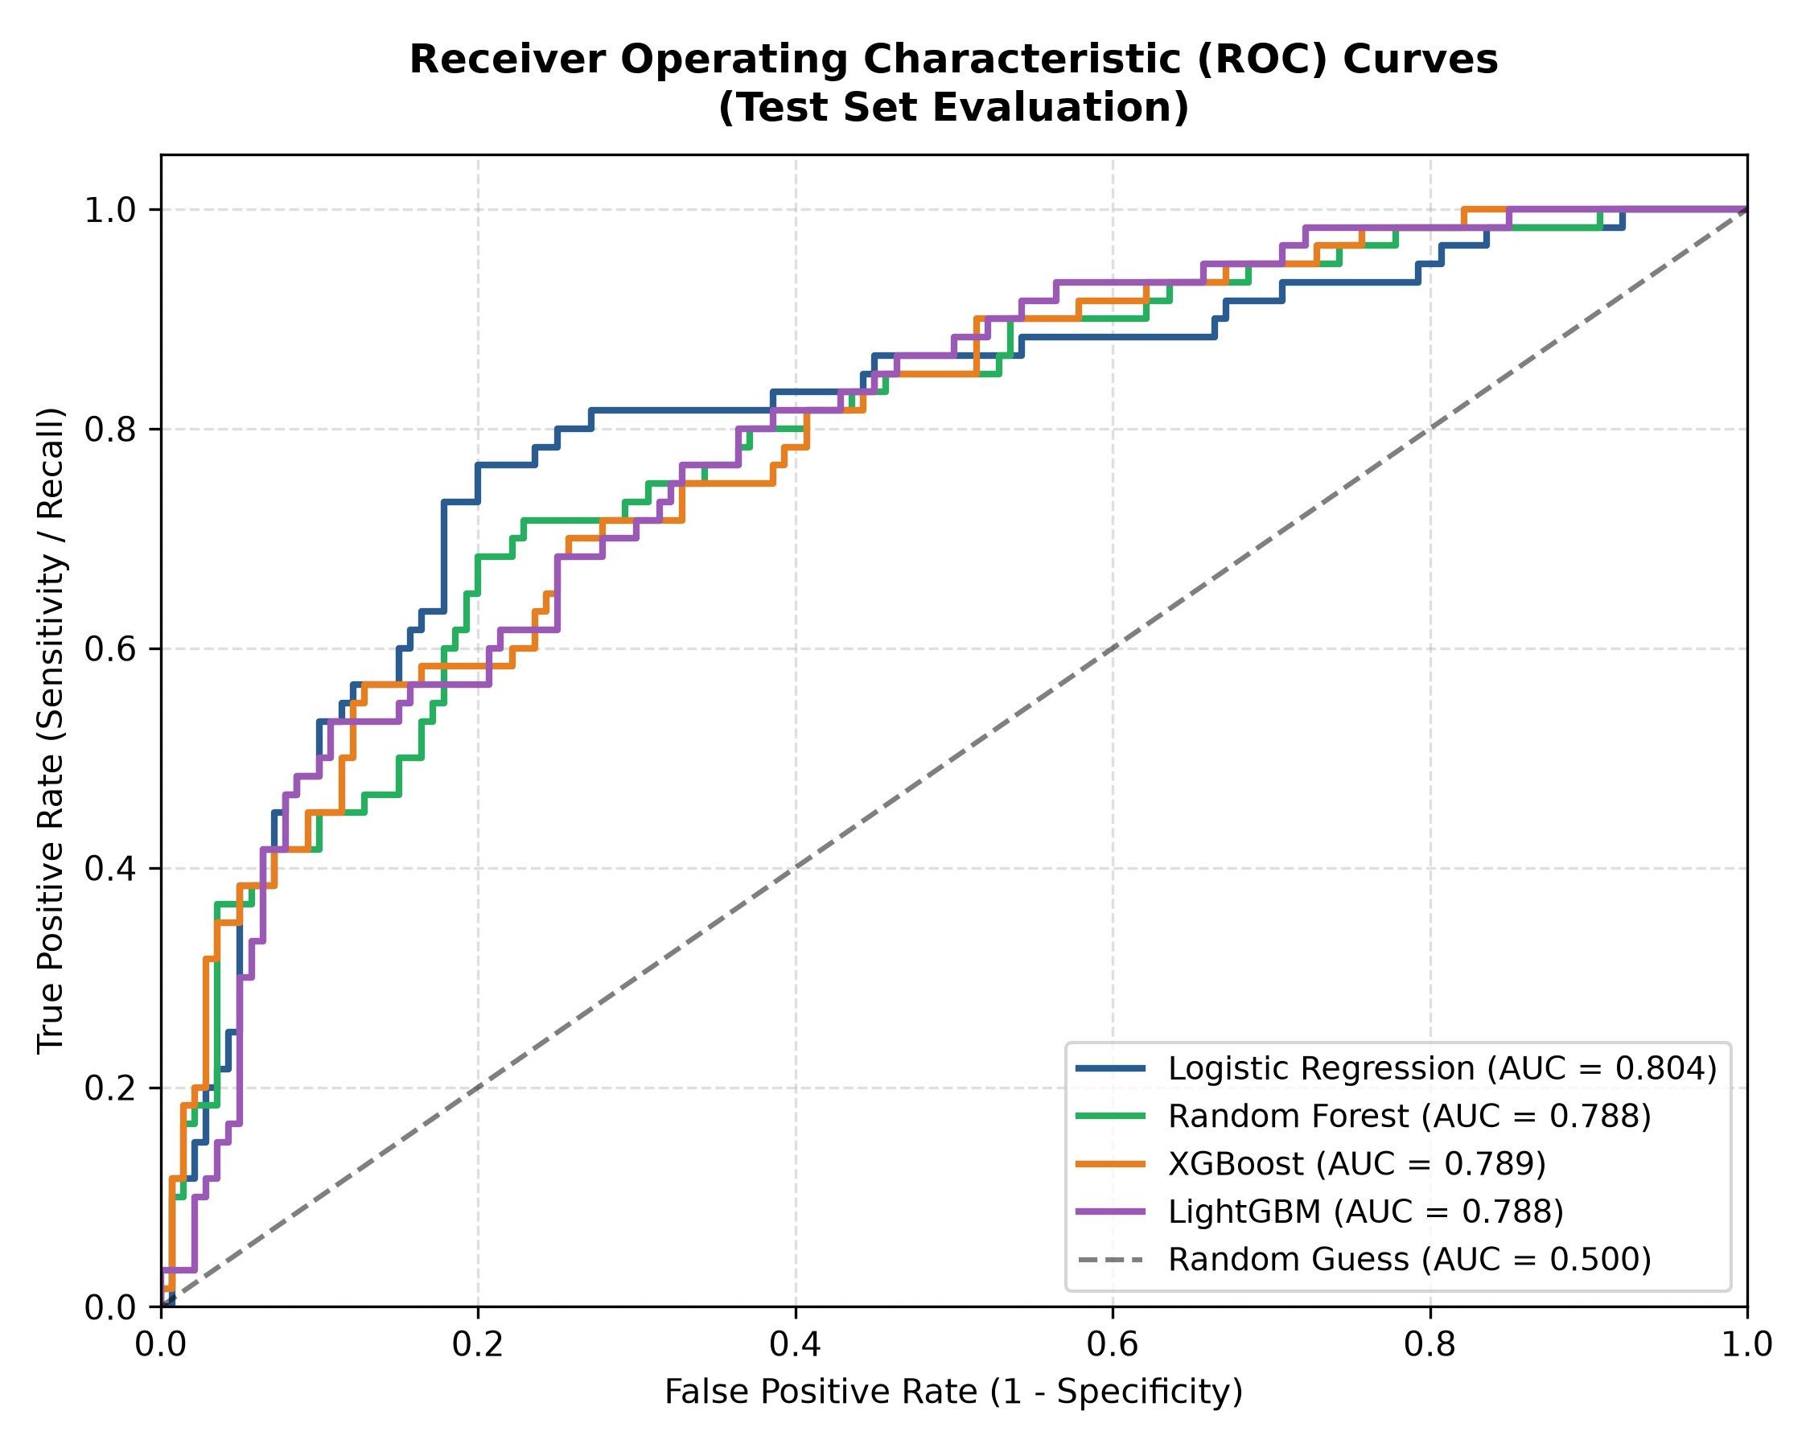
Major Project Final Presentation | Project ID: PT137
Model Benchmarking & Selection
Model | CV ROC-AUC | Test ROC-AUC | F1 | Recall | Precision | FPR
Logistic Regression | 0.7706 ± 0.0535 | 0.8040 | 0.5926 | 53.33% | 66.67% | 11.43%
Random Forest | 0.7888 ± 0.0422 | 0.7879 | 0.5055 | 38.33% | 74.19% | 5.71%
XGBoost (XAI model) | 0.7889 ± 0.0396 | 0.7890 | 0.5347 | 45.00% | 65.85% | 10.00%
LightGBM | 0.7869 ± 0.0496 | 0.7883 | 0.5769 | 50.00% | 68.18% | 10.00%
Bold maroon = best in column. Held-out test n = 200 (140 good / 60 risky), cutoff 0.50. Source: Table 4.1
Logistic Regression: best test ROC-AUC (0.8040) and F1 (0.5926); a regularised linear model stays competitive on 1,000 records.
Random Forest: most conservative, with 74.19% precision and only 8 of 140 solvent applicants wrongly rejected.
XGBoost: chosen as the primary XAI engine: top CV ROC-AUC, CV-to-test gap of +0.0001, and exact TreeSHAP support.
ROC curves, held-out test set (n = 200)
Notes:
Be honest: Logistic Regression wins on this small dataset. We still pick XGBoost for the XAI layer because it is stable in cross-validation, captures interactions, and TreeSHAP gives exact explanations. Random Forest is the choice if minimising wrongful rejections matters most.

Slide 10
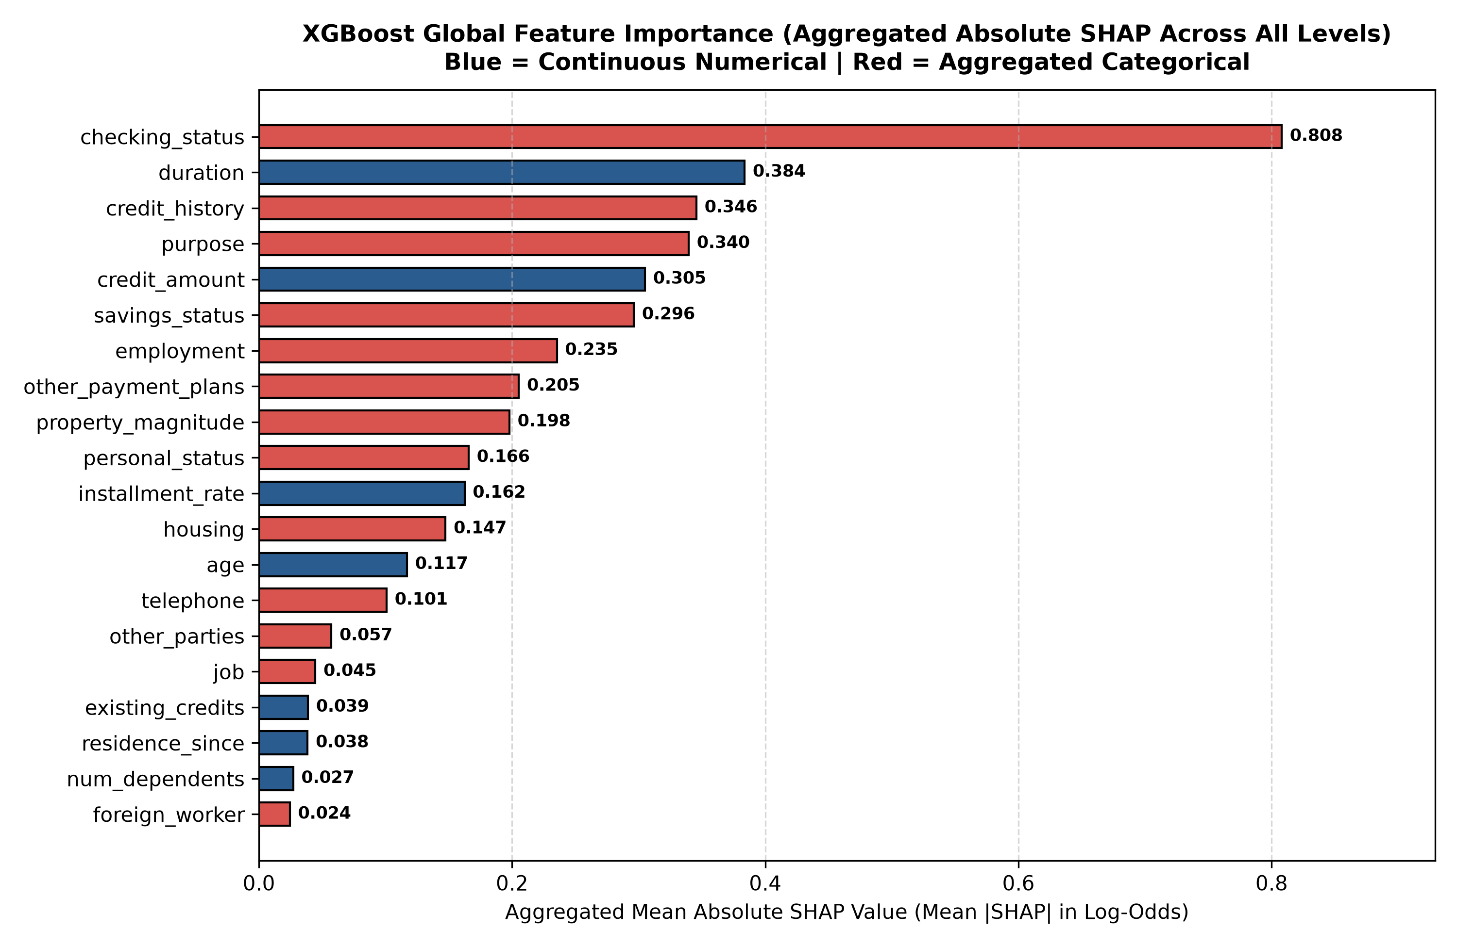
Major Project Final Presentation | Project ID: PT137
Explainable AI: Global SHAP Attribution
Method: TreeSHAP on XGBoost in log-odds space; base value −0.8652 equals a 29.6% default probability.
Exactness: The sigmoid of the SHAP sum reproduces predict_proba, with a maximum error of 1.79 × 10⁻⁷ over all 200 test borrowers.
Top drivers: checking status (0.808), duration (0.384), credit history (0.346), purpose (0.340), credit amount (0.305).
Aggregation: Absolute SHAP values are summed over one-hot levels, so each parent feature is not fragmented.
Fairness flag: personal_status ranks 10th and foreign_worker last (0.024); a formal bias audit is still needed.
Aggregated mean |SHAP| in log-odds, XGBoost, held-out test (n = 200). Blue = numerical, red = categorical.
Notes:
Explain that SHAP gives each feature a share of the prediction, and we verified the maths: attributions reconstruct the model output to within 1e-7. Checking account status dominates.

Slide 11
Major Project Final Presentation | Project ID: PT137
Local Explanations: LIME Case Studies
Applicant #522: risky, P(default) = 91.8% (true positive)
Applicant #772: solvent, P(default) = 0.84% (true negative)
LIME local weight = percentage-point effect on default probability. Red raises default risk, green is protective. Source: Tables 5.3 and 5.4 (redrawn).
SHAP and LIME agree: checking status is the #1 driver for both applicants (A11 raises risk for #522 with SHAP +0.68 log-odds; A14 protects #772), and both flag duration > 24 months and credit > 3,933 DM. They diverge only on weak features, which is why we show both.
Notes:
Walk through #522: overdraft, long duration and a large loan push default probability to 92%. Then #772: no checking account, used car and no other plans make default almost impossible. Both explainers rank checking status first.

Slide 12
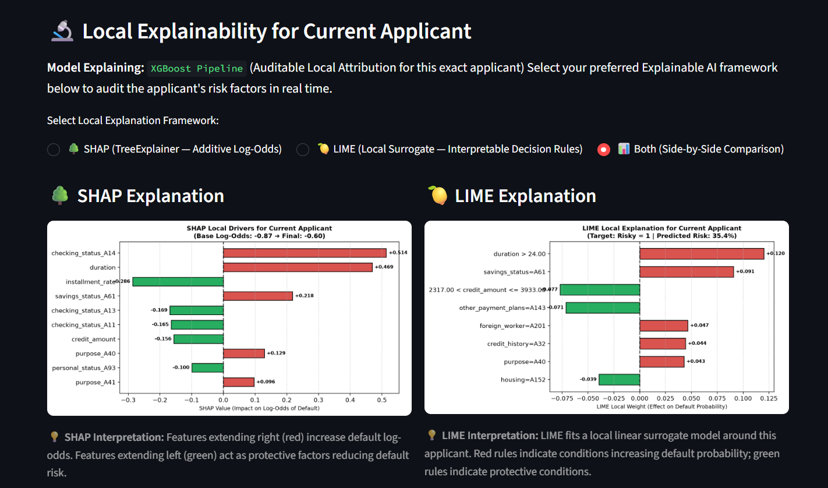
Major Project Final Presentation | Project ID: PT137
Interactive Streamlit Dashboard
Stack: Streamlit with cached scikit-learn, XGBoost, SHAP and LIME objects; prediction < 50 ms, LIME < 2.5 s.
Input: 20 features in five guided sections; dropdowns show the plain-English description first, code in brackets.
Output: Risk verdict, default probability against the 0.50 cutoff, and a probability gauge.
Explainability: Switch between SHAP, LIME or side-by-side views; session state keeps the result.
More tabs: Model benchmarks and a global governance view with SHAP ranking and case studies.
Live side-by-side SHAP log-odds (left) and LIME decision rules (right) for one applicant
Notes:
If time permits, run a live demo: enter an applicant, show the verdict card, then open the side-by-side explanation view.

Slide 13
Major Project Final Presentation | Project ID: PT137
Governance, Limitations & Future Scope
Governance
ECOA and GDPR Art. 22
SHAP / LIME reasons assist ECOA adverse-action notices; legal validation stays with the lender.
Side-by-side views support GDPR human review and the right to contest.
Attributions show association, not causality.
Fairness metrics (disparate impact, equalized odds) are not yet tested.
Limitations
Stated candidly
Only 1,000 records, while real lenders use millions.
Historical Deutsche Mark values and coarse balance tiers.
Fixed 0.50 cutoff, though a missed default costs 4 to 5 times a false rejection.
Demographic attributes remain model inputs.
Future Scope
Next steps
Fairness audit: four-fifths rule, equalized odds, Fairlearn.
Cost-sensitive thresholds near 0.25 to 0.30.
Relational bureau data such as Home Credit or LendingClub.
Counterfactual recourse for rejected applicants (DiCE).
Notes:
Emphasise honesty: SHAP and LIME are aids, not legal proof. The biggest gap is formal fairness testing, which is our first future-work item.

Slide 14
Major Project Final Presentation | Project ID: PT137
Conclusion
4
classifiers benchmarked
61
leakage-safe features
0.789
XGBoost ROC-AUC (CV and test)
< 50 ms
prediction latency
Delivered an end-to-end, leakage-safe credit risk system: four classifiers, dual SHAP + LIME explanations and one underwriting dashboard.
XGBoost generalised consistently (CV 0.7889 vs test 0.7890), while Logistic Regression stayed competitive (test ROC-AUC 0.8040) on this small benchmark.
SHAP and LIME agree on the dominant drivers: checking status, duration over 24 months and credit amount above 3,933 DM.
Explanations are decision-support aids. They do not prove causality, demographic fairness or legal compliance.
Next steps: formal fairness testing, cost-sensitive thresholds, larger relational datasets and counterfactual explanations.
Notes:
Summarise: we made a high-capacity model auditable without giving up its performance, and we were explicit about what explainability cannot prove.

Slide 15
Major Project Final Presentation | Project ID: PT137
References
[1] S. M. Lundberg and S.-I. Lee, "A unified approach to interpreting model predictions," NeurIPS, vol. 30, pp. 4765-4774, 2017.
[2] M. T. Ribeiro, S. Singh, and C. Guestrin, "Why should I trust you?: Explaining the predictions of any classifier," Proc. ACM SIGKDD, pp. 1135-1144, 2016.
[3] T. Chen and C. Guestrin, "XGBoost: A scalable tree boosting system," Proc. ACM SIGKDD, pp. 785-794, 2016.
[4] G. Ke et al., "LightGBM: A highly efficient gradient boosting decision tree," NeurIPS, vol. 30, pp. 3146-3154, 2017.
[5] L. Breiman, "Random forests," Machine Learning, vol. 45, no. 1, pp. 5-32, 2001.
[6] N. Bussmann, P. Giudici, D. Marinelli, and J. Papenbrock, "Explainable AI in fintech risk management," Frontiers in Artificial Intelligence, vol. 3, 580124, 2021.
[7] H. Hofmann, "Statlog (German Credit Data) Data Set," UCI Machine Learning Repository, 1994.
[8] S. M. Lundberg, G. G. Erion, and S.-I. Lee, "Consistent individualized feature attribution for tree ensembles," arXiv:1802.03888, 2018.
[9] S. Wachter, B. Mittelstadt, and L. Floridi, "Why a right to explanation of automated decision-making does not exist in the GDPR," Int. Data Privacy Law, vol. 7, no. 2, pp. 76-99, 2017.
[10] CFPB, "Circular 2022-03: Adverse action notification requirements in connection with credit decisions based on complex algorithms," 2022.
Notes:
Full list of 15 references, including regulations, is in the final report.

Slide 16
Thank You
Notes:
Invite questions. Offer a live dashboard demo.

