Slide 1

Chapter
3
INFORMATION SYSTEMS, ORGANIZATIONS, MANAGEMENT, AND STRATEGY

Slide 2
Essentials of Management Information Systems
Chapter 3 Information Systems , Organizations, Management, and Strategy
OBJECTIVES
What do managers need to know about organizations in order to build and use information systems successfully?
What impact do information systems have on organizations?
How do information systems support the activities of managers in organizations?

Slide 3
Essentials of Management Information Systems
Chapter 3 Information Systems , Organizations, Management, and Strategy
OBJECTIVES
How can businesses use information systems for competitive advantage?
Why is it so difficult to build successful information systems, including systems that promote competitive advantage?

Slide 4
Essentials of Management Information Systems
Chapter 3 Information Systems , Organizations, Management, and Strategy
MANAGEMENT CHALLENGES
Sustainability of competitive advantage
2. Fitting technology to the organization (or vice-versa)

Slide 5

Essentials of Management Information Systems
Chapter 3 Information Systems , Organizations, Management, and Strategy
ORGANIZATIONS AND INFORMATION SYSTEMS
The Two-Way Relationship Between Organizations and Information Technology
MEDIATING FACTORS: Environment Culture
Structure Standard Procedures Politics Management Decisions Chance
ORGANIZATIONS
INFORMATION TECHNOLOGY
Figure 3-1

Slide 6
Essentials of Management Information Systems
Chapter 3 Information Systems , Organizations, Management, and Strategy
ORGANIZATIONS AND INFORMATION SYSTEMS
Organization:
Stable, formal structure
Takes resources from environment and processes them to produce outputs

Slide 7
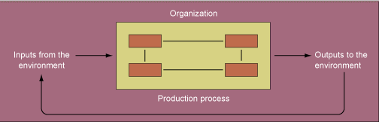
Essentials of Management Information Systems
Chapter 3 Information Systems , Organizations, Management, and Strategy
ORGANIZATIONS AND INFORMATION SYSTEMS
Technical Microeconomic Definition of the Organization
Figure 3-2

Slide 8
Essentials of Management Information Systems
Chapter 3 Information Systems , Organizations, Management, and Strategy
ORGANIZATIONS AND INFORMATION SYSTEMS
Behavioral definition of Organization:
Collection of rights, privileges, obligations, responsibilities
Delicately balanced
Conflict resolution

Slide 9
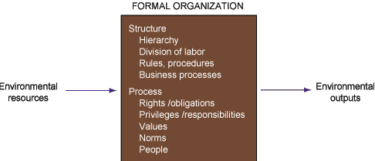
Essentials of Management Information Systems
Chapter 3 Information Systems , Organizations, Management, and Strategy
COMMON FEATURES OF ORGANIZATIONS
The Behavioral View of Organizations
Figure 3-3

Slide 10
Essentials of Management Information Systems
Chapter 3 Information Systems , Organizations, Management, and Strategy
ORGANIZATIONS AND INFORMATION SYSTEMS
Common Features of Organizations
Organizations are bureaucracies that have certain structural features

Slide 11
Essentials of Management Information Systems
Chapter 3 Information Systems , Organizations, Management, and Strategy
ORGANIZATIONS AND INFORMATION SYSTEMS
Common Features of Organizations
Structural Characteristics of Organizations:
Clear division of labor
Hierarchy
Explicit rules and procedures
Impartial judgments

Slide 12
Essentials of Management Information Systems
Chapter 3 Information Systems , Organizations, Management, and Strategy
ORGANIZATIONS AND INFORMATION SYSTEMS
Common Features of Organizations
Structural Characteristics of Organizations (cont.):
Technical qualifications
Maximum organizational efficiency

Slide 13
Essentials of Management Information Systems
Chapter 3 Information Systems , Organizations, Management, and Strategy
ORGANIZATIONS AND INFORMATION SYSTEMS
Common Features of Organizations
Standard Operating Procedures:
Precise rules, procedures, and practices
Enable organizations to cope with all expected situations

Slide 14
Essentials of Management Information Systems
Chapter 3 Information Systems , Organizations, Management, and Strategy
ORGANIZATIONS AND INFORMATION SYSTEMS
Common Features of Organizations
Organizational Politics:
Divergent viewpoints leads to political struggle, competition, and conflict
Hamper organizational change

Slide 15
Essentials of Management Information Systems
Chapter 3 Information Systems , Organizations, Management, and Strategy
ORGANIZATIONS AND INFORMATION SYSTEMS
Common Features of Organizations
Organizational Culture: a set of
fundamental assumptions about:
What products the organization should produce
How and where it should produce them
For whom they should be produced

Slide 16
Essentials of Management Information Systems
Chapter 3 Information Systems , Organizations, Management, and Strategy
ORGANIZATIONS & INFORMATION SYSTEMS
Unique Features of Organizations
All organizations have different:
Structures/Organizational types
Goals
Constituencies
Leadership Styles, Tasks
Surrounding Environment

Slide 17
Essentials of Management Information Systems
Chapter 3 Information Systems , organizations, Management, and Strategy
ORGANIZATIONS & INFORMATION SYSTEMS
Organizational Structures
Entrepreneurial: Start up business
Machine bureaucracy: Midsize manufacturing firm
Divisionalized bureaucracy: Fortune 500
Professional bureaucracy: Law firms, hospitals, school systems
Adhocracy: Consulting firm

Slide 18
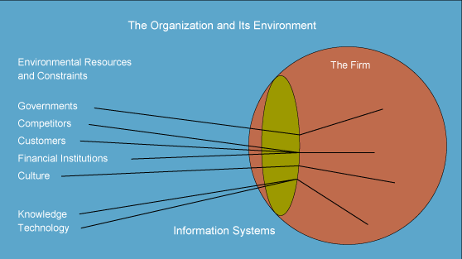
Essentials of Management Information Systems
Chapter 3 Information Systems , Organizations, Management, and Strategy
ORGANIZATIONS & INFORMATION SYSTEMS
Organization and Its Environment
Figure 3-4

Slide 19
Essentials of Management Information Systems
Chapter 3 Information Systems , Organizations, Management, and Strategy
ORGANIZATIONS AND INFORMATION SYSTEMS
Other Differences Among Organizations
Ultimate goal
Different groups and constituencies
Nature of leadership
Tasks and technology

Slide 20
Essentials of Management Information Systems
Chapter 3 Information Systems , Organizations, Management, and Strategy
THE CHANGING ROLE OF INFORMATION SYSTEMS IN ORGANIZATIONS
Information Technology Infrastructure and Information Technology Services
Information systems department:
Formal organizational unit
Responsible for information systems in the organization

Slide 21
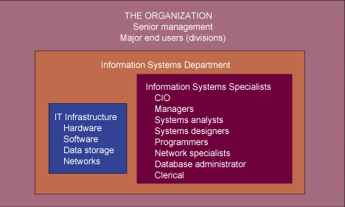
Essentials of Management Information Systems
Chapter 3 Information Systems , Organizations, Management, and Strategy
THE CHANGING ROLE OF INFORMATION SYSTEMS IN ORGANIZATIONS
Information Technology Services
Figure 3-5

Slide 22
Essentials of Management Information Systems
Chapter 3 Information Systems , Organizations, Management, and Strategy
THE CHANGING ROLE OF INFORMATION SYSTEMS IN ORGANIZATIONS
Information Technology Infrastructure and Information Technology Services
Includes specialists:
Programmers: Highly trained, write software
Systems analysts: Translate business problems into solutions, act as liaisons between the information systems department and rest of the organization

Slide 23
Essentials of Management Information Systems
Chapter 3 Information Systems , Organizations, Management, and Strategy
THE CHANGING ROLE OF INFORMATION SYSTEMS IN ORGANIZATIONS
Information Technology Infrastructure and Information Technology Services
Specialists (cont.):
Information system managers: Leaders of various specialists
Chief information officer (CIO): Senior manager in charge of information systems function in the firm
End users: Department representatives outside the information system department for whom applications are developed

Slide 24
Essentials of Management Information Systems
Chapter 3 Information Systems , Organizations, Management, and Strategy
THE CHANGING ROLE OF INFORMATION SYSTEMS IN ORGANIZATIONS
How Information Systems Affect Organizations
Economic theories
Information technology is a factor of production, like capital and labor

Slide 25
Essentials of Management Information Systems
Chapter 3 Information Systems , Organizations, Management, and Strategy
THE CHANGING ROLE OF INFORMATION SYSTEMS IN ORGANIZATIONS
How Information Systems Affect Organizations
Transaction cost theory: Firms can conduct marketplace transactions internally more cheaply to grow larger

Slide 26
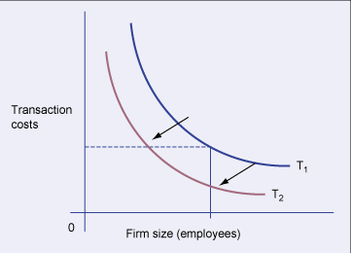
Essentials of Management Information Systems
Chapter 3 Information Systems , Organizations, Management, and Strategy
THE CHANGING ROLE OF INFORMATION SYSTEMS IN ORGANIZATIONS
Transaction Cost Theory
Figure 3-6

Slide 27
Essentials of Management Information Systems
Chapter 3 Information Systems , Organizations, Management, and Strategy
THE CHANGING ROLE OF INFORMATION SYSTEMS IN ORGANIZATIONS
How Information Systems Affect Organizations
Agency theory: Firm is nexus of contracts among self-interested parties requiring supervision

Slide 28
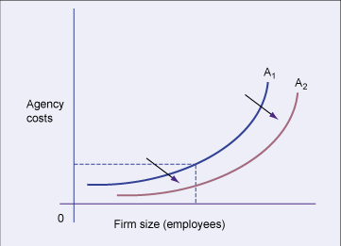
Essentials of Management Information Systems
Chapter 3 Information Systems , Organizations, Management, and Strategy
THE CHANGING ROLE OF INFORMATION SYSTEMS IN ORGANIZATIONS
Agency Cost Theory
Figure 3-7

Slide 29
Essentials of Management Information Systems
Chapter 3 Information Systems , Organizations, Management, and Strategy
THE CHANGING ROLE OF INFORMATION SYSTEMS IN ORGANIZATIONS
How Information Systems Affect Organizations
Behavioral theories:
Information technology could change hierarchy of decision making
Lower cost of information acquisition
Broadens the distribution of information

Slide 30
Essentials of Management Information Systems
Chapter 3 Information Systems , Organizations, Management, and Strategy
THE CHANGING ROLE OF INFORMATION SYSTEMS IN ORGANIZATIONS
How Information Systems Affect Organizations
Virtual organization:
Task force networked organizations
Uses networks to link people, assets, and ideas to create and distribute products and services without being limited to physical locations

Slide 31
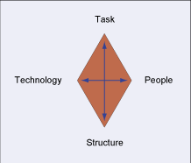
Essentials of Management Information Systems
Chapter 3 Information Systems , Organizations, Management, and Strategy
THE CHANGING ROLE OF INFORMATION SYSTEMS IN ORGANIZATIONS
Implementing Change and Organizational Resistance
Figure 3-8

Slide 32
Essentials of Management Information Systems
Chapter 3 Information Systems , Organizations, Management, and Strategy
MANAGERS, DECISION MAKING, AND INFORMATION SYSTEMS
The Role of Managers in Organizations
Classical model of management:
Traditional description of management
Focuses on formal functions: plan, organize, coordinate, decide, control
Behavioral model of management:
Describes management based on observations of managers on the job

Slide 33
Essentials of Management Information Systems
Chapter 3 Information Systems , Organizations, Management, and Strategy
MANAGERS, DECISION MAKING, AND INFORMATION SYSTEMS
The Role of Managers in Organizations
Managerial roles
Expectation of activities that managers should perform in an organization

Slide 34
Essentials of Management Information Systems
Chapter 3 Information Systems , Organizations, Management, and Strategy
MANAGERS, DECISION MAKING, AND INFORMATION SYSTEMS
The Role of Managers in Organizations
Categories
Interpersonal: Managers act as figureheads and leaders
Informational: Managers receive and disseminate critical information, nerve centers
Decisional: Managers initiate activities, allocate resources, and negotiate conflicts

Slide 35
Essentials of Management Information Systems
Chapter 3 Information Systems , Organizations, Management, and Strategy
MANAGERS, DECISION MAKING, AND INFORMATION SYSTEMS
Managers and Decision Making
Process of Decision Making
Strategic Decision Making: Determines long-term objectives, resources, and policies
Management Control: Monitors effective or efficient usage of resources and performance of operational units

Slide 36
Essentials of Management Information Systems
Chapter 3 Information Systems , Organizations, Management, and Strategy
MANAGERS, DECISION MAKING, AND INFORMATION SYSTEMS
Managers and Decision Making
Operational control: Determines how to perform specific tasks set by strategic and middle-management decision makers
Knowledge-level decision making: Evaluates new ideas for products, services, ways to communicate new knowledge, ways to distribute information

Slide 37
Essentials of Management Information Systems
Chapter 3 Information Systems , Organizations, Management, and Strategy
MANAGERS, DECISION MAKING, AND INFORMATION SYSTEMS
Managers and Decision Making
Decisions are classified as:
Unstructured: Non routine, decision maker provides judgment, evaluation, and insights into problem definition, no agreed-upon procedure for decision making
Structured: Repetitive, routine, handled using a definite procedure

Slide 38
Essentials of Management Information Systems
Chapter 3 Information Systems , Organizations, Management, and Strategy
MANAGERS, DECISION MAKING, AND INFORMATION SYSTEMS
Different Kinds of Information Systems
Organizational Level
TYPE OF
DECISION
OPERATIONAL
KNOWLEDGE
MANAGEMENT
STRATEGIC
STRUCTURED
ACCOUNTS
RECEIVABLE
ELECTRONIC
PRODUCTION
TPS
SCHEDULING
COST OVERRUNS
OAS
MIS
SEMI-
BUDGET
STRUCTURED
PREPARATION
PROJECT
DSS
SCHEDULING
FACILITY
KWS
LOCATION
ESS
UNSTRUCTURED
PRODUCT DESIGN
NEW PRODUCTS
NEW MARKETS
Figure 3-9

Slide 39
Essentials of Management Information Systems
Chapter 3 Information Systems , Organizations, Management, and Strategy
MANAGERS, DECISION MAKING, AND INFORMATION SYSTEMS
Stages of Decision Making
Intelligence: Collect information, identify problem
Design: Conceive alternative solution to a problem
Choice: Select among the alternative solutions
Implementation: Put decision into effect and provide report on the progress of solution

Slide 40
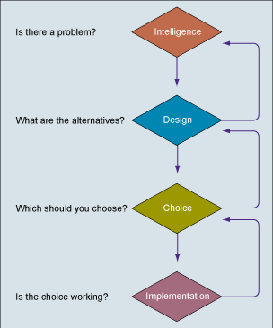
Essentials of Management Information Systems
Chapter 3 Information Systems , Organizations, Management, and Strategy
MANAGERS, DECISION MAKING, AND INFORMATION SYSTEMS
Decision-Making Process
Figure 3-10

Slide 41
Essentials of Management Information Systems
Chapter 3 Information Systems , Organizations, Management, and Strategy
MANAGERS, DECISION MAKING, AND INFORMATION SYSTEMS
Models of Decision Making
Rational: People, organizations, and nations engage in consistent, value-maximizing calculations or adaptations within certain constraints
Cognitive style: Underlying personality dispositions toward the treatment of information, selection of alternatives, and evaluation of consequences

Slide 42
Essentials of Management Information Systems
Chapter 3 Information Systems , Organizations, Management, and Strategy
MANAGERS, DECISION MAKING, AND INFORMATION SYSTEMS
Models of Decision Making
Systematic decision makers: Cognitive style, describes people who approach a problem by structuring it in terms of some formal method
Intuitive: Cognitive style, describes people approaching a problem with multiple methods in an unstructured manner

Slide 43
Essentials of Management Information Systems
Chapter 3 Information Systems , Organizations, Management, and Strategy
MANAGERS, DECISION MAKING, AND INFORMATION SYSTEMS
Models of Decision Making
Organizational models of decision making: Consider structural and political characteristics of an organization

Slide 44
Essentials of Management Information Systems
Chapter 3 Information Systems , Organizations, Management, and Strategy
MANAGERS, DECISION MAKING, AND INFORMATION SYSTEMS
Implications for the Design and Understanding of Information Systems
Factors to consider while planning a
new system:
Organizational environment
Organizational structure, hierarchy, specialization, standard operating procedures

Slide 45
Essentials of Management Information Systems
Chapter 3 Information Systems , Organizations, Management, and Strategy
MANAGERS, DECISION MAKING, AND INFORMATION SYSTEMS
Implications for the Design and Understanding of Information Systems
Culture and politics of the organization
Type of organization and its style of leadership

Slide 46
Essentials of Management Information Systems
Chapter 3 Information Systems , Organizations, Management, and Strategy
MANAGERS, DECISION MAKING, AND INFORMATION SYSTEMS
Implications for the Design and Understanding of Information Systems
Groups affected by the system and the attitudes of workers who will be using the system
Kinds of tasks, decisions, and business processes, information system is designed to assist

Slide 47
Essentials of Management Information Systems
Chapter 3 Information Systems , Organizations, Management, and Strategy
MANAGERS, DECISION MAKING, AND INFORMATION SYSTEMS
Implications for the Design and Understanding of Information Systems
Characteristics to be kept in mind
while designing systems:
Flexibility and multiple options for handling data and evaluating information
Capability to support a variety of styles, skills, and knowledge

Slide 48
Essentials of Management Information Systems
Chapter 3 Information Systems , Organizations, Management, and Strategy
MANAGERS, DECISION MAKING, AND INFORMATION SYSTEMS
Implications for the Design and Understanding of Information Systems
Capability to keep track of many alternatives and consequences
Sensitivity to the organization’s bureaucratic and political requirements

Slide 49
Essentials of Management Information Systems
Chapter 3 Information Systems , Organizations, Management, and Strategy
INFORMATION SYSTEMS AND BUSINESS STRATEGY
What is Strategic Information System
Computer system at any level of an organization
Changes goals, operations, products, services, or environmental relationships
Helps organization gain a competitive advantage

Slide 50
Essentials of Management Information Systems
Chapter 3 Information Systems , Organizations, Management, and Strategy
INFORMATION SYSTEMS AND BUSINESS STRATEGY
Business Level Strategy and the Value Chain Model
Digital firms
Manage the supply chain by building efficient customer “sense and response” systems
Participate in “value webs” to deliver new products and services

Slide 51
Essentials of Management Information Systems
Chapter 3 Information Systems , Organizations, Management, and Strategy
INFORMATION SYSTEMS AND BUSINESS STRATEGY
Business Level Strategy and the Value Chain Model
Value Chain Model:
Highlights the primary or support activities adding a margin of value to products or services
Helps achieve a competitive advantage

Slide 52
Essentials of Management Information Systems
Chapter 3 Information Systems , Organizations, Management, and Strategy
INFORMATION SYSTEMS AND BUSINESS STRATEGY
Business Level Strategy and the Value Chain Model
Primary Activities:
Directly related to the production and distribution of a firm’s products or services
Support Activities:
Make the delivery of primary activities possible
Consist of the organization’s infrastructure, human resources, technology, and procurement

Slide 53
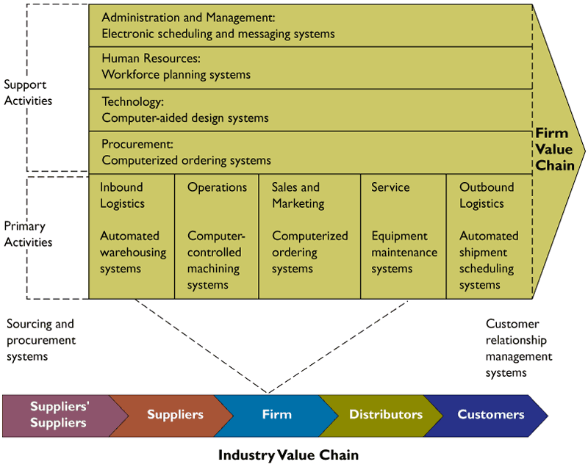
Essentials of Management Information Systems
Chapter 3 Information Systems , Organizations, Management, and Strategy
INFORMATION SYSTEMS AND BUSINESS STRATEGY
Firm Value Chain
Figure 3-11

Slide 54
Essentials of Management Information Systems
Chapter 3 Information Systems , Organizations, Management, and Strategy
INFORMATION SYSTEMS AND BUSINESS STRATEGY
Business Level Strategy and the Value Chain Model
Value Web:
Customer-driven network of independent firms
Uses information technology to coordinate value chains for collectively producing a product or service

Slide 55
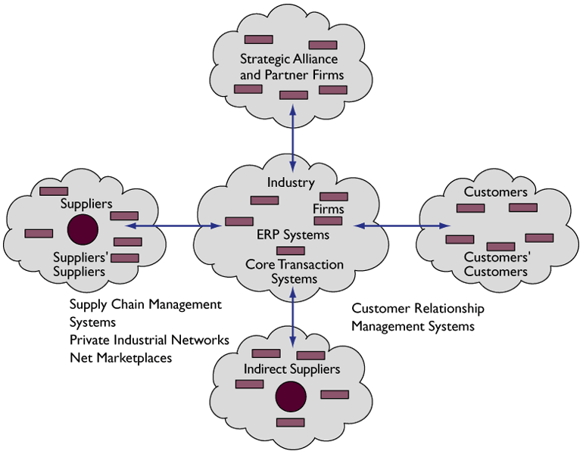
Essentials of Management Information Systems
Chapter 3 Information Systems , Organizations, Management, and Strategy
INFORMATION SYSTEMS AND BUSINESS STRATEGY
The Value Web
Figure 3-12

Slide 56
Essentials of Management Information Systems
Chapter 3 Information Systems , Organizations, Management, and Strategy
INFORMATION SYSTEMS AND BUSINESS STRATEGY
Business Level Strategy and the Value Chain Model
Product Differentiation:
Competitive strategy
Creates brand loyalty by developing new and unique products and services
Products and services not easily duplicated by competitors

Slide 57
Essentials of Management Information Systems
Chapter 3 Information Systems , Organizations, Management, and Strategy
INFORMATION SYSTEMS AND BUSINESS STRATEGY
Business Level Strategy and the Value Chain Model
Focused Differentiation:
Competitive strategy
Enables development of new market niches for specialized products or services
Helps businesses compete better than competitors in the target areas

Slide 58
Essentials of Management Information Systems
Chapter 3 Information Systems , Organizations, Management, and Strategy
INFORMATION SYSTEMS AND BUSINESS STRATEGY
Supply Chain Management and Efficient Customer Response System
Efficient Customer Response System:
Directly links consumer behavior back to distribution, production, and supply chains

Slide 59
Essentials of Management Information Systems
Chapter 3 Information Systems , Organizations, Management, and Strategy
INFORMATION SYSTEMS AND BUSINESS STRATEGY
Supply Chain Management and Efficient Customer Response System
Switching costs:
Expense incurred by a customer or company in terms of time and expenditure of resources when changing from one supplier or system to another

Slide 60
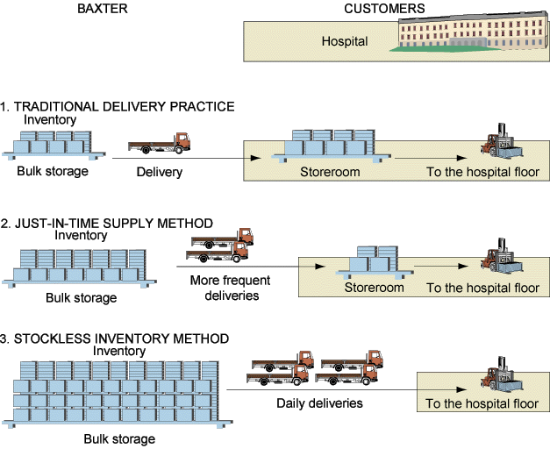
Essentials of Management Information Systems
Chapter 3 Information Systems , Organizations, Management, and Strategy
INFORMATION SYSTEMS AND BUSINESS STRATEGY
Stockless Inventory Compared to Traditional and Just-in-time Supply Methods
Figure 3-13

Slide 61
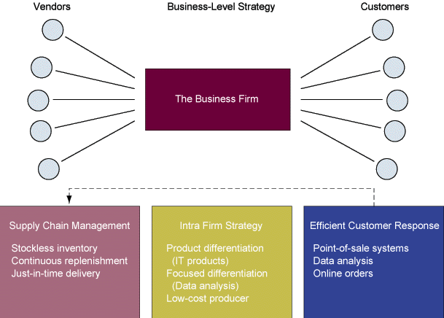
Essentials of Management Information Systems
Chapter 3 Information Systems , Organizations, Management, and Strategy
INFORMATION SYSTEMS AND BUSINESS STRATEGY
Enhancing Core Competencies
Figure 3-14

Slide 62
Essentials of Management Information Systems
Chapter 3 Information Systems , Organizations, Management, and Strategy
INFORMATION SYSTEMS AND BUSINESS STRATEGY
Firm-Level Strategy and Information Technology
Core Competency:
Activity at which a firm excels as a world-class leader
Information system encouraging the sharing of knowledge across business units enhances competency

Slide 63
Essentials of Management Information Systems
Chapter 3 Information Systems , Organizations, Management, and Strategy
INFORMATION SYSTEMS AND BUSINESS STRATEGY
Industry-Level Strategy and Information Systems
Information partnership:
Cooperative alliance formed between two or more corporations for sharing information to gain strategic advantage
Help firms gain access to new customers, creating new opportunities for cross-selling and targeting products

Slide 64
Essentials of Management Information Systems
Chapter 3 Information Systems , Organizations, Management, and Strategy
INFORMATION SYSTEMS AND BUSINESS STRATEGY
Industry-Level Strategy and Information Systems
The competitive forces model:
Describes the interaction of external influences, specifically threats and opportunities, affecting an organization’s strategy and ability to compete

Slide 65
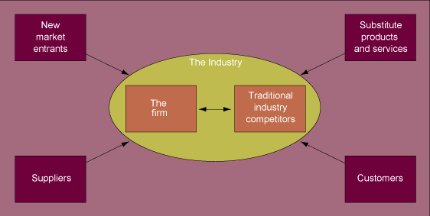
Essentials of Management Information Systems
Chapter 3 Information Systems , Organizations, Management, and Strategy
INFORMATION SYSTEMS AND BUSINESS STRATEGY
Porter’s Competitive Forces Model
Figure 3-15

Slide 66
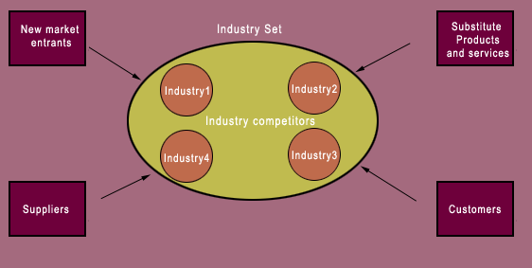
Essentials of Management Information Systems
Chapter 3 Information Systems , Organizations, Management, and Strategy
INFORMATION SYSTEMS AND BUSINESS STRATEGY
New Competitive Forces Model
Figure 3-16

Slide 67
Essentials of Management Information Systems
Chapter 3 Information Systems , Organizations, Management, and Strategy
INFORMATION SYSTEMS AND BUSINESS STRATEGY
Industry-Level Strategy and Information Systems
Network Economics:
Model of strategic systems at the industry level
Based on the concept of a network
Adding another participant entails zero marginal costs but can create much larger marginal gain

Slide 68
Essentials of Management Information Systems
Chapter 3 Information Systems , Organizations, Management, and Strategy
INFORMATION SYSTEMS AND BUSINESS STRATEGY
Using Systems for Competitive Advantage: Management Issues
Managing strategic transitions:
Movement from one level of sociotechnical system to another
Required when adopting strategic systems demanding changes in the social and technical elements of an organization

Slide 69
Chapter
3
INFORMATION SYSTEMS, ORGANIZATIONS, MANAGEMENT, AND STRATEGY

