Slide 1

Wellness Workshop

Slide 2

Benefits of Exercise
Improves your mood
Combats chronic disease
Helps manage your weight
Boosts your energy levels
Promotes better sleep
Improves libido
You have FUN!

Slide 3
HOW MUCH?-
The Recommendation
The Department of Health and Human Services recommends:
At least two hours & 30 minutes a week of moderate aerobic activity (think brisk walking or swimming)
or one hour and 15 minutes a week of vigorous aerobic activity (such as running) preferably spread throughout the week
Strength training exercises at least twice a week

Slide 4




WHAT KIND?-
Choosing a Program
Assess your fitness level
Set your goals
  Short and long term
  Make then specific and attainable
  Write them down
Consider your likes and dislikes
Vary your activities (cross-training)
Do the math
  Figure out what you can afford

Slide 5





A Well-Rounded Routine
Aerobic fitness
Muscular strength
Flexibility
Core stability
Balance Training

Slide 6
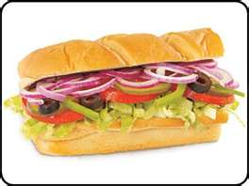


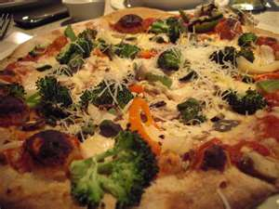
Eating Healthy On The GO!
Best Choices for Fast-Food
Subway / Quiznos / Deli
Panera Bread
Chipotle
Second-Best
Mc.Donald’s / BK / Wendy’s
Pizza
Worst Choices
KFC
Taco Bell
Fish-Fry / Long John Silver’s

Slide 7

Eating Healthy On The GO, Affordably!
*Save $$$ and prepare your food at home!*
Eat breakfast at home &
Invest in a cooler.
Easy things to pack:
-Sandwiches
-Salads
-Fruit
-Cut-up veggies
-Snack bars
-Nut and seed trail mixes.
-Whole grain crackers
-String cheese
-Yogurt
-Cereal and milk

Slide 8
Eating Healthy IS Affordable!
The best way to save money on healthy food:
-Prepare it at home!
*What are the most expensive foods per calorie?
Ready-eat-foods
  -pre-cut veggies, pre-made salads, sandwiches, hot meals, etc.
*Usually, the cheapest-per-calorie foods are also
the least healthy!
  - potato chips, candy, packaged pastries, white bread, soda, fast-food, etc.

Slide 9
Eating Healthy IS Affordable!
How to Navigate the Grocery Store
+ Keep to the OUTER EDGES of the store.
-Fresh items: produce, dairy, eggs, breads, and meats.
-The inner shelves = processed foods.
+ Make a list and stick to it.
-Limit impulse purchases: eat a meal before you shop!
+ Best way to cut the food bill: Limit your intake of meat.
-animal proteins are the most expensive items in the store.
-replace meat with beans 3 days a week = $$$ and nutrition!

Slide 10
Eating Healthy IS Affordable!
Healthy Options
+ Breads
-Buy 2-3 loaves on sale and freeze the two you don’t need right away. Quality is not affected by freezing
+ Fruits and Veggies
-Purchase frozen: stir-fries and frozen fruit bags.
+ Protein
-Beans, nuts, seeds, quinoa
+ Other “health food” items
-Don’t worry about buying other items that you think you need such as specialty yogurts, extra vitamins and minerals, prepared frozen dishes, etc. Eat a balanced diet and you don’t need anything extra.

