Slide 1

Understanding Prop Drilling in React
A Guide to Managing Data Flow in Your Components

Slide 2

What is Prop Drilling?
Prop drilling is a method of passing data from a parent component to a deeply nested child component in React. This involves passing props down through multiple layers of components.

Slide 3
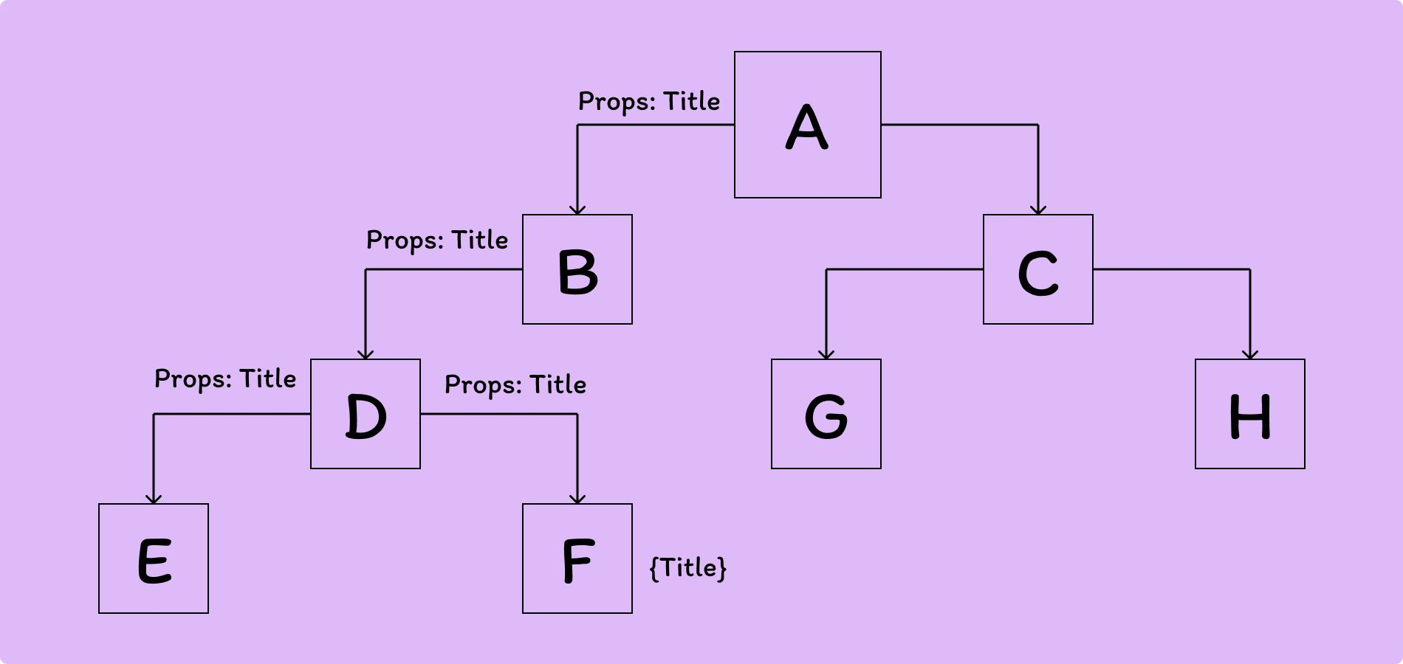

Slide 4
Why Do We Need Prop Drilling?
It’s a straightforward way to share data between components. Keeps your data flow predictable and manageable.

Slide 5
How Does Prop Drilling Work?
Data is passed from a parent component to a child component using props. If the data needs to be used in a deeply nested component, each intermediate component must pass the data down.

Slide 6
Challenges of Prop Drilling
Can lead to 'prop drilling hell' if not managed properly. Intermediate components may receive props they don’t need.

Slide 7
Alternatives to Prop Drilling
React Context API: Allows sharing data without passing props through every level. State Management Libraries (e.g., Redux): Centralize and manage your application’s state.

Slide 8
Best Practices for Prop Drilling
Limit the depth of prop drilling where possible. Use alternatives like Context API or state management libraries for deeply nested data. Keep components small and focused.

Slide 9
Summary
Prop drilling is useful but can become cumbersome in deeply nested structures. Be aware of its limitations and consider alternatives. Maintain clean, organized component hierarchies.

