Slide 1
Docker
Docker is an open platform for developing, shipping, and running applications.
Docker enables you to separate your applications from your infrastructure so you can deliver software quickly.
With Docker, you can manage your infrastructure in the same ways you manage your applications.

Slide 2
Common terminology
Docker Container:
A container is an isolated place where an application runs without affecting the rest of the system
Docker provides the ability to package and run an application in a loosely isolated environment called a container.
A container is a runnable instance of an image. You can create, start, stop, move, or delete a container using the Docker API
Docker Images:
Images are read-only templates containing instructions for creating a container. A Docker image creates containers to run on the Docker platform.
An image is a read-only template with instructions for creating a Docker container. Often, an image is based on another image, with some additional customization.
The Docker daemon:
The Docker daemon listens for Docker API requests and manages Docker objects such as images, containers, networks, and volume.
The Docker client:
The docker client send the command to Docker daemon like docker run, docker pull etc.
The docker command uses the Docker API.
Docker registries:
A Docker registry stores Docker images. Docker Hub is a public registry that anyone can use

Slide 3
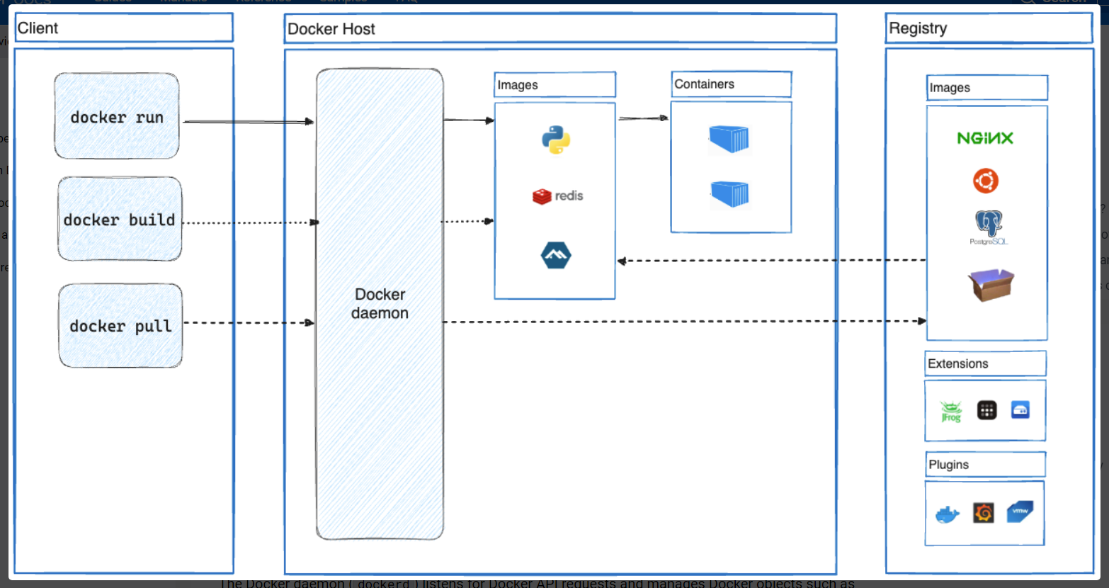
Docker Architecture

Slide 4
Docker Command
Command | Description
docker run <image_name> | The docker run command runs a command in a new container, pulling the image if needed and starting the container
docker ps | list all running containers
docker stop <container_name> | Stop docker
docker run -d <image_name> | Detached mode
docker rm container_name | remove docker container
docker run -p 80:5000 webapp | Port mapping
docker images | Show images
docker rmi <image_name> | Remove docker image

Slide 5
DockerFile and docker-compose
DockerFile:
The Dockerfile is used to build images.
The Dockerfile uses the docker build command
Docker-compose.yaml:
the docker-compose.yaml file is used to run images.
the docker-compose.yaml file uses the docker-compose up command
A docker-compose.yaml file can reference a Dockerfile, but a Dockerfile can’t reference a docker-compose file.

Slide 6
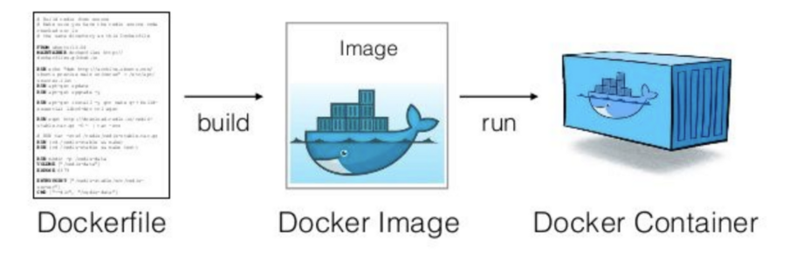
Docker Image and container

