Slide 1

MongoDB NoSQL Database
Presented By: Mohd Tauovir Khan
Organization: TCS
Date: 30-10-2023

Slide 2
MongoDB Topics
MongoDB Concepts
MongoDB with Python
RDBMS Migration to MongoDB

Slide 3
MongoDB
MongoDB is a Document-oriented, NoSQL storage system.
It is an open-source data management tool.
It is designed to deal with large amounts of data and provides flexibility and scalability for managing data.
MongoDB is document model allows for easy and fast data access and manipulation.
MongoDB store JSON-like documents in stead of rows and columns format.
MongoDB does not need any pre-defined data schema, it is schema less database.

Slide 4
MongoDB Features
Document-Oriented storage.
Flexible Document Schema.
High Performance (indexes, embedded models).
High Availability (Redundancy, Fail over).
Horizontal Scalability((Sharding).
Support for Multiple Storage Engines(wired Tiger, Zstd).
Full Index Support
Rich Query language(MQL).
Supported languages: JavaScript, Python, Java, etc.

Slide 5
Common Terminology
Database
Collection
Documents
Shard
Replica
mongoshell
MQL(Mongo Query Language)
Aggregation Framework
Shema-less documents.
Schema validation

Slide 6
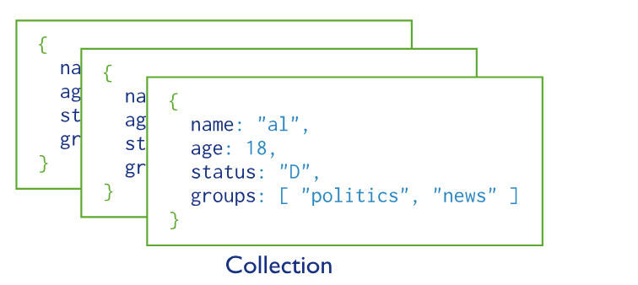
Database, Collection and Document
MongoDB database is a group of collections.
Collection is a group of Documents.
Documents is a collection of key-value pairs data like JSON format.
documents

Slide 7
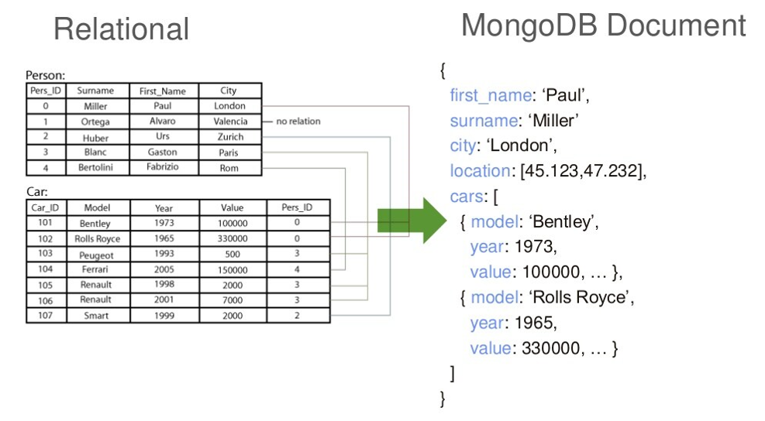
MongoDB vs RDBMS
RDBMS |  | MongoDB
Database |  | Database
Table |  | Collection
Row |  | Document (JSON, BSON)
Columns |  | Fields
Index |  | Index
Join |  | Embedded Documents
Partitions |  | Shards

Slide 8
Common MongoDB Command
show dbs
use database_name
show collections
db.help()
db.collection_name.help()
db.dropDatabase()
db.<collection-name>.drop()
db.createCollection(“collection_name")
db.getCollectionNames()

Slide 9
Database Operations
Creating and deleting: Database and collection.
Inserting documents.
MQL: Query Documents.
  Comparison Operator.
  Logical Operator
  Element Operator.
  Cursor Method.
Update Documents.
Remove Document.
Aggregation Framework.
Schema Validation.
Data Modelling.
Import and Export Database/collections

Slide 10
#A: Database and Collection
Description | Command
Create Database | > use test2_db
Create Collection | > db.createCollection("address") > db.users.insert([{"name":"khan"}]
show collection | > db.getCollectionNames() > show collections
Drop Database | > db.dropDatabase()
Drop Collection | > db.address.drop()

Slide 11
#B: Insert MongoDB Documents
To insert single or multiple documents into a MongoDB collection, we can use below methods respectively
insertOne() .
  Syntax: db.collection_name.insertOne(<document>,{writeConcern:<document>})
insertMany().
  Syntax: db.collection_name.insertMany([<document1>, <documentN>], {writeConcern:<document>, ordered: <boolean>})
>> db.users.insertOne({“name”:”Khan”,”Company”:”TCS”})
>> db.users.insertMany([
{“name”:”Khan”,”Company”:”TCS”},
{“name”:”Ganga”,”Company”:”Wipro”}
])

Slide 12
#C: MQL: Mongo Query Language
To simply query data from MongoDB collections, below methods are used.
find() method will display all the documents
findOne() method returns only one document
Syntax: db.collection_name.find(<query>, <projection>, <options> )
db.users.find({"status":"active"})
db.users.findOne({"status":"inactive"},{"name":1,"company":true,"status":1})
Parameter | Type | Description
query | document | Optional. Specifies selection filter using query operators. To return all documents in a collection, omit this parameter or pass an empty document ({}).
projection | document | Optional. Specifies the fields to return in the documents that match the query filter
options | document | Optional. Specifies additional options for the query.

Slide 13
C/A: Comparison Operator in MQL
Comparison operators return data based on value comparisons.
>> db.users.find({"likes":{$lt:90}})
>> db.users.find({"status":{$in:["inactive","pending"]}})
Operation | Syntax | Example | RDBMS Equivalent
Equality | {<key>::<value>}} | db.mycol.find({“email":“a@g"}) | Where email=‘a@g’
Less Than($lt) | {<key>:{$lt:<value>}} | db.mycol.find({"likes":{$lt:50}}) | where likes < 50
Less Than Equals($lte) | {<key>:{$lte:<value>}} | db.mycol.find({"likes":{$lte:50}}) | where likes <= 50
Greater Than($gt) | ---- | ----- | -----
Not Equals($ne) | {<key>:{$ne:<value>}} | db.mycol.find({"likes":{$ne:50}}) | where likes != 50
Values in an array($in) | <key>:{$in:[<value1>, <value2>,……<valueN>]}} | db.mycol.find({“color":{$in:[“Red", “Blue"]}}) | Where color in (‘Red’,’Blue’)
Values not in an array($nin) | ------- | ----- | ---

Slide 14
C/B: Logical Operator in MQL
Logical operators return data based on expressions that evaluate to true or false.
>> db.users.find({$and:[{"status":"active"},{"company":"TCS"}]})
>> db.users.find({"status":"active","company":"TCS"}) # implicit
>> db.users.find({$or:[{"status":"active"},{"company":"TCS"}]})
Operation | Syntax | Example
AND($and) | db.mycol.find({ $and: [ {<key1>:<value1>}] }) | db.mycol.find({ $and: [ {“name”:”khan”}, { “company”:”TCS”} ] })
OR($or) | db.mycol.find({ $or: [ {<key1>:<value1>}] }) | db.mycol.find({ $or: [ {“name”:”khan”}, { “company”:”TCS”} ] })
Not($not) | db.mycol.find({ $not: [ {<key1>:<value1>}] }) | -------

Slide 15
C/C: Element Operator in MQL
Element operators return data based on field existence or data types.
>> db.users.find({"device":{$exists:false}})
Operation | Syntax | Description
$exists | { field: { $exists: <boolean> } } | Matches documents that have the specified field.
$type | { field: { $type: <BSON type> } } | Selects documents if a field is of the specified type.

Slide 16
C/D: Cursor Method
In MongoDB, when the find() method is used to find the documents present in the given collection, then this method returned a pointer which will points to the documents of the collection, now this pointer is known as cursor.
>> db.users.find({"device":{$exists:true}}).count()
>> db.users.find({}).count()
>> var cur = db.users.find({"status":"active"})
>> cur.next()
Name | Description
cursor.count() | Modifies the cursor to return the number of documents in the result set rather than the documents themselves.
cursor.limit() | Constrains the size of a cursor's result set.
cursor.pretty() | Configures the cursor to display results in an easy-to-read format.
cursor.next() | Returns the next document in a cursor.

Slide 17
D: Update Documents
MongoDB provides the following methods for updating documents in a collection:
To update a document, MongoDB provides update operators, such as $set, to modify field values.
>> db.users.updateOne({"status":"active"},{$set:{"device":"phone"}})
>> db.users.updateMany({"status":"active"},{$set:{"device":"mobile","fruit":"apple"}})
db.collection.updateOne(<criteria>,<data>) | Updates at most a single document that match a specified filter even though multiple documents may match the specified filter.
db.collection.updateMany(<criteria>,<data>) | Update all documents that match a specified filter.

Slide 18
E: Remove Documents
MongoDB's remove() method is used to remove a document from the collection.
remove() method accepts two parameters. One is deletion criteria and second is justOne flag.
>>db.users.remove({"status":"active"})
db.collection.remove(<deletion_criteria>,<justOne>) | Updates at most a single document that match a specified filter even though multiple documents may match the specified filter.

Slide 19
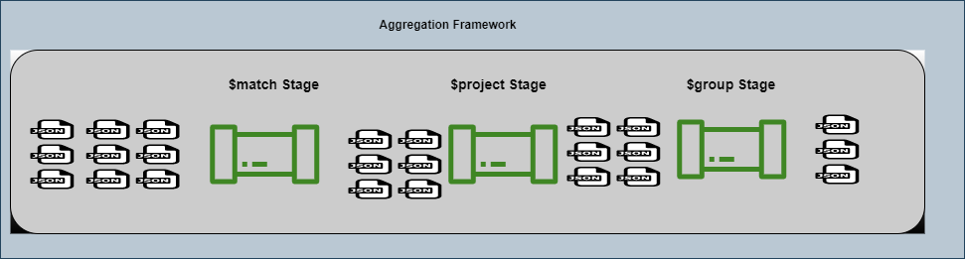
Aggregation Framework
MQL is sufficient for simple query.
The aggregation framework allows for more advance operation. MongoDB provides aggregation operations through aggregation pipelines — a series of operations that process data documents sequentially. These are built as a sequential series of declarative data processing operations known as stages.
Each stage inspects and transforms the documents as they pass through the pipeline, feeding the transformed results into the subsequent stages for further processing. Stages can perform operations on data such as
filtering: This resembles queries, where the list of documents is narrowed down through a set of criteria
sorting: You can reorder documents based on a chosen field
transforming: The ability to change the structure of documents means you can remove or rename certain fields, or perhaps rename or group fields within an embedded document for legibility
grouping: You can also process multiple documents together to form a summarized result

Slide 20
Aggregation Framework
MongoDB provides aggregate() method to aggregation stage pipeline.
Syntax: db.collection_name.aggregate([{stage_1}, {stage_2}, {stage_N}],{options})
$match stage: narrows down the list of documents from the collection
$sorting stage: To sort the result
$project stage: to fetch specified fields.
$group stage: To group the documents
Examples:
>> db.users.aggregate( [ { $match: {"likes":{$gt:50}} },{$project:{"name":1,"company":1,"status":1}}] )
>> db.users.aggregate( [ {$match: {"likes":{$gt:50}}},{$sort:{"likes":1}},{ $group: { "_id": { "status": "$status" },"group_count":{$count:{}}}}] )

Slide 21
Schema Validation
Schema validation provides validation rules for the fields, such as allowed data types and value ranges.
MongoDB uses a flexible schema model, which means that documents in a collection do not need to have the same fields or data types by default.
Once you've established an application schema, you can use schema validation to ensure there are no unintended schema changes or improper data types.
A. Validation Check for New collection.
When you create a new collection with schema validation, MongoDB checks validation during updates and inserts in that collection.
B. Validation Check for Existing collection.
When you add validation to an existing, non-empty collection:
Newly inserted documents are checked for validation.
Documents already existing in your collection are not checked for validation until they are modified

Slide 22
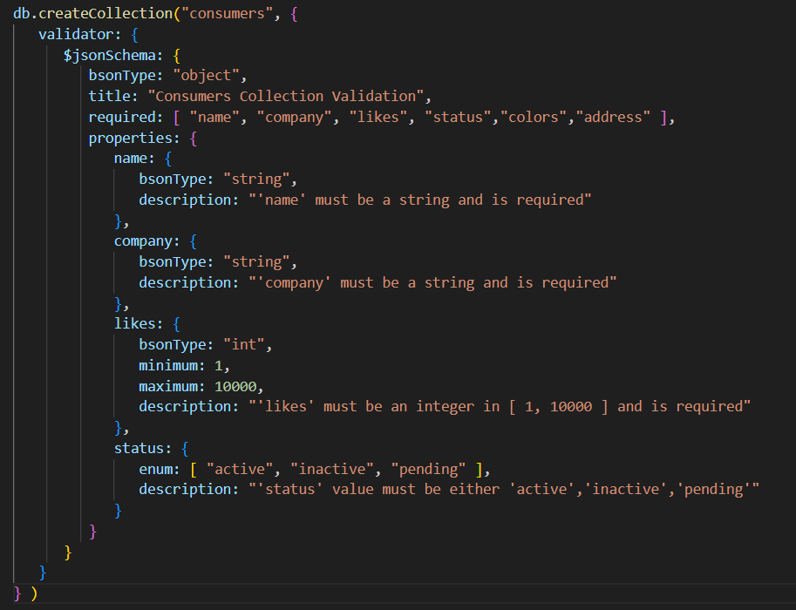
JSON Schema Validation

Slide 23
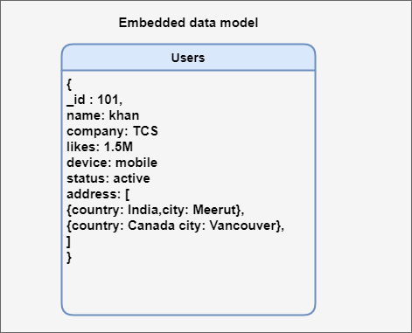
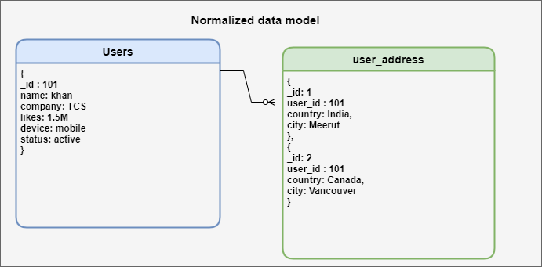
MongoDB- Data Modelling
Data modelling is the process of creating a model for the data to store in a database.
Data in MongoDB has a flexible schema, they do not need a pedefined structure to store data. Data are stored in key-value paired with any data types.
MongoDB provides two types of Data Model: Embedded data model and Normalized data model.
>> db.users.find({"address": { $elemMatch: { "country": "Canada" }}})
>> db.users.find({"address.country": "Canada"})
>> db.users.aggregate([ { $lookup: { from: "posts", localField: "_id", foreignField: "created_by", as: "user_post_detail" } }] )

Slide 24
Database import and export
MongoDB allows you to export its data into other file formats like JSON or CSV so that the data can be used externally by other applications. MongoDB provides the following command-line tools to import, export, dump and restore data.
mongoexport: mongoexport is a command-line tool that produces a JSON or CSV export of data stored in MongoDB
Syntax: mongoexport – uri <url> –db db_name –collection collection_name –out path_or_name_of_the_file
mongoimport: The mongoimporttool imports content from an Extended JSON, CSV, or TSV export created by mongoexport, or potentially, another third-party export tool
Syntax: mongoimport --uri=“<instance_URL>" --collection=<collection_name> --file=file_name.json
mongodump: It simply dumps all the data stored into a dump directory of MongoDB. Backed-up data is in BSON format also known as BSON data dumps.
Syntax: mongodump –uri=<instance_url> --db database_name --collection <collection_name> – out <path_to_dump_data>
Mongorestore: mongorestore utility is used to restore the backup data. It restores the binary backup created by mongodump utility(i.e., BSON data dumps). It can restore either an entire database backup or a subset of the backup. It also restores the indexes which are created for any collection inside that database.
Syntax: mongorestore–uri=<instance_url> --db database_name <dumped_data_path>

Slide 25
PyMongo
The PyMongo distribution contains tools for interacting with MongoDB database from Python. The bson package is an implementation of the BSON format for Python.
The pymongo package is a native Python driver for MongoDB.
Pynongo requires Python >=3.7
Install pymongo: pip install pymongo

Slide 26
References
https://www.geeksforgeeks.org/export-data-from-mongodb/
https://pymongo.readthedocs.io/en/stable/api/pymongo/database.html#pymongo.database.Database.create_collection
https://sparkbyexamples.com/mongodb-tutorial-with-examples/
https://pypi.org/project/pymongo/

