Slide 1
Snowflake Resource Monitors by Janardhan Bandi

Slide 2
What is Resource Monitor?
A virtual warehouse consumes Snowflake credits while it runs. The number of credits consumed depends on the size of the warehouse and how long it runs.
A resource monitor can be used to monitor credit usage by virtual warehouses and the cloud services needed to support those warehouses.
Resource monitors helps in controlling costs and avoid unexpected credit usage.
In resource monitors we can set credit limits can be set for a specified interval or date range. When these limits are reached or approaching, the resource monitor can trigger various actions, such as sending alerts and suspending warehouses.
Resource monitors can only be created by account administrators or with the role that has admin privileges.

Slide 3
Resource Monitor Properties
Resource monitor is an object in Snowflake with below properties.
Credit Quota
Monitor Type
Schedule
Actions

Slide 4
Credit Quota
Credit quota specifies the number of Snowflake credits allocated to the monitor for the specified frequency interval. Any number can be specified.
In addition, Snowflake tracks the used credits/quota within the specified frequency interval by all warehouses assigned to the monitor. After the specified interval, this number resets back to 0.
Credit quota accounts for credits consumed by both user-managed virtual warehouses and virtual warehouses used by cloud services.
For example, your resource monitor limit is set at 1000 credits, if your warehouse consumes 700 credits, and cloud services consume 300 credits within the specified interval, an alert will be triggered.

Slide 5
Monitor Type
A resource monitor can be created to monitor credit usage at
Account level
Warehouse level (single or set of warehouses)
If this property is not set, the resource monitor doesn’t monitor any credit usage.

Slide 6
Schedule
The default schedule for a resource monitor specifies that it starts monitoring credit usage immediately and the used credits reset back to 0 at the beginning of each calendar month (i.e. the start of the standard Snowflake billing cycle).
We can customize the schedule for a resource monitor using the following properties:
1. Frequency: Daily, Weekly, Monthly, Yearly,
Never (used credits never reset; assigned warehouses continue using credits until the credit quota is reached)
2. Start: Date and time when the resource monitor starts monitoring the assigned warehouses. It can be Immediately or any future timestamp
3. End: Date and time when Snowflake suspends the warehouses associated with the resource monitor, regardless of whether the used credits reached any of the thresholds defined. It can be Any future timestamp.

Slide 7
Actions
Specifies what action can be taken once it reaches to the credit threshold.
Resource monitors support the following actions:
Notify & Suspend: Send a notification to all account administrators with notifications enabled and suspend all assigned warehouses after all statements being executed by the warehouses have completed.
Notify & Suspend Immediately: Send a notification and suspend all assigned warehouses immediately, which cancels any statements being executed by the warehouses at the time.
Notify: Perform no action, but send an alert notification
Note: We can specify actions up to
One Suspend action.
One Suspend Immediate action.
Up to five Notify actions.

Slide 8
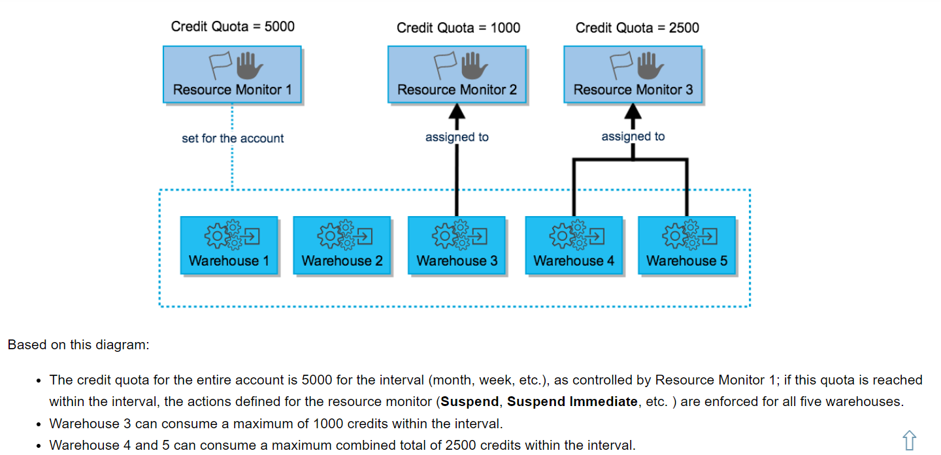
Example
Specifies what action can be taken once it reaches to the credit threshold.
Resource monitors support the following actions:
Notify & Suspend: Send a notification to all account administrators with notifications enabled and suspend all assigned warehouses after all statements being executed by the warehouses have completed.
Notify & Suspend Immediately: Send a notification and suspend all assigned warehouses immediately, which cancels any statements being executed by the warehouses at the time.
Notify: Perform no action, but send an alert notification
Note: We can specify actions up to
One Suspend action.
One Suspend Immediate action.
Up to five Notify actions.

Slide 9
Warehouse Suspension and Resumption
If a monitor has a Suspend or Suspend Immediately action defined and its used credits reach the threshold for the action, any warehouses assigned to the monitor are suspended and cannot be resumed until one of the following conditions is met:
The next interval, if any, starts, as dictated by the start date for the monitor.
The credit quota for the monitor is increased.
The credit threshold for the suspend action is increased.
The warehouses are no longer assigned to the monitor.
The monitor is dropped.

Slide 10
Creating Resource Monitors
We can create monitors in 2 ways.
From Web UI
By using below sql
CREATE [ OR REPLACE ] RESOURCE MONITOR <name> WITH
[ CREDIT_QUOTA = <number> ]
[ FREQUENCY = { MONTHLY | DAILY | WEEKLY | YEARLY | NEVER } ]
[ START_TIMESTAMP = { <timestamp> | IMMEDIATELY } ]
[ END_TIMESTAMP = <timestamp> ]
[ NOTIFY_USERS = ( <user_name> [ , <user_name> , ... ] ) ]
[ TRIGGERS triggerDefinition [ triggerDefinition ... ] ]
Where,
triggerDefinition ::=
ON <threshold> PERCENT DO { SUSPEND | SUSPEND_IMMEDIATE | NOTIFY }

Slide 11
Assigning Warehouses to Monitors
We can assign by using below Alter statement
ALTER WAREHOUSE [ IF EXISTS ] <name>
SET RESOURCE_MONITOR = <monitor_name>

Slide 12
Modifying Monitors
You can modify the following properties for an existing resource monitor:
Increase or decrease the credit quota for the monitor.
If the monitor is monitoring your account, convert it to monitor individual warehouses.
If the monitor is monitoring individual warehouses:
Add or remove warehouses from the list.
Convert it to monitor your account.
Customize the schedule (frequency, start timestamp, and end timestamp) for the monitor.
Add or remove actions, or modify the threshold percentages for existing actions.

Slide 13
Modifying Monitors
We can modify the properties of a monitor from Web UI or by using below Alter Statement.
ALTER RESOURCE MONITOR [ IF EXISTS ] <name>
[ SET { [ CREDIT_QUOTA = <num> ]
[ FREQUENCY = { MONTHLY | DAILY | WEEKLY | YEARLY | NEVER } ]
[ START_TIMESTAMP = { <timestamp> | IMMEDIATELY } ]
[ END_TIMESTAMP = <timestamp> ] } ]
[ NOTIFY_USERS = ( <user_name> [ , <user_name> , ... ] ) ]
[ TRIGGERS triggerDefinition [ triggerDefinition ... ] ]

Slide 14
Creating Monitor at Account level
A resource monitor can be set for your account through either the web interface or using below SQL:
ALTER ACCOUNT SET RESOURCE_MONITOR = <Monitor_name>

Slide 15
Thank You

