Slide 1
Airflow
Airflow is a platform to programmatically develop, schedule and monitor workflows
Apache Airflow is an open-source platform to run any type of workflow.
Airflow is using the Python programming language to define the pipelines.
It is mainly designed to orchestrate and handle complex pipelines of data.

Slide 2
Features of Airflow
Airflow help us to schedule all of the jobs and its historical status.
Airflow helps us to view Directed Acyclic Graphs and its relation and dependencies.
Airflow helps in supporting execution by using Web UI and CRUD Operations on DAG
Failure: Airflow helps in checking retrying if any failure happen.
Monitoring: Airflow help in checking if the status fails or success.
Dependency- Airflow help in tackling the dependencies.
Processing History Data: Help in backfilling historical data.

Slide 3
Common Terminology
DAG(Directed Acyclic Graph)
DAG Run
Task
Task Instance
Task Lifecycle
Operators
Execution Date
Relationships
Hooks
Sensor

Slide 4
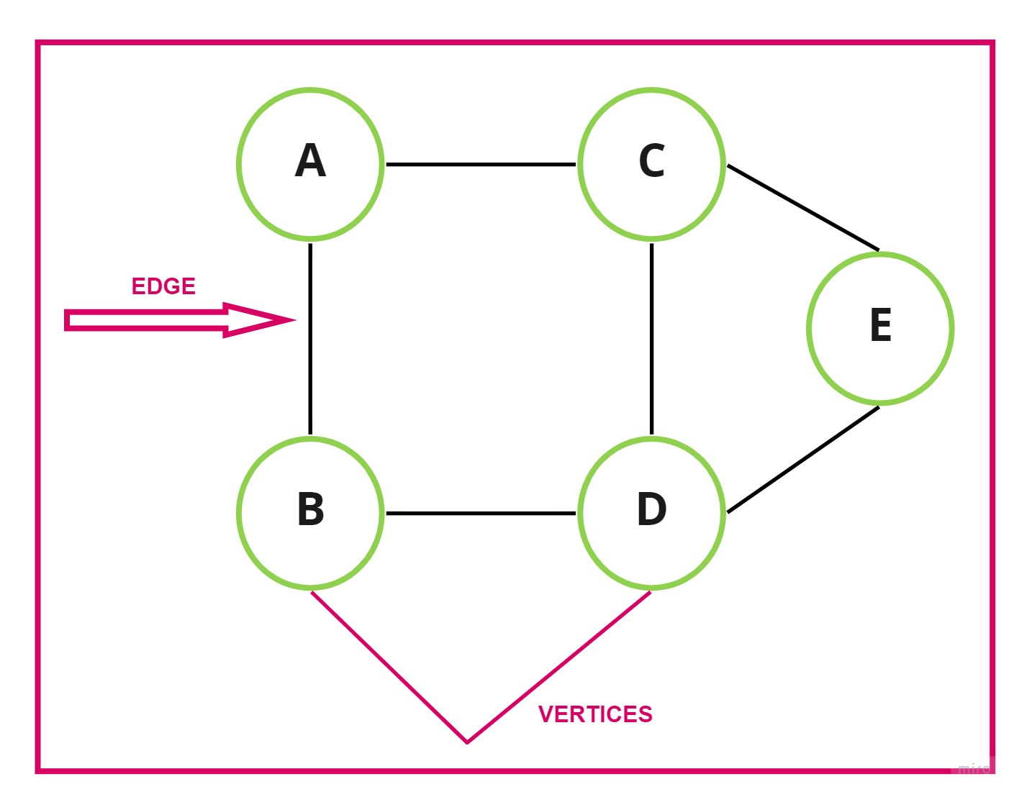
Graph
Graph Solves many real-time problems.
Undirected Graph
Directed Graph
Cyclic Graph
Acyclic Graph

Slide 5
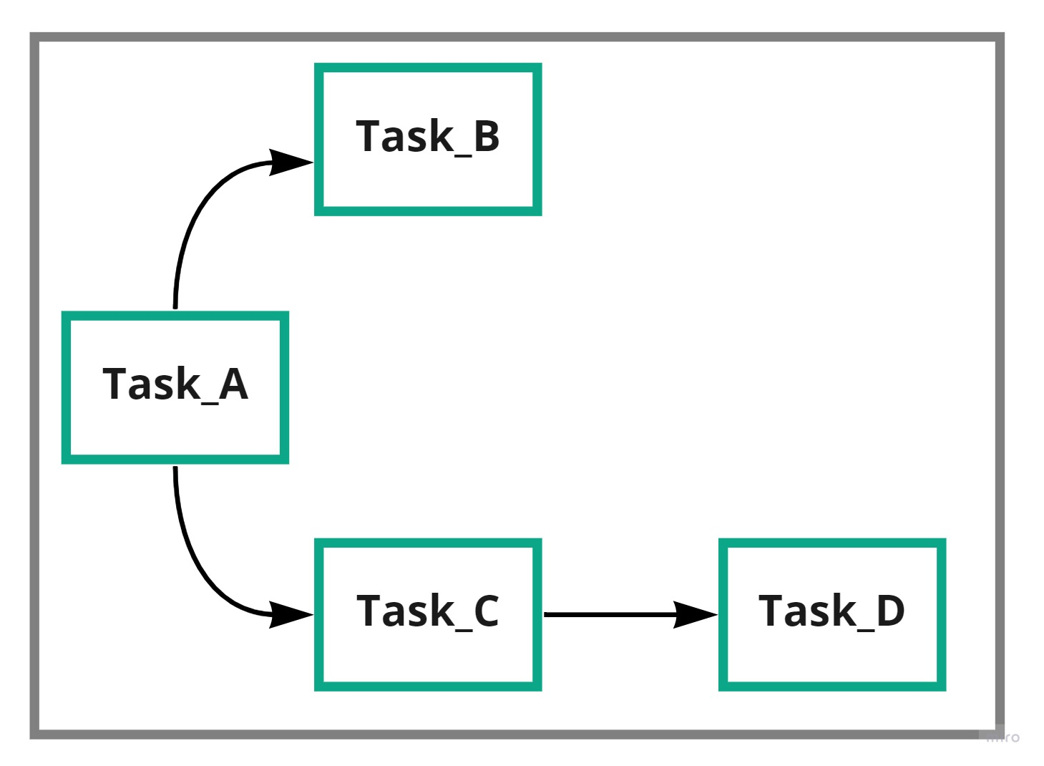
Airflow DAG
DAG(Directed Acyclic Graph) is a collection of all tasks that you want to run, organized in way that reflects their relationships and dependencies.
A Dag is defined in a Python Script, which represent the DAG structure(tasks and their relationships) as code.
It is useful to represent a complex data flow using a Graph
Each Node in the graph is a task.
The edge represent dependencies among the tasks.
The Graphs are called computation graph or Data flow Graph and it transform data as it flow through the graph and enable very complex numeric computations.
Given that data only needs to be computed once on a given task and the computation then carries forward , the graph is directed and acyclic. This is why Airflow jobs are commonly referred to as DAG

Slide 6
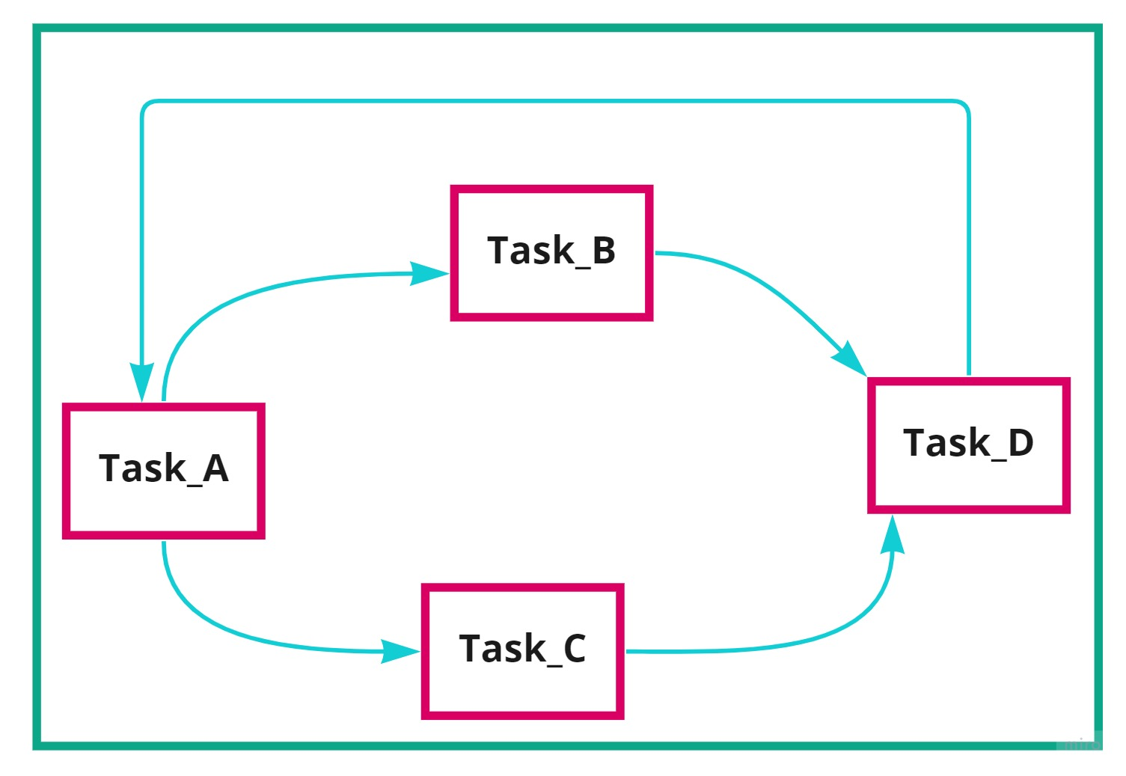
Is this DAG ?

Slide 7
DAG Runs
A DAG Rub is an object representing an instantiation of the DAG in time. Any time the DAG is executed , a DAG Run is created and all tasks inside it are executed . The status of the DAG Run depends on the task’s states.
Task:
A Task defines a unit of work within a DAG , it is represented as a node in the DAG graph, and it is written in python.
Task Instance:
A Task instance represents a specific run of a task
Task instances also have indicative state which could be “running”, “success”, ”skipped” etc.

Slide 8
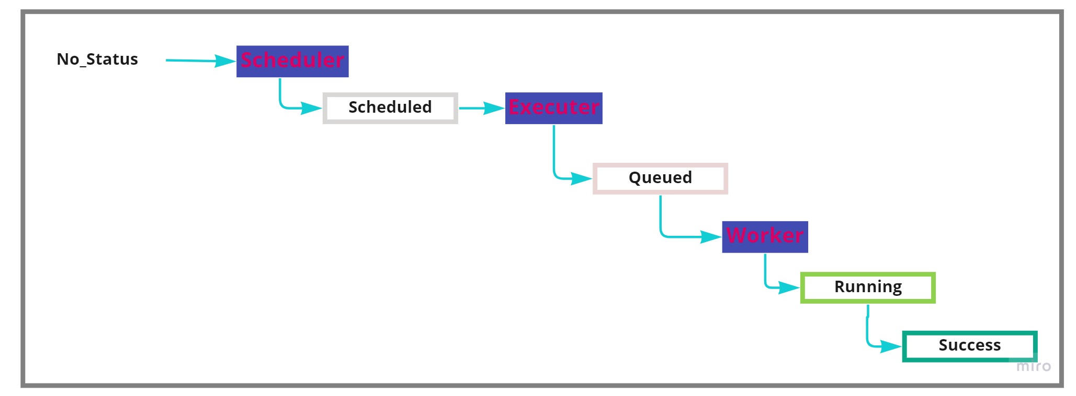
High Level States of Task Instance

Slide 9
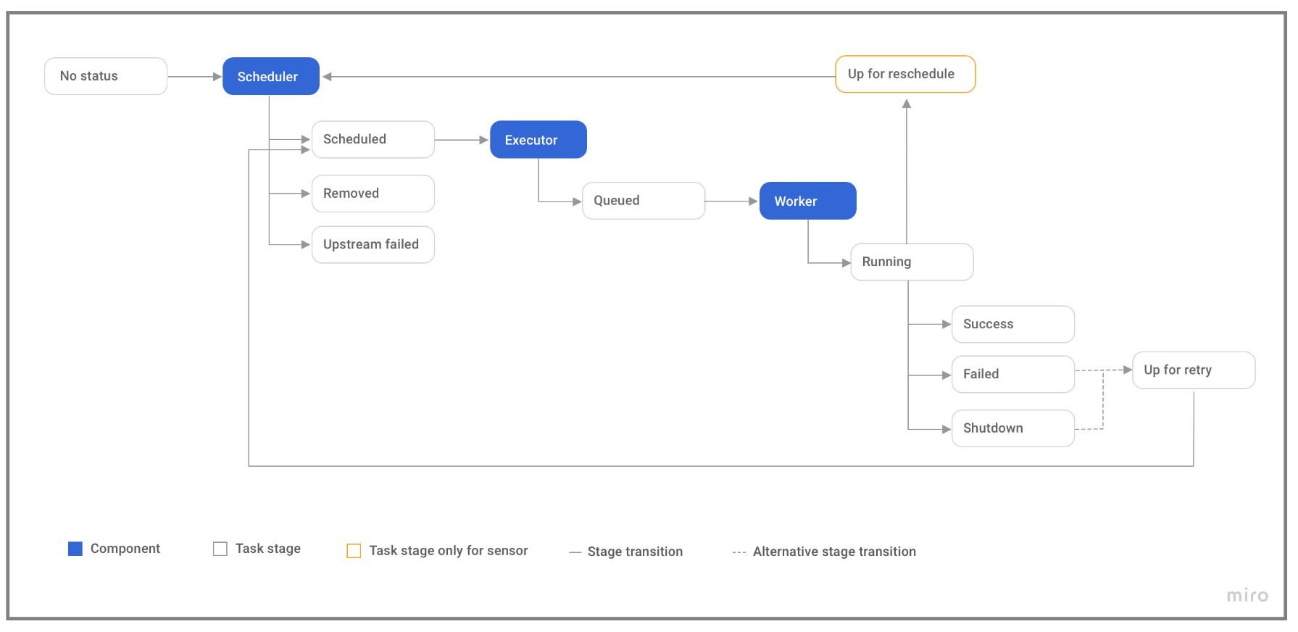
Instance Lifecycle
A task goes through various stages from start to completion. In the Airflow UI (graph and tree views), these stages are displayed by a color representing each stage:

Slide 10
Operators
Operators determine what actually gets done by task.
DAG not perform any actual computation. Instead, operators determine what actually gets done.
An operators describe a single task in a workflow.
The DAG will make sure that operators run in the correct order, other than those dependencies.
Operators generally run independently.
Common Operators:
BashOperators: execute a bash command
PythonOperator: call an arbitrary Python function
EmailOperator: Send an email.
MysqlOperator, SqliteOperator,PostgresOperator, OracleOperator, etc

Slide 11
Hooks:
Hooks enable Airflow to interface with third-party system,With them, you can effortlessly connect with the outside APIs and database.
Sensor: Sensors are a special type of Operator that are design to do exactly one thing-wait for something to occur.
Relationships: It represent relationships between tasks, airflow exceeds at defining complicated relationships.
T2 << T1
T1 >> T3

Slide 12
Installation
Using Pip
Using Docker
Airflow Installation Guide

Slide 13
Installation With Docker
Required:
Python: >=3.7
Docker or Docker Desktop
Docker-compose
Ram : 4GB or more
CPUs: 2 or more
Create a folder and get into created folder.
Create below directories that are require for synching. Run bellow command to create directories.
mkdir dags,plugins,logs
3. Download docker-compose file:
Invoke-WebRequest https://airflow.apache.org/docs/apache-airflow/2.3.2/docker-compose.yaml
4. Run below docker command to get image and initialize database.
docker-compose up airflow-init
5. Run Airflow
Docker-compose up

Slide 14
Brief about Docker Compose
It allows you to run multiple application.
airflow-scheduler - The scheduler monitors all tasks and DAGs, then triggers the task instances once their dependencies are complete.
airflow-webserver- the webserver is available at http://localhost:8080
airflow – worker – The worker that executes the tasks given by the scheduler .
airflow-init- The initializing service .
postgres- The database.
redis- The redis- broker that forwards messages from scheduler to work.
Description of Directory
/dags – you can put your DAG files here.
./logs- contains logs from task execution and scheduler .
./plugins- you can put your custom plugins here.

Slide 15
Scheduling
Preset | Description | Crone
None | Don’t schedule use for externally trigger DAG
@once | Schedule once and only once
@hourly | Run once an hour at begging of the hour | 0 * * * *
@daily | Run once a day in midnight | 0 * * *
@weekly | Run once a week at midnight on Sunday Morning . | 0 0 * * 0
@monthly | Run once a month at midnight of the first day of the month | 0 0 1 * *
@yearly | Run once a year at midnight of Jaunpour 1 | 0 0 1 1 *

Slide 16
Airflow CLI
Airflow version
Airflow- h
Airflow dags list
Airflow tasks list my sample dag

