Slide 1
Medicanna Match, Track and Monitor

Slide 2
Why?
Inaccessible knowledge 😒
Lack of treatment experience 👶
Treatment based on trial and error therefore required attention and usage history 😭
Adjust to modern global medical cannabis treatment trend 🌏🏃

Slide 3


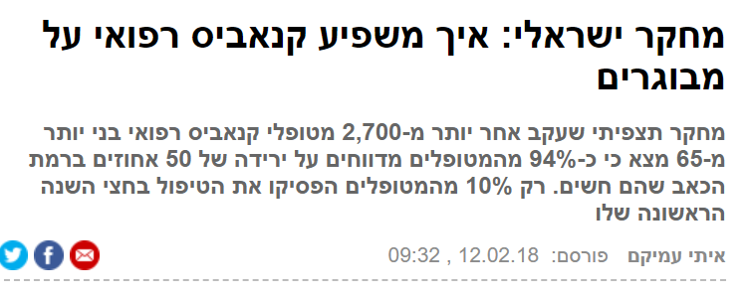
Publications

Slide 4
Medicanna
Record treatment sessions
Receive reccomendations based on medical needs
Cannabis information with one click
Medicanna will help utilize medical cannabis treatment, efficiently helping patients receive guidance and information

Slide 5
Basic Use Case
Create patient profile and medical preferences
Get matched medical recommended strains.
Start, monitor and record your medical treatments
Analyze usage feedbacks and records for treatment adjustment

Slide 6
App Features
Manage personal cloud profile with customized medical preferences.
Get information of more then 1900 different types of cannabis strains dedicated to various medical treatments .
Help patient to get best feedback for each specific medical treatment by asking the user leading questions and monitor heartbeat rate.
Rank each strain usage based on feedback and customized medical preferences.
Record and hold history of treatment sessions for analysis by self, doctor or cannabis official provider.

Slide 7
Upcoming Features
Export treatment sessions straight to your personal doctor.
Improve strain matching algorithm to calculate recommended strains by user preferences, sessions ranking and specific feedbacks from session
Get partial match of recommended strains to (adjusting match accuracy).
Add more general information accessible from the app.
Fine tuning and bug fixes.

Slide 8
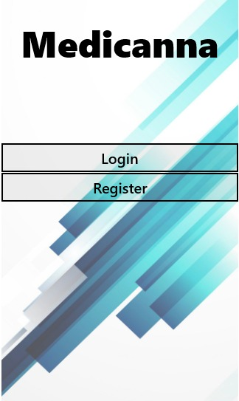
Application Snapshots

Slide 9
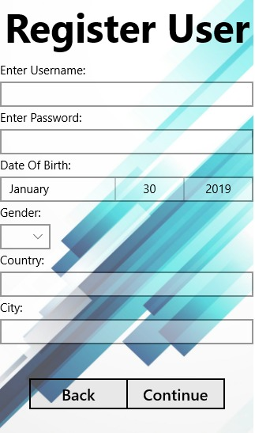
Application Snapshots

Slide 10
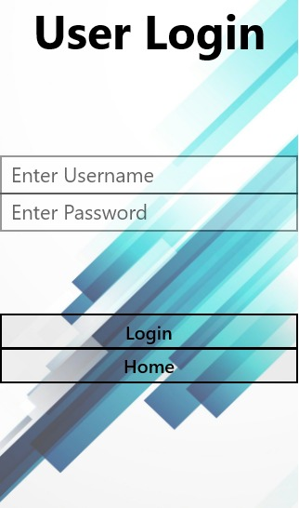
Application Snapshots

Slide 11
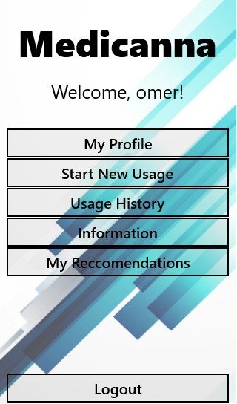
Application Snapshots

Slide 12
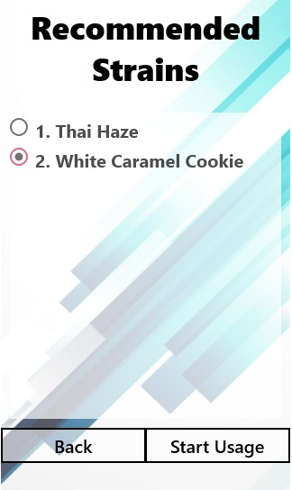
Application Snapshots

Slide 13
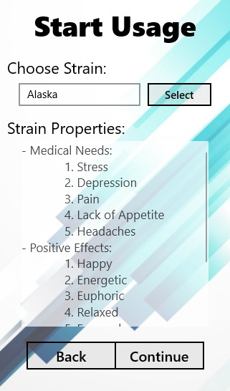
Application Snapshots

Slide 14
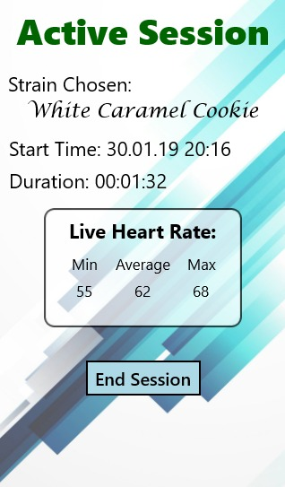
Application Snapshots

Slide 15
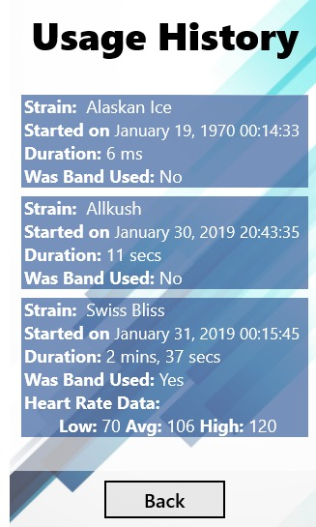
Application Snapshots

Slide 16
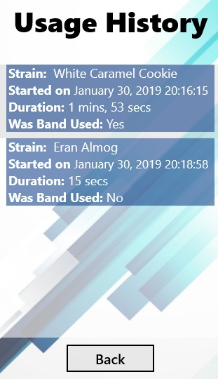
Application Snapshots

Slide 17
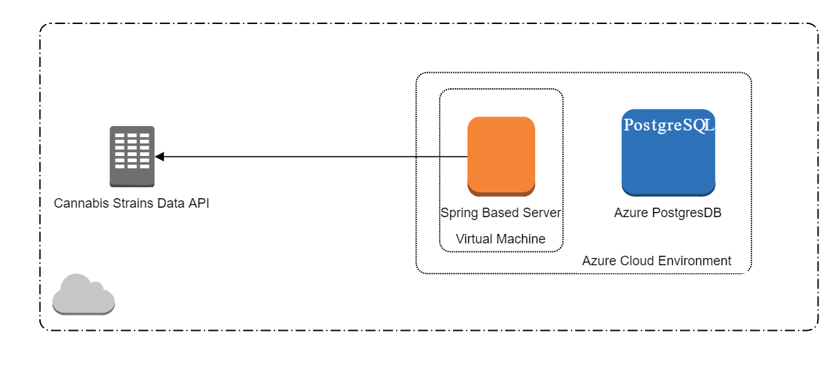
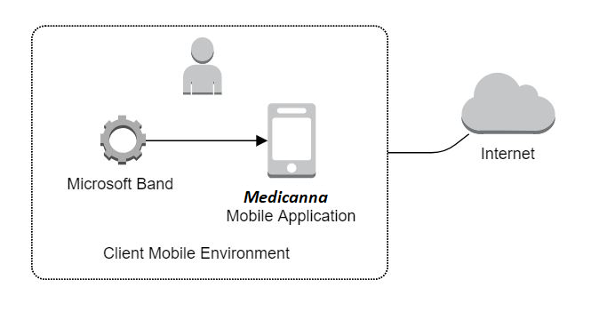
Architecture

Slide 18
THANKS!
😉
Any questions?
You can find me at:
support@medicanna.com

