Slide 1
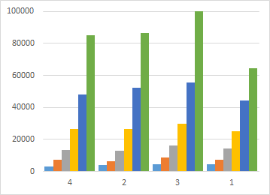
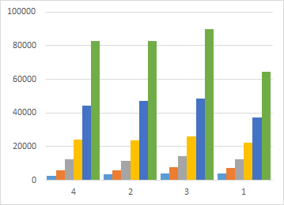
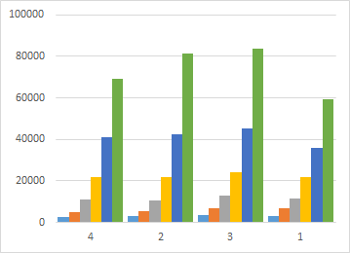
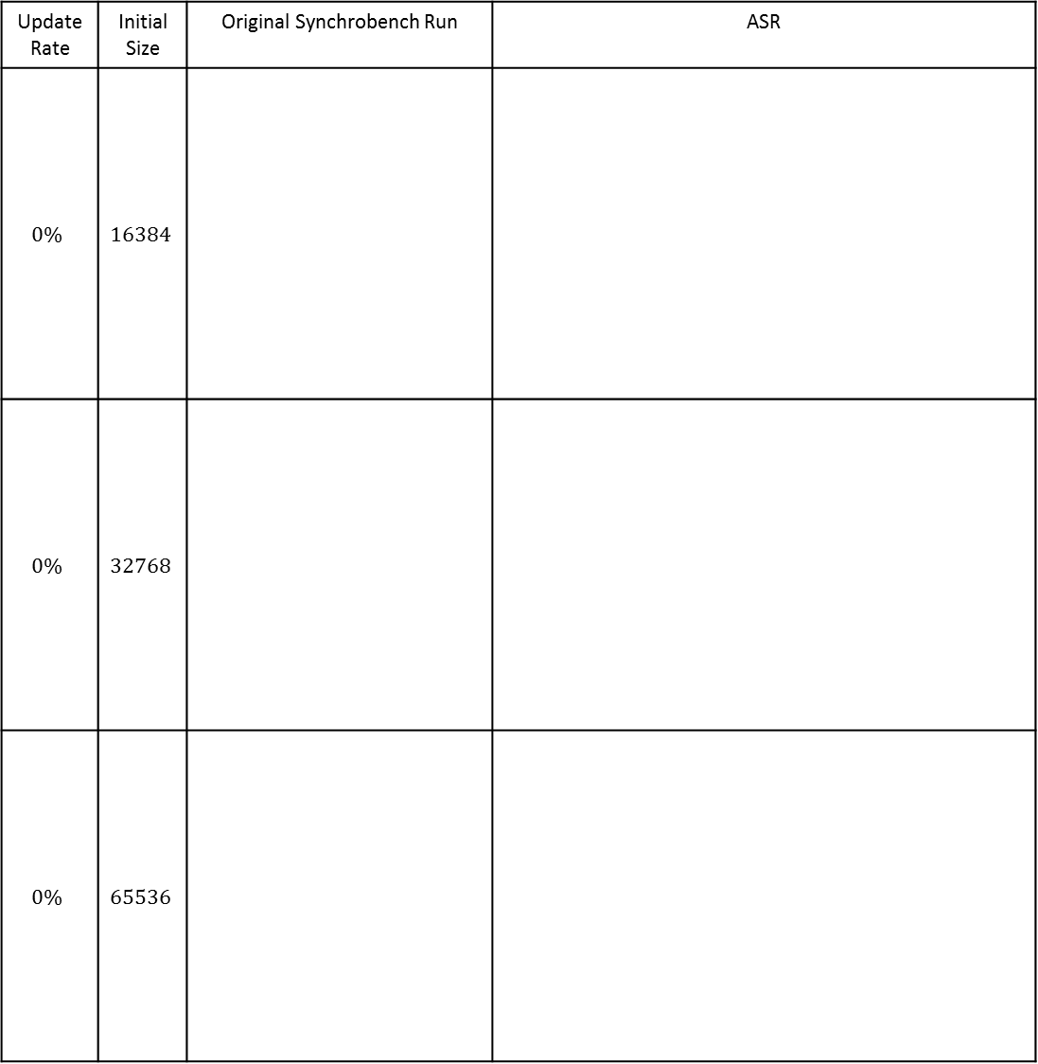
Update Rate | Initial Size | Original Synchrobench Run | ASR
$$0\%$$ | $$16384$$
$$0\%$$ | $$32768$$
$$0\%$$ | $$65536$$

Slide 2
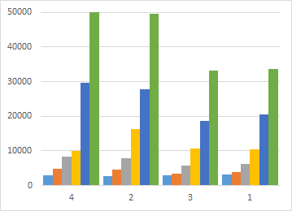
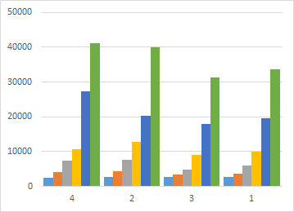
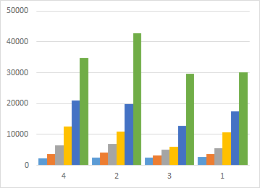
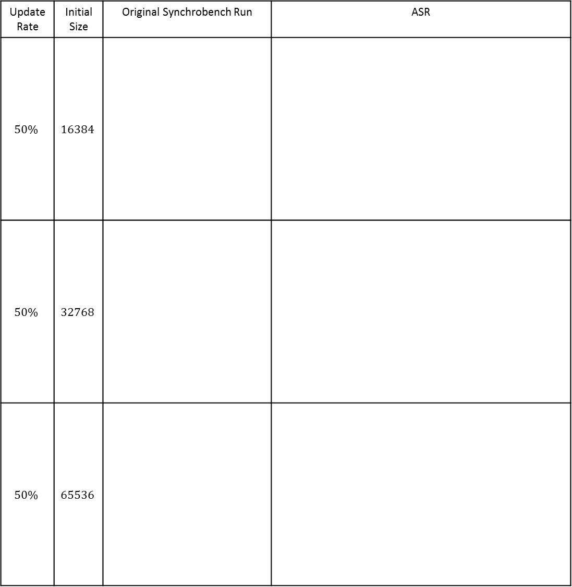
Update Rate | Initial Size | Original Synchrobench Run | ASR
$$50\%$$ | $$16384$$
$$50\%$$ | $$32768$$
$$50\%$$ | $$65536$$

Slide 3
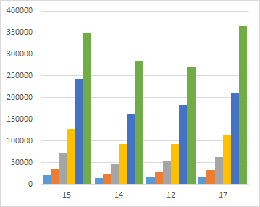
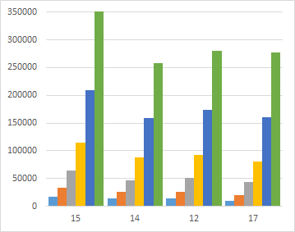
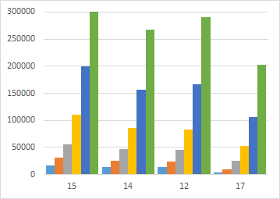
Update Rate | Initial Size | Original Synchrobench Run | ASR
$$0\%$$ | $$16384$$
$$0\%$$ | $$32768$$
$$0\%$$ | $$65536$$

Slide 4
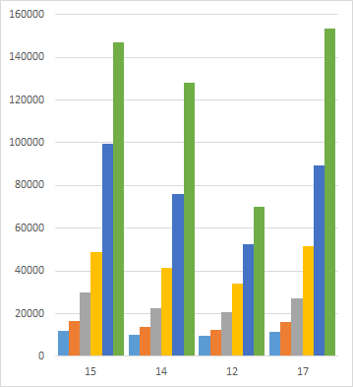
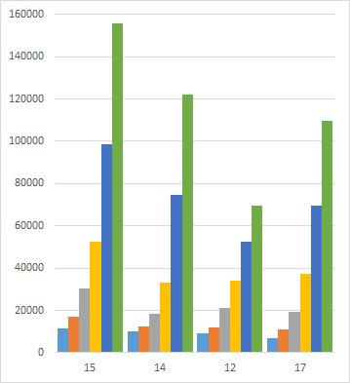
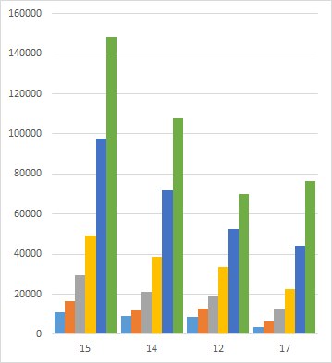
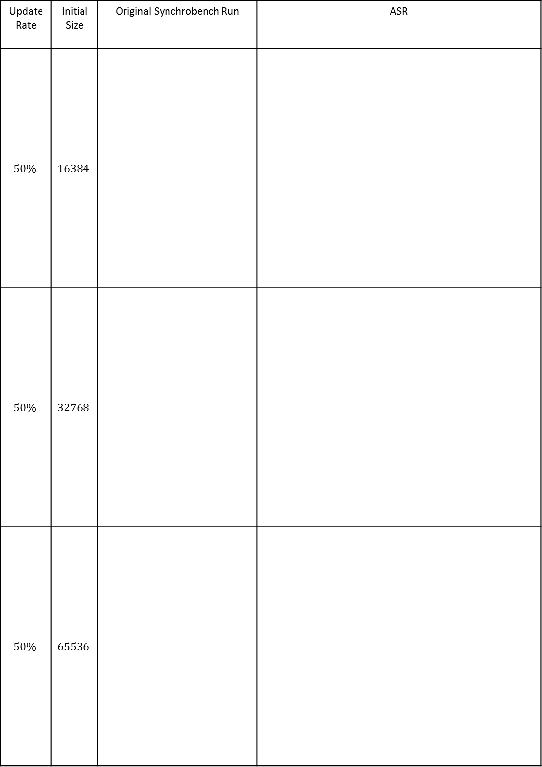
Update Rate | Initial Size | Original Synchrobench Run | ASR
$$50\%$$ | $$16384$$
$$50\%$$ | $$32768$$
$$50\%$$ | $$65536$$

Slide 5
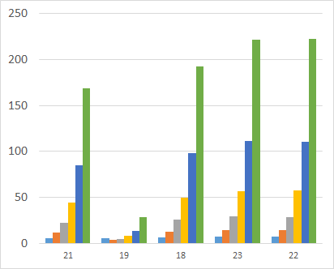
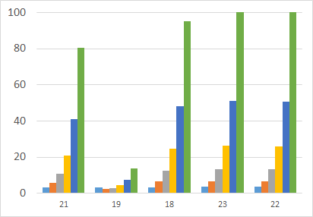
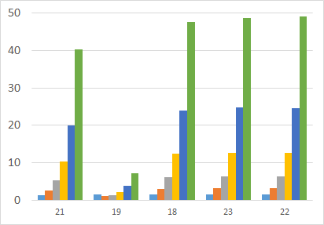
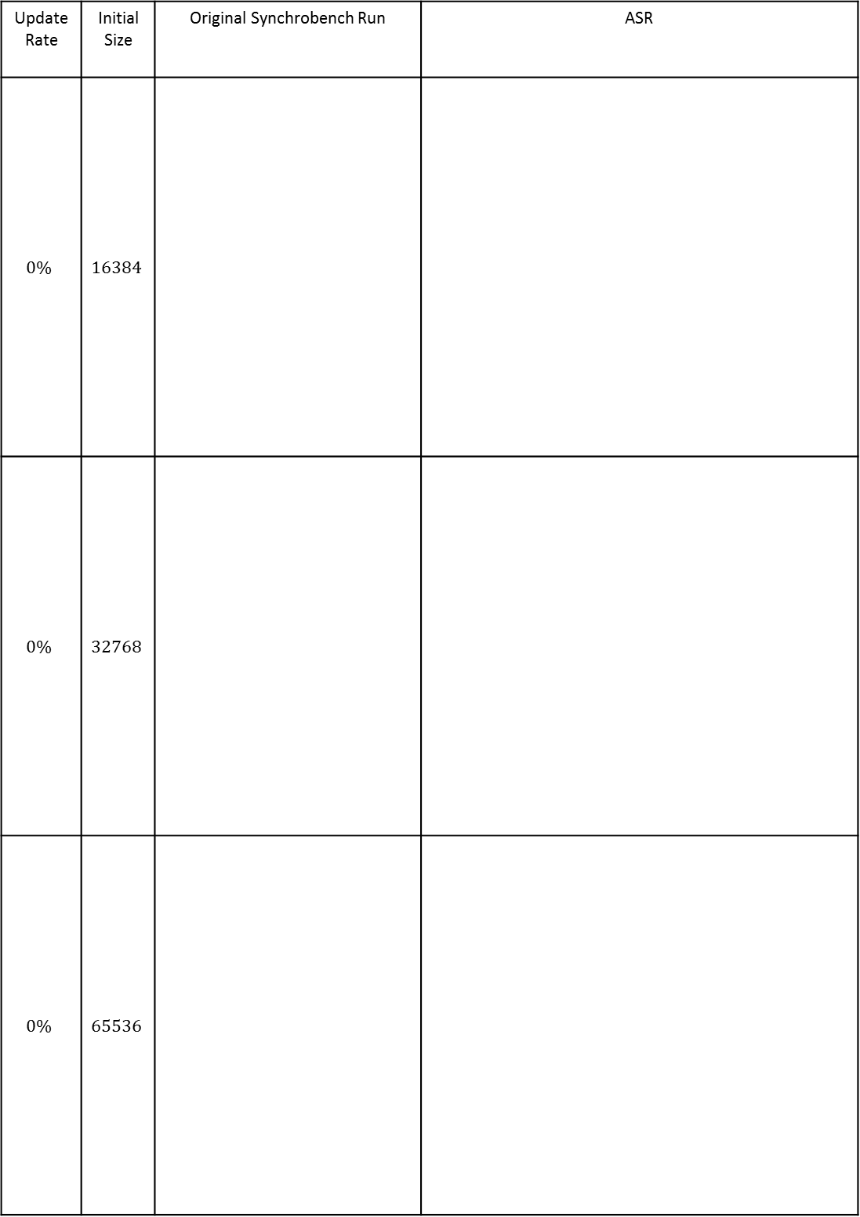
Update Rate | Initial Size | Original Synchrobench Run | ASR
$$0\%$$ | $$16384$$
$$0\%$$ | $$32768$$
$$0\%$$ | $$65536$$

Slide 6
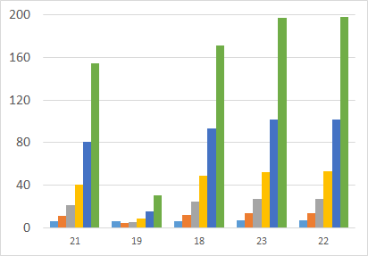
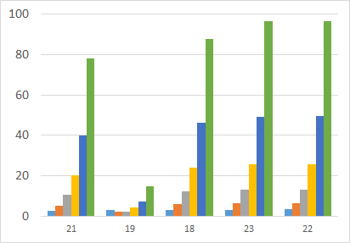
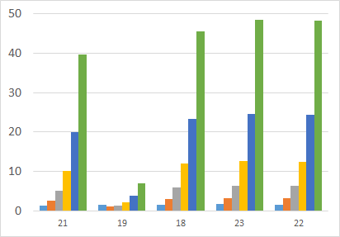
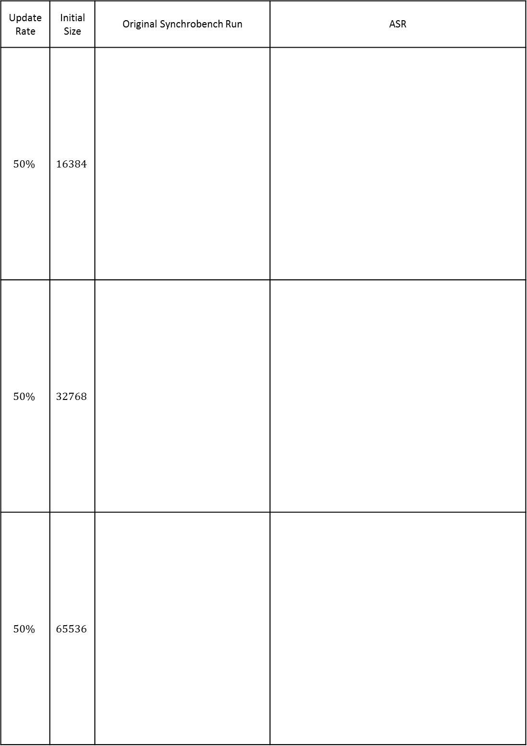
Update Rate | Initial Size | Original Synchrobench Run | ASR
$$50\%$$ | $$16384$$
$$50\%$$ | $$32768$$
$$50\%$$ | $$65536$$

Slide 7
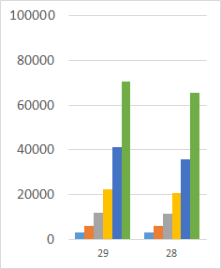
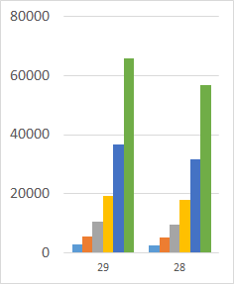
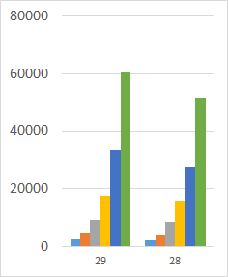
Update Rate | Initial Size | Original Synchrobench Run | ASR
$$0\%$$ | $$16384$$
$$0\%$$ | $$32768$$
$$0\%$$ | $$65536$$

Slide 8
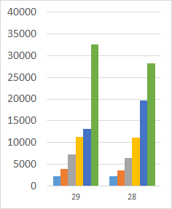
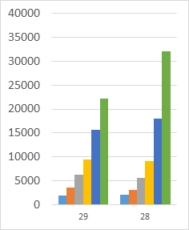
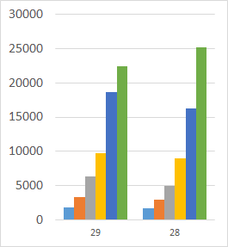
Update Rate | Initial Size | Original Synchrobench Run | ASR
$$50\%$$ | $$16384$$
$$50\%$$ | $$32768$$
$$50\%$$ | $$65536$$

