Slide 1
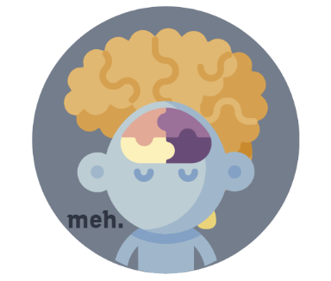

Slide 2
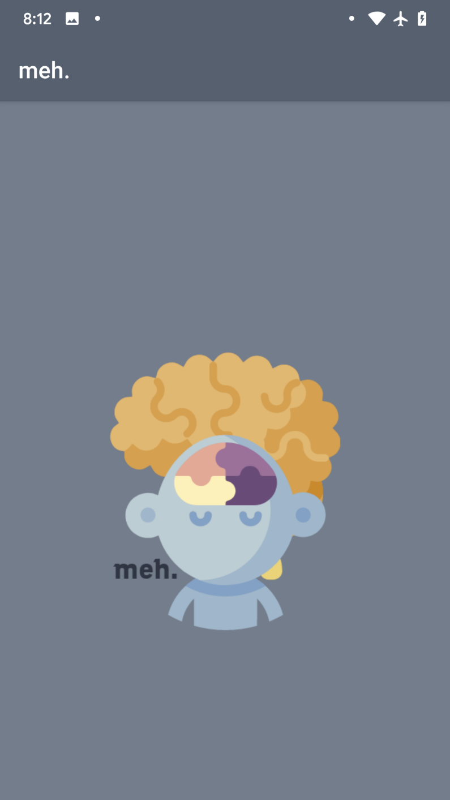
A MENTAL HEALTH BUDDY!

Slide 3
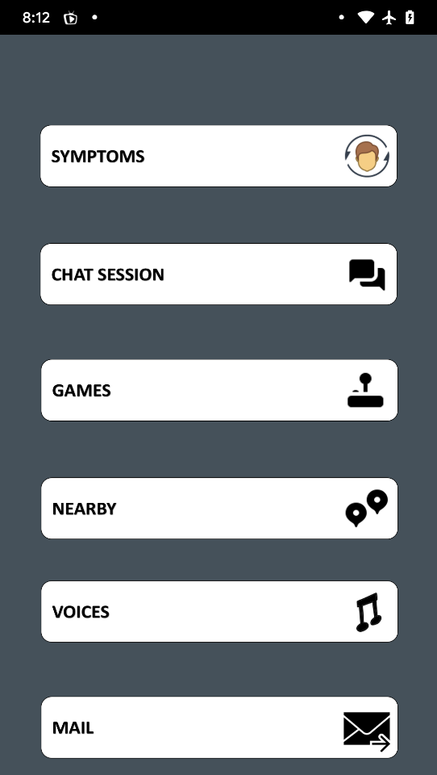


HOMESCREEN
Mobile
4:40 PM
50%
Back
San Francisco
Done
26 July 6:26 AM
MAIN HOME OR MAIN SCREEN
Email
Your Email
MORE OPTIONS
Sign In
DIFFERENT OPTIONS
Sign Up

Slide 4
ALL OPTIONS
SYMPTOMS
CHAT SESSION
GAMES
NEARBY (PSHYCACTRIST)
VOICES
MAIL
Mobile
4:40 PM
50%
Email
Your Email
Sign In
Sign Up

Slide 5
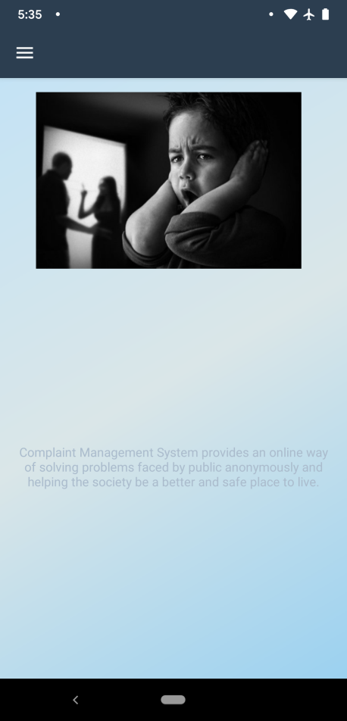

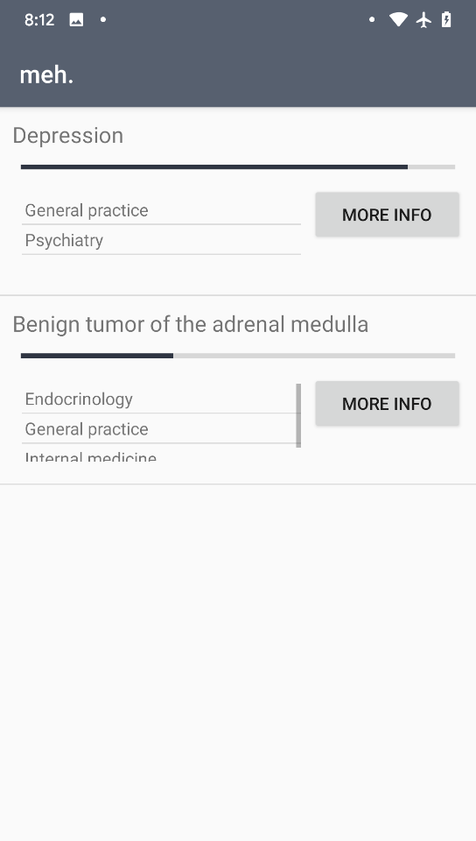
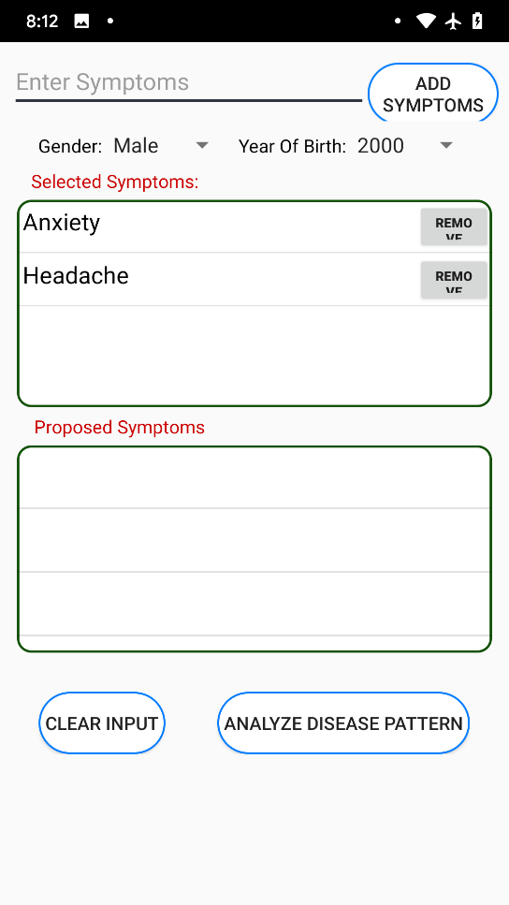
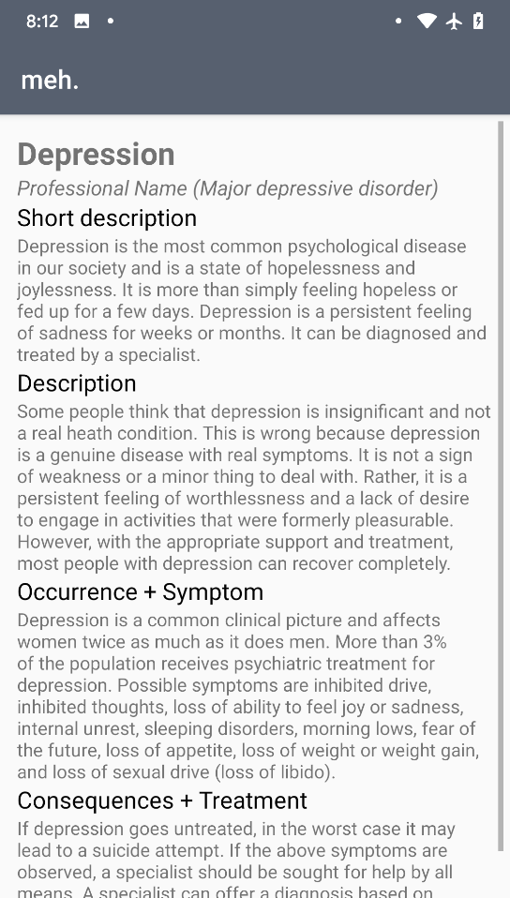


SYMPTOMS
Mobile
4:40 PM
50%
Mobile
4:40 PM
50%
Mobile
4:40 PM
50%
Back
San Francisco
Done
Back
San Francisco
Done
26 July 6:26 AM
26 July 6:26 AM
James Smith
Post Photo
Hey J, we still on for 11?
You
Yeah, remind me again what this meeting is about. I’m drawing a complete blank!
Email
Your Email
James Smith
Podcasting operational change management inside of workflows to establish a framework.
Sign In
James Smith
Sign Up
15 Likes
Popular
New
Chat
Explore
Options
Popular
New
Chat
Explore
Options

Slide 6
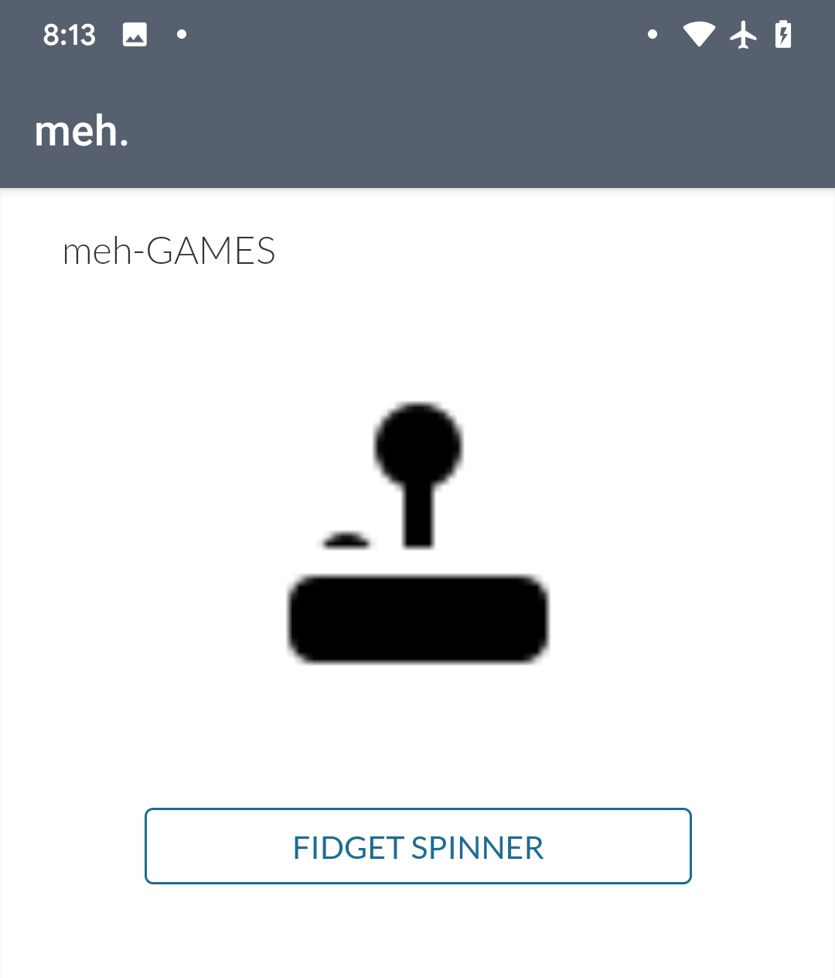

GAMES
DIFFERENT TYPES OF MIND GAMES
Mobile
4:40 PM
50%
Back
San Francisco
Done
26 July 6:26 AM
GAMES TO KEEP YOU OCCUPY
Email
Your Email

Slide 7
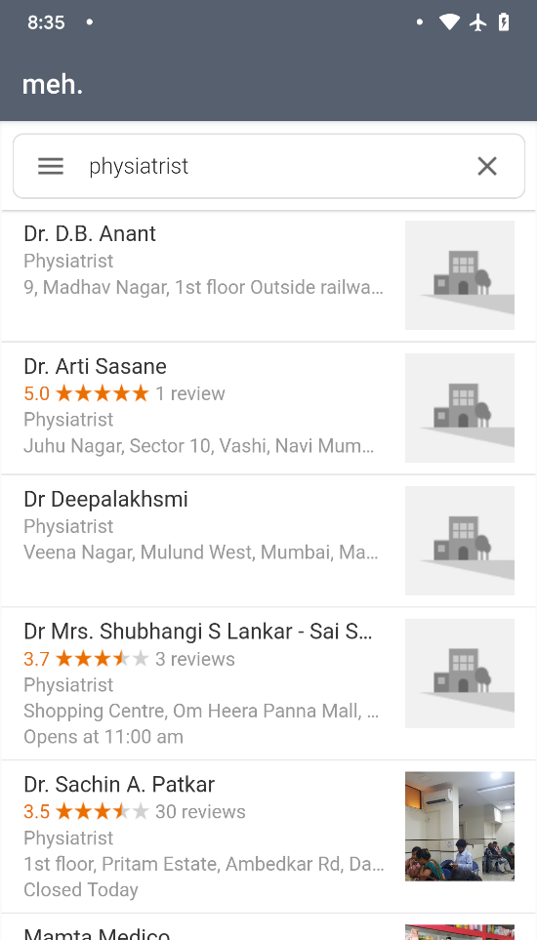
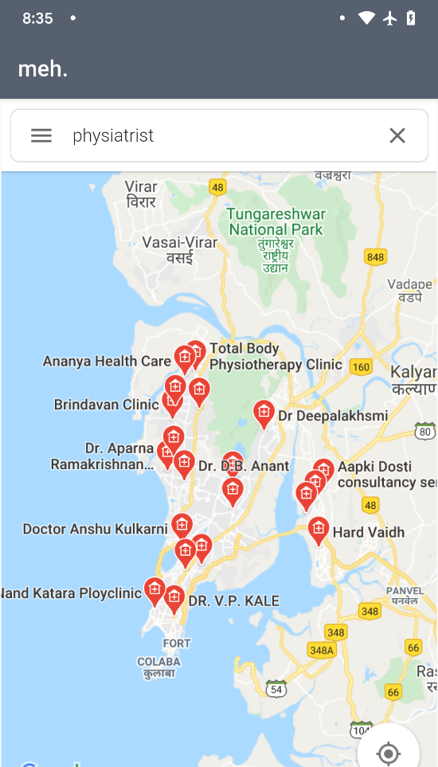
NEARBY
WHEN NEARBY OPTION IS SELECTED THE APLICATION COLLECCT THE LOCTION OF YOURSELF
AFTERWARDS, IT AUTOMATICALLY SEARCHES THE PSYCIATRIST THE NEAREST ONE FOR YOU
IT COULD BE HELPFUL FOR SOMEONE WHO JUST WANTS TO KNOW THE LOCATION OF THE PSYCACTRIST OR ONE IN REAL NEED!
Mobile
4:40 PM
50%
Mobile
4:40 PM
50%
Back
San Francisco
Done
Back
San Francisco
Done
26 July 6:26 AM
26 July 6:26 AM
James Smith
Post Photo
Hey J, we still on for 11?
You
Yeah, remind me again what this meeting is about. I’m drawing a complete blank!
James Smith
Podcasting operational change management inside of workflows to establish a framework.
James Smith
15 Likes
Popular
New
Chat
Explore
Options
Popular
New
Chat
Explore
Options

Slide 8
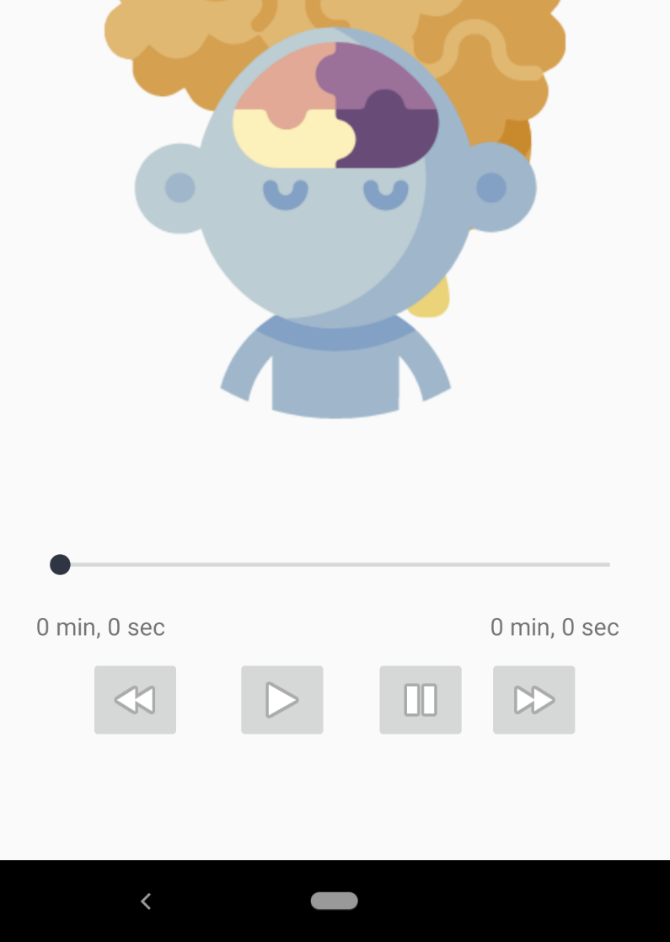



VOICES
Email
Your Email
SLIDER FOR THE MUSIC
Sign In
CONTROLS FOR THE MUSIC
Sign Up
Popular
New
Chat
Explore
Options

Slide 9
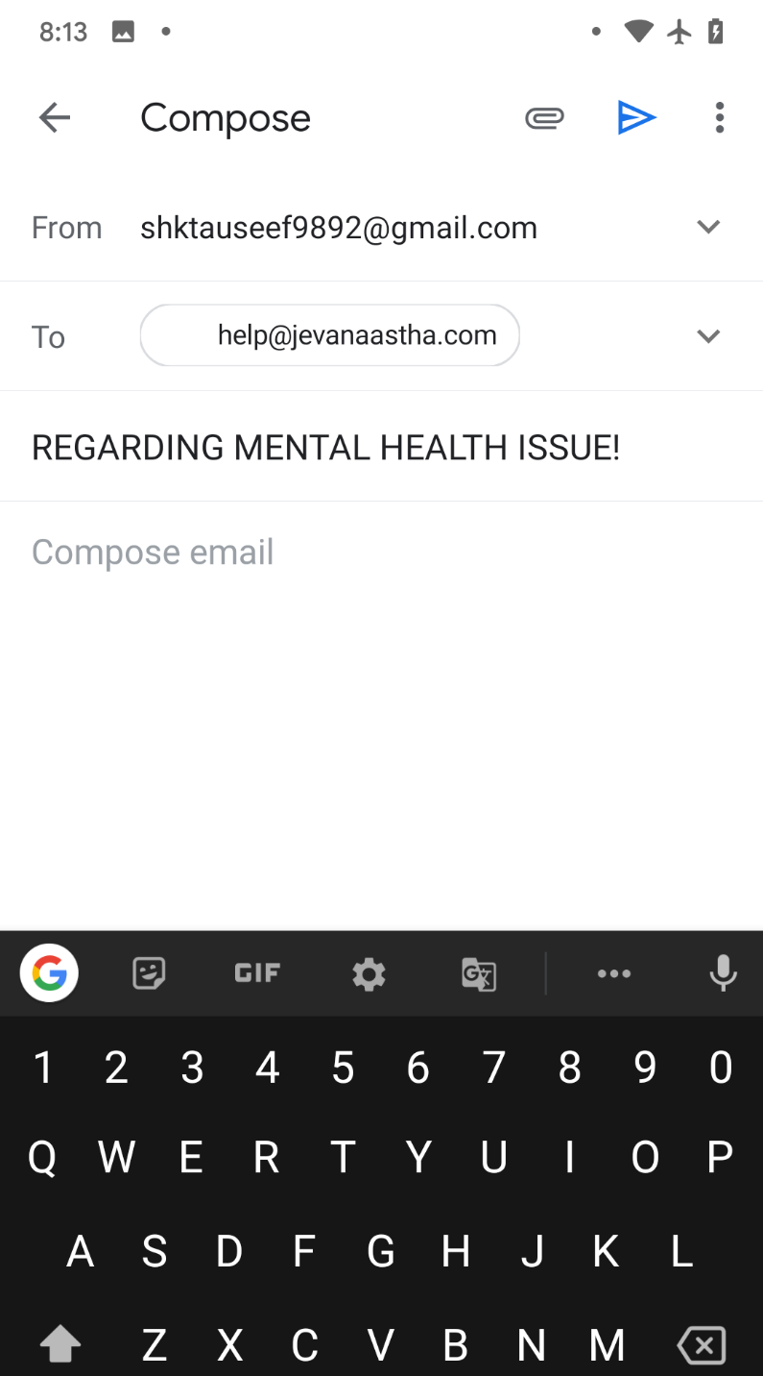
MAIL
Back
San Francisco
Done
26 July 6:26 AM
SENDER NAME
Email
PLACE TO WRITE THE ISSUE
Your Email
Sign In
Sign Up
Popular
New
Chat
Explore
Options

Slide 10
BE HAPPY, BE STRONG & THANK YOU!

