Slide 1
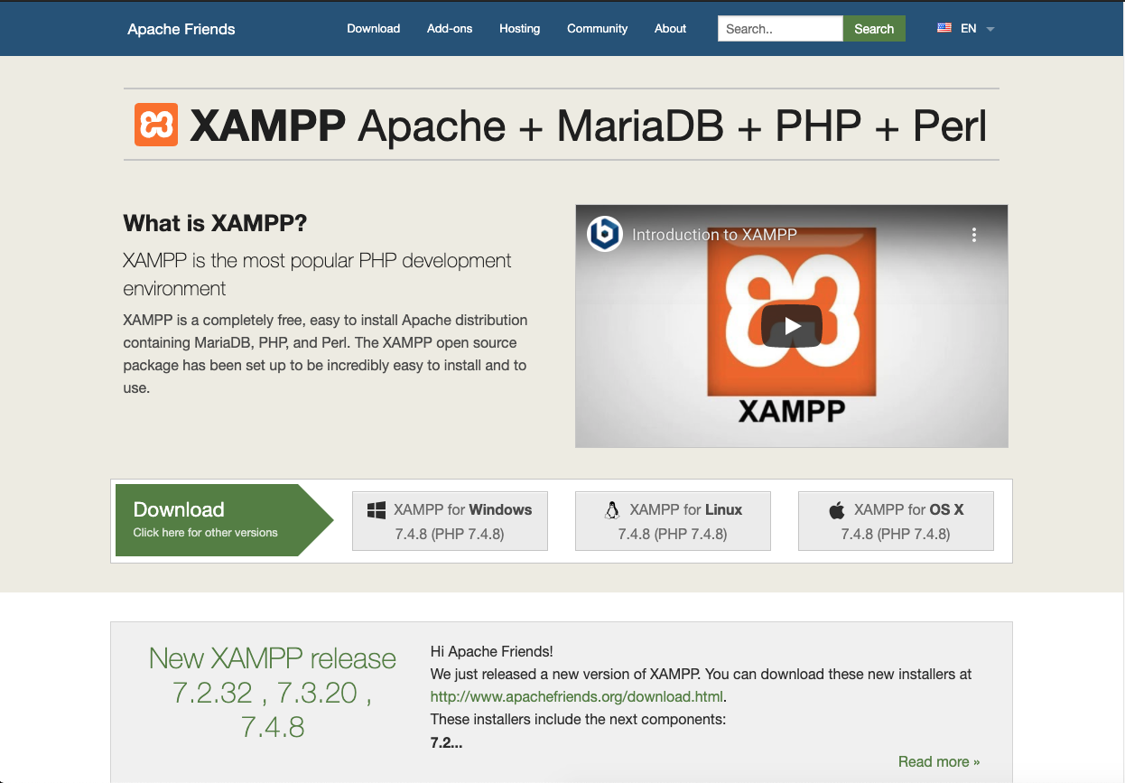
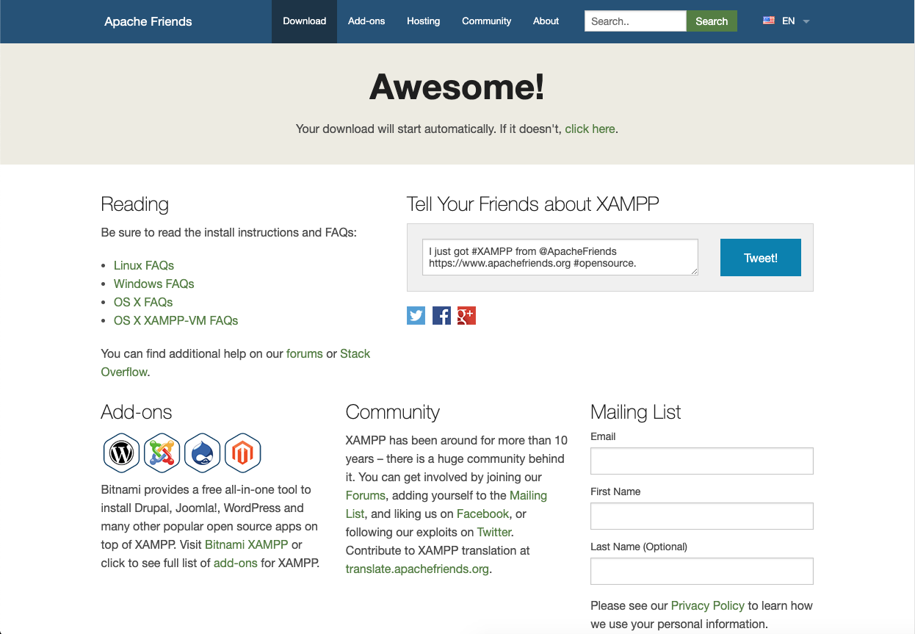
EXPERIMENT 01
NAME: TAUSEEF MUSHATQUE ALI SHAIKH
ROLL NO.: 18CO63 CLASS: TE-CO SUBJECT: WED DEVELOPMENT LAB
AIM: INSTALLING AND SETTING OF LAMP/WAMP/XAMPP
PROCEDURE:
STEP-1: DOWNLOAD XAMPP for Mac OSX Be sure to select the proper version.
Fig: 1.1
Fig: 1.2

Slide 2
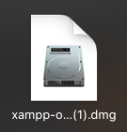
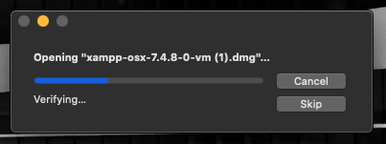
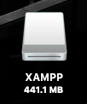
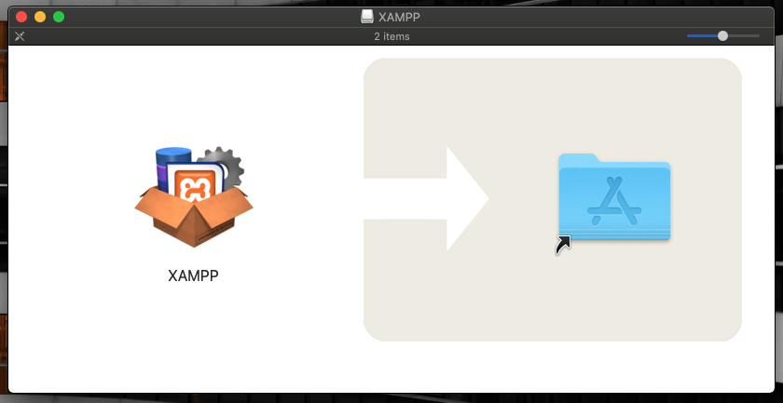
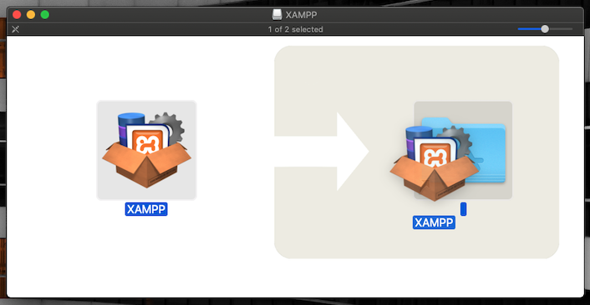
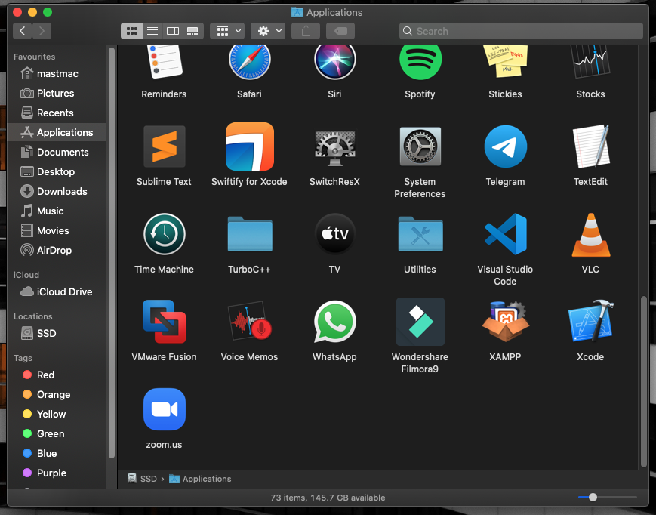
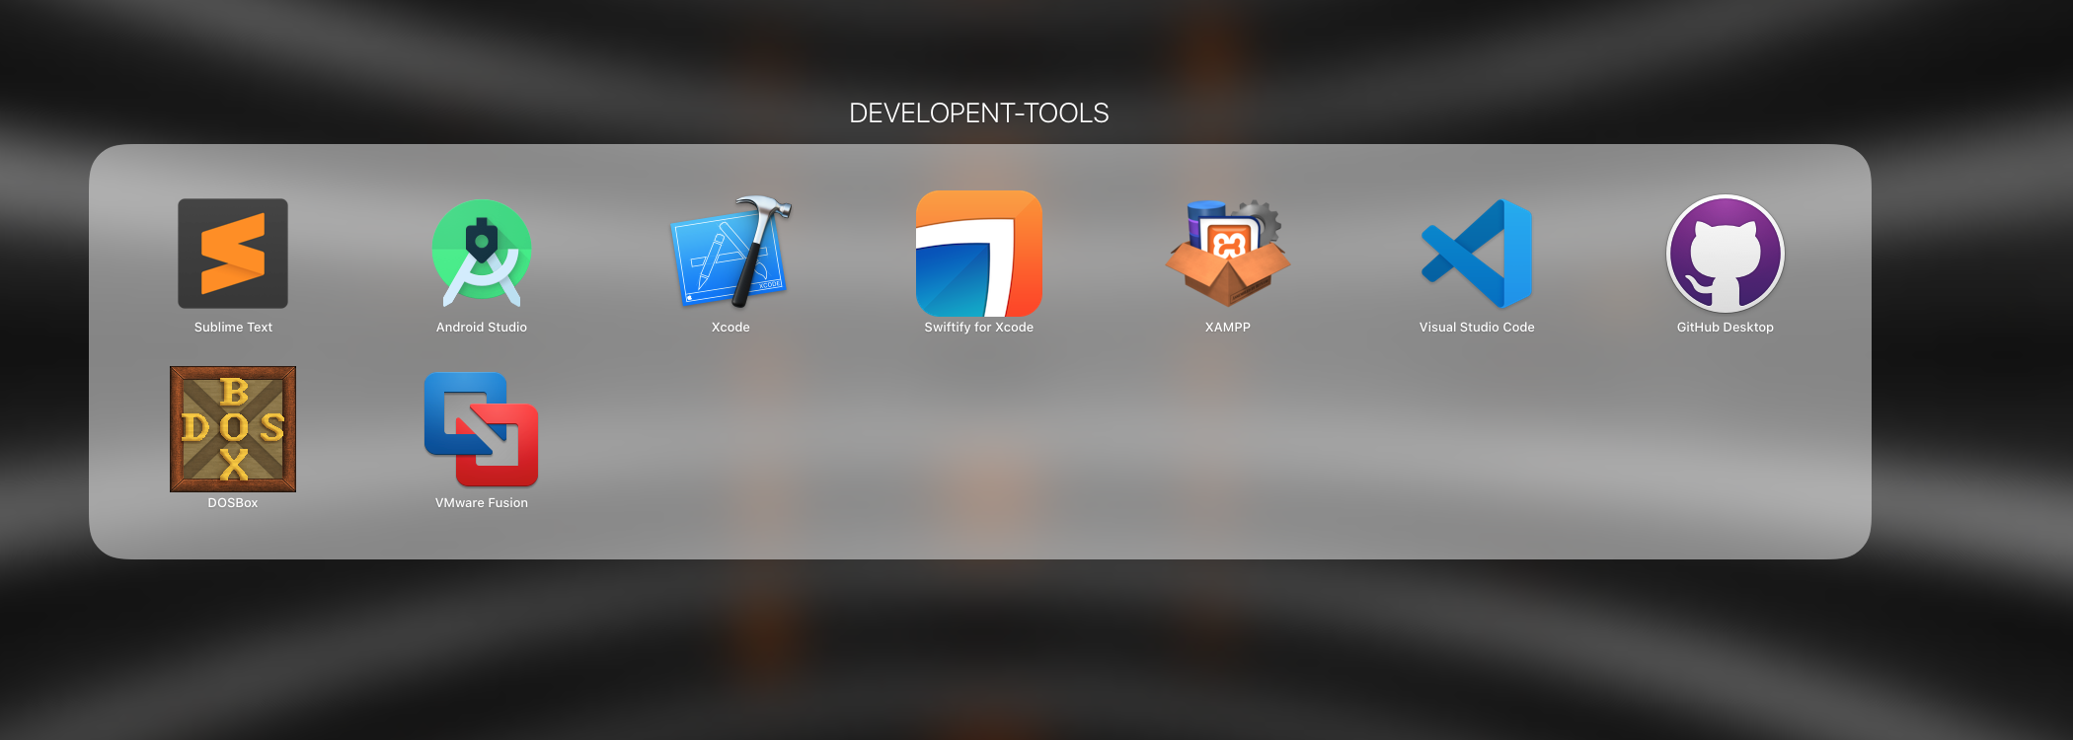
STEP-2: Open the downloaded file (the DMG-Image).
Fig: 2.1
Fig: 2.2
Fig: 2.3
STEP-3:Drag and drop the XAMPP folder into your Applications folder.
Fig: 3.1
Fig: 3.2
Fig: 3.4
Fig: 3.3

Slide 3
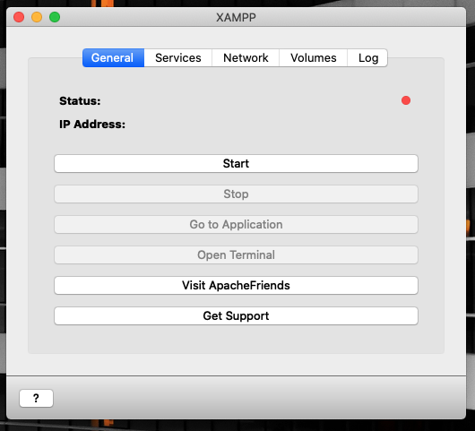
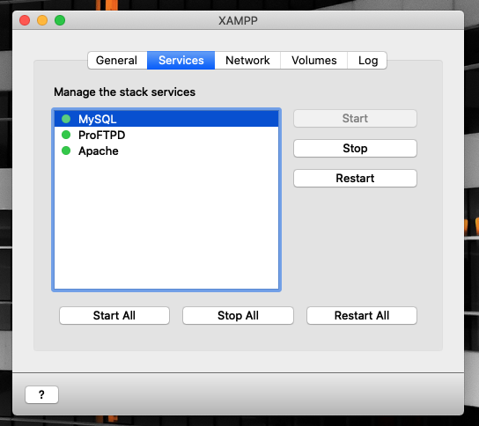
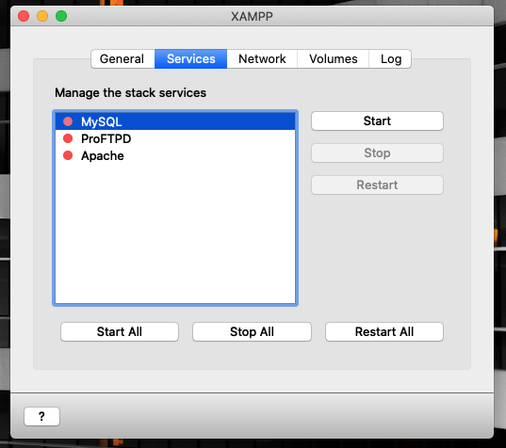
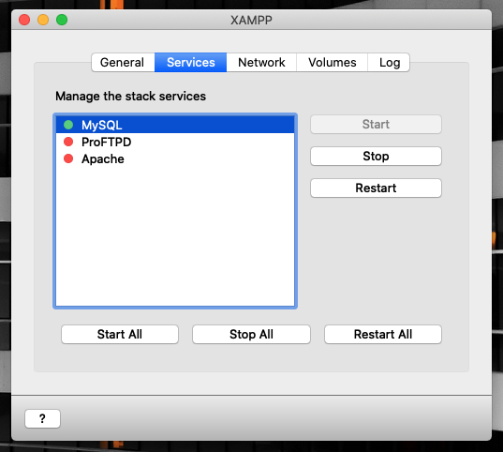
STEP-4:To start XAMPP simply open XAMPP APP from Applications or Launchpad and the start button, The servers can be managed through Services and can be individually used or turned off.
Fig: 4.1
Fig: 4.2
Fig: 4.3
Fig: 4.4

