Slide 1
Internship Task-3
Songs Analysis with Power BI
By-
Mohd Tauseef

Slide 2
Orient of Work-:
This internship project aims to perform a thorough analysis of YouTube songs data using Power BI. The dataset includes key attributes such as video ID, channel title, title, description, tags, published date, view count, like count, favorite count, comment count, video duration, video definition, and caption details. The objective is to leverage Power BI to develop insightful visualizations and reports that offer a deeper understanding of YouTube songs' performance, popularity, and user engagement. The analysis seeks to reveal trends, preferences, and patterns in the data to help content creators and stakeholders optimize their YouTube song content.

Slide 3
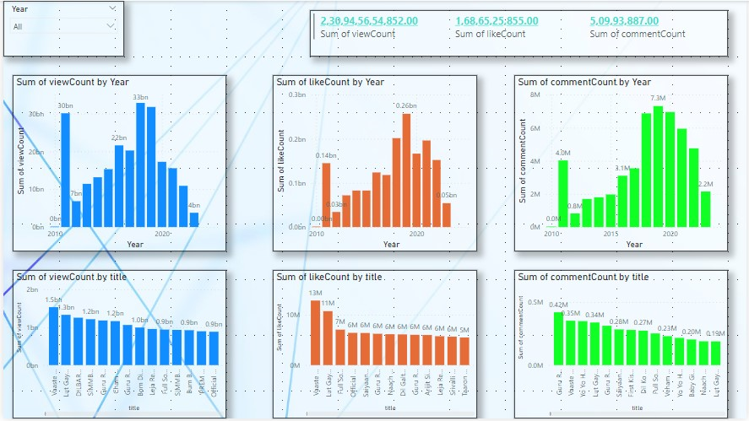
Data Cleaning and Preparation & Exploratory Data Analysis (EDA):

Slide 4
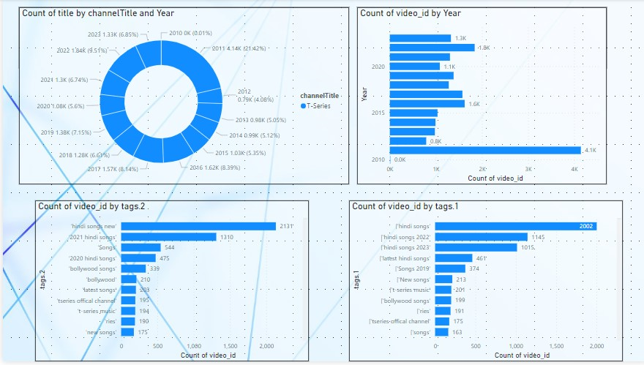
Content and Channel Analysis:

Slide 5
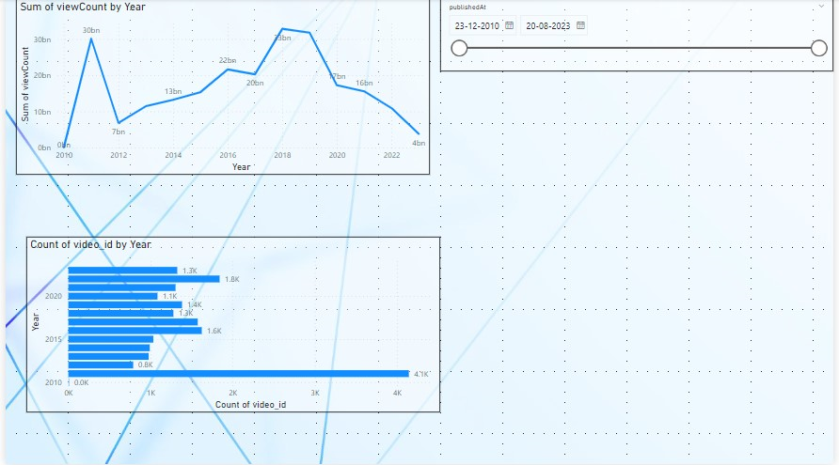
Temporal Trends:

Slide 6
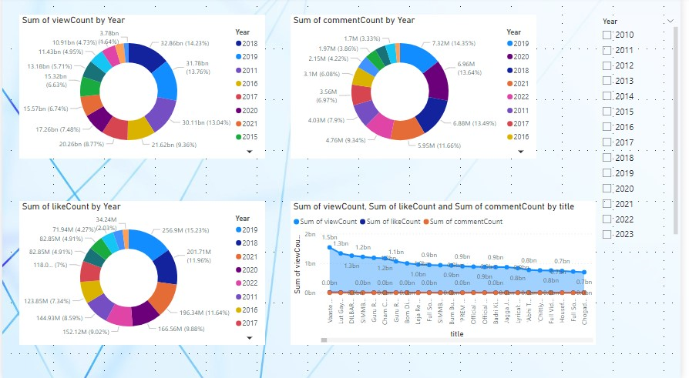
User Engagement Insights:

Slide 7
.
THANK YOU

